Slide 1
HPAR7006: Archaeological Project Reporting
Session 5 6/11/24
Monograph Publication

Slide 2
Outline
Monograph publication
Publication User Needs Survey
Council for British Archaeology
Society for Medieval Archaeology
Oxford Archaeology
BAR
Oxbow
Open access publishing
Preparing a monograph
Economics of monograph publication
Impact

Slide 3
HPAR7006: Archaeological Project Reporting: Module Description and KSBs
K3 | relevant primary and secondary data and sources relating to archaeology
K6 | requirements of formal publication, including standards for writing, editing and style

Slide 4
What we mean by a monograph
A one-off publication volume that addresses a single topic
Not a journal
Popular < > Specialist
Was standard way to share ‘type site’
Word count / page length unrestricted (?)
Formatting and colour
Editorial structure specific to the volume

Slide 5
From the Ground Up. The Publication of Archaeological Projects: a user needs survey.
Council for British Archaeology commissioned by English Heritage to review archaeological publication
Since Cunliffe Report (1983):
PPG16, commercial archaeology, grey literature
Role of SMRs/HERs in research and dissemination
Printing processes – word processing, duplication, BAR
Internet
Increasing design and print costs
Increasing amount of data
Low print runs
County and national journals unable/unwilling to print many reports
Mismatch between principle of full publication with economics and actual readership

Slide 6
From the Ground Up. The Publication of Archaeological Projects: a user needs survey. A summary 2004
Siân Jones, Ann MacSween, Stuart Jeffrey, Richard Morris, Mike Heyworth
https://intarch.ac.uk/journal/issue14/4/recommendations.html
“Recommendations
2: The form and scale of publication should be governed by the significance and scale of results
The report highlights the fallacy of 'preservation by record', whereby a printed report was expected to contain all information necessary to reconstruct the deposits or fabric which had been disaggregated. The survey also indicates that published reports are never going to provide enough detail to satisfy all needs [...]. Indeed, it emerges that many fieldwork publications provide too much detail for the general reader, and too little for the specialist. In the abstract, it is difficult to disagree with a conclusion of an important 1991 Society of Antiquaries report (Archaeological publication, archives and collections: towards a national policy) that print publication must be selective, and that selectivity should be based on the principle that 'the form and scale of [a] publication should be commensurate with what the results have to offer rather than a mechanistic process which is applied regardless of the quality and potential of the data concerned.' We recommend that this be accepted. In practice this will require a more clear-cut, knowledgeable, and hence respected, peer-review system than always obtains at present.”

Slide 7
Key results of PUNS
Grey literature OASIS > ADS > HER
Publication more focused on intended audience
ADS for datasets
Online portals

Slide 8
‘Trowel & Error: Figuring out the past together through archaeology’.
PUNS2
CBA/MOLA/ HE
“We will gather feedback from a diversified audience [...] with the aim of understanding how audiences currently engage, and want to engage, with archaeological outputs. [...] we will arrive at a set of recommendations to use as guidance for those who commission and/or generate archaeological outputs.”
https://www.archaeologyuk.org/our-work/projects/trowel-and-error.html

Slide 9
Historic England- 21st century challenges
https://historicengland.org.uk/research/support-and-collaboration/21st-century-challenges-archaeology/
The Promotion of Archaeological Synthesis
Stewart Bryant (Soc. Ants. of London), Christopher Evans & Chris Gosden (British Academy) and Vicki Cummings & Andrew Gardner (University Archaeology UK) 2024
(file in Other documents tile)

Slide 10
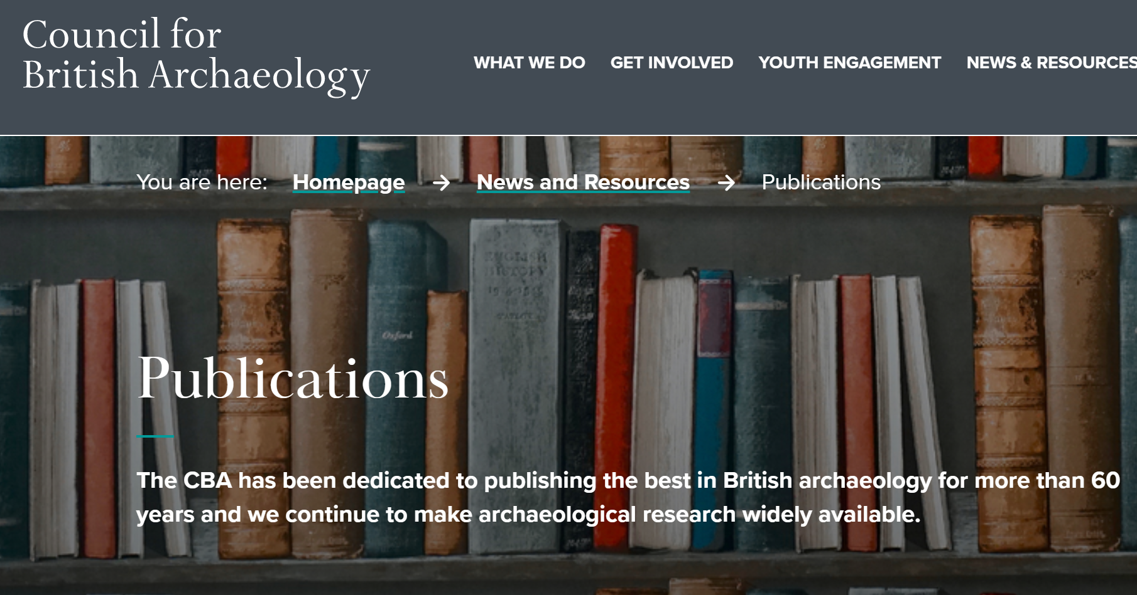
HPAR7006: Archaeological Project Reporting: Monograph Publication by Society
Council for British Archaeology Research Reports

Slide 11
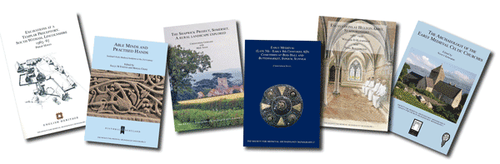
HPAR7006: Archaeological Project Reporting: Monograph Publication by Society
Society for Medieval Archaeology Monograph Series
“The Society has published a series of monographs for more than 50 years. It covers a full range of topics and site types including cemeteries and burials, rural settlement, towns, industry, religious and monastic sites, manors and moats together with more synthetic conference volumes on specific themes.”
House Style
Refereed
Members Discount
Published / Distributed by Routledge

Slide 12
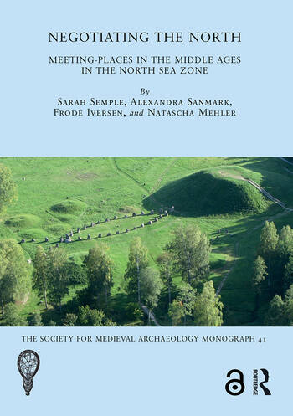
HPAR7006: Archaeological Project Reporting: Monograph Publication by Society
Society for Medieval Archaeology Monograph Series
S Semple, A Sanmark, F Iversen and N Mehler (2020) Negotiating the North: Meeting-Places in the Middle Ages in the North Sea Zone [free and full open access from https://www.taylorfrancis.com/books/9781003045663]

Slide 13
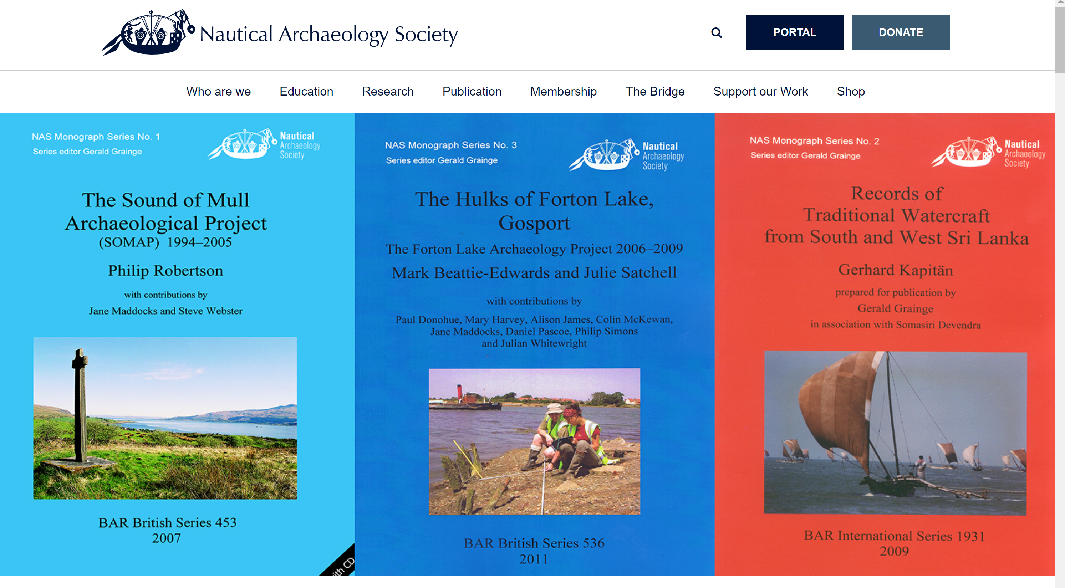
HPAR7006: Archaeological Project Reporting: Monograph Publication by Society
Nautical Archaeology Society Monograph Series

Slide 14
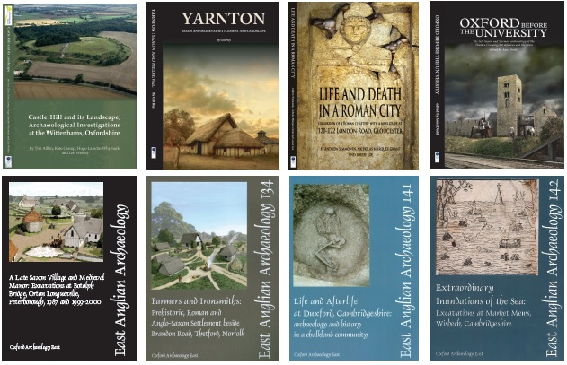
HPAR7006: Archaeological Project Reporting: Monograph Publication by Unit
Oxford Archaeology
“OA has established itself as a major publisher of archaeological reports with the production of major monograph series, such as Thames Valley Landscapes and Lancaster Imprints, and contributions to other major series, including East Anglian Archaeology Reports. Click here for the current list. While some of the earliest titles are now out of print, many of our publications are available from Oxbow Books. A number of publications are also available to download, along with over 5000 grey literature reports, from OA's digital library.”

Slide 15
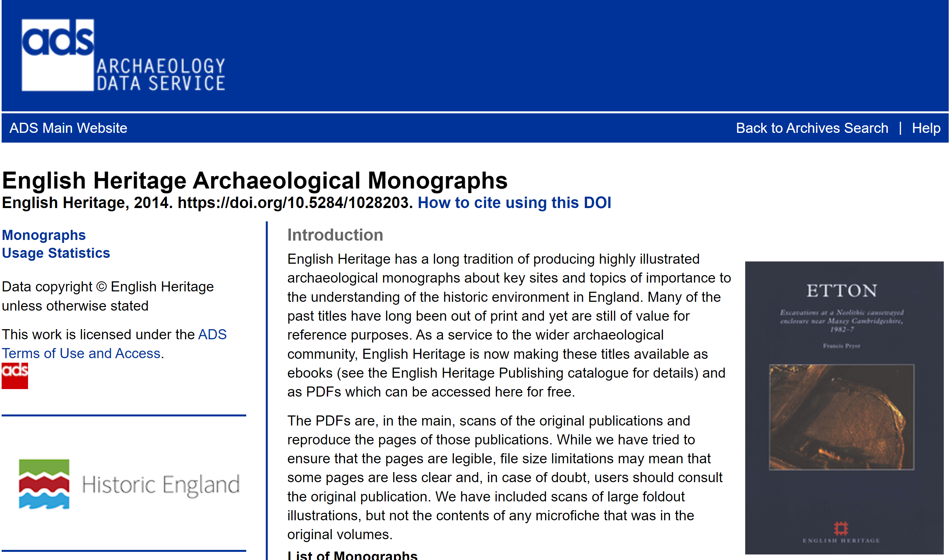
HPAR7006: Archaeological Project Reporting: Monograph Publication: Historic England
Historic England Publications ADS EH Monographs

Slide 16


HPAR7006: Archaeological Project Reporting: Monograph Publication: Archaeology Publishers
BAR Publishing
Archaeopress
“BAR (British Archaeological Reports (Oxford) Ltd) was established in 1974 by Anthony Hands and David Walker. For 17 years BAR produced and published two Series (the BAR British Series, and BAR International Series).
In 1991 Tempvs Reparatvm started publishing the BAR Series in conjunction with British Archaeological Reports (Oxford) Ltd/Hadrian Books Ltd, the Series principal publisher. In time Tempvs Reparatvm was succeeded by Archaeopress and John and Erica Hedges.
For the next 18 years Archaeopress and Hedges successfully grew the output of the two Series by over 2400 titles.
In 2015 British Archaeological Reports (Oxford) Ltd and Archaeopress parted company (the Hedges having retired earlier) with Archaeopress concentrating on its own range of imprints.”

Slide 17
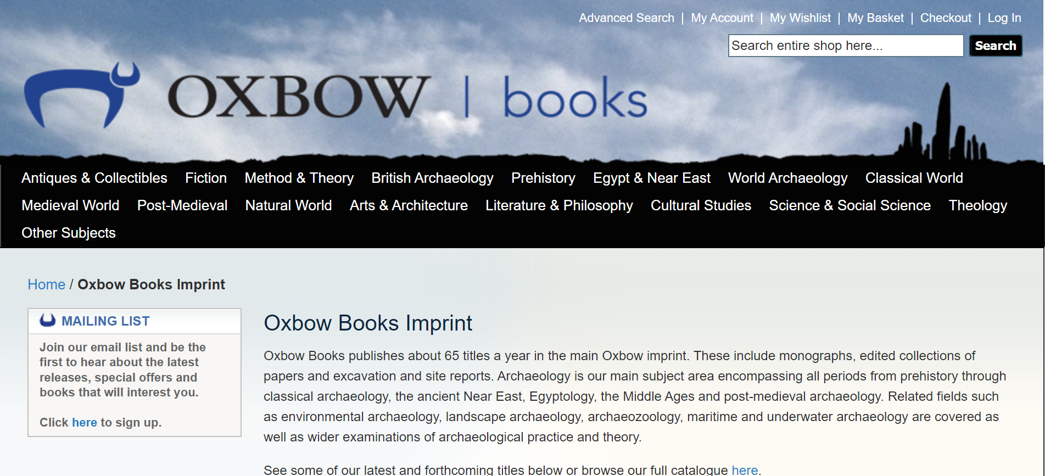
HPAR7006: Archaeological Project Reporting: Monograph Publication: Archaeology Publishers
Oxbow Books Imprint

Slide 18
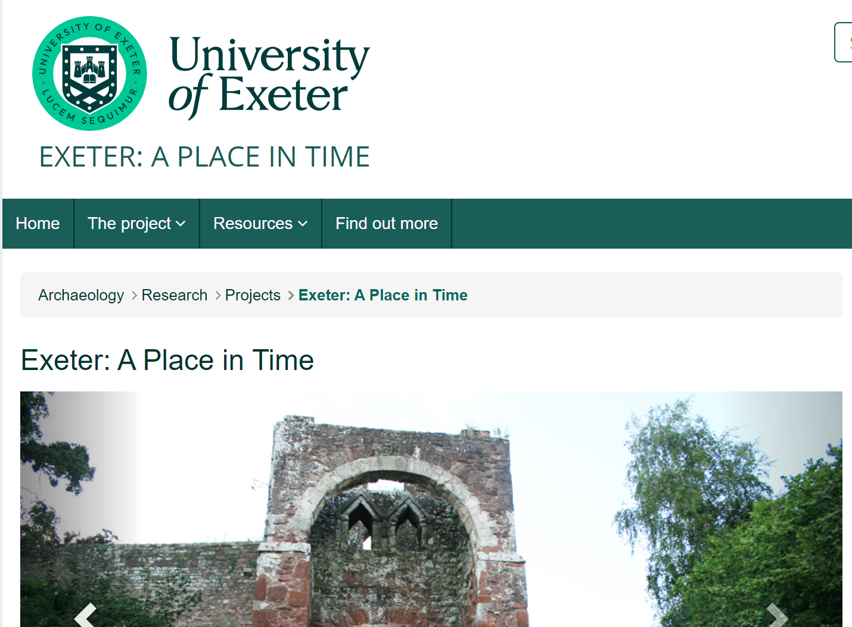
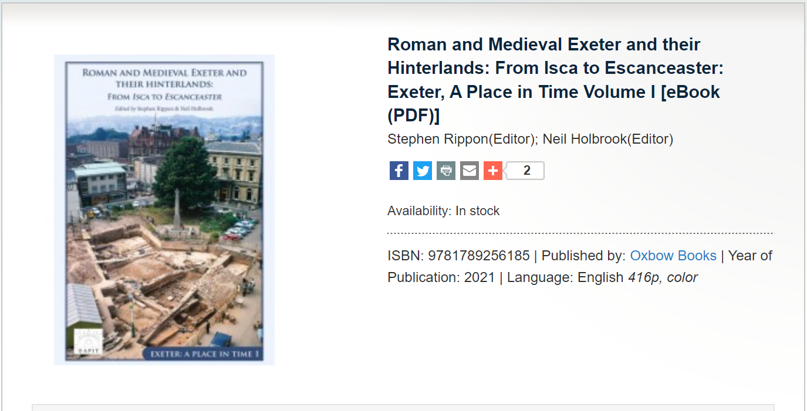
HPAR7006: Archaeological Project Reporting: Monograph Publication: Archaeology Publishers
Oxbow Books Open Access
Exeter, A Place in Time

Slide 19

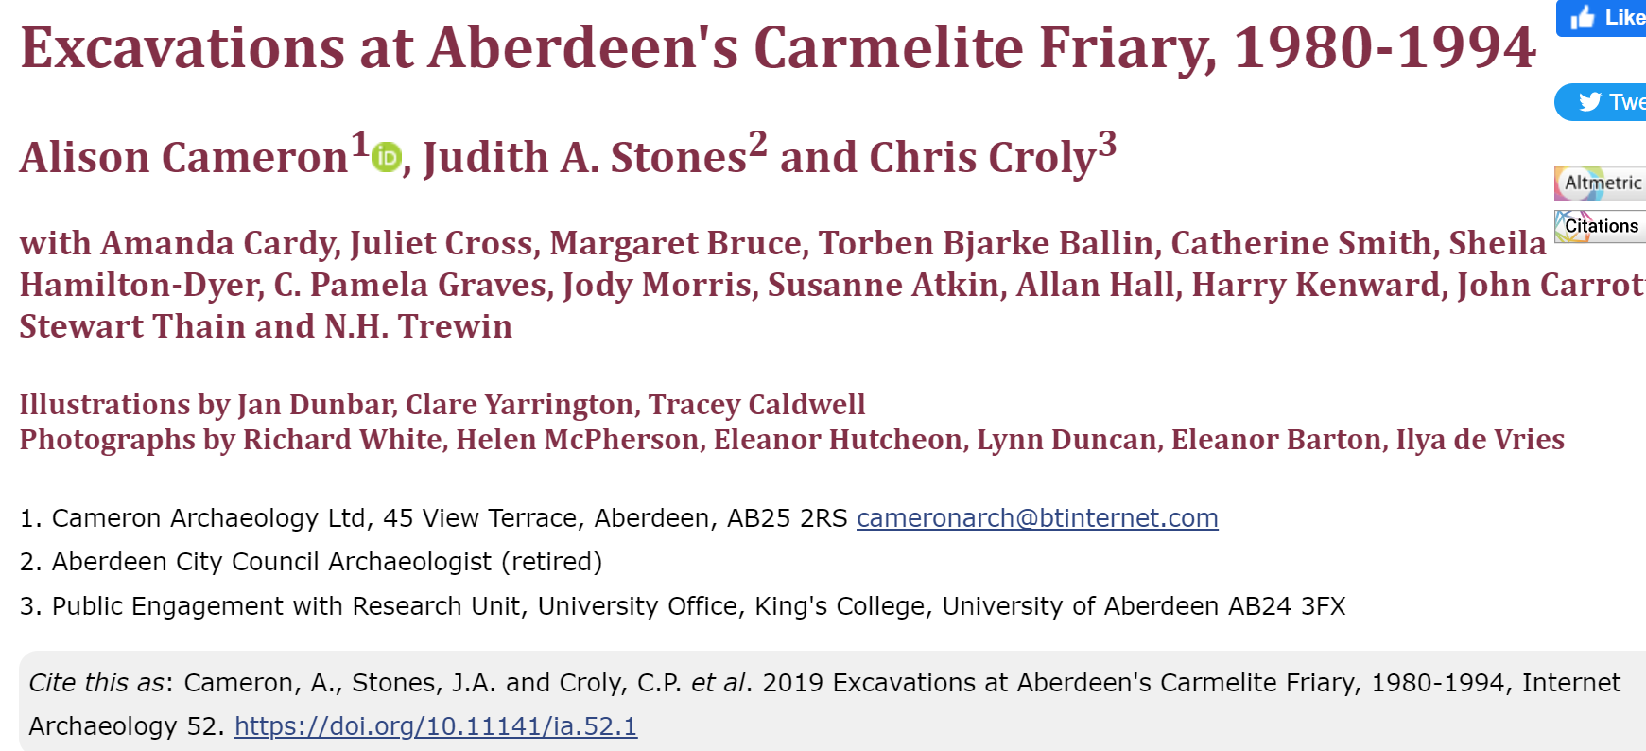
HPAR7006: Archaeological Project Reporting: Monograph Publication: Digital Born Monographs
Internet Archaeology Digital Monograph Series

Slide 20
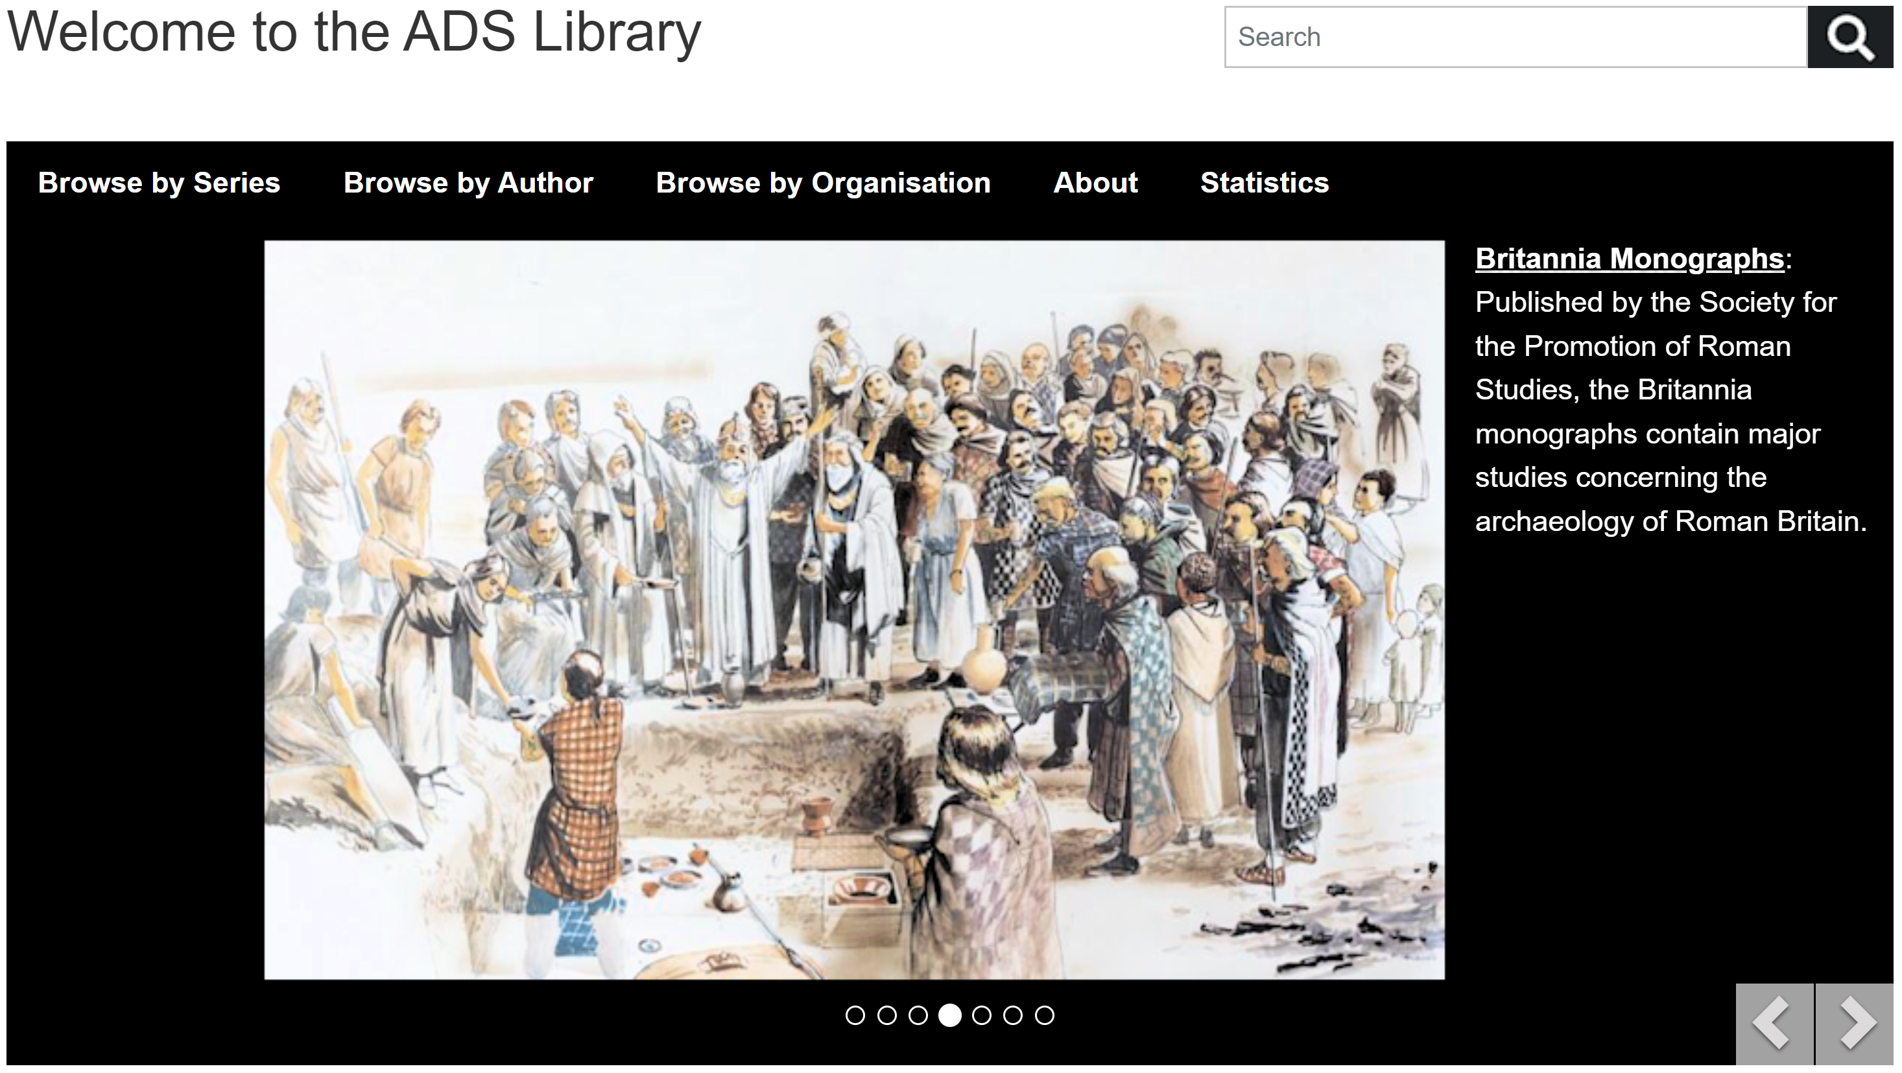
HPAR7006: Archaeological Project Reporting: ADS Library

Slide 21
HPAR7006: Archaeological Project Reporting: Monograph Publication
Recurrent Features / Issues
Publication Inception – Proposals, Editorial Boards/Committees
Monograph Series Editor(s) / House Style
Monograph Editor and Authorship
Copyright – Publisher and Authors? Creative Commons. Illustrations
Distribution and Marketing
Digital Publication
Illustrations
Presentation of Data – Digital Links

Slide 22
Preparing a monograph
Budget
Timeline
Contributors
Contributor brief – word count, images, house style
Progress meetings?
Editing/ peer review
Proofing
Index
ISBN / Legal deposit
Data archive
Production and distribution
Marketing

Slide 23
Economics of monograph publication
Authors
Illustrators
Editors
Design
Printing
Marketing
Distribution
Income
Book sales
Grants- developer, other bodies
Subscribers
Treatment in accounts

Slide 24
Impact of publication
Launch event
Distribution and sales
Citations and discourse
Long tail

Slide 25
HPAR7006: Archaeological Project Reporting: Module Description and KSBs
K3 | relevant primary and secondary data and sources relating to archaeology
K6 | requirements of formal publication, including standards for writing, editing and style

