Slide 1

Module title: To explore how digital technology can improve efficiently, data safety and staff collaboration across the organisation at greenfield home care agency.
Module code: LCHS4007
Tutor: Markus Klingelfuss
Sammar Zaman 2522375
Asma Kousar
Akifah Kousar

Slide 2

Introduction
Hi I'm Sam , Asma , Akifah we are here today to discuss how using Microsoft 365 can be used to improve work efficiency, communication, and digital safety within the greenfield home care agency.

Slide 3

CONTENTS
. Introduction
. Microsoft Word
. Microsoft Teams
. Confidentiality and compliance
. Conclusion
. References

Slide 4
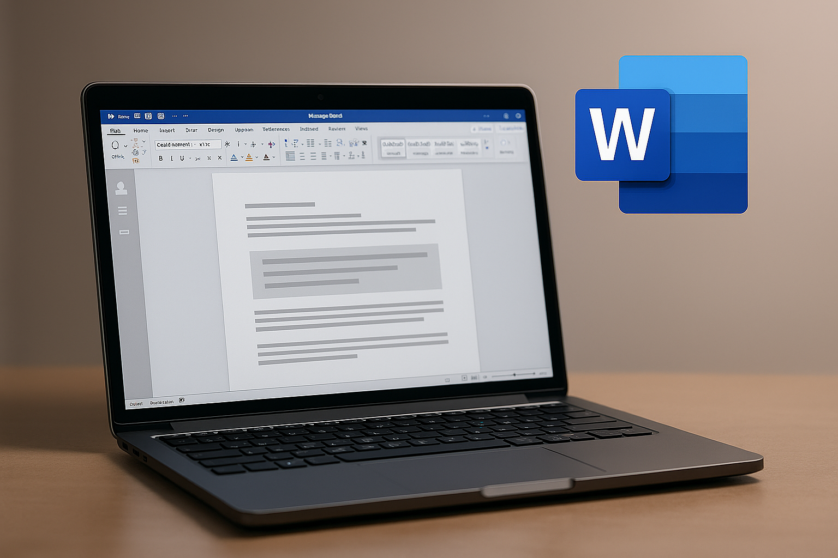

Microsoft Word
We have just recently switched over from the old system which relied upon a lot of handwritten paperwork and outdated methods. Microsoft Word is a Word processing software created by Microsoft which will be beneficial to greenfield. This will help with creating patient records, writing down research papers, resumes and admin documents. (uma technology jan 2025)
. Here are a few examples on what Microsoft Word could be used for in greenfield home care agency
. Documenting patient records
. Creating policies and procedures
. Generating forms
. Legal documentation and compliance
. Electronic health records (uma technology jan 2025)

Slide 5
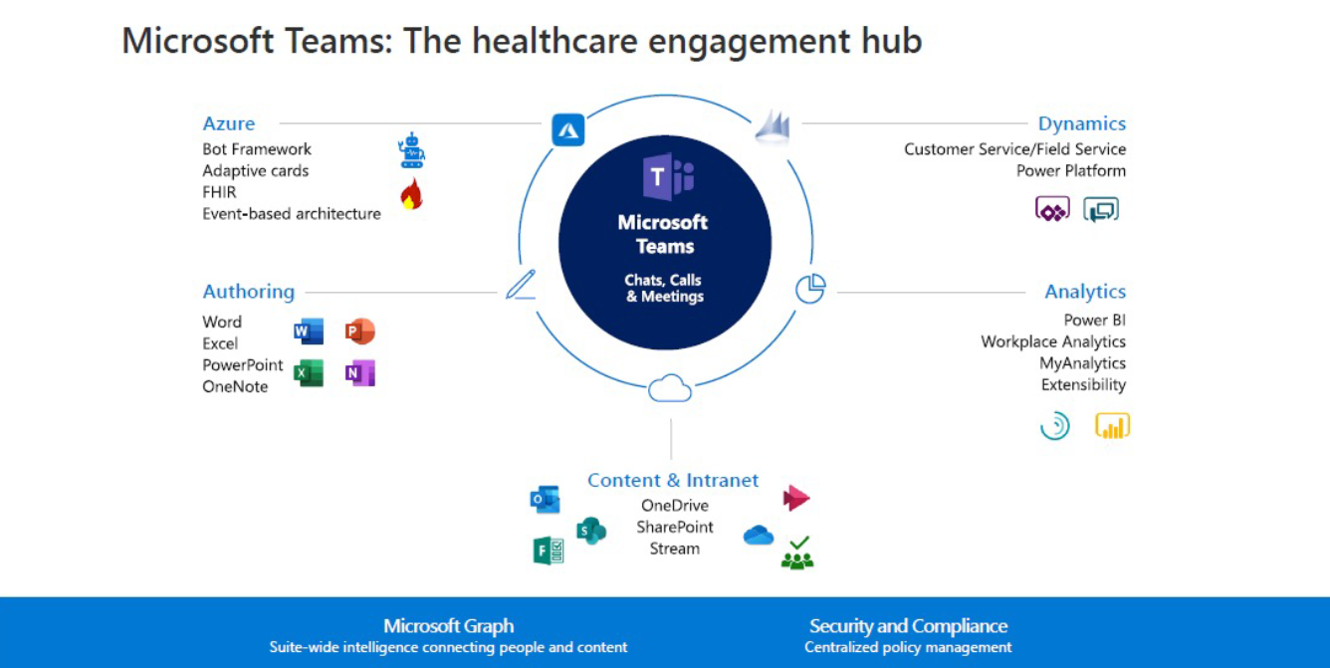

As technology develops, the use of Microsoft word in healthcare is expected to expand, with future improvements likely to strengthen its functionality and reinforce its importance as a key tool within the sector. (uma technology Jan 2025)
Microsoft word could be used for data analysis such as patient audio recordings. It is then transcribed using Microsoft word which then that information is used to enhance analysis. Each patient are given unique reference codes which is easily accessible. (Al Hamid AM, Ghaleb M, Aljadhey H, et al August 2017 )
Microsoft word can be used for authoring documents which means allowing multiple users to edit the same document at the same time.
Nhs Using Microsoft in Healthcare - The Health Informatics Service Website (March 2022)

Slide 6

Microsoft Teams
The covid pandemic accelerated the adoption of digital technology in primary care To support remote working. all staff with an nhs.net account were provided access to Microsoft Teams , enabling virtual communication, collaboration and continuity of the services during the pandemic.
Microsoft Teams is used across the NHS as a secure way for staff to communicate and work together. When it’s accessed through approved NHS networks, it sits safely within the NHS security boundary, which means information can be shared and monitored in line with NHS standards. Teams makes it easier for people to collaborate remotely, whether they’re working in a practice, at home, or moving between different sites.
The platform acts as a central space where staff can chat, make calls, and work on shared documents. This helps teams stay connected even when they’re not in the same location, supporting flexible working and continuity of care.
Using Microsoft Teams, staff can:
Invite both NHS mail and non‑NHS mail users to meetings
Make calls and send messages from mobile devices
Hold meetings with up to 250 participants

Slide 7


It’s free for NHS staff to use and makes remote working much easier.
. Host and record large live events, which is useful for training or virtual conferences of up to 10,000 people
Helps save time because staff don’t need to travel for meetings as often.
Meetings can be arranged in advance or started instantly when needed.
You can create different chat rooms or channels to organize work between groups.
Allows staff to message each other, send voice notes, and share files before, during, and after meetings.
All chat messages and shared documents stay available to look back on whenever needed.
Offers live captions during meetings, which is helpful for people with hearing difficulties.
Supports online meetings with good‑quality audio and video. (NHS England 2025)

Slide 8
References
Uma technology January 2025- How Is Microsoft Word Used In The Medical Field - UMA Technology (accessed February 6th 2026)
Al Hamid AM, Ghaleb M, Aljadhey H, et al. August 2017. bmjopen-2017-017664.pdf (accessed February 8th 2026)
NHS (NA) 21st march 2022 Using Microsoft in Healthcare - The Health Informatics Service Website (accessed February 8th 2026)
NHS England (NA)(2025) 4 April 2025. Available at: NHS England » Microsoft Teams and remote working (Accessed: 8 February 2026).

