Slide 1

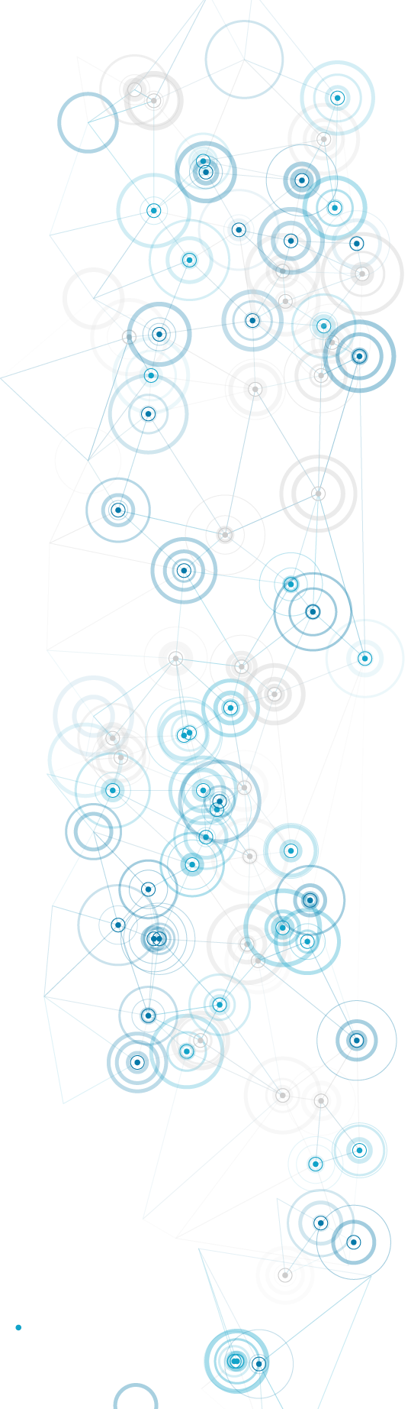


The Digital Professional for Health and Care
Workflow and team working in health and care informatics
Dr Philip Scott MSc PhD FHEA FBCS CITP CHCIO

Slide 2
Lecture learning outcomes
Understand why workflow support is central to digital health and care.
Describe how workflow concepts are modelled in HL7 Fast Healthcare Interoperability Resources and the Proforma language.
Outline how Business Process Modelling Language, value stream mapping and UML sequence diagrams can be used to model workflow.
Illustrate why workflow models often fail to correctly describe operational reality.
Explain the concept of distributed cognition.
Reflect on how you can use these concepts in the coursework.

Slide 3
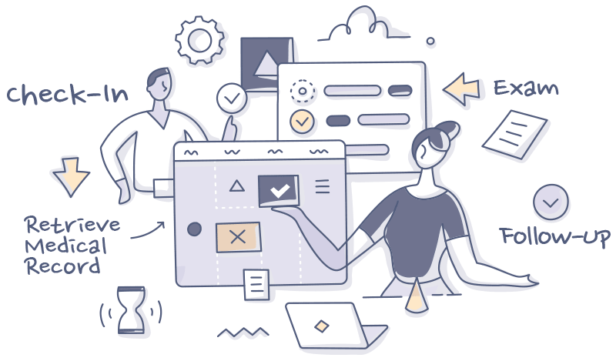
What is workflow? Examples…
Hospital discharge protocol.
Primary care cancer referral pathways.
Medication and test order sets (e.g. warfarin).
Care home admission process.
Elective surgery pathways.
111, ED and primary care triage.
GP remote consultation.
Community pharmacy medication review.
https://www.foreseemed.com/hospital-workflows

Slide 4
What is workflow? General concepts.
A definable sequence of events.
An element of or a whole plan, protocol, pathway, process
What sorts of activities should occur, what order they should occur in, what dependencies they have, and in what circumstances they should start or end.
Prescribed roles and responsibilities.
Common features: time, events, actions, choices, conditional rules.
Software design often struggles to accommodate ‘fuzzy’ decision points.
Workflow is a kind of algorithm, hence its universality in health and care informatics.
To become computable, the workflow needs to be well described and defined – modelled.

Slide 5
How can you model workflow?
Informal flowchart.
Formal notation:
  Business Process Modelling Notation (BPMN)
  Unified Modelling Language (UML)
  Lean value stream map.
Health and care specific:
  Fast Healthcare Interoperability Resources (FHIR)
  Proforma (from Open Clinical).

Slide 6
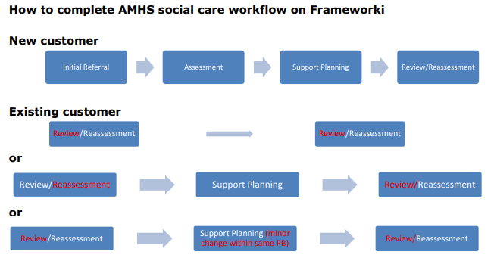
How can you model workflow? An informal flowchart.
http://www2.westsussex.gov.uk/LearningandDevelopment/fwi/How%20to%20complete%20Adult%20Mental%20Health%20Services%20social%20care%20workflow%20on%20Frameworki.pdf

Slide 7
Informal flowchart strengths and weaknesses
Strengths
  Easy to construct.
  Does not need specialist software.
  Does not need familiarity with specific diagramming notation.
Weaknesses
  Hard to depict choices and conditional logic.
  Easily becomes too vague and imprecise.
  Presentation is often inconsistent and can lead to misinterpretation.

Slide 8
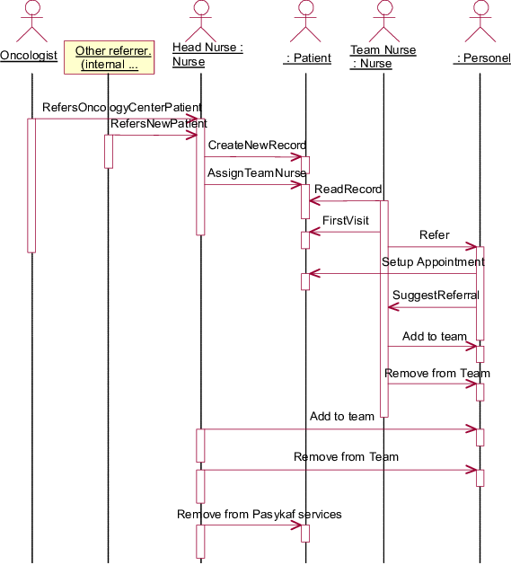
Example: UML sequence diagram (‘swim lanes’) - oncology

Slide 9
UML strengths and weaknesses
Strengths
  Helps to avoid vagueness and imprecision.
  Free online software available for diagrams (https://bpmn.io/).
  Can be used to decompose processes in initial analysis.
  Standard IT modelling language.
Weaknesses
  Sequence diagram does not easily show choices and conditional logic (can use Activity Diagram).
  Does not entirely remove vagueness and imprecision.
  Not executable.
  Need familiarity with specific diagramming notation.
  Need to learn how to use a modelling tool.
  Can become too complex, unreadable and over-engineered.
  Notation can confuse untrained people and lead to misinterpretation.

Slide 10
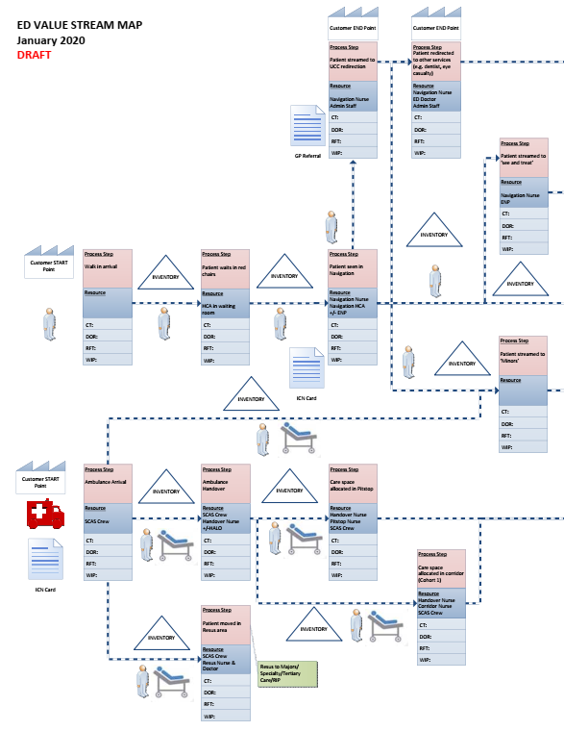
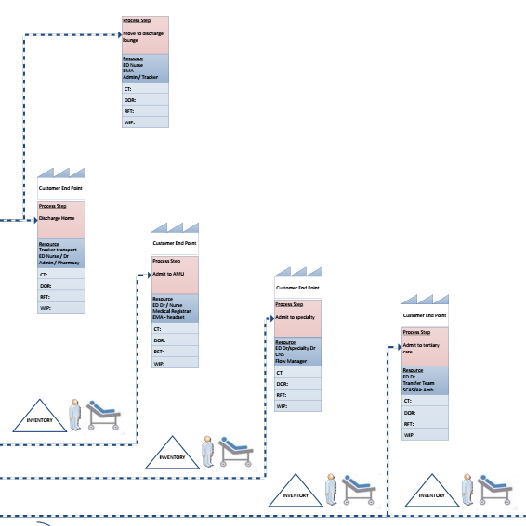
Example: ED value stream map

Slide 11
Value stream strengths and weaknesses
Strengths
  Helps to avoid vagueness and imprecision.
  Shows choices and conditional logic.
  Supports Lean process improvement, identifying waste and value.
  Standard notation.
Weaknesses
  Does not entirely remove vagueness and imprecision.
  Not executable.
  Need familiarity with specific diagramming notation.
  Need to learn how to use a modelling tool.
  Can become too complex, unreadable and over-engineered.
  Notation can confuse untrained people and lead to misinterpretation.

Slide 12
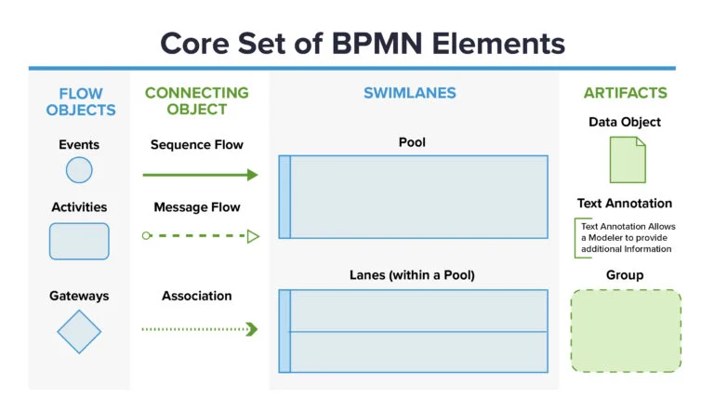
How does BPMN model workflow?
Business Process Modelling Language – published by Object Management Group: https://www.omg.org/spec/BPMN/2.0/About-BPMN/
https://www.processmaker.com/blog/what-is-the-bpmn-2-0-standard/

Slide 13
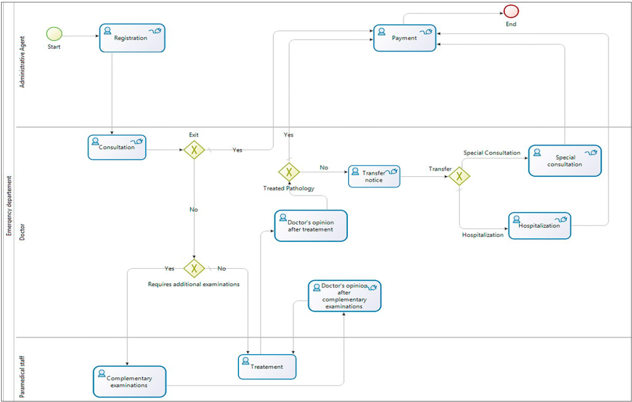
Example: ED process model
Houari & Ghannouchi (2017): https://www.sciencedirect.com/science/article/pii/S1877050917323116

Slide 14
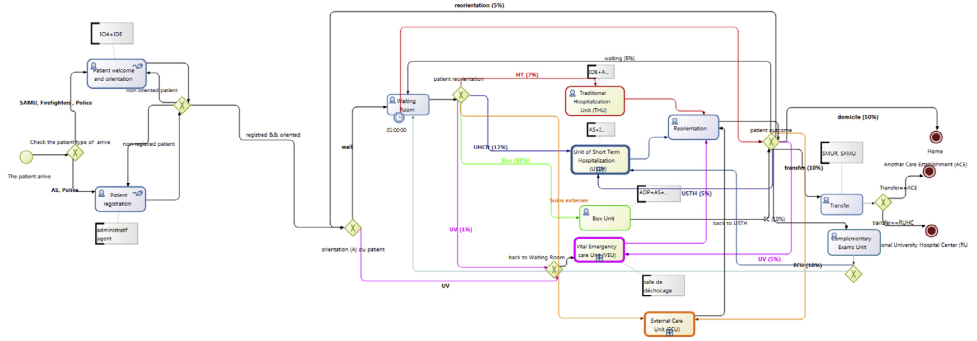
Example: Paeds ED workflow model
Ajmi et al. (2015): https://www.sciencedirect.com/science/article/pii/S153204641400269X

Slide 15
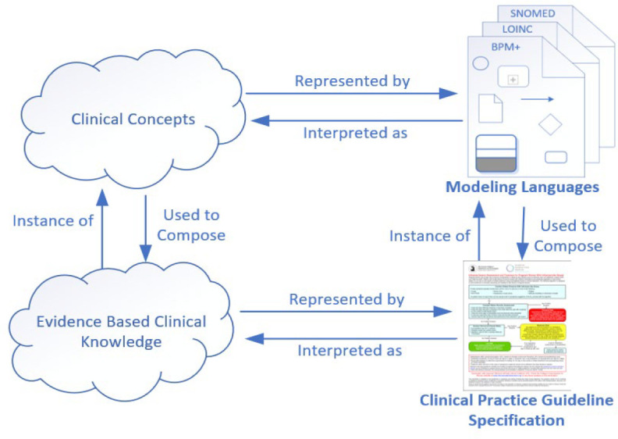
Using BPMN in clinical decision support
Lario et al. (2020): https://www.ncbi.nlm.nih.gov/pmc/articles/PMC8075494/

Slide 16
BPMN strengths and weaknesses
Strengths
  Good support for choices and conditional logic.
  Forces avoidance of vagueness and imprecision.
  Free online software available for diagrams (https://bpmn.io/).
  Open source process execution software available (https://camunda.com/download/).
  Works with Decision Modelling Notation (DMN) and Case Management Model and Notation (CMMN).
  Growing healthcare user community and applications (https://www.bpm-plus.org/).
  Can be used to enable clinical decision support.
  De facto standard business process modelling language.
Weaknesses
  Need familiarity with specific diagramming notation.
  Need to learn how to use a modelling tool.
  Easily becomes too complex, unreadable and over-engineered.
  Notation can confuse untrained people and lead to misinterpretation.

Slide 17
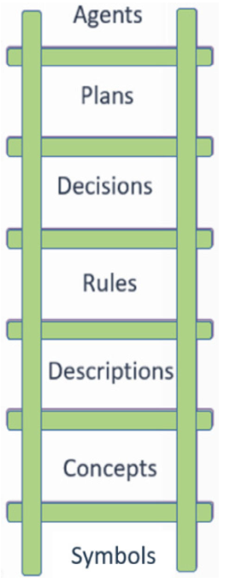
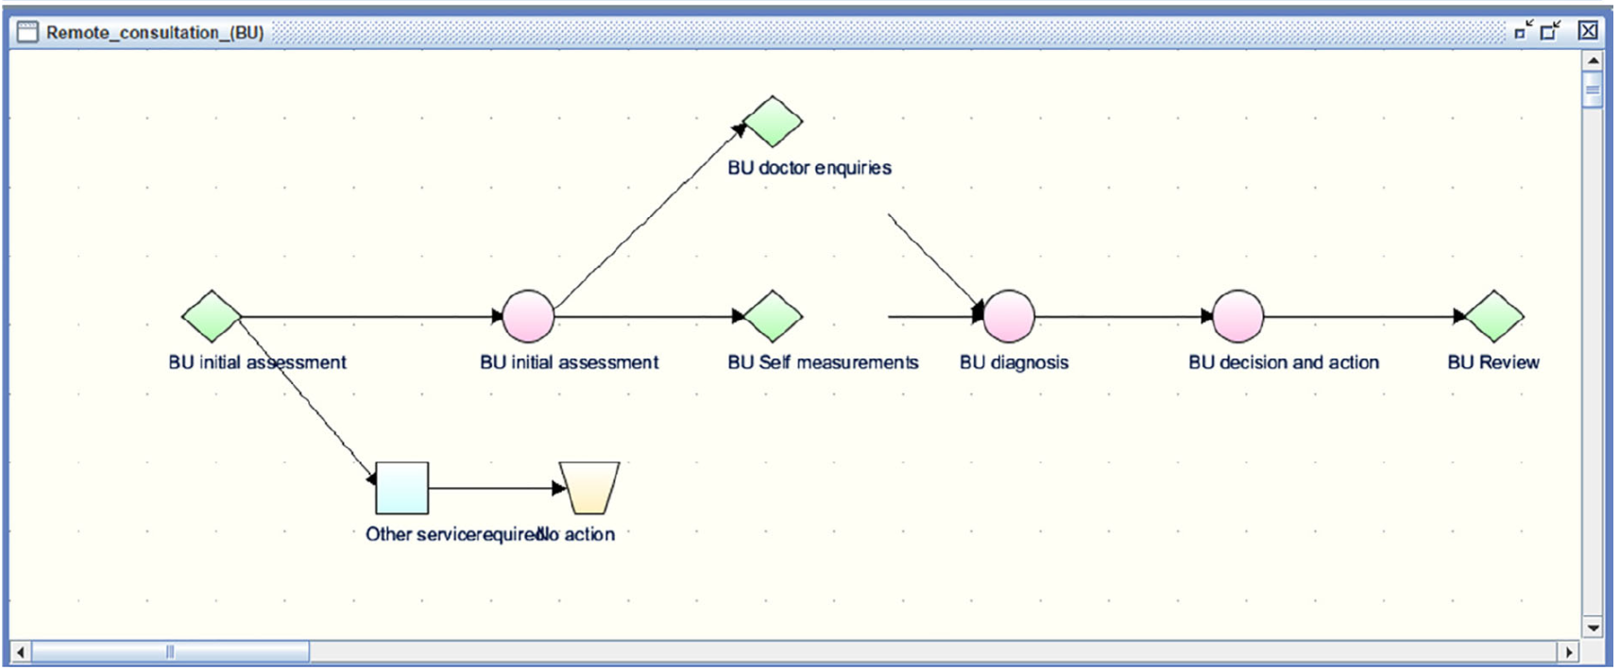
How does Proforma model workflow concepts?
See https://www.openclinical.net/
Fox et al., 2020: https://onlinelibrary.wiley.com/doi/full/10.1002/lrh2.10236

Slide 18
Proforma workflow strengths and weaknesses
Strengths
  Provides a mechanism to avoid vagueness and imprecision.
  Shows choices and conditional logic.
  Standard notation.
  Designed for health and care decision making.
  Well defined concept model.
Weaknesses
  Does not entirely remove vagueness and imprecision (depends how used).
  Not directly executable or interoperable.
  Need familiarity with specific notation.
  Need to learn how to use a data modelling tool.
  Bespoke process modelling language.
  Not widely used.

Slide 19
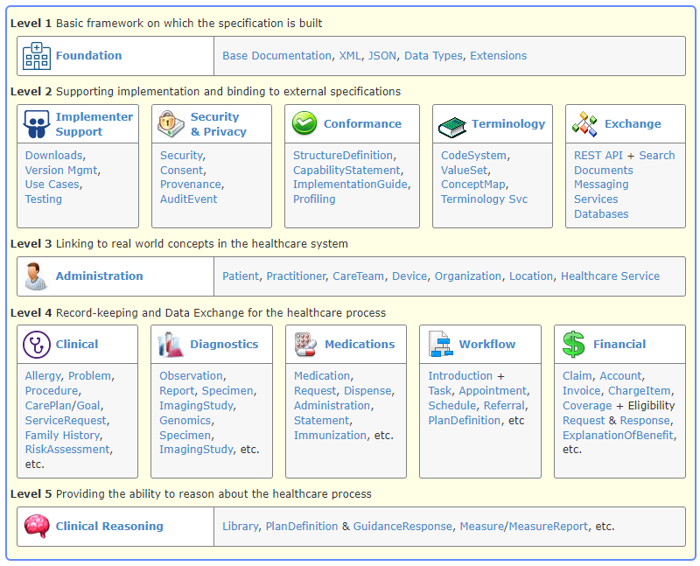

What is FHIR?
Fast Healthcare Interoperability Resources
https://hl7.org/fhir

Slide 20
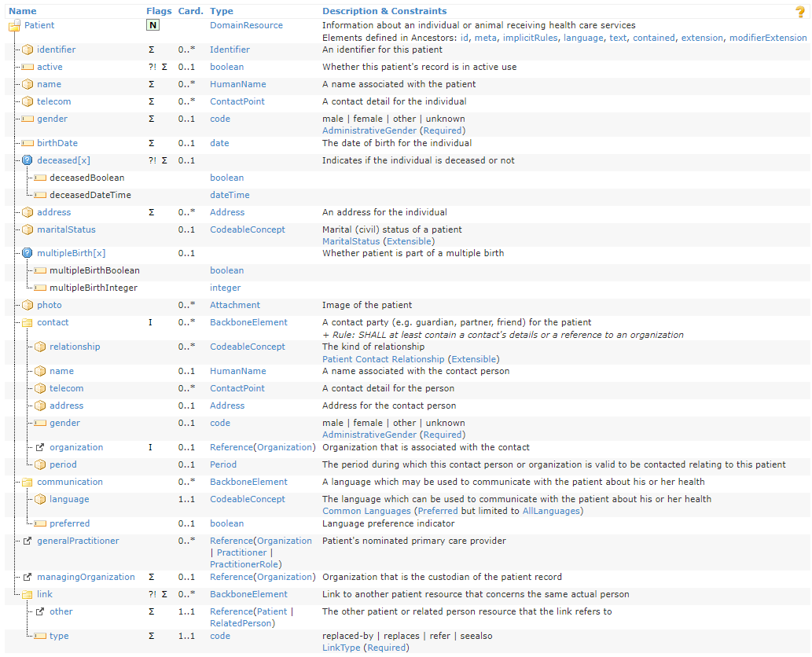
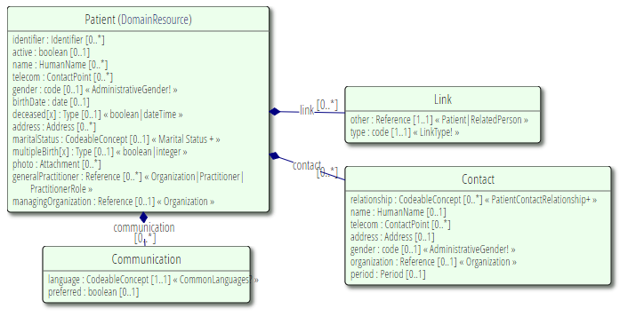
What is FHIR?

Slide 21
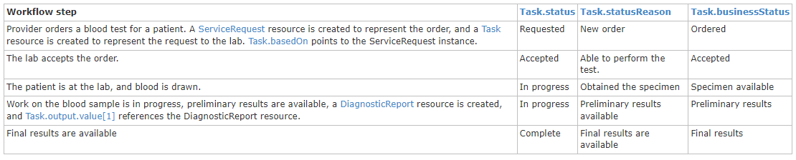
How does FHIR model workflow?
https://hl7.org/fhir/workflow.html

Slide 22
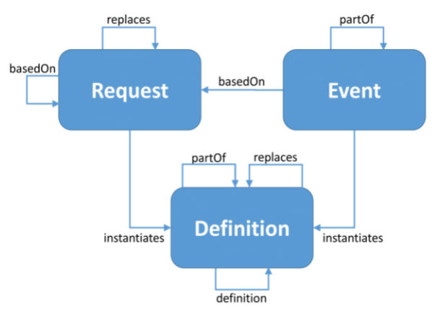
How does FHIR model workflow?
https://hl7.org/fhir/workflow.html

Slide 23
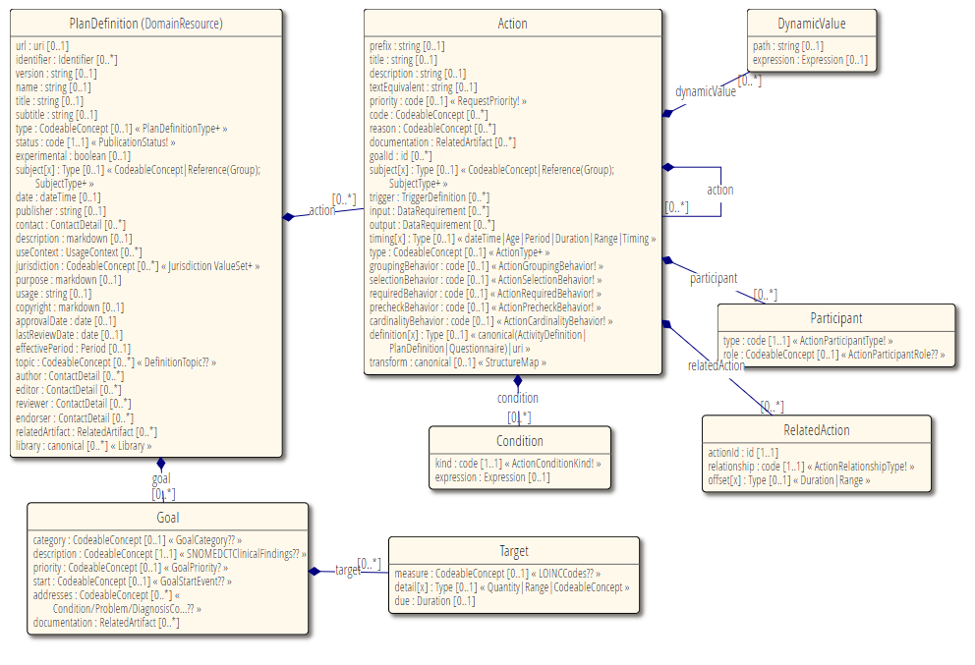
How does FHIR model workflow?
https://hl7.org/fhir/plandefinition.html

Slide 24
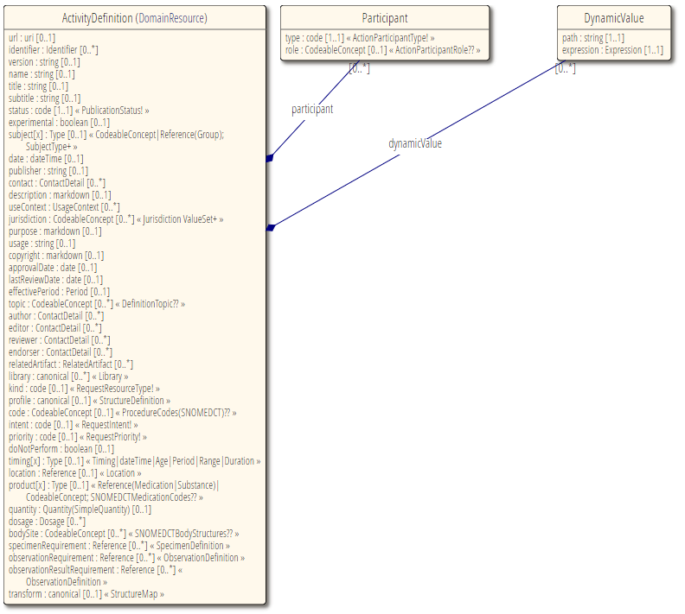
How does FHIR model workflow?
https://hl7.org/fhir/activitydefinition.html

Slide 25
FHIR workflow strengths and weaknesses
Strengths
  Provides a mechanism to avoid vagueness and imprecision.
  Shows choices and conditional logic.
  Standard data structures.
  Designed for health and care.
  Well defined concept model.
  Works with standard health and care terminologies (e.g. SNOMED CT).
Weaknesses
  Does not entirely remove vagueness and imprecision (most things are optional).
  Not directly executable.
  Need familiarity with specific data structures.
  Need to learn how to use a data modelling tool.
  Not yet widely used.
  No specific diagram notation.

Slide 26
Why do workflow models often fail?
Work as imagined, versus work as done.
People consulted in workflow mapping may not know the reality!
We prefer the idealised ‘how it ought to work’ to the actual messy muddling-through: professional pride, misusing the process map as an instrument of change, self-deception to alleviate ‘moral injury’ (https://www.thelancet.com/journals/lanpsy/article/PIIS2215-0366(21)00113-9/fulltext).
Practice varies: the workflow may not actually be standardized.
Workarounds vary by individual and team.
Compliance varies by individual and team.
Overall resource shortages (staff, beds, rooms, equipment, data) constrain actual practice.
Decision making is sometimes justifiably uncertain due to incomplete knowledge.

Slide 27

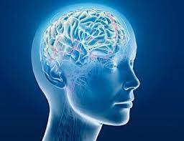
What is distributed cognition? Why is it relevant?
Distributed cognition “locates thought as an emergent property of people interacting with other actors and the environment rather than a process inherently restricted to individual minds”.
“In contrast to classical cognitive theory that is constrained to ‘what goes on in the head’, distributed cognition describes what goes on ‘in the world’ as an interactive cognitive system comprising people, artefacts and environments, and explores ‘how information processing is coordinated in sociotechnical systems’”.
https://bmjopen.bmj.com/content/9/1/e023712

Slide 28
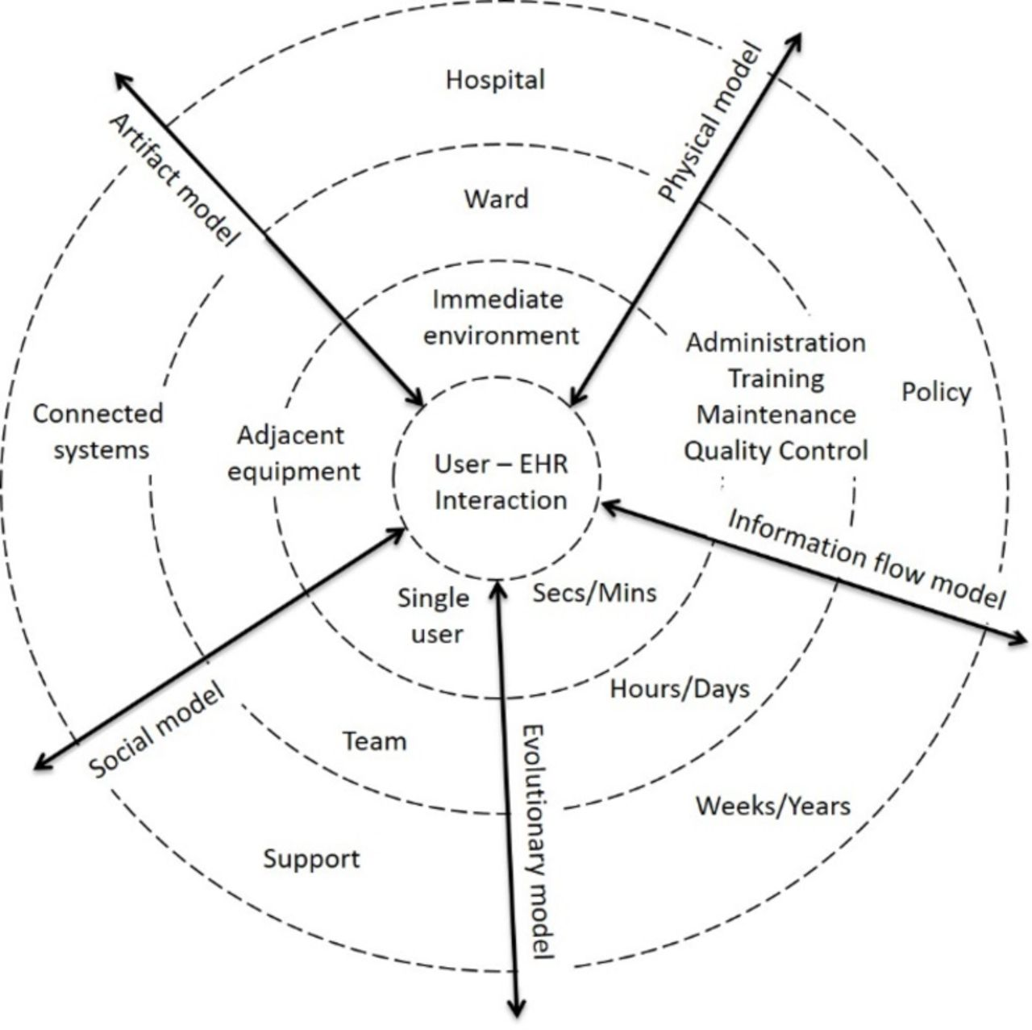
What is distributed cognition? Why is it relevant?
Distributed Cognition for Teamwork—Concentric Layers (DiCoT-CL)
Furniss et al., 2015: https://www.sciencedirect.com/science/article/pii/S1532046414002718
“The idea of the concentric circles draws on Grudin’s description of technology ‘reaching out’ through layers of context or abstraction.”
“This might be interpreted as a ‘ripple effect’ spreading from the micro to the macro without any fixed boundary. The framework encompasses five submodels: information flow, artefact, physical, social and evolutionary.”
https://bmjopen.bmj.com/content/9/1/e023712

Slide 29
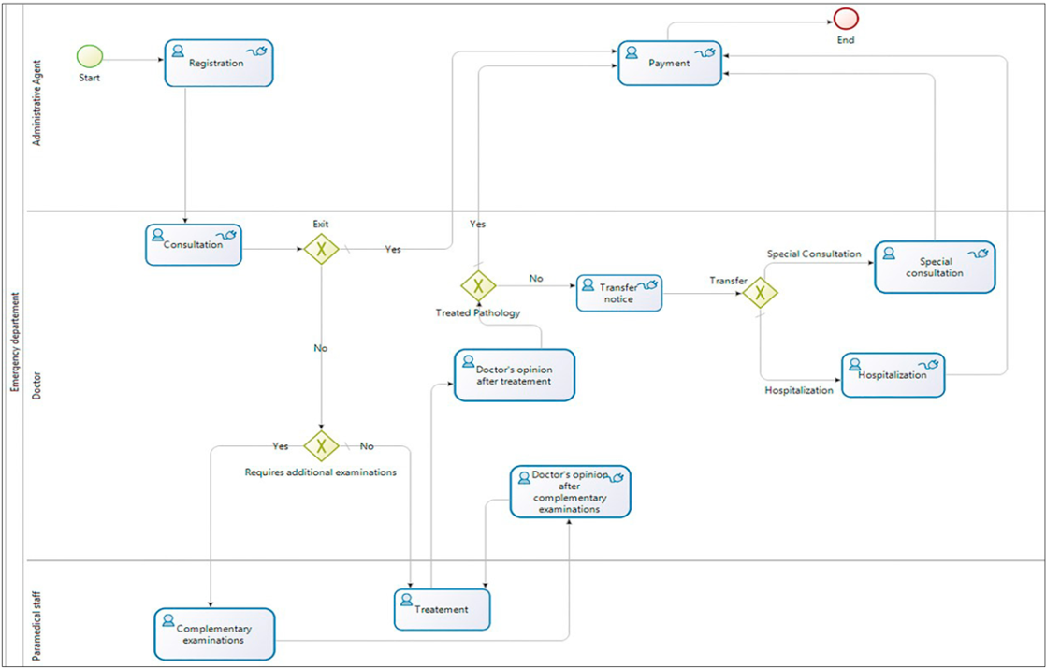
How does distributed cognition interact with workflow?

Slide 30
Lecture learning outcomes
Understand why workflow support is central to digital health and care.
Describe how workflow concepts are modelled in HL7 Fast Healthcare Interoperability Resources and the Proforma language.
Outline how Business Process Modelling Language, value stream mapping and UML sequence diagrams can be used to model workflow.
Illustrate why workflow models often fail to correctly describe operational reality.
Explain the concept of distributed cognition.
Reflect on how you can use these concepts in the coursework.

