Slide 1
Research Methods and Professional Development

Slide 2
Assessment 1a - Project Proposal
Students to produce a project proposal
Consider:
Rationale
Title
Aim
Objectives
Background – Key Literature
Access to resources - Methodology
Ethical considerations
Timeline (Gantt Chart)
Bibliography – Books, Online Articles, Journals, Professional Bodies

Slide 3
Assessment 1b – Research Project
Students produce a research project in report format which considers contemporary themes in the industry and highlights key recommendations for the organisation, community or sector.
Consider:
 | Title
Table of Contents | Introduction | Review of Literature/present findings
Conclusion | Recommendations
Referencing/ Bibliography | Appendices

Slide 4
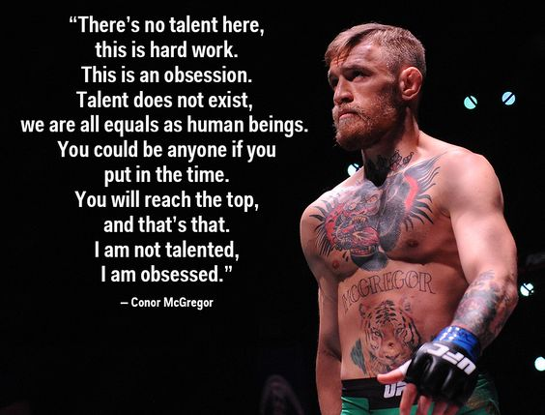

Slide 5
Choosing your research topic
In groups of 3-5 students
Choose a topic to research based on an area of sport BUT remember it must be realistic and achievable within the time and resources available to you.
Here are some examples…….
And some possible sources…….

Slide 6
Title & Source
Investigate the key barriers to increasing participation in Primary and or Secondary Schools. Identity key recommendations for increasing activity levels.
http://www.makesportfun.com/wp-content/uploads/2011/07/Top-10-ways-to-increase-participation-report1.pdf
https://www.sportengland.org/about-us/what-we-do/
https://www.sportscoachuk.org/sites/default/files/Coaching-and-participation.pdf
https://www.brent.gov.uk/media/2025468/Increasing%20participation%20in%20sport%20task%20group%20report.pdf
http://sport.wales/media/506916/sport_wales_english_vision_doc_reprint_all_v3.pdf
http://www.swansea.gov.uk/article/2895/Full-version---improvement-objective-G

Slide 7
Title & Source
Investigate the challenges to local rugby or football clubs of adult player recruitment and retention in Wales.
http://www.walesonline.co.uk/sport/rugby/rugby-news/welsh-rugby-clubs-dying-out-11823052
http://sport.wales/media/1018674/community_sport_strategy___eng_.pdf
http://www.wru.co.uk/eng/news/29967.php#.V_48LU0VCUk
http://www.dailytelegraph.com.au/sport/rugby/almost-7000-players-left-club-rugby-in-australia-last-season-according-to-aru-figures/news-story/8845fc040d01ce82b395c90a8a444724
http://www.sportcal.com/News/PressReleases/76781?sportID=225&size=50
http://sport.wales/research--policy/surveys-and-statistics/statistics.aspx

Slide 8
Title & Source
Analysis of the barriers affecting female students aged 16-19 engaging in sport and physical activity.
http://sport.wales/media/1667685/further_education_sport_survey_-_state_of_the_nation_2015_english__final__2.pdf

Slide 9
Title & Source
Identify the barriers to participation in sport for students aged 16-19
http://sport.wales/media/1667685/further_education_sport_survey_-_state_of_the_nation_2015_english__final__2.pdf

Slide 10
Title and Source
Has foreign ownership impacted on the ‘culture’ of the English football league.
Wolves takeover means 25 of the top English clubs now have foreign ownership- www.dailymail.co.uk article 3703138
Foreign ownership in the premier league- Why so much and what does it mean- www.footballfancast.com
Are ‘foreign owners’ destroying our English game- www.90min.com

Slide 11
Title & Source
Evaluate the barriers affecting participation in sports by girls at secondary school and identify key recommendations to overcome these barriers.
http://sport.wales/media/929360/quality_education.pdf
http://sport.wales/community-sport/sporting-communities/community-strategy-evidence-base.aspx
https://www.icsspe.org/sites/default/files/Girls.pdf
https://www.womenssportsfoundation.org/home/support-us/do-you-know-the-factors-influencing-girls-participation-in-sports

Slide 12
Title & Source
Investigate the trends in adult participation in physical activity in Wales and consider the impacts on general health and well being of the population
https://www.bhf.org.uk/-/media/files/.../bhf_physical-activity-statistics-2015feb.pdf
sport.wales/research--policy/tools-and-resources/publications.aspx
gov.wales/statistics-and-research/welsh-health-survey/?lang=en
http://www.sportengland.org/research/about-our-research/what-is-the-active-people-survey/
http://ukactive.com/downloads/managed/Turning_the_tide/Turning_the_Tide_of_Inactivity.pdf

Slide 13
Identify the reasons for the drop in the number of senior male rugby players in Wales
https://www.theguardian.com/sport/gallery/2013/feb/01/rugby-union-wales-rugby-union-team
http://www.therugbypaper.co.uk/features/columnists/peter-jackson/7562/peter-jackson-talks-to-maesteg-coach-richard-webster-about-the-startling-decline-of-welsh-club-rugby/
http://www.walesonline.co.uk/sport/rugby/rugby-news/welsh-rugby-versus-welsh-football-9356774
https://www.theguardian.com/sport/video/2016/feb/25/welsh-schoolchildren-rugby-wales-football-real-madrid-video

Slide 14
Title & Source
Evaluate the Impact of the Lidl Play more football initiative has had on increasing participation in football and identifications its strengths and weaknesses.
http://welshfootballtrust.org.uk/LidlPlayMore.ink
http://www.lidl.co.uk/en/11023.htm
http://www.southwalesargus.co.uk/news/14435524.Lidl_launch_Play_More_Football_initiative_in_Newport/?ref=rss
http://metro.co.uk/2016/04/19/wales-manager-chris-coleman-backing-innovative-new-grass-roots-scheme-5827483/

Slide 15
Title & Source
Investigate the post 16 drop out in female football, and is enough doing to reduce barriers to participation in South- west wales.
http://www.welshfootballtrust.org.uk/news/WFT94881.ink
http://sport.wales/news--events/news--events/our-news/latest-news/welsh-push-to-get-female-sport-moving.aspx
http://sport.wales/research--policy/surveys-and-statistics/statistics.aspx
www.thefa.com/~/media/ACFF26069B6A4156B8375A3475A2E658.ashx

