Slide 1
Strategic Management for SMEs

Slide 2

What is Strategy?
Please discuss and write down a definition….in plain English!
In the context of organisations
In the context of ‘your’ organisation

Slide 3
Definition
“Strategy is the direction and scope of an organisation over the long term: which achieves advantage for the organisation through its configuration of resources within a changing environment, to meet the needs of markets and to fulfil stakeholder expectations.”
Johnson G., Scholes, K. (1997) Exploring Corporate Strategy. 4th Edn. New York: Prentice Hall

Slide 4

What does that mean?
Look at the key words and explain what they mean in this context.

Slide 5
What is Organisational Strategy About?
The long term direction of the organisation
The scope of the organisations activities
Gaining a competitive advantage over the competition
Addressing and anticipating changes in the organisations environment
Meeting the values and expectation of stakeholders

Slide 6
Clarity on assessment
Depth of critical analysis of your chosen organisation’s internal and external environment.
Conduct a stakeholder analysis and an evaluation of stakeholder expectations.
Application of a range of relevant academic theories/models.
Provide a critical appraisal of your chosen organisation’s current strategic direction.
Depth and clarity of the proposed new strategy.
Evidence of wide reading and research.
Citation/referencing, report structure, syntax, grammar and punctuation.

Slide 7

1. Depth of critical analysis of your chosen organisation’s internal and external
Critical analysis - supported & referenced research
    Detailed (depth) Macro & Micro Environmental analysis
Select an organisation - where you can satisfy the need for supported and referenced research (it might not be your own)
Give a brief explanation - about your chosen organisation and why you chose it. (500 words max)

Slide 8
2. Conduct a stakeholder analysis and an evaluation of stakeholder expectations.
Detailed stakeholder analysis
  Map stakeholders and analyse them by their Power and Interest
  Stakeholder map and analysis

Slide 9
3. Application of a range of relevant academic theories/models.
Select at least two models or theories
    Select ones which are the most appropriate for your selected organisation, ensuring that their selection over the other models or theories is briefly explained
Apply both models and or theories to your chosen organisation
  Use wherever possible use your research to illuminate your application

Slide 10
4. Provide a critical appraisal of your chosen organisation’s current strategic direction
Critically appraise to what degree is or is not, your chosen organisation current strategic direction is followed or achieved and why?
Strategic Direction is about:
  Vision (the why)
  Mission (the how)
  Satisfying stakeholders expectations and goals

Slide 11
5. Depth and clarity of the proposed new strategy.
Propose a clear new strategy based on your detailed research findings and analysis undertaken in assessment 1-4
Have a voice and present your proposal clearly, logically and written in way that would convince a board of directors to consider changing the organisations strategic direction

Slide 12

The final but important touches
6. Evidence of wide reading and research.
7. Citation/ referencing, report structure, syntax, grammar and punctuation.

Slide 13
A Basic Model of the Strategic Management Process

Slide 14
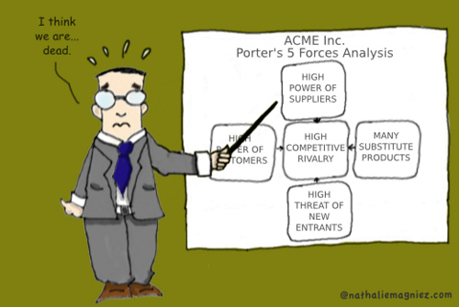
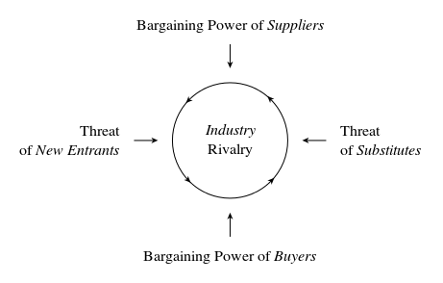
Porter’s 5 Forces

Slide 15
Porter’s 5 Forces Analysis
Five forces analysis helps the marketer to contrast a competitive environment. It has similarities with other tools for environmental audit, such as PEST analysis, but tends to focus on the single, stand alone, business or SBU (Strategic Business Unit) rather than a single product or range of products. For example, Dell would analyse the market for Business Computers i.e. one of its SBUs.
Five forces looks at five key areas namely the threat of entry, the power of buyers, the power of suppliers, the threat of substitutes, and competitive rivalry.
Adapted from: Porter, M.E (1980) Competitive Strategy,. New York. Free Press

Slide 16
The threat of new entries
Economies of scale e.g. the benefits associated with bulk purchasing
The high or low cost of entry e.g. how much will it cost for the latest technology?
Ease of access to distribution channels e.g. Do our competitors have the distribution channels sewn up?
Cost advantages not related to the size of the company e.g. personal contacts or knowledge that larger companies do not own or learning curve effects
Will competitors retaliate?
Government action e.g. will new laws be introduced that will weaken our competitive position?
How important is differentiation? e.g. The Champagne brand cannot be copied. This desensitises the influence of the buyers

Slide 17

The power of buyers
This is high where there a few, large players in a market, e.g. the large grocery chains.
If there are a large number of undifferentiated, small suppliers, e.g. small farming businesses supplying the large grocery chains.
The cost of switching between suppliers is low, e.g. from one fleet supplier of trucks to another.

Slide 18


The power of suppliers
The power of suppliers tends to be a reversal of the power of buyers
Where the switching costs are high e.g. Switching from one software supplier to another
Power is high where the brand is powerful e.g. Cadillac, Pizza Hut, Microsoft, Facebook, Wal-Mart, Tesco, Toyota, etc.
There is a possibility of the supplier integrating forward e.g. Brewers buying bars
Customers are fragmented (not in clusters) so that they have little bargaining power e.g. Gas/Petrol stations in remote places

Slide 19

The threat of substitutes
Where there is product-for-product substitution e.g. email for fax
Where there is substitution of need e.g. better toothpaste reduces the need for dentists
Where there is generic substitution (competing for the currency in your pocket) e.g. TV suppliers compete with travel companies
“We could always do without”, e.g. cigarettes

Slide 20
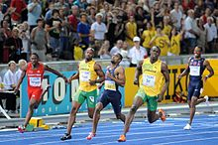
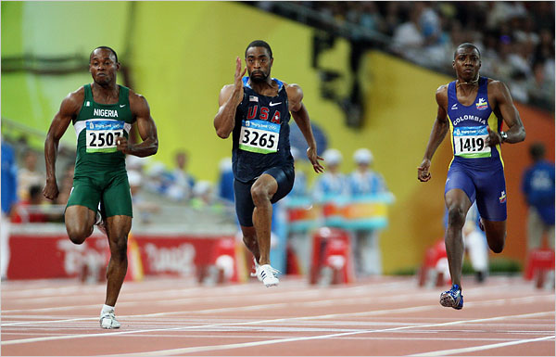
Competitive/Industry rivalry
This is most likely to be high where new entry is likely; there is the threat of substitute products, and suppliers and buyers in the market attempt to control. This is why it is always seen in the center of the diagram

Slide 21
Porter’s 5 Forces
Competitive Force | Advantages Cost leadership Differentiation |  | Disadvantages Cost Leadership Differentiation
New Entrants | Economies of scale raise entry barriers | Brand loyalty and perceived uniqueness are entry barriers
Substitutes | Firm not so vulnerable as its less cost-effective competitors to the threat of substitutes | Customer loyalty is a weapon against substitutes
Customers | Customers cannot drive down prices further than the next most efficient competitor | Customers have no comparable alternative. Brand loyalty should lower price sensitivity |  | Customers may no longer need the differentiating factor. Sooner/later customers become price sensitive
Suppliers | Flexibility to deal with cost increases | Higher margins can offset vulnerability to supplier price rises | Increase in input costs can reduce price leadership
Industry Rivalry | Firm remains profitable when rivals go under through excessive price competition | Unique features reduce direct competition | Technological change will require capital investment, or make production cheaper for competitors. Competitors learn via imitation. Cost concerns ignore product design or marketing issues | Imitation narrows differentiation

Slide 22

The Five Forces
Notes:
https://www.youtube.com/watch?v=mYF2_FBCvXw

Slide 23

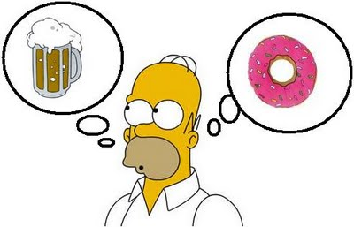


Environmental Analysis - Micro
To what extent are any of the five forces referred to in the Porter framework currently impacting, or seen as likely to have an impact, on your organisation?

Slide 24

Research and Application
Use Porter’s Five Forces to conduct a micro-environmental analysis of your organisation
Be able to feedback to the group – Flipchart, PowerPoint, Handouts, etc.

Slide 26
References
Chapter one from: David, F. R., & David, F. R., 2017. Strategic management: A competitive advantage approach, concepts and cases. 16th ed. Boston, MA: Pearson.
Thompson, A., Peteraf, M., Gamble, J. and Strickland, A., 2016. Crafting And Executing Strategy: The Quest For Competitive Advantage, Concepts And Cases. 20th ed. New York: McGraw-Hill Education.
Slack, N., Brandon-Jones, A., Johnston, R. and Betts, A., 2015. Operations And Process Management - Principles And Practice For Strategic Impact. 4th ed. Harlow, United Kingdom: Pearson Education Limited.

