Slide 1
Workplace Culture and its impact on Organisational Efficiency
Session 2

Slide 2
Last time
Introduced stereotypes, communication and barriers to communication
We also considered the basic concept of ‘What is culture’ and our perception of it.

Slide 3
This Week
We will look at :
Culture Models
Cultural environment
The core elements of organisational culture

Slide 4
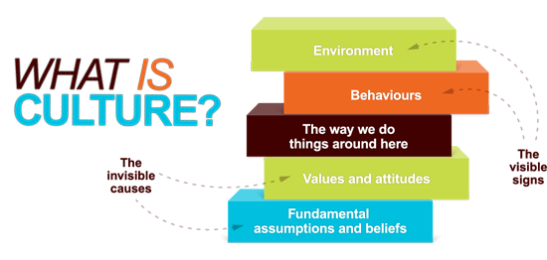
Notes:
Human culture is the result of hundreds of thousands of years of evolution. During most of this time, competition between bands of gatherer-hunters was a powerful evolutionary pressure. As a result our social and intellectual skills have become ever bigger. But we did not lose the elements of our behaviour that identify us as social mammals.

Slide 5
Your culture is like your nose:
  You do not see it properly yourself,
  but everybody else does and thinks it is peculiar if it differs from theirs
For the international manager: Avoid self-reference criterion – try to think outside your own cultural box. This is a deliberate effort.

Slide 6
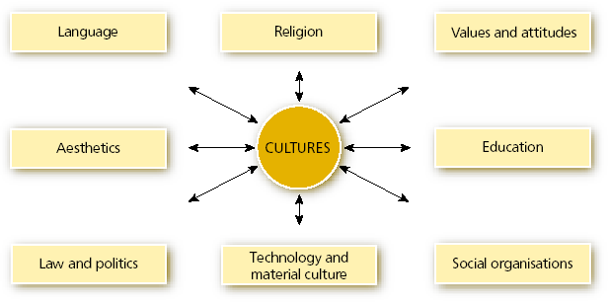
A Cultural Framework
Source: Doole and Lowe, 2008

Slide 7
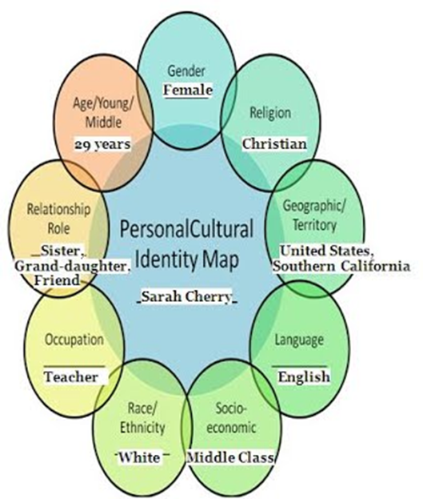
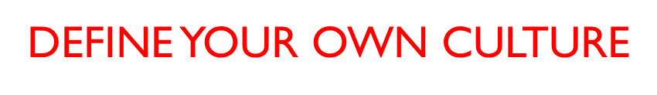

Slide 8
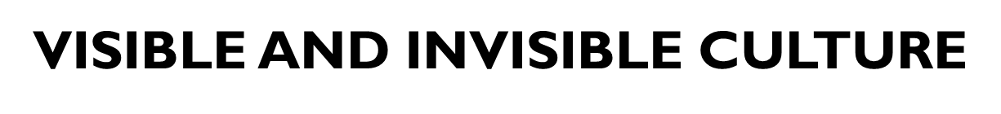
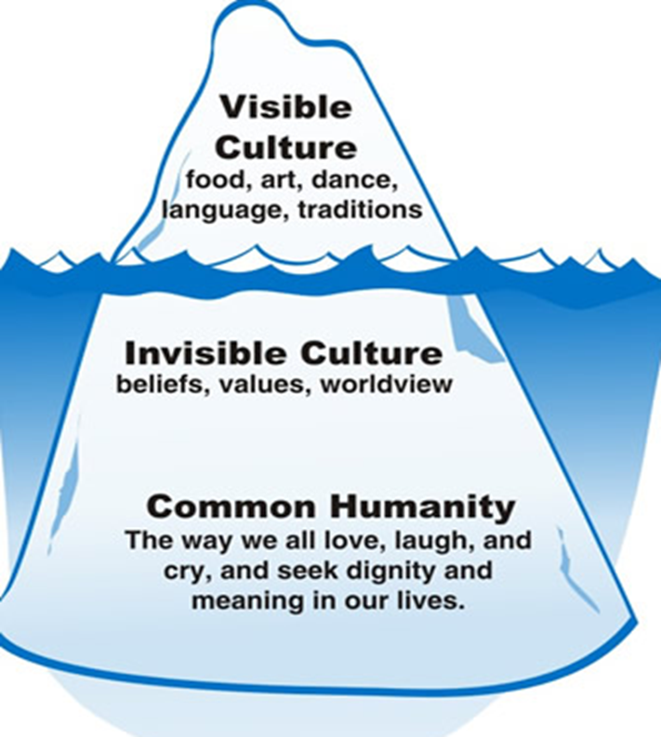

Slide 9
The Core Elements of Corporate Culture
Beliefs
Values
Opinions
Norms
Attitudes

Slide 10
Terminology Exercise
What is meant by each of the following terms?
    Values?
    Beliefs?
    Opinions?
    Norms?
    Attitudes?

Slide 11
Values
Values refer to a set of ideas that guide an individual on how to evaluate right versus wrong, whereas beliefs refer to a set of doctrines, statements or experiences a person holds as true, usually with evidence or proof. Both are deeply intertwined because beliefs influence how an individual develops values.
A value is a measure of the worth or importance a person attaches to something; our values are often reflected in the way we live our lives. e.g. I value freedom of speech, or I value my family. An attitude is the way a person expresses or applies their beliefs and values, and is expressed through words and behaviour.
Notes:
For example, employees working for a manager with an established track record of providing clear direction and holding workers accountable for their assignments are much more likely to believe what their manager says than those working for a manager who says one thing but then routinely does another. Individual beliefs tend to be substantiated by facts, circumstances, and experience. Because of this, beliefs can be changed by the introduction of new facts, changing circumstances, and evolving experience.
Values on the other hand are much more deeply rooted than beliefs. Values reflect what one feels is important in their life. At an individual level, values could include concepts such as caring, empathy, or trust, among many others. At the organizational level, examples of values might include accountability, customer service, and safety.
How Beliefs and Values Relate to Culture
Remember our definition of culture: it’s the collection of expectations and norms that determine how a group behaves. Beliefs beget behaviors, but so do values. The manager whose employees follow procedures only when they are closely supervised is facing an uphill battle because his employees don’t value what he’s asking them to do. They just believe they will get in trouble if they don’t comply.
A leader who is trying to change the culture of her company must focus on the values she is trying to instill to enable truly lasting change. We’ve all seen it happen – as soon a leader moves on, a highly visible change effort falls by the wayside and things revert back to the old way of doing business. This is usually because the focus of effort was on changing people’s behaviors not their values, or enough time was not devoted to the effort for it to become fully internalized. Either way, the whole thing goes down in history as “just one more time someone said we were going to change the way we operate, but nothing really ever came of it.”
Changing what someone values – the things that are important to them – requires the leader to focus on why the changes are important, not just what the changes are. This can take an enormous amount of effort and time. But if you want the changes to truly take hold, they must be important to those on your team just like they are to you.
How are you approaching your change efforts? Are you just telling people what they should do differently? Does your team seem to undermine the changes and your plans every chance they get? Do you feel like the cat who knows the mice are playing while you are away? If so, chances are you are focusing too much on consequences and beliefs and not on changing the values of your team. SOURCE: Wilson Perumal & Company. (2019), Values, Behavior & your Company Culture, [online] http://wilsonperumal.com/blog/values-behavior-you-company-culture, Accessed 1st October 2019

Slide 12
Terminology
An opinion is a view or judgement formed about something, not necessarily based on fact or knowledge
A norm is a social expectation that guides behaviour. Norms explain why people do what they do in given situations. For example, in the United States, it is a norm that people shake hands when they are formally introduced.
Business ethics is the study of proper business policies and practices regarding potentially controversial issues, such as corporate governance, insider trading, bribery, discrimination, corporate social responsibility and fiduciary responsibilities.

Slide 13
When undertaking international business operations Why Pay Attention to Culture?
It influences how work gets done
Critically affects project success or failure
Says who fits in and who doesn’t
Determines the overall mood of the organisation
It can impact negatively or positively on organisational efficiency. Do we have the required culture to be successful in the future?
Notes:
Mindtools (ND):
Whether you can define it or not, you know that culture exists. It's that ethereal something that hangs in the air and influences how work gets done, critically affects project success or failure, says who fits in and who doesn't, and determines the overall mood of the company.
Culture often becomes the focus of attention during periods of organisational change – when companies merge and their cultures clash, for example, or when growth and other strategic change mean that the existing culture becomes inappropriate, and hinders rather than supports progress. In more static environments, cultural issues may be responsible for low morale, absenteeism or high staff turnover, with all of the adverse effects those can have on productivity.
So, for all its elusiveness, corporate culture can have a huge impact on an organisation's work environment and output. This is why so much research has been done to pinpoint exactly what makes an effective corporate culture, and how to go about changing a culture that isn't working.
Fortunately, while corporate culture can be elusive, approaches have been developed to help us look at it. Such approaches can play a key role in formulating strategy or planning change.
The Cultural Web, developed by Gerry Johnson and Kevan Scholes in 1992, provides one such approach for looking at and changing your organisation's culture. Using it, you can expose cultural assumptions and practices, and set to work aligning organisational elements with one another, and with your strategy.

Slide 14
Cultural Web
Johnson, G. & Scholes, K., (1993) Exploring Corporate Strategy, (3rd Edition). New Jersey: Prentice Hall

Slide 15
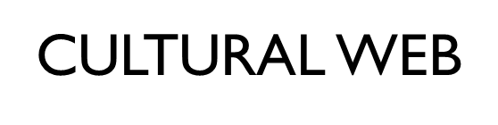
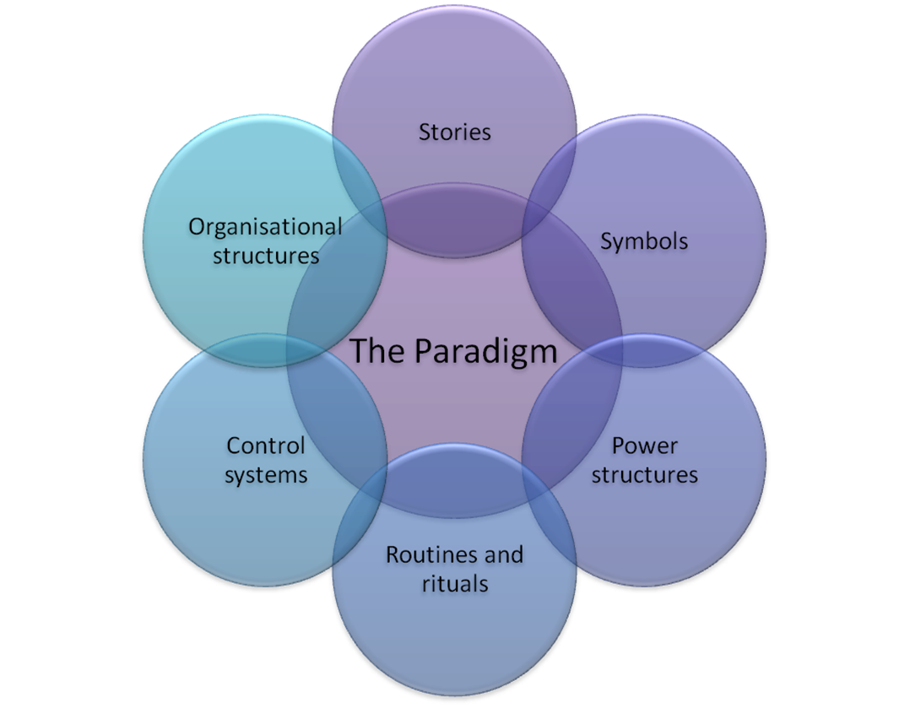
Notes:
The Cultural Web identifies six interrelated elements that help to make up what Johnson and Scholes call the "paradigm" - the pattern or model - of the work environment. By analysing the factors in each, you can begin to see the bigger picture of your culture: what is working, what isn't working, and what needs to be changed. The six elements are
Rituals and Routines - The daily behaviour and actions of people that signal acceptable behaviour. This determines what is expected to happen in given situations, and what is valued by management.
Stories - The past events and people talked about inside and outside the company. Who and what the company chooses to immortalize says a great deal about what it values, and perceives as great behaviour.
Symbols - The visual representations of the company including logos, how plush the offices are, and the formal or informal dress codes.
Control Systems - The ways that the organisation is controlled. These include financial systems, quality systems, and rewards (including the way they are measured and distributed within the organisation.)
Power Structures - The pockets of real power in the company. This may involve one or two key senior executives, a whole group of executives, or even a department. The key is that these people have the greatest amount of influence on decisions, operations, and strategic direction.
Organisational Structure - This includes both the structure defined by the organisation chart, and the unwritten lines of power and influence that indicate whose contributions are most valued.

Slide 16
Routines & rituals
What do customers expect when they walk in?
What do employees expect?
What would be immediately obvious if changed?
What behaviour do these routines encourage?
When a new problem is encountered, what rules do people apply when they solve it?
What core beliefs do these rituals reflect?
“ the way we do things around here”
are difficult to change
are often taken for granted
Can be a key organisational competency
Notes:
Rituals and Routines - The daily behaviour and actions of people that signal acceptable behaviour. This determines what is expected to happen in given situations, and what is valued by management.

Slide 17
Rituals and Routines (Mindtools, ND)
Examples from a car bodywork repair centre:
Customers expect a newspaper and coffee whilst they wait, or a ride to work.
Employees expect to have their time cards examined very carefully.
There's lots of talk about money, and especially about how to cut costs.

Slide 18
Stories
What stories do people currently tell about your organisation?
What reputation is communicated amongst your customers and other stakeholders?
What do these stories say about what your organisation believes in?
What do employees talk about when they think of the history of the company?
What stories do they tell new people who join the company?
What heroes, villains and mavericks appear in these stories
The stories that colleagues tell each other and pass onto new recruits – ”The individual personalities who did or said something that stood out and deviated from the norm “
“Every year Mary from accounts always !!!!! At the Christmas Party”
“No one is ever disciplined for being late”
“Or the founder began the organisation with just a !!!!!”
Notes:
Stories - The past events and people talked about inside and outside the company. Who and what the company chooses to immortalize says a great deal about what it values, and perceives as great behaviour. Stories – typical past and present success stories, failures, heroes, villains and mavericks

Slide 19
Stories
Examples (car bodywork repair company):
We are known as having high customer complaints, and for doing shoddy work.
Staff members talk about the founder starting the company with a $1,000 loan.
The message is that we do things the cheapest way we can.

Slide 20
Symbols
Is company-specific jargon or language used?
How well known and usable by all is this?
Are there any status symbols used?
What image is associated with your organisation, looking at this from the separate viewpoints of clients and staff?
Prestigious offices – size location etc
Types of company cars – makes models
Letter heads – paper quality logo’s
Dining arrangements – in works canteens
Notes:
Examples:
Bright red shuttle vans.
Bright red courtesy cars - compact, economy cars.
The boss wears overalls not a suit

Slide 21
Symbols
Examples:
We use bright red shuttle vans.
We offer bright red courtesy cars – compact, economy cars.
The boss wears overalls, not a suit.

Slide 22
Control Systems
What process or procedure has the strongest controls?
Weakest controls?
Is the company generally loosely or tightly controlled?
Do employees get rewarded for good work or penalised for poor work?
What reports are issued to keep control of operations, finance, etc...?
Measurement & Reward Systems
Operation manuals
Payment by results
Quality Audits
Notes:
Control systems – the measurement and reward systems which emphasise what is important to monitor, and to focus attention and activity on (quality of services)
Examples:
Costs are highly controlled, and customers are billed for parts down to the last screw.
Quality is not emphasized. Getting the work done with the least amount of direct costs is the goal.
Employees docked pay if their quotes/estimates are more than 10% out.

Slide 23
Control Systems
Examples:
Costs are highly controlled, and customers are billed for parts down to the last screw.
Quality is not emphasised. Getting the work done with the least amount of direct costs is the goal.
Employees docked pay if their quotes/estimates are more than 10% out.

Slide 24
Power Structure
Who has the real power in the organisation?
What do these people believe and champion within the organisation?
Who makes or influences decisions?
How is this power used or abused?
Is likely to emulate from the people who are most closely associated with the core paradigm
Time served craftsmen
Strategic business managers
Trade union leaders
Notes:
Power structures – the most powerful individuals or groups in the organisation, perhaps based on position or seniority, etc.
The owner believes in a low cost, high profit model, and is prepared to lose repeat customers.
The threat of docked pay keeps mechanics working with this model

Slide 25
Power Structure
Example:
The owner believes in a low cost, high-profit model, and is prepared to lose repeat customers.
The threat of docked pay keeps mechanics working with this model.

Slide 26
Organisational Structures
Is the structure flat or hierarchical?
Formal or informal?
Organic or mechanistic?
Where are the formal lines of authority?
Are there informal lines?
Hierarchies
Autocratic
Flat
Notes:
Organisation structure – which reflects power structures and delineate important relationships and activities within the organisation, and involve both formal and informal systems
Examples:
Flat structure - Owner, Head Mechanic, Mechanics, Reception.
The receptionist is the owner's wife so she goes straight to him with some customer complaints.
It's each mechanic for himself - no sharing tools or supplies, little teamwork

Slide 27
Organisational Structure
Examples:
Flat structure – Owner, Head Mechanic, Mechanics, Reception.
The receptionist is the owner's wife so she goes straight to him with some customer complaints.
It's each mechanic for himself – no sharing tools or supplies, little teamwork.

Slide 28
Activity (45 minutes)
In groups of 4:
Using the Cultural Web undertake research of McDonalds in Israel or HSBC in Singapore and one of the following countries:
China; India; United Kingdom; United States of America; Malaysia;
Compare and Contrast the culture of McDonalds in the two countries and present back your findings.

