Slide 1

MBA Marketing management
BMMB7012
Brand Strategy
Gwyneth jones
june 2023

Slide 2

Brand strategy
We will explore:
  Brand development
  Brand equity
  Brand tracking
  Brand positioning

Slide 3
What is a brand?
A brand is a name, term, sign, symbol, or design that identifies a product/service - differentiating it from competition
Customers attach meanings
Customers develop brand relationships

Slide 4




One item vs. family of items
Can be one item…
… or a family of items
By Procter & Gamble

Slide 5


Brand name
A Brand Name is part of a brand that can be spoken
Includes letters or numbers or image / combinations
It is often the product’s only distinguishing characteristic

Slide 6

Naming of a Brand
Brand Names are vital to successful branding, and the naming of a brand should be given considerable thought
The name of the brand should:
  Suggest some desirable quality of the product or company
  Be simple to pronounce, recognise and remember
  Be unique and distinctive

Slide 7

How to create a great brand name
How to create a great brand name
Watch this video and take notes:
  What are the key messages that you take away from this?
  We will discuss this together after the video.
https://youtu.be/rzbXht7MJVM

Slide 8
Brand’s strength
Brand Strength is built on six elements
Brand Element | Description
Value | Core characteristics and values of a brand
Domain | Brand’s target market, i.e. where it positions itself
Heritage | Brand’s background and internal culture; how it achieved success/failure over its life
Assets | Brand differentiation: e.g. symbols, features, relationships, images, etc.
Personality | Brand character as described by other entities, e.g. people or objects. Relates to personality the brand has developed and those of people, animals, or objects associated with the brand (e.g. celebrity endorsements)
Reflection | How brand relates to consumers’ self-identity, i.e. how consuming a particular brand impacts consumer’s view of self
Brand Strength is basically what or how much a brand means to a customer
According to Fahy and Jobber (2012), a Brand’s Strength is built on six elements…

Slide 9
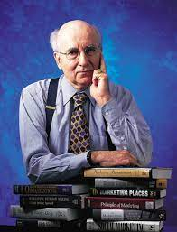
Creating a strong brand
‘Father of Marketing’ Philip Kotler at London Business Forum 2020
Watch this video and take notes:
  What are the key messages that you take away from this?
  We will discuss this together after the video.
https://youtu.be/0Yd3Y4mp1Qc

Slide 10
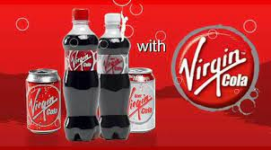
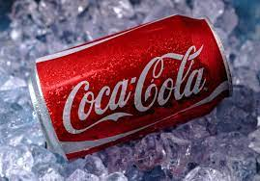
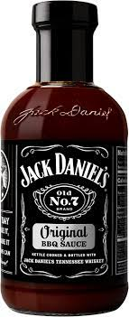

Advantages of a strong brand
Brands can form barrier to entry for new competitors
A strong brand can be enough to see off even highly legitimate new entrants:
  Virgin Cola failed to make a dent in Coca-Cola’s domination of the market, despite being associated with a strong brand and financial position
Strong brand allows companies to charge premium prices as consumers will pay more for a well-renowned brand
Brands can also serve as a base for brand extensions:
  Companies can leverage their brand when launching new offerings

Slide 11


Brand marketing
Apple's Award Winning Strategy for Marketing
By ThoughtCatalyst
Watch this video and take notes:
  What are the key messages that you take away from this?
  We will discuss this together after the video.
https://youtu.be/tFffkU_DwvI

Slide 12

Brand equity
Is the differential effect that the knowledge of a brand name has upon consumer behaviour
Is built on name awareness, loyalty, perceived quality and associations
Requires investment of time and resources in development and communication

Slide 13
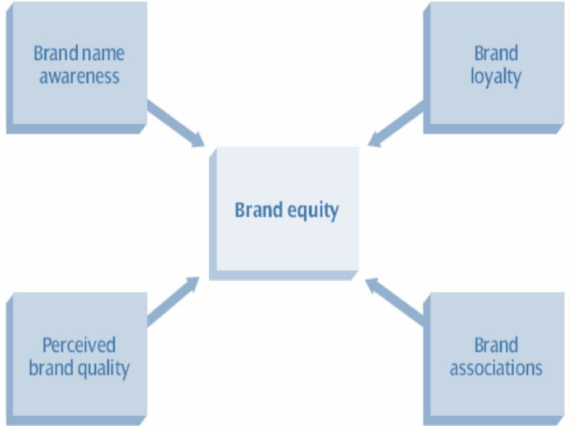
Brand equity
Brand Equity is built on four areas
Developing Brand Equity requires:
  substantial investment in time and resources
  communicating brand outwardly toward potential customers
Brand Equity is built on four areas…

Slide 14

The Customer based brand equity model
The most common model for customer-based brand equity is by marketing professor Kevin Keller
His four-level pyramid depicts how powerful a customer’s attitude toward a brand can be to its success
It shows businesses how to:
  lay the foundation that creates a positive attitude toward a brand
  capitalise on attitudes and loyalties of their customers

Slide 15
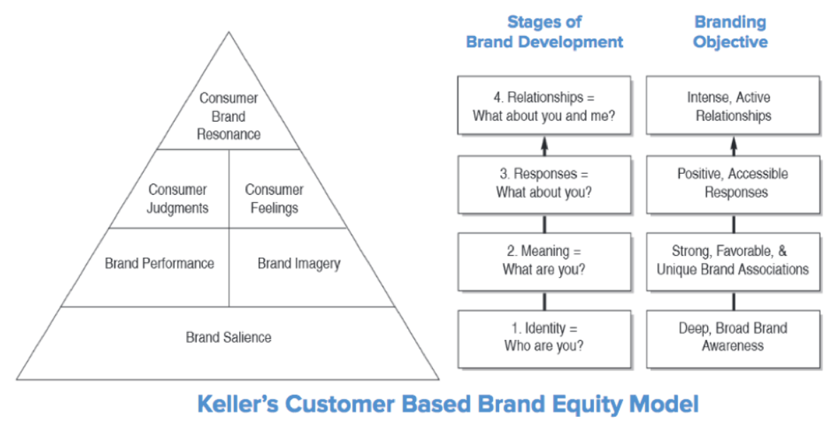
Keller’s customer based brand equity model
Loyalty: customers assess their relationship with brand to decide that it is superior to other brands
How customers think and feel about a brand
Based on actual interaction or perceived reputation
Customer service and product satisfaction
How needs are met both socially and psychologically
What words do customers associate when they hear a specific brand name.

Slide 16

Brand equity – Consumer connection
How powerful branding and brand perception influences consumer behaviour
Big Think
Watch this video and take notes:
  What are the key messages that you take away from this?
  We will discuss this together after the video.
https://youtu.be/4eIDBV4Mpek

Slide 17

Brand awareness
Brand awareness is moving the brand in the consumer's mind from awareness to ‘top of mind’
It is a concept in marketing to quantify the levels/trends of consumer knowledge and awareness of a brand
It refers to the number of consumers who recognise or remember the brand

Slide 18
Creating Brand awareness
There are three main steps to Creating Brand Awareness
Unaware of Brand
1. Brand recognition
2. Brand recall
2. Top of mind
Extent to which consumer can correctly identify a particular product or service
By viewing the product or service's logo, tag line, packaging or advertising campaign
Extent to which a consumer can recall or recognise a brand.
Pure brand recall requires "unaided recall"
The brand is the first brand the consumer thinks about when given a particular product group

Slide 19
Measuring a brand – viewpoints from which to measure
Firm-level | Product-level | Consumer-level
Measure brand purely as a financial asset (as an intangible asset) Take company’s market capitalisation (stock market = total number of shares x present share price) subtract tangible/fixed and “measurable” intangible assets (e.g. copyright / royalty payment), Remainder = Brand Equity | Entails comparing the list prices of two products of similar quality (e.g. competitor products) Determines the value of brand equity for each product | Targets individual consumer's mindset to examine what they associate with a given brand Involves getting sample sets of clients to complete free-association exercises (e.g. thoughts, feelings) to get a sense of their brand perspectives
The best mode for measuring brand equity entails the use of more than one methodology.

Slide 20

Brand tracking
Brand tracking: is the process of continuously measuring a brand by looking at six variables:
  Awareness.
  Preference.
  Usage.
  Attitudes.
  Perceptions.
  Judgement.
Allows company to track how the brand is going in the marketplace
Provides information relating to the product's health or perception by the consumer
Assists the marketing team in making appropriate adjustments to their brand strategy
Involves quantitative and qualitative methods of data collection - using tools such as questionnaires, surveys, etc.

Slide 21

Brand positioning
Companies often develop different strategies to segment and satisfy different consumer needs
Brand Positioning refers to the need to position the product clearly within the consumer’s minds
To be considered at three levels:
  Attributes: the lowest positioning level because while easy to articulate, they are also easily copied by competitors
  Benefits: a higher positioning level because it goes beyond attributes to focus upon results (e.g. guaranteed on-time delivery)
  Beliefs and Values: deepest, most desirable branding level because they engage on an emotional level

Slide 22
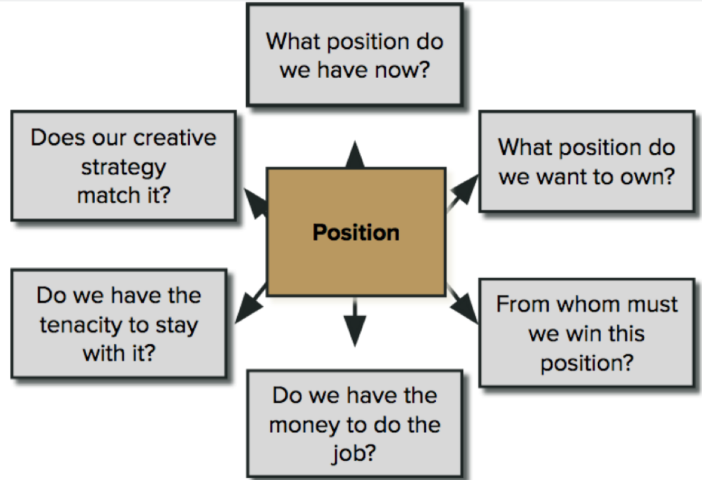
Positioning approaches

Slide 23
Creating a great positioning statement
Developing a great brand positioning statement depends on consumer characteristics (their motivation, opportunity, and ability to process messages) and brand strengths
There are four components of a great positioning statement:
  Defines the target audience (incl. demographic description of the core group the brand is designed to appeal to)
  Provides a clear frame of reference / the category in which the brand competes
  Points out the benefit of the product
  Gives a reason to believe the brand will deliver on its promise

Slide 24
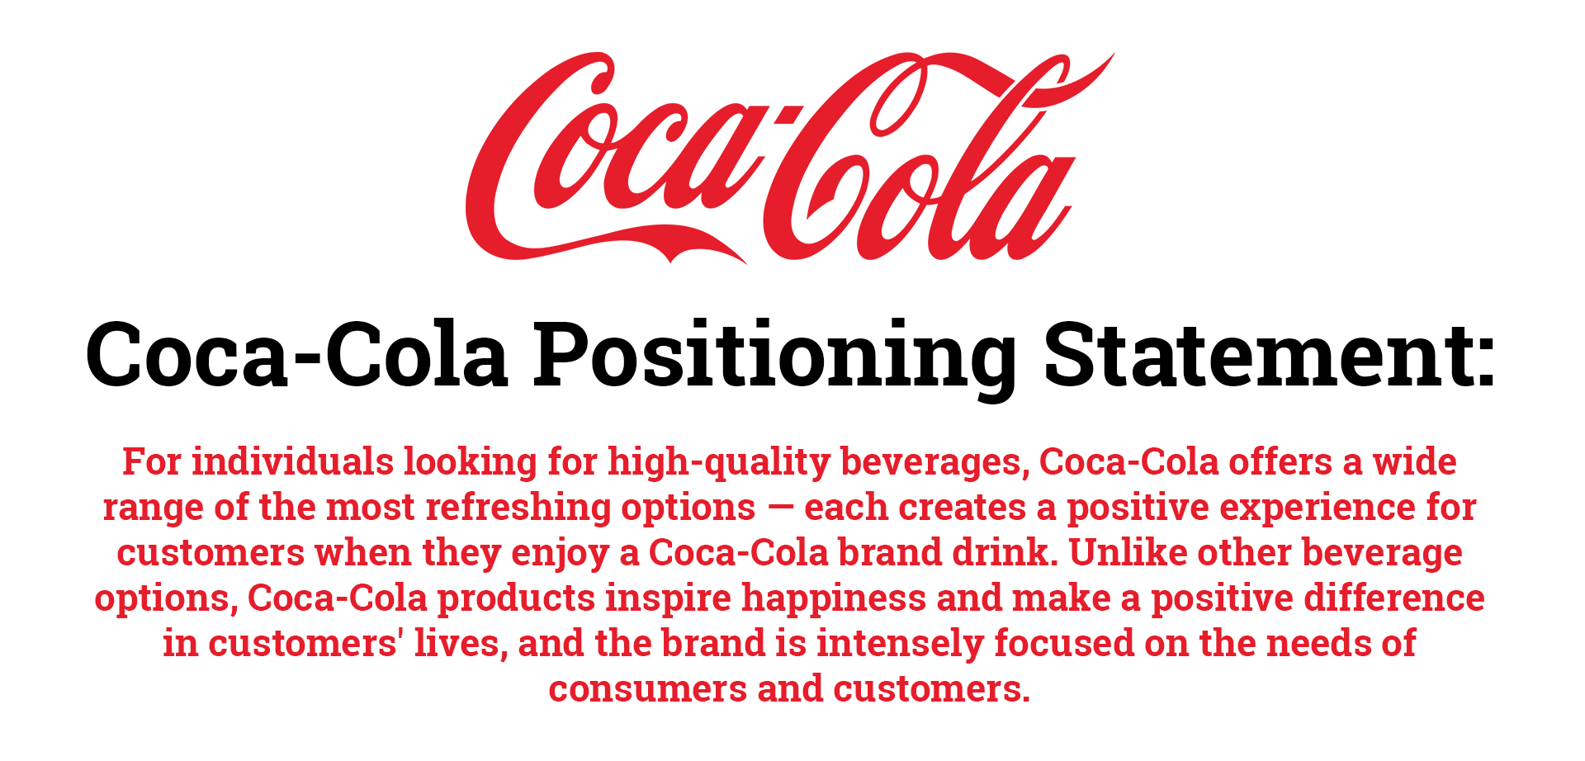

Slide 25
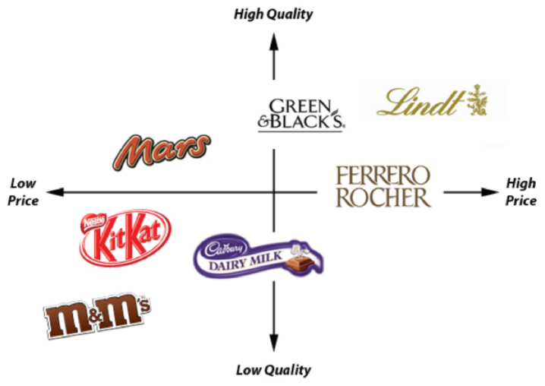
Visualising positioning: perception mapping
Perception Mapping displays position of products or brands in the consumer’s mind in two or more dimensions

