Slide 1

Critical Thinking
Week 3

Slide 2

This week
Toulmin’s Model
Values, Belief and Attitudes

Slide 3
Critical Thinking/Reflection
Critical thinking/reflection provides the ability to:
build new ideas by linking different or opposing concepts;
undertake deductive reasoning to link causes and effects.
Notes:
Its about drawing logical conclusions through balancing evidence and following rational steps

Slide 4
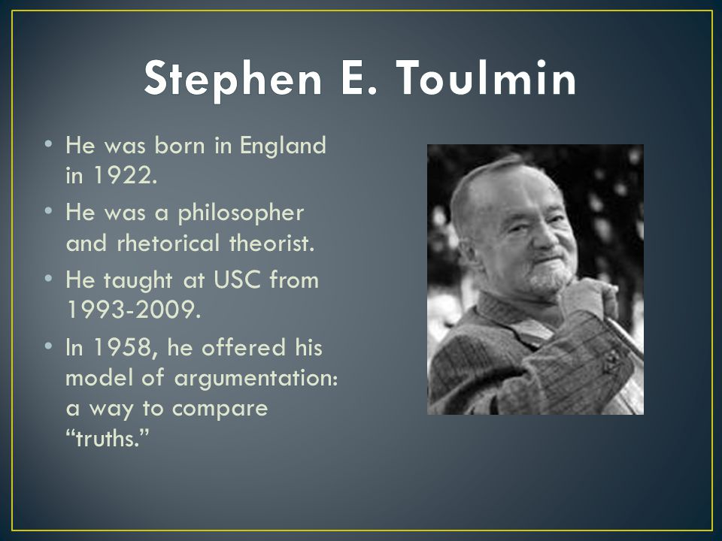
Toulmin Model
Notes:
A critical thinking model found by British Philosopher Stephen Toulmin. He received his PHD in 1950 and taught in Stanford and Cambridge. He wrote a famous book “uses of argument” 1958 and developed a well known model “Toulmin’s model” in the 70’s

Slide 5
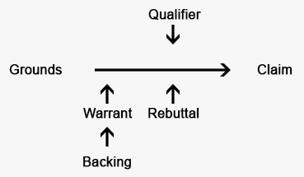
Toulmins model
Notes:
He developed arguments to be used in evaluating the ethics behind moral issues. The Toulmin model of argumentation, a diagram containing six interrelated components used for analyzing arguments. It’s a practical model which argues against deductive logic. Creating a model that was useful and how develop arguments in our every day lives. So first establish the claim and then find a justification for it.
3 of these component are essential (Claim Data (Also known as grounds) and Warrant) HAVE to show up in every argument and 3 non essential (backing, Rebuttal and Qualifier) – these three done have to show up in every argument
Claim – conclusion
Grounds/ data – evidence & Reasoning
Warrant – The reason the data is appropriate to support the claim
Non essential Backing – to get data that adds strength
Rebuttal- objections
Qualifier – indicates the strength of he claim

Slide 6
Toulmins Model
Claim
A claim is a statement that you are asking the other person to accept.
Grounds
The grounds (or data) is the basis of real persuasion and is made up of data and hard facts, plus the reasoning behind the claim.
Warrant
A warrant links data and other grounds to a claim, legitimizing the claim by showing the grounds to be relevant.
Backing
The backing (or support) for an argument gives additional support to the warrant by answering different questions.
Qualifier
The qualifier (or modal qualifier) indicates the strength of the leap from the data to the warrant and may limit how universally the claim applies.
Rebuttal
Despite the careful construction of the argument, there may still be counter-arguments that can be used. These may be rebutted either through a continued dialogue, or by pre-empting the counter-argument by giving the rebuttal during the initial presentation of the argument.
Notes:
The Claim: The first component of the Toulmin model is the claim—the conclusion that we are seeking to establish over the course of the argument. A claim is a statement that requires support. By itself the statement carries little argumentative force. It is missing evidence on which to ground it so the audience can start to accept it.
The Grounds: for an argument represent the facts, data, statistics, or any other type of evidence. The grounds are the second component of the model.
The Warrant: According to Dr. Toulmin, the connection between the evidence and the claim is not automatic. In most arguments, people make strong claims and have some data, but they invest relatively little time in connecting them. The connection is the warrant—the third component of the model. Its key to focus your attention on the warrant – because it is the connection between the grounds and the claim is often the most vulnerable part of an argument.

Slide 7
Toulmin’s model
Qualifier
Claim
Backing
Warrant
Strong Grounds
Rebuttal
Notes:
Claim – your position, your idea you want people to accept , your opinion that you are trying to convince
Grounds – but you need to have very string grounds to use as your evidence, any factual information, data, stats you will use to support your claim
Warrant – is the vital part that connects the claim with the supporting argument and makes sense of it all
3 main elements of setting up your argument
Then you will look for any secondary information o back your claim – known as the Backing
Qualifier – any limitations to your claim
And Rebuttal is alternative view points.- to give a balanced argument

Slide 8
CLAIM: Government should ban animals being used in research
Grounds : millions of animals are killed in cosmetic research
Rebuttal : a law to ban use of all animal in research would go too far
Qualifier (exceptions) – ban should not be applied to life saving medical research
Warrant: the well- being of animals is more important than profits
Backing: cosmetic companies use animal testing to save money
Notes:
So the claim – the introduction to your argument and when finalised you can state it with your qualifier to narrow down your specific argument
Then you start to build your argument by using evidence, relevant data to connect the claim with logical evidence through warrant – serves as a bridge
Then you use the backing – more evidence/ additional evidence that supports the logical claim you have created
Qualifier – indicates limitations
And rebuttal – any counter arguments against the claim and how can you disqualify is by addressing it
So finally repeat the claim in conclusion using your qualifier with matched evidence to the point you have made.

Slide 9
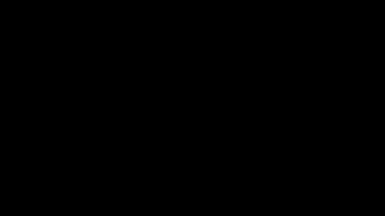

Slide 10
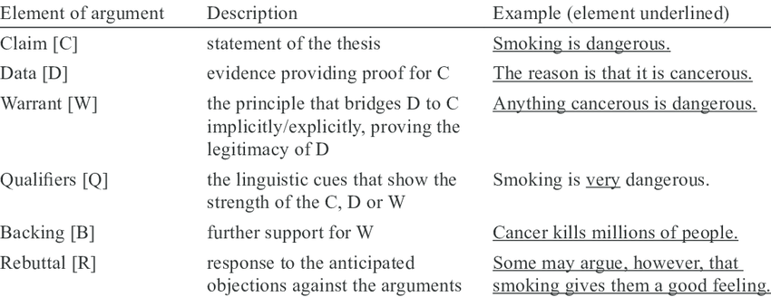

Slide 11
Setting up a clear argument
An argument is not a disagreement
Selecting an argument – would have a description, background information, reasons given to support the argument through persuasion, analysis and through evaluation drawing conclusion
Notes:
In critical thinking there is a distinction between a position of disagreement holding a different point of view from someone else – without any reason and an argument where you use reason to support your point of view and it may include disagreement but only if its based on reason.
So argument or a claim is based on using reasons for the position you want to persuade others.

Slide 12
Using Toulmin Model
Qualifier: Many organic store cupboard essentials such as canned food are similar price to the non-organic variety.
and potatoes, carrots, onions and bread. that often have high levels of pesticide residues, such as grapes, strawberries, raspberries, apples, pears, spinach, pre-packed salad leaves, oranges and wheat products could be bought organically.
Claim: Organic food is no better
Grounds : Demand is higher than ever – UK sales exceeded £2 billion in 2016
Warrant : Article (NHS/ BBC) – research done by London school of hygiene and another by University of Chester found in terms of nutrient, there wasn’t much evidence to suggest organic food was better than frozen or canned as in some cases frozen food like carrots had more VIT C than fresh organic carrots
Rebuttal : Research by Newcastle university found organic meat and milk were found to contain higher amounts of omega-3s (essential fats), as well as higher amounts of some vitamins and minerals. Organic vegetables were found to contain more antioxidants (substances that may prevent or delay some types of cell damage) and fewer pesticides and toxic heavy metals.
Backing: New Castle university and European Parliament released - organic vegetables contain fewer nitrates. Until recently, this was seen as a benefit of organic food, but there is now “good evidence” to suggest nitrates can help lower blood pressure
No clinical human studies have been done to assess the direct impact of an organic diet on human health, so there’s no hard proof it’s better for us. However, there is evidence that eating organic food reduces exposure to pesticide residues, and therefore the potential risk of some health problems.

Slide 13
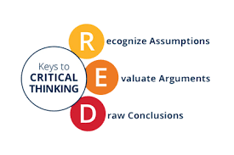
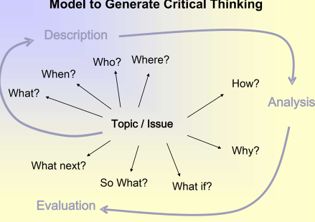
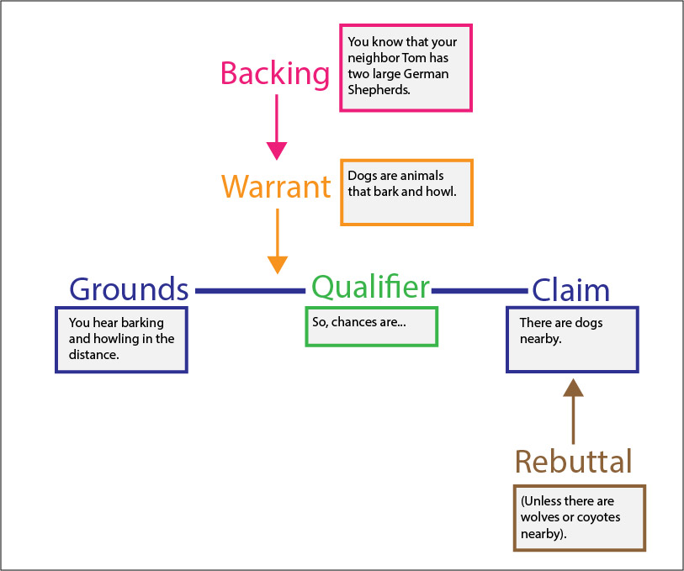
Three critical thinking models

Slide 14

Values Beliefs & Attitudes
Notes:
People’s values, beliefs and attitudes are formed over time through many influences and experiences.
Values – own set of principles which are of great importance to you
Beliefs – ideas that are accepted to be true to you
Attitudes – way of thinking or feeling or acting out our beliefs and values
The combination of our personal values, beliefs and attitudes are our moral principles that guide us in life and affect our behaviour.

Slide 15
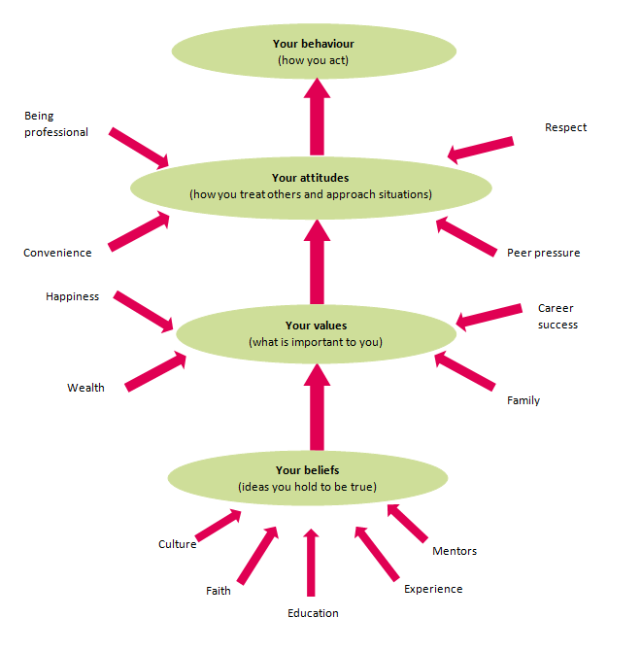
Notes:
The diagram shows the influences on us that result in our behaviour and whether that resulting behaviour is ethical. The diagram first outlines the sources of our beliefs. It then shows the relationship between the beliefs and values to our attitudes and our resulting behaviour.
What is a belief?
A belief is an idea that a person holds as being true. A person can base a belief upon certainties probabilities or matters of faith.
A belief can come from different sources, including:
a person’s own experiences or experiments
the acceptance of cultural and societal norms (e.g. religion- belief in God or belief in life on other planets)
what other people say (e.g. education – belief in evolution ).
A potential belief sits with the person until they accept it as truth, and adopt it as part of their individual belief system.
Each person evaluates and seeks sound reasons or evidence for these potential beliefs in their own way.
Once a person accepts a belief as a truth they are willing to defend, it can be said to form part of their belief system.
What is a personal value?
Values are stable long-lasting beliefs about what is important to a person. They become standards by which people order their lives and make their choices.
A belief will develop into a value when the person’s commitment to it grows and they see it as being important.
It is possible to categorise beliefs into different types of values – examples include values that relate to happiness, wealth, career success or family.
What is an attitude?
Attitudes are the mental state people have towards others before making decisions that result in behaviour. People primarily form their attitudes from underlying values and beliefs.
However, factors which may not have been internalised as beliefs and values can still influence a person’s attitudes at the point of decision-making. So how we behave towards people with different beliefs to us

Slide 16
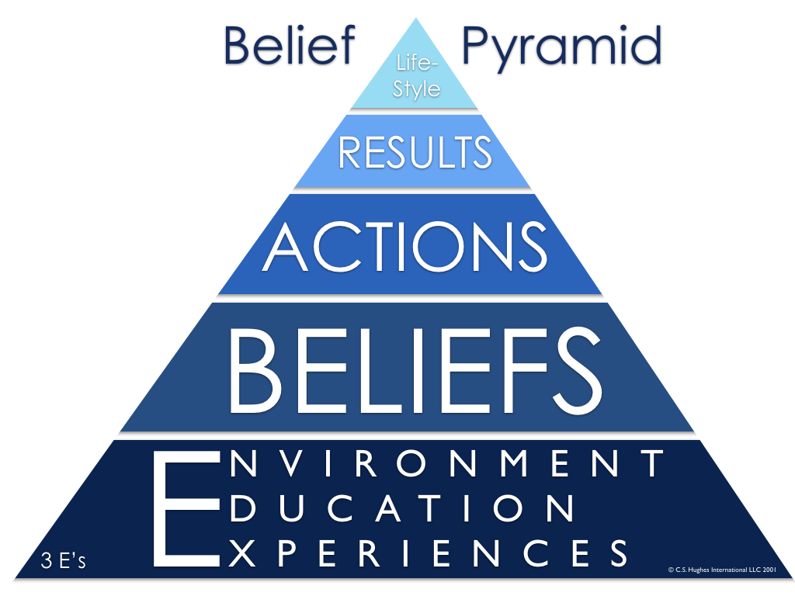
https://www.teammanagementsystems.com/assets/Product-Logos/7d4862976d/Pyramid-Concept_CompressedDetail_AmericanEnglish_450px.png
Notes:
the belief Pyramid model shows that The actions people take in an organisation which are motivated by the beliefs they hold about what they should do and why. These beliefs are created by their experiences and the environment they are given to work in, the education they have received to get to this stage or the training opportunities they are provided whist in the company.
Leaders often make the mistake of working only the action layer of the pyramid. They create new action plans, new policies, new procedures, new organization structures — in hopes of transforming results — only to find that nothing has really changed in the way people think.
By creating new, meaningful experiences for employees –these on-the-ground experiences demonstrate that leaders were serious about collaboration and team-driven results will strengthen the belief in the organisation, which will result in motivated actions by its employees and produce results and this will form part of their every day lifestyle - motivated employees.
When leaders start at the bottom of The belief Pyramid and work their way up, results are achieved faster, more efficiently, and most importantly, they are sustained. That’s because leaders who tap into the hearts and minds of their employees and paint a compelling picture of success give their teams something to hold onto and to work towards.
When leaders engage their employees through meaningful experiences that draw a clear line between their beliefs, actions, and organizational success, business results soar.

Slide 17
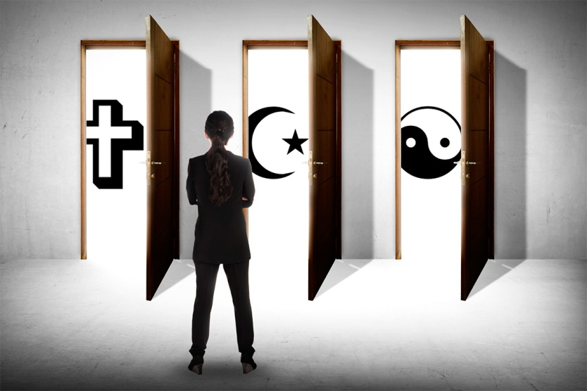
What is a belief?
Beliefs come from real/ original/ spiritual experiences
Our values and beliefs affect the quality of our work and all our relationships.
The beliefs that we hold are an important part of our identity. They may be religious, cultural or moral.
Notes:
Examples – belief in God
Cultural – societal/ regional norms ..belief in equality, fairness way we treat each other
Moral – principles that help us decide what is right and wrong

Slide 18
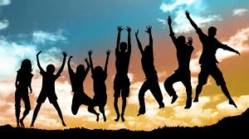
What is a personal value?
Values are stable long-lasting beliefs about what is important to a person. They become standards by which people order their lives and make their choices.
A belief will develop into a value when the person’s commitment to it grows and they see it as being important.

Slide 19

Where do values come from?
Our values come from a variety of sources. Some of these include:
Family
Peers (social influences)
The workplace
Educational institutions such as schools
Significant life events (death, divorce, losing jobs, major accident and trauma, major health issues, significant losses)
Major historical events (world wars, economic depressions, etc).
Religion
Music
Media
Technology
Culture

Slide 20

Values & their benefits
Helps us understand why we believe what we do and if we wish to change it.
Shared Values are the basis of relationship
They can motivate us –if we value something we will go after it.
Knowing our own values makes us more tolerant of others
They help to give lives meaningful significance
Notes:
Shared values – like respect, trust, loyalty

Slide 21
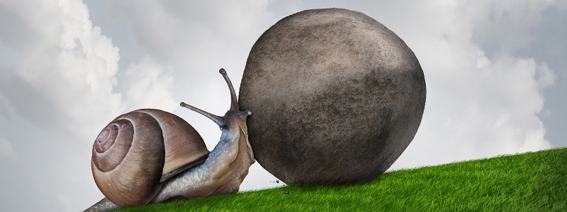
What is an attitude?
Attitude describes what we think is the ‘proper’ way of doing something. Are derived from our values and beliefs.
Sometimes our own attitudes can make us blind to other people’s values, opinions and needs.
Attitudes will always have a positive and negative element and the we hold an attitude will have an impact toward people or objects.
We will need to be aware of our own personal values, beliefs and attitudes and how they might impact on our work.

Slide 22

What is an attitude?
Attitudes are the mental dispositions people have towards others. People primarily form their attitudes from underlying values and beliefs.
However, factors which may not have been internalised as beliefs and values can still influence a person’s attitudes at the point of decision-making. Typical influences include the desire to please, political correctness, convenience, peer pressure.

Slide 23
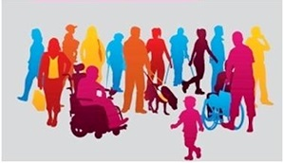
The problem with attitudes
To work effectively it is critical to understand your own values and beliefs.
In order to remain professional it is necessary to leave our personal values out of the professional relationship if they are contradictory.
One of the problems with our attitudes is we often ignore any information which is not consistent with them—we become selective in the way we perceive and respond to events and issues—and lose our ‘objectivity’ about the world.
We Need to develop an insights about our attitudes in order to reduce the risk of making decisions at work based on our unconscious, pre-existing perceptions, allowing us work more professional.

Slide 24

Organisational values
Organisational values are defined as essential tenets and guiding principals not specific cultural or operating practices. Some of the most common values found in organisations are: integrity; respect; customer focus; quality; creative/ innovative; accountability and fairness.
Notes:
Organisational norms and values are a group product; even though all members of the group would not have the same values, a majority of active members would agree on them and members of the group would be aware of the group’s support for a given value
This creats an organisational culture based on these shared beliefs, norms, values, knowledge, and understanding held by members of an organisation. ‘If there is no substantial agreement that a limited set of values is important in a social unit, a strong culture cannot be said to exist’. Establishing a new or modified organisational culture is a long-term process and can be done by creating a shared understanding of the organisation’s vision and values.

Slide 25
Organisation's values
Support the organisation
Values that are being lived already within the organisation
Tested and tried to build ownership
Staff engage with the organisations values (by discussing, challenging, influencing, fleshing it out)
Notes:
Defining the company core values. The next step is identifying techniques that are suitable to the organisation, and that support the values. All this with the aim of increasing external and internal customer satisfaction with a reduced amount of resources.
To create a culture of an organisation consisting of the shared norms, values, and beliefs of members. The culture should observe the surface, e.g. language, products, clothing, stories told about the company, and organisation. The culture is also built on the beliefs and values, e.g. strategies, goals, and philosophies and especially looking at underlying assumptions , the unconscious biases and taken for granted, and as such they tend to be very hard to change.

Slide 26
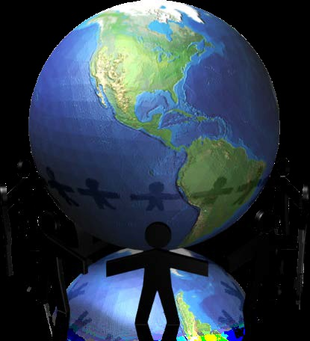
Personal ethics
As with beliefs and values, personal ethics can differ widely from person to person.
In other words, personal ethics are standards by which a person judges behaviour as being ‘right’ or ‘wrong
Ethical expectations often take the form of principles such as:
• concern for the well-being of others
• respect for others
• trustworthiness and honesty
• compliance with the law
• preventing harm to others.

Slide 27
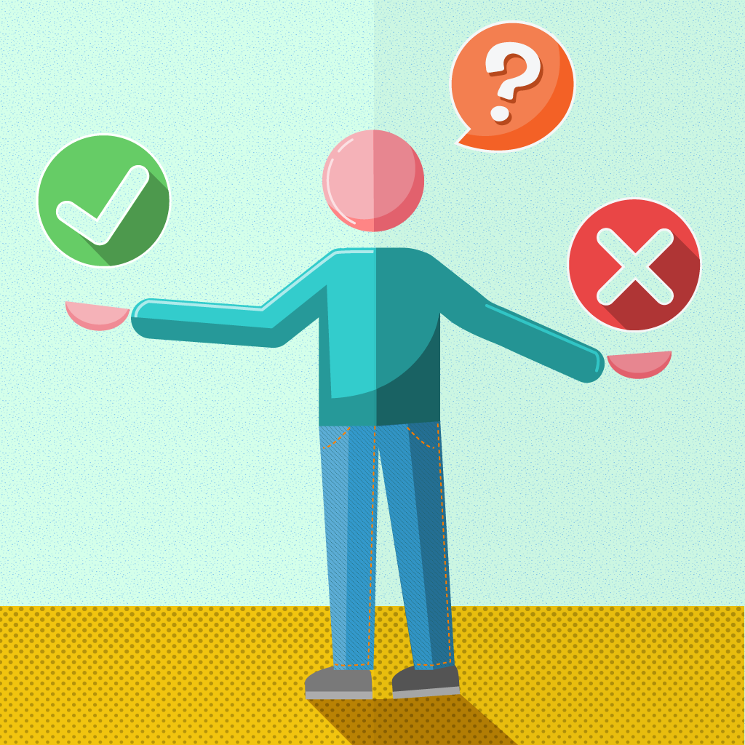
Professional ethics and codes of conduct
Professional ethics are principles that govern the behaviour of a person or group in a business environment. Like values, professional ethics provide rules on how a person should act towards other people and institutions in such an environment.
Ethical principles
Ethical principles underpin all professional codes of conduct. & may differ depending on the profession; for example, medical practitioners will differ from those that relate to lawyers or real estate agents.
However, there are some universal ethical principles that apply across all professions, including:
• honesty
• trustworthiness
• loyalty
• respect for others
• adherence to the law
• doing good and avoiding harm to others
• accountability.

Slide 28
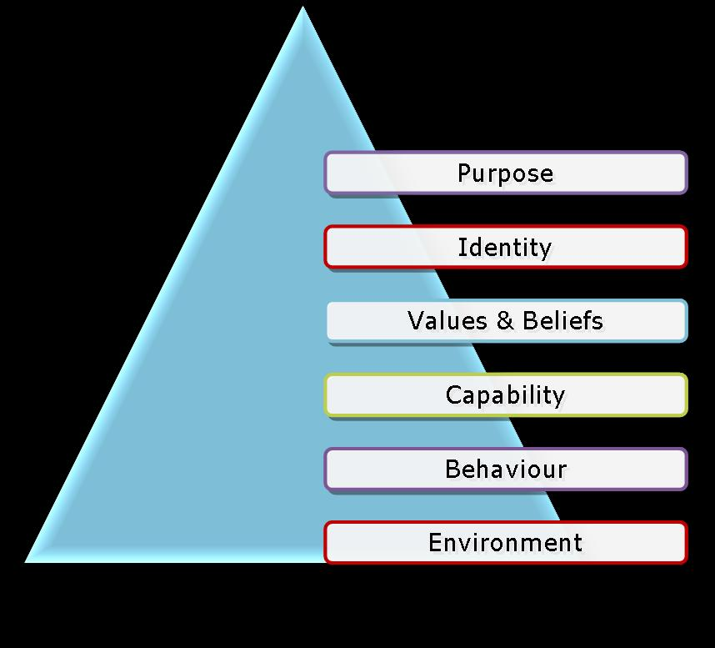
Robert Dilts’ Model (Dilts, 1996)
Notes:
Robert Dilts. The model helps us to understand the different levels at which we experience our world, developed in the 1970's by international expert in leadership and change management,. The different levels are: environment, behaviour, capabilities, values and beliefs, identity and purpose. The model looks at bringing change.. Individual or in an organisation
The model is particularly helpful for understanding change for individuals and organisations. It provides a powerful framework for deciding at what level to work to bring about the required change.
Environment: this refers to everything outside of yourself and is the state of the external context in which people are living and acting - where and when our actions are taking place
Behaviour: relate to the specific steps taken in order to respond to the environment and reach a desired outcome. They involve what must be done and accomplished.
Capabilities: this refers to the mental maps, plans, strategies, skills and capabilities by which groups or individuals select and direct the steps they take within their environment. They direct how steps are generated, selected and monitored.
Beliefs and Values: these provide the drivers that support or inhibit particular capabilities and behaviours. They relate to why a particular path is taken and to the deeper drivers of people's actions.
Identity: these factors are a function of who a person or group perceives themselves to be. This level has to do with the unique, distinguishing characteristics that define an individual, group or organisation.
Purpose: this relates to people's experience of contributing to the larger system of which they are a part. these factors involve for whom or for what a particular step or path has been taken.
Example – so if you are provided with the right environment to work in, with appropriate motivational tools (right leadership, team, training) you will have a motivated behaviour and function with commitment, this will enhance your capabilities because you are growing in the organisation and are aligning your values and increasing your belief within the organisation which then becomes your identity and you’re a proud to an employee of this organisation and contribute to its wider aims and missions.

Slide 29
Ikea’s Values
IKEA culture
IKEA culture reflects Swedish roots coming from Småland in southern Sweden. People living here are hard-working, down-to-earth, help each other and live in a close contact with nature around. These aspects are translated into IKEA values which form the basics of IKEA culture.
IKEA Key values
We believe that every individual has something valuable to offer and we strive to have the same values in the way we work.

Slide 30
Developing Effective organisational and individual values
When developing core values of organisation, it is transferring something very personnel into a business setting, looking at:
What are your core values and beliefs that you would take with you to your organisation
What are you really committed and won’t compromise?
What values and beliefs guides your daily interactions?

Slide 31
Personal Values Assessment
https://www.valuescentre.com/our-products/products-individuals/personal-values-assessment-pva
Please complete the above personal values statement

