Slide 1
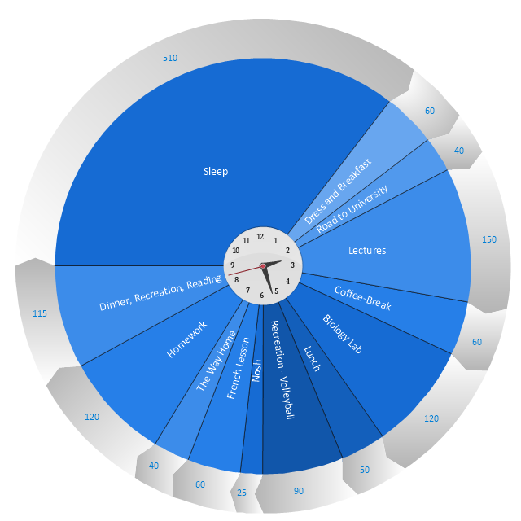
A Quick Start Guide to Academic Study Skills
2315485
ECEY 4008/C
1077
To introduce and develop an understanding of three key academic study skills, to use in your academic writing.
Critical Thinking Skills
Burns & Sinfield (2016, p94) define critical thinking as follows:
“Critical thinking is the art of making clear,
reasoned judgements based on
interpreting, understanding, applying
and synthesising evidence gathered
from observation, reading and
experimentation.”
Similarly, Cohen (2015) identifies critical thinking as the development of a range of skills and understanding necessary to play with language and ideas in a sensitive and open-minded context, leading to creativity and insight, in addition to following a line of reasoning to a logical conclusion. Also encompassing skills, such as logical argument, reasoning by analogy and both puzzle and problem solving.
One element of critical thinking is purposeful thinking, drilling down to the purpose or telos (Greek for end or purpose) of a piece of writing. It asks the questions: what, where, when, who, why and how (in what style, with what bias) did they write it and what is the main point of the article. Hermida (2009) purports asking these questions can assist in furthering understanding of a text and help to clearly summarise its main argument. The difference between deep and surface reading is also discussed and concluded to be an essential critical thinking skill.
Time Management
Cottrell (2013) suggests that effective time management is an essential academic skill, one which allows students to prioritise, plan and execute academic tasks successfully. There is an emphasis on clarifying your study time requirements and being systematic in how you use your time to avoid distraction and procrastination. Colour coded checklists and ‘to do’ lists may also provide a helpful way forward. In addition, a more visual time circle may be helpful in providing an ‘at a glance’ picture of how time is being spent and how that time may be used more effectively to achieve the assignment goals.
University of Aberdeen (2023) identify the Pomodoro technique, first identified by Francesco Cirillo in the 1980’s. This approach breaks study time into twenty-five-minute blocks. Step one is to decide on the task to be completed. Step two setting a timer for the twenty- five minutes. Step three working on the task, with step four ending work when the timer rings.
Coursera (2023) emphasises efficiently and effectively planning your time to be the most productive. They stress learning how to prioritise and goal set, to sort out the immediate from the still important and lower priority tasks. With goals as helpful to measure sustained progress.
Note Taking
Research conducted by Imperial College London (2023) promotes a variety of note-taking techniques. From writing the date and name of the lecture, to using abbreviations and highlighting important points and direct quotations. The study highlights the importance of referencing and bibliographic details. Also stressing to only record the most important points and questions to prompt memory retention.
Mills (2019) presents the interesting concept of visual note taking, using the term Sketchnoting or visual communication. The learner makes a sketch of the information they are taking notes on, these can be as simple or complex as desired to aid visual learning for student who is more predisposed to better process visual information. Mills (2019) asserts that 65% of the population identify as visual learners. The research also conveys that the visual and kinaesthetic engage more parts of the brain, so the information retention rate rises by up to six times.
McMillan and Weyers (2021) highlight the impossibility of writing down every word in a lecture or text and give suggestions as to how to structure notes. They suggest noting the introduction or title, the main points, with the supporting evidence and arguments, and also any counter arguments, with a logical conclusion drawing all the themes together.
A time circle or a pie chart, giving a visual snapshot, helpful in time management. (Source: Concept draw 2023)
In conclusion both time management and note taking are immensely helpful in your studies, however critical thinking is essential to academic success.

Slide 2
References
Burns, T. and Sinfield, S. (2016) Essential Study Skills Guide: the Complete Guide to Success at University. 4th edn. London: Sage Publications Ltd.
Chatfield, T. (2022) Critical thinking explained by Tom Chatfield. [video] Available at: Critical Thinking explained by Tom Chatfield - YouTube (Accessed 19th October 2023)
Cohen, M. (2015) Critical Thinking Skills For Dummies. Chichester West Sussex: John Wiley & Sons Ltd.
ConceptDraw (2023) Schedule pie chart – Daily action plan. Available at: https://www.conceptdraw.com/examples/a-students-time-table-by-pie-chirt (Accessed on 15th October)
Cottrell, S. (2013) Study Skills Handbook. 4th edn. Basingstoke: Palgrave Macmillan.
Coursera (2023) 7 Essential Time Management Skills. Available at: 7 Essential Time Management Skills | Coursera (Accessed 14th October 2023)
Hermida, J. (2009) The Importance of Teaching Academic Reading Skills In First-Year University Courses. Available at SSRN: https://ssrn.com/abstract=1419247 or http://dx.doi.org/10.2139/ssrn.1419247 (Accessed 14th October 2023)
Imperial College London (2023) Success Guide – undergraduate Students: Effective note taking. Available at: Effective note-taking | Imperial students | Imperial College London (Accessed 12th October 2023)
McMillan, K. and Weyers, J, (2021) The Study Skills Book. 4th edn. Harlow: Pearson Education Ltd.
The Open University (2023) time management skills – Helpful tips for time management. Available at: Time management skills: Helpful tips for time management | Help Centre | The Open University (Accessed 19th October2023)
Mills, E. (2019) The art of visual notetaking. California USA: Walter Foster Publishing.
University of Aberdeen (2023) Pomodoro Technique. Available at: https://www.abdn.ac.uk/toolkit/productivity/pomodoro-technique/ (Accessed 15th October 2023)
University of Edinburgh (2023) Institute for academic development: Time management. Available at: Time management | The University of Edinburgh (Accessed 19th October2023)

