Slide 1
ECIE6001
Moving away from the traditional classroom: Outdoor Education and Learning
Darlith 4 / Lecture 4 –
Recap theories, policies, best practices/Assignment guidance

Slide 2
The module aims:
To appreciate and critically reflect upon the role of outdoor education in Wales and further afield.
To demonstrate understanding of the debates in outdoor pedagogy.

Slide 3
LEARNING OUTCOMES
Upon the successful completion of this module, you should be able to:
Appreciate the importance of outdoor education on protecting our natural resources now and in the future and an understanding of what this means socially, economically and culturally.
Critically reflect upon the approaches to out of classroom learning and real-life experiences in nature, for all ages and abilities.
Critically discuss/evaluate challenges and multiple benefits of bringing the three strands of natural environment, learning and health together.
Organise their knowledge and learning through use of a range of media, and present their work appropriately in a manner that can be understood by specialist and non-specialist audiences.

Slide 4
Aseiniad Assignment
Portffolio
4 Elements
4000 gair
Dyddiad cau 26.04.26, 23.59
Gweler Cefnogaeth Aseiniad sy’n dilyn
Portfolio
4 Elements
4000 words
Hand in date 26.04.26, 23.59
See following Assignment Guidance

Slide 5
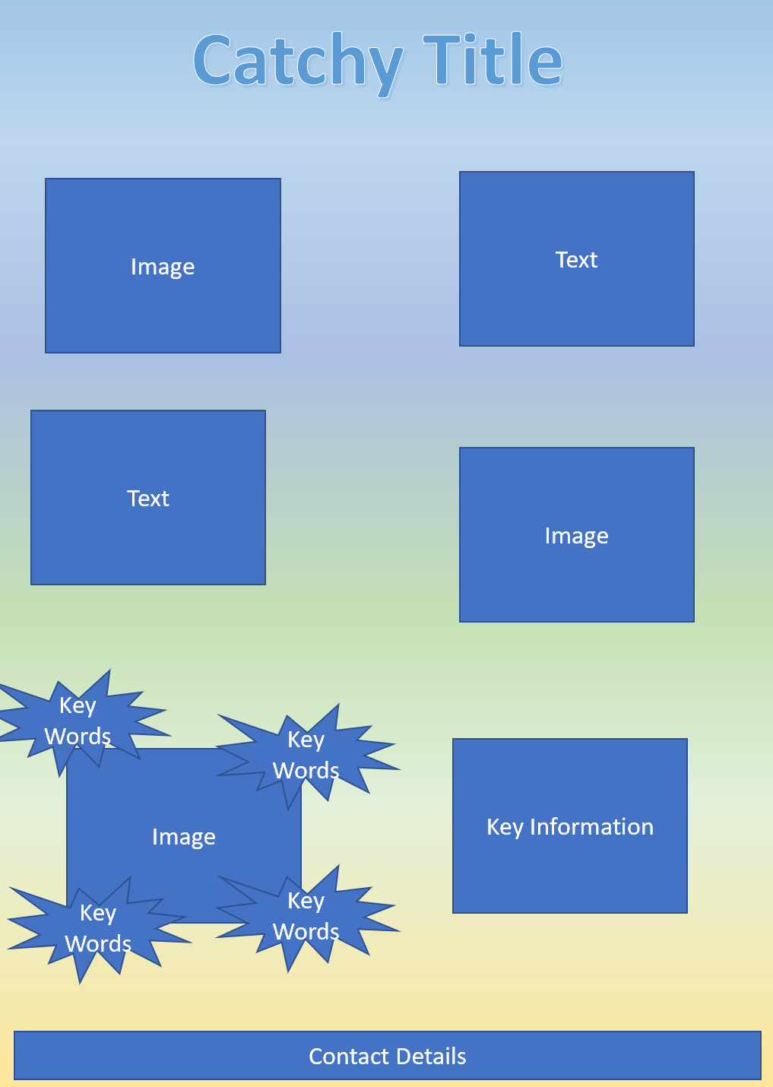
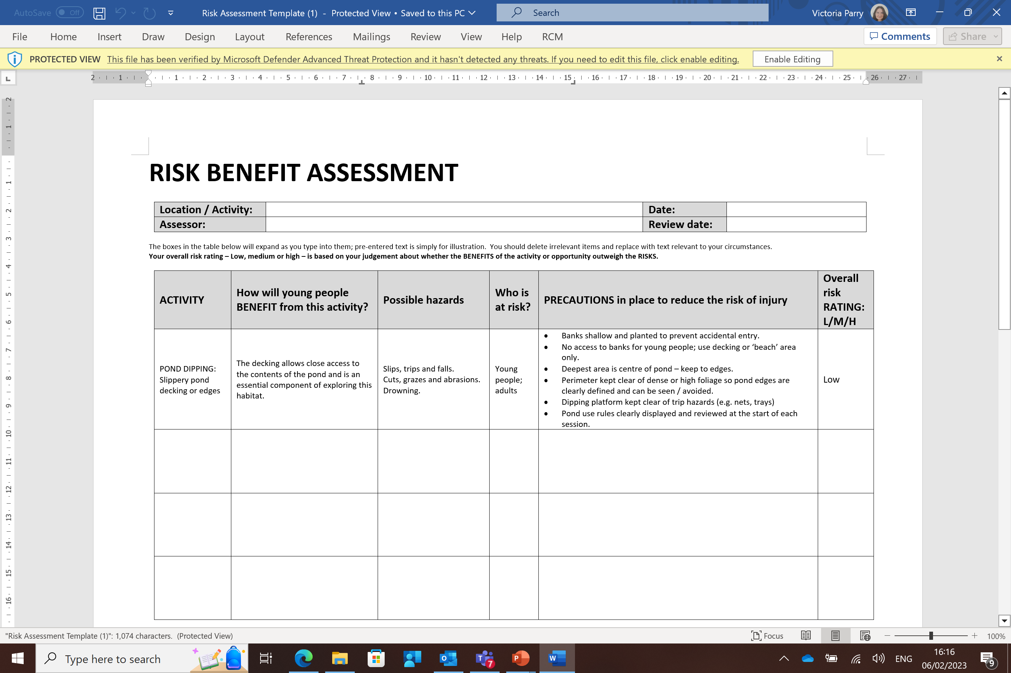
Aseiniad Assignment
Portffolio Portfolio
Essay
‘Compare and contrast the scope and approach to outdoor provision in two types of setting e.g. early years, primary, secondary, PRU, ALN units, etc’
(Approx. 1200 words)
Flyer
(Approx. 500 words)
Risk Benefit Assessment
(Approx. 600 words)
Literature Review
‘The role of Outdoor Education’
(Approx. 1700 words)

Slide 6
Portffolio Portfolio
Component 1 – Essay
Compare and contrast the scope and approach to outdoor provision in two types of setting e.g. early years, primary, secondary, PRU, ALN units, etc.
Approx 1200 words
[Refer to lecture 2]

Slide 7
Essay plan
See suggested essay plan on Moodle and Teams

Slide 8
Portffolio Portfolio
Component 2 – Flyer
Produce a leaflet advertising an outdoor learning experience for a group of your choice.
Include: A brief outline of experience, age group targeted, number of learners that can take part, adult: child ratio, resources (what they’ll use and what they need to bring), activities, type of environment (e.g. woodland, beach, field, local park, outdoor classroom, garden).
Do the activities you’re advertising link to a particular theorist or approach, .e.g. Piaget’s ‘little scientists’, Froebel, Vygotsky, ideas from Scandinavia, Te Whariki, Montessori, Steiner, etc. (Could this be a selling point?)
Could it link to specific areas of the curriculum? Theme(s)?
Make sure that the leaflet is presented in a manner that can be understood by a non-specialist audience.
(Approx. 500 words)
[Refer to lecture 3]

Slide 9
Portffolio Portfolio
Component 3 – Risk Benefit Assessment
Create an appropriate risk assessment for an outdoor learning experience.
This will involve you filling in a prepared risk assessment template which will be on Moodle.
(Approx. 600 words)
[Refer to lecture 3]

Slide 10
Portffolio Portfolio
Component 3 – Risk Benefit Assessment
You are risk assessing the environment and the resources in terms of how they will be used.
For example-
If you are using wood pieces- assess for risk of scratches or splinters.
If using mud in mud kitchen risk assess for infection of cuts.
(Approx. 600 words)

Slide 11
Portffolio Portfolio
Component 3 – Risk Benefit Assessment

Slide 12
Portffolio Portfolio
Component 4 – Literature review ‘The role of Outdoor Education’
It is essential that you read critically in preparing your literature review and using it to help develop your understanding of the role of outdoor education.
What have others said about the role of outdoor education?
How did they go about gathering their evidence?
Where are you going to look for what others have said?
[Refer to lecture 1]

Slide 13
Portffolio Portfolio
Component 4 – Literature review ‘The role of Outdoor Education’
You will need to consider the following issues as part of your literature review:
Introduction: definitions of outdoor education by key people/organisations (e.g. Froebel; Learning Through Landscapes) (Approx. 300 words)
What are the key themes concerning outdoor education? (e.g. physical and mental health & well-being; sustainability/natural environment; skills’ development; outdoor learning opportunities; links to new Curriculum for Wales)
Critically discuss approx. 3 of these. Make sure you refer to information and research from several different sources and to contrasting opinions. (Approx 300 words for each theme)
In your conclusion, draw together the key themes you have identified and set out what you consider to be the role of outdoor education. (Approx 500 words)
(Approx. 1700 words in total)

Slide 14
Some theorists to engage with
Froebel (outdoor play beneficial to learning)
Montessori (emphasises sensory experiences)
Piaget (philosophy of learning through play)
John Dewey (learning by doing)
Maslow (all physical and psychological needs must be met to be ready to learn)
Vygotsky (scaffolding)
Bandura (modelling)
Bronfenbrenner (community around a child supports wider learning opportunities)
Steiner – Waldorf (experiential learning)
Te Whariki
Others?

Slide 15
Some policies to engage with
Article 31 is part of the UN Convention on the Rights of the Child. It states that all children have a right to have rest and leisure, to engage in play and recreational activities and to participate in cultural life and the arts.) UNCRC, 1989
Seven Core Aims (Wales) Core Aim 4: Have access to play, leisure, sporting and cultural activities Wales Government, 2014
In 2010, Wales became the first country in the world to legislate for play through the Children and Families (Wales) Measure 2010. Section 11 of the Measure places a duty on local authorities to assess and secure sufficient play opportunities for children in their area. Play Wales, 2012
Your own school policies

Slide 16
Aseiniad Assignment
Portffolio
4 Elements
4000 gair
Dyddiad cau 26.04.26, 23.59
Gweler Cefnogaeth Aseiniad
Portfolio
4 Elements
4000 words
Hand in date 26.04.26, 23.59
See Assignment Guidance

Slide 17
Contact me!
Remember that I am here to support you throughout this module.
If you have any questions, please contact me
s.ainsworth@uwtsd.ac.uk
Diolch yn fawr iawn.

