Slide 1
Cheyenne Lewis-Peters
2529576

Slide 2

Emotional
Definitions
I will be talking about the emotional side in the work place how Gary felt within the work and how all the emotions could have been sorted with out Gary being overwhelmed and unsupported.
By Cheyenne Lewis-Peters

Slide 3
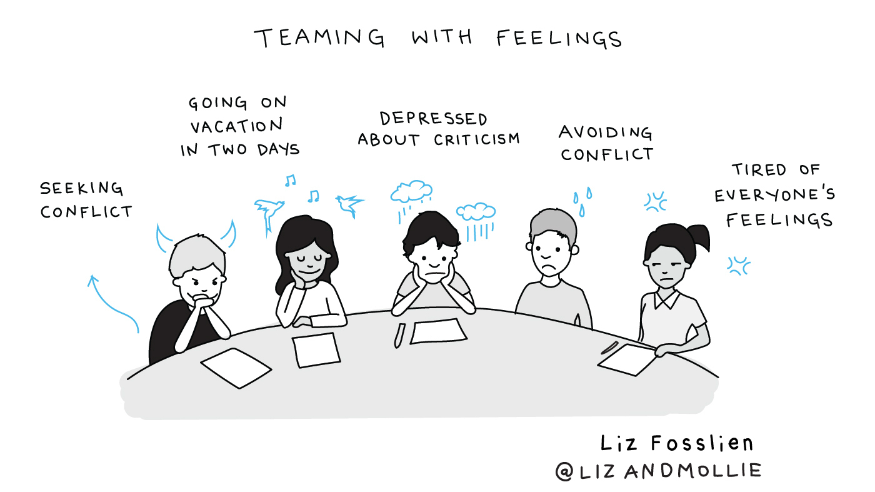
This barrier in the case study
Garys emotional reality
Gary is overwhelmed, burnout and carrying the whole weight alone of the job environment.
He cares deeply but feels unheard, unsupported and rushed management forces him to skip proper training and he is the only one trying to keep everyone safe.

Slide 4
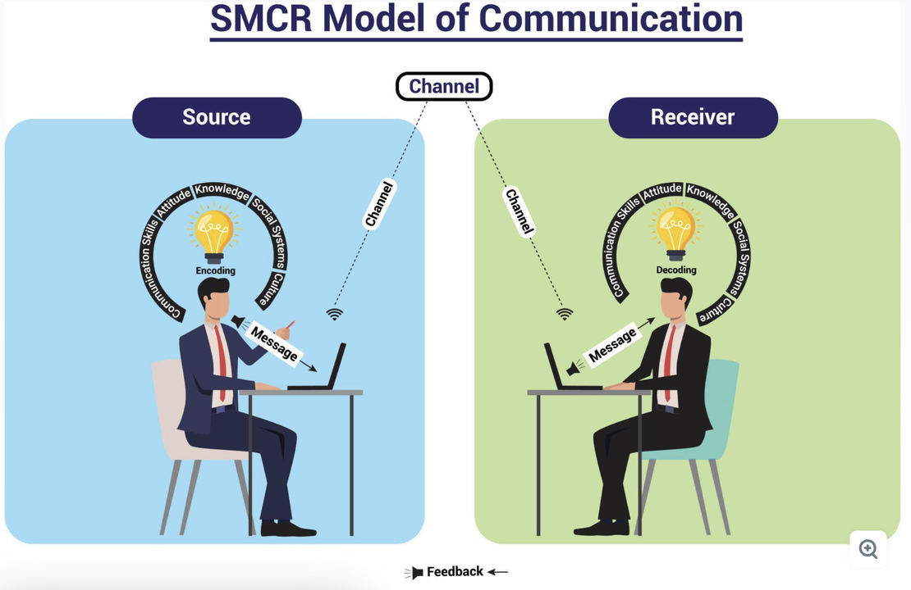
What does theory and research say
I will be using the Berlo theory to explain the communication in a work place.
Communication effectiveness depends on the alignment between sender and receiver the more they share in language, culture, experience and context the clearer the message the less they share the more the message breaks down

Slide 5

The solution
Build respect and trust
Creat mixed cultural between work pairs use multilingual notices around the work
Give Gary clear management training for less stress and more support
Teach skills step by step for work pairs

