Slide 1
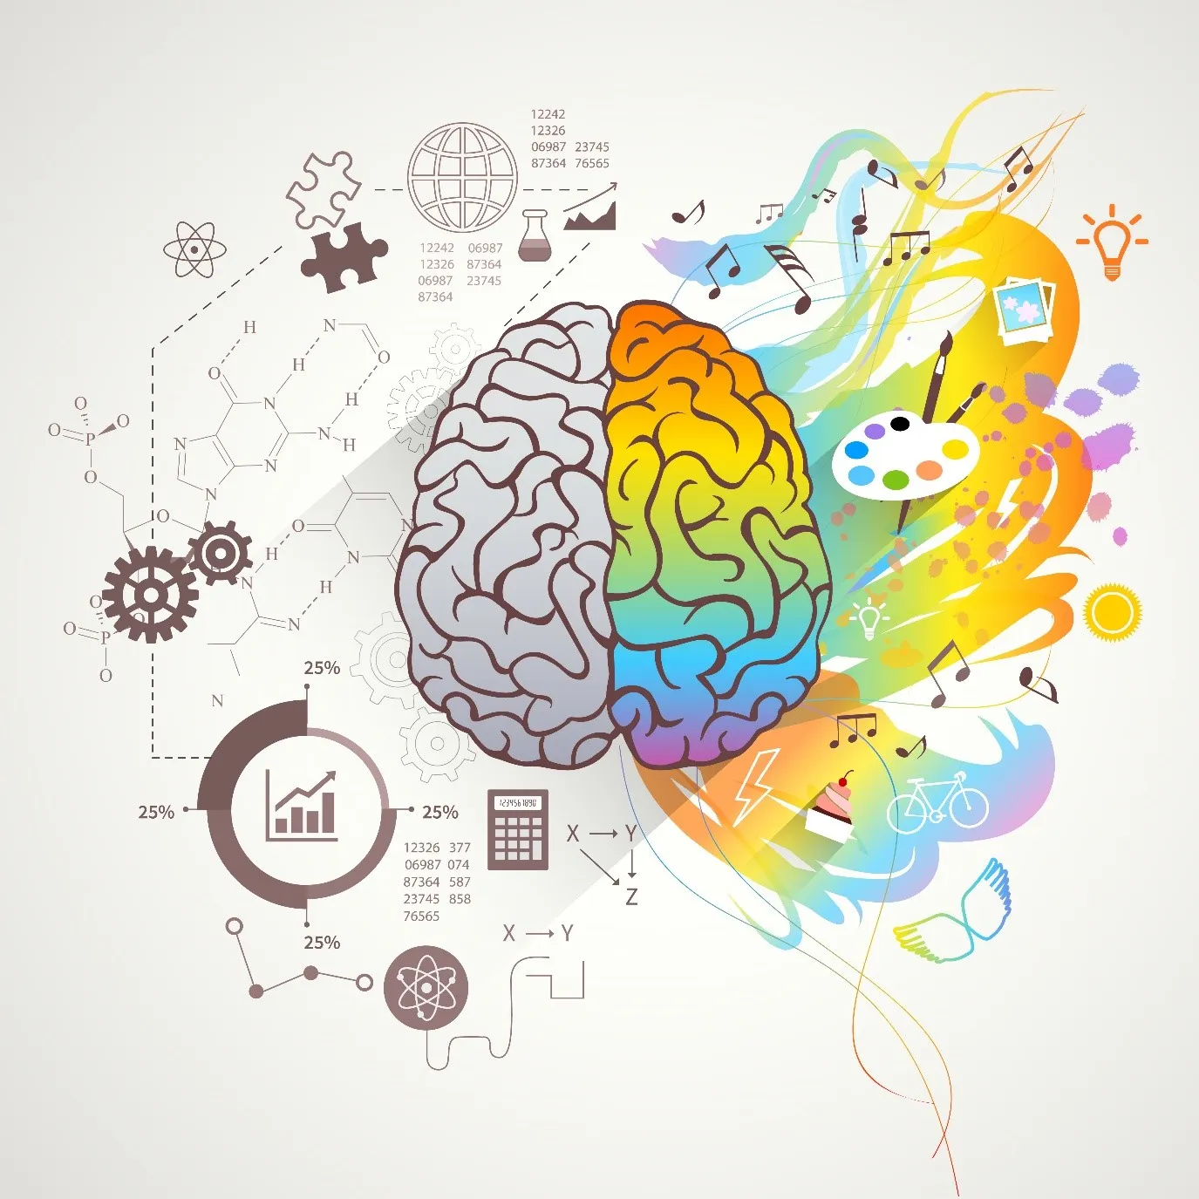
Sesiwn 7
Y Ddadl Celf v Gwyddoniaeth
The Art v Science Debate
ECES5021C
Y Meddwl Ymholgar
The Enquiring Mind
Notes:
Week 4
1

Slide 2
Nod ac Amcanion
Aim and Objectives
Nod:
  Archwilio'r tebygrwydd a'r gwahaniaethau rhwng dulliau creadigol a gwyddonol
  Amcanion:
  Beirniadu'r dulliau creadigol a gwyddonol a ddefnyddir mewn addysg
  Cymharu'n feirniadol y tebygrwydd a'r gwahaniaethau rhwng ymholi gwyddonol ac ymholi creadigol
Aim:
  To explore the similarities and differences between creative and scientific approaches
  Objectives:
  To critique the creative and scientific approaches used in education
  To critically compare the similarities and differences between scientific enquiry and creative inquiry
Notes:
Overall aims and objectives
2

Slide 3
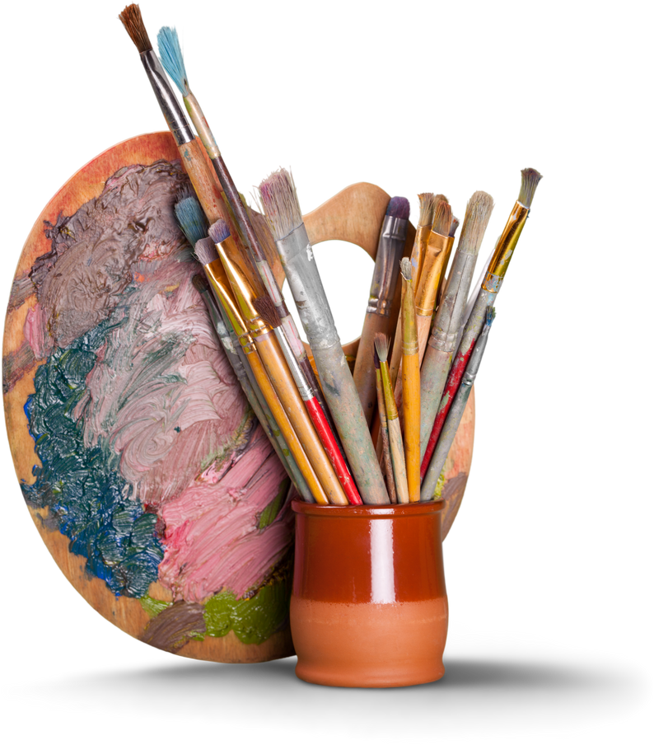
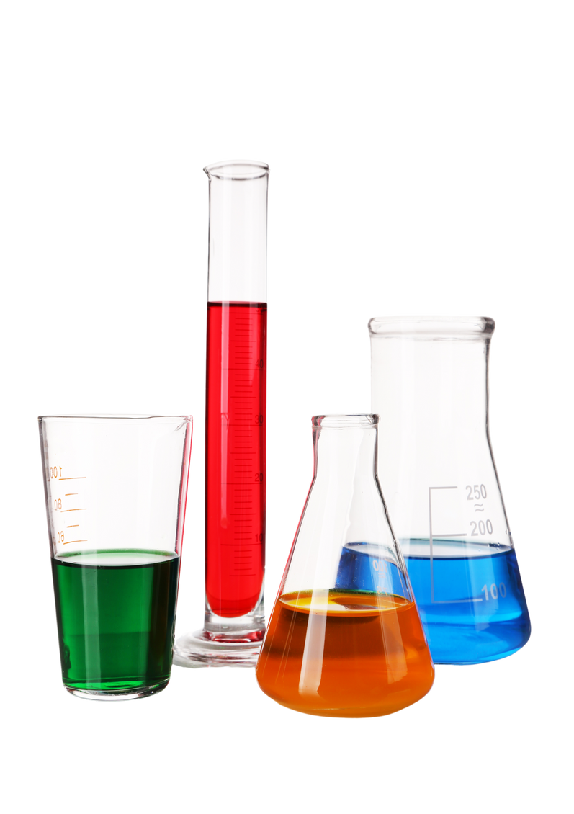
Tasg / Task
Creuwch ddau restr:
  Pethau rydych yn perthnasu gyda’r celfyddydau
  Pethau rydych yn perthnasu gyda gwyddoniaeth
Create two lists:
  Things that you relate to the arts
  Things that you relate to science
Notes:
Create two lists; art and science
3

Slide 4
Nodau celf / The aims of art
  I ddarparu profiadau gweledol, cyffyrddol a synhwyraidd a ffordd unigryw o ddeall ac ymateb i'r byd.
  I ddisgyblion ddefnyddio lliw, ffurf, gwead, patrwm a gwahanol ddefnyddiau a phrosesau i gyfleu'r hyn maen nhw'n ei weld, ei deimlo a'i feddwl.
  Mae Cwricwlwm i Gymru yn cynnwys celfyddydau gweledol, cerddoriaeth, drama, dawns a chrefftau.
  I feithrin deallusrwydd lluosog a dysgu unigol myfyrwyr
  O gyfnodau allweddol 1 (CS) i 3 (disgyblion rhwng pump a 14 oed), mae celf, cerddoriaeth, drama (fel rhan o wersi iaith) ac addysg gorfforol (dawns) yn orfodol i bob myfyriwr o fewn y MDaPh Y Celfyddydau Mynegiannol.
  Mynd i'r afael â darllen, ysgrifennu a sgiliau sylfaenol eraill ym mhob maes pwnc
  NFER (2008)
  To provide visual, tactile and sensory experiences and a unique way of understanding and responding to the world.
  For pupils to use colour, form, texture, pattern and different materials and processes to communicate what they see, feel and think.
  The new Curriculum for Wales includes visual arts, music, drama, dance and crafts.
  To cultivate multiple intelligences and students' individual learning
  From key stages 1 (FPh)to 3 (pupils aged five to 14), art, music, drama (as part of language lessons) and physical education (dance) are compulsory for all students under the Expressive Arts AoLE.
  Address reading, writing, and other fundamental skills within all subject areas
  NFER (2008)
Notes:
Focus is on sensory experiences, hands on learning which is experiential. Caters for all intelligences and different types of learners. Promotes experimentation with colour, texture and pattern.
4

Slide 5
Ystyrir Gwyddoniaeth fel…
Science is viewed as…
  Pwnc statudol (craidd) yng Nghymru tan 16 oed.
  Ynghlwm yn ein penderfyniadau o ddydd i ddydd
  Yn bwnc sy’n cynorthwyo plant i ddatblygu deallusrwydd, sgiliau rhesymu ac agweddau o fewn byd sy’n newid yn barhaol
  Ceir dulliau gwahanol o addysgu gwyddoniaeth mewn ysgolion cynradd ac uwchradd
  (Harlen and Qualter, 2014)
  A compulsory (core) subject area in Wales until 16 years of age.
  Being involved in our everyday life choices
  A subject that helps children to develop understanding, powers of reasoning and attitudes in the ever changing world.
  There is a different approach to teaching science in primary and secondary schools
  (Harlen and Qualter, 2014)
Notes:
Compulsory in education whereas art can be dropped in y9
Viewed as important as it provides us with scientific thinking skills which we use in every day life. Cooking – follows scientific methods.
Promotes inquiry – encourages the asking of questions and being inquisitive.
Secondary – teaching takes place in a laboratory, type of teacher changes from a generalist to a specialist (more of a formal investigative approach in secondary), problems occur in secondary : pupils may repeat work done in primary, scientific language and to teaching style can become too complex for children, science teachers often fail to refer to pupils previous experiences
6

Slide 6
Nodau gwyddoniaeth / The aims of science (DfE, 2013)
  i gyffroi a swyno plant sydd â synnwyr o ryfeddod am y byd naturiol.
  datblygu gwerthfawrogiad o sut mae gwyddoniaeth wedi cyfrannu at ddatblygiad hanesyddol a diwylliannol ein cymdeithas.
  i roi profiad ymarferol o sut mae gwyddonwyr yn arsylwi ar y byd naturiol, meddwl am ddamcaniaethau a gwneud arbrofion i gael tystiolaeth i gefnogi neu wrthbrofi'r damcaniaethau hyn.
  achosi i blant ddeall pwysigrwydd tystiolaeth wrth wneud penderfyniadau a gallu barnu a yw honiadau'r cyfryngau, hysbysebwyr, gwleidyddion, newyddiadurwyr, ac ati, yn seiliedig ar dystiolaeth ac yn ddibynadwy.
  i roi digon o wybodaeth ar sail tystiolaeth i ddisgyblion allu llunio barnau personol gwybodus er mwyn byw bywydau iach, diogel, cyfforddus ac amgylcheddol gynaliadwy.
  datblygu ymwybyddiaeth o gasgliadau damcaniaethau gwyddonol pwysig mewn ffordd bendant a hygyrch
  to excite and enthuse children with a sense of awe and wonder at the natural world.
  to develop an appreciation of how science has contributed to the historical and cultural development of our society.
  to give practical experience of how scientists make observations of the natural world, come up with hypotheses and do experiments to obtain evidence to support or disprove these hypotheses.
  to cause children to understand the importance of evidence when making decisions and to be able to judge whether the claims of the media, advertisers, politicians, journalists, etc, are evidence-based and reliable.
  to give pupils enough evidence-based knowledge to be able to make informed personal judgements in order to lead healthy, safe, comfortable and environmentally sustainable lives.
  to develop awareness of the conclusions of important scientific theories in a concrete and accessible way
Notes:
Aims taken from DFE – mainly focus on England. Can be seen from the aims that Science plays a key part in everyday life. Appears that learning about science will set them up for their future. Importance on evidence based and practical activities. Similar features to the aims of art?
7

Slide 7
Beth am y Cwricwlwm i Gymru?
What about the Curriculum for Wales?
  Ystyriwch a chymharwch gyda’r datganiadau o’r hyn sy’n bwysig o fewn y MDaPh Gwyddoniaeth a Thecholeg.
  Consider and compare the statements of what matters for the Science and Technology AoLE.
Notes:
9

Slide 8
MDaPh Gwyddoniaeth a Thechnoleg
Science and Technology AoLE
Datganiadau o'r hyn sy'n bwysig
  Mae bod yn chwilfrydig a chwilio am atebion yn hanfodol er mwyn deall a rhagfynegi ffenomenau
  Mae meddwl dylunio a pheirianneg yn cynnig ffyrdd technegol a chreadigol o ddiwallu anghenion a dymuniadau cymdeithas.
  Mae'r byd o'n cwmpas yn llawn o bethau byw sy'n dibynnu ar ein gilydd i oroesi.
  Mae mater a'r ffordd y mae'n ymddwyn yn diffinio ein bydysawd ac yn siapio ein bywydau
  Mae grymoedd ac egni yn darparu sylfaen ar gyfer deall ein bydysawd
  Cyfrifo yw sylfaen ein byd digidol.
Statements of what matters
  Being curious and searching for answers is essential to understanding and predicting phenomena
  Design thinking and engineering offer technical and creative ways to meet society’s needs and wants
  The world around us is full of living things which depend on each other for survival
  Matter and the way it behaves defines our universe and shapes our lives
  Forces and energy provide a foundation for understanding our universe
  Computation is the foundation for our digital world

Slide 9
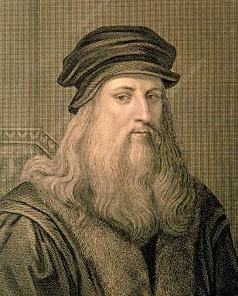
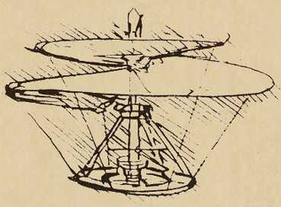
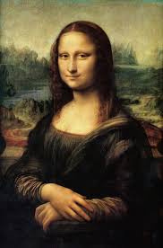
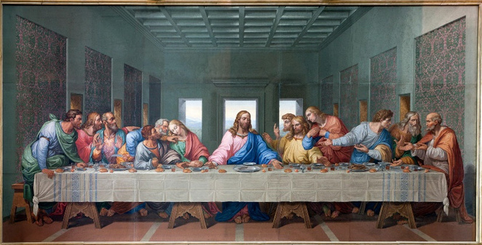

Leonardo Da Vinci
(1452 – 1519)
Artist neu Wyddonydd?
Artist or Scientist?
Pam? / Why?
Ymchwiliwch i geisio ddod i’ch barn eich hun.
Reseach to make your own judgement.
Notes:
Discuss which one and reasons why in groups
Debate going on between the National gallery and queens galley in London. NG believes artist, QG believes scientist. - both correct. Da Vinci started out as an artist but referred to himself as a scientist in later life.
10

Slide 10
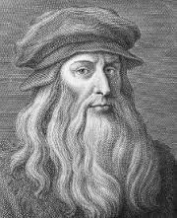
Leonardo Da Vinci
(1452 – 1519)
  Gwyddoniaeth y cyfnod; daeth gwybodaeth wyddonol o Feibl neu waith gwyddonydd arall
  Gwyddonydd cyntaf oedd yn cysylltu mathemateg a gwyddoniaeth
  Dechreuodd chwyldro gwyddonol
  Ei luniadau anatomegol yn dal i gael eu defnyddio gan feddygon heddiw
  Atalay (2014)
  Science of the time; scientific knowledge came from the Bible or work of another scientist
  First scientist that correlated maths and science
  Started a scientific revolution
  His anatomical drawings are still used by doctors today
  Atalay (2014)
Notes:
Born 1452 –
Most famous piece of work – Mona Lisa
Inventions and anatomy
To understand his significance you must understand the science of the time – over 500 years ago –knowledge from bible (they believed that science that involved experiments were full of errors
He was the first to see clearly that knowledge of science would have to come from repeated experiments done, not unproven ideas.
One of the reasons that he did fail in scientific investigations was because many of the mathematic laws that he needed had not yet been discovered.
11

Slide 11
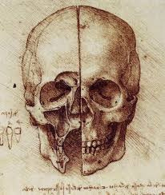
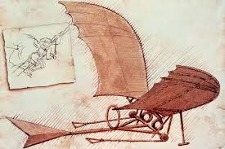
Leonardo Da Vinci
(1452 – 1519)
Cysylltu Celf a Gwyddoniaeth
Anatomeg:
  Mae llawer o'r lluniadau mor gywir â delweddau technoleg digidol heddiw.
  Mae rhai lluniadau yn dal i gael eu defnyddio gan y proffesiwn meddygol heddiw.
  Dyfeisiadau
  Roedd yn dymuno hedfan….felly ddyfeisiodd beiriant hedfan.
  Cynhyrchodd fwy na 35,000 o eiriau a 500 o frasluniau yn ymwneud â pheiriannau hedfan.
  Mae’r ‘Codex on the Flight of Birds’ yn amlinellu nifer o arsylwadau a chysyniadau cychwynnol a fyddai’n dod o hyd i le yn natblygiad awyren lwyddiannus ar ddechrau’r 20fed ganrif.
  https://www.youtube.com/watch?v=jMTJD5hTx4U
Linking Art and Science
Anatomy:
  Many of his drawings are as accurate as digital imaging technology today.
  Some drawings are still used by those in the medical profession.
  Inventions
  Desired to fly….so invented a flying machine.
  He produced more than 35,000 words and 500 sketches related to flying machines.
  the Codex on the Flight of Birds outlines a number of observations and beginning concepts that would find a place in the development of a successful airplane in the early twentieth century.

Slide 12
Y cysylltiad rhwng y celfyddydau a’r gwyddorau mewn addysg
The link between art and sciences in education
“to develop a complex mind, study the science of art, study the art of science, learn how to see.” (Leonardo Da Vinci).
  Mae Celf a Gwyddoniaeth yn rhannu ‘chwilfrydedd’ cynhenid ​​i wybod, i ddeall a mynegi.
  Pum prif gategori o gyffredinedd:
  dulliau ymholi
  meysydd astudio
  arbrofi;
  creadigrwydd
  dychymyg
  Robson et al (2005)
  Art and Science share an inherent ‘curiosity’ to know, to understand and express.
  Five main categories of commonality:
  modes of inquiry
  fields of study
  experimentation;
  creativity
  imagination
  Robson et al (2005)
Notes:
Thoughts are that art and science should be combined, possibly this is already done unknowingly . Both art and science promote inquiry – this is why these subject are focused on the most when looking at enquiring minds.
Both subjects encourage exploration and the engagement of pupils in sessions.
From categories it can be seen that both subjects promote a hands on approach to learning. Pupils guided by own interests? Does this increase imagination?
14

Slide 13
Mae Jemison
Ystyriwch negeseuon Mae yn y fideo isod. Sut maent yn berthnasol i addysgu disgyblion ysgol?
Consider Mae’s points in the video below. How do they relate to teaching school pupils?
‘Teach Art and Science Together’
http://www.ted.com/talks/mae_jemison_on_teaching_arts_and_sciences_together?language=en
Notes:
Astronaut, doctor, dancer, art collector – first women in America to travel to space
15

Slide 14
Yoko Shimizu
Ystyriwch negeseuon Yoko yn y fideo isod. Sut maent yn berthnasol i addysgu disgyblion cynradd?
Consider Yoko’s points in the video below. How do they relate to teaching primary pupils?
‘Yoko Shimizu: Integration of Art and Science’
https://www.youtube.com/watch?v=uDfVMvbCusY

Slide 15
Tasg / Task
  Find one piece of research that links the teaching of art and science in education
  Prepare a creative task that blends art and science that can be used in the classroom.
  Chwiliwch un darn o ymchwil sy’n cysylltu addysgu celf a gwyddoniaeth o fewn addysg
  Paratowch dasg creadigol sy’n cyfuno celf a gwyddoniaeth y gellir ei ddefnyddio yn yr ystafell ddosbarth.

Slide 16
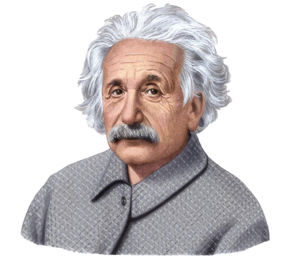
Ystyriwch ddyfyniad Albert Einstein mewn perthynas a chynnwys y cyflwyniad yma. Sut mae’n berthnasol i addysg?
  “The most beautiful thing that we can experience is the mysterious. It is the source of all true art and science.” (Einstein, n.d.)
Ystyriwch ddyfyniad Albert Einstein mewn perthynas a chynnwys y modiwl. Sut mae’n berthnasol i addysg? Rhannwch eich meddyliau.
Consider Albert Einstein’s quote in relation to the content of this module. How does it relate to education? Share your thoughts.

Slide 17
Cyfeirnodau / References
  Atalay, B. (2014) Math and the Mona Lisa. USA: Smithsonian Institution Press.
  Department for Education (2013) Science programmes of study: key stage 3. https://www.gov.uk/government/uploads/system/uploads/attachment_data/file/335174/SECONDARY_national_curriculum_-_Science_220714.pdf(accessed on 14ᵗʰ October 2014)
  Smith, R. and Simpson, S. (1991) Aesthetics and Arts Education. Champaign: University of Illinois Press
Notes:
19

