Slide 1

Hieroglyphs, Text & Society
The Alphabet:
Democratization of Writing

Slide 2
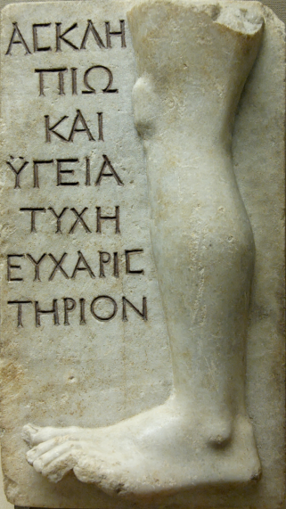
Origins of the Alphabet
Ancient Greeks believed that the alphabet was learnt from the Phoenicians
  Herodotus V.58: knowledge of writing was brought to Greece from the Phoenicians by Kadmos
Modern scholarship: Greeks adopted Semitic alphabet c.750 BC
Greek inscription

Slide 3
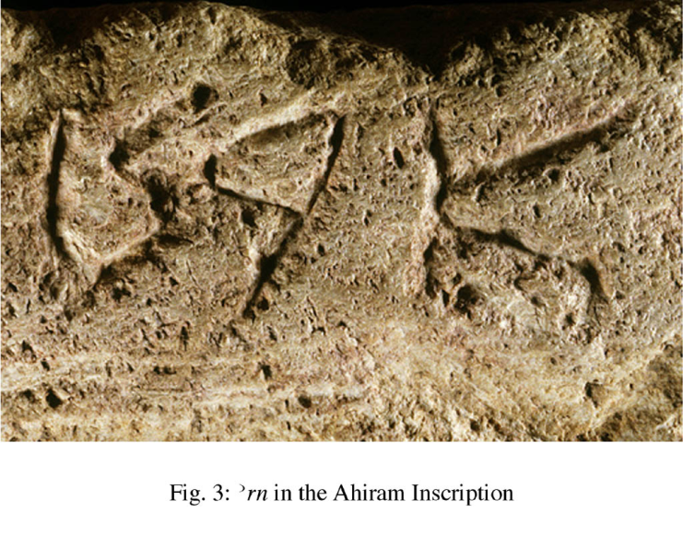
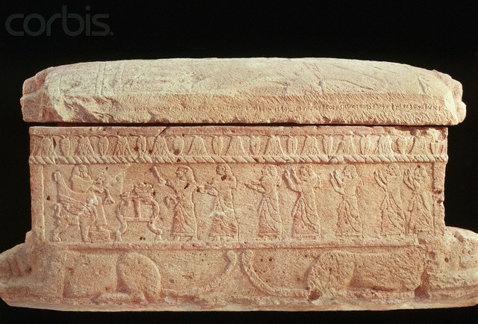
Phoenician Script
Ahiram’s coffin, Byblos (c.1000 BC):
  Earliest intelligible text of more than two or three words written with the Phoenician alphabet
  Letters have developed a conventional form
  Script is becoming cursive
What are the formative phases of this alphabet?
Ahiram’s coffin

Slide 4

Proto-Sinaitic Script
Serabit el Khadem
c. 15th-14th centuries BC appearance of a new pictographic script with around 30 signs
An alphabet not a syllabary = Proto-Sinaitic
Serabit el Khadem

Slide 5
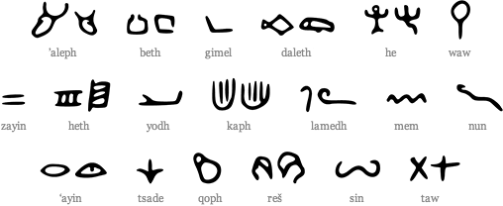
Proto-Sinaitic Script
Gardiner: certain recurring signs identified as acrophonic values of equivalent Canaanite word:
  ox aleph = A
  ox goad lamedh = L
  house beth = B
  eye ‘ayin = ‘A
Each pictograph symbolizes only the initial sound
Proto-Sinaitic Script

Slide 6
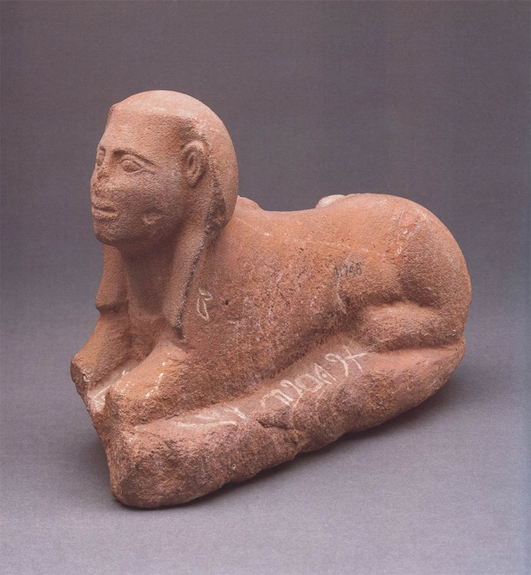
Proto-Sinaitic Script
Gardiner identified a Canaanite word meaning “to the lady”:
  lb‘lt
Further “decipherment” by Albright:
  Language identified as Canaanite
  Extensive use of Ugaritic vocabulary & grammar
  Votive inscriptions dedicated to a goddess (Ba‘alat; Hathor in Hieroglyphs)
Sphinx, Serabit el Khadem

Slide 7
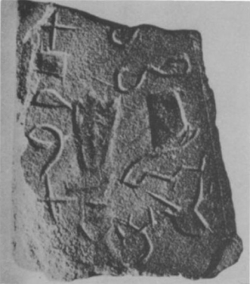
Proto-Sinaitic Script
Many signs are the original forms of the Phoenician letters
Script developed & used by turquoise miners
  Simpler system allowing spread of writing beyond elite
Proto-Sinaitic isncription

Slide 8
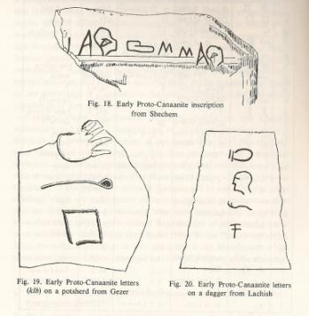
Proto-Canaanite
c.1500 BC: earliest appearance of Proto-Canaanite
Short inscriptions from sites in southern Levant
First signs were clearly pictographic
Later examples are more schematized
Proto-Sinaitic belongs to this corpus of alphabetic scripts
Proto-Canaanite

Slide 9
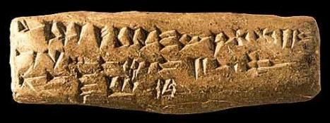
Ugaritic Script
Ugarit 14th-13th centuries BC: many tablets using a derivative of cuneiform:
Limited number of signs: 31
  Not a syllabary
  Acrophonic value of signs
Used to write a NW Semitic (Ugaitic) language
Earliest evidence for the present-day ordering of signs was found at Ugarit: abecedary tablets
Ugaritic tablet

Slide 10
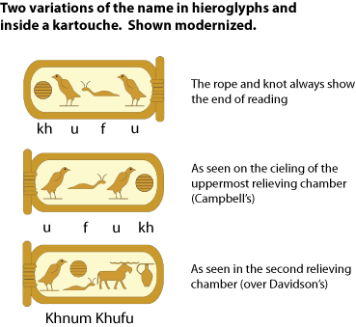
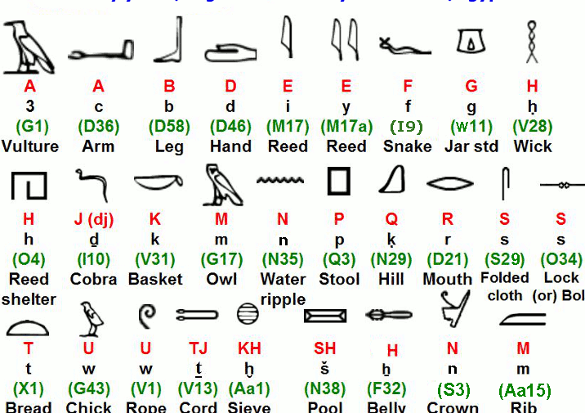
Egyptian Alphabet
In addition to syllabic signs the Egyptians also used uni-consonantal signs
Essentially an alphabetic script
  But used within a more complex writing system

Slide 11
Invention of the Alphabet
Proto-Sinaitic & Proto-Canaanite scripts ancestral to the early Phoenician alphabet
An indigenous Semitic writing system used within a melting pot of cultural interaction:
  Scribes in region probably required to record information in several languages using complex syllabic scripts
  Hieroglyphs/hieratic on papyrus
  Akkadian on clay tablets
Perfect circumstance for experiment & invention, resulting in development of a much simpler script for writing indigenous Semitic language

Slide 12
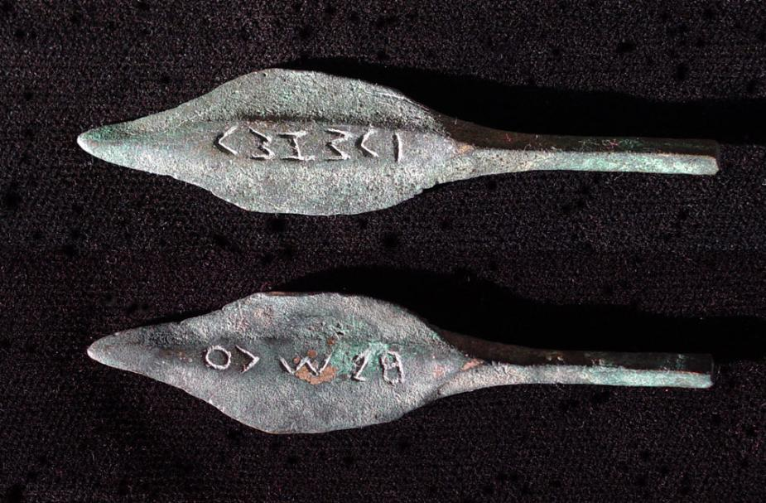
Phoenician Alphabet
Iron Age descendant of Proto-Sinaitic
11th century: arrowheads written in what appears to be Phoenician rather than Proto-Canaanite
  Letter forms have not yet stabilized
By 10th century the Phoenician script is fully formed
Phoenician inscribed arrowheads

Slide 13
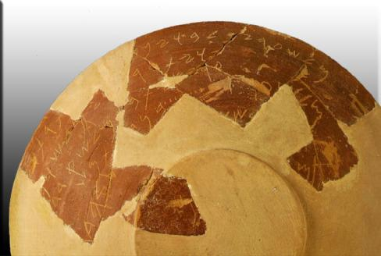
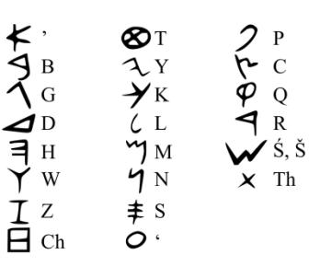
Phoenician Alphabet
Script usually written from right to left
22 signs:
  Schematized, losing pictographic origins
  No vowels
Inscriptions tend to be short:
  Personal dedications and dedications of buildings
Red Slip Bowl, Kition
Phoenician alphabet

Slide 14
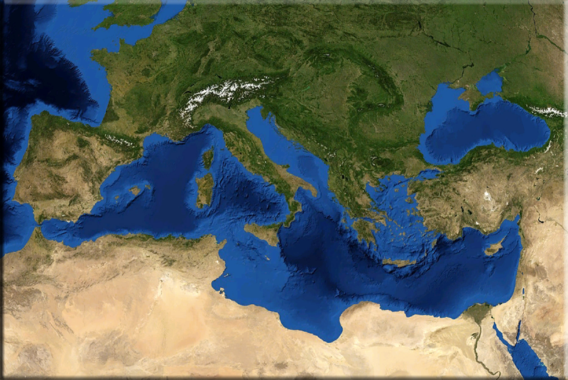
Spread of the Alphabet
“The alphabet’s advantages of simplicity & versatility brought it to supremacy over all other writing systems in the Levant from the beginning of the Iron Age” (Millard 1986: 396)
Phoenician maritime
  Stage 1: Phoenician inscriptions in the west
  Stage 2: Greek adoption of alphabet
Mediterranean

Slide 15
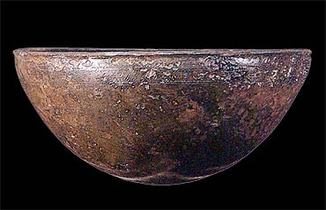
Knossos Inscription
9th century BC
  ks šm‘ bn l’[
  The cup of Šema‘ son of L[…
Early use of writing to mark ownership
  What does this tell us about literacy?
Is this a traded object or the personal possession of a Phoenician buried at Knossos?
  If traded what is the significance of the inscription for a Greek consumer
Inscribed bronze bowl

Slide 16
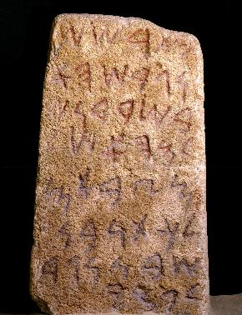
Nora Stela, Sardinia
Epigraphically c.830-825 BC
Discovered 1773 near Pula, Sardinia
Commemorates building of a temple dedicated to Pmy on the island of Sardinia (b šrdn)
  Arrival of first Phoenicians in Nora
  Phoenician interest: iron & lead resources
Nora Stela

Slide 17
Kadmos and the Greeks
Earliest examples of Greek alphabetic writing: graffiti on pottery, c.8th century BC
  Lefkandi, Pithekoussai & Al Mina
  Personal names
8th-7th C.: writing becomes widespread throughout Greek world
“The impulse to write one’s name on a cup was evidently irresistible to the eight-century Greek” (Powell 1996: 142)
Mediterranean

Slide 18
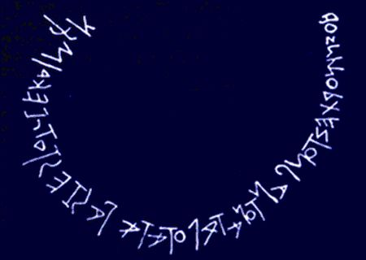
Early Writing, Literacy & Epic
Early inscriptions in verse
“this new alphabet enabled Homer to compose & set down his great poem(s)” (Boardman 1980: 83-4)
Dipylon Oinochoe (c.740 BC):
  Whoever of all the dances now dances most friskily
    Of him this….
    ????
Composed in hexameter
  Contemporary with writing down of Homeric epic
Dipylon oinochoe inscription

Slide 19
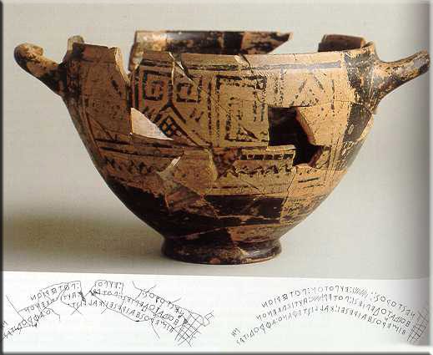
Nestor’s Cup
Pithekoussai: Rhodian import, late 8th century
Euboean inscription:
  I am the cup of Nestor, a joy to drink from, but anyone who drinks from this cup will soon be struck with desire for fair-crowned Aphrodite
Nestor’s Cup

Slide 20
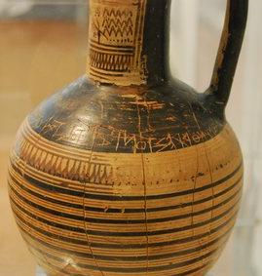
Early Alphabetic Inscriptions
Very different use of writing to Near East in Bronze Age
More personal in character
  Initially personal votive dedications by private individuals
  Records ownership, personal possessions
  Writes down allusions to popular literature
Dipylon oinochoe

Slide 21
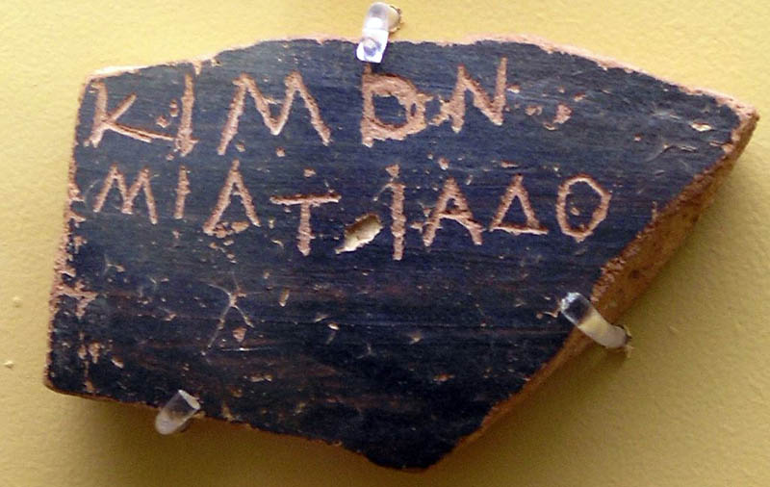
Early Alphabetic Inscriptions
Alphabet: simpler writing system developed for use by private individuals
Not just a bureaucratic tool & part of the apparatus of state
Ostraca, Athens

Slide 22
Summary
Alphabetic writing systems developed to record Semitic languages in later second millennium BC
Earliest recorded is Proto-Sinaitic
Other Late Bronze Age alphabets are Ugaritic & Proto-Canaanite
First millennium BC: development of Phoenician
c.8th century the alphabet spreads to Greek world
Simpler writing system with fewer signs to learn
The written word was more widely available beyond the palace elites

