Slide 1
BSC Health and Social Care
Public Health Policy BMHP5013
Dr Besty Jose
Community project
The current covid-19 Pandemic and its impact on the BAME community worldwide.
Group 1
Sanara Begum Akbar 1713889
Nageena Ahmed 1808213
Hasna Begum 1808766
Sabina Khanam 1713883

Slide 2
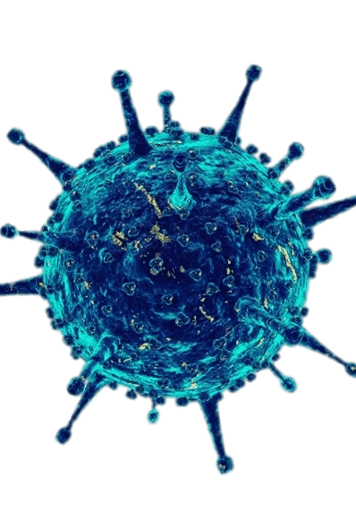
Introduction
Covid-19
Coronavirus (Covid-19) is an infectious disease which attacks the respiratory system. Most people that get infected show mild to moderate symptoms however if the infected person has any underlying health problems this may aggravate the virus to develop a more serious illness (WHO, 2020).
The epi centre of the disease was Wuhan city, Hubei Province which is situated in China.
The rate of infection has created a global pandemic and has spread worldwide impacting everyone. On January 30th, 2020 The World Health Organisation declared the outbreak as a public health emergency.
In order to slow the rate of infections and deaths many restrictions and policies have had to change or adapt (WHO, 2020).

Slide 3
Symptoms
COVID-19 affects different people in different ways. Most infected people will develop mild to moderate illness and recover without hospitalization.
Most common symptoms: Fever, dry cough, tiredness.
Less common symptoms:
aches and pains.
sore throat.
diarrhoea.
conjunctivitis.
headache.
loss of taste or smell.
a rash on skin, or discolouration of fingers or toes.
Serious symptoms: difficulty breathing or shortness of breath, chest pain or pressure, loss of speech or movement.
(NHS Engand, 2020)

Slide 4
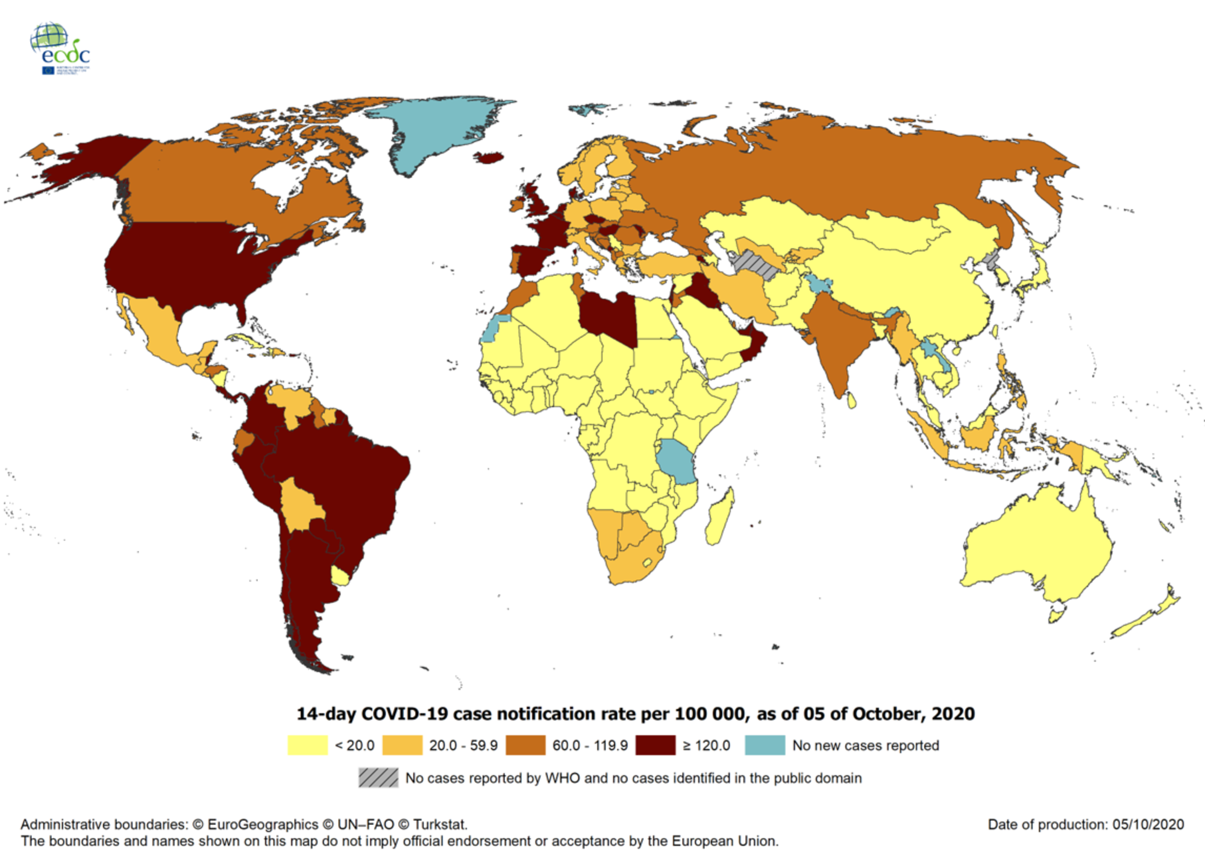
Current worldwide Figures (As of 5th October 2020)
Total cases
35.2 Million
Recovered
24.5 Million
Deaths
1.04 Million
(European Centre for Disease Prevention and Control
2020)

Slide 5
Black and Minority Ethnic Community
B A M E
Our chosen population group is the Black and Minority Ethnic community (BAME).
We have chosen the B.A.M.E community due to the disparities of the deaths compared to the white ethnic community. This has all been highlighted due to the Covid-19 Pandemic. (Public Health England 2020. B)
According to Public Health England (2020) the rate of morbidity (death rates) is higher in those in Black, Asian and Minority Ethnic (BAME) groups than in White ethnic groups.
This is alarming especially when compared to last year where the rates were the opposite showing that mortality was higher in the white ethnic groups compared to the B.A.M.E. (Public Health England 2020, B).
The evidence can also be seen on the incidence rates on the UK government website

Slide 6
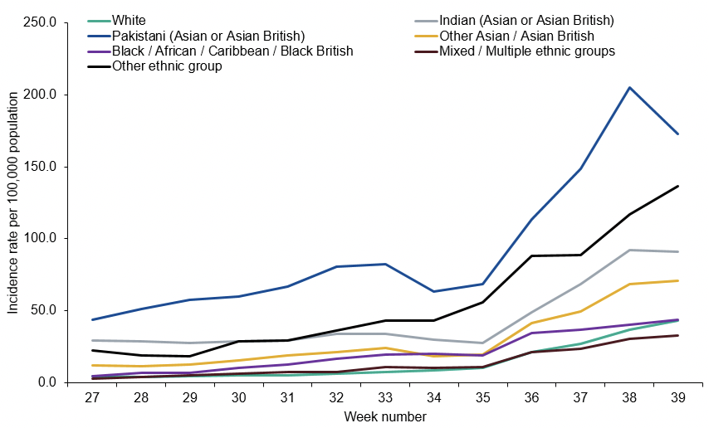
Weekly incidence per 100,000 population by ethnicity, England
(Public health England 2020,A)

Slide 7
Findings
The highest rates are seen in Asian communities of either Other ethnic background or Bangladeshi?Pakistani origin, most likely reflecting the ethnic mix in the most affected local areas.
In the regions with the highest overall rates the age groups most affected tends to be young working age adults (20-29 years).
This is consistent with mixing patterns in this age group who may be more likely to be working away from home, including in public facing roles.
(Public Health England, 2020,A)

Slide 8
These disparities are not just nation-wide in the UK but on an international level.
According to the centres for disease control and prevention (CDC, 2020) in the USA the data collected showed
When examining overall age-adjusted rates by race and ethnicity
The rate for Hispanic or Latino persons was approximately 4.6 times more than the rate among non-Hispanic White persons
hospitalization rates for both non-Hispanic Black persons and non-Hispanic American Indian or Alaska Native persons were approximately 4.5 times that of non-Hispanic White persons

Slide 9
Impact
The huge disparity in deaths of the BAME community compared to the white community.
Covid-19 has made it clear that there are health and social inequalities on a large scale which include Social care, Housing, Employment.
This all factors into the everyday decisions and choices BAME communities make.
With prominent evidence highlighting clearly that there is a fundamental difference in the experience of Covid-19 based on geography and race.
(Public Health England 2020,B)
Evidence shows that health care professionals withing the B.A.M.E community possess overrepresentation in the Coronavirus deaths. (Hafesji, S. 2020).

Slide 10
Purpose
The purpose of this assignment is to identify public health policies and identify how they have been brought into practise. We can then see the effect these policies have on the people that are using these services. Also we will be able to see the impact on other services including voluntary organisations
We will do this by using our target population which is the BAME community.
This will help us create a presentation highlighting how and if current policies are effective especially with the current Covid-19 pandemic.
The need for Small scale community projects are necessary to tackle inequalities.
.

Slide 11
Covid-19 and the BAME Community
Sabina Khanam 1713883
Identify the incidence of Covid-19 the incidence of Covid-19

Slide 12
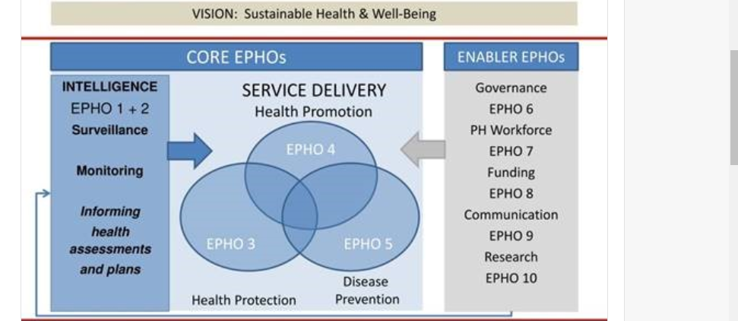
Public Health Strategy
Sabina Khanam - 1713883
The World Health Organisation (WHO) developed 10 Essential Public Health Operations (EPHO) so that countries can adjust together, have access and to have a stronger plan for public health services.
The key delivery is: Health Protection, Disease Prevention and health promotion.
(WHO, 2020A)

Slide 13
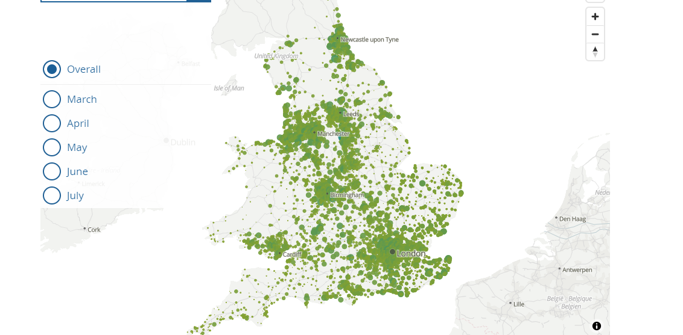
Number of deaths involving COVID-19 in England and Wales, deaths occurring between 1 March and 31 July 2020
60% of London is Black Residents
50% of London is Bangladeshi Residents
Two areas, Leicester and Ashford recorded more than 20 deaths in July 2020.
(Office for National Statistics, 2020A).
Sabina Khanam - 1713883

Slide 14
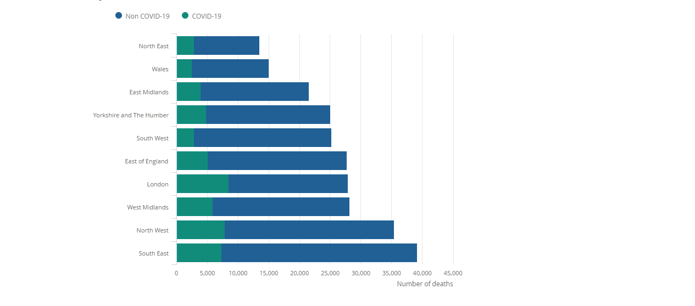
Number of deaths involving and not involving coronavirus, Wales and regions of England, deaths occurring between 1st March and 31st July 2020.
London with high area of deaths between March and July 2020, making up 30.6% of the 27,908 total deaths.
Lowest area of deaths was the South West, making it 11.5% of the 25,262 total deaths.
Wales had lowest number of deaths making it 16.8% of the 2,526 total deaths.
(Office for National Statistics, 2020B).
Sabina Khanam - 1713883

Slide 15
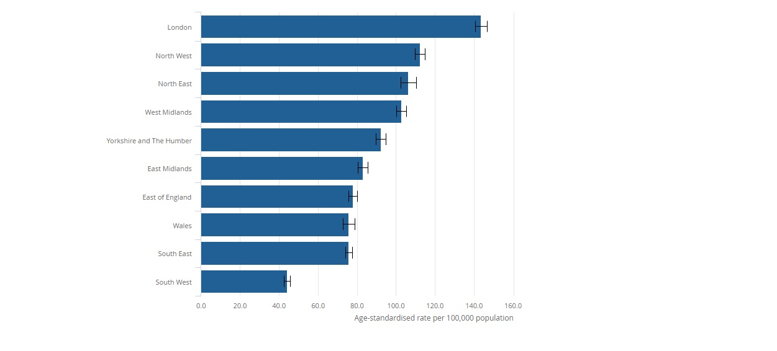
Age-standardised mortality rates for deaths involving the coronavirus (COVID-19), per 100,000 population, English regions and Wales, deaths occurring between 1 March and 31 July 2020
London: 143.4 deaths per 100,000 population
South West: 44.1 deaths per 100,000 population
(Office for National Statistics, 2020C).
Sabina Khanam - 1713883

Slide 16
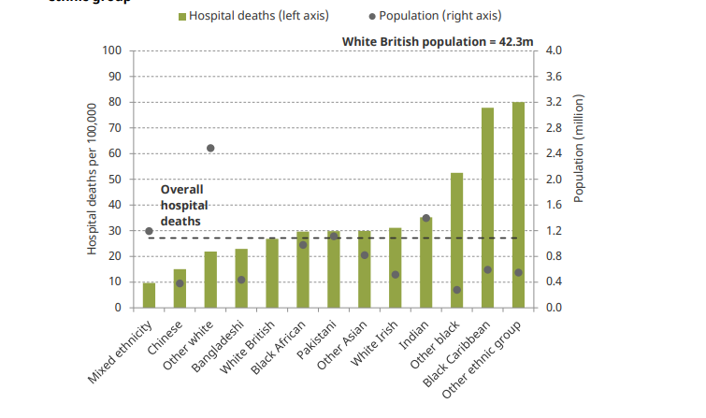
Incidence Rates: Total Registered hospital deaths from COVID-19 per 100,000 in England by ethnic group.
(Nuffield Foundation, 2020A).
Source: Authors calculations using population data from ONS and NHS England COVID-19 hospital death figures by ethnicity as of 21 April 2020.
Sabina Khanam - 1713883

Slide 17
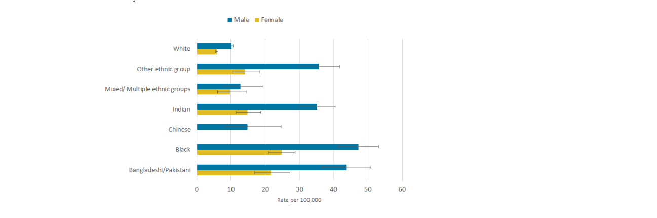
Age-standardised rates for deaths involving COVID-19 at age 9 to 64 years by sex and ethnic group, per 100,000 people, England and Wales, deaths occurring between 2 March and 15 May 2020
Source: (Office of National Statistics, 2020)
Sabina Khanam - 1713883

Slide 18
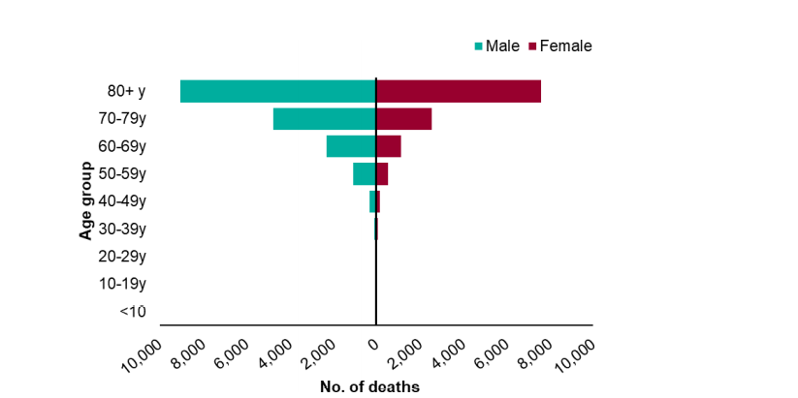
Age sex pyramid of laboratory confirmed COVID-19 deaths as of 13 May 2020, England.
Source: Public Health England COVID-19 Specific Mortality Surveillance System.
Of 17,598 confirmed deaths, males (59.3%) and females (40.7%)
56.3% of deaths were 80+ years over.
(Public Health England, 2020B).
Sabina Khanam - 1713883

Slide 19
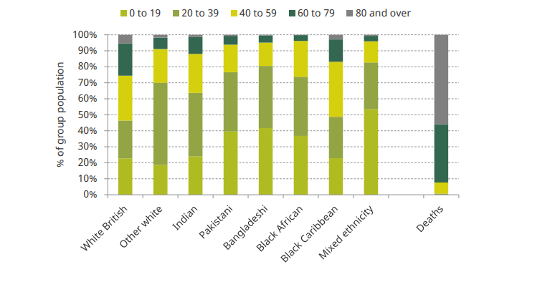
Age distributions of selected ethnic groups in England and Wales and overall deaths by age band
(Nuffield Foundation, 2020B).
Source: Population data from ONS and NHS England COVID-19 hospital death figures by ethnicity as of 17 April 2020.
Sabina Khanam - 1713883

Slide 20
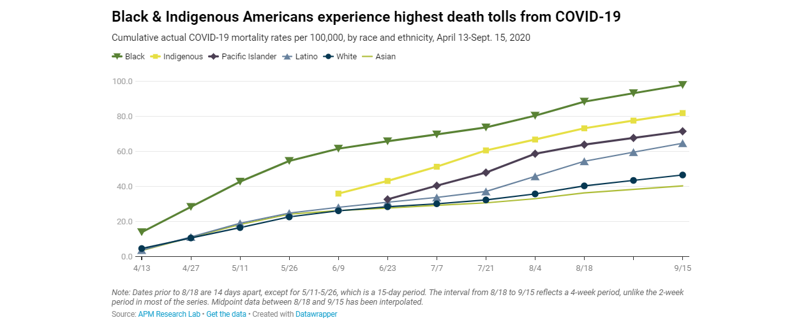
(APM Research Lab, 2020)
Sabina Khanam - 1713883

Slide 21
Trends
People in Pakistan the deaths are 2.9 times as high from COVID-19 and black African deaths are 3.7 times as high.
Health conditions: Bangladeshis are prone to have a long-term health condition making them vulnerable to infection this being up to 60%, which may answer to the deaths caused with COVID 19 related to White British people over 60 plus.
The minority groups from men are likely to be affected by the shutdown from COVID 19, with Bangladeshi men up to four times as white British men to have jobs in shut-down industries. These areas consist mainly in the restaurant sector, and Pakistani men are nearly three times as likely, with their workforce area being in the taxi driving. Black African and black Caribbean men are both 50% more likely than white British men to be in shut-down sectors.
Occupational exposure may be one cause of deaths for our target group. Key workers such as areas in the health and social care, cleaners and the use of public transport are more prone to getting infectious by their work sector. Black African women are employed in health and social care which is two in ten this coincides with Indian ethnic group making up 3% of the working-age population of England and Wales, accounting for 14% of doctors.
The Official deaths in care homes cannot be taken into account as 95% of these residents are white.
Deprivation: Studies have found from the diagnosis rates and deaths are linked with deprived areas.
(Public Health England, 2020B)
Sabina Khanam - 1713883

Slide 22
Causes and Spread
When affected people will experience mild to intense respiratory illness either recovering on their own or needing special medical help.
COVID-19 increases through droplets of saliva in the air when sneezed or coughing. To protect yourself and others it is required to sneeze or cough in the elbow which stops the spread, wear a mask when outdoors in public areas and also washing hands or using a alcohol based hand gel (WHO B, 2020).
Older people from 60 years plus with primary medical conditions for example, cardiovascular disease, diabetics, chronic respiratory disease and cancer will mainly suffer more to COVID 19. These are all common in African than white population (Kirby, 2020).
Social and structural determinants: Using the Dahlgren and Whitehead Policy Model by Exworthy (2008) social and economic circumstances described can affect health throughout an individuals life and those that are most deprived have the highest risk of serious illness and premature death (Public Health England A, 2020).
Health behaviours increase over time: those that are richer have even better health and those that are poorer lag further behind (Public Health England, 2020B).
Work Occupations: BAME groups will possibly work more in higher risk COVID 19 exposure areas (Public Health England, 2020B).
.
Overcrowding: BAME households have more likely increased transmission having more residents within a room (Public Health England, 2020B).
Similar factors include, being poorer, where people live, overcrowded housing, types of job, other illnesses, and access to health services (Hammett, 2020)
Sabina Khanam - 1713883

Slide 23

Measures to control COVID 19
Personal Protective Equipment (PPE) to be worn in high risk services i.e staff managing patients in clinical areas (Public Health England B, 2020)
Use of face masks or face coverings to be worn by staff and individuals entering buildings.
Social distancing of 2 meters
Washing of hands for hygiene including wearing alcohol-based hand gel to lower the risk of transmission (Public Health England B, 2020).
Isolation
Cough or sneeze on the inside of the elbow, avoid touching the eyes, mouth and nose.
Stay away from large social gatherings and avoid contact with someone who is sick.
Clean and disinfect areas which are being touched frequently (WHO C, 2020).
Test and Trace (Gov.uk, 2020)
Measures for NHS Key workers:
Protection of Key Workers: Valuing and respecting by Having stronger arrangements in place for wellbeing and risk assessments in BAME groups for staff safety (Public Health England, 2020).
Health Promotion Programs: to strengthen and improve early diagnosis
Zero discrimination: Creating strategies to help healthy and supportive workplaces.
Communication within staff (NHS, 2020).
Sabina Khanam - 1713883

Slide 24
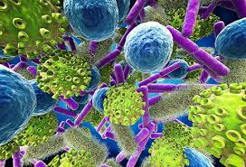
Conspiracy Theories
One conspiracy theory that had many discussions raised all across social platforms during this pandemic was 5G, the newest mobile technology infrastructure being the source and spread of this virus.
The increased discussed caused great uproar on all social media platforms leading to the burning of the 5G towers in the United Kingdom (Ahmed et al, 2020).
Bruns, et al (2020) discussed how all this mis information regarding the pandemic was all false. It relates to how 5G network had health and environmental impacts to humans, to the extent that the effects of COVID-19 were from 5G.
He also discussed the 5G connection is not the only COVID-19-related conspiracy but other claims that the virus was developed in a laboratory in Wuhan, from where it was accidentally or intentionally released. These theories circulating was because people had a big role in the social and economic disruptions.
Sabina Khanam - 1713883

Slide 25
Presentation covid- 19 and the BAME Community
Nageena Ahmed 1808213
Policies to covid-19 Proposed by the Government

Slide 26
Policy 1 – “RULE OF SIX”
From 14th September government has introduced the “Rule of 6” Police have the powers to enforce fines of £100 if anyone is found breaking this rule. (Alderwick et al. 2020)
People can only meet in groups of 6 at any social gathering indoors or outdoors.(Patel,2020)
Exception to the “Rule of 6” is for educational settings, workplaces, weddings, funerals and if a single household or support bubble has more than 6 persons.
Venues such as gyms, places of worship, restaurants and hospitality venues can hold more than 6 people as long they are not individual groups, these venues hold responsibility of keeping individuals 2 metres apart from one another, or risk facing a fine of upto £10,000.(Hawkins, 2020)
The rule will be kept under constant review and will only remain in place as long as necessary.
The most important thing everyone can do is remember the basics: Hands. Face. Space.

Slide 27
Impact this policy has on the BAME community….
BAME people are more likely to live in extended families, bame people also make up a high percentage of the frontline workers. This can be very stressful for people working because they are putting their elderly parents and children at risk of bringing the infection home, adding to this the bame community are already at high risk with existing medical conditions such as diabetes and mental ill health. (Bevan foundation, 2020)
This policy has had a positive impact on the bame community as well as the wider population it has bought families' closer relationships have improved and people are appreciating being at home a lot more. An article from the guardian states a research from the university of Essex found parents felt their relationship with their children improved by staying at home and home schooling, whilst 5% mentioned it got worse. (Doward,2020)
Religious festivals such as Eid celebrations are an important event for the Muslims within the bame community. Recently the government announced a lockdown a night before Eid this had a detrimental effect on this community Muslims were not allowed to go pray together or visit their families. Restricting Eid celebrations was painful but not in comparison to the number of bame deaths due to Covid. (Khan, 2020)
An article from the HuffPost states the "Rule of six" is just an excuse to over police the young BAME people” universities are welcoming new students on campus young people will hang around on campus with friends this rule will have a negative impact on their social life, young people from the bame community are more likely to be stopped by the police if in a group, they will feel racially discriminated. This can make the existing problem become worse. (Sajid, 2020)
The inner cities have large percentage of BAME communities where cases of COVID are very high, This policy will have a positive impact on reducing the spread of the virus, if people don’t socialise and stay within their bubble. Social distancing from one another will reduce infection rates.

Slide 28
Limitations…..
The limitations to this policy are, neighbourhoods where families have not got along can report one another if they witness more than six people in a household, as the guardian reports the police minister has encouraged people to report their neighbours for not complying with “the rule of six” this can lead to neighbourly feuds.(Walker, 2020)
"Rule of 6" is hard to comply with within the BAME community as majority live in an extended family setting, children will go to school and adults in the household will go to work both are at high risk of catching the infection and bringing it home to vulnerable elderly.
Bame people represent the highest number of frontline workers putting them at risk of catching this virus, where most of the time the social distancing rules are not met at the workplace and the correct PPE equipment not available to them.(Bevan foundation,2020)
Social restrictions on the Bame people can have a negative effect on their mental health. As it's been said in a study from the mental health foundation "we are all in this storm, but we are in different boats" (Mental health foundation, n.d)

Slide 29
Solutions and Recommendations
The “rule of 6” overall is an effective policy for fighting the rising infection rates, we can see the results from previous months when the lockdown was in place how cases dropped dramatically. Not just in the UK but in other countries to. (Irfan, 2020). Many countries cross the globe put social distancing measures in place all with their own rules and different measures in place, some countries implemented the 1 metre rule some 1.5 metre and UK says 2 metres apart it's too early to make comparison of figures with different countries at this moment in time.(Conolly, 2020)
More needs to be done to protect the BAME communities, the government needs to take responsibility to protect these people whilst doing their jobs as frontline workers, social distancing measure need to be put in place for them in their workplaces giving employers grants towards making their workplace a safer place, this can also be done in educational settings.
Boris Johnson has left people very confused when he sets out his policies, “Rule of six” policy is not clear and precise people in the BAME community feel confused who they can meet who they can't. What he means by sharing a bubble with another household. As bame people have larger families which family do they choose to bubble with.
I recommend educational settings close and teaching is done online government funds laptops to individuals who don’t have access to one, because schools and colleges are a breeding ground for these infections this will make a huge impact on reducing infection rates this winter.

Slide 30
Policy 2 – Furloughed Scheme
When an employee is furloughed it means they are not working. Their employer has had to close their business or lay employees off work due to government lockdown rules, the employee will remain on the employer's payroll register. The government will pay 80% of their wages and their employer can pay up to 100% if they want to.
The minimum time period an employee can be furloughed is three months.
The furlough scheme is designed to prevent large number of redundancies and job losses and help employers survive the economic effects of coronavirus.
(Real business rescue, 2020)

Slide 31
Impact on the BAME community
Furlough scheme is not available to self-employed workers this will have a negative effect on the BAME community as majority of the people are self-employed running their own businesses such as restaurants, corner shops, taxi drivers, and takeaways. The government is offering self-employed workers a support scheme where they can claim 70% of their average monthly trading profits paid in a single instalment covering 3 months of profits. (Gov.uk, n.d)
The furlough scheme gives people from this community financial security that they remain in employment whilst the country is in lockdown.
Furlough scheme will create greater challenges in relation to people's mental health with more than 9 million people being expected to be placed on furlough. It is important people take care of their wellbeing during this time. This may be an opportunity for some to take a break from working whilst for others it can be challenging.
(Mind, n.d)

Slide 32
Limitations…..
Once the furlough scheme comes to an end we will see rise in unemployment; people will have no choice but to claim benefits leaving benefit agencies under huge pressure to meet demand.
Furlough scheme has a potential to commit fraud, firms can claim benefits whilst employers are still working for them.
The longer this Covid crisis is going to last the longer companies will remain closed with some eventually having to close for good leaving furloughed workers unemployed.
A survey from the charity hope not hate found BAME people are twice as likely to lose their job due to this pandemic and a further third will have had their hours reduced people are struggling to pay rent and buy food leading them to poverty.
BAME people are already classed as the low paid workers with no saving, this will be a struggle for them. (Johnstone, 2020)
This scheme is very expensive for the government costing around £8 billion a month.
(Pettinger,2020)

Slide 33
Solutions and recommendations
Where an organisation has a BAME network, engaging with that network will assist an employer to understand the concerns facing BAME employees in their organisation and for BAME employees to feel that their voice is being heard.(Hayes,2020)
Employers need to ensure safe return for their employees, under the Equality Act 2010 employees from the BAME community should be comfortable to voice their concerns in the workplace if something is putting them at risk of being affected by the virus. (Gov.uk, n.d)
The government is offering to pay 80% of wages to people who are not working this amount is the second highest amount compared to other countries which are only offering 60% to 75% the highest amount is 85% which is paid by Sweden government to its people during this pandemic.(Institute for government, n.d) I recommend this scheme is extended longer than 3 months for people who won't be able to return to work after 3 months.
This policy has been effective so far only the future knows what will happen to our economy and how this will affect people in the BAME community regarding job losses.

Slide 34
Presentation covid- 19 and the BAME Community
Group member: Hasna Begum
Student number: 1808766
Role of local authorities and WHO regarding COVID-19 policies and their impacts on the black and ethnic minority

Slide 35
Role of the local authorities
The local government in the UK acknowledges the higher risk of COVID 19 caseloads in the black and ethnic minority communities (GOV UK, 2020).
The local authority is assigned with the duty to ensure effective and equal delivery of COVID-19 response.
Deliver the payment benefits and other essential public services.
The local authorities in the UK carry out NHS informed COVID-19 policies to ensure an equal delivery of public health care service, including the delivery of service to BAME communities (GOV UK, 2020).
In the USA, different local authorities had carried out different strategies and followed different approaches with their COVID 19 responses (Harder and Harder, 2020).
There have been a lack of uniform policy in the USA, unlike the UK, in terms of COVID 19 response (Harder and Harder, 2020).
This led to disproportionate delivery of health care service to the BAME community in the USA, unlike the UK.

Slide 36
Role of WHO
WHO’s role during the pandemic has been to deliver the necessary information and research data for public and government awareness (McGauran, 2020).
WHO assisted the national governments with policy level recommendations.
WHO also assessed the effectiveness of the governments’ response to the COVID-19 and the effectiveness of their policies in containing the outbreak.
The international organization has been reviewing the effectiveness of the government policies in delivering equal and accessible health care to BAME communities as well (Scally, Jacobson and Abbasi, 2020).

Slide 37
Critical evaluation of the local government’s roles during the pandemic
The local government in the UK, in association with the NHS, tries to ensure that BAME communities get the same access and the needed awareness regarding Covid-19 response as others.
However, the local authorities in the UK, especially in many impoverished places, were not completely prepared to tackle the Covid situation, despite WHO’s warnings.
The national and local governments in the UK could have been more equipped with medical and treatment facilities (McGauran, 2020).
Especially the BAME communities suffered badly due to the lack of immediate facilities available to them.
On the contrary, the local governments in the USA or in the OECD countries show evidences of disproportionate and ineffective implementation of policies across different parts of the communities (Scally, Jacobson and Abbasi, 2020).
The vulnerable ethnic minorities in the OECD countries were more affected by misinformation, unawareness and lack of access to health care (McGauran, 2020).

Slide 38
Critical evaluation of WHO’s roles during the pandemic
WHO’s role during the recent pandemic has been very important for both local and national governments.
WHO’s information and suggested policies had also helped acknowledge the Covid-19 risks faced by the BAME community (Lauriault, 2020).
However, contradictions between the government policies and the WHO’s approach in some countries did affect the effectiveness of risk containment.
In the USA, the government policies and responses to Covid 19 was often contradictory to WHO’s interventions, which affected the BAME communities in that country (Harder and Harder, 2020).
The BAME community have often been quite unaware of the Covid19 risks and pandemic situations in the USA, which had increased the caseloads, especially in the BAME communities (Scally, Jacobson and Abbasi, 2020).
Thus, the impact of WHO’s roles in the USA was less significant.

Slide 39
Barriers faced by these agencies
The major challenge that both WHO and the local governments faced with their response to Covid 19 is the negative public receptions in many cases (Harder and Harder, 2020).
Many people considered the lockdown and other restrictive measures to be completely unnecessary, and thus, they went on to ignore the suggestions from the local authorities and WHO (McGauran, 2020).
In the UK, there were significant strategic gaps between the local governments and WHO, which led to more caseloads.
Another limitation for WHO was its lack of resources to intervene in the local levels and ensure better awareness among the BAME communities (Lauriault, 2020).

Slide 40
Recommendations to improve
The local governments should be more open to cooperate with the international agencies.
There should be transparent exchange of information, and better communication between the authorities and the communities.
Regarding health policy implementation, local authorities should also accept recommendations from WHO.
The BAME community should be targeted for greater awareness programs to minimize risks among them.

Slide 41
Conclusion
Sanara Begum Akbar 1713889
In conclusion Covid-19 has opened our eyes to the socio-economic disparities which exist.
During the pandemic the statistics and rates of death in the BAME community highlighted the importance of the need for more small-scale community projects to help on a more local level.
Currently all the policies and practises that are in place are aimed at a national level which do not take into account the deprivation in certain local authorities/regions.
(Public Health England. 2020, B)

Slide 42
Research indicates that ethnicity and income inequalities are both associated with Covid-19 moratality
Individuals from BAME groups are more likely to work in occupations with a higher risk of COVID-19 exposure.
They are more likely to use public transportation to travel to their essential work.
Historic racism and poorer experiences of healthcare or at work means that individuals in BAME groups are less likely to seek care when needed.
NHS staff from the BAME community are less likely to speak up when they have concerns about Personal Protective Equipment (PPE) or risk. 119
(Public Health England, 2020,B)

Slide 43
We have established the trends, the statistics and facts and figures from numerous sources which can't be denied. (Refer to slide 21)
The findings highlight
Pre-existing Health conditions/Comorbitities
Deprivation
Occupation
Social and economic determinants
The lack of education as most people are believing the conspiracy theories such as of 5G. so they are not taking the virus seriously.
(Public Health England,2020,B)

Slide 44
policies that have been introduced
Rule of 6 (14th September 2020).
Hard to implement when households containing 2/3 generations live under one roof.
Furlough scheme (1st March 2020).
As the country goes into lockdown the BAME community are most effected as they are in the industries which have been impacted the most. Losing jobs and struggling to maintain household costs even with the furlough scheme. More needs to be done.
(GOV.UK)

Slide 45
Local Authorities have been assigned the responsibility of delivering a effective Covid-19 response
They have not been able to implement them as there has been inconsistencies in testing kits and PPE
So, managing the spread has been difficult to implement
how do you follow through with penalties on a local level where there's a language barrier?
Also there has been a negative response from the public on the restrictions imposed.
WHO are there to provide guidelines and up to date data of the spread and the rates of deaths.
They ensure government policies are delivering accessible health care to all communities, they are more neutral and look at the bigger picture.
Limitations for WHO is they lack the resources to implement small scale projects. They are there In an advisory capacity.

Slide 46
Recommendations
The government needs to acknowledge these disparities exist and create an action plan to prevent this from happening again.
Communication is key. keeping all channels open for dialogue. Between the community, local authority and the government.
Education is essential in deprived areas as knowledge is misinterpreted so more needs to be done.
Education to promote behaviour changes to reduce the infection and thus reduce the level of impact.
Overcoming the language barrier needs addressing as BAME will only access healthcare services as a last resort. When early intervention is key.
All this can be changed with the introduction of small-scale community projects as they will be better equipped to analyse each community/borough and assess the needs better as not every community will need the same help.
Organising and supporting community action projects will also help coordinate community responses to outbreaks
Researchers now have hard evidence that targeted programs can improve health and reduce inequality. (Robert & Sapolsky, 2018).

Slide 47
Benefits
There is evidence of the benefits of these projects where resilience to recovery from illness was vastly improved. (King’Fund,2020).
Research done Knapp et al (2011) found that every £1 spent on health volunteering programmes has shown a return of £4-£10
Pevalin and Rose (2003) Found Social support programmes increased the resilience and recovery of illnesses.
Building a strong social capital improves lifestyle risks such as smoking/drinking (Folland 2008; Brown et al 2006).
Halpern (2004) found that the most deprived communities lack support which increases their vulnerability to health effects of social and economic disadvantages.

Slide 48
REFERENCES
Ahmed, W., Vidal-Alaball, J., Downing, J., Segui, FL. (2020) ‘COVID-19 and the 5G conspiracy theory: Social Network Analysis of twitter data’, Journal of Medical Internet Research, 22(5).
Alderwick H. Cameron G. Allen L. Dunn P. (2020), The Health Foundation, COVID 19 policy tracker, Available at, https://www.health.org.uk/news-and-comment/charts-and-infographics/covid-19-policy-tracker, (Accessed on 3rd October 2020)
APM Research Lab (2020) The colour of coronavirus: COVID-19 deaths by race and ethnicity. Available at: https://www.apmresearchlab.org/covid/deaths-by-race (Accessed: 29 September 2020).
Bevan foundation,(2020) All in it together, The impact of coronavirus on bame people in wales, Available at, https://www.bevanfoundation.org/commentary/all-in-it-together-the-impact-of-coronavirus-on-bame-people-in-wales/ Accessed on [08/10/20]
Bruns, A., Harrington, S., Hurcombe, E. (2020) ‘Corona? 5G? Or both?’: the dynamics of COVID-19/5G conspiracy theories on facebook’, Media International Australia, DOI: 10.1177/1329878X20946113.
Conolly K. (2020)BBC News, Coronovirus, How to tell which countries are coping best with COVID, Available at, https://www.bbc.co.uk/news/world-europe-54391482, Accessed on [09/10/20]
Cook,T. Kursumovic, E. Lennane, S. (2020). Exclusive: deaths of NHS staff from covid-19 analysed. Available at:>h ttps://www.hsj.co.uk/exclusive-deaths-of-nhs-staff-from-covid-19-analysed/7027471.article. (Accessed online 9th October 2020)
* Coronavirus disease 2019 (COVID-19): A literature review.
Available at :> https://www.sciencedirect.com/science/article/pii/S1876034120304329#!. (Accessed online 1st October 2020).
* COVID-19 Hospitalization and Death by Race/Ethnicity (CDC), 2020. Available at :>
https://www.cdc.gov/coronavirus/2019-ncov/covid-data/investigations-discovery/hospitalization-death-by-race-ethnicity.html. (Accessed online October 9th, 2020).
* Currie, J (2020). Born Unequal. Scientific America. Vol. 323, Issue 4, p50-57. 8p.

Slide 49
REFERENCES
Disparities in the risk and outcomes of COVID-19. Available at :>Disparities_in_the_risk_and_outcomes_of_COVID_August_2020_update.pdf. (Accessed online 5th October 2020).
Exworthy, M. (2008) ‘Policy to tackle the social determinants of health: using conceptual models to understand the policy process’, Health Policy and Planning, 23(5), pp. 318-327. Hammett, E. (2020) Why is COVID-19 disproportionately affecting BAME communities? Available at: https://firstaidforlife.org.uk/covid19-bame-communities/ (Accessed: 30th September 2020).
Gov.uk. (2020) NHS Test and Trace: how it works. Available at: https://www.gov.uk/guidance/nhs-test-and-trace-how-it-works (Accessed: 13th October 2020).
GOV UK, 2020. Coronavirus (COVID-19): Guidance For Local Government. [online] GOV.UK. Available at: <https://www.gov.uk/guidance/coronavirus-covid-19-guidance-for-local-government> [Accessed 6 October 2020].
GOV UK, 2020. Critical Workers Who Can Access Schools Or Educational Settings. [online] GOV.UK. Available at: <https://www.gov.uk/government/publications/coronavirus-covid-19-maintaining-educational-provision/guidance-for-schools-colleges-and-local-authorities-on-maintaining-educational-provision> [Accessed 6 October 2020].
Harder, M. and Harder, C., 2020. COVID-19 Response Strategies: Differences Between Strategies of Male and Female Heads of Governments?. SSRN Electronic Journal,.
* * Hafesji, S (2020). The impact of COVID-19 on BME communities and health and care staff Available at:>https://www.nhsconfed.org/resources/2020/04/the-impact-of-covid19-on-bme-communities-and-staff. (Accessed online 5th October 2020).
Irfan U. (2020) Vex, Two new studies show shutdowns where astonishingly effective, Available at, https://www.vox.com/2020/6/9/21284087/coronavirus-covid-19-shutdown-lockdown-cases-deaths Accessed on, [09/10/20]
Institute for government, (n.d) Coronovirus, how have different countries supported workers through this crisis, Available at, https://www.instituteforgovernment.org.uk/coronavirus-support-workers-comparison Accessed on [10/10/20]

Slide 50
REFERENCES
Johnstone J.(2020) Politics home, BAME brits twice as likely to lose their jobs during furlough, new study finds. Available at, https://www.politicshome.com/news/article/bame-brits-twice-as-likely-to-have-lost-their-job-during-furlough-new-study-finds Accessed on [09/10/20]
* Journal of Infection and Public Health Volume 13, Issue 5, May 2020, Pages 667-673. Available at :>https://www.sciencedirect.com/journal/journal-of-infection-and-public-health. (Accessed online 1st October 2020).
King’sfund, 2020. Available at:>https://www.kingsfund.org.uk/projects/improving-publics-health/strong-communities-wellbeing-and-resilience. (Accessed online 15th October 2020).
Kirby, T. (2020) ‘Evidence mounts of the disproportionate effect of COVID-19 on ethnic minorities’. The Lancet Respiratory System, 8(6), pp.547-548.
Khan A. (2020) Amid the sorrow over cancelled Eid plans, British muslims should feel let down too, Available athttps://www.theguardian.com/commentisfree/2020/jul/31/eid-cancelled-british-muslims-bame-covid, Accessed on [08/10/20]
* Kabarriti R, Brodin NP, Maron MI, et al, (2020). Association of Race and Ethnicity with Comorbidities and Survival Among Patients With COVID-19 at an Urban Medical Center in New York. Available at:> https://jamanetwork.com/journals/jamanetworkopen/fullarticle/2770960. (Accessed online 2nd October 2020).
Lauriault, T., 2020. Tracing COVID-19 Data: Data and Technological Citizenship during the COVID-19 Pandemic. Canadian Journal of European and Russian Studies, 13(1).
Mind for better mental health, (n.d) Available at, https://www.mind.org.uk/workplace/coronavirus-and-work/support-if-youre-furloughed/ Accessed on [09/10/20]
McGauran, A., 2020. Localgov.Co.Uk - Your Authority On UK Local Government - Racism Raises The Risk From COVID-19 For Minorities. [online] Localgov.co.uk. Available at: <https://www.localgov.co.uk/Racism-raises-the-risk-from-COVID-19-for-minorities/50634> [Accessed 6 October 2020].

Slide 51
REFERENCES
NHS (2020) Addressing impact of COVID-19 on BAME staff in the NHS. Available at: https://www.england.nhs.uk/coronavirus/workforce/addressing-impact-of-covid-19-on-bame-staff-in-the-nhs/ (Accessed: 28th September 2020).
Nuffield Foundation, A. (2020) Are some ethnic groups more vulnerable to COVID-19 than others?. London: The Institute of Fiscal Studies.
Nuffield Foundation, B. (2020) Are some ethnic groups more vulnerable to COVID-19 than others?. London: The Institute of Fiscal Studies.
Omar, S (2020). How is Covid-19 affecting BAME communities? Available at:>https://www.imperial.nhs.uk/about-us/blog/how-covid19-affects-bame-communities. (Accessed online 5th October 2020).
Office of National Statistics, A (2020). Deaths involving COVID-19 by local area and socioeconomic deprivation: deaths occurring between 1 Mar and 31 July 2020. Available at: https://www.ons.gov.uk/peoplepopulationandcommunity/birthsdeathsandmarriages/deaths/bulletins/deathsinvolvingcovid19bylocalareasanddeprivation/deathsoccurringbetween1marchand31july2020#country-and-region (Accessed: 28 September 2020).
Office of National Statistics, B (2020). Deaths involving COVID-19 by local area and socioeconomic deprivation: deaths occurring between 1 Mar and 31 July 2020. Available at: https://www.ons.gov.uk/peoplepopulationandcommunity/birthsdeathsandmarriages/deaths/bulletins/deathsinvolvingcovid19bylocalareasanddeprivation/deathsoccurringbetween1marchand31july2020#country-and-region (Accessed: 28 September 2020).
Office of National Statistics, C (2020). Deaths involving COVID-19 by local area and socioeconomic deprivation: deaths occurring between 1 Mar and 31 July 2020. Available at: https://www.ons.gov.uk/peoplepopulationandcommunity/birthsdeathsandmarriages/deaths/bulletins/deathsinvolvingcovid19bylocalareasanddeprivation/deathsoccurringbetween1marchand31july2020#country-and-region (Accessed: 28 September 2020).

Slide 52
REFERENCES
Office of National Statistics (2020). Coronavirus (COVID-19) related deaths by ethnic group, England and Wales: 2 March 2020 to 15 May 2020. Available at: https://www.ons.gov.uk/peoplepopulationandcommunity/birthsdeathsandmarriages/deaths/articles/coronaviruscovid19relateddeathsbyethnicgroupenglandandwales/2march2020to15may2020 (Accessed: 15 September 2020). #
Patel, P (2020), GOV.UK, Rule of six comes into effect to tackle coronavirus, Available at, https://www.gov.uk/government/news/rule-of-six-comes-into-effect-to-tackle-coronavirus, Accessed on,[03/10/20]
* Pan, D. Size, S. Jatinder, S. Mansoor, S. Bangash. Pareek, N. Divall, P. Caroline, M. Marco,R. Ian, B. Laura, B. Hanif, W. Khunti, K. Pareek,M. (2020). The impact of ethnicity on clinical outcomes in COVID-19: A systematic review.
Available at :>http://creativecommons.org/licenses/by-nc-nd/4.0/. (Accessed online Friday 9th October 2020).
* Patel,P. Hiam,L. Sowemimo, A. Devankumar, D. Mckee, M. 2020. Ethnicity and covid-19. Public Health England's review of disparities in covid-19 is a serious missed opportunity. Available at:>http://dx.doi.org/10.1136/bmj.m2282. (Accessed online October 9th 2020)
Pettinger T(2020) Economics, Pros and cons of furlough scheme, Available at, https://www.economicshelp.org/blog/164384/economics/pros-and-cons-of-coronavirus-furlough-scheme/ Accessed on [09/10/20]

