Slide 1
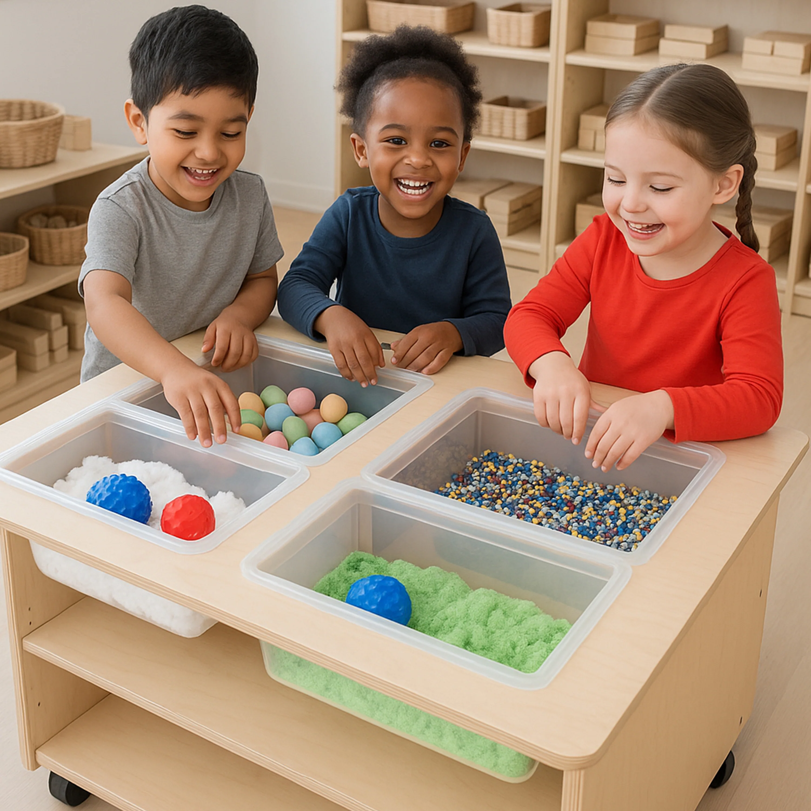
PSYCHOLOGY IN HEALTH AND SOCIAL CARE
Module Title: Psychology in Health and Social Care
Module code: LCHS4010
Assignment Title: Assessment 1: Individual
Presentation
Student Name: JANAT KICONCO
Student ID: 2426595
Lecturer’s Name: MUHAMMAD ALIYU

Slide 2
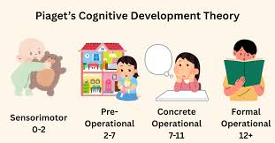
OVERVIEW OF THE THEORY

Slide 3
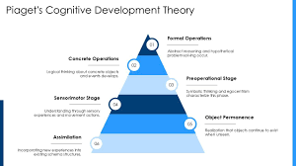
Introduction
This presentation uses Piaget’s Cognitive Development Theory to understand the needs of Amira, a three-year-old showing separation anxiety, limited speech, and difficulty joining group play.
The theory helps explain her development and guides strategies that support her early learning, social confidence, and emotional wellbeing within the nursery environment.

Slide 4
Cognitive Development Theory developed by Piaget
Piaget’s theory helps explain Amira’s behaviour.
Amira, age 3 - shows separation anxiety, limited speech, and avoids group play.
Supports strategies for learning, confidence, and wellbeing (Piaget, 1952).
Schemas (Goswami, 2001)
Assimilation (Berk, 2013)
Accommodation (Siegler, Deloache and Eisenberg, 2017)
Equilibration (Santrock, 2018)
Notes:
Piaget put forward a number of fundamental principles which explain how children construct their knowledge and make sense out of the world (Piaget, 1952). These principles describe the processes of cognitive growth and the reason why children below puberty do not think like adults.
a. Schemas
Mental structures that are employed to organise knowledge and interpret new experiences are called schemas. They assist the children in making decisions regarding what something is and how they should react to it (Goswami, 2001). The schemas at early childhood are simple and from firsthand experience which become more complicated as children grow.
b. Assimilation
Assimilation occurs when a child inserts some information into an already existing schema. Indicatively, a child, who is aware of what a dog is, might refer to all animals with four legs as dog. Assimilation allows the children to formulate fast sense of the world based on what they already have (Berk, 2013).
c. Accommodation
Accommodation is a process that takes place when a child modifies a schema, which is not effective. Whenever a child discovers that a cat is not a dog, he or she will modify the categories to have both. This process broadens the minds of children and makes them learn through experience (Siegler, Deloache and Eisenberg, 2017).
d. Equilibration
The balance that children strive to achieve among assimilation and accommodation is called equilibration. When they make sense of something they are in a state of disequilibrium which drives them to modify their thinking. Equilibration stimulates cognitive development and assists children to shift to more organized and logical thinking (Santrock, 2018).
e. Cognitive Development stages.
Piaget developed four stages which are universal. Amira is three years old, which is in the preoperational stage (2-7 years). The three hallmarks of this stage include symbolic thinking, language development, and pretend play. Egocentrism, lack of logical thinking, and the need to be seen instead of explained is also exhibited by children (Berk, 2013).
f. Egocentrism
The challenge faced by young children is known as egocentrism where a child is not able to view or look at the situation as seen by another individual. This influences their social relationships, sharing, taking turn as well as peer intentions understanding. The preoperational stage is natural and goes through the process of egocentrism which later diminishes as age and experience advance (Sanghvi, 2020).
g. Conservation and Centration.
Though these are more pronounced in older children, the ideas describe an early point of thinking. Centration It occurs when children concentrate on an aspect of something and neglect others. The reason behind this narrow attention is why young children have difficulties in rules, multi-step directions, and intricate reasoning (Pakpahan, 2022).

Slide 5
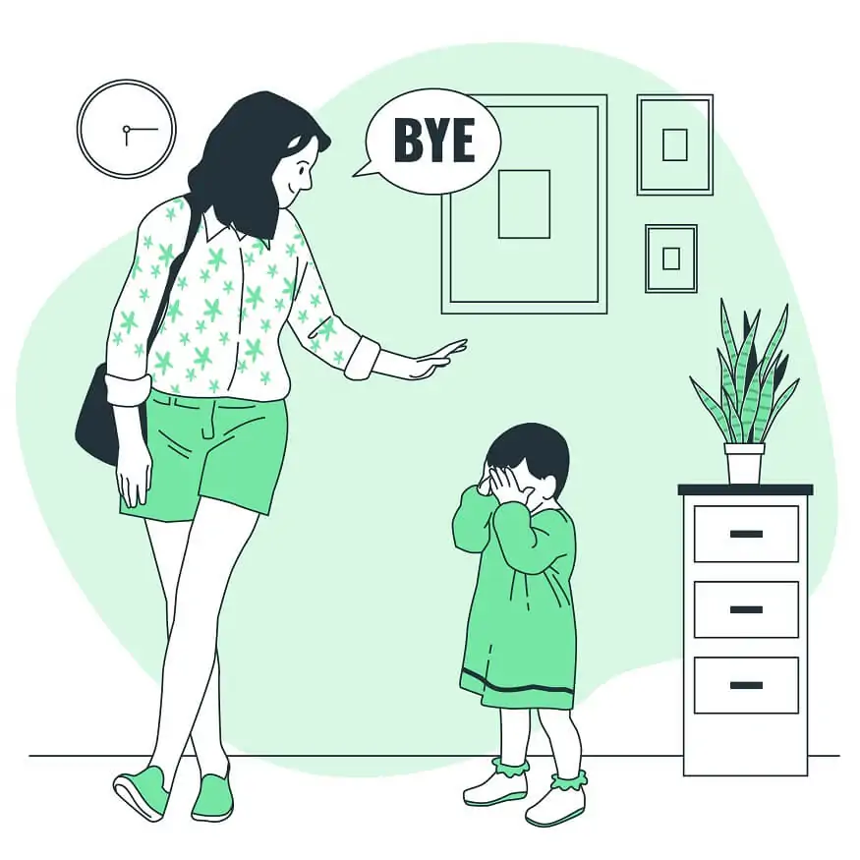
Using the Piaget Theory to explain the Behaviour exhibited by Amira.
Limited speech - Underdeveloped symbolic thinking affects interaction (Malik, 2023).
Separation anxiety - Can’t grasp time or future events (Santrock, 2018).
Play difficulties - Egocentrism and low communication limit social ability (Siegler et al., 2017).
Separation anxiety (Santrock, 2018)
Notes:
The experiences of Amira are quite in line with the preoperational stage proposed by Piaget. Her verbal communication is limited, which implies that she still has not developed her symbolic thinking, which impacts her object labeling, need expression, and the ability to engage in social play (Malik, 2023). Language is a crucial element of group interaction among children and thus lack of strength in symbolic skills may cause the withdrawal of the child in the course of play.
Her separation anxiety displays the inability of young children to conceptualize time and foresee the future. Piaget maintained that the reasoning of kids at this stage is concrete. Amira might not be capable of thinking that her carers would not fail to come back when they drive away (Santrock, 2018). This complicates the practice of transitions.
The inability to play with other children can also be explained using the concept of egocentrism. She might not be able to read the intentions of other people or to modify her behaviour to suit group norms. Lack of language is one more obstacle that complicates the process of negotiating, sharing, or playing with others (Siegler, Deloache and Eisenberg, 2017).
The principles of Piaget demonstrate that the behaviours demonstrated by Amira are not the evidence of failure but the normal patterns of early thought and communication. Knowledge of this assists practitioners to arrange aid that is corresponding to her intellectual level.

Slide 6
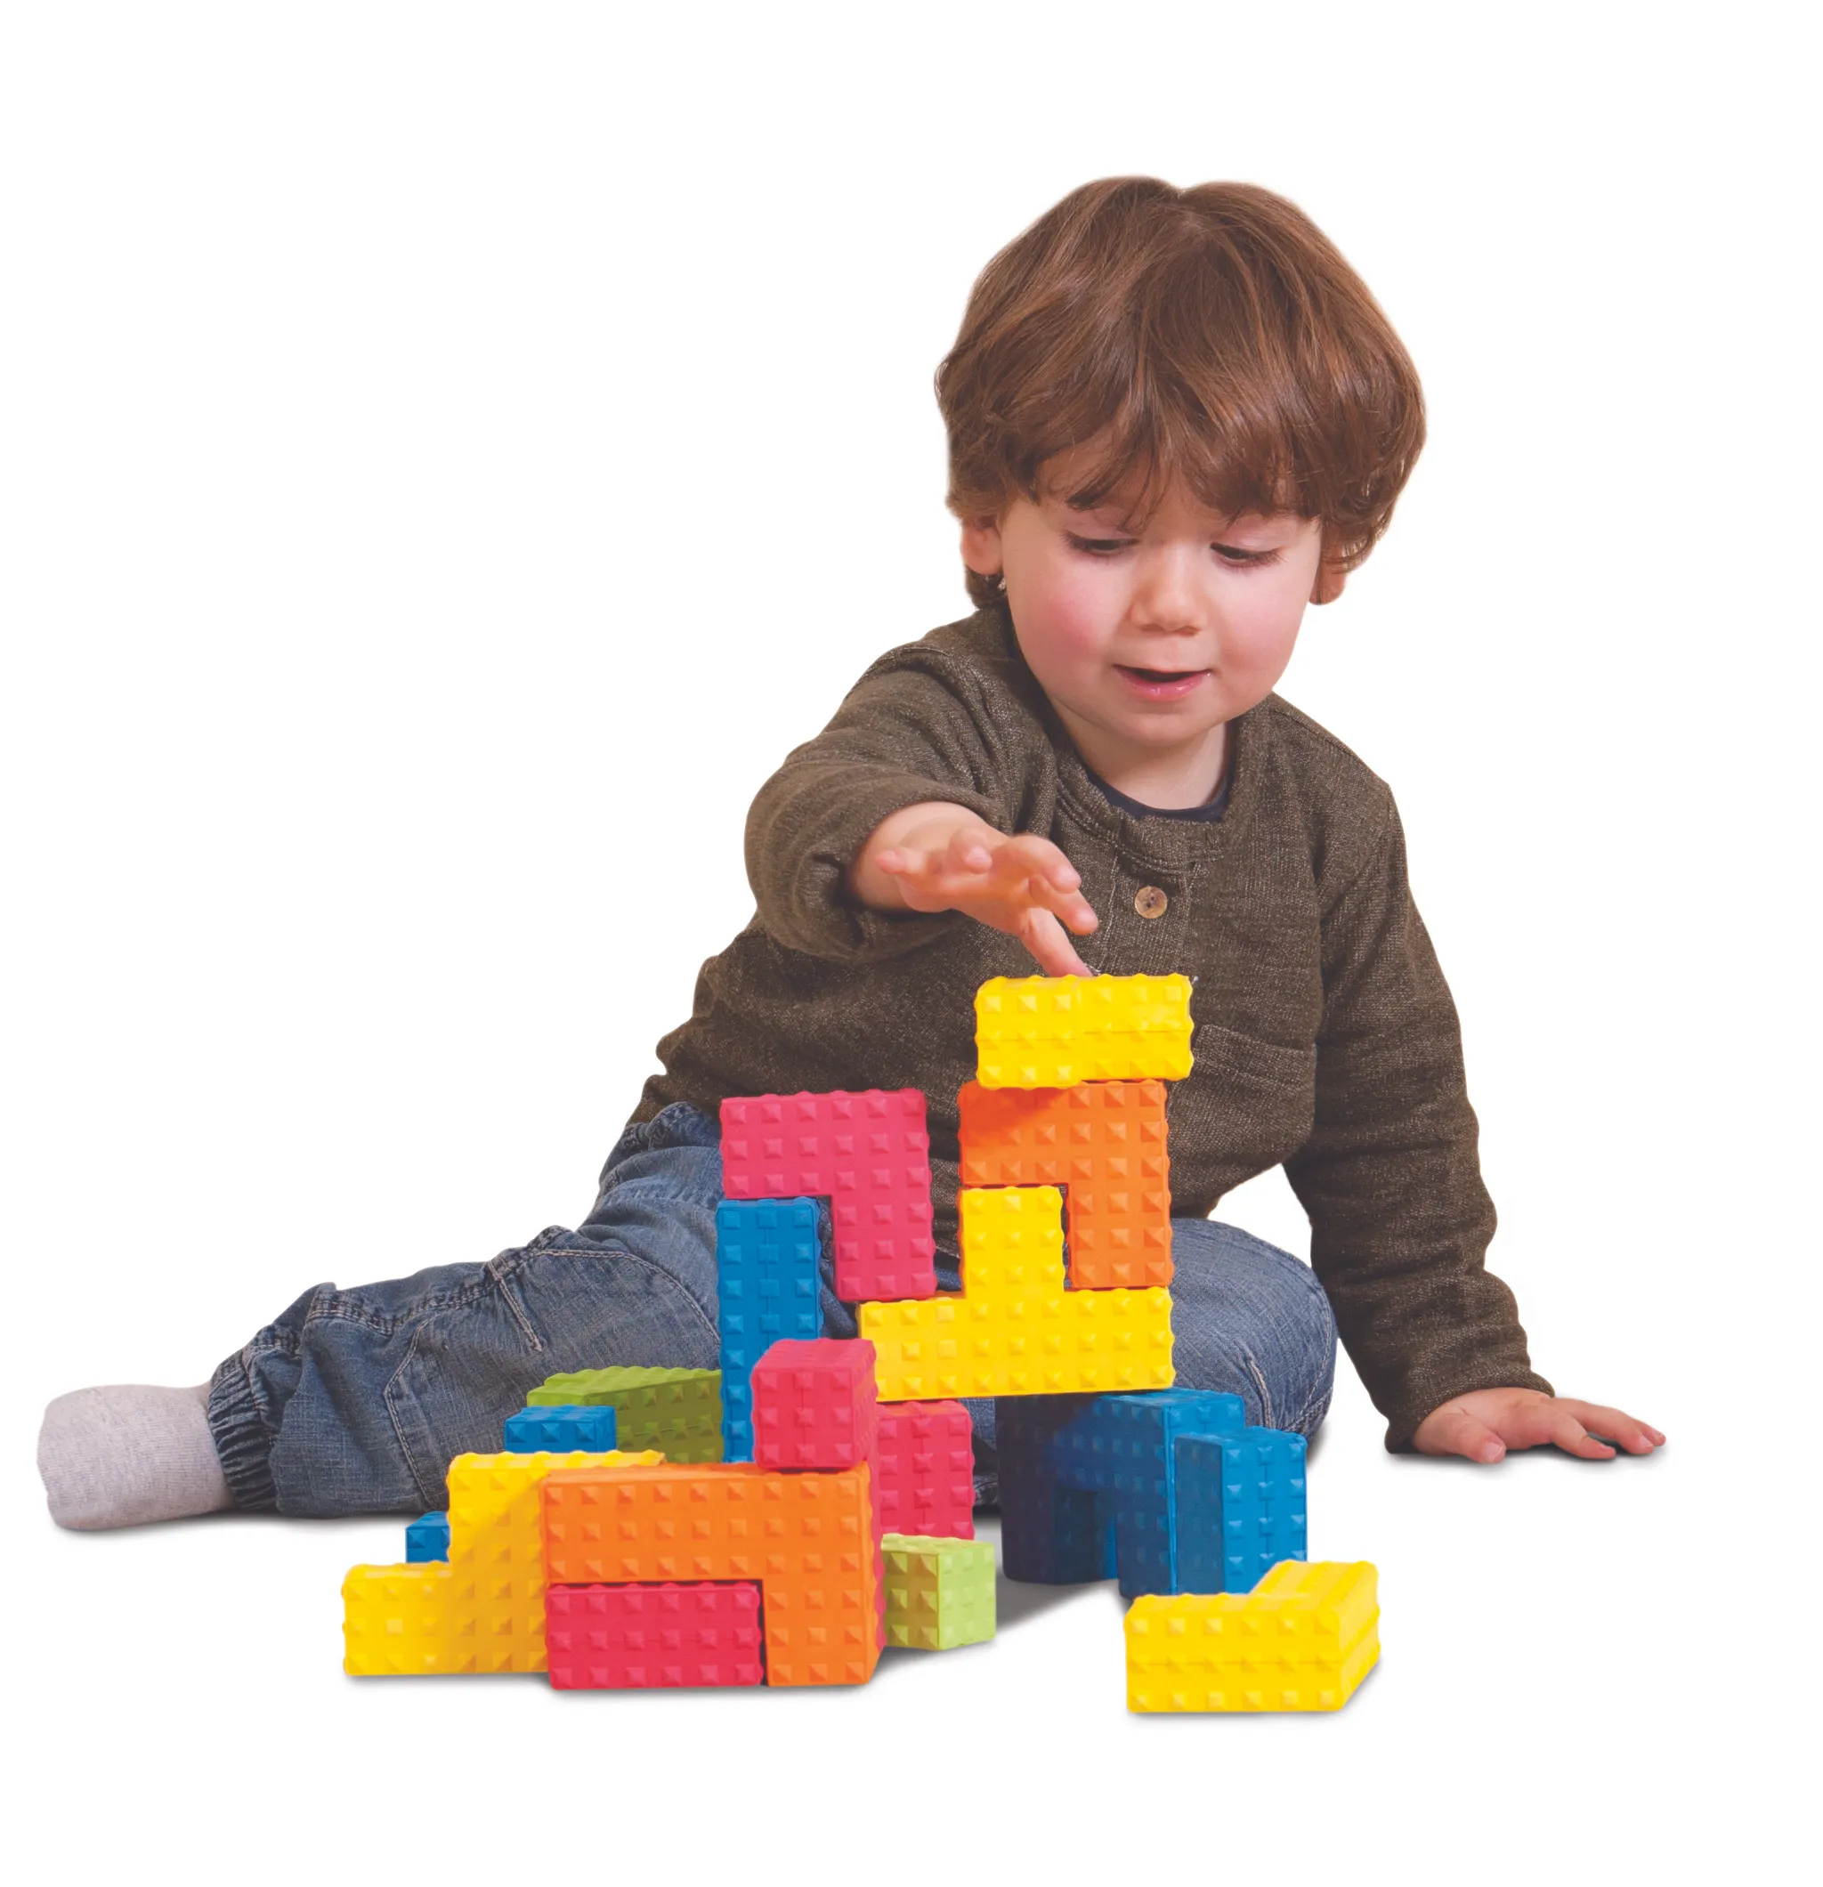
Strategies and Interventions on the Piaget Theory.
Concrete play (Berk, 2013)
Symbolic play (Pakpahan, 2022)
Language modelling (Malik, 2023)
Routines (Malik, 2023)
Guided play (Siegler, Deloache and Eisenberg, 2017)
Sorting exercises (Berk, 2013).
Notes:
Hands-on, concrete learning
Present puzzles, blocks, sensory trays, and sorting exercises which assist Amira in schema formation and problem solving. Active exploration endorses assimilation and accommodation (Berk, 2013).
Enhancing symbolic reasoning.
Pretend play, storytelling, role-play and puppets. Simple language in play. Symbolic activity faciltates cognitive and language development (Pakpahan, 2022).
Reinforcement and language modelling.
Short sentences, repeating important words, describing actions. Provide one-to-one and small group communication to develop confidence and communication (Malik, 2023).
Routine, habitual practices.
Visual schedules and obvious signals. Predictability also assists in diffusing anxiety as it provides structure to the things that children are not yet able to reason about (Santrock, 2018).
Guided social play
Encourage early social skills through demonstration of turn-taking, labeling of emotions and simple cooperation. Minimize the role of adults slowly as Amira becomes more confident (Siegler, Deloache and Eisenberg, 2017).
All these strategies are indicative of the active learning, symbolic support and matching expectations to a child stage of development, which Piaget stresses upon.

Slide 7

Biological and Environmental Influences (Nature and Nurture)
Biological
Temperament
language development pace.
Environmental
Family routines
emotional security
language exposure
(Goswami, 2001).
Notes:
Piaget was willing to believe that biological maturation and experience to the environment cooperate in the development of cognition. In the case of Amira, biological variables can be in the form of temperament or inherent language speed. The environmental factors consist of the past social experience, language exposure to vivid language, emotional safety, and family practices (Goswami, 2001). The awareness of both assists practitioners to help her in a holistic manner (Piaget, 1952).

Slide 8
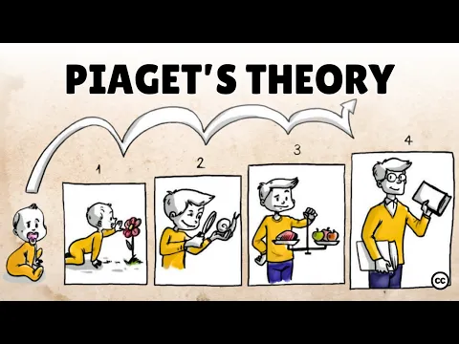
Critical Analysis of the Piaget Theory.
Strength - Key for early education practice (Berk, 2013).
Limits - Misses emotional, cultural variation; underestimates ability (Cerovac, 2025).
Still a strong tool for understanding Amira.
(Piaget, 1952)
Notes:
The theory by Piaget is fundamental and has a lot of explanations of early thinking. It has been a significant influence of the early childhood education and is still applicable in practice (Berk, 2013). This, however, is criticized by the fact that he underestimated the abilities of young children and later studies indicate that there is more social and cultural variation than his stages do (Cerovac, 2025). The theory also isn't very sensitive to the development of emotion that is crucial when explaining such behaviours like the ones of separation anxiety (Sanghvi, 2020). Nonetheless, Piaget offers a good cognitive model to use when comprehending Amira and how to respond to her.

Slide 9
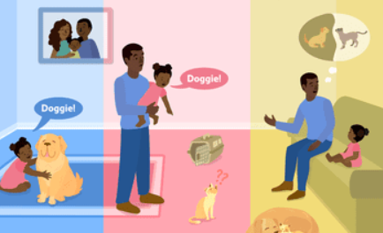
Conclusion
Children learn by doing - not by logic alone.
Piaget helps explain Amira’s needs and behaviours.
Supports active, guided, play-based learning with realistic expectations
Notes:
The theory describe the way young children learn by means of exploration, the inconsistency in their thought processes, and the slow and stage-by-stage development of their understanding. They demonstrate that early age education must be based on practical experiences, straightforward explanations, modeling, and symbolical play.
Piaget is useful in explaining the communication needs of Amira, social challenges and separation anxiety through demonstrating how young children reason and learn. His theory favors the application of direct, figurative and guided experiences which minimize the amount of stress and develop confidence. However, in spite of certain limitations, the theory is of great value in the practice in early years.

Slide 10
References
Berk, L.E. (2013) Child Development. 9th ed. London: Pearson.
Cerovac, M. (2025) ‘Early insights into Piaget’s cognitive development model’, International Journal of Technology and Design Education, 35(1), pp. 1–15.
Goswami, U. (2001) Cognition in Children: From Piaget to Educational Neuroscience. Hove: Psychology Press.
Malik, F. (2023) ‘Cognitive development’, StatPearls, pp. 1–12.
Pakpahan, F.H. (2022) ‘Theory of cognitive development by Jean Piaget’, Journal of Arts and Letters, 3(2), pp. 45–52.
Piaget, J. (1952) The Origins of Intelligence in Children. London: Routledge and Kegan Paul.
Santrock, J.W. (2018) Lifespan Development. 16th ed. New York: McGraw-Hill Education.
Sanghvi, P. (2020) ‘Piaget’s theory of cognitive development: a review’, Indian Journal of Mental Health, 7(2), pp. 213–220.
Siegler, R., Deloache, J. and Eisenberg, N. (2017) How Children Develop. 5th ed. New York: Worth Publishers.
Tosolini, K.E. et al. (2025) ‘A Piagetian lens on cognitive development of children and youths with congenital deafblindness’, Frontiers in Education, 10, pp. 1–12.
Notes:
The theory describe the way young children learn by means of exploration, the inconsistency in their thought processes, and the slow and stage-by-stage development of their understanding. They demonstrate that early age education must be based on practical experiences, straightforward explanations, modeling, and symbolical play.
Piaget is useful in explaining the communication needs of Amira, social challenges and separation anxiety through demonstrating how young children reason and learn. His theory favors the application of direct, figurative and guided experiences which minimize the amount of stress and develop confidence. However, in spite of certain limitations, the theory is of great value in the practice in early years.

