Slide 1
The Starting Point
Like many projects, ours began with a broad idea that was difficult to define. We initially called it “D-MAN Data Solution” from the project idea we chose show bellow. The project covered several areas, including:
1. Building infrastructure
2. Access control
3. Cybersecurity
4. An AI enhancement platform
5. And more
Smart Home/Office solution:
Design and implement a fully autonomous building using AI. Use Machine/Deep learning torecognise patterns of behaviour for better management of lighting, heating, security, appliance, etc. For office solution, should include track, access and secure employee attendance using biometric (fingerprint, facial, etc)
To make the project’s goal clearer and more specific, we refined the original idea of an “office solution” and named it D-MAN OfficeSense.

Slide 2
Welcome To
OfficeSense: Smart Office Monitoring And Energy-Optimisation Platform
Smart Office Solution
Project Name: D-MAN OfficeSense

Slide 3
Goal Discussion
Energy Efficiency Challenges Facing Offices
Commercial Energy Waste: Modern office buildings can waste up to 30% of their lighting and HVAC (heating, ventilation, and air conditioning) energy by conditioning unoccupied spaces.
Disconnected Building Systems: Isolated sensors, manual spreadsheets, and delayed utility reports make proactive facility management difficult.
Late Alerts and Slow Responses: Critical issues such as HVAC failures, elevated CO₂ levels, or server-room overheating may go unnoticed until occupants report them.
The Goal: Create a centralized, human-in-the-loop operations dashboard that delivers real-time zone insights, quickly flags anomalies, and offers AI-assisted energy recommendations.
Notes:
Speaker Notes: "Commercial real estate is experiencing massive energy wastage. Lights and air conditioning remain active in empty meeting rooms, while facilities operators lack unified tools to see real-time zone health. OfficeSense bridges this gap by turning sensor data into actionable insights and quantifiable energy savings without sacrificing human safety or comfort."

Slide 4



Means Of Communications
Project Coordination
Use MS Teams for weekly meetings and communication.
Use OneDrive or SharePoint for shared documents and meeting notes.
WhatsApp for noting inversion ideas
Mohamad

Slide 5
Team Formation And Means Of Communications
Team member | Role(s) | Areas of responsibility
David | Prototype lead; Design/testing lead; Security/privacy lead | Build and integrate the prototype; define requirements and run tests; review privacy, security and ethical risks; maintain synthetic data and fictional credentials; contribute to the risk register and threat analysis.
Mohamad | Project Coordinator | Coordinate meetings, tasks, deadlines, notes, decisions, risks and project integration.
Adefemi | Research lead | Find and verify sources; compare existing approaches; research smart buildings, occupancy prediction, privacy, security and accessibility; support the project gap and recommendations.
Narcis | Presentation lead | Organise slides and speaking roles; prepare the prototype demonstration; check claims and visuals; coordinate timed rehearsals.

Slide 6
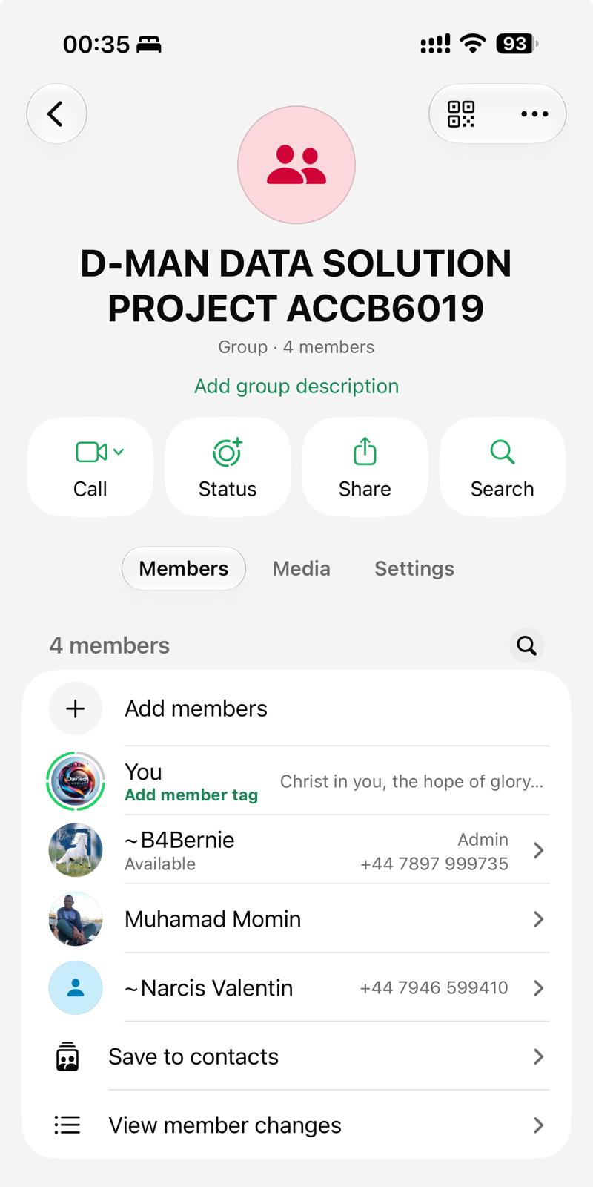
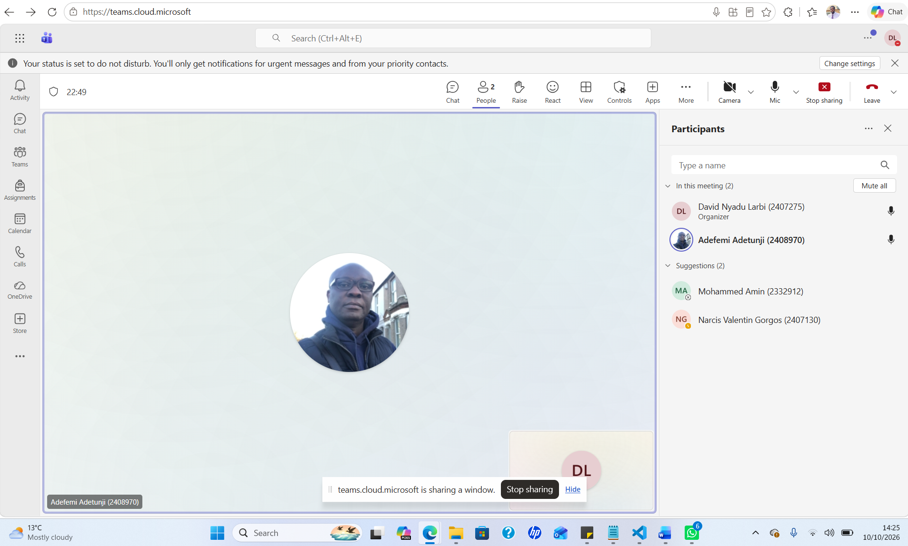
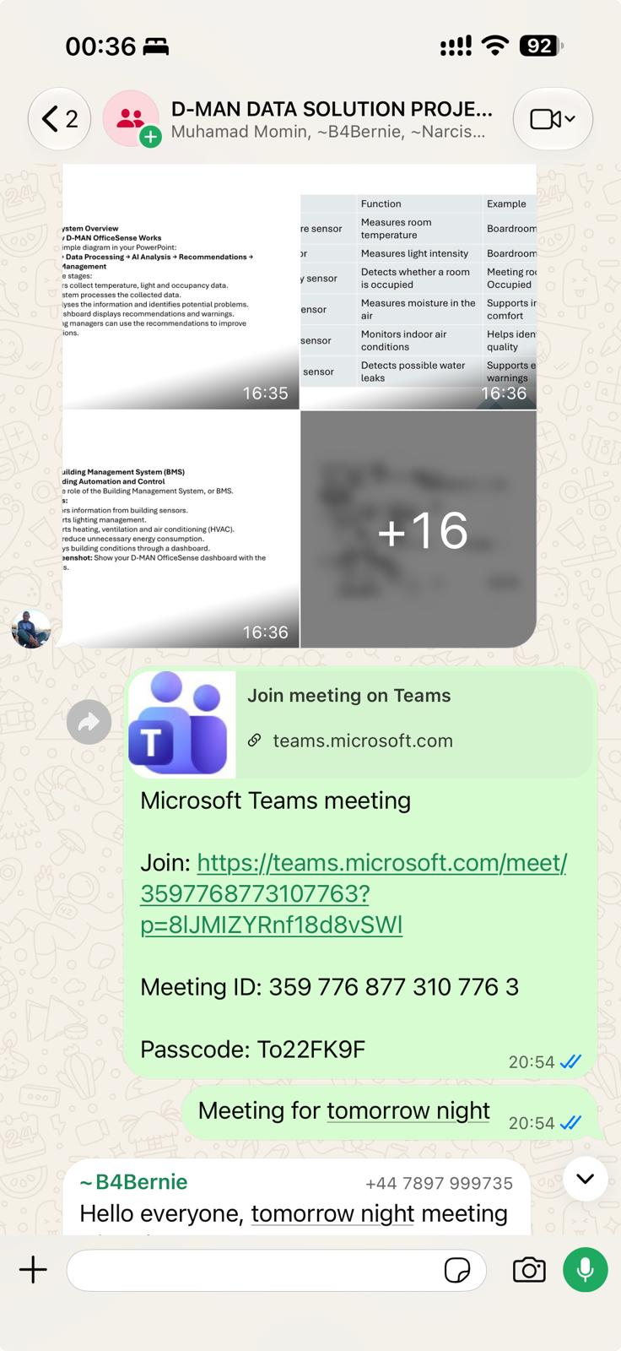
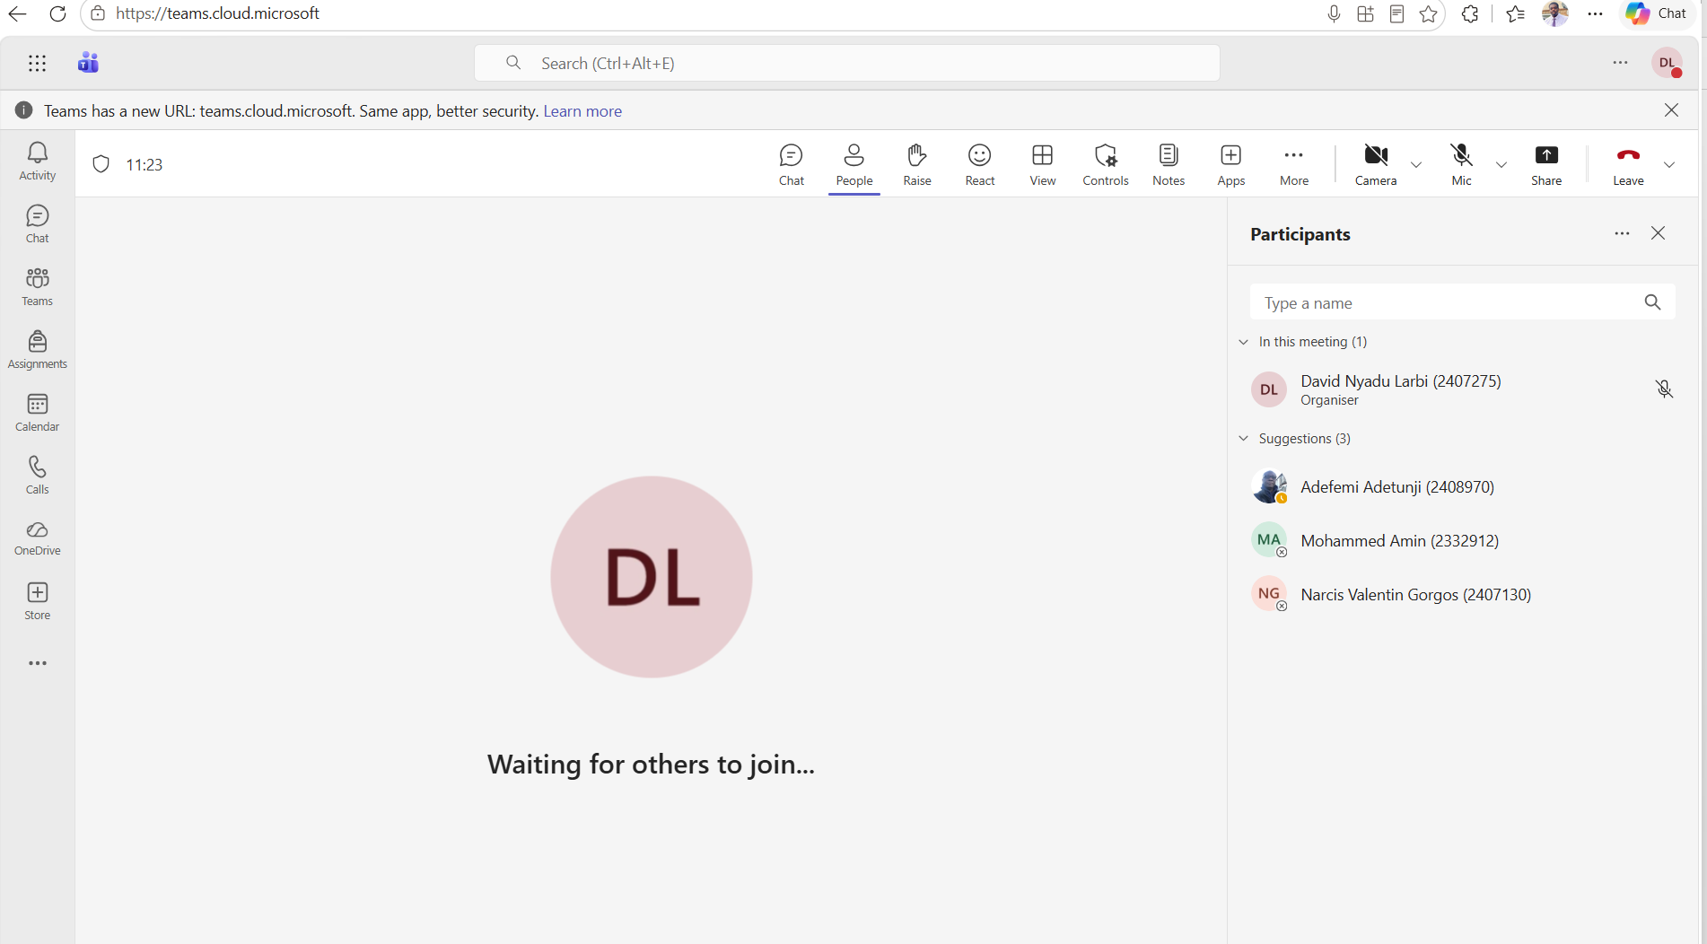
Proof of Communication

Slide 7
Research Lead
Adefemi

Slide 8
What is a smart office?
A smart office combines building sensors, connected systems and data analytics to adapt workplace conditions and operations to actual needs.
SENSOR
AI & ML
AUTOMATIC RECOMADATION
Measure temperature, humidity, light, air quality, energy use, equipment status and space occupancy.
Combine sensor streams; identify patterns, unusual conditions and likely demands.
Recommend or automate lighting, HVAC, maintenance tasks and space planning—with human override.
Scope: May include office floors, meeting rooms, open-plan zones, reception, shared facilities and plant/equipment rooms.

Slide 9
Research Approach: MoSCoW research method
MUST HAVE • Centralised dashboard
MUST HAVE • Real-time zone insights
One view of building status, energy use and alerts.
Monitor temperature, humidity, occupancy, CO₂, lighting and energy use.
MUST HAVE • Anomaly alerts
MUST HAVE • Harmonised data
Flag unusual readings, HVAC faults, high CO₂ or abnormal energy use.
Combine sensor and building-system data using consistent units, timestamps and zone IDs.
SHOULD HAVE • AI recommendations
COULD HAVE • Energy insights & reports
Suggest energy-saving actions and explain expected impact.
Trends, comparisons, configurable thresholds and scheduled reports.
MVP rule: deliver the four “Must Have” capabilities first; introduce recommendations only after sensor quality and governance are proven.

Slide 10

Prototype lead
David

Slide 11

Technology Stack
Python: Handles the prototype’s data processing and application logic.
Streamlit: Builds the interactive dashboard for viewing room conditions and recommendations.
scikit-learn: Creates a simple model to predict room occupancy using synthetic data.
Pandas: Organizes and displays sensor readings and test results.
SQLite: Stores fictional access-event records.
Visual Design
Dark navy and teal colour scheme for clear, modern dashboard.
Three areas
1. IoT Telemetry: Displays simulated sensor readings, such as occupancy, temperature, and light levels.
2. Predictive AI: Shows the occupancy prediction and explains the energy-saving recommendation.
3. Facilities Operations: Gives facilities staff a way to review alerts, manage recommendations, and use manual overrides.
Technology Stack
Visual Design
Three Areas
Notes:
Speaker Notes: "Good morning everyone. Today, I am presenting OfficeSense — a centralised facility management and smart-office intelligence platform. OfficeSense combines real-time environmental telemetry, rule-based alarm lifecycle management, and predictive machine learning to help facility managers reduce energy waste while maintaining optimal occupant comfort."

Slide 12
Controller Dashboard
Text
Text
Text
Text
Text
Text
Text
Text
Text
Text
Text
Text
Text
Text
Text
Text

Slide 13
How the System Works
Operations Centre
Zone & Room Management
Predictive Analytics & ML
Alarms & Lifecycle
Schedules & Access Management
Historical Telemetry & Analytics
AI Energy & Policy Simulator
Each system sends its progress updates to the central system.

Slide 14
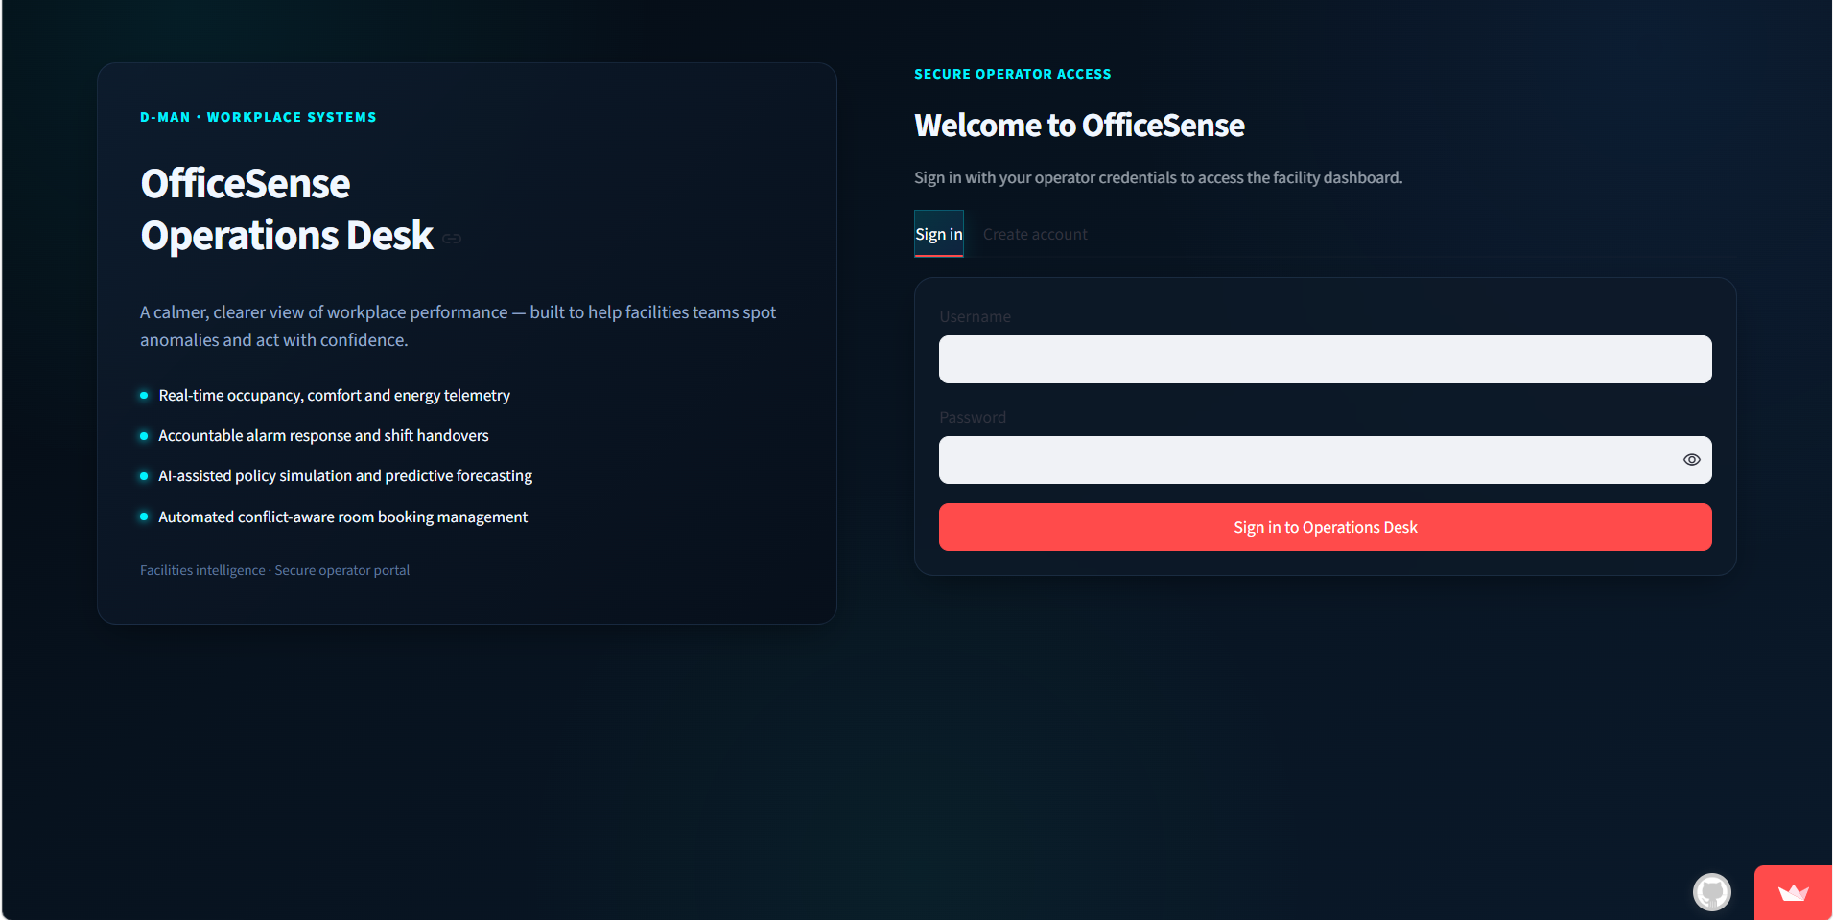
Sign In

Slide 15
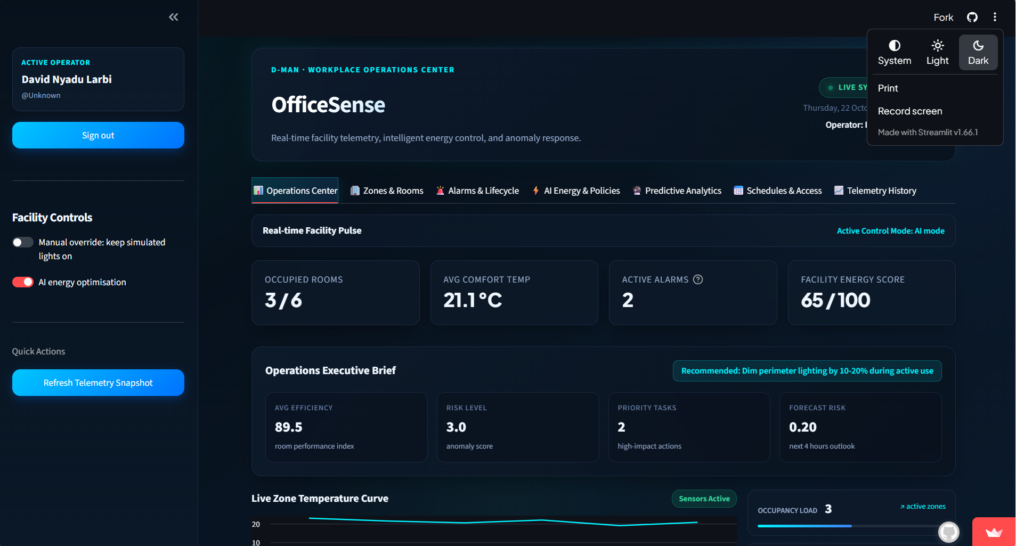
Operating Centre Dashboard

Slide 16

Presentation lead
Narcis

Slide 17
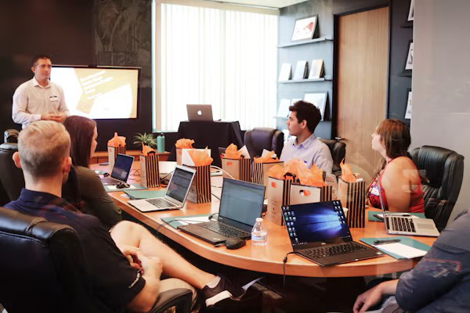


Coordinate presentation slides
Schedule Time frame for each team member
How a team member should start and end his or her presentation
Note down short coming of each team member
Closing remarks

Slide 18
References and research sources
• [1] Supplied research survey, “Sensing and Activity Recognition in Smart Building Environments,” ACM Computing Surveys, DOI: 10.1145/3596600. Source file supplied with this task; includes review of 137 papers.
• [2] Information Commissioner’s Office (ICO), “Data protection and monitoring workers,” UK GDPR guidance. Available: https://ico.org.uk/for-organisations/uk-gdpr-guidance-and-resources/employment/monitoring-workers/data-protection-and-monitoring-workers/
• [3] M. J. Fagan, K. N. Megas, K. Scarfone, and M. Smith, “IoT Device Cybersecurity Capability Core Baseline,” NISTIR 8259A, National Institute of Standards and Technology, May 2020. DOI: 10.6028/NIST.IR.8259A.
• [4] NIST, “NISTIR 8259 Series: Internet of Things Cybersecurity,” updated May 14, 2026. Available: https://www.nist.gov/itl/applied-cybersecurity/nist-cybersecurity-iot-program/nistir-8259-series
• [5] User-provided Smart Office MoSCoW requirements image: centralised dashboard, real-time zone insights, anomaly alerts, harmonised data, AI recommendations, energy insights/reports and custom settings.

