Slide 1
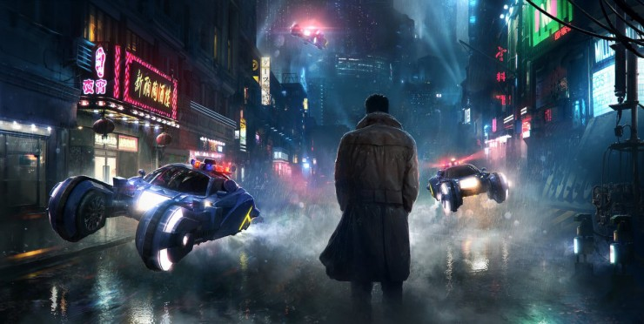


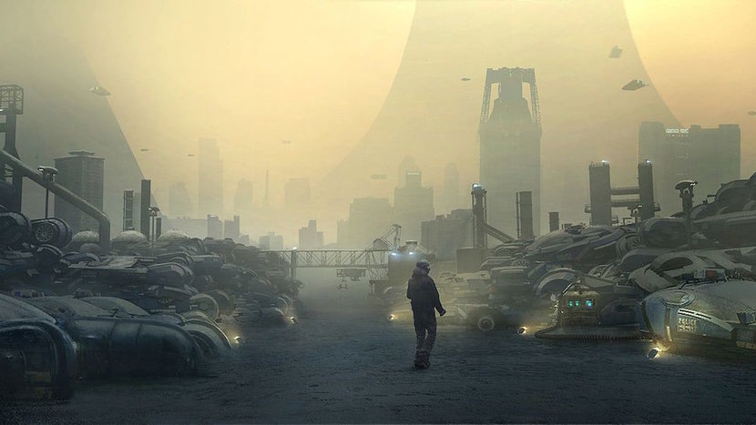

SCI-FI INSPIRED ELECTRIC MOTOCYCLE
PROJECT RATIONALE / DESCRIPTION :
My rationale for this project is that I wanted to take a risk and do something new that I’ve not yet attempted to design. I understand the importance of having variety in my portfolio and therefore I saw this as a great opportunity to design a motorcycle.
There have been lots of electric motorcycle projects emerging lately that have a focus on practicality and a future movement towards compact mobility. Although these concepts are great, I feel like the design can sometimes become restricted to something too conventional.
I wanted to create something futuristic and sci-fi inspired and focus on creating an unconventional design to stand out from the crowd.

Slide 2
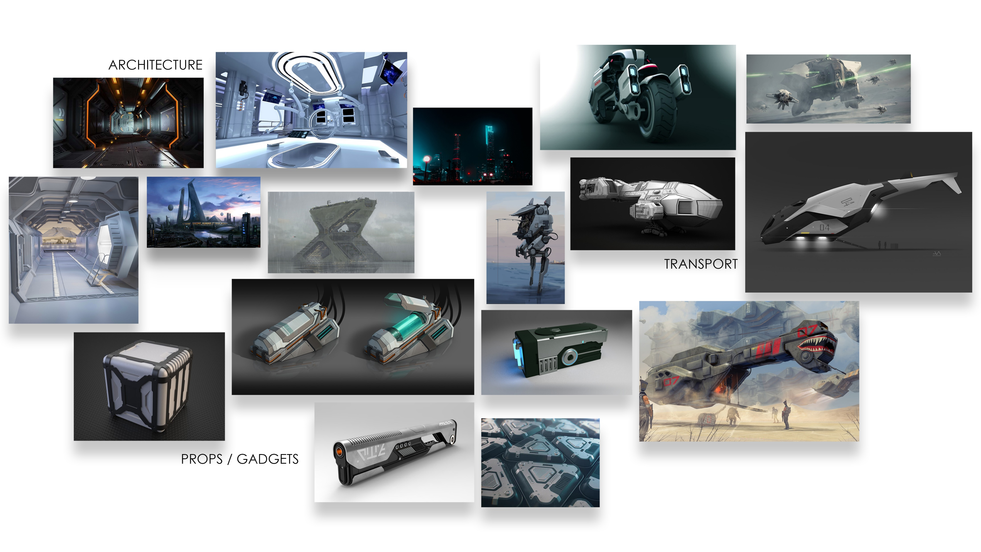

Slide 3
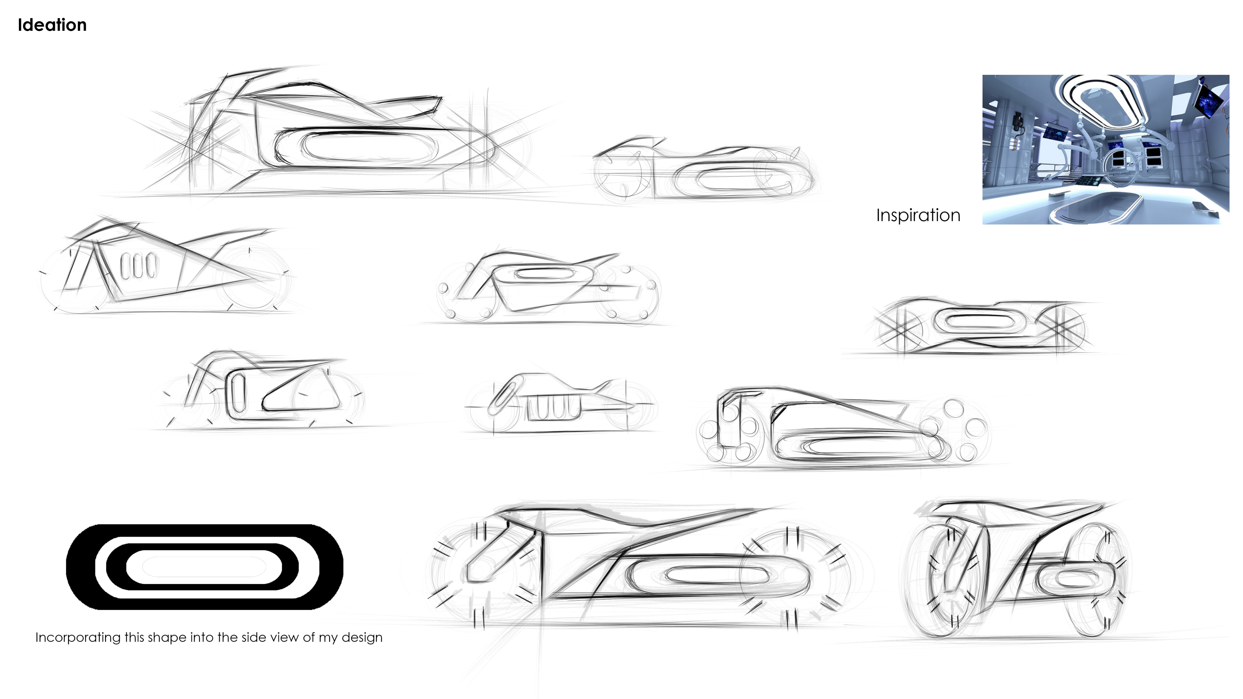

Slide 4
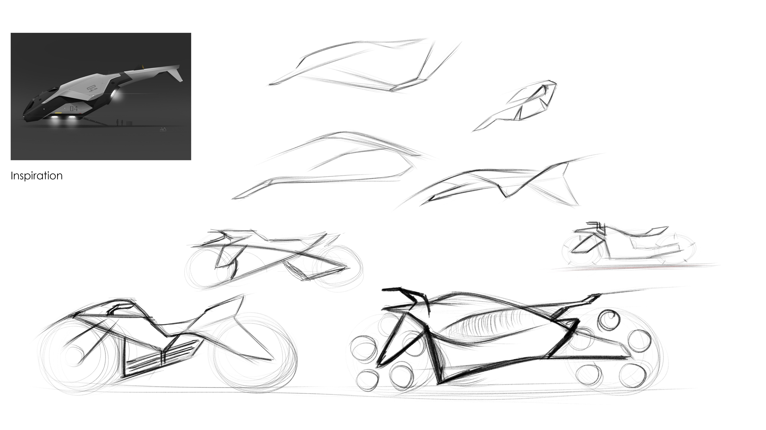

Slide 5
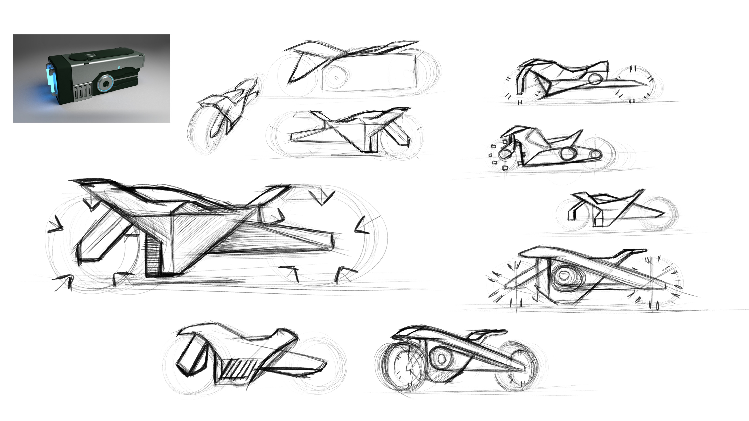

Slide 6
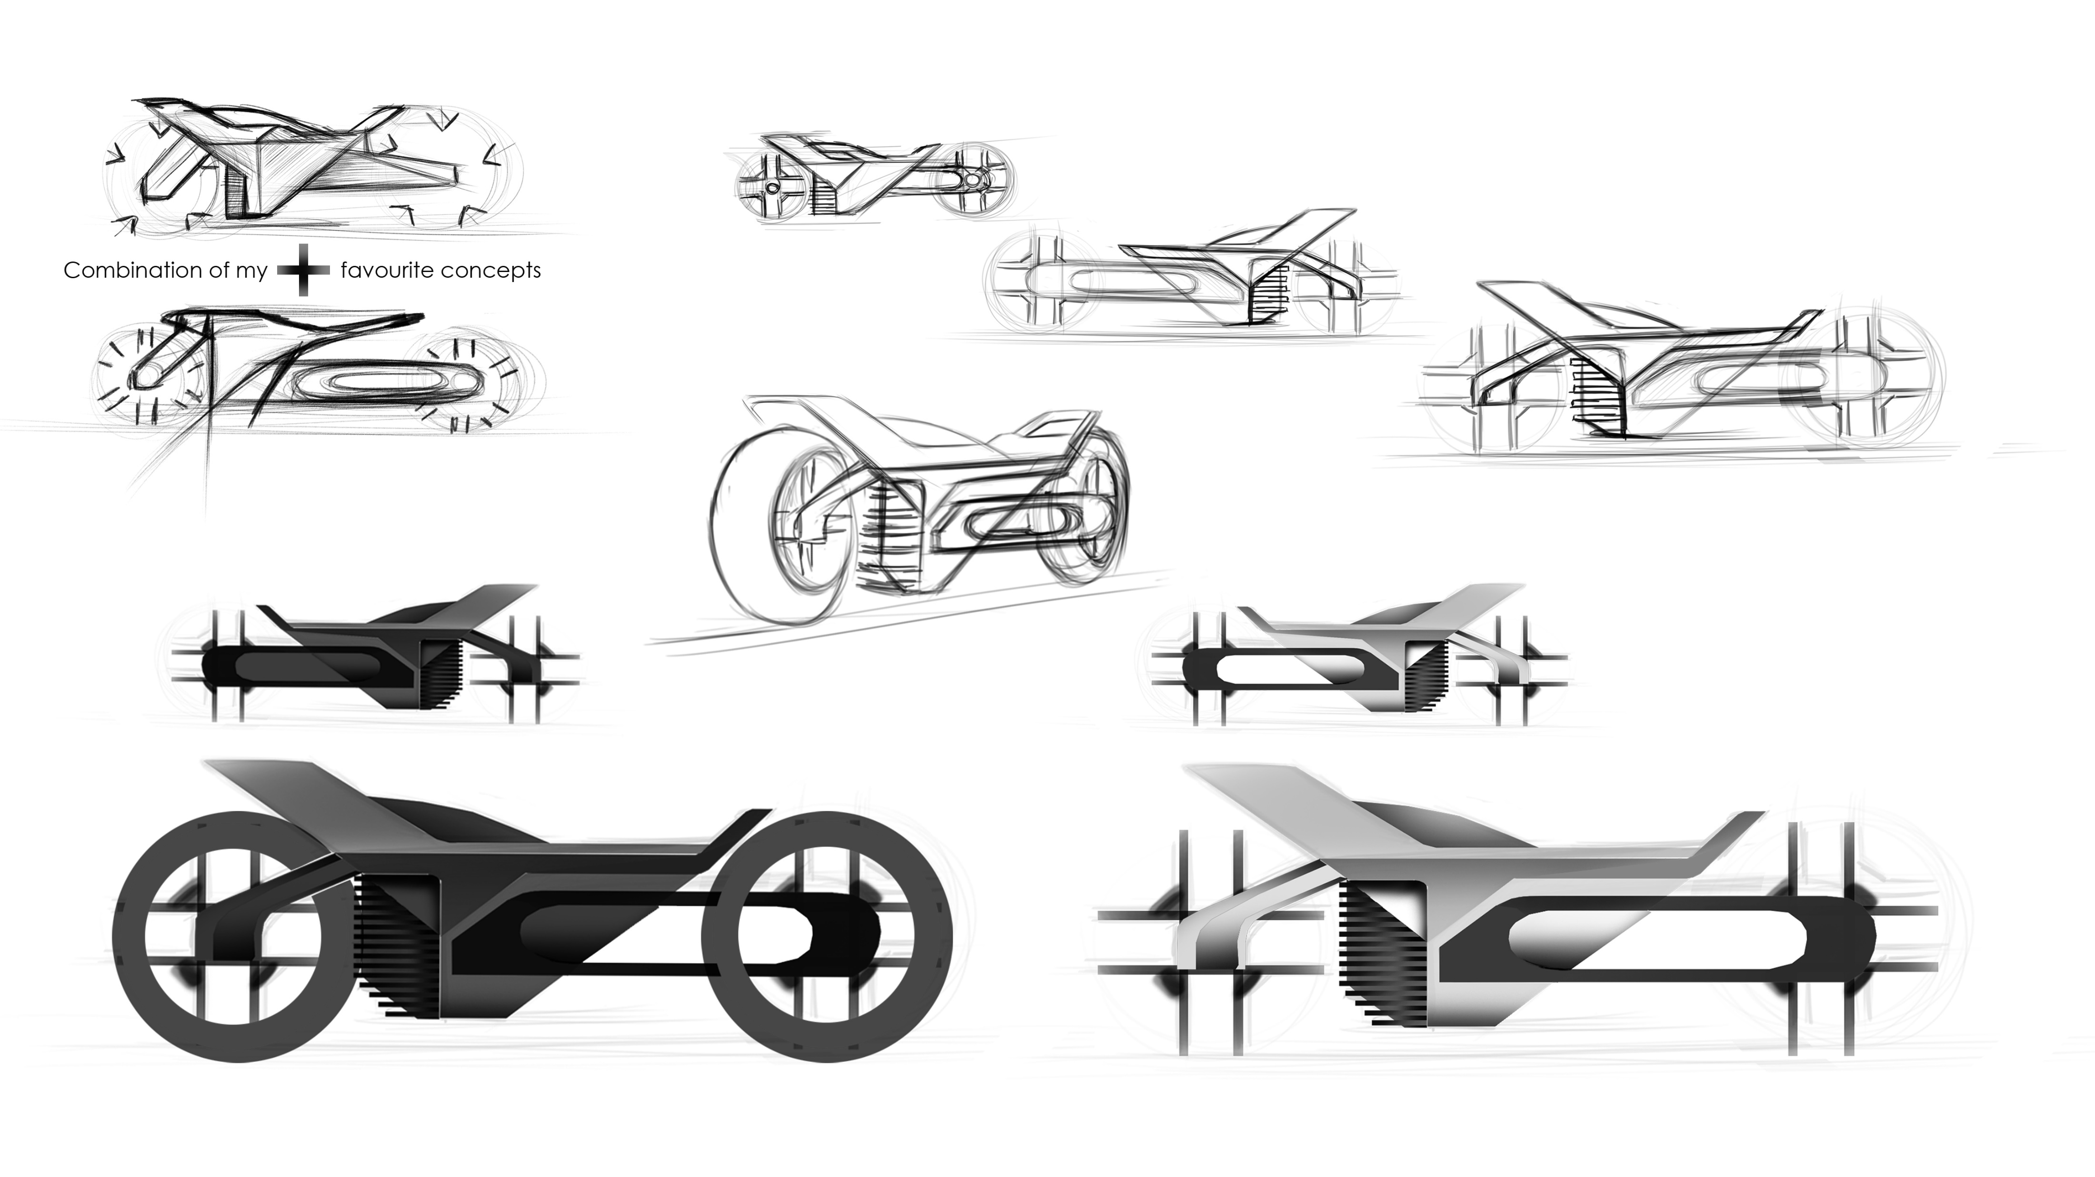

Slide 7
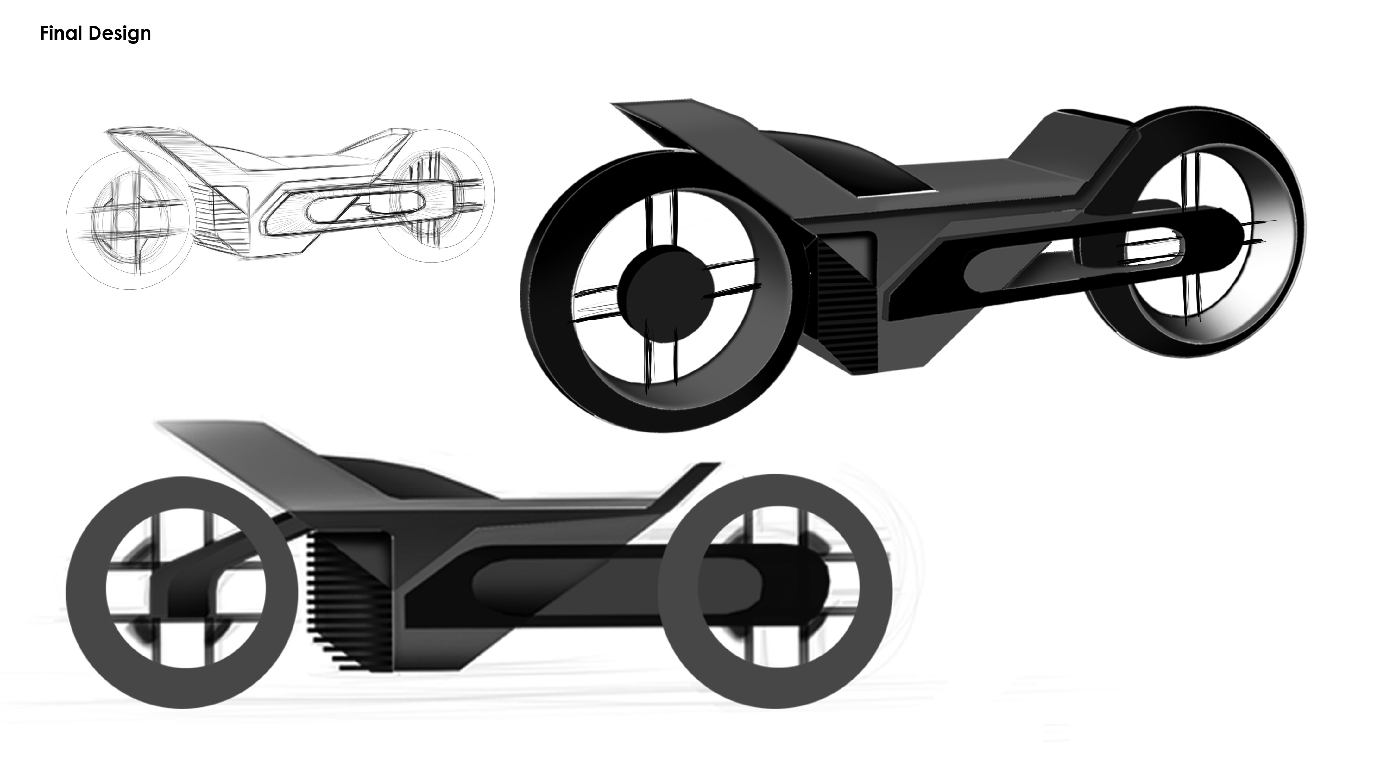

Slide 8
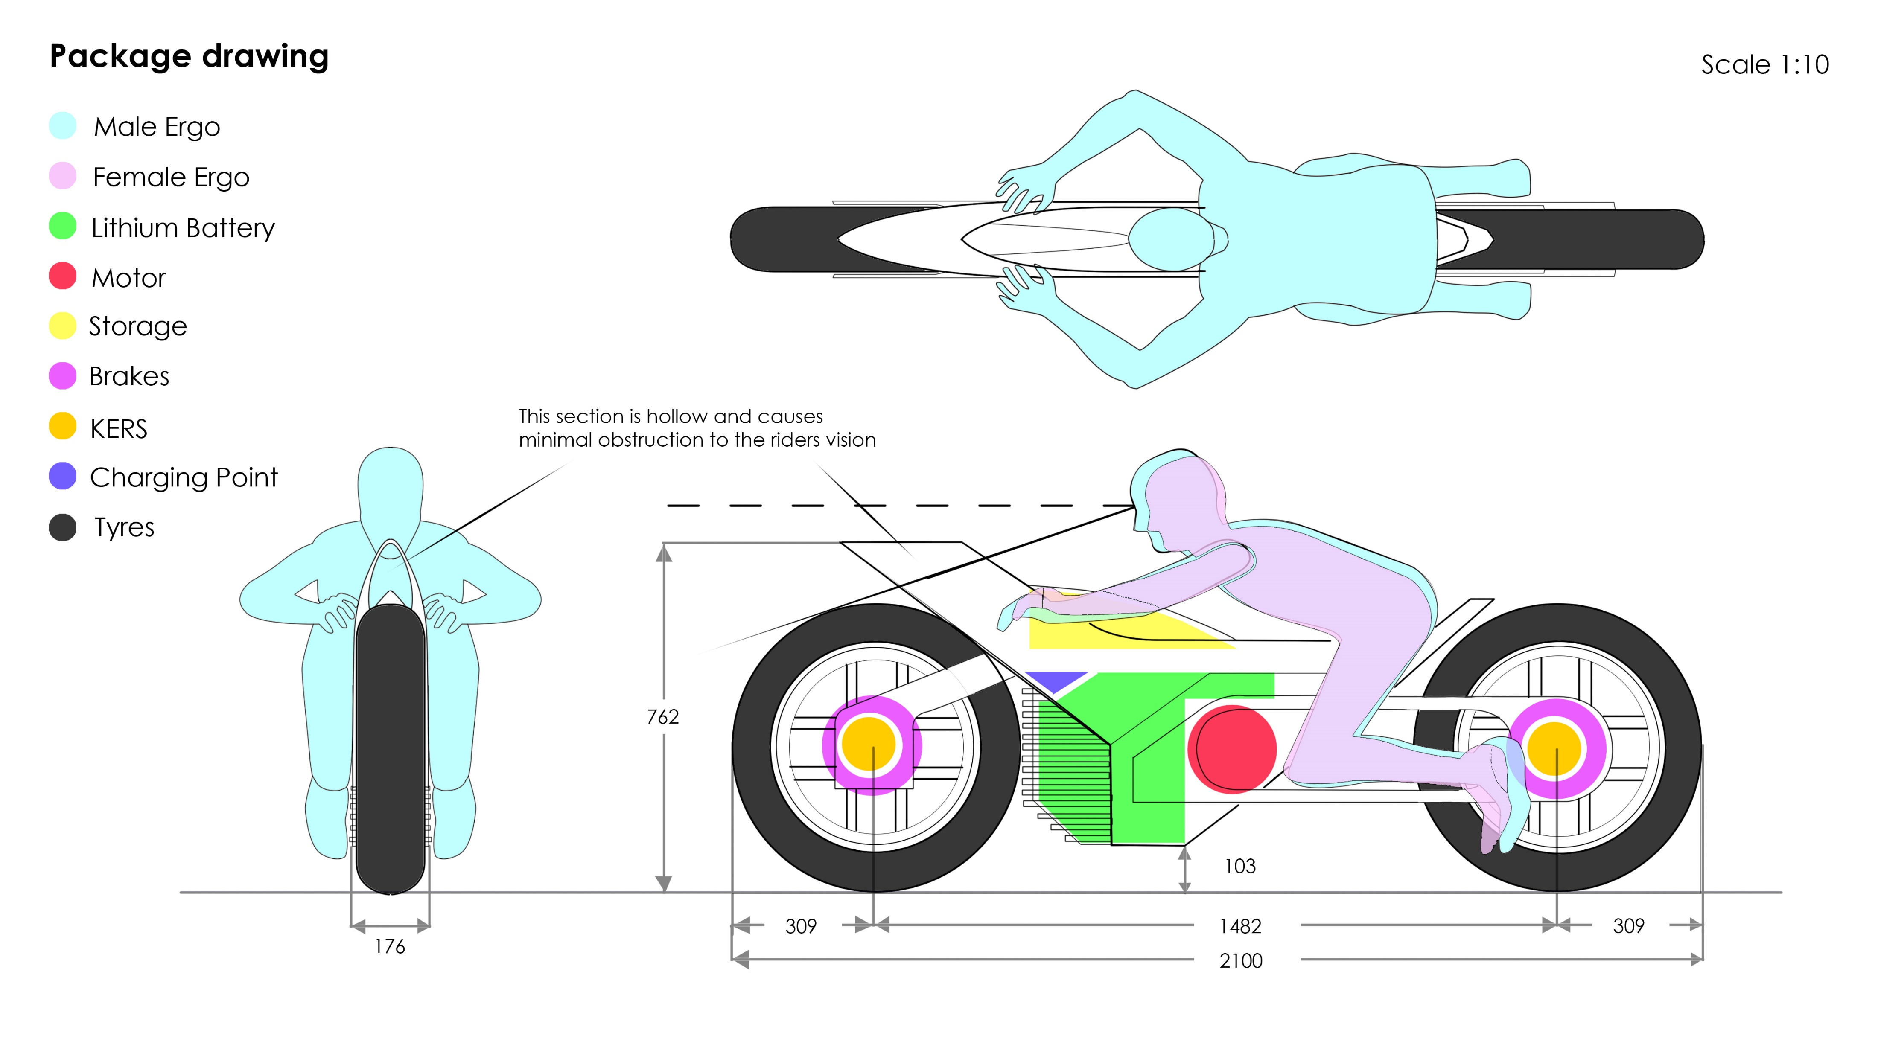

Slide 9
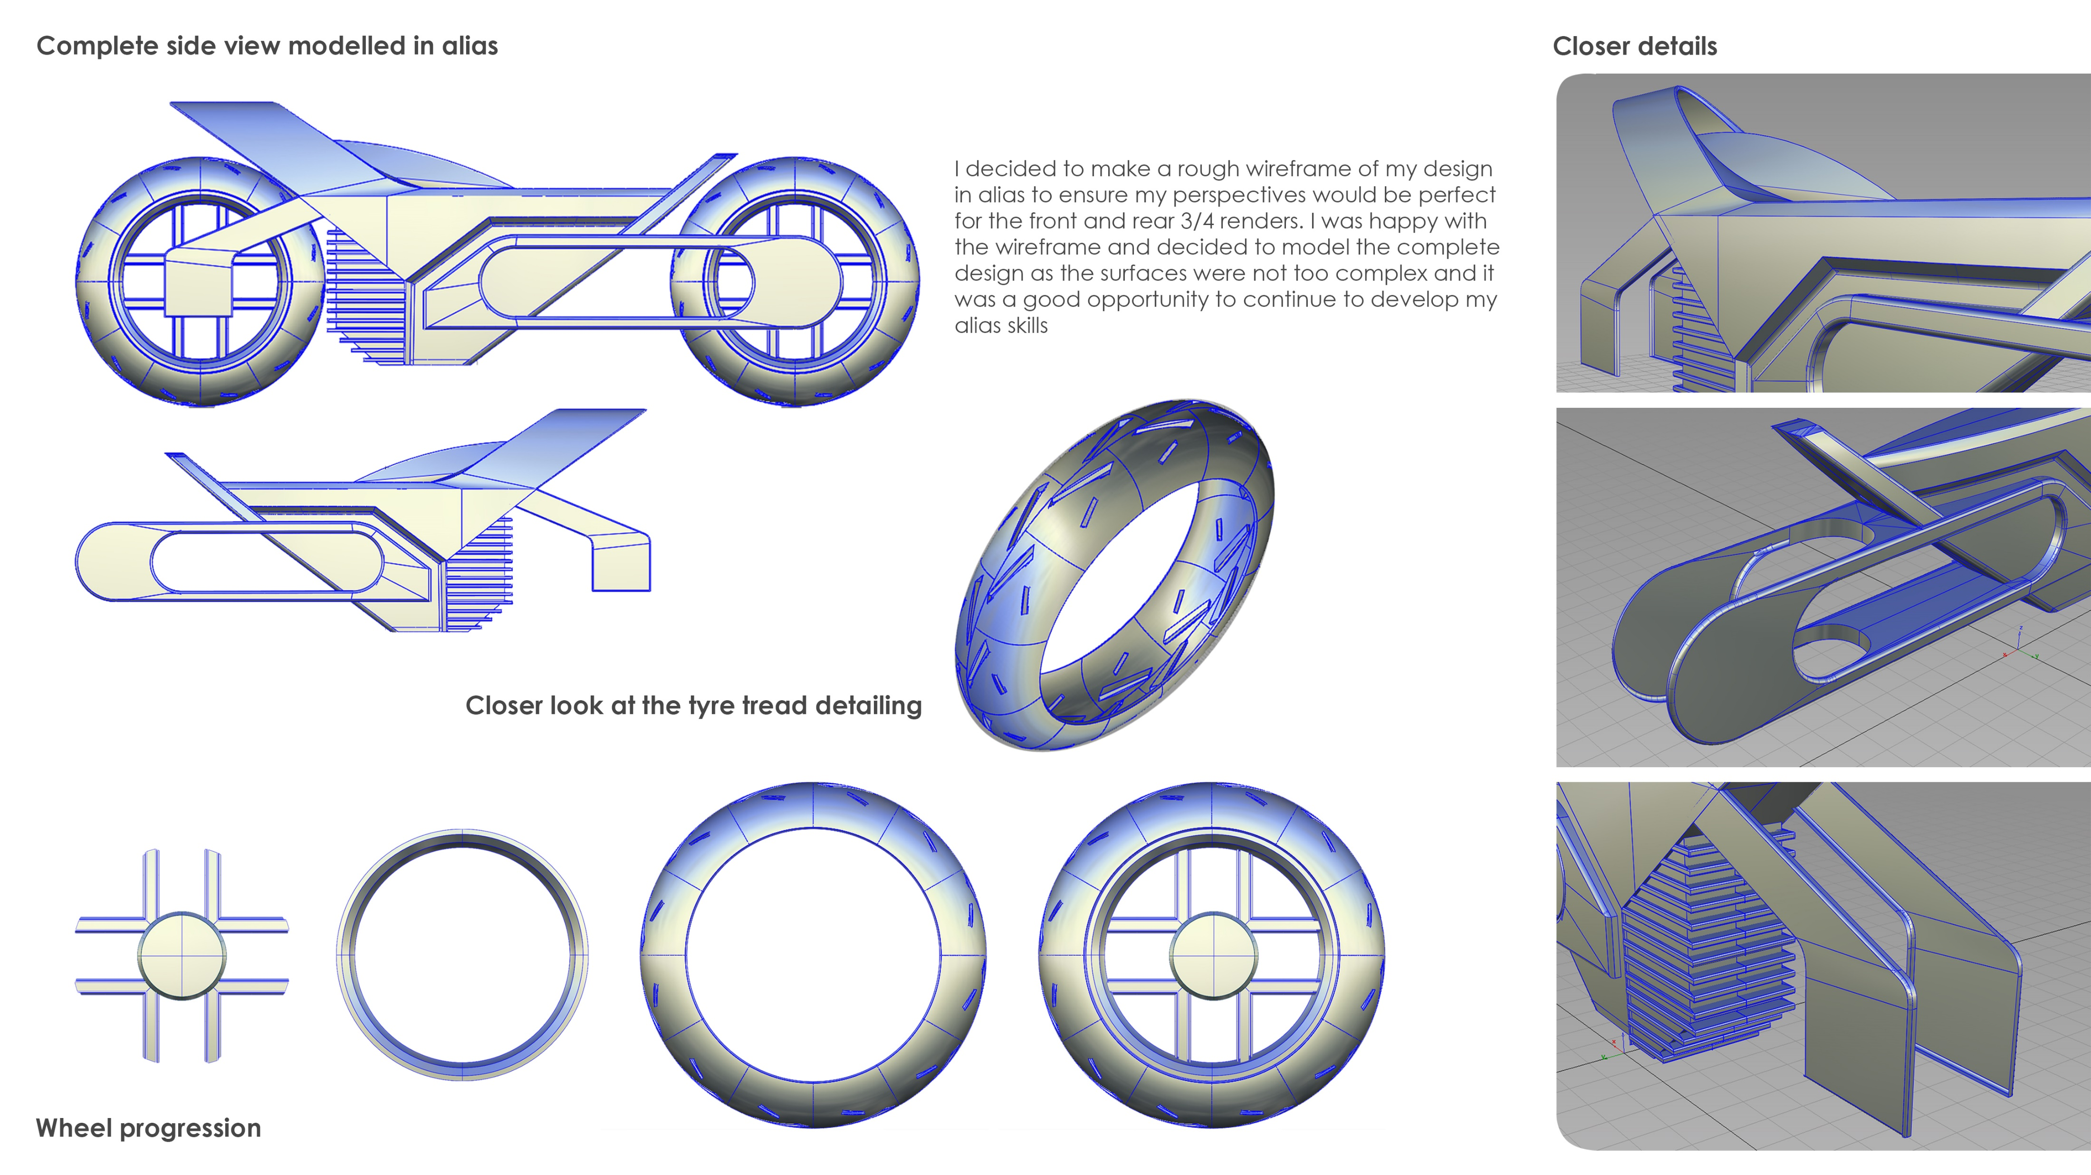

Slide 10
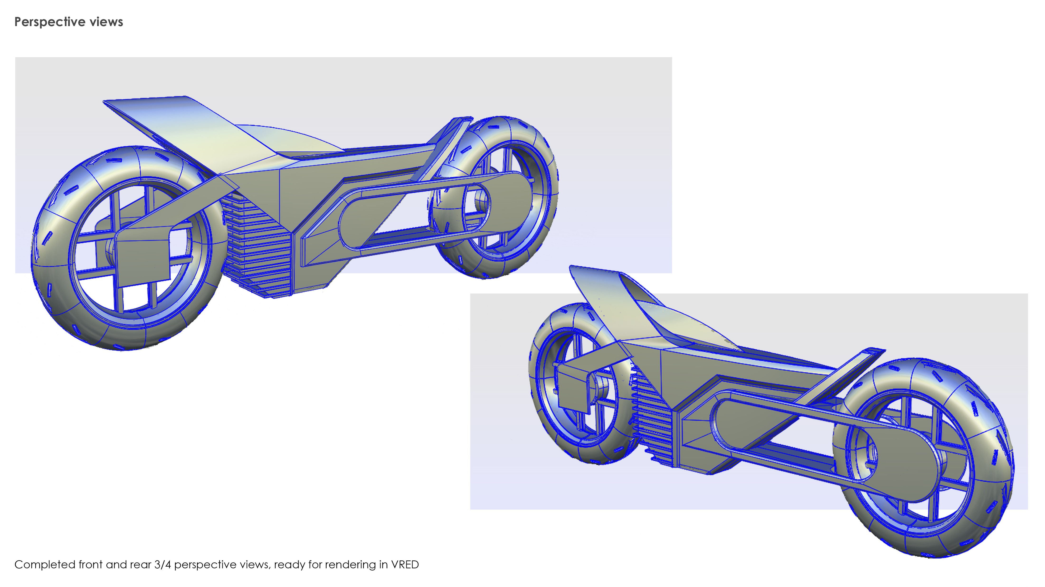

Slide 11
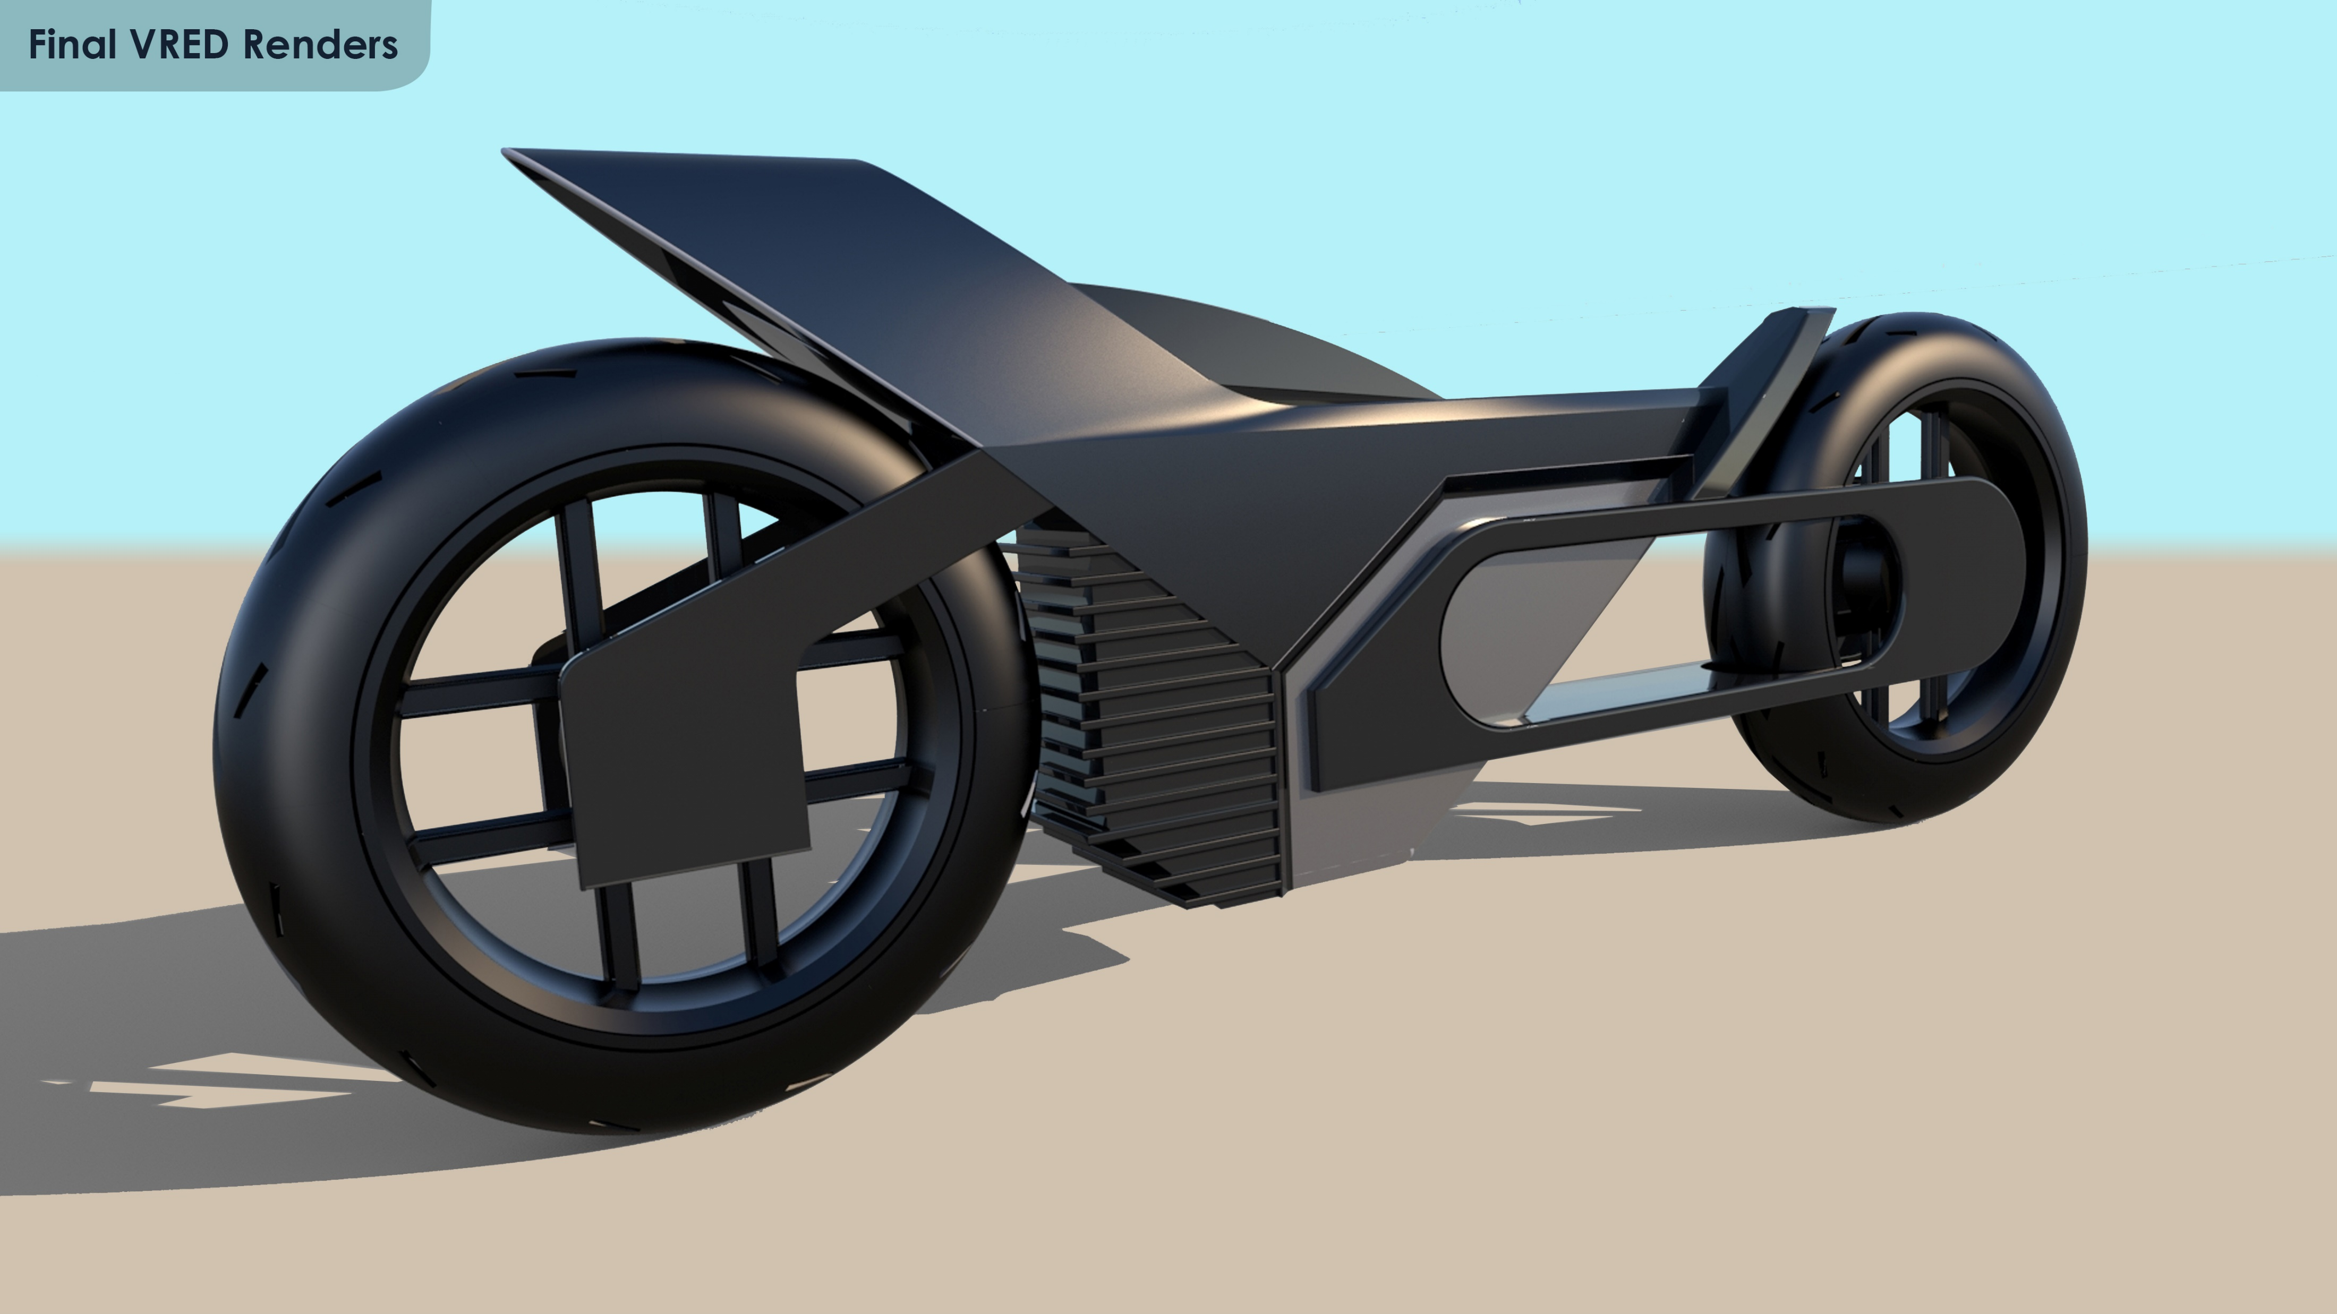

Slide 12
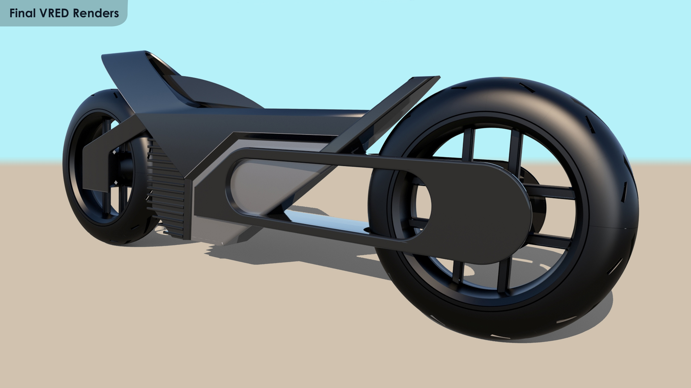

Slide 13
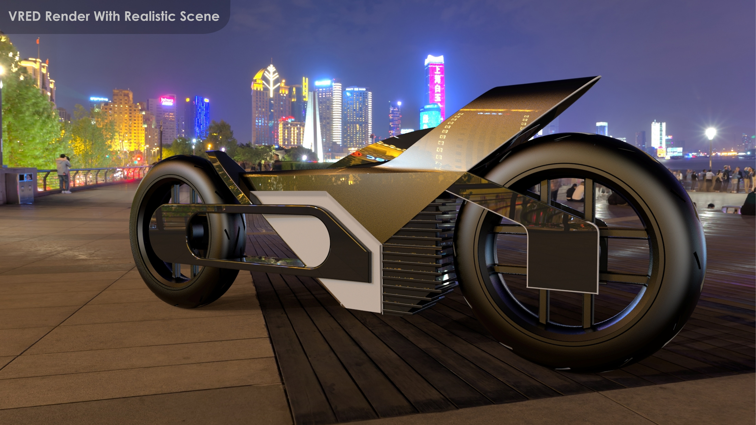

Slide 14


