Slide 1

Name: Lucian Daniel Oprea Student number: 2107118 Module code: BMSW 5106 Knowledge and Information Skills for the Workplace Lecturer’s Name: Dr Sujeewa Herath Sampath Liyanage

Slide 2

Introduction
The following presentation will explore the Knowledge Management (KM) system in Uber Eats, its purposes, strengths, and weaknesses.
The discussion will also highlight recommendations to improve the KM system in Uber Eats.
(Rahman, 2019)
Notes:
The presentation will explore the Knowledge Management (KM) system in Uber Eats, its purposes, strengths, and weaknesses. The KM system enables Uber Eats to make data-driven decisions, improve customer satisfaction, and increase operational efficiency. The discussion will also highlight recommendations to improve the KM system in Uber Eats, such as investing in advanced analytics and AI technology, enhancing cybersecurity measures, developing a centralized knowledge-sharing platform, providing training and support, and implementing a feedback mechanism.

Slide 3
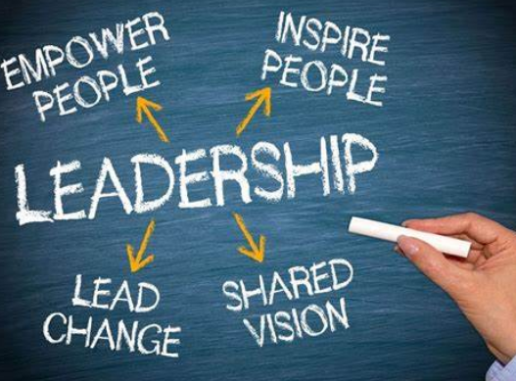
Company background and explain the MIS
Uber Eats is a food delivery platform launched in August 2014 by Uber Technologies Inc., is a global transportation network organization situated in San Francisco, California.
Knowledge Management Systems (KMS) are information systems that support the creation, sharing, dissemination, and management of knowledge within an organisation like Uber Eats.
(Rahman, 2019)
Notes:
Uber Eats is a food delivery platform launched in August 2014 by Uber Technologies Inc., is a global transportation network organization situated in San Francisco, California. The help permits clients to arrange food from cafés through a portable application or site and have it conveyed to their doorsteps by Uber drivers. At first sent off in Los Angeles, California, Uber Eats has since extended to north of 6,000 urban areas in 45 nations around the world (Rahman, 2019). As of 2021, it is one of the leading food delivery services in the world, with a reported market share of around 25%. In addition to its food delivery service, Uber Eats has also launched a grocery delivery service and a delivery platform for local merchants. Uber Eats has faced competition from other food delivery services, including Grubhub, DoorDash, Postmates, and Deliveroo. However, the company has continued to expand and innovate, introducing features such as in-app tipping, virtual restaurants, and a subscription service called Uber Eats Pass.
Knowledge Management Systems (KMS) are information systems that support the creation, sharing, dissemination, and management of knowledge within an organisation (Mills, et. al., 2019). They assist Uber Eats with utilizing its insight assets and make an upper hand. KMS helps the firm with further developing efficiency, increment advancement, and lessen the gamble of information misfortune because of worker turnover.

Slide 4

Demonstrate the selected system graphically and explain
A knowledge Management (KM) system is a system that facilitates the creation, sharing, and utilization of knowledge within an organization.
It involves capturing, organizing, and sharing knowledge to enhance organizational performance and improve decision-making.
(Fontes, et. al., 2019)
Notes:
A knowledge Management (KM) system is a system that facilitates the creation, sharing, and utilization of knowledge within an organization. It involves capturing, organizing, and sharing knowledge to enhance organizational performance and improve decision-making. A KM system consists of four main components: knowledge creation, knowledge storage, knowledge dissemination, and knowledge utilization.

Slide 5
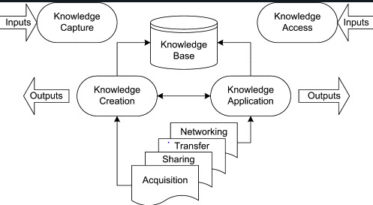
To be continued……..
In the context of Uber Eats, the KM system works in the following way:
Knowledge Creation
Knowledge Storage
Knowledge Dissemination
Knowledge Utilization
(Mills, et. al., 2019)
Notes:
In the context of Uber Eats, the KM system works in the following way:
Knowledge Creation: Uber Eats collects data and feedback from various sources, including customers, delivery partners, and restaurants, to create knowledge. For example, feedback on the quality of the food and delivery experience can be used to improve the service.
Knowledge Storage: The knowledge created is stored in various forms, such as databases, documents, and reports, accessible through a centralized platform.
Knowledge Dissemination: The knowledge stored in the KM system is shared through various channels, such as email, intranet, and chat platforms (Fontes, et. al., 2019). In Uber Eats, knowledge is disseminated through the company's communication channels, such as email and chat, to guarantee that staffs are conscious of the newest information.
Knowledge Utilization: The knowledge shared is used to make informed decisions, improve processes, and enhance organizational performance.

Slide 6
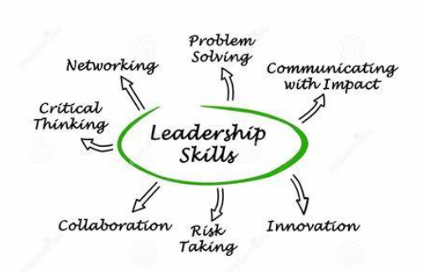
Explain its purposes and how it adds value to the business model
The purpose of the Knowledge Management (KM) system in Uber Eats is to facilitate the creation, sharing, and utilization of knowledge to enhance the performance of the business model.
The KM system helps Uber Eats add value to the business model in the following ways:
Improving Customer Experience
Increasing Efficiency
Supporting Decision Making
(Ogona, 2022)
Notes:
The purpose of the Knowledge Management (KM) system in Uber Eats is to facilitate the creation, sharing, and utilization of knowledge to enhance the performance of the business model. The KM system helps Uber Eats add value to the business model in the following ways:
Improving Customer Experience: The KM system captures customer feedback and helps Uber Eats to identify the areas that need improvement (Ogona, 2022).
Increasing Efficiency: The KM system helps Uber Eats to optimize its delivery process by providing insights into the most popular restaurants, the busiest delivery times, and the most efficient routes.
Supporting Decision Making: The KM system provides Uber Eats with valuable data and insights that can be used to make informed decisions.

Slide 7
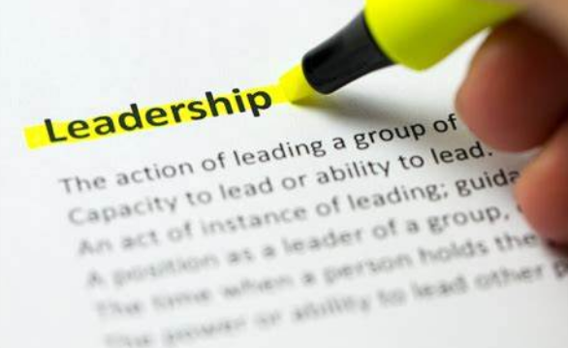
Evaluate its strengths and weaknesses
Strengths of KM System:
Improved decision-making
Better customer experience
Increased efficiency
(Samul, 2019)
Notes:
The strength and weaknesses of the KM system within Uber Eats are discussed below:
Strengths:
Improved decision-making: The KM system in Uber Eats provides valuable insights and data that can be used to make informed decisions. This helps Uber Eats to stay ahead of its competitors and meet the evolving needs of its customers.
Better customer experience: The KM system captures customer feedback and helps Uber Eats identify areas that need improvement. This enables the Uber Eats to provide better services and ultimately improve the customer experience.
Increased efficiency: The KM system helps Uber Eats to optimize its delivery process by providing insights into the most popular restaurants, busiest delivery times, and efficient routes. This leads to reduced delivery times, lower costs and increased efficiency.

Slide 8
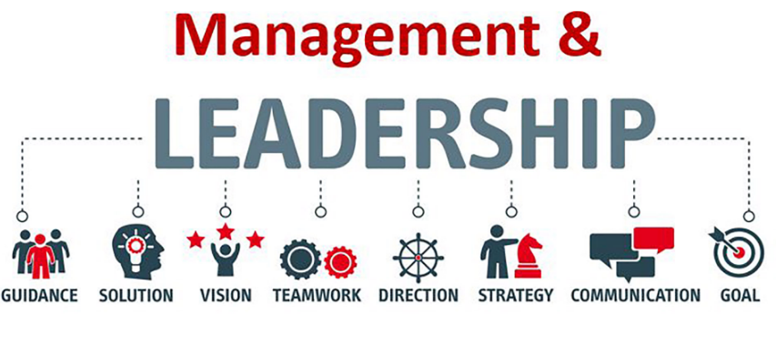
To be continued…….
Weaknesses of KM System:
Dependence on technology
Cost
Privacy and security concerns
(Samul, 2019)
Notes:
Weaknesses:
Dependence on technology: The KM system relies heavily on technology, and any glitches or system failures can have a significant impact on the business. This may lead to delays in service and decreased customer satisfaction.
Cost: Developing and maintaining a robust KM system requires a significant investment in technology, infrastructure, and human resources (Samul, 2019). This can be a significant cost for smaller companies and may not be feasible for businesses with limited resources.
Privacy and security concerns: The KM system in Uber Eats involves the collection and storage of customer and business data. This raises concerns about privacy and security, and any data breaches can hurt customer trust and brand reputation.

Slide 9

Recommendations
To improve the Knowledge Management (KM) system in Uber Eats, it is recommended to invest in advanced analytics and AI technology.
Developing a centralized knowledge-sharing platform Uber Eats can develop a centralized platform that facilitates the sharing of knowledge across the organization.
(Cui, 2021)
Notes:
To improve the Knowledge Management (KM) system in Uber Eats, it is recommended to invest in advanced analytics and AI technology. Uber Eats can leverage advanced analytics and AI technology to gain deeper insights into customer preferences, improve route optimization, and reduce delivery times. This would help to increase efficiency, improve customer satisfaction, and reduce costs. Enhance cybersecurity measures to address privacy and security concerns, Uber Eats should enhance its cybersecurity measures to prevent data breaches and protect customer and business data. This would help to increase customer trust and protect the company's reputation (Cui, 2021). Developing a centralized knowledge-sharing platform Uber Eats can develop a centralized platform that facilitates the sharing of knowledge across the organization. This would encourage collaboration and enable employees to access relevant information quickly and easily. Additionally, this platform can be used to capture and disseminate best practices, enabling continuous improvement across the organization. Provide training and support to ensure the successful adoption and use of the KM system, UberEats should provide training and support to employees. This would help to ensure that employees understand how to use the system effectively and that they are comfortable sharing and accessing knowledge through the system.

Slide 10

Conclusion
In conclusion, the Knowledge Management system plays a critical role in Uber Eats' success by enabling data-driven decision-making, improving customer experience, and increasing operational efficiency.
While KM System has some weaknesses, such as dependence on technology and privacy concerns, these can be addressed through investments in advanced analytics
(Fontes, et. al., 2019)
Notes:
In conclusion, the Knowledge Management system plays a critical role in Uber Eats' success by enabling data-driven decision-making, improving customer experience, and increasing operational efficiency. While KM System has some weaknesses, such as dependence on technology and privacy concerns, these can be addressed through investments in advanced analytics and AI, enhanced cybersecurity measures, centralized knowledge-sharing platforms, training and support, and feedback mechanisms. By implementing these recommendations, Uber Eats can continue to leverage its KM system to achieve its business objectives.

Slide 11
References
Rahman, U.H.F.B., 2019. Diversity management and the role of leader. Open Economics, 2(1), pp.30-39.
Mills, C.B., Keller, M., Chilcutt, A. and Nelson, M.D., 2019. No laughing matter: Workplace bullying, humor orientation, and leadership styles. Workplace health & safety, 67(4), pp.159-167.
Cui, Y., 2021. The role of emotional intelligence in workplace transparency and open communication. Aggression and Violent Behavior, p.101602.
Fontes, K.B., Alarcão, A.C.J., Santana, R.G., Pelloso, S.M. and de Barros Carvalho, M.D., 2019. Relationship between leadership, bullying in the workplace and turnover intention among nurses. Journal of nursing management, 27(3), pp.535-542.
Ogona, I.K., 2022. Temperamental disposition of leaders: Its relevance to educational leadership and management in nigeria. Management, 4(1), pp.195-212.
Samul, J., 2019. Spiritual leadership: Meaning in the sustainable workplace. Sustainability, 12(1), p.267.
Notes:
Rahman, U.H.F.B., 2019. Diversity management and the role of leader. Open Economics, 2(1), pp.30-39.
Mills, C.B., Keller, M., Chilcutt, A. and Nelson, M.D., 2019. No laughing matter: Workplace bullying, humor orientation, and leadership styles. Workplace health & safety, 67(4), pp.159-167.
Cui, Y., 2021. The role of emotional intelligence in workplace transparency and open communication. Aggression and Violent Behavior, p.101602.
Fontes, K.B., Alarcão, A.C.J., Santana, R.G., Pelloso, S.M. and de Barros Carvalho, M.D., 2019. Relationship between leadership, bullying in the workplace and turnover intention among nurses. Journal of nursing management, 27(3), pp.535-542.
Ogona, I.K., 2022. Temperamental disposition of leaders: Its relevance to educational leadership and management in nigeria. Management, 4(1), pp.195-212.
Samul, J., 2019. Spiritual leadership: Meaning in the sustainable workplace. Sustainability, 12(1), p.267.

