Slide 1

Problems and Solutions
What is a problem?

Slide 2

What is a problem?
A problem can be defined as an : obstacle, perceived gap between the ideal and current state or deviation from the norms.

Slide 3

n
In this case the NHS absenteeism is the problem and we are going to use the PESTEL analysis to solve it.

Slide 4
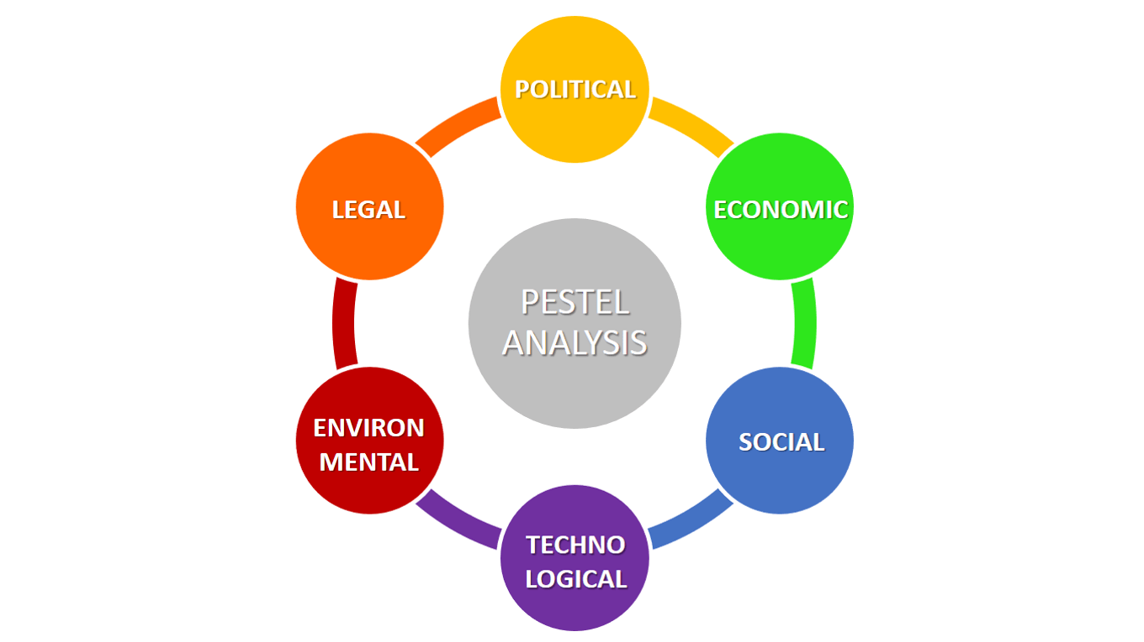
SOLVING WITH PESTEL ANALYSIS
First, POLITICAL of course as a lot of staff are getting sick they will have a right to have off days for a certain amount of time or till they feel better however , if the time they need is an amount the NHS can not provide and other staff keep getting sick it wont be convenient for the NHS which also makes it possible for the tax to not be able to be paid as they have not worked so they will not receive their salary which leads to

Slide 5

SOLVING WITH PESTEL ANALYSIS
ECONOMIC problems as they won’t be able to get paid they will not be able to pay for their medicine or stuff they need to be able to still work at the NHS.Which also leads to possible huge financial problems

Slide 6



SOLVING WITH PESTEL ANALYSIS
Furthermore, if we think about how it was able to spread so fast the easiest way that could be is by SOCIAL interaction as most sicknesses are contagious.

Slide 7



SOLVING WIH PESTEL ANALYSIS
However, there could be a solution such as TECHNOLOGY. Going back to when the pandemic was around some people were working from home if they were sick and patients could get treated just by staying at home for example if the doctor was on the other side of the screen/ phone he could give instructions to the patient on how they can treat themselves without the doctor having to go to see them

Slide 8
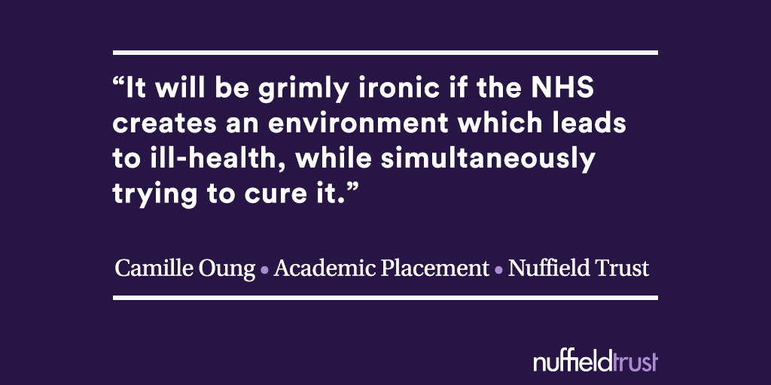

SOLVING WITH PESTEL ANALYSIS
How does the absenteeism of the NHS affect the environment?
The absenteeism of the NHS can have a huge impact on the environment in different ways such as: the lack of staff could cost somebody’s life.

Slide 9

SOLVING WITH PESTEL ANALYSIS
The most important of them all ; you have to think about the ways you want to solve the problem and if it will be LEGAL. For example one way in which you can have a legal solution is having better offers so that way more people will want to apply and work for the NHS which will prevent having lack of staff in such situations.

Slide 10

SOLVING WITH PESTEL ANALYSIS

