Slide 1
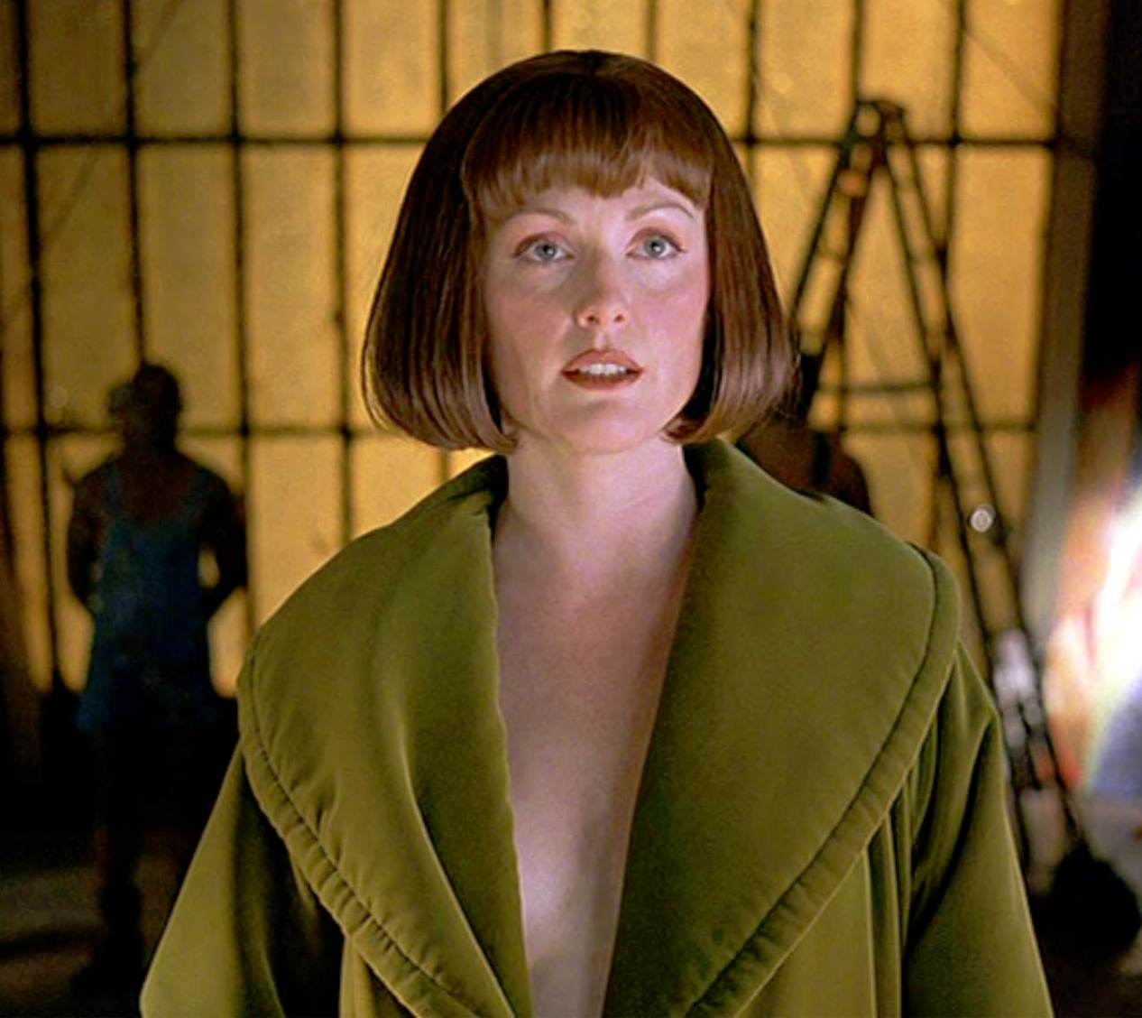
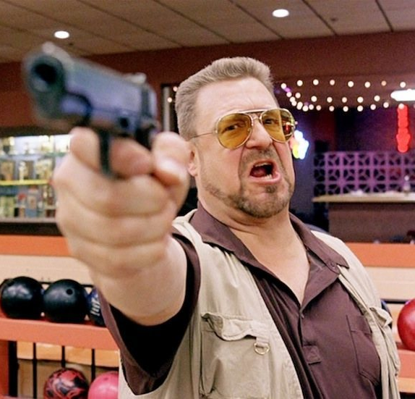
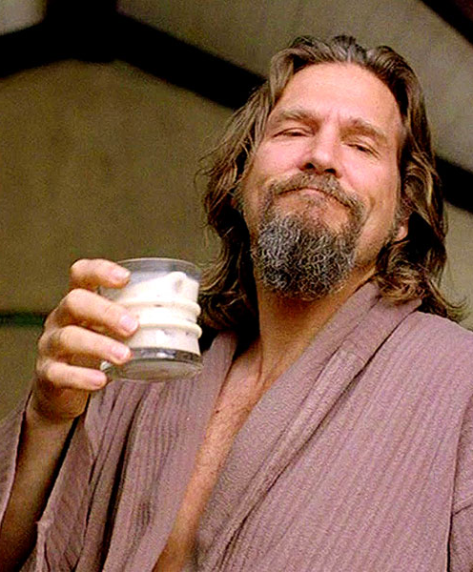
Genre Case Study
Neo-Noir
The Big Lebowski (Coens, 1998)

Slide 2
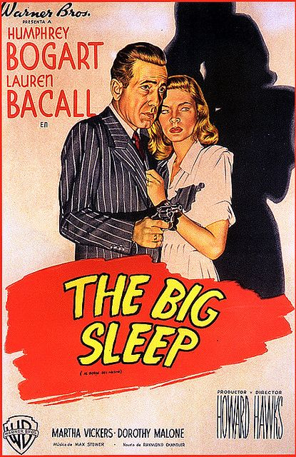
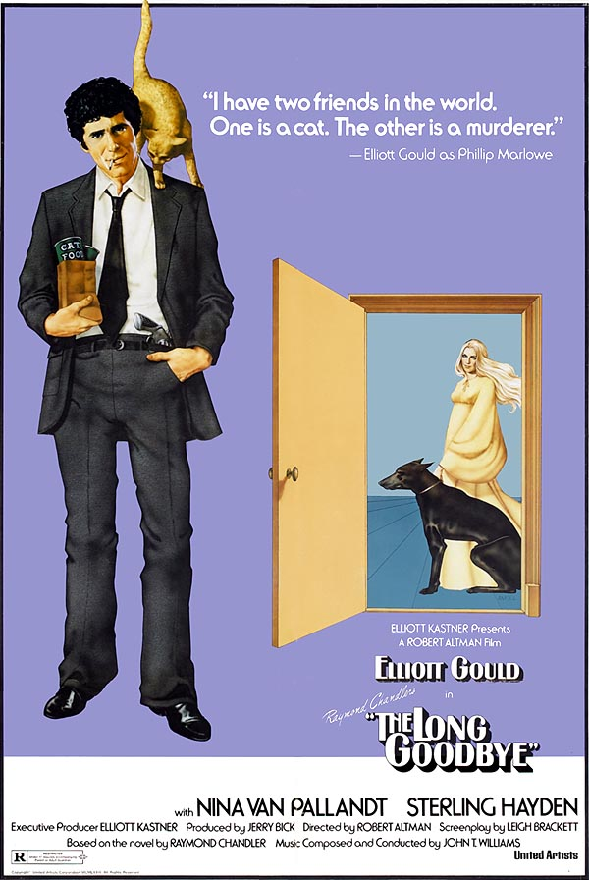
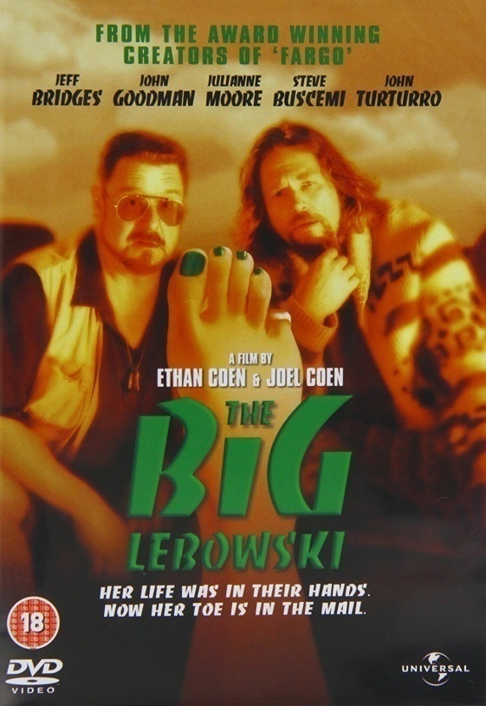
1 - Classical Hollywood: pre-1960s
2 - Post-Classical Hollywood: 1960s-present
2a – ‘New Hollywood’: Polanski, Altman, etc
2b – ‘Postmodern Hollywood’: Coens, Tarantino, Anderson, etc
Hawks, 1946
Altman, 1973
Coens, 1998

Slide 3
The Big Lebowski
Coens, 1998
intertextuality/influence
parody/pastiche
disjuncture/incongruity
miscommunication
‘abuse of genre convention’
playful, subversive humour
masculinity and heroism
Social/Cultural Contexts:
Classical Noir
Comedy
1991 – Gulf War era setting
Late-90s, Postmodern cinema

Slide 4
TBL, Neo-Noir, and Genre Deconstruction
1 - What do we know about the genre (film noir)?
2 - What we do we know about the story world of TBL?
By simply reading genre conventions, we misread elements of the narrative, or find them jarring and confusing.
3 – How do we engage more effectively with the text?
By recognising that TBL engages with genre convention in a self-reflexive way. It has INTERTEXTUAL connections with film noir. It references the films noirs of the past, and by deconstructing genre convention, creates the neo-noirs of the present.

Slide 5
The Big Lebowski
“The Big Lebowski is … a lovingly informed parody of a highly codified established form, whose gleeful subversion of genre expectation is matched by genuine emotional resonance.”
“A film whose ostensibly ramshackle form turns out to be the perfect vessel for a story whose very subjects are disjunction and miscommunication, the abuse of genre convention, and the defiance of received notions of heroism and masculinity.”
J. M. Tyree and Ben Walters

Slide 6
“Strong men also cry”: Coens & masculinity
Miscommunication
  Pomeranian
  Lennon & Lenin
Masculinity
  authority
  fragility
  instability
  hysteria
  violence
War
Imperialism
  Nixon; Reagan; Bush

Slide 7
Maude: intertextuality and deconstruction
Hawks (1946)
  Marlowe
  Vivian Rutledge
  Carmen Sternwood
  The General
  Geiger & Lundgren
  Eddie Mars
Coens (1998)
  The Dude
  Maude
  Bunny
  The Big Lebowski
  Jackie Treehorn

