Slide 1

ReviveGrow Investments
Business Presentation – Assignment 2
Stefania Beatrice Iordache
Student Number: 2430125
Module: LCLM4006 – Enterprise & Entrepreneurship
Lecturer: Balendran Kandasamy
Date: 8 December2025

Slide 2

Overview of the Business Idea
ReviveGrow Investments buys small failing businesses in the UK.
We improve these businesses by fixing problems and making them work better.
After the improvements, we sell the business for a profit.
We focus on small shops, services, and hospitality businesses.
Our goal is to give failing businesses a second chance and create value.

Slide 3

Problem We Solve
Many small businesses in the UK struggle with low sales and high costs.
Some owners want to sell quickly because they feel stressed or cannot continue.
Many businesses close because they lack good marketing or management.
Investors want safe, ready-to-run businesses but can’t find them easily.
ReviveGrow helps by buying, improving, and selling these businesses.

Slide 4
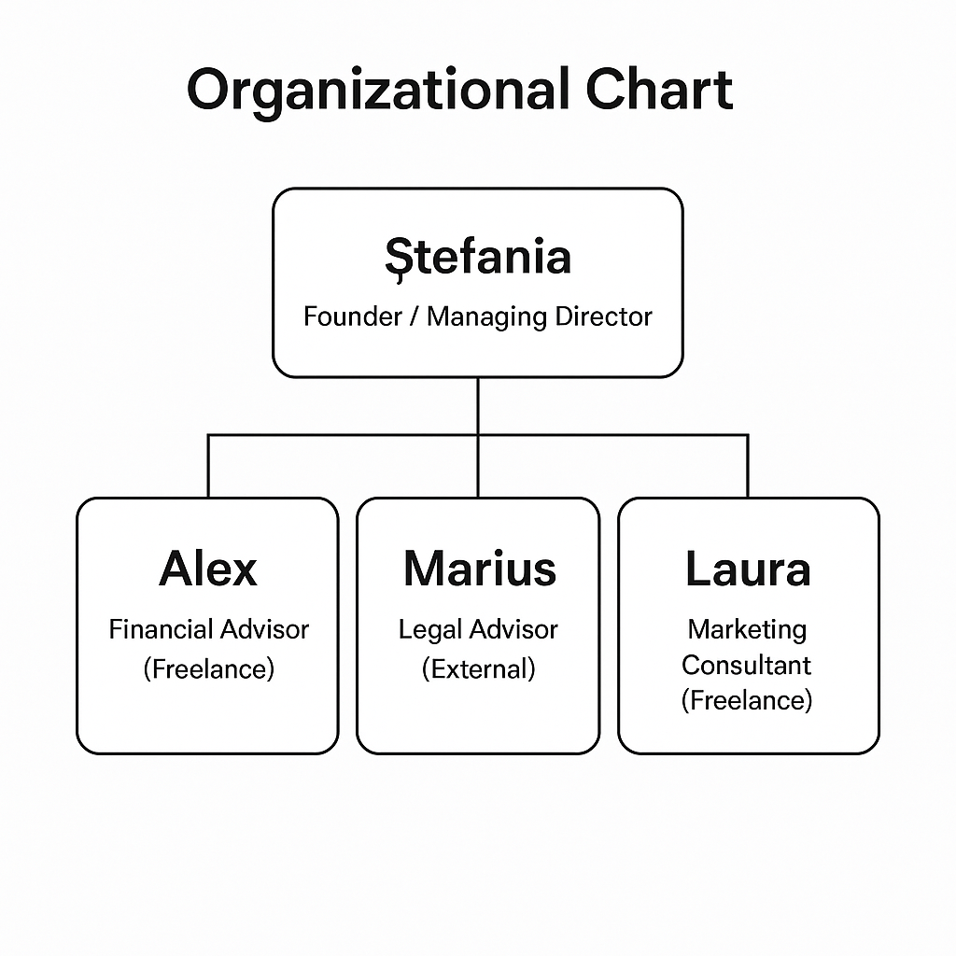
Legal Format & Management Structure
Legal Format (Ltd Company):
The business operates as a Private Limited Company (Ltd).
This protects my personal money (limited liability).
It is trusted in the UK and easy to register.
Management Structure:
Small and low-cost team.
Founder manages the business and key decisions.
Support from freelance professionals.

Slide 5
PESTEL Analysis
Political: UK supports small businesses with grants and loans.
Economic: High costs and inflation → more failing businesses to buy.
Social: People like supporting improved local businesses.
Technological: Many small firms lack digital tools → easy to improve.
Environmental: Must follow waste and recycling rules.
Legal: UK has strong business laws → need a legal advisor.

Slide 6
Target Market (STP Model)
👥 Segmentation:
Failing small business owners
Older owners who want to retire
Investors looking for ready-to-run businesses
🎯 Targeting:
Owners who want a fast sale
Investors who want improved, low-risk businesses
⭐ Positioning:
A fast and reliable turnaround company
We buy, improve, and sell small businesses

Slide 7
Marketing Strategies
A clear and simple website for information
LinkedIn and Facebook marketing
Networking events to meet business owners
Partnerships with accountants and lawyers
Direct contact with struggling businesses

Slide 8

Funding Required
Total funding needed: £5,020
Money will cover:
• Company registration and legal fees
• Website and marketing
• Accounting and professional fees
• First small business purchase
Funding will come from personal savings and a small UK Start-Up Loan.

Slide 9

Financial Forecast & Break-Even
The business becomes profitable in Month 3 (March).
In March:
• Revenue = £1,200
• Total costs = £1,200
• Profit = £0 (break-even)
After Month 3, the business starts making profit every month.
Profit increases as more businesses are improved and sold.

Slide 10
Conclusion
ReviveGrow helps failing small businesses become successful again.
The business model is simple, low-cost, and effective.
There is strong demand in the UK for business turnaround.
The company has good potential for growth in the future.
ReviveGrow creates value for owners, customers, and investors.

