Slide 1
Complementary Therapies
Aromatherapy & Anxiety

Slide 2
Complementary and Alternative Therapies (CAM)
Healing therapies for both the mind and the body.
Used to support or replace conventional medicine.
Acupuncture, Aromatherapy, Homeopathy and Reiki.
Aromatherapy is the therapeutic use of essential oils derived from herbs, flowers and barks
Can be diffused, inhaled or bathed and massaged.
4,000 years ago – famous painkiller?
(Wieland et al., 2011) (Worwood, 1997)

Slide 3
The Mental Health Foundation (2018)
Impacts…
      Physical?
      Emotional?
      Societal?
      (Murray (2017); Smith & Perez (2018); World Health Organisation (N.D.))
74% Adults
Stress
Overwhelmed
Cannot Cope

Slide 4

Conventional treatment for Anxiety
Selective Serotonin Reuptake Inhibitors (SSRIs)
(The National Institute of Mental Health, 2018).

Slide 5
(The National Institute of Mental Health, 2016)
How do SRRIs work?
Messages
Serotonin
Messages
Serotonin
Messages
Serotonin
Side effects
Nausea
Diarrhoea
Weight Gain
Increased Sleep
Decreased Libido
Increased reliance

Slide 6
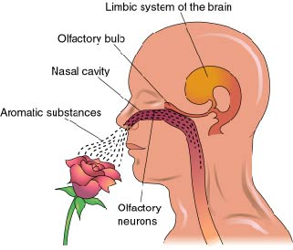
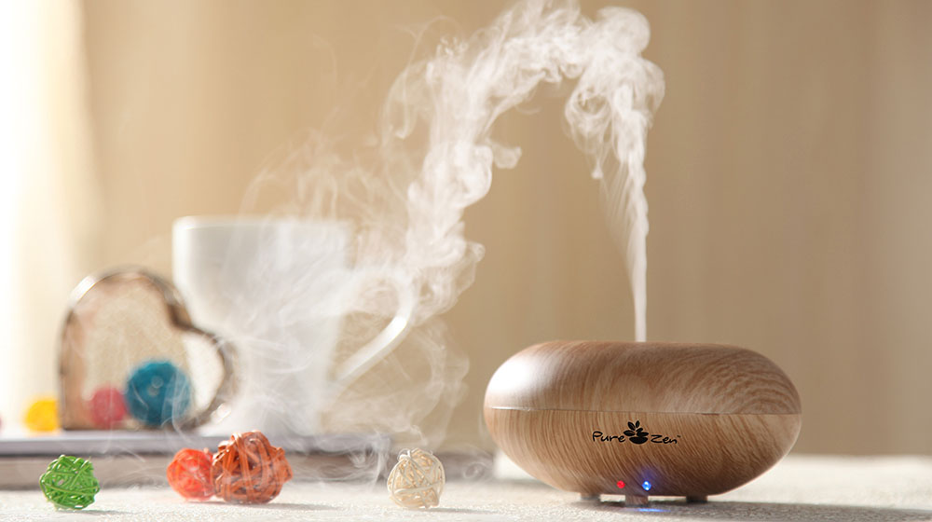
A Natural Approach: Aromatherapy Oil Inhalation
Braden et al (2009) Howard and Hughes (2008) Lee et al (2011)

Slide 7
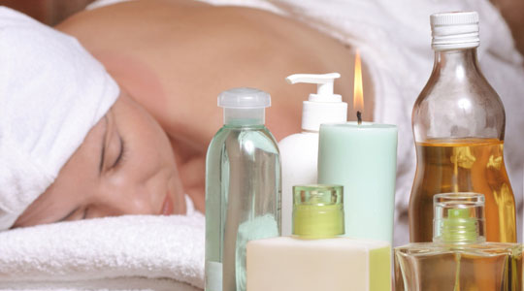
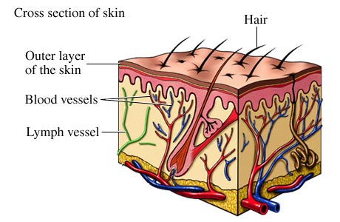
A Natural Approach: Aromatherapy Oil Topical Application
Braden et al., (2009); Howard and Hughes (2008); Lee et al.,(2011)

Slide 8
Research Evidence into the Efficacy of Aromatherapy Oils
Lavender Oil

Slide 9
Aromatherapy as a treatment for pre-operative anxiety (Jaruzel et al., 2018).
Aim – Could Lavender Oil help pre-operative breast surgery patients’ anxiety?
Method – Bioesse patches placed on sternum of patients and vital signs and anxiety scores were recorded.
Results - Significant decrease in anxiety scores but vital signs decrease did not reach significance
Conclusion – Authors acknowledged small sample size affected results but it was concluded Aromatherapy was beneficial in reducing symptoms of anxiety.

Slide 10
Aromatherapy Oil to reduce needle insertion pain and anxiety (Ghods et al., 2015).
Aim – Could Lavender Oil reduce pain and related anxieties towards needle insertion for haemodialysis patients?
Method – 34 patients split into 3 groups: G1- Lavender Oil, G2- Placebo and G3 -No intervention. Pain insertion assessed after insertion of the arterial needle and prior to insertion of the venous needle.
Results – Participants in the lavender oil condition (G1) reported the lowest pain intensity.
Conclusion – Application of lavender oil can decrease pain intensity (but acknowledgment that participant's’ psychological conditions may have had an effect on the results).

Slide 11
Aromatherapy Oil to reduce stress?
(Toda & Morimoto, 2008).
Aim – Could Lavender oil reduce stress by measuring specific stress markers (Cortisol & Chromogranin A (CgA)) in saliva?
Method – Induced stress in format of arithmetic test known as ‘mental stressor’. 30 Participants split into G1 Aroma and G2 No intervention for rest period of 10 minutes after test. Stress level scale and saliva testing on all participants.
Results – Aroma group tested significantly lower in stress and saliva results.
Conclusion – Lavender oil can have a positive effect in relieving stress.

Slide 12
Note of caution and recommendations...
Cannot draw firm conclusions as the body of evidence is not extensive.
Sample sizes are typically smaller due to lack of funding and therefore cannot be generalized.
Further funding is required in this field to undertake more rigorous randomized trails to overcome methodological limitations.
Larger sample sizes are needed to reach significance in results.

Slide 13
Reference List & Bibliography
Benitex, C. et al., (2008). Use of Benzodiazepines and Selective Serotonin Reuptake Inhibitors in Middle-Aged and Older Adults With Anxiety
Disorders: A Longitudinal and Prospective Study. he American Journal of Geriatric Psychiatry, 16(1), pp. 5-13.
Braden, R., Reichow, S. & Halm, M. A., (2009). The Use of the Essential Oil Lavandin to Reduce Preoperative Anxiety in Surgical Patients.
Journal of PeriAnesthesia Nursing, 24(6), pp. 348-355.
Ghods, A. A., Abforosh, N. H., Ghorbani, R., & Asgari, M. R. (2015) The effect of topical application of lavender essential oil on the intensity of pain caused
by the insertion of dialysis needles in hemodialysis patients: A randomized clinical trial. Complementary Therapies in Medicine, 23(3), 325-330.
Howard, S. & Hughes, B. M., (2008). Expectancies, not aroma, explain impact of lavender aromatherapy on psychophysiological indices of relaxation in young
healthy women. British Journal of Health Psychology, 13(4), pp. 603-617.
Jaruzel, C. et al., (2018). Aromatherapy for Preoperative Anxiety: A Pilot Study. Journal of PeriAnesthesia Nursing, p. In Press.
Lee, Y. et al., (2011). A Systematic Review on the Anxiolytic Effects of Aromatherapy in People with Anxiety Symptoms. The Journal of Alternative and
Complementary Medicine, 17(2), pp. 101-108.
Mental Health Foundation, (2018). Stress: Are we coping?, London: Mental Health Foundation.
Murray, E., (2017). Mental stress and human cardiovascular disease. Neuroscience & Biobehavioral Reviews, 74(B), pp. 269-276.
Rowland, E., (2013). Beyond Aromatherapy: Revisiting Essential Oils. Natural Life, pp. 16-19.
Smith, J. & Perez, M., (2018). The importance of stress management in today's society.. Revisa, 7(1), pp. 1-4.
Toda, M. & Morimoto, K. (2008) Effect of lavender aroma on salivary endocrinological stress markers. Archives of Oral Body, 53(10), pp. 964-968.
The National Institute of Mental Health, (2016). Mental Health Medications. [Online]
Available at: https://www.nimh.nih.gov/health/topics/mental-health-medications/index.shtml#part_149855
[Accessed 03 November 2018].
Wieland, L. S., Manheimer, E. & Berman, B. M., (2011). Development and Classification of an Operational Definition of Complementary and
Alternative Medicine for the Cochrane Collaboration.. Alternative Therapies in Health and Medicine, 17(2), pp. 50-59.
World Health Organisation, (2017). World Health Organisation. [Online]
Available at: http://www.who.int/en/news-room/fact-sheets/detail/depression
[Accessed 13 Nov 2018].
Worwood, V. A., (1997). The Fragrant Mind. London: Transworld Publishers Ltd.

