Slide 1


LCBB5001 Entrepreneurship
Business Plan: Task 1

Slide 2

Introduction: overview of the business idea
Herb Coffee Shop is a specialty coffee store set to open its doors in Manchester,
Single origin is Arabica beans.
Premium beans and advanced processing techniques with boasting a cozy ambiance.
Reasonably priced and high-quality coffee.
Notes:
Herb Coffee Shop, a specialty coffee store set to open its doors in Manchester, promises customers an organic coffee-drinking experience like no other. Their goal is to delight customers with exceptional offerings such as their single origin Arabica beans. Herb Coffee Shop prides itself on creating raw coffee products using only premium beans and advanced processing techniques, all while boasting a cozy ambiance perfect for gathering friends around for a cup of their favorite brew. Exciting events, such as coffee tastings and brewing lessons, will be held to foster community spirit among coffee enthusiasts and bring people closer together. Herb Coffee Shop takes great pride in providing customers with reasonably priced, high-quality coffee that ensures they can relax and enjoy their beverage without fear of potential caffeine-related side effects (Ferreira and Ferreira, 2020). Their long-term vision is to become the go-to location for coffee connoisseurs looking for pure beans available.

Slide 3

Ownership and legal format
Herb Coffee Shop will have LLC legal structure as the basis of its operations.
Herb Coffee Shop ensures its owners are benefiting from limited liability protection.
Formation of an LLC involves multiple steps.
Protecting members' interests.
Notes:
Herb Coffee Shop has thoughtfully decided to choose an LLC legal structure as the basis of its operations, due to the many benefits associated with an LLC such as adaptability, liability protection and ease of establishment. Herb Coffee Shop ensures its owners, known as members, benefit from limited liability protection by creating an LLC. This safeguard prevents personal assets from being used to meet legal or financial obligations incurred by the business in case of legal disputes or financial troubles. Formation of an LLC involves multiple steps, beginning with choosing an identifying name that avoids confusion with existing businesses and trademarks (Jang and Lee, 2019). Herb Coffee Shop's chosen structure has given it a solid base, enabling it to operate efficiently while protecting members' interests.

Slide 4
Management of the company
Owners
External Professional Services/Experts
Employees
Customer Service Representatives
Support Staff
Notes:
Owner: Herb Coffee Shop's owner bears ultimate responsibility for its overall success, including making strategic decisions and assuring sufficient financial resources are available. Their responsibility also lies in setting long-term objectives and developing effective strategies to achieve them.
Employees: Herb Coffee Shop employs an expert staff comprised of baristas, service representatives and back-of-the-house employees who all play an essential part in keeping its coffee business running smoothly and contributing their skillset in unique ways (Li et al., 2019). Baristas utilize their in-depth knowledge of coffee brewing techniques to guarantee consistent quality and flavor across each cup served to customers.
Customer Service Representatives: Herb Coffee Shop understands the value of customer service agents as essential elements to its success, especially Herb Coffee Shop's. These frontline representatives play an instrumental role in engaging directly with customers to facilitate order placements, answer inquiries and find solutions to any problems that arise.
Support Staff: Herb Coffee Shop's support staff carries out various essential roles that ensure its smooth functioning, such as managing inventory, procuring supplies, assuring cleanliness and overall upkeep (Areiza-Padilla et al., 2020).
External Professional Services/Experts: Herb Coffee Shop may use external consultants or specialists with expertise in specific areas to ensure optimal operations, providing invaluable advice and insight that help to enhance many aspects of the company.

Slide 5
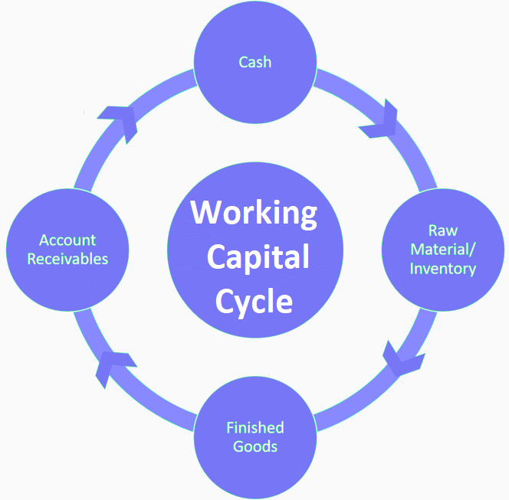
Working capital management
The process of ensuring that a company is making the best use of its available financial resources in order to achieve the greatest potential success.
Effective working capital management can enhance a company's liquidity and financial stability.
Poor working capital management can cause financial and operational issues. If a corporation doesn't manage its current assets and liabilities, it may run out of cash to pay its bills.
Notes:
Working capital management refers to the process of managing a company's short-term assets and liabilities in order to ensure sufficient liquidity and operational efficiency. It involves monitoring and controlling the components of working capital, such as cash, accounts receivable, accounts payable, inventory, and short-term debt.
The primary goal of working capital management is to strike a balance between maintaining an adequate level of current assets to support day-to-day operations while minimizing the cost of financing these assets. It involves making strategic decisions to optimize cash flow, manage receivables and payables, and control inventory levels.
By effectively managing working capital, companies can improve their liquidity position, reduce financing costs, enhance profitability, and ensure the smooth operation of their day-to-day activities.

Slide 6

USP and Reasons for starting the business
The Herb is distinguished from other shops by using only premium beans and cutting-edge processing technique.
As specialty coffee market expansion increases, raw coffee products is being famous.
Notes:
Herb Coffee Shop stands out from its Manchester peers by providing an organic coffee-drinking experience unlike any other. The Herb is distinguished from other shops by using only premium beans and cutting-edge processing techniques in its products, making this experience truly one-of-a-kind. Herb Coffee Shop's inviting atmosphere creates the ideal setting for customers to gather with friends and relax with their beverages. As specialty coffee market expansion increases, the demand for unique organic experiences increases exponentially (Ferreira et al., 2021). Herb Coffee Shop strives to fill this niche market by providing raw coffee products and creating a comfortable space where customers can enjoy them. They use only premium beans and use cutting-edge techniques in processing coffee processing, this dedication to quality has enabled Herb Coffee Shop to attract coffee enthusiasts as a premier destination for purest java.

Slide 7
Investment required
Initial investment of £50,000.
£40,000 financing through term loans.
£5,000 will come through lines of credit.
£5,000 will come via business angel involvement.
Notes:
Herb Coffee Shop requires an initial investment of £50,000. Financial institutions frequently provide term loans and lines of credit as viable financing solutions for small businesses like Herb Coffee Shop. These funding solutions offer essential assistance to new coffee shop owners, helping with expenses such as rent, building down payments, equipment purchases and opening fees. Herb Coffee Shop plans to finance its planned £40,000 financing through term loans, while an additional £5,000 will come through lines of credit. Business angels provide invaluable business knowledge, coaching and industry connections beyond just financial aid; for this investment the remaining £5,000 will come via business angel involvement who will also contribute expertise and guidance alongside their financial contribution.

Slide 8
Competition (Local/ International)
Local
The Beanery.
Cafe Morningside.
Brew & Bites.
International
Starbucks.
Coffee Expresso.
Roast & Brew..
Notes:
Local competitors: The Beanery is renowned for its cozy atmosphere and specialty coffee offerings, while Cafe Morningside emphasizes organic and fair trade coffee. Brew & Bites creates an inviting ambiance by offering both artisanal coffees as well as homemade baked goods, they focus on local ingredients as well as sustainability (Areiza-Padilla et al., 2020).
International Competitors: Starbucks is an established international coffee chain with multiple locations in Manchester. Coffee Expresso hails from Italy and provides an authentic Italian coffee experience (Ferreira et al., 2021). Roast & Brew is an international brand which sources beans from various regions worldwide to highlight each coffee's origin and flavor profile, providing global coffee experiences.

Slide 9

Conclusion
Herb Coffee Shop strives to become Manchester's go-to spot for coffee enthusiasts by providing an unrivalled, organic coffee drinking experience.
Prioritizing quality customer satisfaction will build loyal customer bases.
Notes:
Herb Coffee Shop strives to become Manchester's go-to spot for coffee enthusiasts by providing an unrivalled, organic coffee drinking experience. By emphasizing organic products made with raw coffee beans from only the highest-grade beans and cutting-edge processing techniques, Herb Coffee Shop stands apart from both local and international competitors, creating a cozy environment and community events to round off customer experience. Prioritizing quality customer satisfaction as well as health conscious approaches to caffeine consumption will build loyal customer bases; an LLC legal structure combined with knowledgeable management ensures its success in today's competitive coffee market.

Slide 10
References
Areiza-Padilla, J. A., Cervera-Taulet, A., and Manzi Puertas, M. A. (2020). Ethnocentrism at the coffee shop industry: a study of starbucks in developing countries. Journal of Open Innovation: Technology, Market, and Complexity, 6(4), 164.
Ferreira, J., and Ferreira, C. (2020). From the grounds up: the coffee shop industry and the circular economy.
Ferreira, J., Ferreira, C., and Bos, E. (2021). Spaces of consumption, connection, and community: Exploring the role of the coffee shop in urban lives. Geoforum, 119, 21-29.
Jang, H. W., and Lee, S. B. (2019). Applying effective sensory marketing to sustainable coffee shop business management. Sustainability, 11(22), 6430.
Li, Y., Liu, B., and Huan, T. C. T. (2019). Renewal or not? Consumer response to a renewed corporate social responsibility strategy: Evidence from the coffee shop industry. Tourism Management, 72, 170-179.

