Slide 1
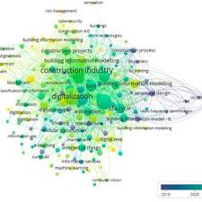
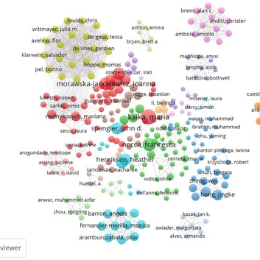
DBA CRITICAL LITERATURE REVIEW FOR DOCTORAL RESEARCH
Visual Strategies for Doctoral Literature Reviews
Ebad Banissi(Prof)

Slide 2
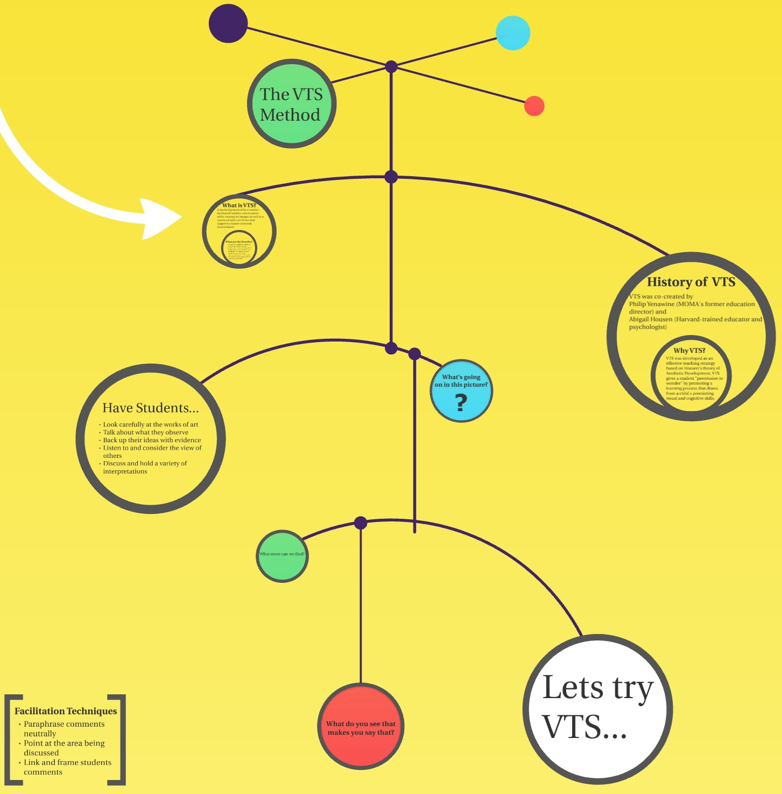
Visual Strategies for Doctoral Literature Reviews
Conceptual Frameworks
Literature Evolution Timelines
Research Gap Matrices
Notes:
For him is Paradise packed with bounties, pleasure and delight and spiritual sustenance and comforts

Slide 3
Why This Matters…
Many doctoral literature reviews fail because they:
  summarise articles
  list authors chronologically
  lack synthesis
  fail to identify a clear research gap
A strong literature review should:
  organise knowledge
  explain theory
  identify research gaps
  justify the research design

Slide 4
The Purpose of a Literature Review
A literature review should answer:
1️⃣ What do we know?
2️⃣ How are concepts related?
3️⃣ What do we still need to know?
Visual tools help researchers structure these answers.

Slide 5
Three Visual Literature Review Tools
Three powerful tools used in high-quality doctoral research:
1️⃣ Conceptual Framework Diagrams
2️⃣ Literature Evolution Timelines
3️⃣ Research Gap Matrices
These tools transform literature reviews from descriptive summaries into analytical synthesis.

Slide 6
Conceptual Frameworks
What is a Conceptual Framework?
A conceptual framework visually represents:
key constructs
theoretical relationships
causal mechanisms
It synthesises existing literature into a theoretical model.

Slide 7
Why Conceptual Frameworks Matter
Conceptual frameworks help researchers:
  organise theoretical constructs
  identify relationships between variables
  develop hypotheses
  clarify research design
They answer:
  How do concepts in the literature relate?

Slide 8
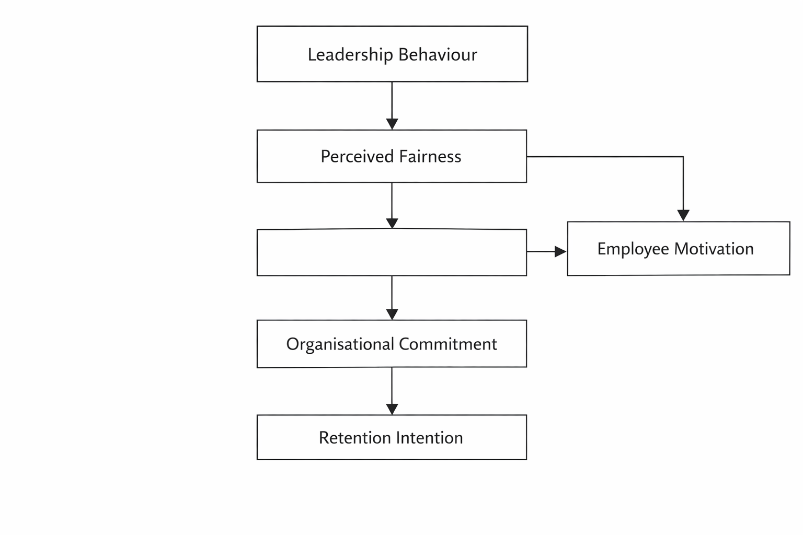
Example Conceptual Framework
Leadership Behaviour
Influences how employees interpret organisational policies and managerial decisions.
↓
Perceived Fairness
Employees evaluate whether reward systems, evaluations, and leadership actions are fair.
↓
Employee Motivation
Perceptions of fairness influence motivation levels and engagement.
↓
Organisational Commitment
Motivated employees develop stronger attachment to the organisation.
↓
Retention Intention
High commitment increases employees’ willingness to remain with

Slide 9
Literature Evolution Timeline
What is a Literature Timeline?
A literature timeline shows how:
  theories evolved
  research themes developed
  new perspectives emerged
It helps researchers understand knowledge development over time.

Slide 10
Why Literature Timelines Matter
Literature timelines help researchers:
identify paradigm shifts
understand theoretical evolution
identify emerging research themes
contextualise their study

Slide 11
Example Timeline
Example: Leadership Research
Period | Key Development
1930s–1950s | Trait theory
1960s–1970s | Behavioural leadership
1980s | Transformational leadership
1990s | Strategic leadership
2000s | Leadership & culture
2010s | Ethical leadership
2020s | Leadership in digital organisations

Slide 12
Timeline Analysis
When analysing literature timelines ask:
  What theories dominate each period?
  What paradigm shifts occur?
  What new research themes emerge?
These insights help identify future research directions.

Slide 13
Research Gap Matrix
What is a Research Gap Matrix?
A research gap matrix compares previous studies across:
  context
  theory
  methodology
  variables
It helps researchers systematically identify gaps in the literature.

Slide 14
Why Research Gap Matrices Matter
Gap matrices help researchers:
  organise large volumes of literature
  compare studies systematically
  justify research questions
  avoid vague research gaps

Slide 15
Example Research Gap Matrix
Example: Leadership and Retention
Study | Context | Method | Focus | Gap
Bass (1985) | US firms | Survey | Leadership | No retention focus
Allen (2003) | HR research | Quantitative | Retention | Leadership not included
Kim (2015) | Hospitality | Regression | Leadership + motivation | No reward systems
Current Study | Oil & Gas Nigeria | Mixed methods | Leadership + reward alignment | Emerging market

Slide 16
Types of Research Gaps
Common research gaps include:
  Context gap (different country or industry)
  Method gap (different research method)
  Theory gap
  Variable gap
  Time gap
Doctoral research often addresses multiple gaps simultaneously.

Slide 17
Integrating the Three Tools
A strong literature review integrates all three tools
Literature Timeline
↓
Conceptual Framework
↓
Research Gap Matrix
↓
Research Questions

Slide 18
Example Integration
Example research process:
1️⃣ Identify key theories using timeline
2️⃣ Synthesise constructs into conceptual framework
3️⃣ Identify missing research using gap matrix
4️⃣ Develop research questions

Slide 19
Key References
Recommended readings:
Paul & Criado (2020)
The art of writing literature review
Webster & Watson (2002)
Analyzing the past to prepare for the future
Torraco (2005)
Writing integrative literature reviews
Snyder (2019)
Literature review as a research methodology

Slide 20
Seminar Exercise
For your doctoral topic, produce:
1️⃣ A literature timeline (10 key studies)
2️⃣ A conceptual framework diagram
3️⃣ A research gap matrix
Then answer:
How does your research contribute to the literature?

Slide 21
From Knowledge Mapping to Research Design
A high-quality literature review progresses through three stages:
Stage 1 — Map the Literature
Use a timeline to understand how knowledge developed.
Stage 2 — Synthesise the Literature
Use a conceptual framework to connect theories and constructs.
Stage 3 — Identify the Gap
Use a research gap matrix to show what is missing.
These three tools transform a literature review from:
reading articles → building a research project

Slide 22
“The Architecture of a Doctoral Literature Review”
Literature review leads to:
  conceptual model
  hypotheses
  research methodology
  contribution to theory
It is one of the most powerful diagrams for teaching DBA students how to structure a thesis.

Slide 23
EXAMPLE

Slide 24
Topic: AI Adoption in Small and Medium Enterprises (SMEs)
Example Research Topic
“Determinants of Artificial Intelligence Adoption in SMEs: The Role of Organisational Readiness and Leadership Capability.”
This example demonstrates:
1️⃣ Literature evolution timeline
2️⃣ Conceptual framework diagram
3️⃣ Research gap matrix

Slide 25
1️⃣ Literature Evolution Timeline
Evolution of AI Adoption Research
Period | Research Focus | Key Insight
1980s | Expert systems | Early organisational AI applications
1990s | IT adoption models | Technology Acceptance Model (TAM)
2000s | Digital transformation | Strategic role of IT
2010s | Machine learning adoption | Organisational readiness becomes critical
2020s | AI-driven organisations | AI strategy and leadership capability
Interpretation
The timeline shows that research evolved from:
technology focus → organisational capability focus
However, SME research remains limited.

Slide 26
2️⃣ Conceptual Framework Example
From the literature, we identify key constructs:
AI adoption
organisational readiness
leadership capability
technological infrastructure
firm performance
Conceptual Framework
Leadership Capability
↓
Strategic Vision
↓
Organisational Readiness
↓
AI Adoption
↓
Operational Efficiency
↓
Firm Performance
Theoretical foundations
Technology Acceptance Model (TAM)
Resource-Based View (RBV)
Dynamic Capabilities Theory

Slide 27
3️⃣ Research Gap Matrix
Study | Context | Method | Focus | Gap
Davis (1989) | IT adoption | Survey | Technology acceptance | No AI context
Venkatesh (2003) | Large firms | Quantitative | Technology adoption | SME context missing
Mikalef et al. (2019) | Large organisations | Mixed methods | AI capability | Leadership role unclear
Ransbotham et al. (2021) | Global firms | Survey | AI strategy | SME adoption understudied
Proposed Study | SMEs | Mixed methods | Leadership capability + AI adoption | SME leadership perspective

Slide 28
Integrating the Three Tools
Literature Timeline
↓
Understanding evolution of AI adoption research
Conceptual Framework
↓
Identifying relationships between leadership, readiness, and AI adoption
Research Gap Matrix
↓
Identifying missing SME leadership research
Research Question
↓
How does leadership capability influence AI adoption in SMEs?

Slide 29
Example Research Questions
Central research question:
  How does leadership capability influence AI adoption in SMEs?
Sub-questions:
  How does organisational readiness affect AI adoption?
  What role does leadership vision play in digital transformation?
  How does AI adoption influence SME performance?

Slide 30
Example DBA Contribution
Academic contribution
Extends AI adoption literature to SME context
Integrates leadership theory and technology adoption theory
Develops an AI adoption framework for SMEs
Practical contribution
Helps SME leaders implement AI effectively
Supports digital transformation strategies
Improves organisational capability development

