Slide 1
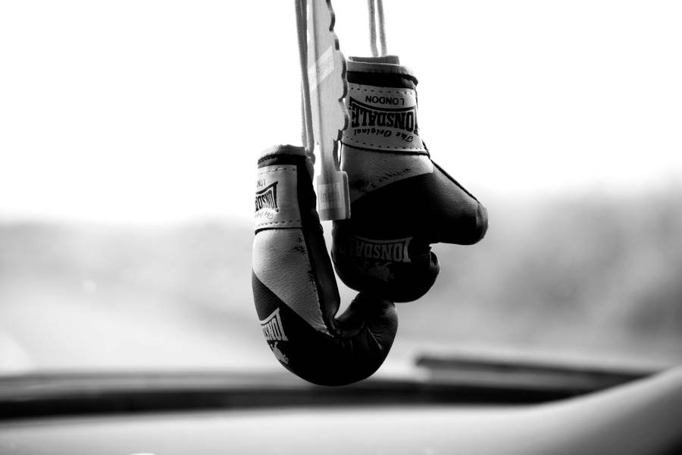

BUSINESS PLAN
Title: Boxing Academy
Alexandru Csaba Eros 2008584
Lecturer Name:Vasilios Tavlaridis

Slide 2
Introduction of yourself
Alexandru Csaba Eros
I am 28 years old.
I’m from Romania and I have been in the UK for 4 years.
I want to start my own business but I would like to advance to manager position in the company I work.

Slide 3
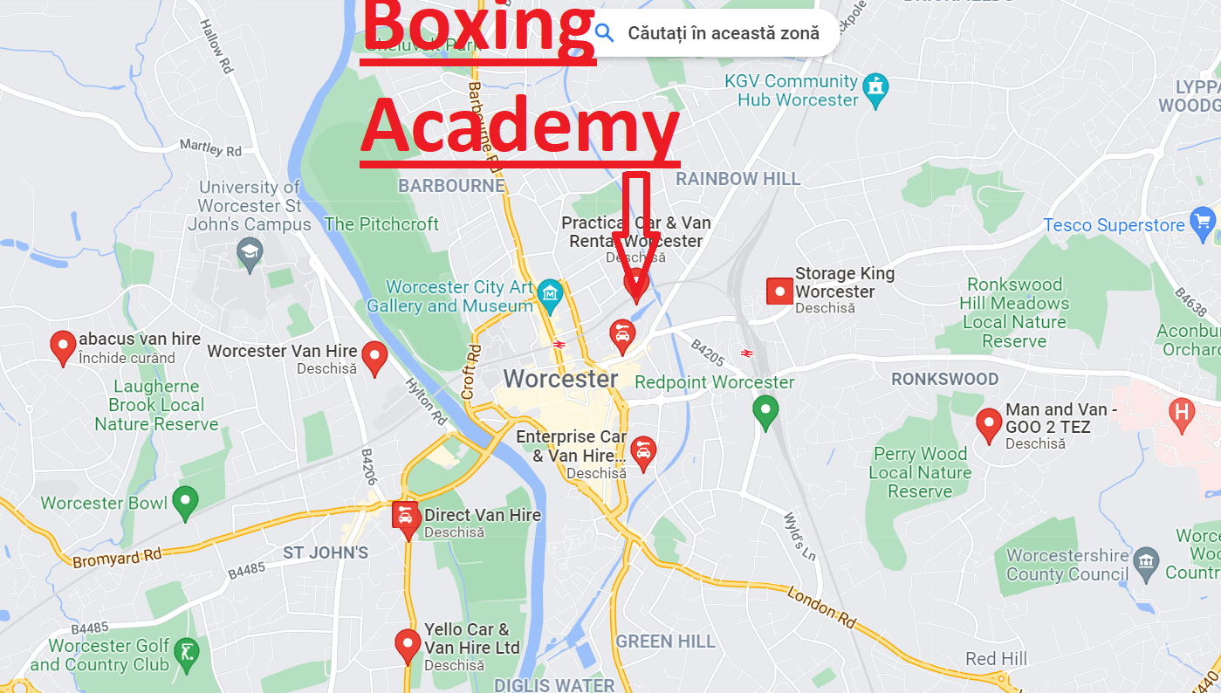

Business/Company Overview
*Near City Centre in Worcester
*Boxing and fitness>Lifting Weights
*Gym Shop *Cardio/Strength Equipment
*Boxing bags and Boxing ring.

Slide 4
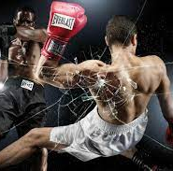
Product or Service
3 Levels of Boxing training Challenge.Learn the technique.
Professional fitness and strength Building trainers.
Personalized nutritional plan.Keep in shape.
Sparring with the professional trainers in the boxing ring.

Slide 5

Market Research
We are the cheapest in west midlands.
Most complete service offer.
Creative and interactive training sessions.
We encourage anyone to join.Experienced/ unexperienced.

Slide 6

Target Market
We think we can make anyone join no matter the age,physical shape,experience or sex.
Don’t be afraid we will teach you the technique.
It is 100% safe!You won’t get Hurt!
To determine the target market for the business it will use the STP.

Slide 7
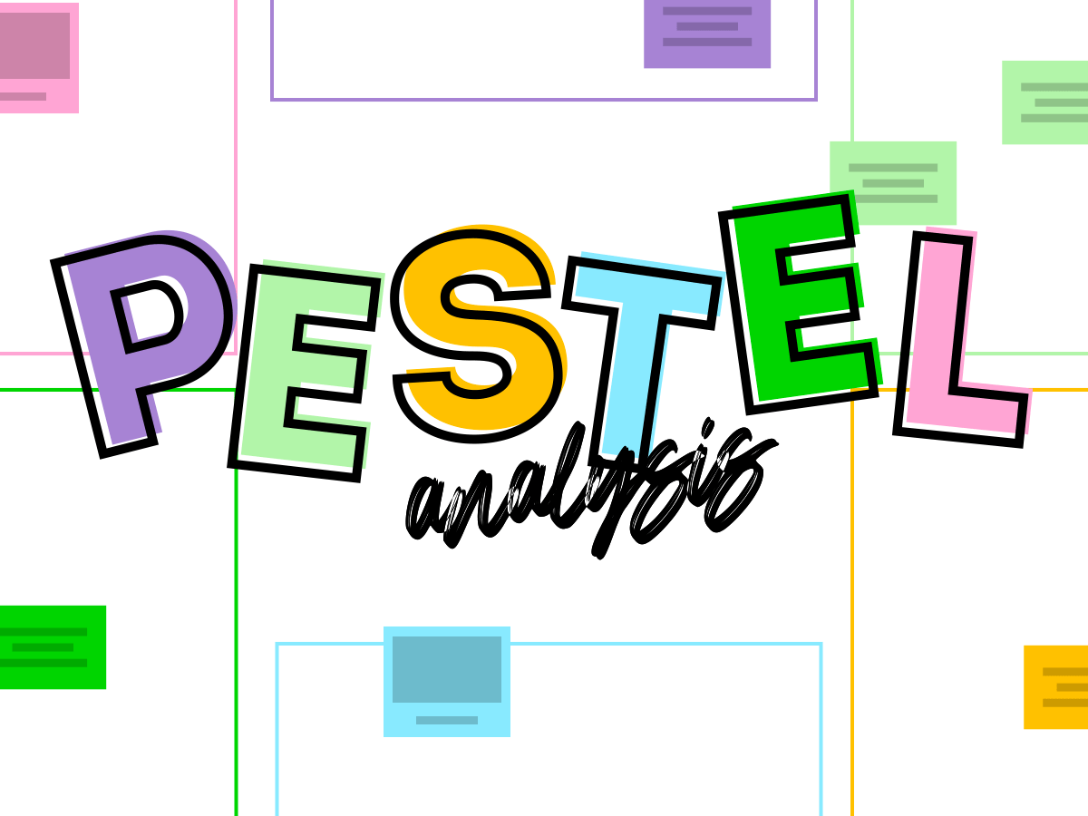
PESTEL Analysis
Political
The UK has a stable political environment with a stability index of 0.47 as of 2020 (The Global Economy, 2022).
The corruption index rate of the UK was noted to be 78 (Trading Economic, 2022).
Economical
The GDP growth rate of the UK experienced an expansion in the first quarter by 0.8% (Trading Economics, 2022).
The interest rate of the UK as of 2022 was 1.25% which indicates a low interest rate for a country (Trading Economics, 2022).
Social
The UK has a high literacy rate that amounts to 7.1 million people being literate (National Literacy Trust, 2022).
The GDP per capita income of the UK is 47334.4 USD as of 2021 (The World Bank, 2022).
Technical
The internet usage rate for the UK is 94.62% as of the year 2020 (Statista, 2022).
The research and development expenditure of the UK is 1.74% as of the year 2019 (Rhodes et al., 2021).
Environment
Energy Act of 2020 in the UK suggests that businesses in planning their energy usage and reduce their extreme consumption of it (Field.ORG.UK, 2018).
Hazardous Waste Regulation of 2005 in the UK covers issues that are regarded as harmful to the environment (Country Cycle, 2022).
Legal
Health and Safety at Work Act 2010 suggest making a safer workplace work for the employees. It suggests mitigating any kind of hazard that might occur in the workplace (Citation, 2022).
The UK has an Equality Act of 2010 that suggest the organisation in maintaining and promoting equality among the employees (GOV.UK, 2022).
PESTLE analysis is referred to as the framework that allows an organisation in determining its external environment (Matovic, 2020).
Political
This indicates a stable politics that shows Boxing Academy will be able to run smoothly without being subjected to constant changes in laws. This in comparison to other countries is a clean and corruption free country. It also indicates that the business will be able to run smoothly and will not have to pay illegal taxes to the authorities.
Economical
This is able to help the business in generating decent revenue as the purchasing power of the citizens is indicated to be high. It is also low in comparison to other economies in the world. It will allow the business in taking loans from the bank and investing them in further business operations.
Social
This is high literacy in comparison to other countries. It indicates that the company will be able to recruit highly skilled employees to enhance their productivity. In comparison to other countries the per capita income is high in the UK. This indicates that business will be able to generate decent revenue as the purchasing power of consumer will be high.
Technical
This will allow the business in promoting their service on the internet and attract higher clientele. This amounts to 38.5 billion GBP of the total GDP of the country. This shows that the organisation will have access to advanced automation that will help them in enhancing their productivity. It will also allow them in using advanced equipment that will help them in fitness opportunities.
Environment
Following this act might help the business in contributing positively to the environment. It restricts dumping waste that consists of fluorescent tubes, television sets, PC monitors and more. The organisation must follow this regulation as it will help them in establishing better CSR policies.
Legal
This law will allow the organisation in maintaining good relations with their employees. It helps people from being discriminated against in the basis of colour, religion and more. Following this law will allow the organisation in maintaining better relationship with their employees. It will help them in establishing appropriate employee laws that will restrict any discrimination in the workplace.

Slide 8
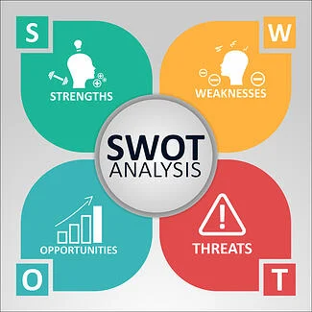
SWOT Analysis
Strength
The organisation has a larger capital that can be invested in the marketing of the services.
Weakness
The business is not known to a larger audience, which might restrict them from attracting new consumers.
Opportunities
The political stability and the recovering GDP of the UK can be helpful for the business in making decent revenue.
Threat
The constant change in consumer preferences might affect the organisation and its success in the future.
SWOT analysis is referred to the strengths and weaknesses of a company (Benzaghta et al., 2021). The model allows for determining the opportunities and threats for the business.
Strength
It also has highly skilled owners with greater competency to operate and gain success through operations.
Opportunities
It can easily grow steadily and gain success in the future.

Slide 9
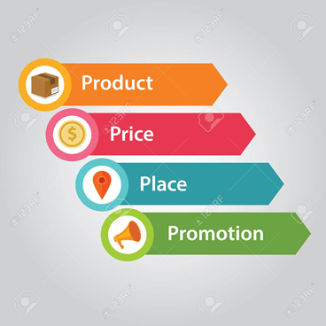
Marketing mix (4Ps)
Price
Boxing Academy will be using the competitive pricing strategy.
Product
The academy will provide joiners with adequate training programmes and nutritional plans that will help them in being fit.
Place
The services will be provided in the UK.
Promotion
It will use both online and offline means to promote the product.
Price
This will allow them in providing their services at a lower price than their competitors in the market provide. Competitive pricing strategy will help the organisation in attracting people who belongs from the lower income class. It will also allow them in enhancing their clientele every year.
Product
The organisation will offer the consumer with advanced equipment and trainer who will help them in being fit and healthy. It will ensure that the consumer get the value form the services they pay for.
Promotion
Online means will include using social media platforms. Offline means might include magazines and television advertising.

Slide 10
Financial plan
Components | Budget (￡)
Marketing | 3000
Rent | 2000
types of equipment | 4000
Staffing | 5000
Total | 14000

Slide 11

Refferences
Benzaghta, M.A., Elwalda, A., Mousa, M.M., Erkan, I. and Rahman, M., 2021. SWOT analysis applications: An integrative literature review. Journal of Global Business Insights, 6(1), pp.55-73.
Camilleri, M.A., 2018. Market segmentation, targeting and positioning.In Travel marketing, tourism economics and the airline product (pp. 69-83).Springer, Cham.
Citation, 2022.UK Employment Laws Explained [online] Available at: https://www.citation.co.uk/news/hr-and-employment-law/uk-employment-laws-explained/#:~:text=UK%20employment%20laws%20are%20in,relationship%20between%20the%20two%20fair.[Accessed 09 August 2022]
Country Cycle, 2022. LEGISLATION [online] Available at: https://www.countrystylerecycling.co.uk/about-us/compliance/legislation/#:~:text=The%20Environmental%20Protection%20Act%201990%2C%20a%20UK%20act%20of%20parliament,of%20pollution%20from%20industrial%20processes. [Accessed 09 August 2022]
Field.ORG.UK, 2018.List Of Environmental Laws [online] Available at: http://www.field.org.uk/list-of-environmental-laws/[Accessed 09 August 2022]
GOV.UK, 2022. Equality Act 2010: guidance [online] Available at: https://www.gov.uk/guidance/equality-act-2010-guidance#:~:text=Print%20this%20page-,Overview,strengthening%20protection%20in%20some%20situations. [Accessed 09 August 2022]
Kurniawan, D., Iswahyudin, M.D. and Suciati, T.R., 2020. SWOT Analysis and Ansoff Matrix in Creative Food Industry Business Development: A Study on Creative Food Business “Komala”. Open Access Indonesia Journal of Social Sciences, 3(2), pp.128-136.
Mariotti, S. and Glackin, C., 2016. Entrepreneurship: starting and operating a small business. Pearson.
Matovic, I.M., 2020. PESTEL analysis of external environment as a success factor of startup business. ConScienS, p.96.
National Literacy Trust, 2022.Adult literacy [online] Available at: https://literacytrust.org.uk/parents-and-families/adult-literacy/#:~:text=Information%20on%20adult%20literacy%20in,having%20'very%20poor%20literacy%20skills.[Accessed 09 August 2022]
Rhodes, C., Hutton, G., and Ward, M., 2021. Research and development spending [online] Available at: https://commonslibrary.parliament.uk/research-briefings/sn04223/#:~:text=In%20the%20UK%20in%202019,real%20terms%20increase%20of%2096%25.[Accessed 09 August 2022]
Statista, 2022.Gym, health &fitness club industry market size in the United Kingdom (UK) 2012-2022 [online] Available at: https://www.statista.com/statistics/1194831/fitness-health-club-market-size-uk/#:~:text=While%20the%20market%20size%20of,billion%20British%20pounds%20in%202021.[Accessed 09 August 2022]
Statista, 2022.Internet penetration in the United Kingdom (UK) 2000-2020 [online] Available at: https://www.statista.com/statistics/468663/uk-internet-penetration/[Accessed 09 August 2022]
The Global Economy, 2022.United Kingdom: Political stability [online] Available at: https://www.theglobaleconomy.com/United-Kingdom/wb_political_stability/ [Accessed 09 August 2022]
The World Bank, 2022. GDP per capita (current US$) - United Kingdom [online] Available at: https://data.worldbank.org/indicator/NY.GDP.PCAP.CD?locations=GB [Accessed 09 August 2022]
Trading Economic, 2022. United Kingdom Corruption Index [online] Available at: https://tradingeconomics.com/united-kingdom/corruption-index [Accessed 09 August 2022]
Trading Economics, 2022. United Kingdom Interest Rate [online] Available at: https://tradingeconomics.com/united-kingdom/interest-rate [Accessed 09 August 2022]
Trading Economics, 2022.United Kingdom GDP Growth Rate [online] Available at: https://tradingeconomics.com/united-kingdom/gdp-growth[Accessed 09 August 2022]
Tsatsoula, E., 2018. Application of Ansoff's Matrix-Methodology: Marketing Growth Strategies For Products.

