Slide 1
ACADEMIC AND EMPLOYABILITY SKILLS
MODULE CODE:
MODULE NAME:

Slide 2

INTENDED CAREER, ROLES AND RESPONSIBILITIES
My intended career is to take a superior and prestigious job to improve the needs of school children by raising awareness and enhancing their knowledge.
It assists in ensuring the involvement of parents and students to improve their educational process to foster teaching-learning (Grob et al. 2019).
Notes:
Working with the needs of children is a prestigious option that takes the role of both "teacher and social worker." I want to develop my career in this field to support children of different backgrounds and eradicate illiteracy from the country. This gear is significant to examine and assess students' educational environment and other factors affecting their physical, mental and emotional health. Adapting general education lessons to various subjects, I take the role of enhancing students' knowledge about the universe and their fundamental rights as citizens.

Slide 3
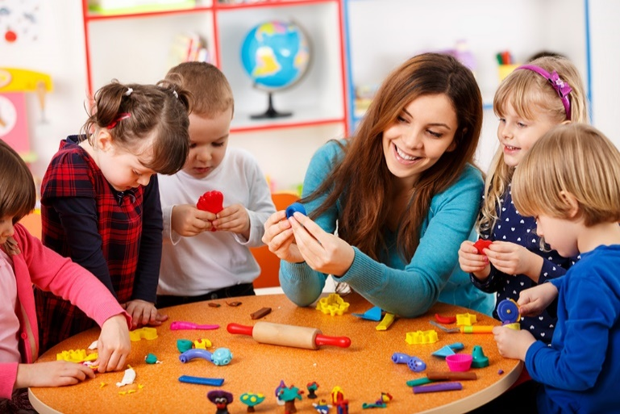
CONTD…
The key responsibility of this career is to understand students' needs and factors affecting their education to improve their knowledge.
As opined by Price (2019), the significant role of the profession is to deliver instruction to assist students in learning by preparing lessons and offering feedback.
Notes:
The role and responsibilities of a teacher are essential to improve and enhance students' careers by understanding their social environment. I am highly concerned about delivering proper relations to the students and encouraging them about this vast universe and their fundamental rights. This job role also ensures safety, security and stability through educational support and listening actively about their actual problems. I have also taken the responsibility to create a better teacher-student relationship to facilitate their learning skills.

Slide 4
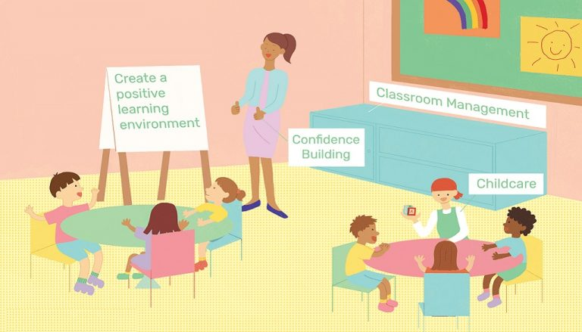
SKILLS
In taking the roles of a teacher and social practitioner, academic, employability and communication skills are required to achieve this intended career option (Beardsley et al., 2021).
Graduation in a subject is the critical educational capability to spread education and improve students' knowledge.
Notes:
Educational capabilities play a significant role through critical thinking, communication and collaboration, and it further assists in vital success in schools. Improvement of the academic skills in this century is substantial to provide lessons and encourage the students to enrich their knowledge in different addresses. In addition, it further improves teachership skills in spreading knowledge and improving student outcomes on a particular subject.

Slide 5

CONTD…
Employability skills of teachers are also significant, which involve learning, problem-solving, creative thinking, self-management and taking the initiative.
It improves teachers' interpersonal and problem-solving skills by meeting students' needs with initiatives and reducing illiteracy (Huttar and BrintzenhofeSzoc, 2020).
Notes:
The role of a social practitioner and teacher is essential for the benefit of society and for improving personal development skills for the country. It further ensures safety and security and enhances the educational abilities of minority groups and deprived and socially marginalized students. Due to the lack of different ideologies and political complexities in these challenging times, gender diversities are becoming a fundamental issue. In this aspect, improving the Employability Skills of social practitioners and teachers is essential for society to raise awareness and spread knowledge by meeting childrens' needs.

Slide 6

CONTD…
Communication skills, exceptionally verbal, are a significant capability in teaching to understand students, deficiencies and backgrounds.
Downes and Brosseuk (2022) noted that active listening capabilities, verbal communication, and humour encouraged the students to develop their knowledge through playing activities.
Notes:
Therefore, the role of the teacher and social practitioner requires diverse communication, education and employability skills to reach the students. It further reduces student fears and develops teacher-student relationships, and students are able to share their problems with specific teachers. Improvement of communication, employability and academic skills are significant to reach different students and enhance their knowledge. To achieve this intended career, practical communication skills, active learning capabilities, problem-solving, team activities, and decision-making capabilities are core skills.

Slide 7
WAYS TO ACHIEVE THESE SKILLS
Learning and development need | Types of development | Timescales | Who is Responsible | Further Outcome
Graduation in any subject | Developing knowledge in a specific subject | 2-3 years | The candidate | It makes the students able to develop specific skills and knowledge.
Knowledge of constitution and fundamental rights | Understanding the Fundamental Rights of a citizen to access education and proper healthcare. | Six months | The student | It assists in understanding students from developing and getting a proper education.
Communication skills | This type of development is necessary to understand students' needs and develop their knowledge (Price, 2019). | One month | The candidate | It creates a significant bond with the students to develop their understanding process.
Teachership skills | This social and intellectual development is required to improve the career in this area. | Six months | The candidate | This skill significantly contributes to students' knowledge with proper teaching-learning.
Decision-making skill | This moral development is required to instruct the students in different activities. | Two months | The candidate | It brings different initiatives to understand students' situations in diverse circumstances.

Slide 8
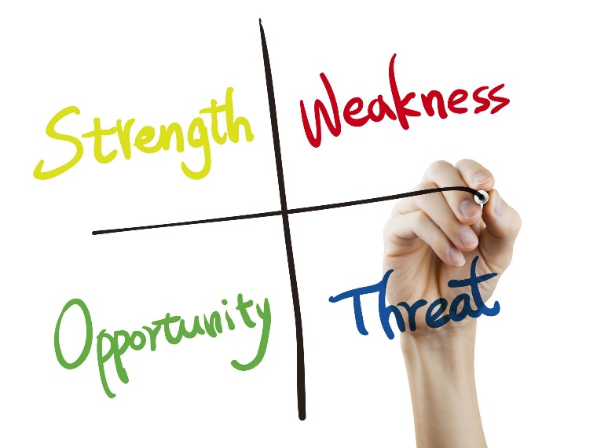
SWOT ANALYSIS
In terms of achieving the goal, I have developed my communication and listening skills to understand students' requirements.
The major weakness is managing time and problem-solving skills, which can raise different problems (Porayska-Pomsta et al. 2018).
Notes:
These strengths and weaknesses are significant to developing my skills and improving my knowledge in this area by understanding students' needs. Practical communication skills assist me in sharing different concepts and building strong relationships with young minds. It further improved the teaching-learning process, and I am able to spread knowledge on diverse issues and my specific subjects. This analysis is significant to identify my weakness in time managing and problem-solving skills, and it should be developed to achieve my intended career options.

Slide 9
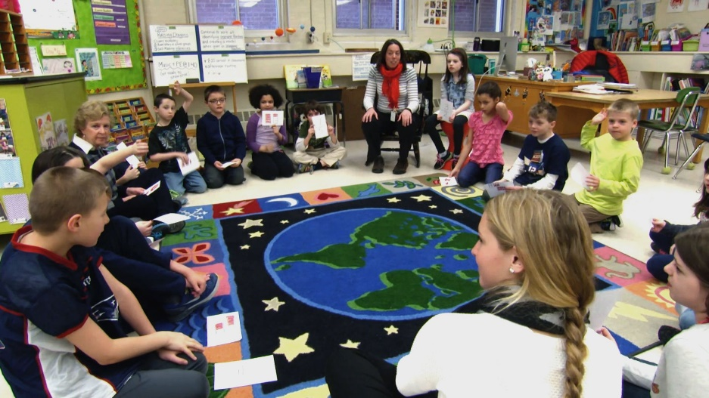
CONTD…
My educational capabilities as a graduate and teaching skills are vital opportunities that foster me in taking these career options.
The emergence of property in different areas, lack of proper resources, social prejudices and presence of additional graduates are other challenges (Arko-Achemfuor et al., 2019).
Notes:
My academic qualification is the significant opportunities that assist in taking this job role, and the presence of diverse communities and misconceptions stands as a barrier. I am highly concerned about mitigating weaknesses and threats by developing and utilizing opportunities to take a prestigious role in this field. As a graduate, my teachership capabilities are essential to spreading my knowledge for the benefit of society and eradicating illiteracy from this country. The personal development plan assists me in enhancing my employability capabilities and makes me suitable for this role.

Slide 10
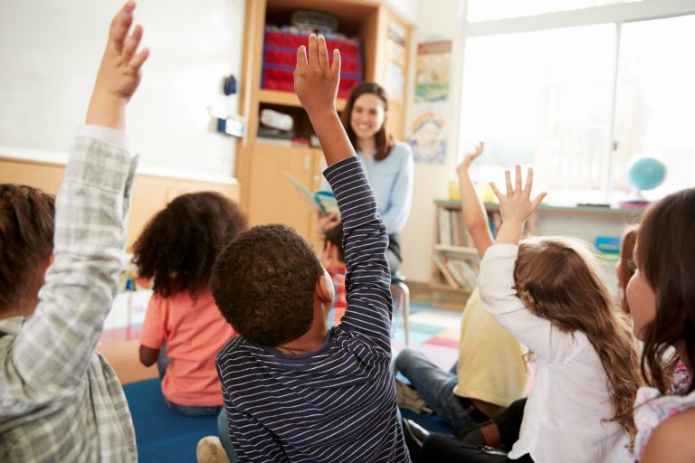
CONCLUSION AND REFERENCES
Based on the above discussion, it can be concluded that the role of a teacher and social practitioner is significant by enhancing communication and academic and employability skills.
The study critically explains SWOT analysis and Personal Development Plan with the required skills to understand my condition and ensure my success in this field.
Notes:
Arko-Achemfuor, A., Romm, N. and Serolong, L., 2019. Academic-practitioner collaboration with communities towards social and ecological transformation. International Journal for Transformative Research, 6(1), pp.1-9.
Beardsley, M., Albó, L., Aragón, P. and Hernández‐Leo, D., 2021. Emergency education effects on teacher abilities and motivation to use digital technologies. British Journal of Educational Technology, 52(4), pp.1455-1477.
Downes, L. and Brosseuk, D., 2022. The sophisticated literacy practitioner and the global pandemic. The Australian Educational Researcher, 49(2), pp.347-365.
Grob, C.M., Lerman, D.C., Langlinais, C.A. and Villante, N.K., 2019. Assessing and teaching job‐related social skills to adults with autism spectrum disorder. Journal of applied behavior analysis, 52(1), pp.150-172.
Huttar, C.M. and BrintzenhofeSzoc, K., 2020. Virtual reality and computer simulation in social work education: A systematic review. Journal of Social Work Education, 56(1), pp.131-141.
Porayska-Pomsta, K., Alcorn, A.M., Avramides, K., Beale, S., Bernardini, S., Foster, M.E., Frauenberger, C., Good, J., Guldberg, K., Keay-Bright, W. and Kossyvaki, L., 2018. Blending human and artificial intelligence to support autistic children’s social communication skills. ACM Transactions on Computer-Human Interaction (TOCHI), 25(6), pp.1-35.
Price, A., 2019. Using outdoor learning to augment social and emotional learning (SEL) skills in young people with social, emotional and behavioural difficulties (SEBD). Journal of Adventure Education and Outdoor Learning, 19(4), pp.315-328.

