Slide 1

Sress levels in the UK
STUDENT NUMBER: 2027579
NAME: DELIA MARIA- MICLEA
MODULE: BMSW4004
LECTURER:YOHAN MENDIS

Slide 2
INTRODUCTION
Stress is the body's reaction to feeling threatened or under pressure. It's very common, can be motivating to help us achieve things in our daily life, and can help us meet the demands of home, work and family life.
But too much stress can affect our mood, our body and our relationships – especially when it feels out of our control. It can make us feel anxious and irritable, and affect our self-esteem.
Experiencing a lot of stress over a long period of time can also lead to a feeling of physical, mental and emotional exhaustion, often called burnout.

Slide 3
Job stress can be defined as the harmful physical and emotional responses that occur when the requirements of the job do not match the capabilities, resources, or needs of the worker. Job stress can lead to poor health and even injury. The concept of job stress is often confused with challenge, but these concepts are not the same. Challenge energizes us psychologically and physically, and it motivates us to learn new skills and master our jobs. When a challenge is met, we feel relaxed and satisfied.

Slide 4
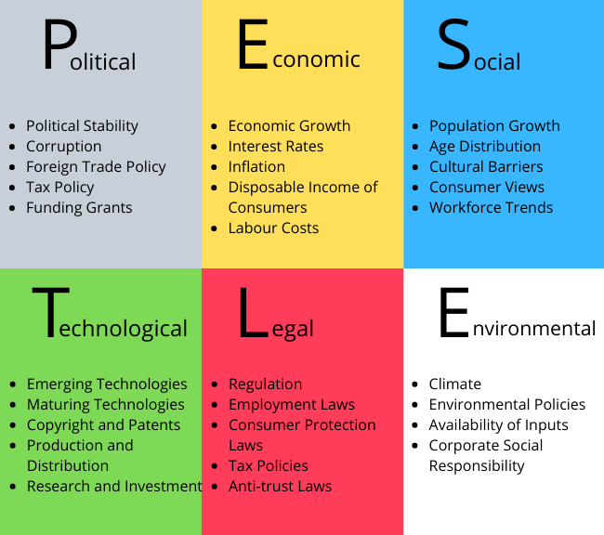
environment
A PESTLE study enables a deliberate and methodical assessment of the prospects, risks, and opportunities for a firm in a new environment.
While a SWOT analysis focuses on an organization's internal processes, PESTLE focuses on external issues.
PESTLE is suitable for both big and small tasks.

Slide 5
Cause and effect analaysis
Cause:
being under lots of pressure.
facing big changes.
worrying about something.
not having much or any control over the outcome of a situation.
having responsibilities that you're finding overwhelming.
not having enough work, activities or change in your life.
times of uncertainty.
Effect:
Stress can play a part in problems such as headaches, high blood pressure, heart problems, diabetes, skin conditions, asthma, arthritis, depression, and anxiety.

Slide 6
POSSIBLE SOLUTION
Encourage workplace wellness.
Revamp the habitat.
Allow for flexible hours and remote working.
Encourage social activity.
Create quiet time.
Recognize your employees.

Slide 7
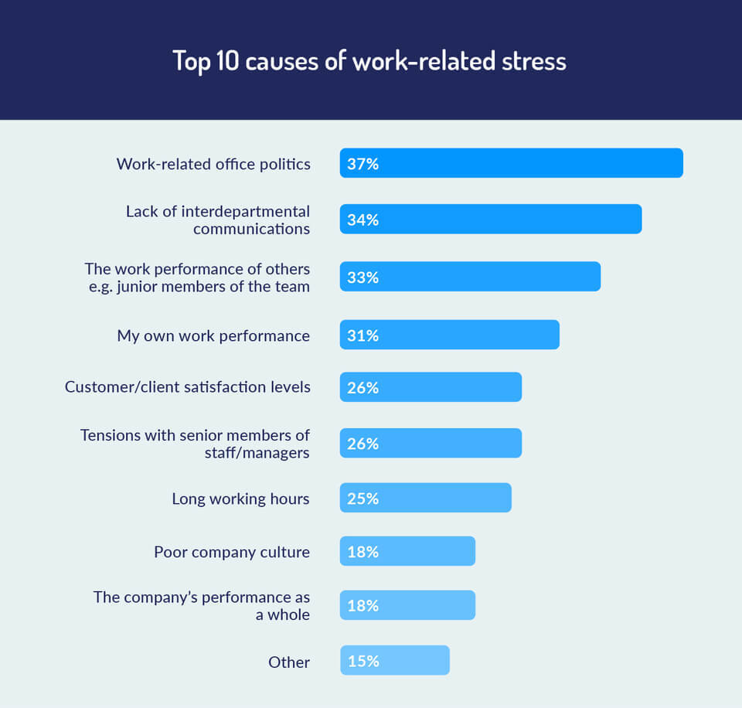

Slide 8
Summary and conclusion
In conclusion, Stress is a reaction that individuals may have when confronted with job expectations and pressures that are out of step with their knowledge and skills and that put their capacity to cope in jeopardy. Stress occurs in a broad variety of work situations, but is often exacerbated when employees perceive a lack of support from superiors and co-workers, as well as a lack of control over work procedures. Often, the terms "pressure" or "challenging" and "stress" are used interchangeably, and this is often used to justify poor management practises. Workplace pressure is inescapable owing to the demands of today's work environment. Individuals who tolerate pressure may even remain attentive, motivated, and capable of work and learning, depending on available resources and personal attributes. When that pressure becomes overwhelming or uncontrollable, however, it results in stress. Stress may have a detrimental effect on both an employee's health and the success of the firm.

