Slide 1

Finding and using information: an introduction.
Alison Evans.
Academic Liaison Librarian.

Slide 2

The aims of today's session.
Consider the importance of academic information and critical thinking.
See how to locate and navigate the library web pages – help and support.
Begin using library resources – online resource lists, library catalogue.
Notes:
Overview

Slide 3

Set some time aside when you begin your studies to learn about the services the library provides and how they can help you.
It will save you time and improve your results.

Slide 4
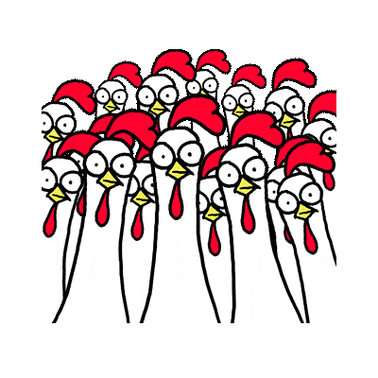
Evaluate all information critically.
Currency. | Relevance. | Authority. | Accuracy. | Purpose.
Is it up-to-date? | Who is the intended audience? Will it help further your argument? | What are the author’s credentials? | Can it be verified - is it supported by evidence? | Why has it been produced? Is it objective?
CRAAP Test.
InfoSkills Section – Evaluating Information.

Slide 5
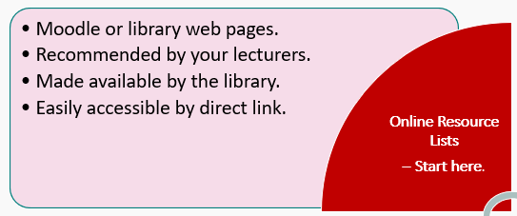
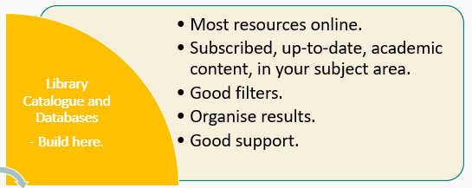
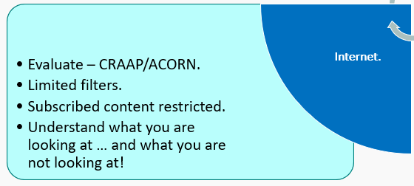
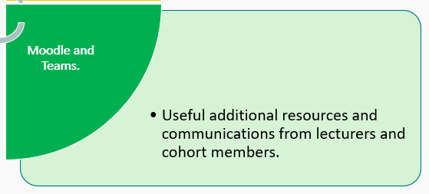
Where to begin searching for academic information.

Slide 6
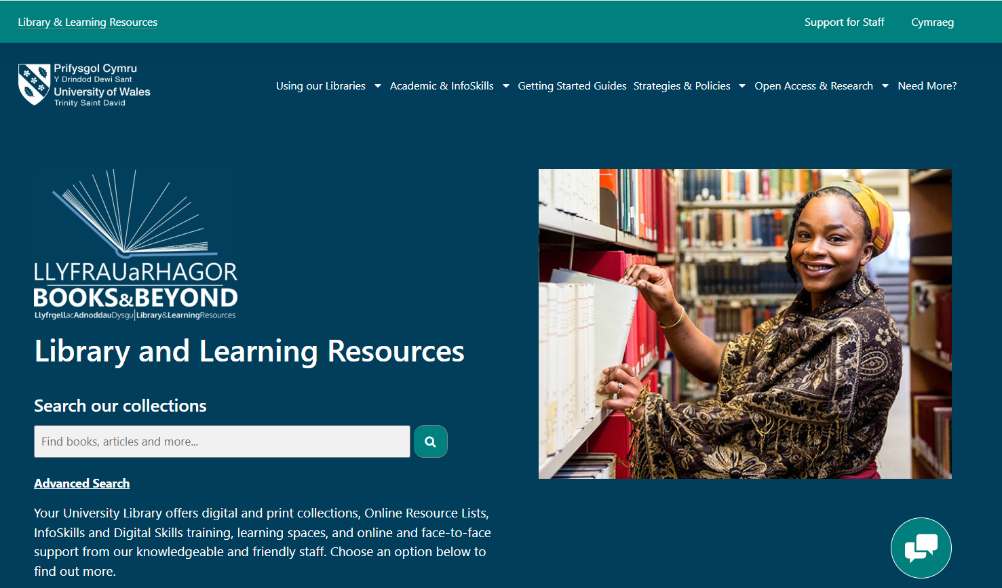
Library resources are found on the university web pages.
The library pages look like this.
From here you can access our library resources. Find at:
https://digitalservices.uwtsd.ac.uk/library/
UWTSD web pages - Hwb – Library.
Remember: bookmark the location!

Slide 7
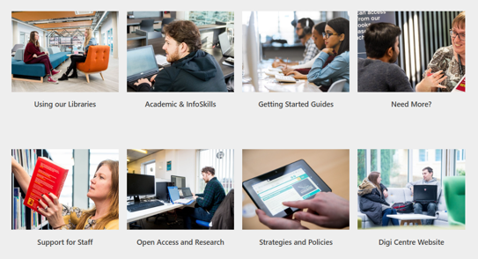
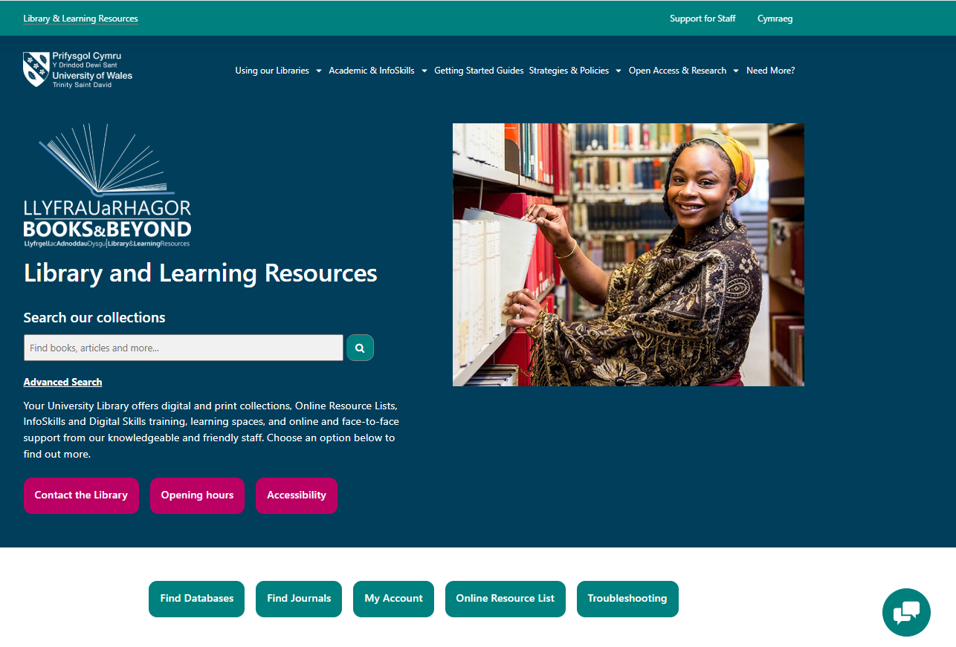
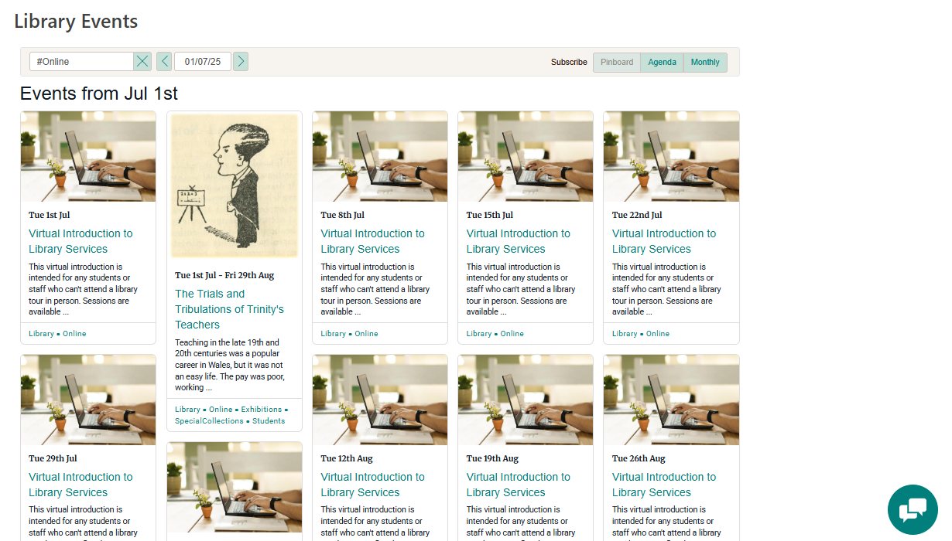
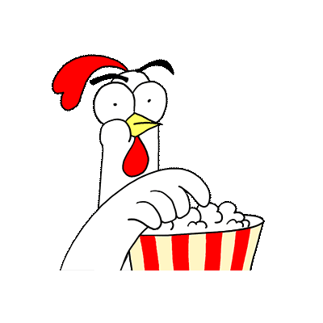
From the library web pages you can …
Search the library catalogue.
Locate online help and support.
Find library events.
Library web pages.

Slide 8
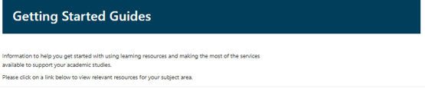

Getting started.
If you are unsure where to begin, go to our Getting Started pages.
Choose from the list of subjects to find:
Online resource lists.
Reference guides.
Library catalogue.
Popular and new books in your subject.
Journals.
Digital skills support.
Academic and Infoskills programme.
Getting Started Guides

Slide 9
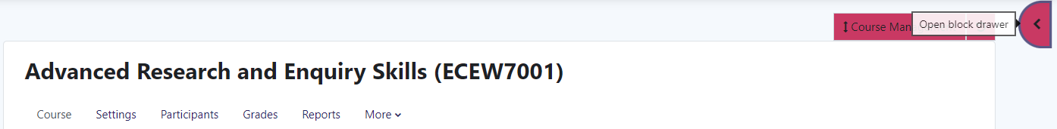
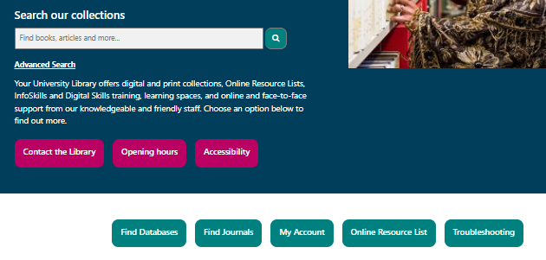
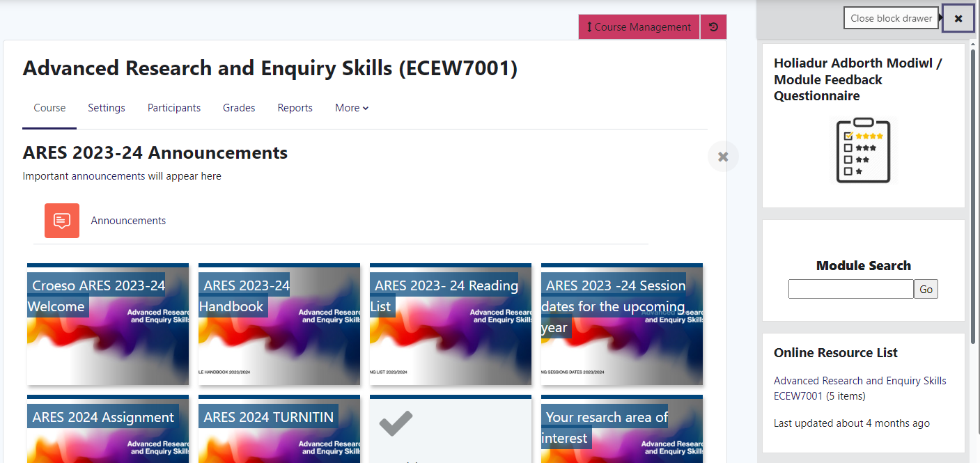
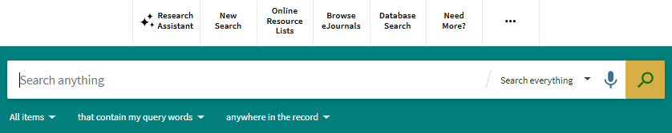
What are online resource lists?
Resources recommended by your lecturers, made available by the library. Access resources directly; learn key terms and authors.
Online Resource Lists
Via Moodle.
Via Library Catalogue.
1
2

Slide 10
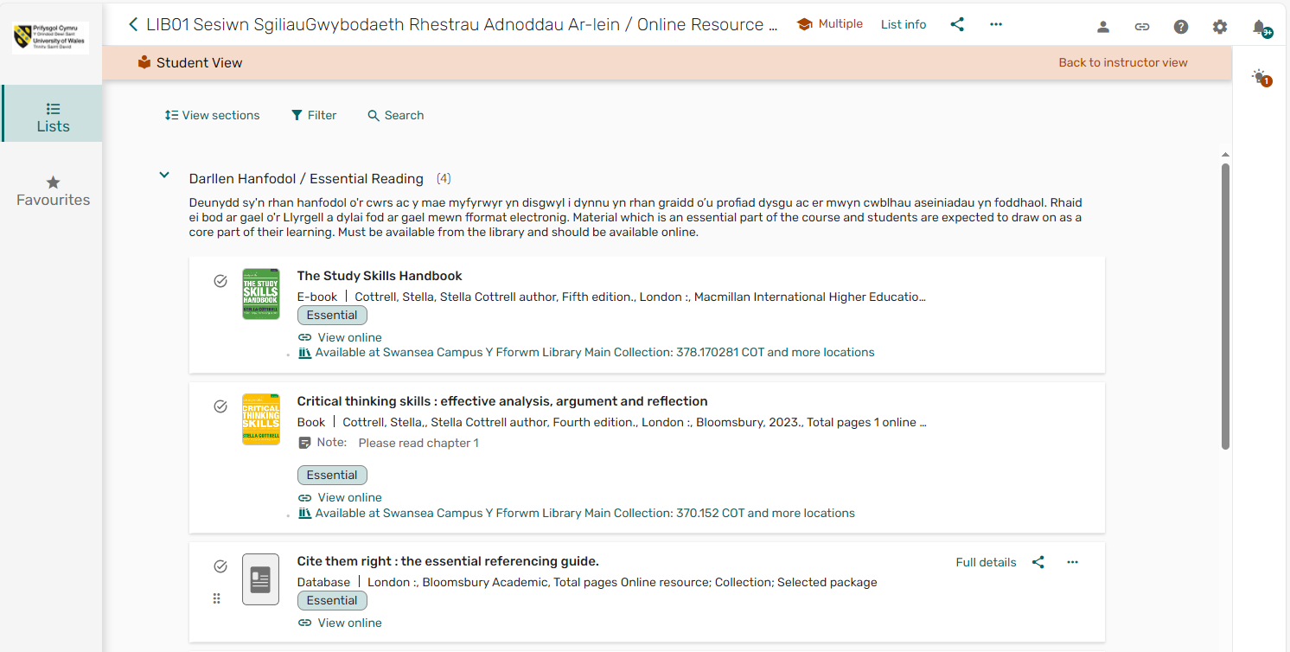
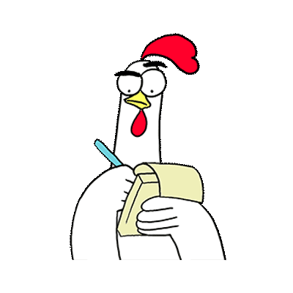
Why use an online resource list?
Prioritised Essential and Further resources.
Checked by library. Easy to use, direct links to live content or loan information.
Recommended and annotated by lecturers.
Add Lists and create your own Favourites.
4
1
2
3
Links: Online Resource Lists page
Infoskills Section - Online Resource Lists

Slide 11
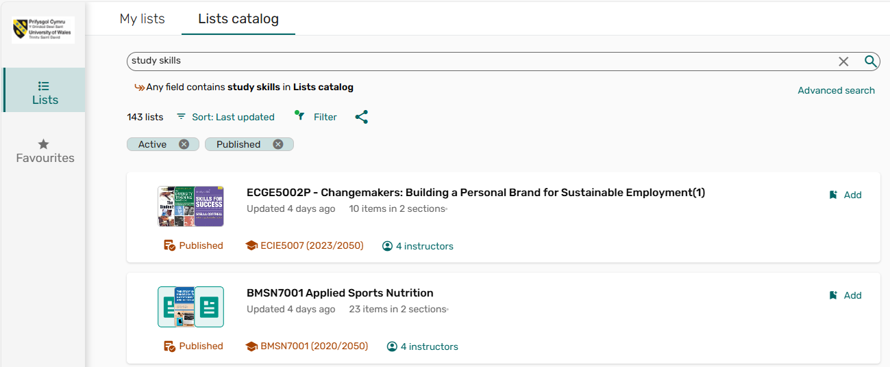
Online resource lists: maintain your own Lists.
My lists are a collection of resource lists associated with modules you are enrolled on, or which you have added to your account. Lists catalog includes all resource lists.
In Lists (left of screen), you can add any online resource lists to your own collection of lists:
Choose the Lists catalog tab and search for a resources list, code, subject or lecturer.
Go to the list and click Add to my lists.
1
2

Slide 12
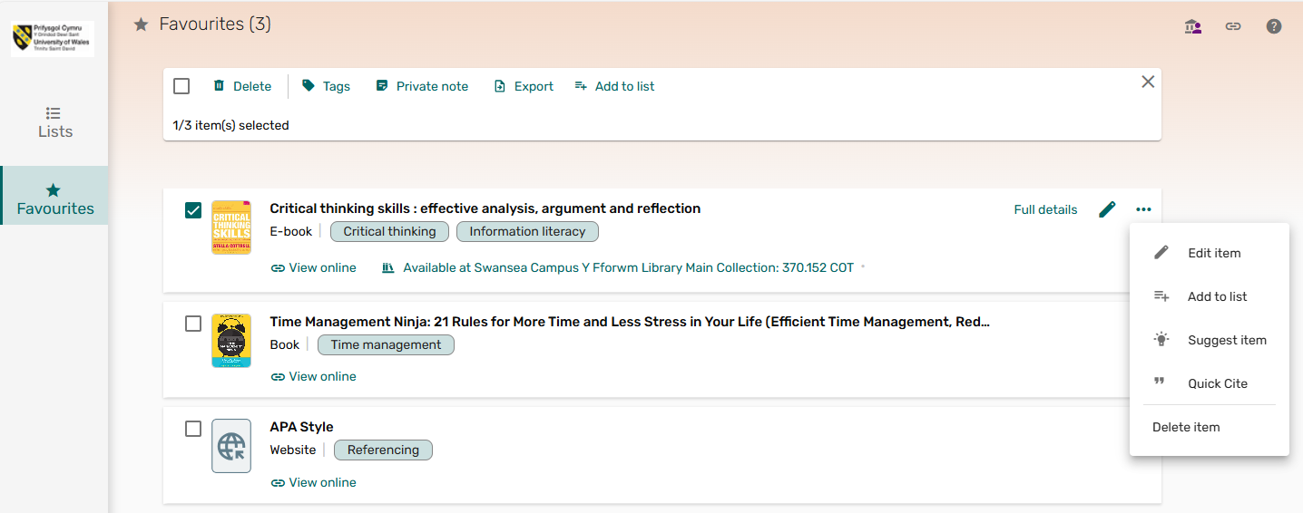
Create and manage your favourite information.
In Favourites (left of screen), you can create and manage your own resource list of favourite items. This will make it easier to retrieve resources. It is also useful for saving references.
Add a Private note.
Tag information to make it easier to retrieve.
Find full bibliographical details.
Additional functions.
1
3
2
4
Remember: Online resource lists are a starting
point. Do not limit yourself!

Slide 13

Why use the library catalogue?
A search on the library catalogue will include most of our full-text databases. It provides free access to good quality, subscribed resources which are up-to-date and in your subject area, in multiple formats:
Electronic and print based books.
Specialist databases and journal articles.
Newspapers.
Conference proceedings and reviews.
Legislation and statistical data.
Visual media, eg. videos and photographs.
And much more ...

Slide 14

You can also use the library catalogue to...
Check loan information, make requests.
Save favourite resources.
Organise saved information - add labels, set alerts.
Find help with referencing, export to RefWorks.
Finding good quality information which you can organise and recall when needed, will help improve you work and ultimately your grade.

Slide 15
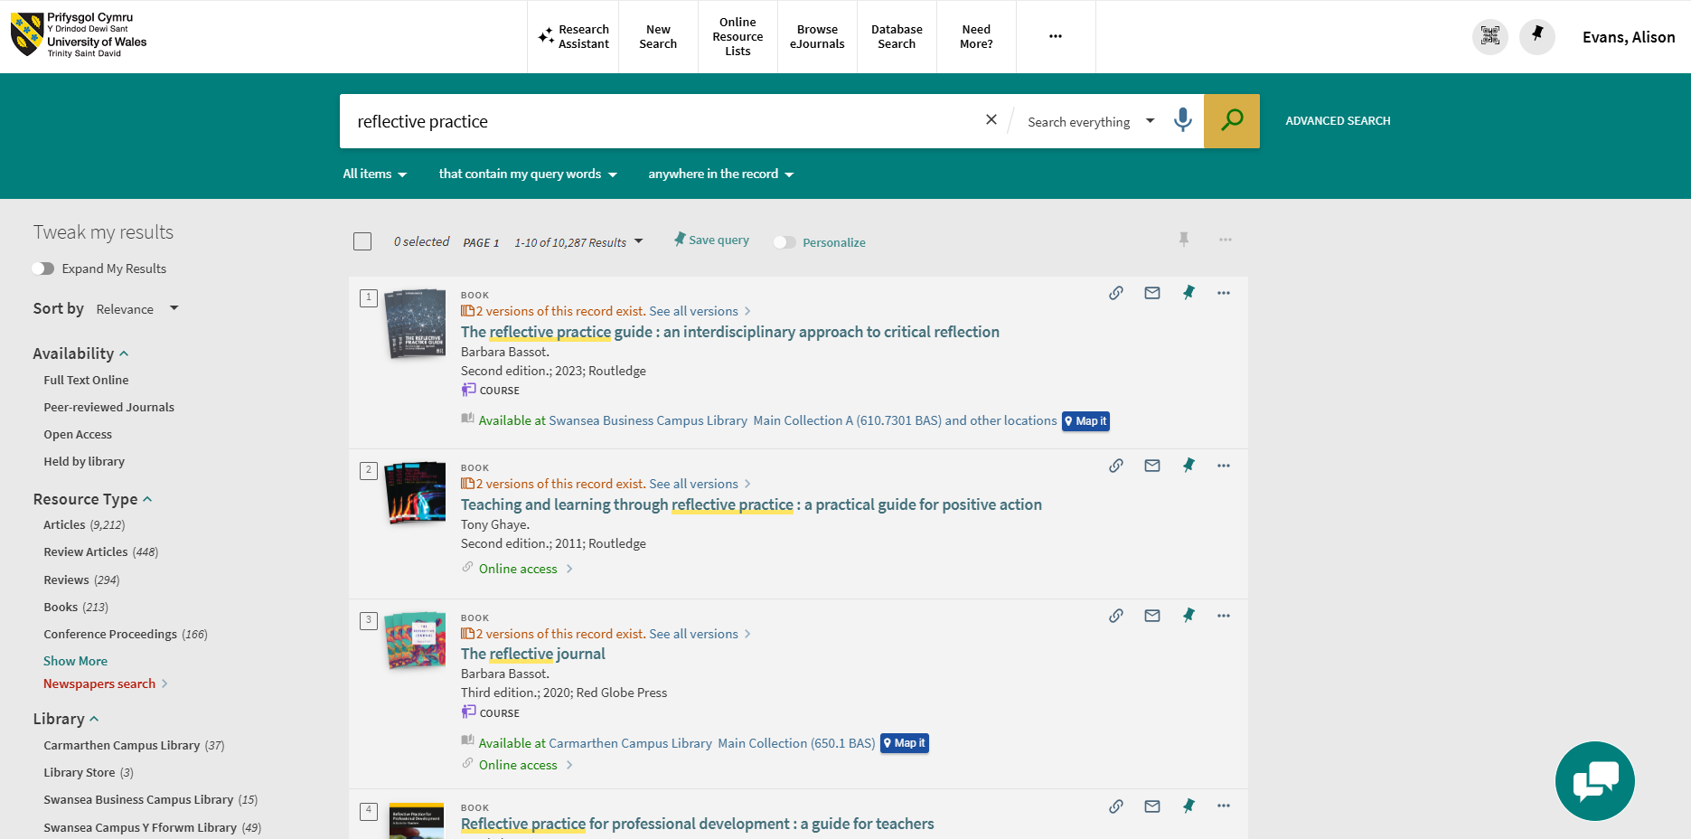

Library catalogue search.
Search for information.
Good quality, up-to-date resources in your subject area
Manage information.
Save and organise favourite items.
Save queries and set alerts.
You can also access ...
Research Assistant.
Browse eJournals.
Database Search.
Need More?
Library Catalogue
Infoskills Section – Introduction to Searching

Slide 16
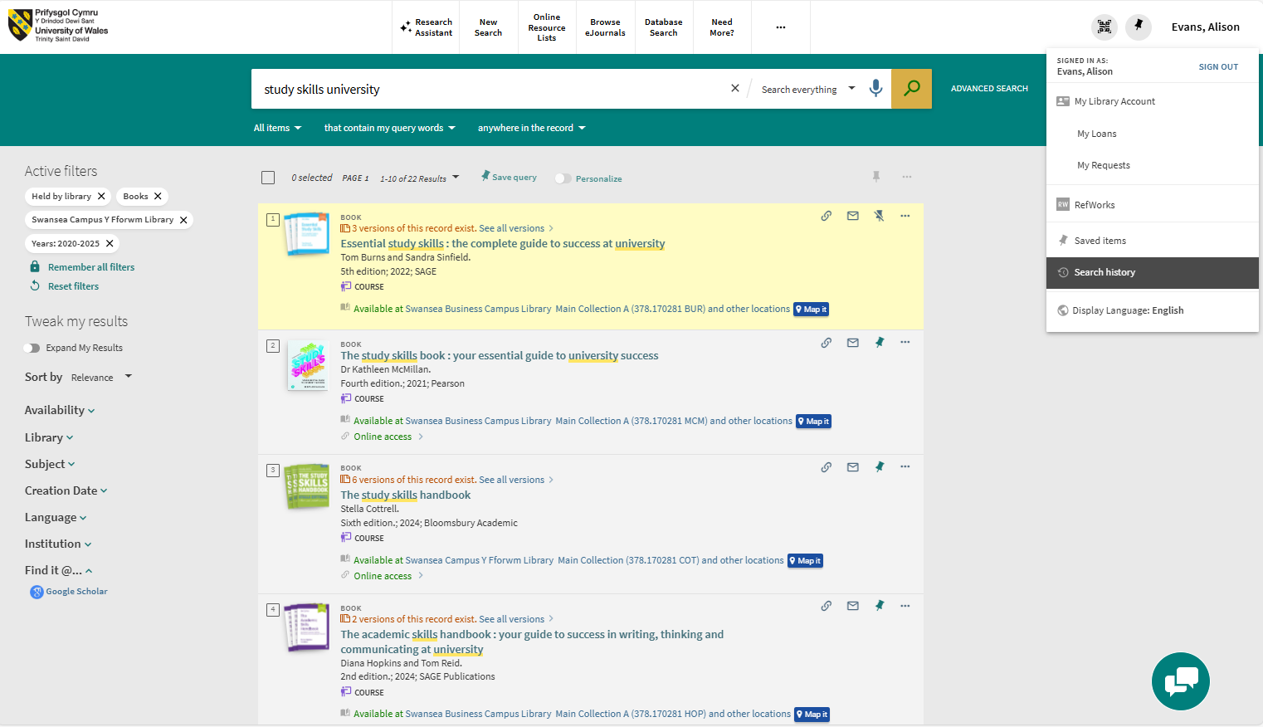
Library catalogue search.
2
1
Sign-in and library account.
Additional functionality.
Search box.
Refine search.
Number of results.
Save query / set alert.
Filter results.
Save and manage information.
Bibliographic details.
Location.
3
4
5
6
7
8
9
10

Slide 17
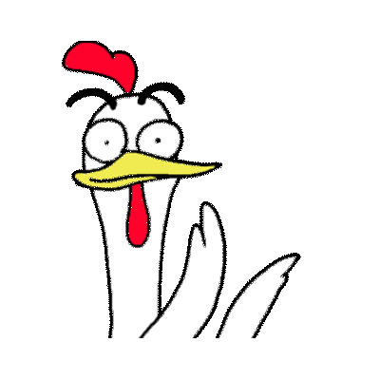
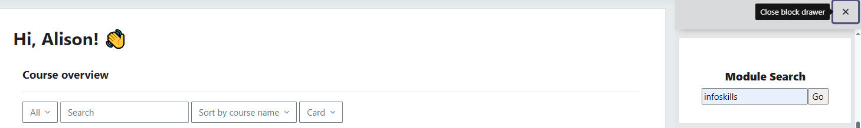
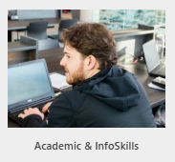
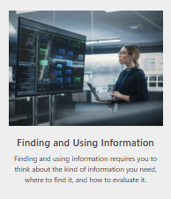
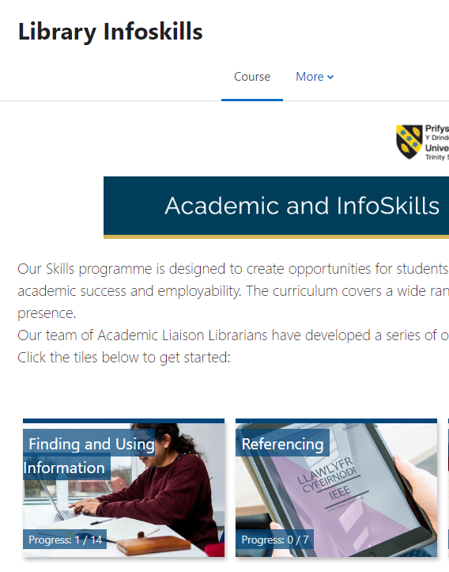
Online support: Academic and Infoskills programme.
Designed to help you develop your academic and information skills. The online curriculum covers a wide range of topics. Follow our structured programme or just drop in …
Via Moodle.
Via Library Web Pages.
1
You may have to self-enrol the first time you access the module.
2
1
2
Academic and Infoskills.

Slide 18
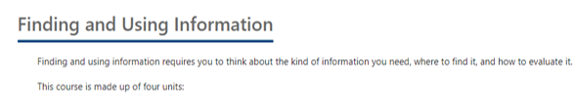
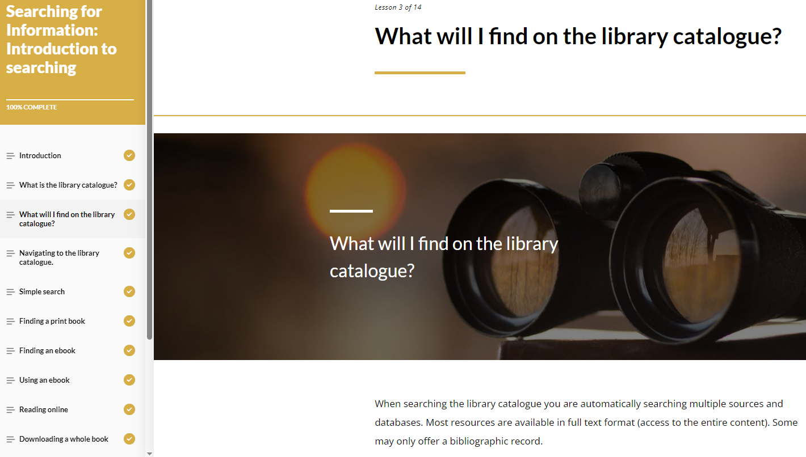
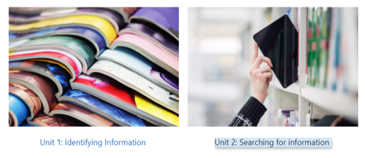
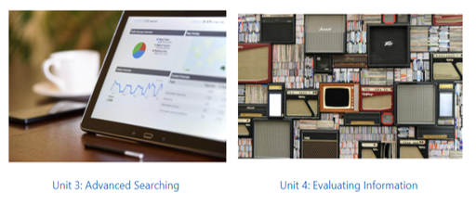
Interactive unit: Searching for information
Work your way through the units in your own time, at your own pace, and return as necessary.

Slide 19
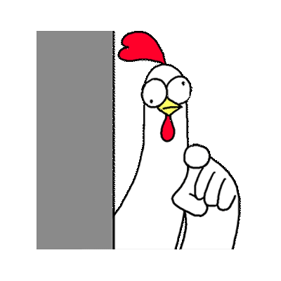
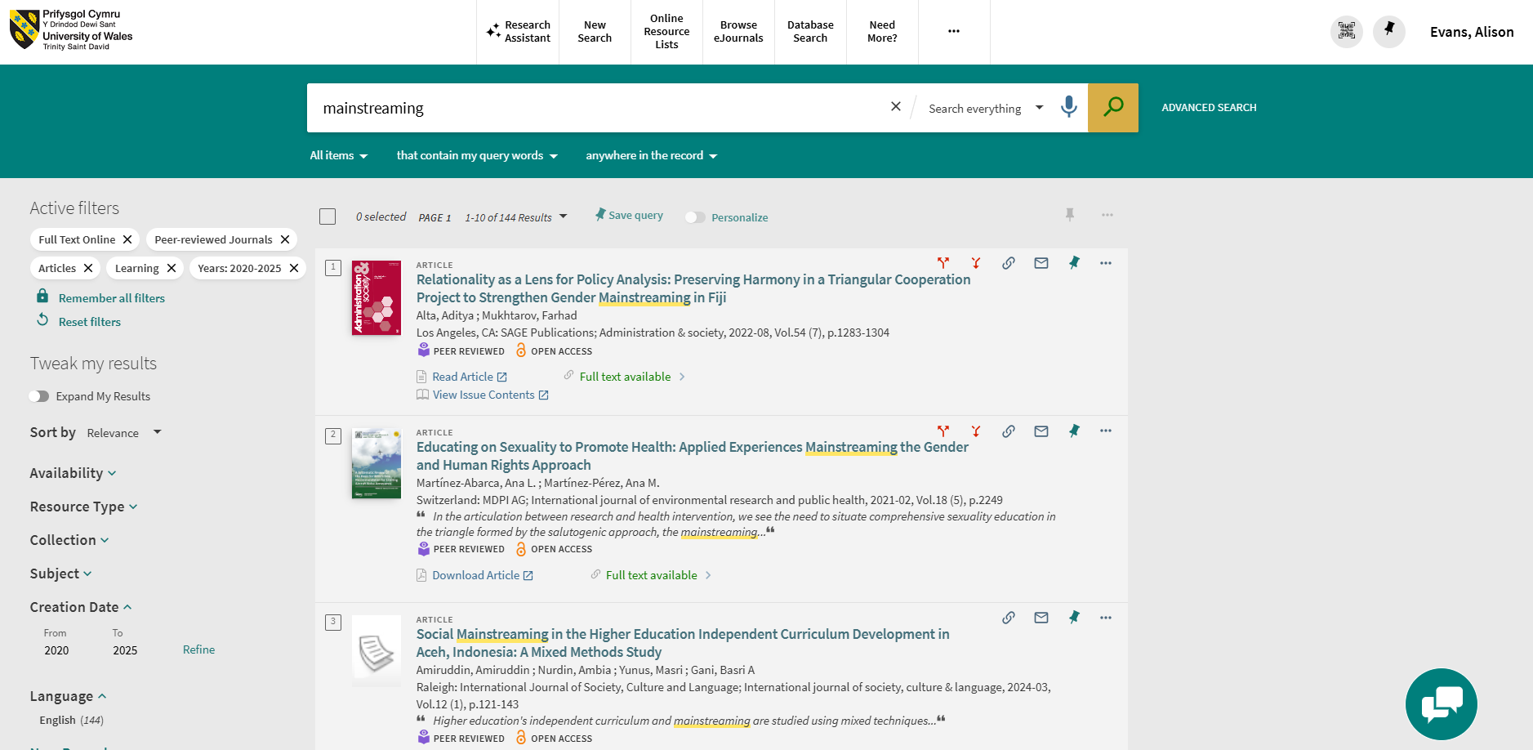
Your turn ….
Make sure you can access your online resource lists and the online Academic and Infoskills programme.
2. Go to the library catalogue:
Search for a topic of your choice.
Refine your search to peer reviewed journal articles written since 2020.
Save 3 items to your Favourites. Retrieve them.
Remember: login to your university account!

Slide 20
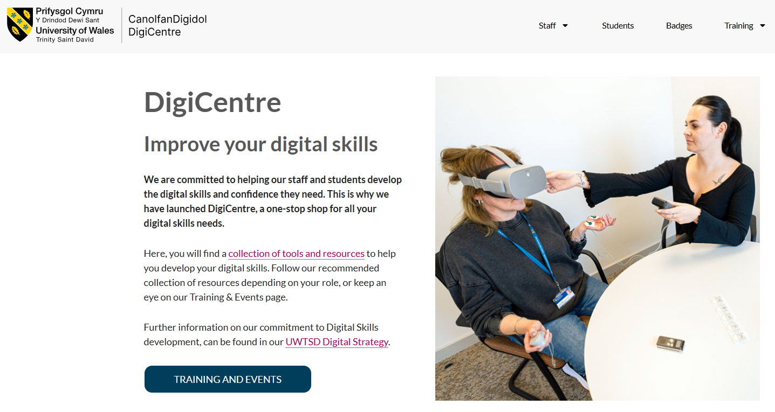
We also provide digital support.
The DigiCentre is a one-stop shop for all the digital skills needs of both staff and students.
Explore to find:
A collection of tools and resources to help you develop your digital skills.
Each institute has a Digital Skills Advisor. The IEH advisor is Gwennan Couch.

Slide 21



Help is always available.
Search and subject related help:
Alison Evans Academic Liaison Librarian.
alison.evans@uwtsd.ac.uk
Digital skills queries:
Gwen Couch Digital Skills Advisor.
g.couch@uwtsd.ac.uk
Online infoskills programme:
Academic and Infoskills.
General library help or chat:
Library@uwtsd.ac.uk

Slide 22
Students
We would be happy if you told us how we did ...
If you have a couple of minutes, please scan the QR code and complete the feedback form

