Slide 1
Chapter 13
Leadership for Performance Excellence

Slide 2
Role of Leadership in Quality and Performance Excellence
The Juran Center for Leadership in Quality at the University of Minnesota observed:
  Despite substantial efforts, only a few U.S. organizations have reached world-class excellence.
  Even fewer companies have sustained such excellence during changes in leadership.
  Most corporate quality failures rest with leadership.
Leadership is the first category in the Baldrige framework, signifying its importance in driving quality and performance excellence throughout an organization.

Slide 3
Leadership in Deming’s 14 Points
Point 1. Create and publish to all employees a statement of the aims and purposes of the company or other organization. The management must demonstrate constantly their commitment to this statement.
Point 7. Teach and institute leadership.
Point 12. Remove barriers that rob people of pride of workmanship.
Point 14. Take action to accomplish the transformation.

Slide 4
Quality Profile: The Studer Group
Studer Group’s senior leadership has embedded Evidence-Based Leadership (EBL) within the organization to provide the framework for its internal operations.
Senior leaders have created a culture at that is values-driven, transparent, and fosters passion for making a difference.
The firm models the Evidence-Based Leadership service excellence it teaches and identifies its key support mechanism as “people interacting with people.”

Slide 5
Quality Profile: St. Luke’s Hospital
SLH is driven by its vision, “The Best Place to Get Care, The Best Place to Give Care,” and its core values of Quality/Excellence, Customer Focus, Resource Management, and Teamwork.
Saint Luke’s “Leadership for Performance Excellence Model” captures all of the elements that drive its focus on performance improvement and excellence, including the strategic planning and performance management process, process improvement model, and a commitment to excellence assessment model based on Baldrige.
At a series of retreats, the leadership team develops strategy and uses a 90-day action planning process to deploy the strategy to all departments.

Slide 6
Leadership
…the ability to positively influence people and systems under one’s authority to have a meaningful impact and achieve important results

Slide 7
Six Key Leadership Competencies
Navigator: Creates shared meaning and provides direction towards a vision, mission, goal or end-result.
Communicator: Effectively listens and articulates messages to provide shared meaning.
Mentor: Provides others with a role to guide their actions.
Learner: Continuously develops personal knowledge, skills, and abilities through formal study, experience, reflection, and recreation.
Builder: Shapes processes and structures to allow for the achievement of goals and outcomes.
Motivator: Influences others to take action in a desirable manner.

Slide 8
Personal Leadership Characteristics
(1 of 2)
1. Accountability: Taking responsibility for the organization, community, or self that the leader serves.
2. Courage: The mental or moral strength to venture, persevere, and withstand danger, fear, or difficulty with a firmness of mind and will, allowing leaders to navigate into the unknown.
3. Humility: What gives excellent leaders their ability to mentor, communicate, and learn, and understand that they are servants of those that follow.
4. Integrity: The ability to discern what is right from wrong and commit to the right path.

Slide 9
Personal Leadership Characteristics
(2 of 2)
5. Creativity: The ability to see possibilities, horizons, and futures that don’t yet exist, enabling the leader to help create a shared vision.
6. Perseverance: Sticking to a task or purpose, no matter how hard or troublesome.
7. Well-Being: The ability to stay healthy in both work and play, demonstrating the importance of being ready to implement leadership competencies when needed.

Slide 10
Key Practices for Performance Excellence Leadership (1 of 3)
Set organizational vision and values and deploy them through the organization’s leadership system, to the workforce, to key suppliers and partners, and to customers and other stakeholders as appropriate.
Demonstrate a commitment to organizational values through personal actions.
Foster a sustainable organization by creating (1) an environment for organizational performance improvement, the accomplishment of the organization’s mission and strategic objectives, innovation, competitive or role-model performance leadership, and organizational agility; (2) an environment for organizational and workforce learning; (3) a culture that fosters customer engagement; and developing and enhancing leadership skills and developing future organizational leaders.

Slide 11
Key Practices for Performance Excellence Leadership (2 of 3)
Promote an organizational environment that fosters, requires, and leads to legal and ethical behavior.
Communicate with and engage the entire workforce by encouraging frank, two-way communication throughout the organization, communicating key decisions, and taking an active role in reward and recognition programs to reinforce high performance and a customer and business focus.
Create a focus on action to accomplish the organization’s objectives, improve performance, and attain the organization’s vision.
Create and balance value for customers and other stakeholders in their organizational performance expectations.

Slide 12
Key Practices for Performance Excellence Leadership (3 of 3)
Maintain an effective governance system that provides for accountability for management’s actions, transparency, and protection of stakeholder and stockholder interests.
Evaluate performance of senior leadership and use performance reviews to improve personal leadership effectiveness.
Actively support and strengthen key communities such as charitable organizations, education, and others.

Slide 13
Strategic Leadership
For a strategy to be successful, senior leaders must have extensive involvement in the planning process, create an environment for competitive success and performance leadership, and guide the design of the work and leadership systems that will ensure that the strategy is carried out.
Strategic leadership is “a person’s ability to anticipate, envision, maintain flexibility, think strategically, and work with others to initiate changes that will create a viable future for the organization, and its competitive advantage to the organization in this way.”

Slide 14
Characteristics of Strategic Leadership
Serving as both leaders and team members;
Demonstrating the importance of integrity through actions rather than simply articulating it;
Thinking in terms of processes rather than outcomes;
Leveraging the collective knowledge of everyone in the organization;
Designing work that reflects relationships rather than the organizational hierarchy;
Anticipating environmental change rather than reacting to it;
Viewing employees as organizational citizens rather than resources; and
Operating with a global mindset rather than a domestic mindset.

Slide 15
Leadership Systems
Leadership system – how leadership is exercised, formally and informally, throughout an organization. These elements include how key decisions are made, communicated, and carried out at all levels.
The leadership system includes structures and mechanisms for decision making, selection and development of leaders and managers, and reinforcement of values, directions, and performance expectations.
It builds loyalties and teamwork based upon shared values, encourages initiative and risk taking, and subordinates organization to purpose and function.
An effective leadership system also includes mechanisms for leaders’ self-examination and improvement.
Notes:
CRI Steering committee of 4
sets directions, frequent interaction with employees, review performance daily, formal monthly evaluations and OFIs

Slide 16
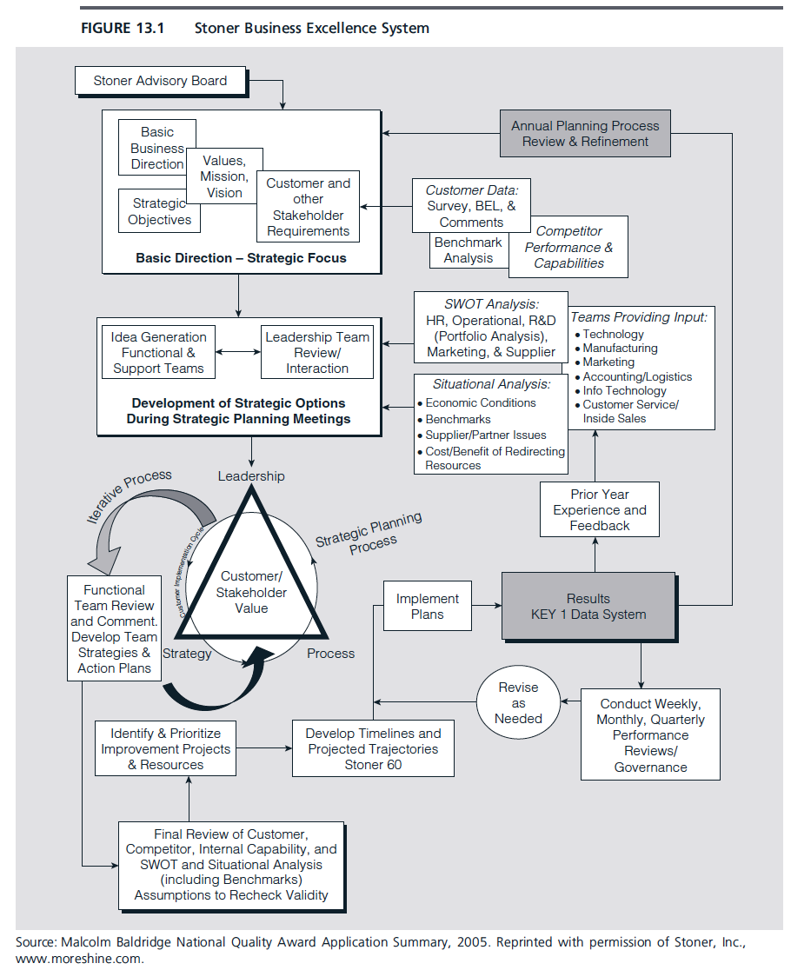

Slide 17
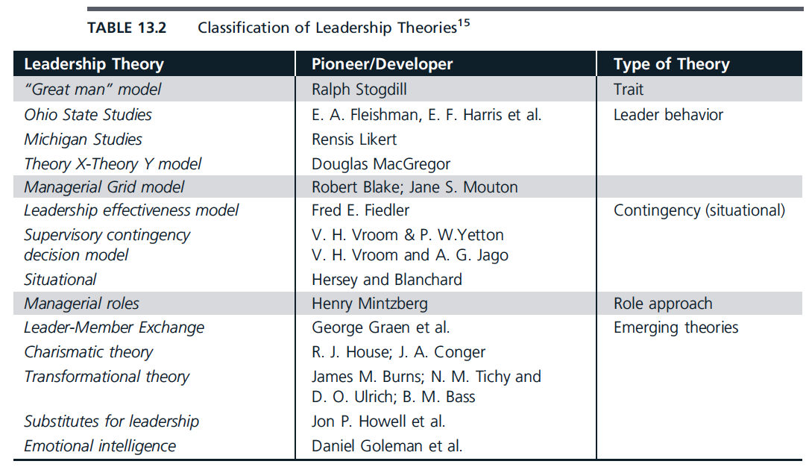

Slide 18
Situational Leadership Theory
Leadership styles might vary from one person to another, depending on the “readiness” of subordinates, which is characterized by their skills and abilities to perform the work, and their confidence, commitment, and motivation to do it.
Four levels of follower maturity (readiness) and associated leadership styles:
1. Unable and unwilling – “directing” style
2. Unable but willing – “coaching” style
3. Able but unwilling – “supporting” style
4. Able and willing – “delegating” style

Slide 19
Situational Leadership Styles
Directing. In this style of leadership, managers define tasks and roles, and closely supervise work.
Coaching. In this style, leaders set the overall approach and direction but work with subordinates and allow them to manage the details.
Supporting. Here, leaders allocate tasks and set direction, but the subordinate has full control over the performance of the work.
Delegating. In this style, subordinates can do their work with little supervision or support (minimal task-oriented behavior).

Slide 20
Transactional Leadership
Transactional leadership theory assumes that certain leaders may develop the ability to inspire their subordinates to exert extraordinary efforts to achieve organizational goals through behaviors that may include contingent rewards, and active and passive management by exception.

Slide 21
Transformational Leadership
Transformational leadership theory suggests that leaders adopt behaviors such as: idealized influence, individualized consideration, inspirational motivation, and intellectual stimulation, and have a long-term perspective, focus on customers, promote a shared vision and values, work to stimulate their organizations intellectually, invest in training, take some risks, and treat employees as individuals.
Transformational leadership is more aligned with organizational change required by total quality and Baldrige-like performance excellence models.

Slide 22
Leadership, Governance, and Societal Responsibilities
“Good leaders give back . . . It’s up to us to use our platform to be a good citizen. Because not only is it a nice thing to do, it’s a business imperative.” – Jeffrey Immelt, General Electric

Slide 23
Corporate Social Responsibility (CSR)
…the “responsibility of enterprises for their impacts on society.”
Organizations must behave ethically and be sensitive of social, cultural, economic, and environmental issues. This includes compliance with legal and ethical standards, corporate governance, and protection of public health, safety, and environmental protection.
Item 1.2 in the Leadership category of the Baldrige Criteria is focused exclusively on CSR as well as organizational governance. The item addresses an organization’s governance system; performance evaluation; legal, regulatory, and ethical behavior; societal well-being; and community support.

Slide 24
Organizational Governance
Governance – the system of management and controls exercised in the stewardship of an organization.
  Approving strategic direction
  Monitoring and evaluating CEO performance
  Succession planning
  Financial auditing
  Executive compensation
  Disclosure
  Shareholder reporting

Slide 25
Societal Responsibilities
Safety in product design and manufacturing
  Planning activities such as product design should anticipate adverse impacts from production, distribution, transportation, use, and disposal of a company’s products to protect the welfare of consumers and society.
Security of sensitive information
Environmental sustainability
Community support

