Slide 1
Business Model Canvas
By Aaron Roberts, Emma Mae and Alexandra Williams
Level 5 Entrepreneurship
M5X00846

Slide 2
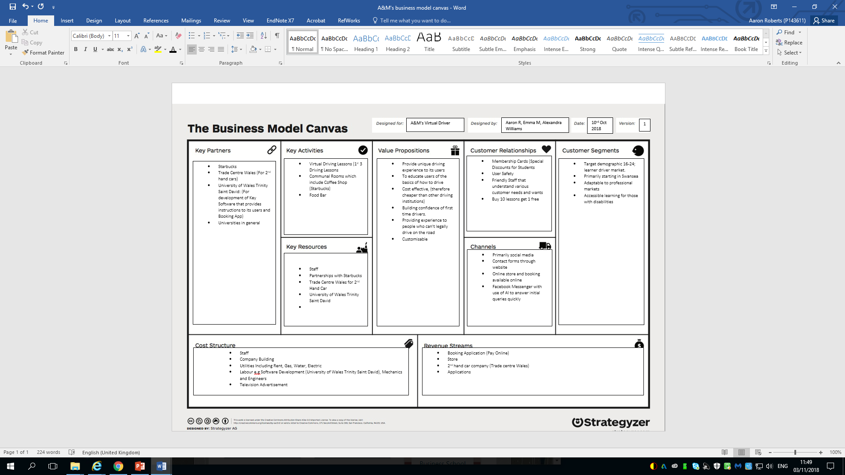
Business Model Canvas

Slide 3
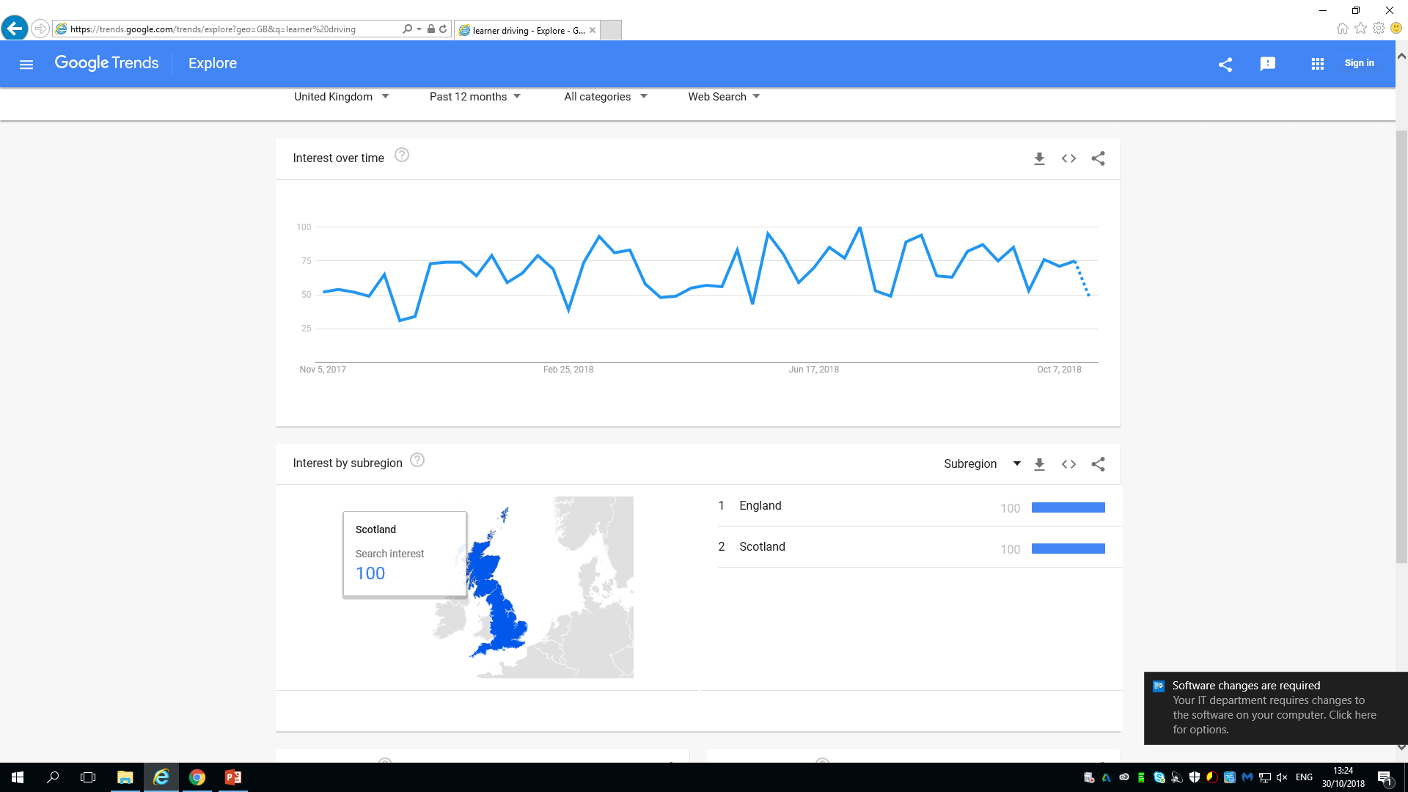
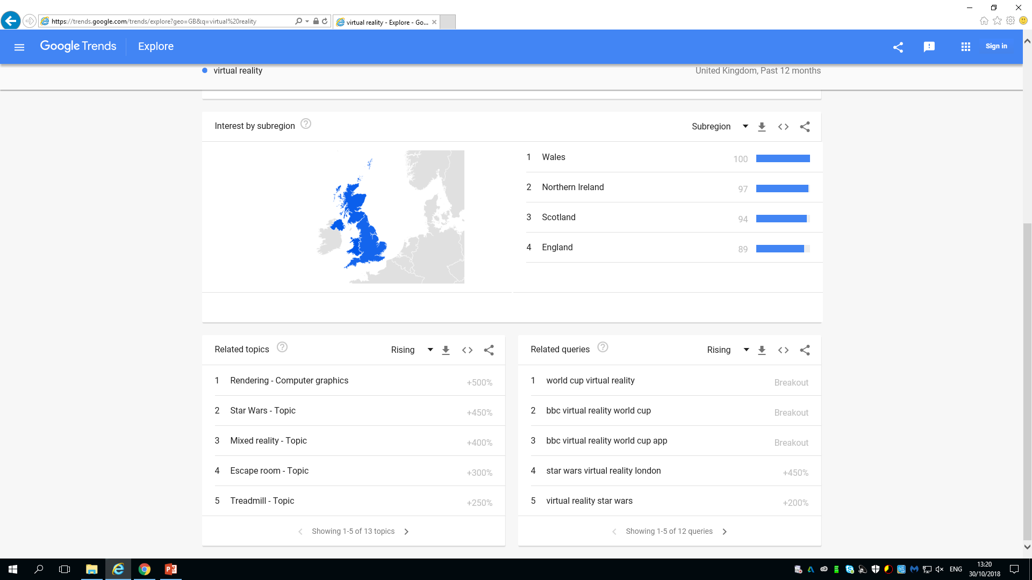
Google Trends
UK Statistics for learner driving UK Statistics for Virtual Reality
Source: Google Trends 2018

Slide 4
References
Aaron:
Clarke, C. V. and Edmond Jr., A. A. (2003) ‘Success Is a Science, Not a Secret’, Black Enterprise, 33(8), p. 113. (Accessed: 16 October 2018).
Google Trends, (2018), (Online) Available at: https://trends.google.com/trends/?geo=US Accessed 18th October 2018
McDonald, C (2018) “Buying Into Retail AI”, Computer Weekly, pp. 16- 21, Viewed 16th October 2018
Red Driving School, (2017), The Straight Road to Success for Driving Instructors (Online) Available at: http://www.reddrivingschool.com/wp-content/uploads/RED-White-Paper.pdf Accessed 30th October 2018
TeenSafe, (2018) Teen Driver Facts and Statistics, (Online) Available at: https://www.teensafe.com/blog/teen-driver-facts-and-statistics/ Accessed 18th October 2018
Emma:
DVSA. (2018). DVSA1203 - Practical car test pass rates by age (17-25 year olds), year and DTC. Available: https://www.gov.uk/government/uploads/system/uploads/attachment_data/file/722841/dvsa1203.ods. Last accessed 1st Nov 2018.
Office for National Statistics . (2017). Social networking by age group, 2011 to 2017. Available: https://www.ons.gov.uk/peoplepopulationandcommunity/householdcharacteristics/homeinternetandsocialmediausage/adhocs/007401socialnetworkingbyagegroup2011to2017. Last accessed 1st Nov 2018.
Swansea City Council. (2018). A Demographic Profiling of Swansea. Available: https://www.swansea.gov.uk/2011censusswansea. Last accessed 1st Nov 2018
Alexandra:
Anastasia, (2015) Customer Relationship block in Business Model Canvas. Available at: https://www.cleverism.com/customer-relationship-block-in-business-model-canvas/ (Accessed: 1st November 2018)
Anastasia, (2015) Key Partners in Business Model Canvas. Available at: https://www.cleverism.com/key-partners-in-business-model-canvas/ (Accessed: 27th October 2018)
Business Model Canvas. Available at: https://bmcintroduction.wordpress.com/customer-relationships/ (Accessed: 27th October 2018)
Entrepreneur Europe, 5 Key Ways to Build Customer Relationships. Available at: https://www.entrepreneur.com/article/77686 (Accessed: 29th October 2018)
Entrepreneur Europe Customer Relationships. Available at: https://www.entrepreneur.com/encyclopedia/customer-relationships (Accessed: 29th October 2018)
Jefferies, I (March 21), BMC Part Four: Customer Relationships. Available at: https://isaacjeffries.com/blog/2017/3/18/bmc-part-four-customer-relationships (Accessed: 29th October 2018)
Mcgill, A, The Business Model Canvas Series: Revenue Streams & Cost Structure. Available at: http://www.ashtonmcgill.com/business-model-canvas-series-introducing-revenue-streams-cost-structure/ (Accessed: 1st November 2018)
Veyrat,P (2017) Determine key business partners with 8 questions. Available at : https://www.heflo.com/blog/business-management/key-partners-in-a-business-model/ (Accessed: 27th October 2018)

