Slide 1

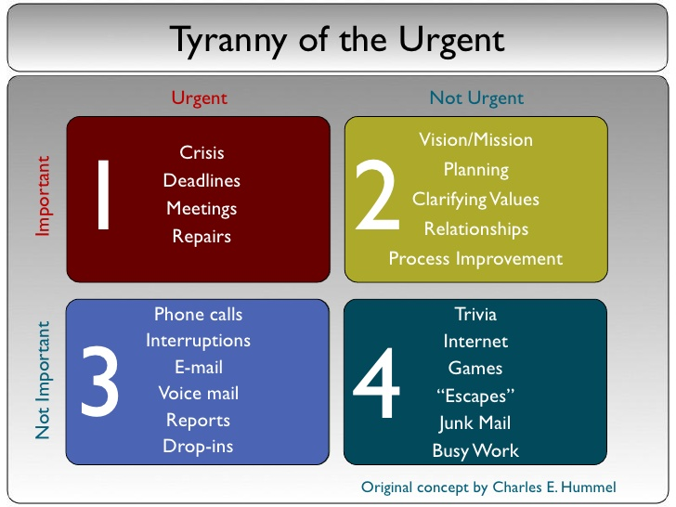
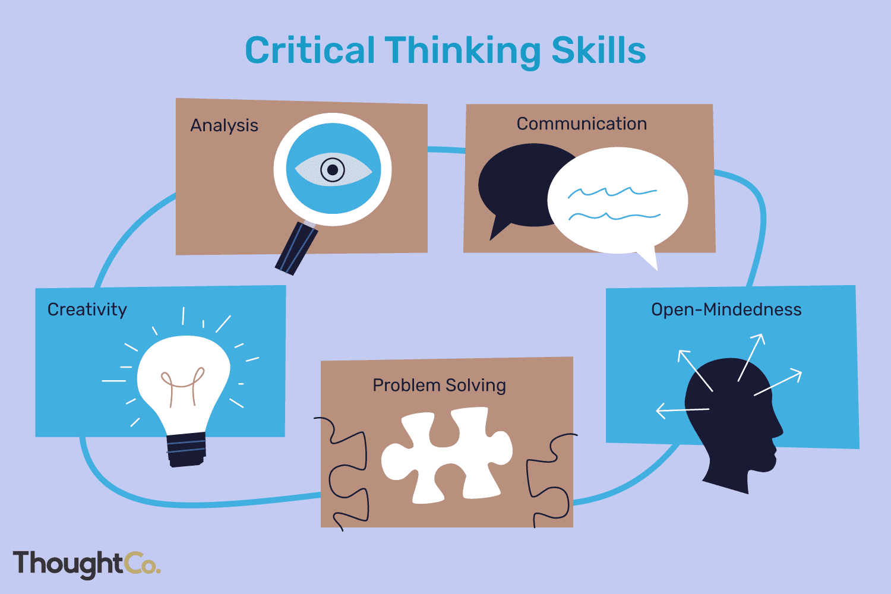
Who?
Where?
Learning to become a critical thinker
When?
Why?
What?
Student number:2205937 Module code:
How?
Time management
Time management is personal, everyone manages time differently. Through managing time you can learn more about yourself as it reaches into the details of your life. Digging deeper can help us to become aware of how long we take to achieve our goals. As we develop and grow with time keeping we become critical thinkers. Where do you spend your time? Are you being productive? (wudtke,2022)
In order to manage time we must understand the difference between urgent and important. Charles Hummel wrote a booklet called ‘Tyranny of the urgent’ where he prioritises urgent, not urgent, important and not important. (barret,2022) ‘Your greatest danger is letting the urgent things crowd out the important’ (Hummel, n.d.) Meaning we sacrifice important things to react and act upon the urgent. As an example, during setting an urgent matter would be an injury and an important matter would be an accident form. You would be required to prioritise dealing with the injury but ensure you have the time to fill out an accident form.
What is critical thinking?
How do we critically think, and what skills do we need to enable us to think critically? Firstly we need to understand what is meant by critical thinking. As stated in the oxford dictionary (2012) critical thinking is ‘the process of analysing information in order to make a logical decision about the extent to which you believe something to be true or false’ (Hornblower, Spawforth and Eidinow, 2012).
According to Stella Cottrell (Cottrell 2005) In order to think critically you must develop scepticism. This isn’t to say you shouldn’t trust or believe anything you read ever again but it does mean having an open mind and that it can always be possible that what you have learnt or your knowledge may only be part of the picture.
Team circle DNA (2021) states that the importance of critical thinking achieves piece of mind and helps with decision making.
Open mindedness
Being open minded is a positive quality, it is an ability to rationally and critically think.
In order to be open minded you must be tolerant and not judge based on factors such as gender, race, age or sexuality.
Closed minded people are generally not humble whereas being open minded leaves you more vulnerable and scared to be wrong.(Patrick,2022)
Children have an unbiased view of the world whereas adults have fixed ideas. When you have fixed ideas about the world it can bring on a fear of change, learning to be open to this change is fundamental to becoming a critical thinker. You must also learn to balance open mindedness and critical thinking by being open to take on board new facts and experiences but also not being afraid to thinking critically and analyse information to help make your decisions. (keeping an open mind and think critically, 2022)
(Critical Thinking Diagram - Search, 2022)
Researching resources and referencing
According to Sturt. C (2020) Research starts with a question. This will then encourage you to discover new information and understanding through analysis of existing knowledge. Nicholas(2021) states that all research quality needs to be measured through reliability and validation. Finding reliable sources can be challenging. There are many resources you can access to help you find credible sources that will support your academic research. (Carlton.G 2022).
Chris (2017) clarifies that in order to use any sources you find for assignments they must be referenced. To reference correctly you must mention where you got your information and acknowledge the publisher or author. There are many reasons to reference, such as supporting your arguments and showing the depth of your research but more importantly we must avoid plagiarism at all costs.
Critical thinking is based on a variety of skills including time management, open mindedness and researching by putting these skills into action they will support you on your journey to develop the knowledge, skills and positive attitude to be a successful critical learner.
(simms,2022)

Slide 2
barret, m.( 2022.) Time Management: Making Time for What Matters Most | McCormick Center for Early Childhood Leadership. [online] Mccormickcenter.nl.edu. Available at: https://mccormickcenter.nl.edu/library/time-management-making-time-for-what-matters-most [Accessed 27 March 2015].
Carlton. G (2022) 10 best online websites for academic research [online] Best colleges. Available at: https://www.bestcolleges.com/blog/best-online-resources-academic-research/ [
CircleDNA, Wabe, H. and Ng (2022.) What Is Critical Thinking And Why Is It Important?. [online] Circle Magazine | Health, Wellness & Genetics By CircleDNA. Available at: https://magazine.circledna.com/what-is-critical-thinking-and-why-is-it-important? [Accessed 17 September 2022].
Cottrell, S. (2005). Critical thinking skills. palgrave macmillan, p.page 2.
Critical Thinking Diagram - Bing images
Critical thinking diagram (N.D) Thought co [image] Available at:
Article title: | critical-thinking noun - Definition, pictures, pronunciation and usage notes | Oxford Advanced Learner's Dictionary at OxfordLearnersDictionaries.com
Website title: | Oxfordlearnersdictionaries.com
URL: | https://www.oxfordlearnersdictionaries.com/us/definition/english/critical-thinking
Article title: | critical-thinking noun - Definition, pictures, pronunciation and usage notes | Oxford Advanced Learner's Dictionary at OxfordLearnersDictionaries.com
Website title: | Oxfordlearnersdictionaries.com
URL: | https://www.oxfordlearnersdictionaries.com/us/definition/english/critical-thinking
Dudovskiy, J (2008). An ultimate guide to writing a dissertation in business studies.
Dudovskiy, j.(2008). Referencing - Research-Methodology. [online] Research-Methodology. Available at: https://research-methodology.net/research-methodology/referencing/
Exploring your mind. (2022). Keep an Open Mind and Think Critically. [online] Available at: https://exploringyourmind.com/keep-an-open-mind-and-think-critically/ [Accessed 3 May 2019].
Hornblower, S., Spawforth, A. and Eidinow, E. (2012). The Oxford classical dictionary. Oxford: Oxford University Press, p.critical thinking definition.
Hummel, C. (1984). Tyranny of the urgent.
Patrick. (2022). What is open mindedness?. [online] Available at: https://riskfail.com/what-is-open-mindedness/ [Accessed 13 July 2020].
Sims, P. (2022). Urgency is a poor substitute for priority.. [online] The Dream Factory. Available at: https://pastortomsims.typepad.com/the_dream_factory/2017/07/urgency-is-a-poor-substitute-for-priority.html [Accessed 19 September 2022].
Sims,P (2022) Tyranny of the urgent [Image] Available at: https://pastortomsims.typepad.com/the_dream_factory/2017/07/urgency-is-poor-substitute-for-priority.html> [assessed 19 September 2022].
wudtke, j. (2022). Critical Thinking Towards Time Management Active Learning Solutions. [online] Active-consultants.com. Available at: https://active-consultants.com/critical-thinking-towards-time-management [Accessed 17 September 2022].

