Slide 1
Part: Two PRESENTATION
Project Management Plan
Adolfo Heras
Student Number 1915415
Module code:
BMSW5104 _BIRM
Managing Projects in the Organisation.
Lecture:
Daminabo Pokubo

Slide 2

Project Outline
New product line (multi-vitamin).
The company has failed to launch a new product line due to the inadequate project management plan.
The demand of the multi-vitamin is high due to the rise in the health consciousness people after the outbreak of the COVID-19 pandemic.
The application of the Project Management tools is implemented in the current project to drive the project success and also to achieve the project deliverables.

Slide 3
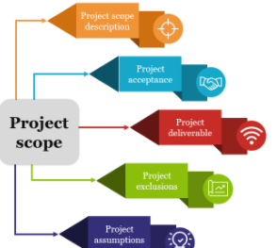
Project Scope
The project will introduce the new product line (multi-vitamin) to cater the demand of the new customers.
Stakeholder analysis, Work-Break Down structure, Gantt chart, risk assessment and cost structure.
Impact of the stakeholders to the decision making process of the organisation.
Planning stages to achieve the project results.

Slide 4
Stakeholder Analysis
Stakeholders | Contribution | Influence | Impact
Founder | Approval to the project in the context of funding, resources, deadline extension etc. | High | High
CEO | Primary advisor of the project | High | High
Project Management team | Execution of the project tasks as per the direction and guidance of the Project manager | Low | High
Project manager | Monitoring and tracking the progress of the project with an aim to achieve the project deliverables | High | High
Marketing Team | Sharing the valuable insight to the Project Manager regarding the product sales, shelf life of the product, target market demand etc. | Low | High
Customers | Purchasing the new products and eventually increases the business turnover of the organisation | High | High

Slide 5
Stakeholder’s Engagement
Stakeholders | Engagement strategy
Owner | Formal communication in the form of reports, letter and presentation.
CEO | Accessibility is given to the CEO to track the progress of the project.
Project Manager | Direct face-to-face communication of the project manager with the team for the sake of guidance and monitoring.
Project Team | Integrated IT platform that can share real-time information.
Customers | Web-based questionnaire survey will be distributed in the social media platforms to fetch the customer attitude towards the new product.
Marketing Team | Team meeting will be arranged to understand the market perspective.

Slide 6
WORK BREAK DOWN STRUCTURE
WBS ID | Level | Name of the element | Work Description | Resources | Deliverables
PA_1 | 1 | Initiation | Background description, secondary data collection, project aim and scopes | RESEARCH JOURNALS and Books | Background analysis
PA_2 | 2 | Planning | Project planning phases involves the determination of the project scope, project team formulation and budget preparation | PROJECT MANAGEMENT TOOLS | PROJECT MANAGEMENT TECHNIQUES
PA_3 | 3 | Project Execution | Analysis of the collected data and moving as per the project planning phases | RESEARCH METHODOLOGY | PROJECT IMPLEMENTATION
PA_4 | 4 | Closure | Project outcomes are achieved | PROJECT PRESENTATION | VALID CONCLUSION

Slide 7
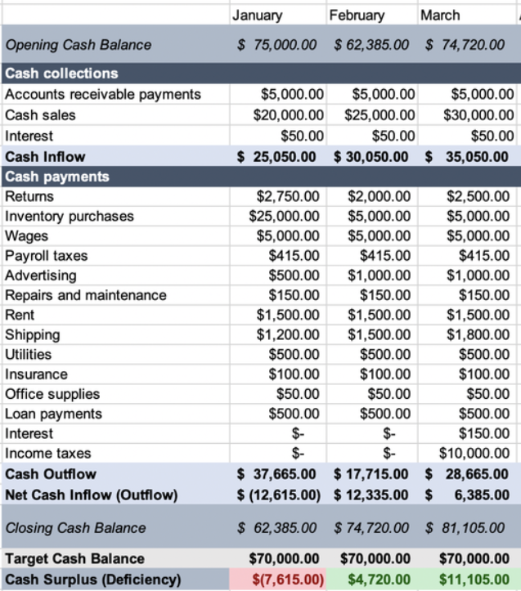
Consideration of the Resources

Slide 8
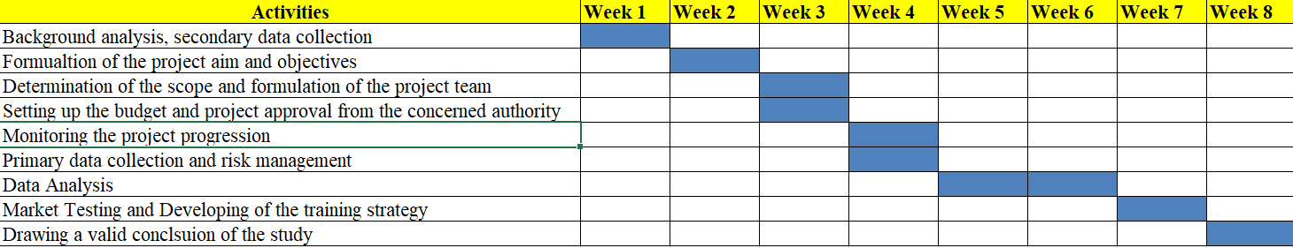
Project Schedule
Gantt chart

Slide 9
Risk Assessment
Key Risks | Impact | Measures to eliminate the risks
Improper market assessment | High | Utilisation of the Marketing Intelligence information to collect the relevant information about the project outcomes.
Misleading data | High | In-depth analysis of the market by involving the sample respondents from the concerned target segment of the new product.
Miscommunication within the project team | Moderate | Integrated communication plan can sort out the miscommunication issues.
Financial constraints | High | Determination of the cost structure and budget based on the project activities.

Slide 10
References
Buysse, K. a. V. A., 2018. Proactive environmental strategies: A stakeholder management perspective. Strategic management journal, 24(6), pp. 453-470.
Crawford, L., 2017. Senior management perceptions of project management competence. International journal of project management, 33(6), pp. 7-16.
Ibbs, C. a. K. Y., 2016. Assessing project management maturity. Project management journal, 34(5), pp. 32-43.
Kerzner, H., 2018. Project management: a systems approach to planning, scheduling, and controlling. London: John Wiley & Sons.

