Slide 1

MA IN PSYCHOTHERAPEUTIC PRACTICE:
Writing a Research Proposal and applying for Ethical Consideration
Dr Beverly Cole

Slide 2

Opening round:

Slide 3
Qualities and Skills shared by Counsellors and Qualitative Researchers
Ability to establish rapport
Attending Skills
Paraphrasing skills
Listening Skills
Framing questions
Open questions
Seeing the music behind the words
Determining patterns and themes
Reflective skills
Holding uncertainty
Confidentiality and anonymity
Reading and critique skills
Analytic skills
Bracketing of own experience
Intuitiveness
Being in the ‘moment’
Ability to notice and deal with distress
Debriefing skills
Think and respond quickly
Responsiveness
Ethics

Slide 4

BEGINNING TO BUILD A RESEARCH PROPOSAL

Slide 5
Assessment … … …
Within a 20minute presentation, identify your chosen dissertation topic and critically engage with your project proposal and ethical considerations, presenting your key points to a group of your peers.

Slide 6
The aims of this lesson are to:
Familiarise you with the basics of how to write a research proposal
FAMILIARISE YOU WITH SOME ETHICAL CONSIDERATIONS WHICH ARISE IN QUALITATIVE RESEARCH

Slide 7



Asynchronous learning

Slide 8

What do we mean by a ‘research proposal’?
A ‘research proposal’ is a document that formalizes the research design by describing the proposed programme of research.

Slide 9
What do we mean by Research Ethics: The moral principles by which we conduct ourselves as researchers
UWTSD Research Ethics & Integrity Code of Practice
UWTSD Research Data Management Policy
BACP Ethical Guidelines for Research in the Counselling Professions (2019) bacp-ethical-guidelines-for-research-in-counselling-professions-feb19.pdf
BACP Ethical Framework for the Counselling Professions (2018) https://www.bacp.co.uk/media/3103/bacp-ethical-framework-for-the-counselling-professions-2018.pdf
The moral obligation we have to:
  Our participants/patients/clients
  The profession
  The academic/professional field
  Our university employers/funding body
  Ourselves

Slide 10

Designing a Research Project/Writing a Research Proposal
What is involved in designing a research project, writing a research proposal and applying for ethical approval

Slide 11
Deciding upon a research topic and drafting a research proposal:
I Keep Six Honest Serving Men {Rudyard Kipling}
I keep six honest serving-men
(They taught me all I know);
Their names are What and Why and When
And How and Where and Who.
I send them over land and sea,
I send them east and west;
But after they have worked for me,
I give them all a rest.

Slide 12

The ‘Kipling’ questions:
[Free Writing]
What
Why
When
Where
How
Who

Slide 13

Draft process … … …
Decide upon a research topic
Decide upon a research question
Determine your aims and objectives
Write your research proposal
Apply for ethical approval
Decide upon your Methodology and Methods {Analysis}
Who are your participants & how will you recruit them?

Slide 14
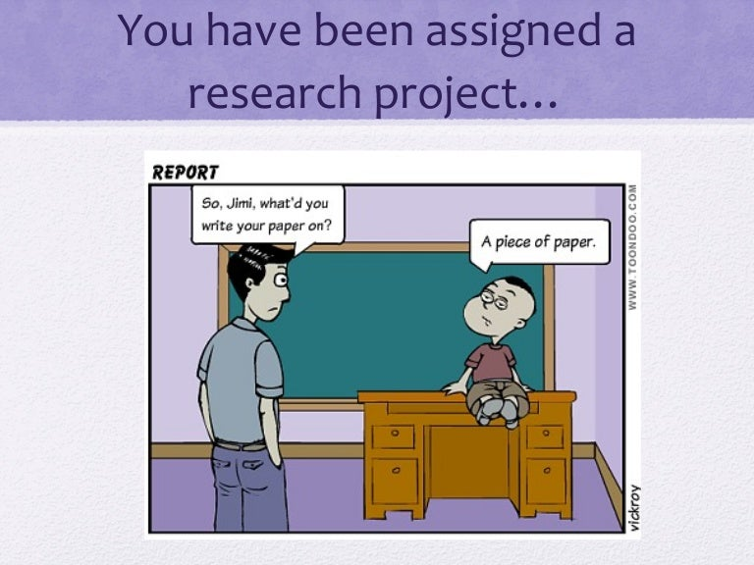

Slide 15

Deciding upon a research topic … some ways to gain inspiration
Observing Consider how you have observed phenomena or behaviour … patterns, behaviour or processes.
Reflecting on your experiences.
Questioning What have you noticed that needs researching?
Visualizing Drawings or mind maps.
Reading If you have a general idea for a topic, read around it.
Brainstorming Alone and/or with colleagues.
Level of interest Something you are very interested in

Slide 16
Choosing a research topic worksheet
[Free writing and small group work]

Slide 17

It’s all in the title …

Slide 18
Deciding upon a research question …
A research question is a clear, concise and complex question around which your research is focused.
It helps you to focus in on your study, determines your methodology
Guides and structures your choice of data collection. and analysis, and methods.

Slide 19

Deciding upon a research question …
Developing the right research question is crucial to the success of your research project
A ‘working’ question
Open or closed question ??????????????????????????????
Relevant, clear and simple [Rhetorical / combination]
Capable of being answered in the wordcount and in the time available
Add to existing knowledge - Be consistent with the requirements of your course

Slide 20
Research Question exercise:
Develop your research question using the guidance given on the previous slide.
Once you have done this, you will present your research question to the rest of your group for peer feedback.
You should also be prepared to offer feedback on the research questions of your fellow students.

Slide 21

Some reading which may help with deciding upon a topic and a research question:
Alvesson, M. and Sandberg, J. (2013) Constructing Research Questions: Doing Interesting Research. London: Sage.
White, P. (2009) Developing Research Questions: A Guide for Social Scientists. London: Palgrave Macmillan.

Slide 22

Determining your aims and objectives …
Aims: What you want to do
Objectives: How you intend to do this

Slide 23


Determining your aims and objectives [Free writing] …
Aim = What you hope to achieve.
Objective = The action(s) you will take in order to achieve the aim.

Slide 24
Aim = What you hope to achieve.
Check out your aims:
Aims are what you hope to achieve
Aims are statements of intent.
Aims are usually written in broad terms.
Aims set out what you hope to achieve at the end of the project.

Slide 25
Objective = The action(s) you will take in order to achieve the aim.
Check out your Objectives:
Objectives are how you will achieve your aims
Objectives are specific statements that define measurable outcomes, e.g. what steps will be taken to achieve the desired outcome.
Objectives should contain strong, positive statements.
Objectives should also be S.M.A.R.T. –

Slide 26
S M A R T ….
Specific – Be precise about what you are going to do
Measurable – You will know when you have reached your goal
Achievable – Don’t attempt too much – a less ambitious, completed objective is better than an over-ambitious one that is impossible to achieve
Realistic – Do you have the necessary resources to achieve the objective – time, skills, equipment etc.
Timed – Determine when each stage needs to be completed. Adopt a time schedule, ensuring that you build in time for unexpected delays

Slide 27

Some reading which may help with determining your aims and objectives:
Chapter 3 in Thomas and Hodges (2010) provides some practical and useful information about producing aims and objectives for a research project in the social and health sciences, covering issues such as ‘How to write good aims and objectives and avoiding common errors’.
Thomas, D. and Hodges, I. (2010) Designing and Managing Your Research Project: Core Skills for Social and Health Researchers. London: Sage.
Part 4 of Williams (2013) includes information about producing aims and objectives and ensuring that methods match aims when planning a dissertation
Williams, K. (2013) Planning Your Dissertation. Basingstoke: Palgrave Macmillan.

Slide 28
Deciding upon your methodology and methods ... moving from good research questions to good research design
Methodology
Methods
Thematic Analysis
Heuristics
Narrative research
Grounded theory
Ethnography
Phenomenology – IPA
Case Study
Literature Reviews
Questionnaires
Interviews
Focus Groups
Analysis

Slide 29
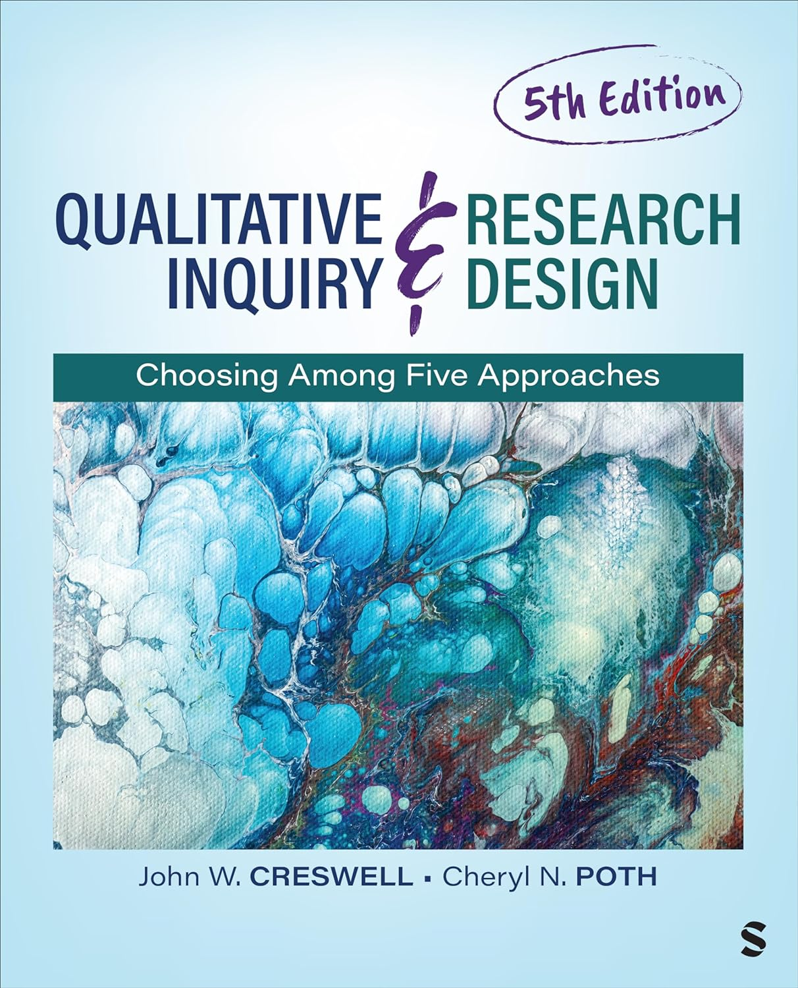
A book which may help with determining your methodology and methods:
Creswell, J. W. and Poth, C.N. 2023. Qualitative Inquiry and Research Design: Choosing among five approaches. London: SAGE

Slide 30



Participants … … …
Who?
How many?
How?

Slide 31


Who are the big thinkers?
Topic
Methodology

Slide 32
Applying for ethical approval … … …

Slide 33
Ethics Committees
Ethical applications

Slide 34
A key resource

Slide 35

Check the content you came up with for your research proposal with the information on the PG1, PG2 and information on Moodle

Slide 36
Project Proposal form PG1 : A key source
Section 1 Student Details
Complete all boxes
Section 2 Proposed Research
Current Proposed Title: Keep the working title to approximately 20 / 30 words.
Background & Context (approx. 500 words) In this section you will need to: Place the research topic in its historical, cultural and social context. Explain why the research is significant and important. Place the research in the current academic context. Provide a list of references of cited works.
Aims and Objectives (250- 500 words approximately) In this section you will need to: Explain what you want to achieve through the research. Outline the aims of the research.

Slide 37
Ethical Approval : Form PG2 :
A key source

Slide 38

A Key source: Level 7 Assessment Specification Form

Slide 39

Presentation skills

Slide 40

Further reading …
Bell, J. (2010) Doing your Research Project, 5th edition. Maidenhead: Open University Press.
Cottrell, S. (2014) Dissertations and Project Reports: A Step by Step Guide. Basingstoke: Palgrave Macmillan.
Denscombe, M. (2012) Research Proposals: A Practical Guide. Maidenhead: Open University Press
Thomas, D. and Hodges, I. (2010) Designing and Managing Your Research Project: Core. Skills for Social and Health Researchers. London: Sage
Thomas, G. 2022. How to do your research project: A guide for students. Fourth edition. London: Sage.
Walliman, N. (2011) Your Research Project: Designing and Planning your Work, 3rd edition. London: Sage.
Williams, K. (2013) Planning Your Dissertation. Basingstoke: Palgrave Macmillan

Slide 41

It is not a case of thinking about something, writing it down and moving on, all these topics need to be revisited as you work through your research proposal.

Slide 42


Slide 43
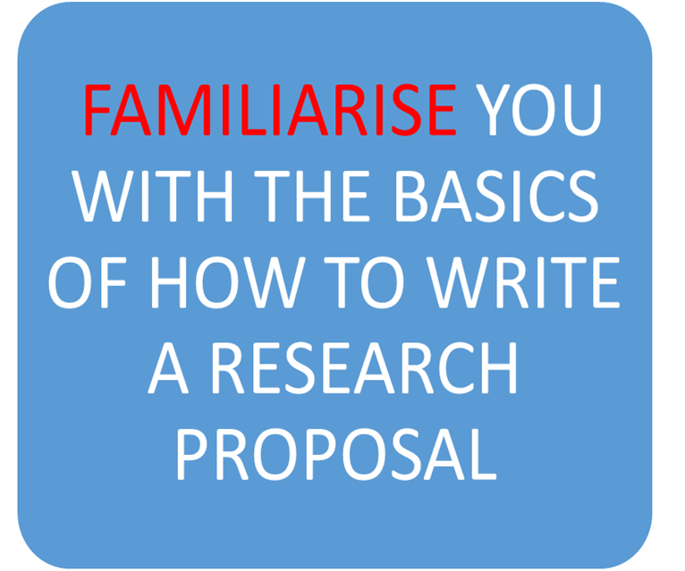
Have we met the aims of this lesson to:
FAMILIARISE YOU WITH SOME ETHICAL CONSIDERATIONS WHICH ARISE IN QUALITATIVE RESEARCH

Slide 44
Closing round: One thing you know now that you didn’t know this morning about research {i} Proposals and {ii} Ethics …

