Slide 1
THERMOCHEMISTRY
Lecture 10
Dr Ewa Kazimierska
e.kazimierska@uwtsd.ac.uk

Slide 2
Today’s lecture
Introduction to thermochemistry
Heat of reaction (hess’s law vs bond enthalpies)
Combustion vs detonation

Slide 3
Learning outcomes
Define and explain the fundamental concepts of thermochemistry, including heat, enthalpy, exo- and endo-thermic reactions
Calculate and interpret enthalpy changes (ΔH) for chemical reactions using experimental data, standard enthalpy of formation values, and Hess's Law.
Apply stoichiometric principles to relate reactants and products in thermochemical equations and calculations.
Use Hess's Law to calculate ΔH for a reaction by combining known ΔH values of related reactions
Calculate bond energy changes in chemical reactions and relate them to enthalpy changes, recognizing the role of bond breaking and bond formation in thermochemistry

Slide 4
DEFINITIONS
thermochemistry – studies heat changes that occur during reactions
heat (q) – energy that is transferred as a result of temperature differences
enthalpy (H) – a thermodynamic function that represents the total heat content of a system.
enthalpy change, ΔH or Δ_{rxn}H - heat transferred by chemical reaction or process at constant pressure
unit of heat: Joule, 1 J = 1 Nm = 1 (kgms⁻¹)m = 1 kgm²s⁻²

Slide 5
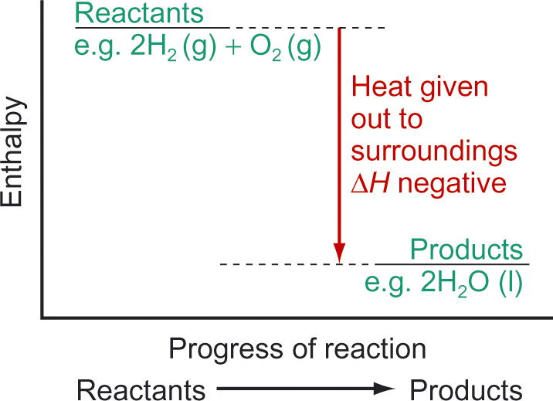
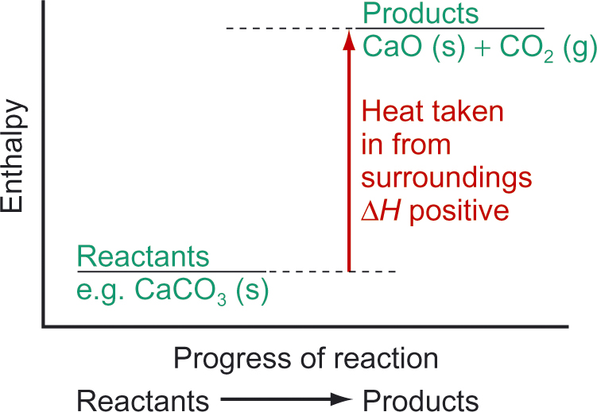
HEAT OF REACTION - ΔH
Reaction can give off heat and warm the ‘outside’
Δ_{rxn}H becomes negative
EXOTHERMIC reaction (e.g. combustion)
Reaction can ‘give off cold’ and cool down the ‘outside’ (absorbs heat)
Δ_{rxn}H becomes positive
ENDOTHERMIC reaction (e.g. cold pack)
unit of heat: Joule, 1 J = 1 Nm = 1 (kgms⁻¹)m = 1 kgm²s⁻²

Slide 6
ΔH – MOLAR QUANTITY
CaCO₃ (s) → CaO (s) + CO₂ (g) Δ_{rxn}H = + 180 kJ
endothermic
1 mole of CaCO₃ (s) reacted needs 180 kJ
1 mole of CaO (s) produced needs 180 kJ
1 mole of CO₂ (g) produced needs 180 kJ
BUT:
2 CaCO₃ (s) → 2 CaO (s) + 2 CO₂ (g) Δ_{rxn}H = 2 × 180 kJ = 360 kJ
2 moles of CaCO₃ (s) reacted needs 360 kJ
2 moles of CaO (s) produced needs 360 kJ
2 moles of CO₂ (g) produced needs 360 kJ

Slide 7
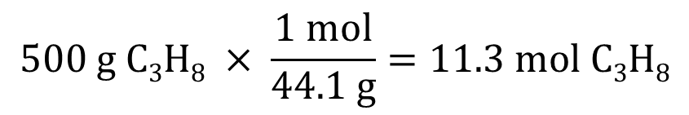
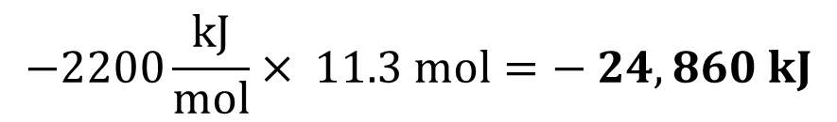
SAMPLE PROBLEM
A portable cap stove burns propane fuel according to equation:
C₃H₈ (g) + 5 O₂ (g) → 3 CO₂ (g) + 4 H₂O (l) Δ_{rxn}H = -2200 kJ
How much heat will be released when 500 g of propane combusts completely in oxygen?
When 1 mol of C₃H₈ reacts with oxygen, 2200 kJ of energy is released. Exothermic process.
How many moles of C₃H₈ in 500 g? molar mass = 44.1 g/mol
Heat supplied by burning 500 g C₃H₈
$$500 g C3H8 × \frac{1 mol}{44.1 g}=11.3 mol C3H8$$
$$−2200\frac{kJ}{mol}× 11.3 mol=− 24,860 kJ$$

Slide 8
PRACTICE PROBLEM
How much heat will be released when 2.9 g of butane (molar mass 58.0 g/mol) combusts completely in oxygen according to:
2 C₄H₁₀ (g) + 13 O₂ (g) → 8 CO₂ (g) + 10 H₂O (l) Δ_{rxn}H = -5600 kJ

Slide 9
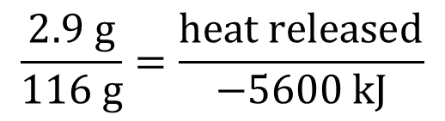
PRACTICE PROBLEM
How much heat will be released when 2.9 g of butane (molar mass 58.0 g/mol) combusts completely in oxygen according to:
2 C₄H₁₀ (g) + 13 O₂ (g) → 8 CO₂ (g) + 10 H₂O (l) Δ_{rxn}H = -5600 kJ
2 moles of C₄H₁₀ (2 $×$ 58.0 = 116 g) can release 5600 kJ of heat
$2.9 g × \frac{1 mol}{58.0 g} ×$ $\frac{−5600 kJ}{2 mol}=\frac{2.9 g ×(−5600 kJ)}{116 g}=−140 kJ of released heat$
Proportions:
$$\frac{2.9 g}{116 g}=\frac{heat released}{−5600 kJ}$$
$heat released= \frac{2.9 g ×(−5600 kJ)}{116 g}=−140 kJ of released heat$

Slide 10
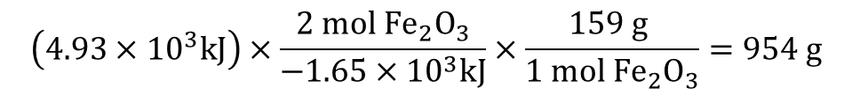
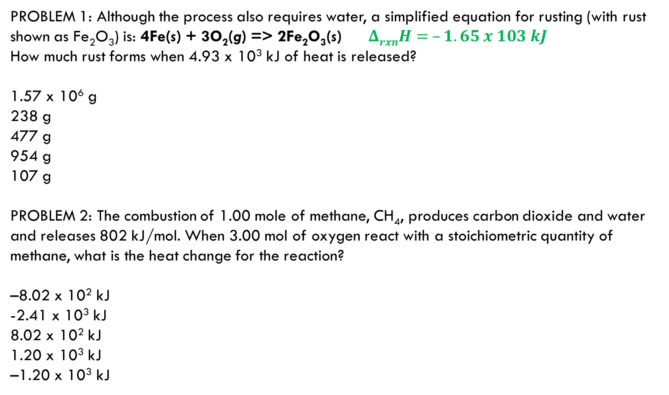
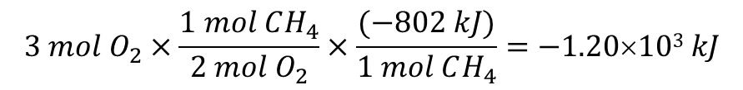
PRACTICE PROBLEMS
PROBLEM 1: Although the process also requires water, a simplified equation for rusting (with rust shown as Fe₂O₃) is: 4Fe(s) + 3O₂(g) => 2Fe₂O₃(s) $ΔrxnH= –1.65 x 103 kJ$
How much rust forms when 4.93 x 10³ kJ of heat is released?
1.57 x 10⁶ g
238 g
477 g
954 g
107 g
PROBLEM 2: The combustion of 1.00 mole of methane, CH₄, produces carbon dioxide and water and releases 802 kJ/mol. When 3.00 mol of oxygen react with a stoichiometric quantity of methane, what is the heat change for the reaction?
–8.02 x 10² kJ
-2.41 x 10³ kJ
8.02 x 10² kJ
1.20 x 10³ kJ
–1.20 x 10³ kJ
Fe₂O₃ = 159.7 g/mol
$$\left(4.93×{10}^{3}kJ\right)×\frac{2 mol {Fe}_{2}O_{3}}{−1.65×{10}^{3}kJ}×\frac{159 g }{1 mol {Fe}_{2}O_{3}}=954 g$$
CH₄ + 2 O₂ → CO₂ + 2 H₂O $ΔcombH = –802 kJ/mol$
$$3 mol O_{2}×\frac{1 mol CH_{4}}{2 mol O_{2}}×\frac{(−802 kJ)}{1 mol CH_{4}}=−1.20×103 kJ$$

Slide 11
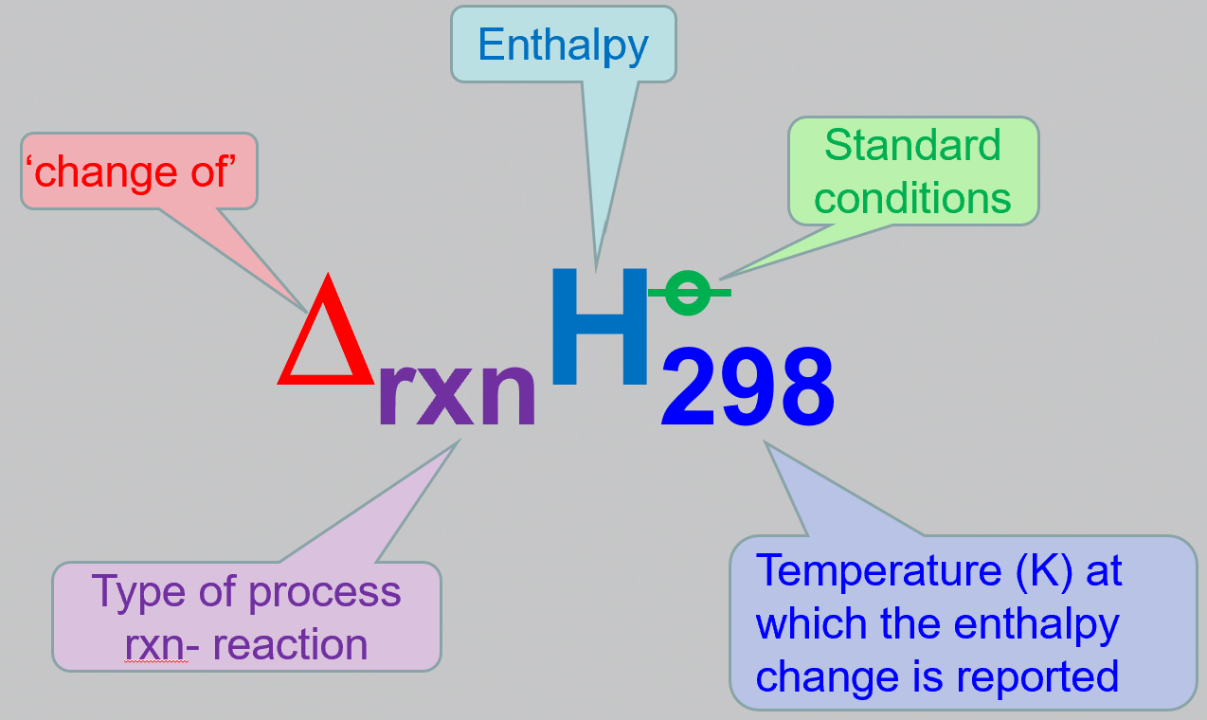
STANDARD CONDITIONS
Any chemical equation that describes a reaction has a value of ΔH (Δ_{rxn}H)
Δ_{rxn}H depends on T, P and the physical state of the components (H₂O: liquid or steam)
Standard conditions – allow comparison between values:
Solids and liquids must be pure solids and liquids
Solutions at 1 mol/L
Gases at the pressure of 1 bar
Temperature usually 298 K (can be any, but specified)
Always have a sign
NOT STP or SATP !!!

Slide 12
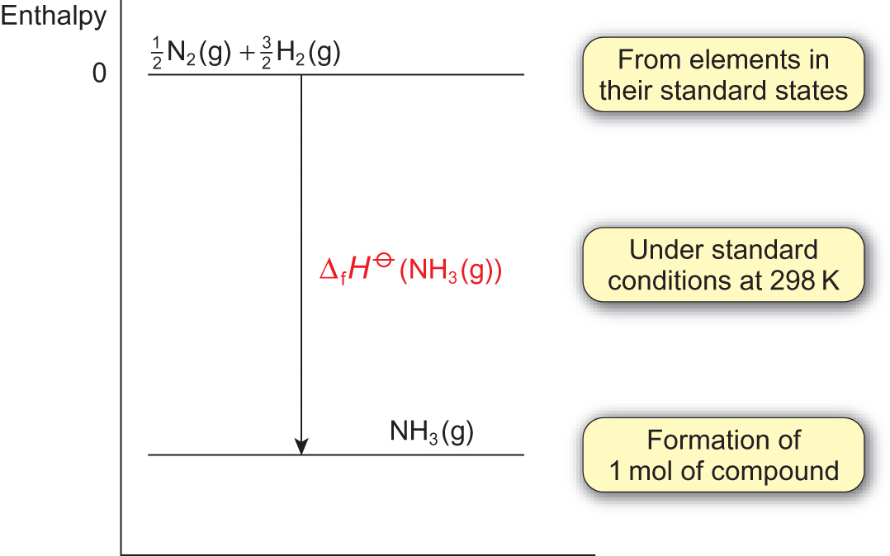
STANDARD HEAT OF FORMATION - Δ_{f}H° (X)
Δ_{f}H° (X) = heat of formation - heat released or absorbed when 1 mole of pure substance X is formed from its elements at standard conditions (kJ/mol)
enthalpy of formation for an element in its standard state is ZERO
H₂ (g), N₂ (g), O₂ (g)
F₂ (g),Cl₂ (g), Br₂ (l), I₂ (s)
Noble gases (g)
P₄ (s), As₄ (s), S₈ (s), C (s, graphite)
Metals (s) except Hg (l), [Cs and Ga]
Δ_{f}H°₂₉₈ (N₂ (g)) = 0 kJ/mol
Δ_{f}H°₂₉₈ (H₂ (g)) = 0 kJ/mol
Δ_{r}H°₂₉₈ = Δ_{f}H°₂₉₈ (NH₃ (g)) = - 46.1 kJ/mol

Slide 13
STANDARD HEAT OF COMBUSTION - Δ_{comb}H°
Δ_{comb}H° (X) – heat of combustion- released when 1 mole of substance X burns completely in oxygen gas at 1 bar pressure (kJ/mol)
always negative – always exothermic - - Δ_{comb}H°(X)
C₃H₈ (g) + 5 O₂ (g) → 3 CO₂ (g) + 4 H₂O (l) Δ_{rxn}H = - 2200 kJ
Δ_{comb}H° (C₃H₈ (g)) = - 2200 kJ/mol
2 C₄H₁₀ (g) + 13 O₂ (g) → 8 CO₂ (g) + 10 H₂O (l) Δ_{rxn}H = - 5600 kJ
Δ_{comb}H° (C₄H₁₀ (g)) = - 5600 ÷ 2 = -2800 kJ/mol
Thermochemical equation can have fractional coefficients
C₄H₁₀ (g) + 13/2 O₂ (g) → 4 CO₂ (g) + 5 H₂O (l) Δ_{rxn}H ° = -2800 kJ/mol

Slide 14
STANDARD HEAT OF COMBUSTION - Δ_{comb}H°
2 C₄H₁₀ (g) + 13 O₂ (g) → 8 CO₂ (g) + 10 H₂O (l) Δ_{rxn}H = - 5600 kJ
Δ_{comb}H° (C₄H₁₀ (g)) = - 5600 ÷ 2 = -2800 kJ/mol
C₄H₁₀ (g) + 13/2 O₂ (g) → 4 CO₂ (g) + 5 H₂O (l) Δ_{rxn}H ° = -2800 kJ/mol
Thermochemical equation can have fractional coefficients

Slide 15
OTHER STANDARD HEATS
Δ_{fus}H° (X) heat of fusion of X, X (s) → X (l) always ENDO
Δ_{vap}H° (X) heat of vaporisation of X, X (l) → X (g) always ENDO
Δ_{sub}H° (X) heat of sublimation of X, X (s) → X (g) always ENDO
per 1 mole of substance !!!

Slide 16
HESS’S LAW
a fundamental principle in chemistry that states that the total enthalpy change for a chemical reaction is the same regardless of the sequence of individual reactions or steps that make up the overall reaction, as long as the initial and final conditions are the same
Δ_{rxn}H – state function => depends only on the initial and final states of the reactants and products and is independent of the specific pathway or intermediates involved in the reaction

Slide 17
HESS’S LAW
A + B → C ΔH₁ C → A + B -ΔH₁
C → D ΔH₂
A + B → D ΔH₁ + ΔH₂
Δ_{rxn}H (forward reaction) = = - Δ_{rxn}H (backward reaction)
ΔH₁ + ΔH₂
ΔH₁
ΔH₂
A + B C D
The overall enthalpy of the reaction is the sum of the reaction enthalpies of the steps into which the reaction can be divided

Slide 18
SAMPLE PROBLEM
Hess's Law is especially useful in thermochemistry for calculating the enthalpy change of a chemical reaction when it cannot be measured directly. It allows to combine known enthalpy changes of other reactions to determine the desired enthalpy change.
Given these ΔHº values
2 H₂ (g) + O₂ (g) → 2 H₂O (l) ΔHº = -576 kJ / : 2
C (s) + O₂ (g) → CO₂ (g) ΔHº = -394 kJ / x 2
2 C₂H₂ (g) + O₂ (g) → 4 CO₂ (g) + 2H2O (l) ΔHº = -2600 kJ / : (-2)
Find ΔHº for 2 C (s) + H₂ (g) → C₂H₂ (g)
(-576) / 2 + (-394) x 2 + 2600 / 2 = 244 kJ

Slide 19
HESS’S LAW, cnt.
Δ_{rxn}H°
Hess's Law is closely related to the concept of standard enthalpy of formation (Δ_{f}H°), which is the change in enthalpy when one mole of a compound is formed from its elements in their standard states.
reactants product
- Δ_{f}H°
+ Δ_{f}H°
elements
Δ_{rxn}H° = Δ_{atom}H° + Δ_{f}H°
OR
Δ_{atom}H
Δ_{f}H°(2)
reactants elements products
Δ_{f}H°(1)
Δ_{atom}H° = - Δ_{f}H°

Slide 20
HESS’S LAW, cnt.
Δ_{rxn}H° = Δ_{atom}H° + Δ_{f}H°
Δ_{atom}H
Δ_{f}H°(2)
reactants elements products
Δ_{atom}H° = - Δ_{f}H°
Δ_{f}H°(1)
Reactants → Elements: -Δ_{f}H° (reactant 1)
-Δ_{f}H° (reactant 2) etc
- Σ Δ_{f}H° (reactants)
Elements → Products: Δ_{f}H° (product 1)
Δ_{f}H° (product 2) etc
Σ Δ_{f}H° (products)
Δ_{rxn}H = - ΣΔ_{f}H° (reactants) + Σ Δ_{f}H° (products)
Δ_{rxn}H = Σ Δ_{f}H° (products) - Σ Δ_{f}H° (reactants)
represents the reversion

Slide 21
SAMPLE PROBLEMS
What is the value of Δ_{r}Hº in kJ for:
2 HgCl₂(s) → Hg₂Cl₂(s) + Cl₂(g)
given the Δ_{f}Hº values (in kJ/mol) for HgCl₂ = -230 and Hg₂Cl₂ = -265?
-195
-495
-35
+195
-725
Reactants: Δ_{f}Hº HgCl₂= -230 kJ/mol is for reaction Hg + Cl₂ → 1 mol HgCl₂
Products: Δ_{f}Hº Hg₂Cl₂= -265 kJ/mol is for reaction 2 Hg + 2 Cl₂ → 1 mol Hg₂Cl₂ + Cl₂
2 HgCl₂(s) → Hg₂Cl₂(s) + Cl₂(g)
⎯→
⎯→
2(Δ_{f}H₁°)
Δ_{f}H₂°
2 Hg + 2 Cl₂
2(Δ_{f}H₁°) = 2x(-230) = -460 kJ
Δ_{f}H₂° = -265 - 0 = -265 kJ
Δ_{rxn}H = Σ Δ_{f}H° (products) - ΣΔ_{f}H° (reactants)
Δ_{rxn}H = (-265) – (-460) = +195 kJ

Slide 22
SAMPLE PROBLEMS
PROBLEM 2: Calculate Δ_{r}H for the reaction C₄H₄(g) + 2H₂(g) => C₄H₈(g), using the following information:
combustion reactions
C₄H₄ + 5O₂ → 4CO₂ + 2H₂O
H₂ + ½ O₂ → H₂O
C₄H₈ + 6O₂ → 4CO₂ + 4H₂O
Δ_{combustion}H for C₄H₄(g)= -2341 kJ/mol
Δ_{combustion}H for H₂(g) = -286 kJ/mol
Δ_{combustion}H for C₄H₈(g)= -2755 kJ/mol
as is
x 2
reversed
-700 kJ
-128 kJ
-158 kJ
-316 kJ
-4810 kJ
Combine these combustion reactions:
C₄H₄ + 5O₂ + H₂ + ½O₂ + 4CO₂ + 4H₂O → 4CO₂ + 2H₂O + H₂O + C₄H₈ + 6O₂
C₄H₄ + 5O₂ + 2H₂ + O₂ + 4CO₂ + 4H₂O → 4CO₂ + 2H₂O + 2H₂O + C₄H₈ + 6O₂
Group/cancel H₂O, CO₂
C₄H₄ + 5O₂ + 2H₂ + O₂ + 4CO₂ + 4H₂O → 4CO₂ + 2H₂O + 2H₂O + C₄H₈ + 6O₂
C₄H₄ + 6O₂ + 2H₂ + 4CO₂ + 4H₂O → 4CO₂ + 4H₂O + C₄H₈ + 6O₂
C₄H₄(g) + 2H₂(g) => C₄H₈(g),
Δ_{rxn}H = (-2341 + 2(-286)) + 2755 = (-2913) + 2755 = -158 kJ

Slide 23
PRACTICE PROBLEMS
PROBLEM 1: Given the thermochemical equation: 2 NO(g) + O₂(g) => 2 NO₂(g). ΔH = 1140 kJ Calculate ΔH for the reaction NO₂(g) => NO(g) + 1/2 O₂(g)
-114 kJ
+114.0 kJ
-570 kJ
+570 kJ
+128 kJ
Reaction 2 is the reversed reaction 1 divided by 2
ΔH (2) = ½ (- ΔH (1) = -570 kJ
PROBLEM 2: What is the standard enthalpy of formation of propene, C₃H₆, in kJ/mol, if its standard enthalpy of combustion is –2059 kJ/mol?
The heats of formation of H₂O and CO₂ are -286 kJ/mol and -394 kJ/mol, respectively.
-1379
-19
-2059
-699
19
C₃H₆ + 9/2 O2 → 3 CO₂ + 3 H₂O Δ_{comb}H = -2059 kJ/mol
Δ_{rxn}H = Δ_{comb}H = -2095 kJ/mol
Δ_{rxn}H = Σ Δ_{f}H (products) - Σ Δ_{f}H (reactants)
Δ_{f}H (reactants) = Δ_{f}H C₃H₆ + 9/4 x Δ_{f}H O₂
Δ_{f}H (products) = 3 x Δ_{f}H CO₂ + 3 x Δ_{f}H H₂O
Δ_{rxn}H = Δ_{comb}H = (3 x Δ_{f}H CO2 + 3 x Δ_{f}H H2O) - (Δ_{f}H C3H6 + 9/4 Δ_{f}H O2)
-2059 = (3 x (-394) + 3 x (-286)) - (Δ_{f}H C3H6 + 9/4 x 0)
-2059 = (3 x (-394) + 3 x (-286)) - (Δ_{f}H C3H6 + 9/4 x 0)
-2059 =-2040 - Δ_{f}H C3H6
Δ_{f}H C3H6 = 19 kJ/mol

Slide 24
BOND ENTHALPY
Bond enthalpy, is the enthalpy change per mole when a particular chemical bond, A-B, is broken under standard conditions in the gas phase
Reactants → Products
break bonds → form bonds
ENDOTHERMIC → EXOTHERMIC
The overall result is an approximation of ΔH
⎯
• •
break – ENDOTHERMIC form – EXOTHERMIC
N N + 3 H⎯H → 2 H ⎯ N ⎯ H
⎯
⎯
⎥
⎯
⎯
N N 945
3 H⎯H 3 x 432
Total 2241
H
⎯
6 H⎯N 6 x 391
Total 2346
break
form
⎯
⎯
N N 945 kJ/mol
H⎯H 432 kJ/mol
H⎯N 391 kJ/mol
Δ_{rxn}H = broken – formed = 2241 – 2346
Δ_{rxn}H = -105 kJ
⎯

Slide 25
SAMPLE PROBLEMS:
PROBLEM 1(2): Estimate the delta H in kJ, for the following reaction from the bond energies given.
H₂ + I₂ => 2 HI Bond energy (kJ/mol); H-H = 436; H-I = 297; I-I = 151.
884
-7
-290
+7
+290
Δ_{rxn}H = broken – formed = (1 x H-H + 1 x I-I) – (2 x H-I) =
= (436 + 151) – (2 x 297) = -7
Given these bond energies in kJ/mol: (C – C) = 348, (C = C) = 614, (H – C) = 413, (H – H) = 436, (O = O) = 495, (C – O) = 396, (C = O) = 799, (O – H) = 463, estimate ΔHº for the following reaction: 2 C₂H₆ (g) + 7 O₂ (g) → 4 CO₂ (g) + 6 H₂O (g).
(2(C-C) + 12(C-H) + 7(O=O)) – (8(C=O) +12(O-H)) =
= (2 x 348 + 12 x 413 + 7 x 495) – (8 x 799 + 12 x 463) = 9117 – 11948 = - 2831 kJ
PROBLEM 3(1): Which of the following statements concerning estimating delta H from bond energies is incorrect?
a) The sum of the bond energies of the reactants is subtracted from the sum of the bond energies of the products.
b) Bond breaking is endothermic (pos).
c) Bond making is exothermic (neg).
d) Bond energies must be multiplied by the number of each bond and the number of moles of the species in the balanced equation.
e) Bond energies are average values.

Slide 26
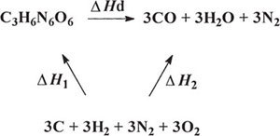
HEAT OF DETONATION
heat of explosion - the energy liberated during the formation of decomposition products at adiabatic* conditions Q_{exp} (kJ/g) or Δ_{det}H° (kJ/mol)
Δ_{f}H°₁ =
= Δ_{f}H°₂
*adiabatic process – a thermodynamic process that occurs without transferring heat or mass; energy is transferred only as work
- combustion - produces heat and gases slowly for a certain time period,
- explosion – produces heat and gases rapidly in an instant
- heat of explosion provides information about work capacity of the explosives.
- detonation - supersonic explosions created by high explosives that travel through shock waves
Notes:
For explosive substances, the energy liberated during the formation of decomposition products such as CO, C and H₂ gas, is known as the ‘heat of explosion’
If these products are then isolated and allowed to burn in excess oxygen to form CO₂, H₂O, etc. the heat evolved added to the heat of explosion would be equal to the heat of combustion
Heat of combustion is higher than the value for heat of explosion for substances which have insufficient oxygen for complete oxidation.
For explosive substances with positive oxygen balances, e.g. nitroglycerine, there is generally no difference between the value for the heat of explosion and that for the heat of combustion.
The value for the heat of formation can be negative or positive. If the value is negative, heat is liberated during the reaction and the reaction is exothermic; whereas, if the value is positive, heat is absorbed during the reaction and the reaction is endothermic. For reactions involving explosive components the reaction is always exothermic. In an exothermic reaction the energy evolved may apper in many forms, but for the practical purposes it is usually obtained in the form of heat.
The energy liberated when explosives deflagrate is called the heat of deflagration, whereas the energy liberated by detonating explosives is called heat of detonation in kJ/mol or the heat of explosion in kJ/kg

Slide 27
ENTHALPY OF DETONATION – HESS’S LAW
Δ_{f}H° (RDX) = +70.3 kJ/mol
Δ_{f}H° (CO) = -110.5 kJ/mol
Δ_{f}H° (H₂O_{(g)}) = -241.8 kJ/mol
Δ_{f}H° (C ), (H₂), (O₂), (N₂) = 0 kJ/mol
Δ_{rxn}H° = Δ_{detonation}H° = Σ Δ_{f}H° (products) - ΣΔ_{f}H° (reactants)
ΔH₁ = -Δ_{atom}H = Δ_{f}H° = Δ_{f}H° (RDX) – (Σ Δ_{f}H° (C ), (H₂), (O₂), (N₂)) = 70.3 - 0 = 70.3 kJ/mol
ΔH₂ = Δ_{f}H° =[3 x Δ_{f}H°(CO) + 3 x Δ_{f}H°(H₂O_{(g)}) + 3 x Δ_{f}H°(N₂)] – [Σ Δ_{f}H°(C),(H₂),(O₂),(N₂)] =
= [3 x (-110.5) +3 x (-241.8) + 3 x 0] – 0 = -1057.1 – 0 = - 1057.1 kJ/mol
Δ_{detonation}H = ΔH₂ - ΔH₁ = -1057.1 – 70.3 = -1127.4 kJ/mol
the heat of detonation can be converted to the heat of explosion Q
$$Qexp= \frac{∆_{detonation}H°×1000}{MM}=\frac{(−1127.4 kJ/mol×1000}{222.1 g/mol}=−5075.5 kJ/kg$$
Notes:
The calculated values do not exactly agree with those obtained experimentally since the conditions of loading density, temperature, pressure, are not taken into consideration.
The value for Q in is generally derived from the heat of detonation in The heat of detonation for RDX can be illustrated using Hess’s law as shown in Figure
At const P and V, the heat of explosion is calculated from the difference between the sum of the energies for the formation of the explosive components and the sum of the energies for the formation of the explosion products,

Slide 28
PRACTICE PROBLEM
Calculate the heat of explosion (detonation) of PETN (C₅H₈N₄O₁₂ , MM 316.3 g/mol), given the following products and heats of formation:
Δ_{detonation}H
Δ_{f}H° (PETN) = -530.5 kJ/mol
Δ_{f}H° (CO) = -110.5 kJ/mol
Δ_{f}H° (CO₂) = -393.5 kJ/mol
Δ_{f}H° (H₂O_{(g)}) = -241.8 kJ/mol
C₅H₈N₄O₁₂ 3CO₂ + 4H₂O + 2CO + 2N₂
Δ_{detonation}H
C₅H₈N₄O₁₂ 3CO₂ + 4H₂O + 2CO + 2N₂
⎯→
⎯→
Δ_{f}H₁°
Δ_{f}H₂°
5 C + 4 H₂ + 2 N₂ + 6 O₂
Δ_{f}H° (C ), (H₂), (O₂), (N₂) = 0 kJ/mol
Δ_{detonation}H = Σ Δ_{f}H° (products) - ΣΔ_{f}H° (reactants)
Δ_{f}H₁° = -Δ_{atom}H = Δ_{f}H° (PETN) – (Σ Δ_{f}H° (C ), (H₂), (O₂), (N₂) = (– 530.5) – 0 = -530.5 kJ/mol
Δ_{f}H₂° = [3 x Δ_{f}H°(CO₂) + 4 x Δ_{f}H°(H₂O_{(g)}) + 2 x Δ_{f}H°(CO) + 2 x Δ_{f}H°(N₂)] – [Σ Δ_{f}H°(C),(H₂),(O₂),(N₂)] =
= [3 x (-393.5) + 4 x (-241.8) + 2 x (-110.5) + 3 x 0] – 0 = -2368.7 – 0 = - 2368.7
Δ_{detonation}H = ΔH₂ - ΔH₁ = -2368.7 – (-530.5) = -1838.2 kJ/mol
$$Qexp= \frac{∆_{detonation}H °×1000}{MM}=\frac{(−1838.2 kJ/mol×1000}{316.3 g/mol}=−5811.6 kJ/kg$$

Slide 29
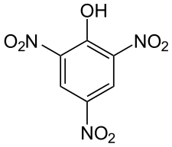



EXPLOSIVE POWER, POWER INDEX and TNT EQUIVALENCE
in an explosive reaction, the amount of heat and gases liberated (Q_{explossion} and V_{gas}, calculated independently) combine to give the value for the explosive power
$$explosive power=Q_{explosion} × V_{gas}$$
power index in relation to standard explosive, picric acid
$$power index=\frac{Q_{explosion} × V_{gas}}{Q_{explosion}\left(PA\right) × V_{gas}(PA)}×100\%$$
picric acid
C6H3N3O7
229 g/mol
Q_{explossion} 3301.02 kJ/kg and V_{gas} 831.06 dm³/kg
“TNT equivalence” - a normalization technique for equating properties of an explosive to TNT, the standard compares the explosive power to the explosive power of TNT
$$TNT equivalence=\frac{Q_{explosion} × V_{gas}}{Q_{explosion}\left(TNT\right) × V_{gas}(TNT)}$$
power index and TNT equivalence of secondary explosives are much higher than the values for primary explosives.
Notes:
In an explosive reaction, heat and gases are liberated. The volume of gas V and the heat of explosion Q can both be calculated independently but these values can be combined to give the value for the explosive power as shown in Equation

Slide 30
VOLUME OF GASEOUS PRODUCTS OF EXPLOSION
IMPORTANT because the volume of gas produced during an explosion provides information on the amount of work done by the explosive.
STP (0 °C or 273K, 1 atm)
  volume of gas varies with temperature at which the measurement is taken.
  enable comparisons between one explosive and another.
  one mole of gas occupies 22.4 dm³ (molar gas volume)
volume of gas V liberated from an explosive during detonation can be calculated from its equation of decomposition
C₃H₆N₆O₆ → 3 CO (g) + 3 H₂O (g) + 3 N₂ (g)
  9 moles of gas are produced from 1 mole of RDX (MM = 222.1 g/mol)
  at STP 9 moles of gas will occupy (9 moles x 22.4 dm³/mol) 201.6 dm3
  1 g of RDX will produce 201.6 dm³ / 222.1 g) 0.908 dm³/g (908 cm³/g)
Notes:
The volume of gas produced during an explosion will provide information on the amount of work done by the explosive. In order to measure the volume of gas generated standard conditions must be established, because the volume of gas will vary according to the temperature at which the measurement is taken. These standard conditions also enable comparisons to be made between one explosive and another. The standard IUPAC conditions set the temperature at 0 °C or 273K, and the pressure at 1 atm. These conditions are known as ‘standard, temperature and pressure’, ‘STP’. Under these standard conditions one mole of gas will occupy 22.4 dm3 which is known as the molar gas volume. The volume of gas V produced from an explosive during detonation can be calculated from its equation of decomposition, where information can be obtained on the amount of gaseous products liberated. Examples for the calculation of V during detonation of RDX and TNT are given below.
C3H6N6O6 → 3 CO + 3 H2O + 3 N2
The production of water will be turned into steam as the temperature of explosion will be very high; therefore, water will be regarded as a gaseous product. From Reaction 5.9 it can be seen that 9 moles of gas are produced from 1 mole of RDX. Therefore, 9 moles of gas will occupy 201.6 dm3 and 1 g of RDX will produce 0.908 dm3/g (908 cm3/g of gas at ‘STP’ as shown in Equation
1 mol of gas at ‘STP’ will occupy 22.4 dm3
9 mol of gas will occupy 22.4 x 9 = 201.6 dm3
Therefore, 1 mol of RDX produces 201.6 dm3 of gas
1 g of RDX produces 201.6/222 = 0.908 dm3/g
Where the molecular mass of RDX is 222.

Slide 31
PRACTICE PROBLEM
The chemical equation for an explosion of TNT (C₇H₅N₃O₆) was derived using the modified K-W rules and is shown below.
C₇H₅N₃O₆ → 3½ CO + 3½ C + 2½ H₂O + 1½ N₂
Calculate the volume of all gas products liberated upon detonation of one mole of TNT.
What volume of gases is produced from 1 g of TNT?
One mole of TNT produces 7½ moles of gas which will occupy 168 dm3 and 1 g of TNT will produce 0.740 dm3/g (740 cm3/g) of gas at ‘STP’ as shown in Equation
7½ mol of gas will occupy 22.4 × 7½ = 168 dm3
Therefore, 1 mol of TNT produces 168 dm3 of gas
1 g TNT produces 168/227 = 0.740 dm3/g
where the molecular mass of TNT is 227

