Slide 1
Name : divya j modi student id : 2227499
Module : CHANGE & STABILITY MANAGEMENT tutor : marie pitson

Slide 2

Introduction
Change in an organisation refers to any alteration or modification made to the organization's existing practises, processes, systems, or structure.
Airbnb is a website that allows people to rent out their homes, apartments, or other types of lodging to travellers.
The pandemic of COVID-19 had a significant impact on the travel industry, including Airbnb. As a result, in order to adapt to the new reality of the pandemic, Airbnb had to undergo a large-scale transformational change. Such changes are allowing only quality rentals with proper safety measurements to be listed on the platform, monitoring feedback from the users using AI and Natural Language Processing (NLP) and show suggesstions according to the requirements.
Notes:
Change can occur at various levels, including individual, team, departmental, or organisational, and can be influenced by a variety of factors, including technological advancements, market trends, competition, regulatory requirements, or internal factors such as restructuring, mergers, or acquisitions. Such changes are allowing only quality rentals with proper safety measurements to be listed on the platform, monitoring feedback from the users using AI and Natural Language Processing (NLP) and show suggesstions according to the requirements.

Slide 3
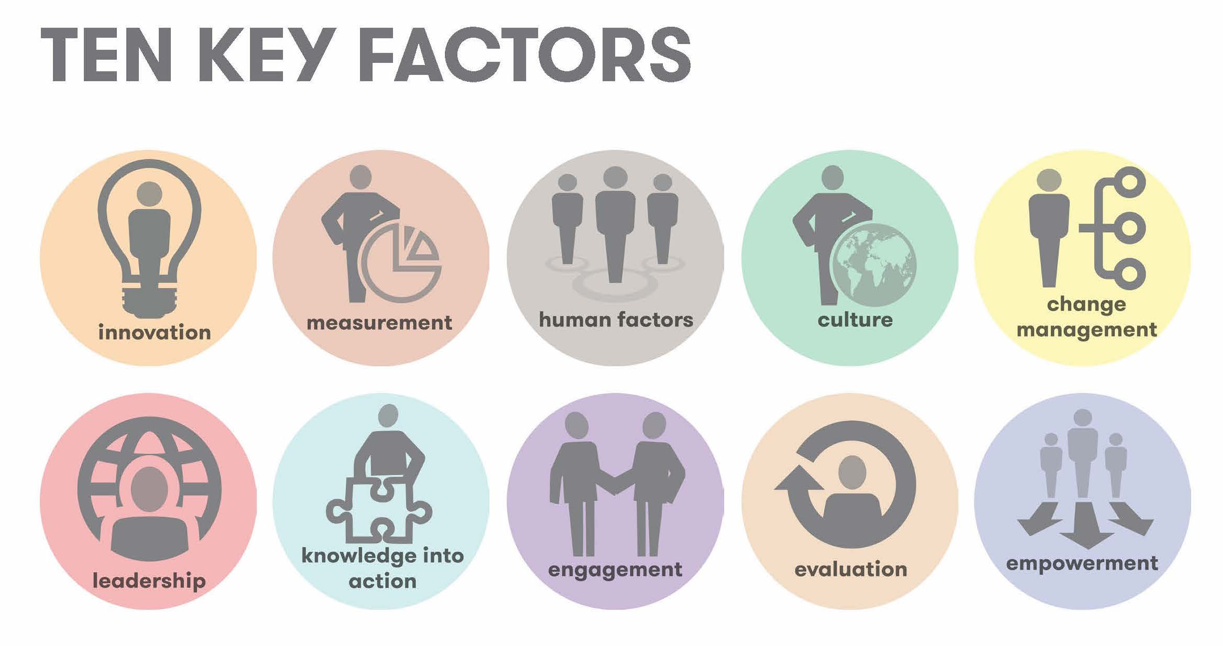
Key factors and drivers of change
The company's culture of innovation, agility, and customer-centricity aided in its response to the pandemic. To adapt to the rapidly changing market conditions, the company's leadership encouraged employees to think creatively and act quickly.
During the pandemic, Airbnb's leadership was critical in driving change.
Airbnb's digital platform enabled the company to quickly pivot its business model and adapt to changing traveller needs.
Notes:
The company's culture of innovation, agility, and customer-centricity aided in its response to the pandemic. Compoany adapt changes rapidly as per the requirement of market conditions, the company's leadership encouraged employees to think creatively and act quickly.
Airbnb was able to navigate the pandemic's challenges and emerge as a stronger and more resilient company by leveraging these factors.

Slide 4
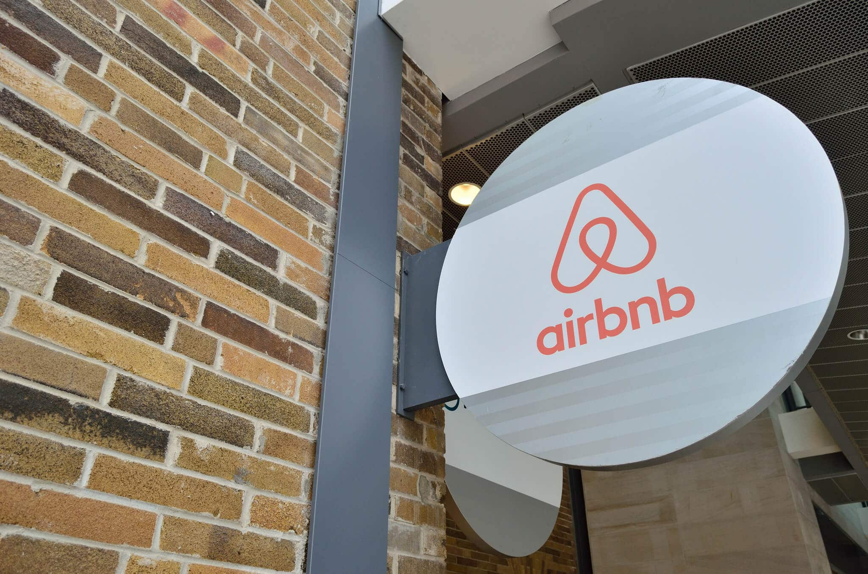
Internal factors - SWOT
Strengths:
Airbnb is a well-known brand with a reputation for providing unique and personalised travel experiences.
Airbnb's platform offers a unique and flexible way for hosts to rent out their properties, as well as for guests to find accommodations that meet their specific needs (Harmon, 2019).
Weaknesses:
Airbnb is vulnerable to external factors such as economic downturns, political instability, and public health crises, all of which can have an impact on travel demand and revenue.
Notes:
The company's strengths and opportunities provide a solid foundation for growth and innovation, but it must continue to address its weaknesses and threats in order to maintain its competitive advantage and market position.
Strength
Airbnb is a well-known brand with a reputation for providing unique and personalised travel experiences.
Airbnb's platform offers a unique and flexible way for hosts to rent out their properties, as well as for guests to find accommodations that meet their specific needs
Weakness
Airbnb is vulnerable to external factors such as economic downturns, political instability, and public health crises, all of which can have an impact on travel demand and revenue.

Slide 5
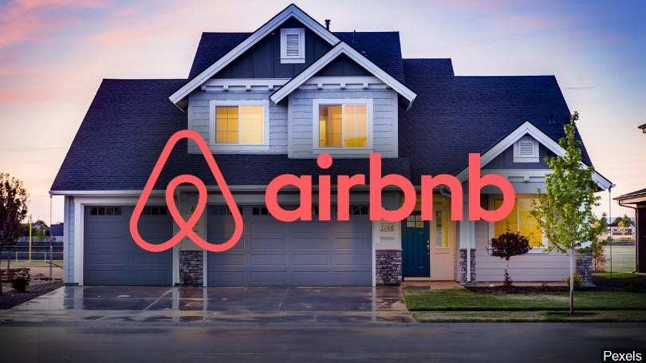
Internal factors- SWOT
Opportunities:
Expansion into new markets: In order to grow its customer base, Airbnb has the opportunity to expand into new markets such as emerging economies or new travel segments.
Airbnb can continue to innovate and develop new features and offerings to meet the changing needs and expectations of travellers (Nwakanma, 2022).
Threats:
Other online travel agencies and short-term rental platforms compete with Airbnb for market share and revenue.
Economic downturns or recessions can have an impact on travel demand and reduce the number of bookings on the platform.
Notes:
Read as it is

Slide 6
External factors - PESTLE
Political:
In many jurisdictions, local governments are attempting to regulate short-term rentals in order to protect local housing markets and residents.
Economical:
Economic downturns or recessions can have an impact on travel demand and reduce the number of bookings on the platform (Branson and Martinez, 2023).
Social:
Changes in consumer preferences and travel behaviours, such as a shift towards sustainable travel, may have an impact on demand on the platform.
Notes:
The success of Airbnb is heavily reliant on external factors such as politics, economics, social, technological, legal, and environmental factors.
Read all factors

Slide 7
External factors - PESTLE
Technological:
Disruptive technologies such as blockchain and artificial intelligence may have an impact on the travel industry and Airbnb's business model.
Cybersecurity threats and data breaches may have an impact on the company's reputation and customer trust (Callander, et al. 2022).
Legal:
Changes in data protection laws may have an impact on the company's ability to collect and use customer data.
Environmental:
Changes in consumer preferences for sustainable travel may have an impact on demand on the platform and the company's overall sustainability goals (Arthur, 2022).
Notes:
Read as it is with summary

Slide 8
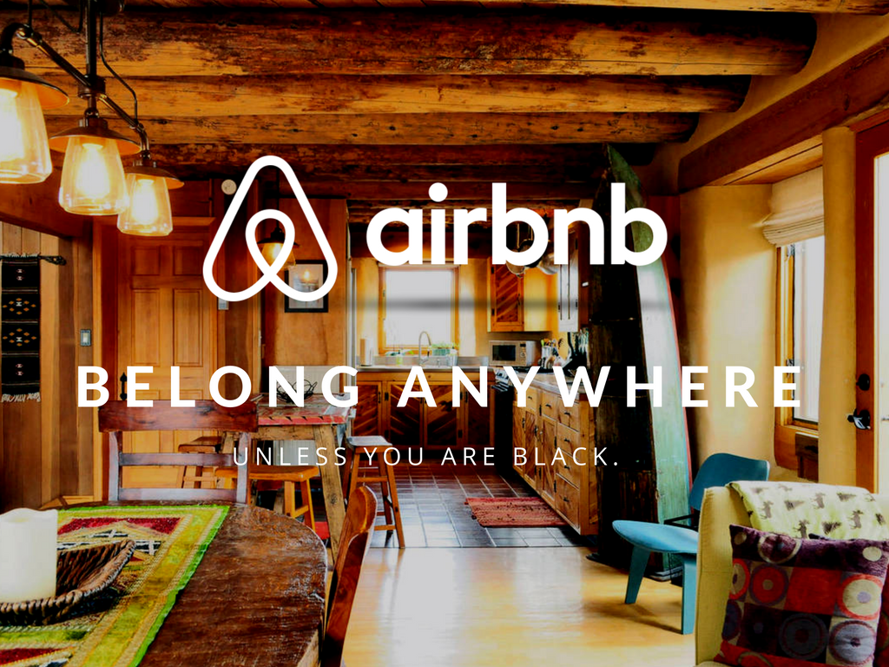
Stakeholders
Individuals or groups who have an interest in or are impacted by an organization's operations and outcomes are referred to as stakeholders.
Customers of Airbnb include both guests who book accommodations through the platform and hosts who list their properties for rent.
Airbnb hosts are an important stakeholder group. They list their properties on the platform and are responsible for ensuring that guests have a positive experience.
Notes:
Overall, understanding and managing these stakeholder groups' needs and interests is critical to Airbnb's success and reputation.

Slide 9
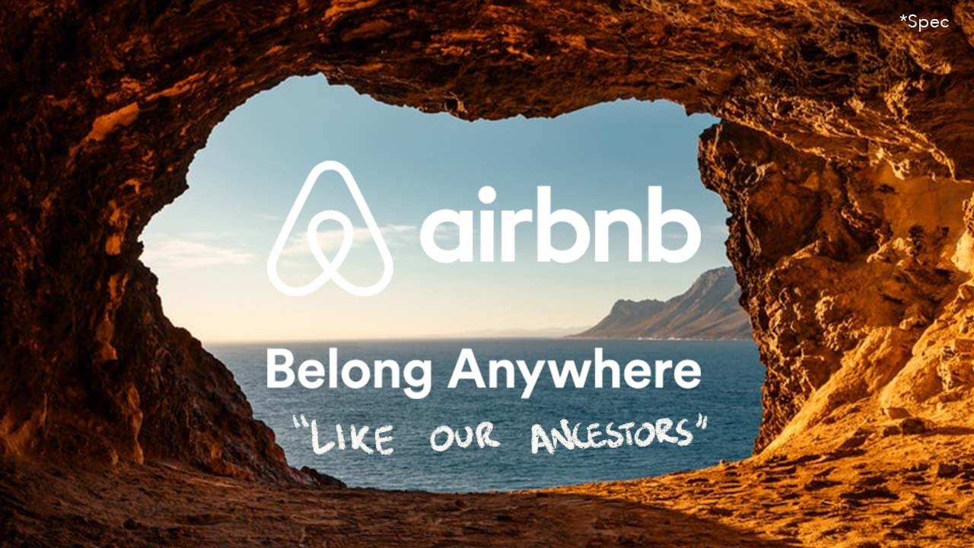
The emergence of change and how different approaches were brought
The impact of the COVID-19 pandemic on the travel industry was a major driver of change in Airbnb.
In response to the pandemic, Airbnb implemented cost-cutting measures such as layoffs and reduced marketing spend in order to conserve cash and weather the storm.
Airbnb accelerated its digital transformation efforts to adapt to the changing environment, including expanding its online experiences offerings.
Notes:
Overall, the need to adapt to a changing environment and address the challenges posed by the pandemic drove the emergence of change in Airbnb.

Slide 10

Resistance to change and how it was overcome
Resistance to change is common in many organisations, and Airbnb was not immune to this during its transformation efforts in response to the COVID-19 pandemic.
Airbnb also involved its employees and stakeholders in the change process by seeking their input and feedback. This helped to ensure that the changes were aligned with the stakeholders' needs and interests.
Airbnb launched pilot program to test new approaches in a controlled environment and collect feedback before implementing the changes more broadly (Agostino, et al. 2022).
Notes:
Overcoming resistance to change, in general, necessitates a combination of different strategies tailored to the specific context and needs of the organisation. By putting these strategies in place, Airbnb was able to successfully navigate the pandemic's challenges and emerge as a more resilient and adaptable company.

Slide 11
Need for a change ....
Airbnb is currently involved on the short term rentals with collaboration of private home, vacation rentals and short term rentals. To grow a business Airbnb must tie with hotels , villas to make a significant change to its business model by shifting its focus from short-term rentals to long-term rentals so that more growth in financial term can be achieved by the company. Company can also collaborate with tour operators so that business range can be increased.
Notes:
Airbnb is providing only short term rentals with collaboration of private home, vacation rentals and short term rentals. To grow the business company must tie with hotels , villas to make a significant change to its business model by shifting its focus from short-term rentals to long-term rentals so that more growth in financial term can be achieved

Slide 12
Lewin’s model for change management
Unfreezing:
Top management of Airbnb must identify the market trends and must adapt change in their business model. They communicate with the stakeholders and discuss the challenges and opportunities associated with the change, and the benefits of offering long-term rentals. They should address concer of the hosts and guests and make them ready for the change.
Moving
As Airbnb providing online platform to rent a stay they should starts to upgrade their platform for long-term rentals, which includes longer stay booking, must prepare proper package for long term stay. Meanwhile continue with short term rentals is necessary too as it is main business of Airbnb.
Refreezing
After long-term rental option has been successfully implemented, Airbnb can highlights the new model. By Collecting reviews and analysing those reviews and feedback prepare a plan and make necessary changes to improve the user experience. Airbnb must upgrade marketing strategies to highlight the new feature of long-term stays. It can lead the business of Airbnb to the new heights.
Notes:
Unfreezing
For the change managment Lewin’s model is one of the best models. Management of company must identify the market trends and must adapt change in their business model. Proper communication should be established with the stakeholders and discuss the challenges and opportunities associated with the change of long term rentals in addition with short term rentals.
Moving

Slide 13
Lewin’s model for change management
Refreezing
After long-term rental option has been successfully implemented, Airbnb can highlights the new model. By Collecting reviews and analysing those reviews and feedback prepare a plan and make necessary changes to improve the user experience. Airbnb must upgrade marketing strategies to highlight the new feature of long-term stays. It can lead the business of Airbnb to the new heights.
Notes:
After long-term rental option has been successfully implemented, Airbnb can highlights the new model. By Collecting reviews and analysing those reviews and feedback prepare a plan and make necessary changes to improve the user experience. Airbnb must upgrade marketing strategies to highlight the new feature of long-term stays. It can lead the business of Airbnb to the new heights.

Slide 14
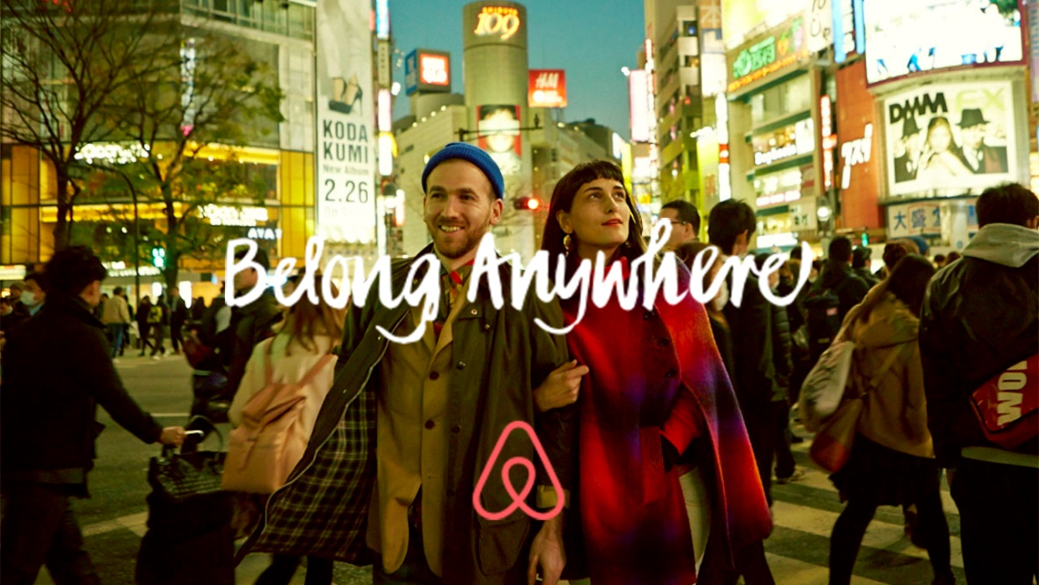
Conclusion
One of the most significant changes made by Airbnb was the shift from short-term rentals to longer-term stays.
With travel restrictions and lockdowns in place, many travellers were looking for longer-term rentals to work or study remotely rather than short-term vacations.
Airbnb was able to navigate the crisis and emerge as a stronger and more resilient company by implementing various approaches such as cost-cutting, digitalization, health and safety measures, diversification, and partnerships.
Notes:
It is critical that Airbnb engage with these stakeholders and address their concerns and needs in a responsible and transparent manner. Airbnb must continue to monitor these factors and adjust its strategy as needed.

Slide 15
References
Abdelmaboud, A., Ahmed, A.I.A., Abaker, M., Eisa, T.A.E., Albasheer, H., Ghorashi, S.A. and Karim, F.K., 2022. Blockchain for IoT applications: taxonomy, platforms, recent advances, challenges and future research directions. Electronics, 11(4), p.630.
Agostino, D., Saliterer, I. and Steccolini, I., 2022. Digitalization, accounting and accountability: A literature review and reflections on future research in public services. Financial Accountability & Management, 38(2), pp.152-176.
Arthur, T.O., 2022. “We Bring Home the Roots”: Black Women Travel Influencers, Digital Culture Bearing, and African Internationalism in Instagram. Social Media+ Society, 8(2), p.20563051221103843.
Branson, M.L. and Martinez, J.F., 2023. Churches, cultures, and leadership: A practical theology of congregations and ethnicities. InterVarsity Press.
Callander, S., Foarta, D. and Sugaya, T., 2022. Market Competition and Political Influence: An Integrated Approach. Econometrica, 90(6), pp.2723-2753.
Gin, L.E., Pais, D.C., Parrish, K.D., Brownell, S.E. and Cooper, K.M., 2022. New online accommodations are not enough: the mismatch between student needs and supports given for students with disabilities during the COVID-19 pandemic. Journal of Microbiology & Biology Education, 23(1), pp.e00280-21.
Harmon, P., 2019. Business process change: a business process management guide for managers and process professionals. Morgan Kaufmann.
Islam, M.N., Furuoka, F. and Idris, A., 2020. Employee championing behavior in the context of organizational change: a proposed framework for the business organizations in Bangladesh. Journal of Asia Business Studies.
Latilla, V.M., Frattini, F., Franzo, S. and Chiesa, V., 2020. Organisational change and business model innovation: an exploratory study of an energy utility. International Journal of Innovation Management, 24(04), p.2050036.
Le Grand, T. and Deneckere, R., 2019, July. COOC: an agile change management method. In 2019 IEEE 21st Conference on Business Informatics (CBI) (Vol. 2, pp. 28-37). IEEE.
Naser, M.Z. and Kodur, V.K., 2022. Explainable machine learning using real, synthetic and augmented fire tests to predict fire resistance and spalling of RC columns. Engineering Structures, 253, p.113824.
Nwakanma, A.P., 2022. From black lives matter to EndSARS: Women’s socio-political power and the transnational movement for black lives. Perspectives on Politics, 20(4), pp.1246-1259.
Player-Koro, C., Jobér, A. and Bergviken Rensfeldt, A., 2022. De-politicised effects with networked governance? An event ethnography study on education trade fairs. Ethnography and Education, 17(1), pp.1-16.

