Slide 1
Module Name: Electronics II
Module Code: ACDA6001
Activity 1
Prepared By,
- Jenifer Prince Devaraj M.E., M.Ed.

Slide 2
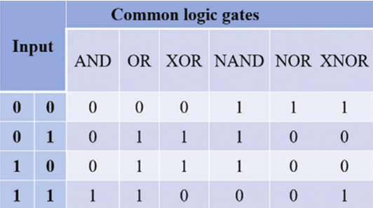
ACTIVITY
Verify the Following Gates with its truth table using Proteus. Submit the Output File in the given link
AND
OR
NOT
NAND
NOR
XOR
XNOR

