Slide 1
Presentation topic:
Forensic Evidence Analysis: A Case Study of Corporate Espionage at Quantum Tech
Submitted by:
Submitted to:
Name: Md Riad Hossain
Student ID: 2434324
Subject: Digital Forensics Analysis (ACCA7031)
Name: Dr. Mohamed Ghanem
Lecturer: Digital Forensics Analysis (London campus)
Module code: ACCA7031

Slide 2
Case Background
Quantum Tech identified unauthorized access to a proprietary AI chip design patent, labelled QT-AI-2025. Initial suspicion pointed toward an insider, specifically a recently joined employee named Emma. The organisation believed that Emma attempted to sell this confidential data to a competitor through an intermediary. The primary communication channel identified was WhatsApp, which became the focus of this forensic investigation.
This raises concerns of corporate espionage and insider threat activity.

Slide 3
Objectives
The objectives of this investigation were fourfold.
First, to identify the roles of the individuals involved, including the perpetrator, intermediary, and potential buyer.
Second, to analyse communication and digital evidence extracted from the devices.
Third, to reconstruct a clear timeline of events based on the available data.
And finally, to determine the intent and motive behind the suspicious activities.

Slide 4
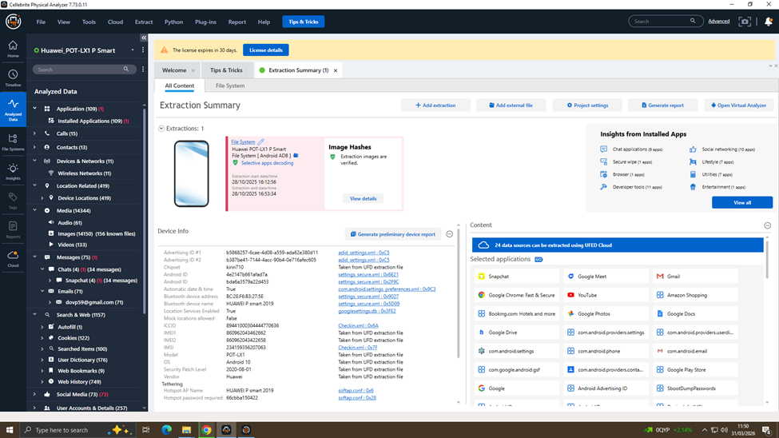
Methodology
The investigation followed standard digital forensic procedures.
Data was extracted using Cellebrite Physical Analyzer through a file system extraction method. To ensure evidence integrity, hash verification was performed, confirming that the data had not been altered.
The analysis focused on WhatsApp communications, media files, and metadata.
This approach ensures that the findings are reliable, reproducible, and legally admissible
However, to show how I will do the extraction of this four images if I get their physical version therefore I use UFED to extract my device which I added below.

Slide 5
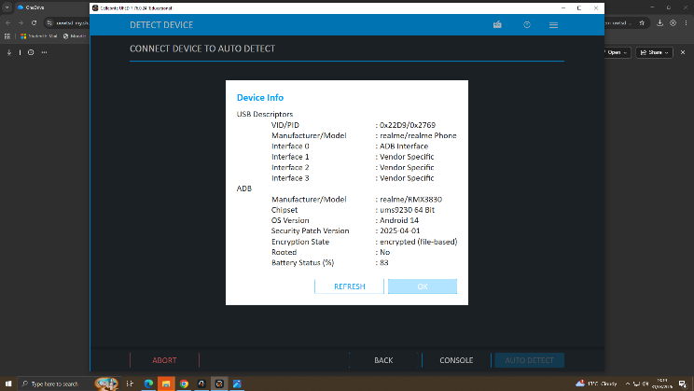
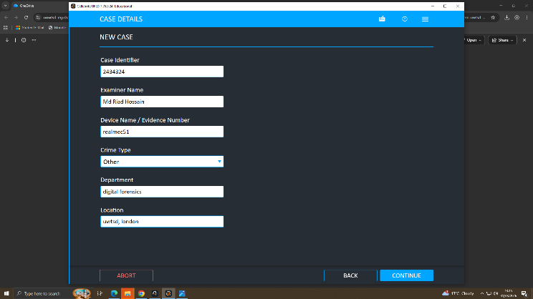
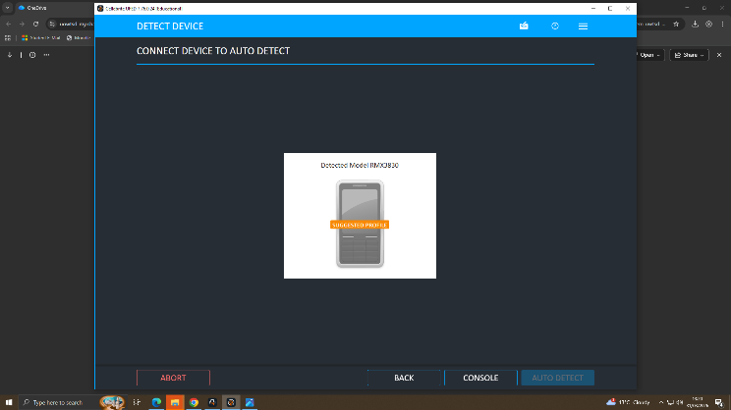
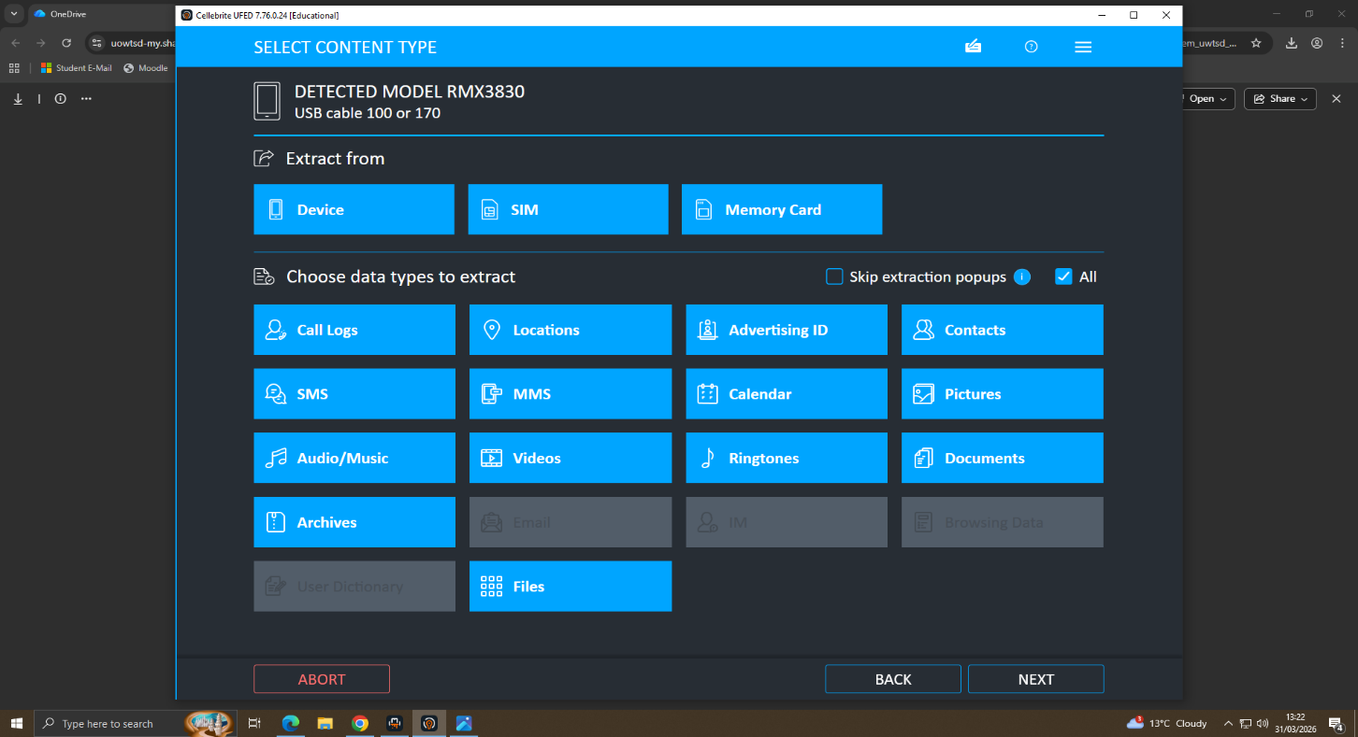
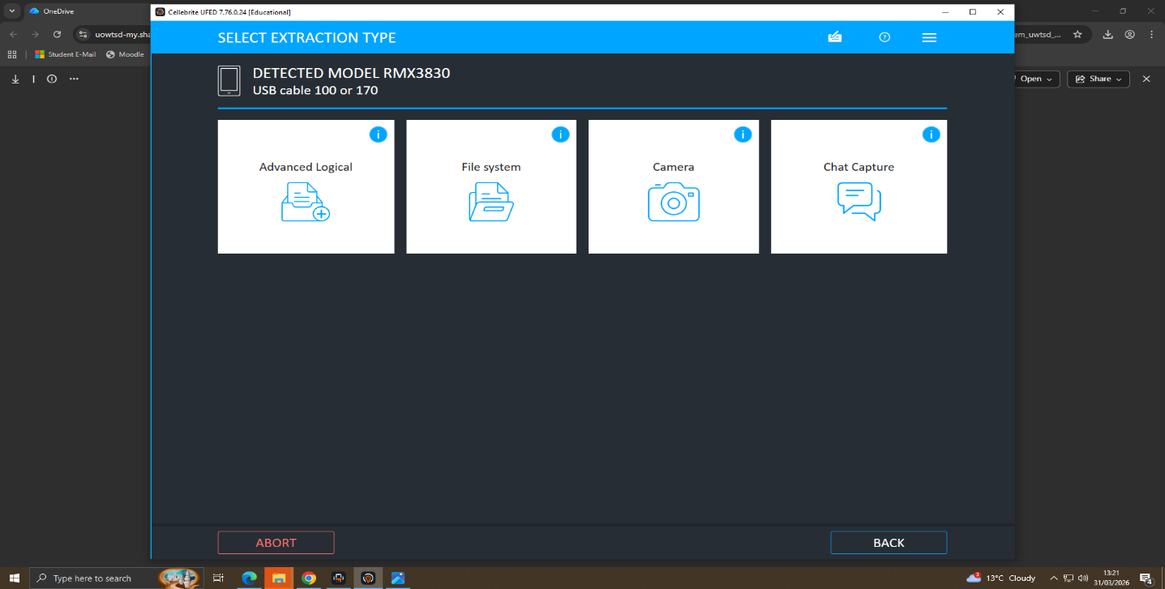
UFED

Slide 6
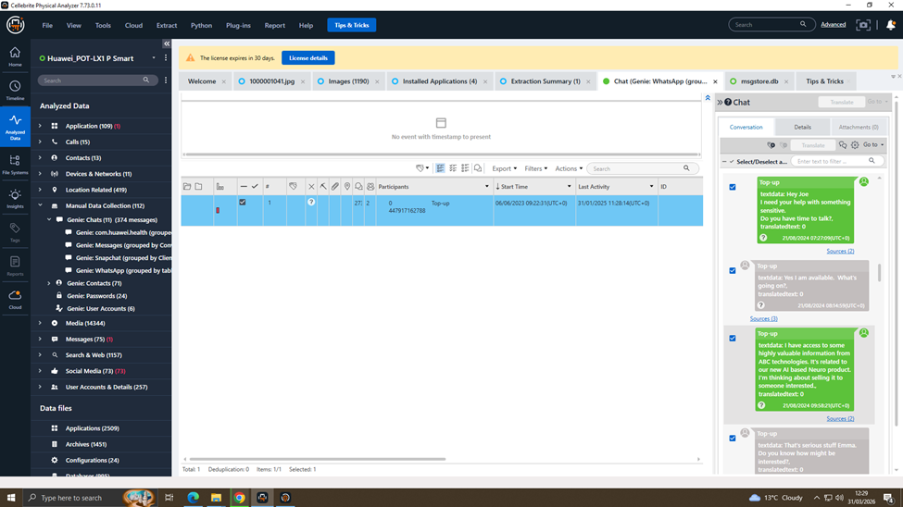
Communication Analysis
The most critical evidence comes from WhatsApp conversations between Emma and Joe.
Emma begins by stating she needs help with something ‘sensitive,’ indicating awareness of confidentiality.
She then reveals access to highly valuable information related to an AI product. Importantly, she explicitly states she is thinking about selling this information.
Further messages show discussions about meeting clients in a hotel, confirming progression toward execution. This clearly demonstrates intent to sell confidential data.

Slide 7
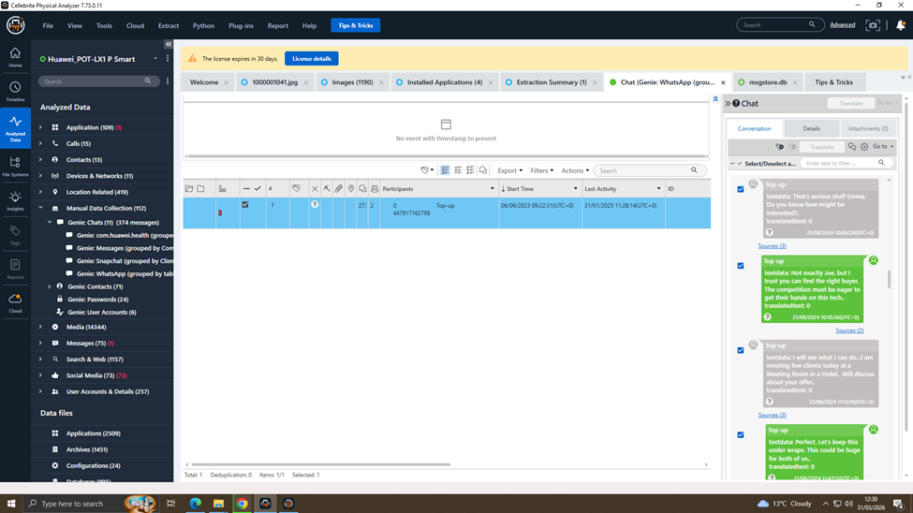
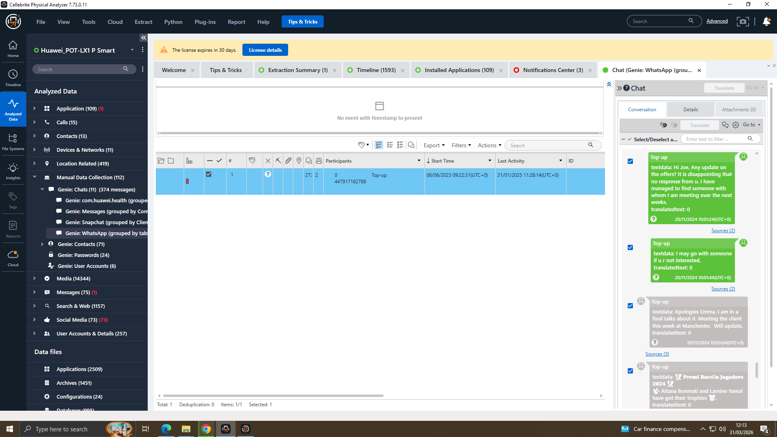
Behavioral Pattern
The communication follows a clear behavioral pattern typical of insider threats. It begins with trust-building, followed by disclosure of sensitive information, and then moves into execution planning.
Emma uses negotiation tactics, such as suggesting competition and alternative buyers, to create urgency. The activity persists over time, showing this was not a one-time action.
Additionally, secrecy is emphasised with phrases like ‘keep this under wraps.’ This confirms a structured and deliberate approach.

Slide 8
Timeline of Events
The timeline reconstruction shows how the activity developed over time.
On August 21st, Emma initiated contact and expressed intent to sell the data.
By August 26th, she was actively searching for buyers and expanding her network.
By November 20th, she continued follow-ups, indicating ongoing efforts to complete the transaction.
This demonstrates a progression from initial intent to sustained execution attempts.
The timeline is crucial in proving continuity and persistence.

Slide 9
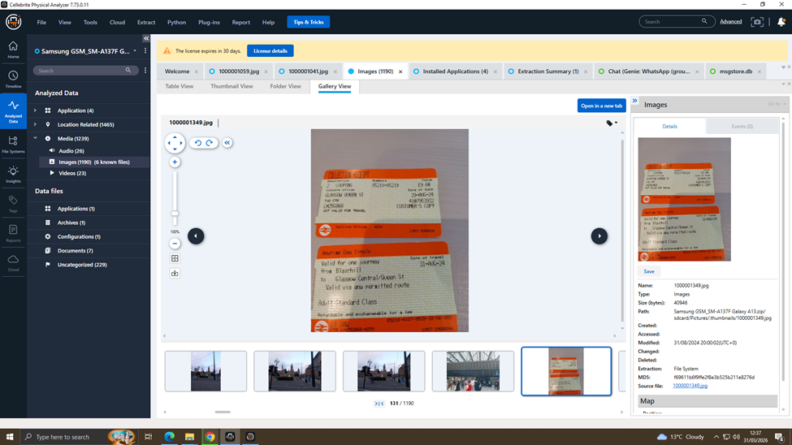
Supporting Evidence
In addition to chat data, supporting evidence further strengthens the case.
A train ticket indicates physical movement, which aligns with the planned meetings discussed in chats.
An image of a card suggests a possible method of financial transaction.
Location sharing through maps indicates coordination of meeting points without leaving detailed text records. This combination of digital and physical evidence provides strong corroboration.
It shows that the activity extended beyond communication into real-world actions.

Slide 10
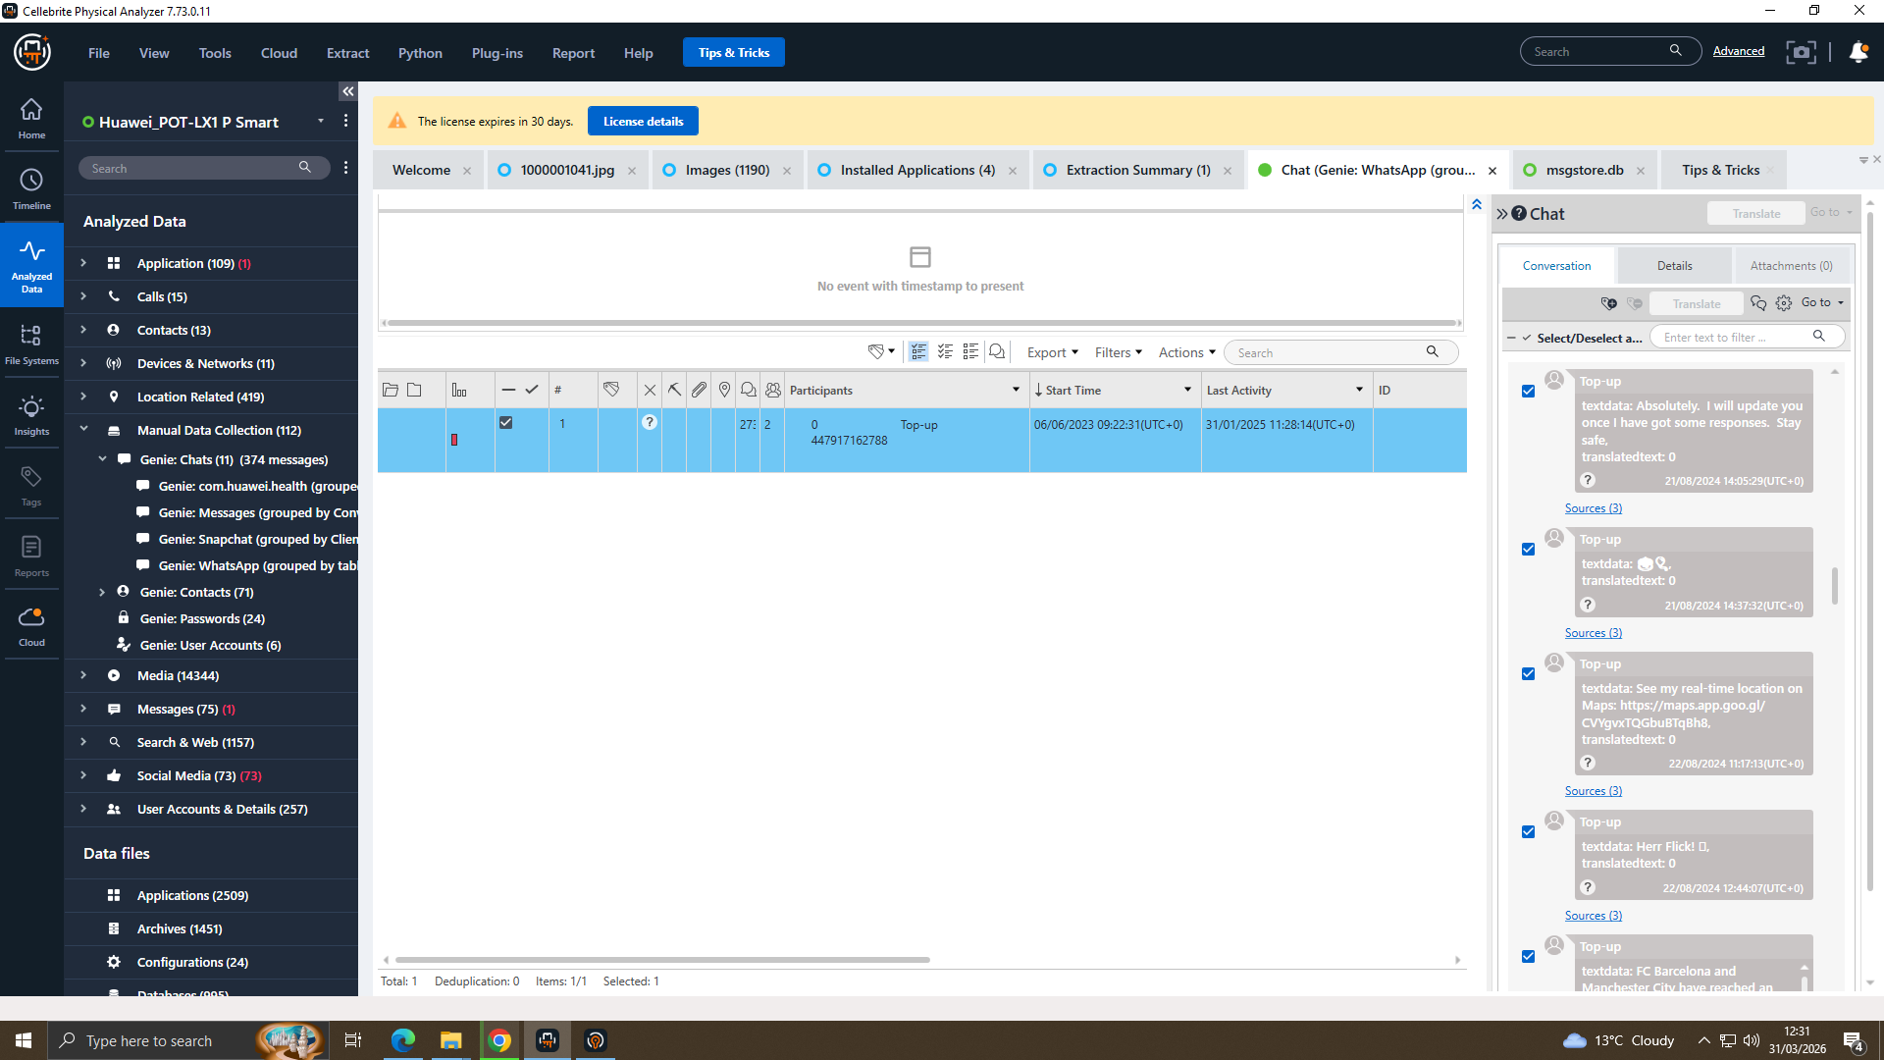
Conclusion & Suspect Roles
In conclusion, the investigation identifies Emma as the primary perpetrator, acting as an insider with access to sensitive data. Joe is identified as an intermediary who assisted in facilitating the transaction. There is also evidence of involvement from unknown external buyers. The findings clearly demonstrate intent, planning, and attempted execution of data exfiltration.
Overall, the evidence strongly supports a case of corporate espionage and insider threat activity. This highlights the importance of strong internal security controls and monitoring.

