Slide 1
LCHS4009_BIRM
FARAH PARVEEN
2440156
ANIKA TASIN AHMED

Slide 2

Content Page
What skill I have chosen
Communication Skill
Aims and objectives
Why is the communication skill important in a health and social care setting
Examples of communication skill for example given scenario
Conclusion
References
This Photo by Unknown Author is licensed under CC BY-NC

Slide 3

Aims and objectives
The main aim of communication in a health and social care setting is to ensure that information is shared clearly and safely. This is to provide safe and effective patient care.
A few communication objectives we can look at in health and social care are:
To promote person-centred care
To build trust and positive relationships
To understand and empathise with the needs of service users
(Mylearningcloud, 2025).
This Photo by Unknown Author is licensed under CC BY

Slide 4

Why is the skill communication important in a Health and Social Care setting?
Clear communication helps professionals understand symptoms, needs and risks. If information is misunderstood or not shared accurately it can lead to medication errors, misdiagnosed treatments or missed warning signs. It builds trust and relationships. People often using the services are vulnerable, distressed, anxious and can require constant re-assurance. Listening and explaining things clearly and responding with empathy and compassion can build trust.
(QCS, 2024).
This Photo by Unknown Author is licensed under CC BY-SA-NC

Slide 5
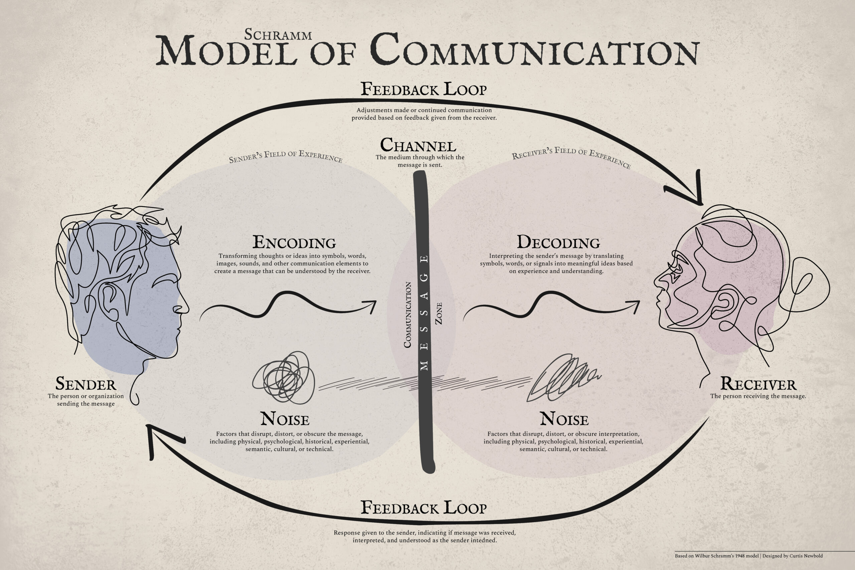
Example of a scenario in a health and social care setting
So here we are going to use the Interactive model of Communication (Schramm 1954).
So, my example would be, we have a patient who is not from the UK they have not been in this country for long. They are sick and need medical attention but have a language barrier which is also a communication barrier.
When there is a language barrier in an HSC care setting, communication skills must be adapted to make sure the patient feels safe, understood, and respected.
For example;
Speak slowly and clearly, use short sentences
Use gestures, hand signs, facial expressions to support what you are saying
You can also check understanding by asking the patient if they understand. Encoding (Sender/Encoder). The process of turning thoughts into a communicable message (verbal, non-verbal, or visual).
Decoding (Receiver/Decoder); The process of interpreting the message based on the recipient own field of experience.
You can even have an interpreter for assistant
(NICE,2024). (Schramm 1954).

Slide 6

The skill that I have chosen is Communication
Communication skill in health and social care is an ability that helps professionals share information clearly and build trust with people who use our services. It helps you listen properly and understand families and other professionals. Communication could also be through body language and active listening.
One key example is active listening such as;
Eye contact
Positive body language
Showing full attention
Nodding
Verbal responses
Responding as given response
Not interrupting
(Mylearningcloud, 2025).

Slide 7
Conclusion
In conclusion effective communication is a very essential skill in health and social care setting.
It's showing that individuals are being heard, feeling valued, respected, understood and safe. By using appropriate verbal and non-verbal communication and active listening and other communication methods to meet individual's needs.
This then delivers high quality health and social care services.
It plays a vital role in building trust, showing empathy and compassion.

Slide 8

References
THE QCS (2024) Effective Communication In Health and Social care. Available at: https://www.qcs.co.uk/effective-communication-in-health-and-social-care/ (Accessed at 17th February 2026).
My Learning Cloud (2025) What is Effective Communication in Health and Social Care. Available at: What is Effective Communication in Health and Social Care? (Accessed at 10th February 19, 2026).
Nation Institute for Health and Care Excellence (2021) Language Barrier Communication. Available at: Recommendations | Patient experience in adult NHS services: improving the experience of care for people using adult NHS services | Guidance | NICE (Accessed at 17th February 2026).
The Process and Effects of Mass Communication (1955). Wilbur Schramm’s 1954 book, The Process and Effects of Mass Communication. K. Available at: Process and Effects of Mass Communication, by Wilbur Schramm | Political Science Quarterly | Oxford Academic (Accessed at 15th February, 2026).

