Slide 1
Problem Solving and Decision Making
Name Alexandru Dragomir
Student ID 2107400
Module Code BMSW4004
Lecturer name Chijioke Uba

Slide 2

Introduction
The purpose of the study is to evaluate the staff absenteeism in the workplace.
Mid Cheshire Hospitals NHS Foundation Trust has faced the problem of staff absenteeism (Mcht, 2022).
It refers to the habitual non presence of employees in their job.
Notes:
The purpose of the study is to evaluate the staff absenteeism in the workplace. Mid Cheshire Hospitals NHS Foundation Trust has faced the problem of staff absenteeism (Shrm, 2022). In workplaces, staff absenteeism is a huge problem for organizations. It refers to the habitual non presence of employees in their job.

Slide 3
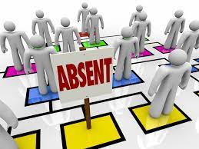
The nature and the impact of the complex problem on employees and their organizations
In the workplace absenteeism affects the individual's productivity.
Excessive absenteeism develops the chances of dropping from the work to the employees.
The positive impact is that individuals can rest and they can reduce their stress from their mind (Shrm, 2022).
Notes:
In the workplace absenteeism affects the individual's productivity. However, excessive absenteeism develops the chances of dropping from the work to the employees that leads to the long term consequences for employees such as higher incidences of unemployment, lower average income and many more things.

Slide 4
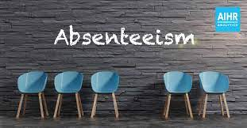
PESTLE analysis of the macro-environmental factors in Mid Cheshire Hospitals NHS Foundation Trust-
Political factors
The government has several rules that motivate their employees in their workplace and reduce absenteeism.
In the year of 2017, the UK government has topped in terms of political stability (Tarro, et al. 2020).
Economic factors
In the year of 2019, the GDP rate of the country is almost 2.744 trillion in US dollars.
It puts the country's economy in 6th position globally.
The unemployment or the absenteeism rate in the UK's economy is approximately 3.8% (Pestleanalysis, 2022).
In the organization the tax rate is almost 19%.
Notes:
Political factors
In the organization there are several factors that determine the stability of government like effectiveness of government policies, low corruption, control and rules of the laws (Mcht, 2022). In the UK, the government has several rules that motivate their employees in their workplace and reduce absenteeism.
Economic factors
In the year of 2019, the GDP rate of the country is almost 2.744 trillion in US dollars that puts the country's economy in 6th position globally. In the organization the tax rate is almost 19%. In the UK, the inflation is almost 1.94% (Pestleanalysis, 2022). The unemployment or the absenteeism rate in the UK's economy is approximately 3.8%.

Slide 5
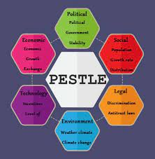
PESTLE analysis of the macro-environmental factors in Mid Cheshire Hospitals NHS Foundation Trust-
Social factors
The health care organizations have progressed in recent years in providing quality service to their patients (Attendanceworks, 2022).
It prefers the British health care system for complicated, serious diseases or injuries.
Technological skills
The country has the world's leading development and research institutes.
The economy provides several great opportunities for organizations.
Notes:
Social factors
In the UK, people spend a huge amount of money on their health insurance. The health care organizations have progressed in recent years in providing quality service to their patients as well as it prefers the British health care system for complicated, serious diseases or injuries (Taibi, et al. 2021).
Technological skills
The country has the world's leading development and research institutes and it always strives to break the barriers in every field. However the economy provides several great opportunities for organizations. The development and invention contributes to the economy of the country.

Slide 6
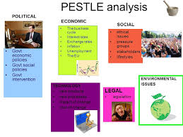
PESTLE analysis of the macro-environmental factors in Mid Cheshire Hospitals NHS Foundation Trust
Legal factors
The organization operates their business to follow their employees act.
Policies help the organization to develop their management system in business.
Environmental factors
The organization has faced some serious environmental issues.
Organizations have taken some steps and they spread some information about services, eco-friendly products, less plastic waste and recycling (Taibi, et al. 2021).
Notes:
Legal factors
In the UK, the organization operates their business to follow their employees act (Attendanceworks, 2022). In this factor organizations have to protect their rights such as sick pay, paternity or maternity leave, holiday pay, minimum wage and more things.
Environmental factors
The organization has faced some serious environmental issues (Neuprofessionals, 2022). However, private corporations, government as well as other organizations have taken some steps and they spread some information about services, eco-friendly products, less plastic waste and recycling.

Slide 7
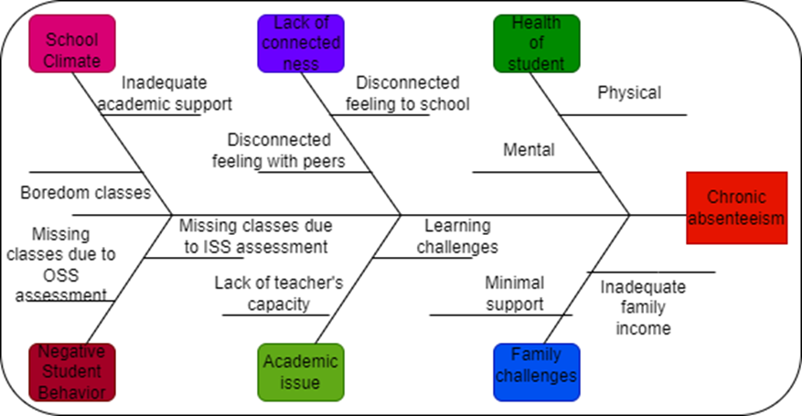
Cause-and-effect analysis of the complex problem
Causes
Challenging curriculum.
Negative self image.
Effect
Higher incidences of unemployment.
Lower average income (Forbes, 2022).
Notes:
In the workplace Absenteeism is a term while the employees could not provide any legitimate reason for missing their work. Depression is the leading cause of absenteeism in the workplace. Besides this there are several causes such as a challenging curriculum, negative self image, lack of interest in work and more things (Neuprofessionals, 2022). Effects are higher incidences of unemployment, lower average income and more things.

Slide 8
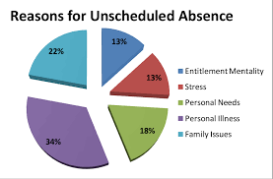
An evaluation of alternative solutions to absenteeism
Rewards for good attendance.
Providing feedback (Tarro, et al. 2020).
Reducing workplace stress.
Notes:
In the workplace there are several solutions to absenteeism such as reducing workplace stress, rewards for good attendance, providing feedback and several alternative things that reduce absenteeism from the workplace.

Slide 9
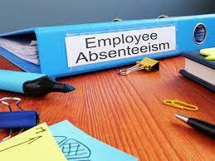
An aim of choosing the most appropriate solution among these alternatives
Management policies and programs.
Decision making (Neuprofessionals, 2022).
Return to work support.
Notes:
The organizations choose the alternative solution to reduce the absenteeism in their workplace because it is the trend by tracking the absence to improve the absence management policies and programs (Tarro, et al. 2020).

Slide 10

Conclusion
Absenteeism in the workplace affects badly (Forbes, 2022).
The absence from the work that is considered customary and reasonable due to occasional illness, personal time and vacation.
It affects individual productivity.
Notes:
The above study has shown that the absenteeism in the workplace affects badly. Sometimes it refers to the absence from the work that is considered customary and reasonable due to occasional illness, personal time and vacation. There are several reasons for absenteeism among employees in the workplace.

Slide 11
References
Mcht, (2022). Mid Cheshire Hospitals NHS Foundation Trust. Available in- https://www.mcht.nhs.uk/ ( accessed on 27th february 2022)
Shrm, (2022). Managing Employee Attendance. Available in- https://www.shrm.org/resourcesandtools/tools-and-samples/toolkits/pages/managingemployeeattendance.aspx( accessed on 18th february 2022)
Attendanceworks, (2022). The Problem. Available in- https://www.attendanceworks.org/chronic-absence/the-problem/( accessed on 15th february 2022)
Forbes, (2022). The Causes And Costs Of Absenteeism In The Workplace. Available in- https://www.forbes.com/sites/investopedia/2013/07/10/the-causes-and-costs-of-absenteeism-in-the-workplace/( accessed on 22th february 2022)
Neuprofessionals, (2022). Mid Cheshire Hospitals NHS Foundation Trust (MCHFT). Available in- https://neuprofessionals.com/our-current-and-historic-trusts/mid-cheshire/ ( accessed on 25th february 2021)
Pestleanalysis, (2022). PESTLE Analysis of the NHS. Available in- https://pestleanalysis.com/nhs-pestle-analysis/ ( accessed on 23th february 2022)
Taibi, Y., Metzler, Y.A., Bellingrath, S. and Müller, A., 2021. A systematic overview on the risk effects of psychosocial work characteristics on musculoskeletal disorders, absenteeism, and workplace accidents. Applied ergonomics, 95, p.103434.
Tarro, L., Llauradó, E., Ulldemolins, G., Hermoso, P. and Solà, R., 2020. Effectiveness of workplace interventions for improving absenteeism, productivity, and work ability of employees: a systematic review and meta-analysis of randomized controlled trials. International journal of environmental research and public health, 17(6), p.1901.

Slide 12


