Slide 1

Leading digital & strategic change
BMSW7003
Welcome Session
GWYNETH JONES
January 2026

Slide 2

a bit about myself – Gwyneth Jones
My name is Gwyneth Jones. I have lectured for over 25 years in the UK and Internationally. I also have industry experience within a range of private companies and public sector organisations.
I joined the University of Wales Trinity Saint David in 2023. As a full-time lecturer in the university’s Institute of Management and Health where I specialise in the areas of Strategic Marketing, Digital Marketing, Strategic Management, Change Management ….
I have a BA (Hons) in Business from Brunel University, an MSc in Strategic Marketing from Swansea University, a CIM Post Graduate Diploma in Marketing and a teaching qualification in Post Compulsory Education.
I am a member of The Chartered Institute of Marketing, The Chartered Management Institute and a Fellow of The Higher Education Academy
You can contact me at Gwyneth.jones@uwtsd.ac.uk

Slide 3

How I would like to work with you
Be curious and embrace the module
Keep up to date with business news in the media
Contribute to our discussions
Complete the tasks that you are given for the next session (e.g. reflect and answer questions, work on case studies)

Slide 4
a bit about you
What industry is your organisation in?
What is your current role in your organisation?

Slide 5
Module timetable
Overall
  10 weeks January – April 2026
  Tuesdays 10 am – 1 pm (UK time): Lectures
  Tuesdays 9 am – 10 am: Bookable drop-in sessions
Lectures
  Consist mainly of taught sessions, drawing upon additional resources available to you on Moodle
  W/C 23rd February: READING WEEK’ there will be NO LECTURE this week.
Assignment Focus
  Week 9 and 10: Bookable drop-in sessions related to your assignment
  Focus entirely on the requirements of the assignment
  By appointment only and can be used for:
    Review a draft summary of your assignment
    Assignment questions, specific to your assignment
    Assignment submission: 28th April 2026 (TBC)

Slide 6
A few administration points
Your Lecturer – for all content / assignment questions
  Gwyneth Jones: Gwyneth.jones@uwtsd.ac.uk
Programme Manager – for course questions
  Marie Pitson: marie.pitson@uwtsd.ac.uk
University Administration Team (IMH) – for timetables etc.
  Their email address: imh.admin@uwtsd.ac.uk

Slide 7
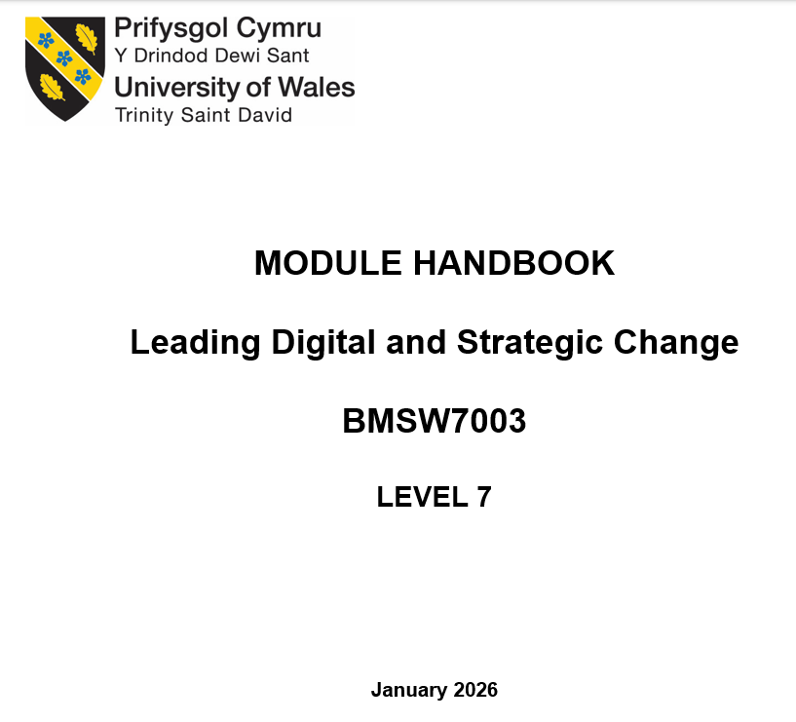
Key document to study very carefully
(on Moodle & Teams page)

Slide 8
Introduction to Leading Digital & Strategic Change – module handbook
Welcome to this generic handbook for Leading Digital and Strategic Change, which has been designed to offer an overview of the module but should be read in conjunction with other supplementary information, materials and instructions discussed during the module.
It is intended that the module itself will look at strategy and change management within a digital context from a variety of perspectives with the aim of being informative, interesting as well as enlightening, providing useful insights into crucial and very often complex issues facing leaders – sometimes operating on the edge of chaos in a continually changing and unpredictable business environment.

Slide 9

Introduction (continued…)
It is therefore important that leaders understand the strategic direction of the organisation, the overall context of the organisation’s environment and related change requirements. They must be able to communicate this effectively to those they are leading.

Slide 10

Introduction (continued…)
Throughout the module, it is anticipated that you will develop in-depth knowledge and understanding of the strategic and change management process in a variety of contexts, including digital. This includes the identification of key issues for the organisations’ future success and competitive advantage.

Slide 11

Introduction (continued…)
In order to get the best out of this module it is vital that you engage with the themes explored as well as with both the online and/or offline activities which are designed to enrich the learning experience as well as to encourage self-directed study together with collaboration and interaction with your peer group.

Slide 12
Module aims
To provide a comprehensive understanding of strategy and the strategic management process for organisations.
To develop a comprehensive understanding of the role of leaders in the implementation of digital and strategic change, especially in view of the rapid digitalisation of organisations.

Slide 13
Learning outcomes
Upon the successful completion of this module, you should be able to:
  Synthesise the relationship between the external and internal context of an organisation and their impact on strategic directions and management.
  Critically evaluate theoretical perspectives and approaches to change management regarding rapid change of organisational strategies and ways of operating.
  Demonstrate knowledge and understanding of how leaders create a clear roadmap for developing and implementing their organisation’s digital and strategic change.

Slide 14

Indicative content
Strategic management in different contexts; to include small businesses, including start-ups, multinational corporations, manufacturing and services, public sector and not for profit.
The strategic importance of resources, core competences and organisation capabilities.
The role of technology in changing the competitive position of incumbents and new entrants.

Slide 15

Indicative content (continued…)
  Theoretical perspectives and approaches to strategic change and change management in organisational environments.
  The role of leaders in driving effective digital and strategic change within organisations and developing strategies to communicate, influence and engage with employees.
  Organisational purpose and stakeholder expectations; to include the importance of stakeholder management.

Slide 16

Indicative content (continued…)
  The importance of culture in relation to strategy implementation and digital and strategic change.
  The impact of technology on roles and their potential replacement by technology and how leaders can support employees through this transition.
  Understanding the impact of resistance to change and developing strategies for dealing with this.

Slide 17
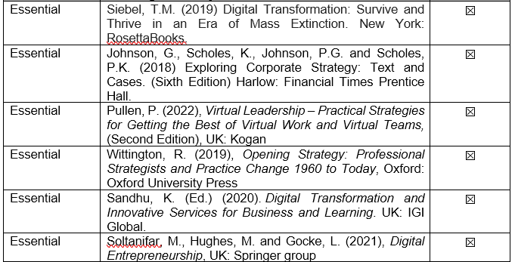
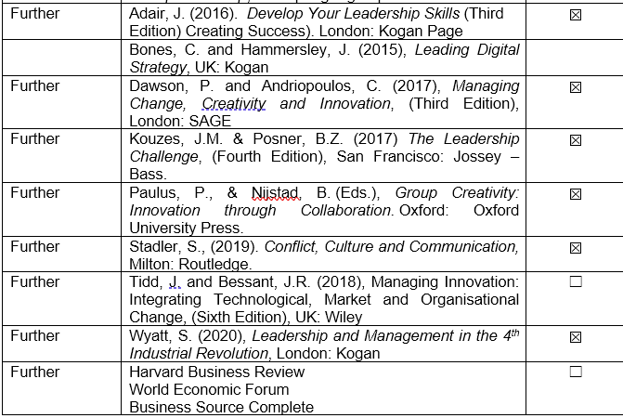
Indicative Reading list
Essential Reading
Further Reading

Slide 18
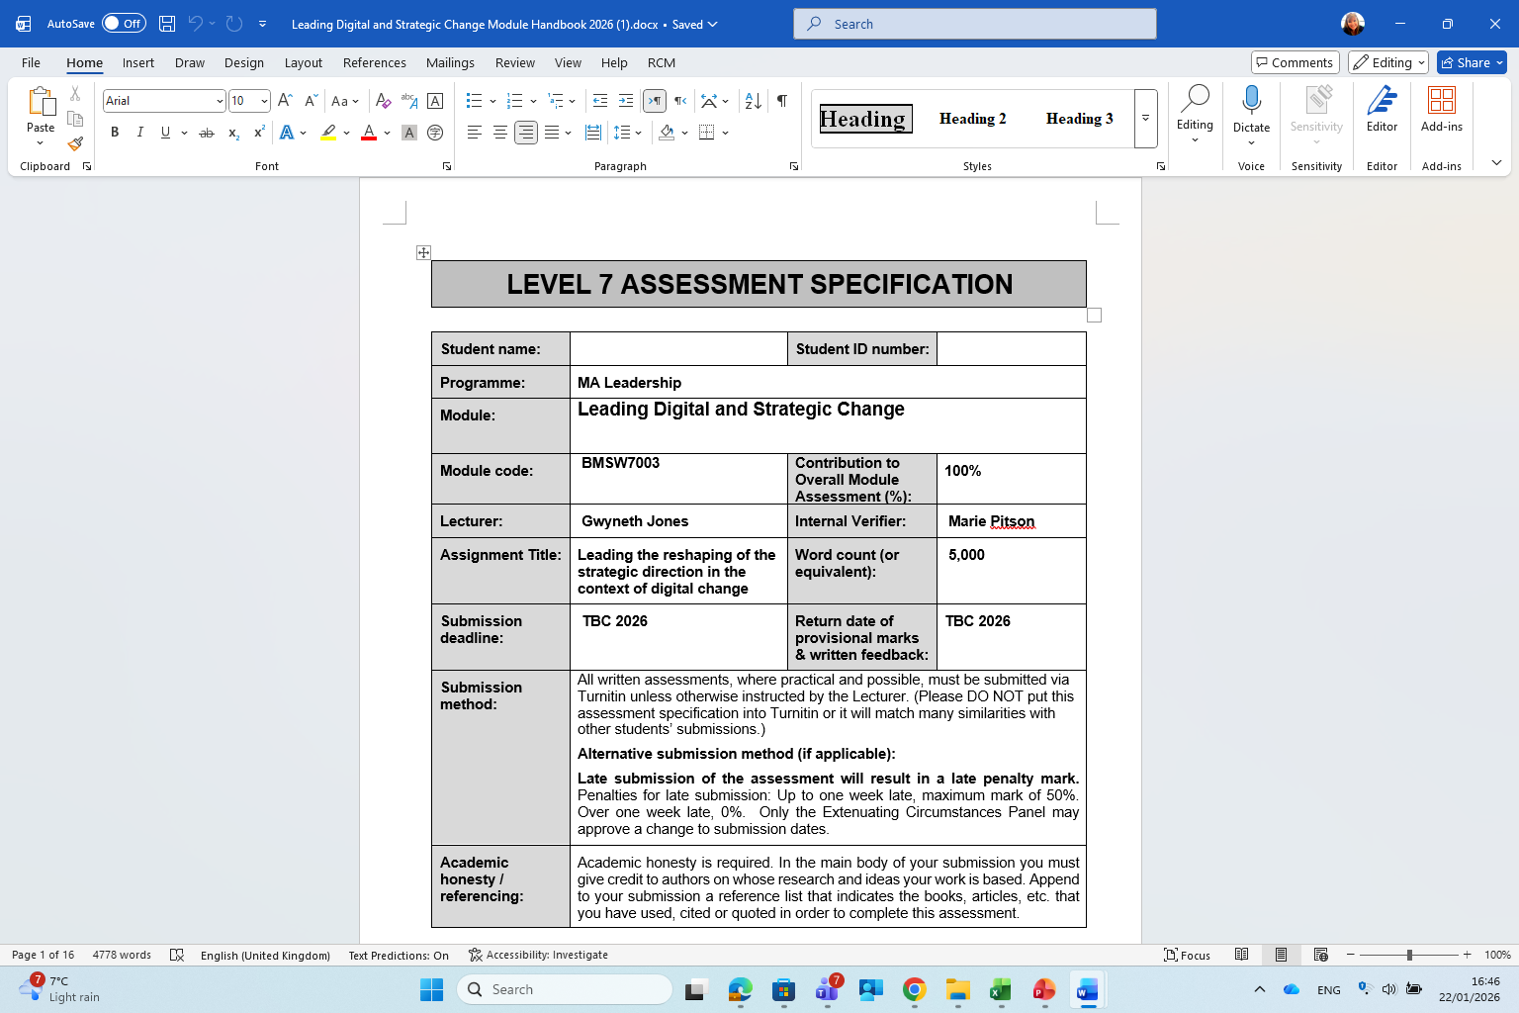
Assignment

Slide 19
Assignment – report – the task
THE TASK:
You have been asked by the senior management of your chosen organisation to support them with creatively reshaping the organisation’s strategic direction in the context of digital change, ensuring future resilience and sustainable competitive advantage.
You are required to produce an individually written report. You should justify your recommendations by using appropriate concepts, theoretical frameworks and techniques explored within the module or other modules.
SUMMARY:
Conduct a strategic analysis for your chosen organisation. Evaluate its strategic environment and the impact of digital developments on their current strategy. Identify strategic opportunities and potential threats related to this changing digital context and provide strategic options.
Following your strategic analysis, identify the organisation’s choices in the context of two different leadership theories to evaluate the likelihood of success for each.
Make logically derived recommendations to the organisation on reshaping their strategic direction in the context of digital change and on how to lead a successful change implementation, taking into consideration the wider implications of your proposal on different areas of the organisation.

Slide 20
Assignment: report word count and content
The report should be 5,000 words (+/- 10%)
The report should contain a Title Page, Table of Contents, Executive Summary, Introduction, Main Findings, Conclusion, Recommendations, References, Appendices (if appropriate).
However, please note that your word count starts at your Introduction and finishes with your Recommendations. Everything that is included before and after these sections do not form part of the word count.

Slide 21
Choosing an organisation for your assignment
Before you start your research:
  Discuss and agree the organisation with your lecturer
Consideration:
  All information must be publicly available
  Sources you use must be verifiable
  Choose an organisation that is different to the ones you chose /choose for other modules
  This is important for avoiding plagiarism of your own work (e.g. following submission to Turnitin)
Individual Report:
  You must write your report assignment on your own – NO GROUP WORK IS PERMITTED
  You are responsible for providing YOUR OWN WORK
  If you use shared content from someone else in your report, Turnitin (submission system) will flag this (similarity score)
  A high similarity score = losing points and a reduced mark for your report

Slide 22
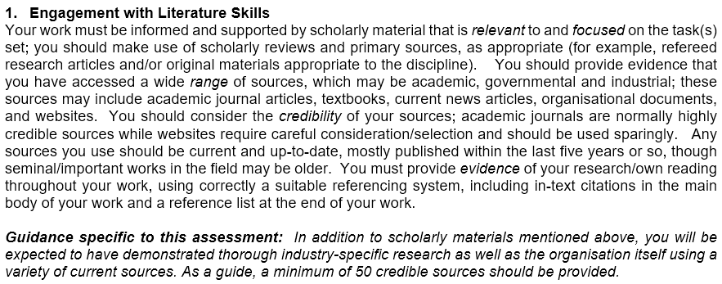
GUIDANCE FOR STUDENTS IN THE COMPLETION OF TASK

Slide 23
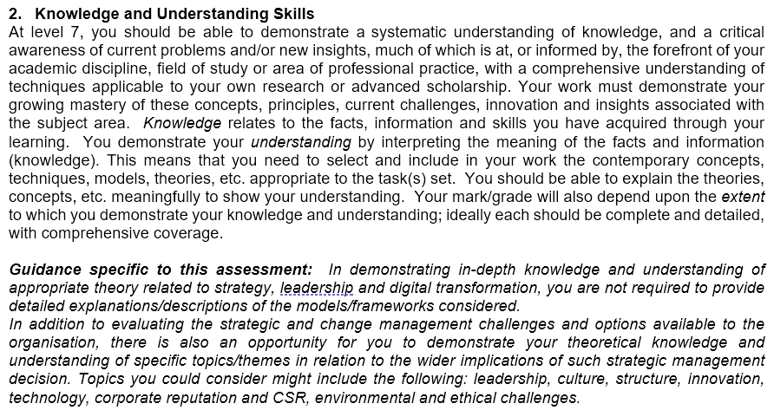
GUIDANCE FOR STUDENTS IN THE COMPLETION OF TASK

Slide 24
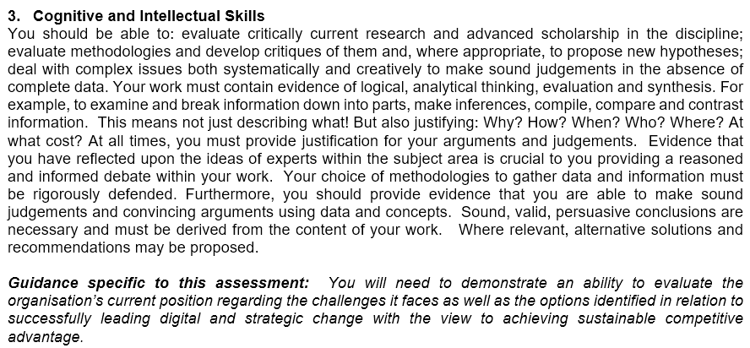
GUIDANCE FOR STUDENTS IN THE COMPLETION OF TASK

Slide 25
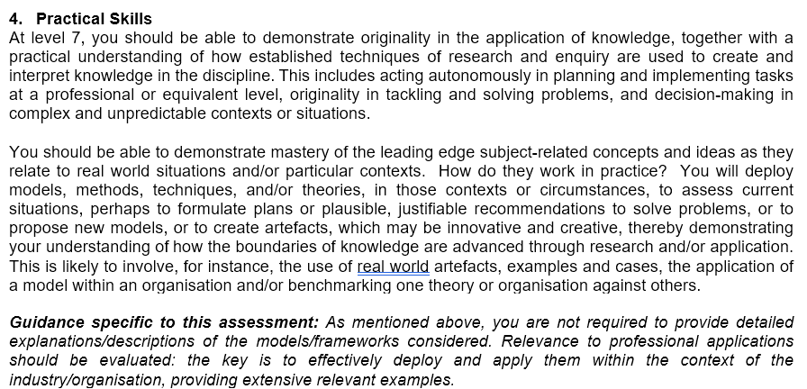
GUIDANCE FOR STUDENTS IN THE COMPLETION OF TASK

Slide 26
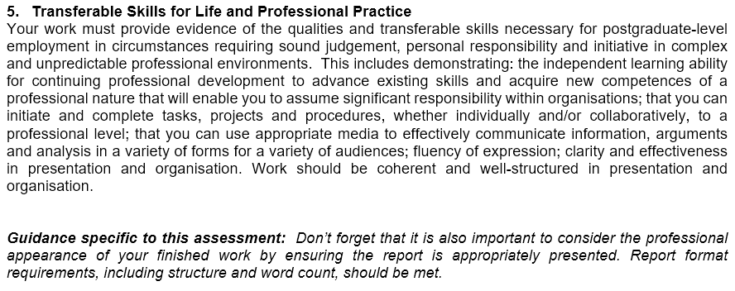
GUIDANCE FOR STUDENTS IN THE COMPLETION OF TASK

Slide 27

This is the end of our welcome session ☺
Any Questions?

