Slide 1
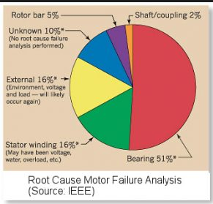
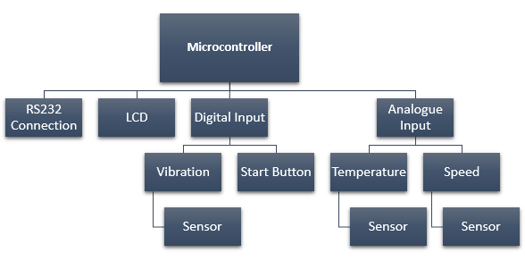
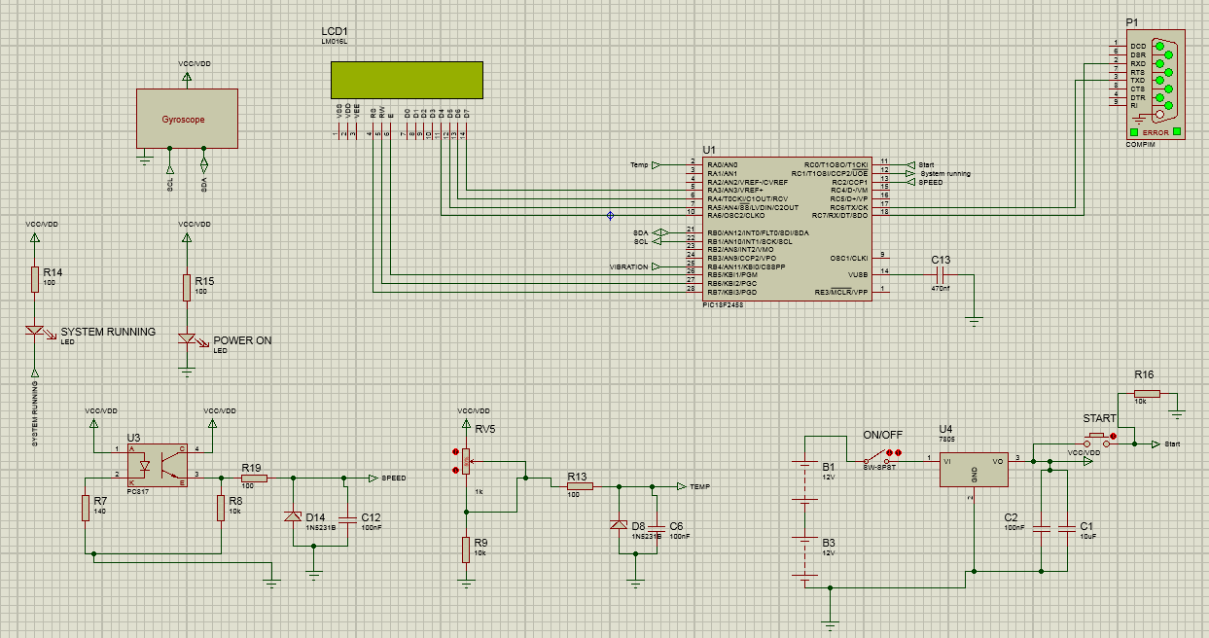
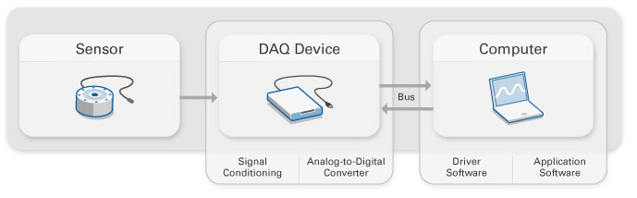
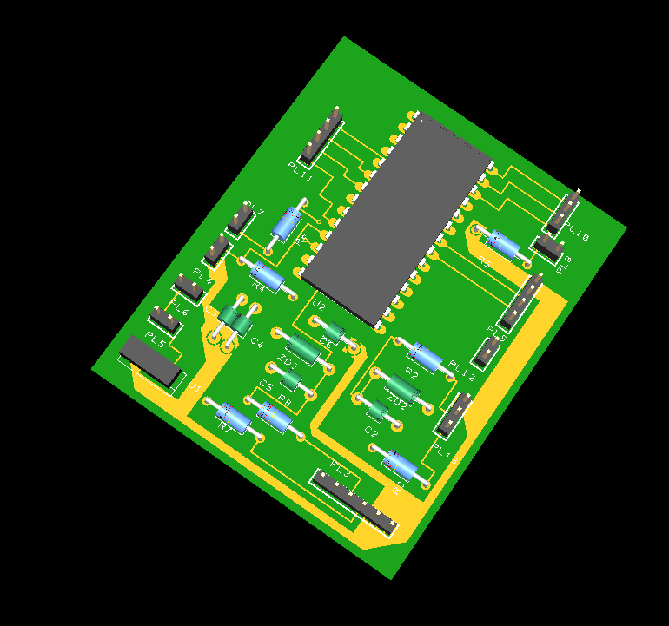
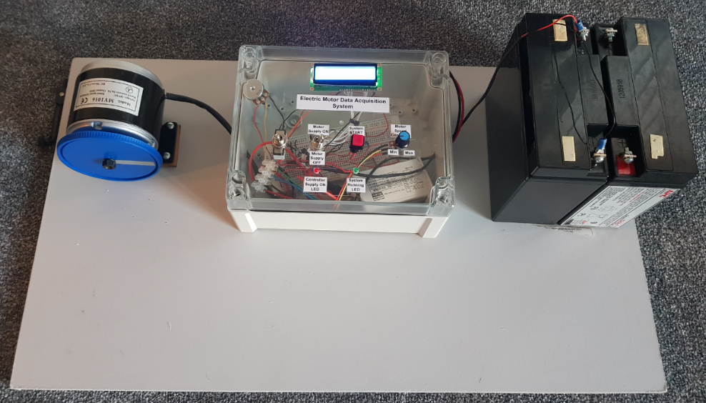
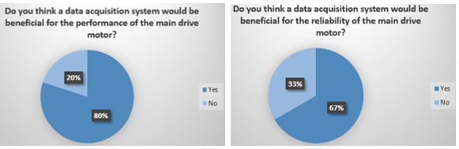
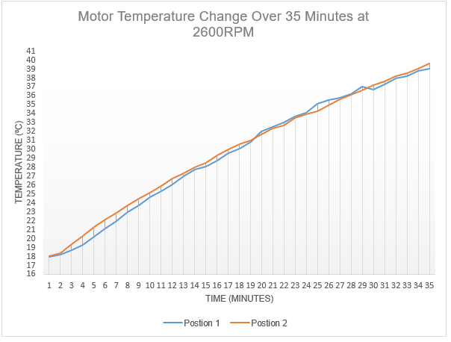
Electric Motor Data Acquisition System
BEng Electrical & Electronics Engineering
Domenico Todaro P152110
University of Wales Trinity Saint David, Mount Pleasant, Swansea, SA1 6ED
1. Introduction
4. Research
6. Design & Implementation
An Electric Motor Data Acquisition System, was identified as a relevant target area to produce a data logging system that could measure key areas of the main drive motor within the authors place of work. Not just compare the major differences with AC and DC main drive motors performance, but to be used as a maintenance tool for both the operation and maintenance departments. For the purpose of the Major Project, a prototype data acquisition system was produced. The main findings and learnings of the prototype could be adapted for a full scale Electric motor data acquisition system for further use.
Motor Failure pie chart to the right was
extracted from the ‘EC&M paper’ which reflected
a root cause motor failure analysis.
A Data Acquisition System, also
known as ‘DAQ’ is a system that
collects information from a specific
device to obtain the measured
variable, producing adequate
and accurate data.
Work based survey reflecting requirement for a DAQ.
System function blocks outlined
Proteus schematic built and
tested with CCS coding to reflect
DAQ’s operation
Easy-PC used to build PCB design
Structural Implementation
2. Aim
Design and produce a Microcontroller based Electric Motor Data Acquisition System
3. Objectives
Research into AC and DC motors and identify their main characteristics
Research into the major failings for AC and DC motors
Identify a way in which the failings could be monitored via sensors
Design and build a prototype data acquisition system
Test the data acquisition system
Gather data from the bench motor
Evaluate and conclude the project
Look at further opportunities for the system to be improved and produced as a usable system on site.
5.Testing
Component Testing
Motor and Speed sensor tested for operation and functionality.
Proteus Testing
Speed sensor and temperature operation was tested within proteus – Actual values against displayed values.
7. Conclusion & Recommendations
Conclusion
There were many successful and unsuccessful aspects of this Major Project. Successful aspects included a fully working CCS/Proteus design and implementation. Unsuccessful aspects included unable to display values of on structural LCD display.
Recommendations
Rectify fault with LCD Display via soldered breadboard/PCB
Develop prototype into a handheld device
Universal measurement device ports
SD Card storage
Operator control panel display
8. References
[1] ECM.[Online}. Available:http://www.ecmweb.com/content/explaining-motor-failure.[Accessed 27 04 18].
[2] “National Instruments,” [Online]. Available:http://www.ni.com/data-acquisition/what-is/. [Accessed 27 04 18].

