Slide 1
AN ADVENTUROUS ACTIVITIES UNIT OF WORK FOR KEY STAGE 3
HANNAH TOZER

Slide 2

THE GOAL
To prepare pupils for a residential visit by the end of the unit of work.
To develop pupils’ interpersonal skills through the individual activities set each lesson.
Give pupils the opportunity to participate in and learn a range of new, lifelong skills.

Slide 3
THE CURRICULUM
Adventurous activities provide pupils with “the opportunities to increase awareness of the natural environment” (Welsh Government, 2008, pp.18).
Pupils “learn the benefits of working with others to strengthen a team or partnership while outwitting others, planning a journey or practising for a performance.” (Welsh Government, 2008, pp.11).
The curriculum also says that this type of activity can be pursued in curriculum time, after school or as a part of a residential experience in new and challenging environments.

Slide 4

PROGRESSION FROM KS2
In KS2 pupils should have skills such as:
  Reading a compass, map or instructions.
  Constructing a shelter.
  Water safety.
  Personal survival.
In KS3 pupils should be working to achieve:
  Skills and techniques in outdoor adventurous activities, problem solving or initiative challenges and journeys.
  Taking responsibility for themselves and others.
  Listening carefully to the contribution of peers.
  Plan and evaluate activities to improve next attempts.

Slide 5
WEEK 1
Bouldering Wall
Development of Skills – trust in partnership, collaborating well with others, and communication.
Pupils will learn learn safety aspects such as how to spot for those on the wall.
The lesson will consist of activities on the bouldering wall which will contribute to building strength and confidence in this type of adventurous activity.
Risks:
  Pupils falling off the bouldering wall and onto others who are spotting.
  Slipping off wall due to wet weathering.
KS3 pupils will develop skills in this adventurous activity and become responsible for themselves and others’ safety.

Slide 6
WEEK 2
Orienteering on School Grounds
Development of Skills – communication, awareness of yourself and others, navigation, teamwork, and thinking.
Pupils will learn how to read a map on ground that is familiar to them, and grasp a sense of navigation.
The lesson will start with warm up activities that will allow pupils to familiarise themselves with map symbols and directions.
The main activity will be to find flags following a map around the school ground.
Risks:
  Pupils may trip and fall on uneven ground.
  Foot and ankle injuries from walking on slippery and uneven ground.
From KS2 pupils should be able to use a compass and/or map, in this lesson pupils will get the opportunity to use these skills in orienteering.

Slide 7
WEEK 3
Team Building Activities
Development in Skills – socialising, empathy, tolerance of others, and teamwork.
Pupils will participate in small activities such as ’Crossing the Swap’ and arranging themselves in age/height order on a bench.
The main activity of this lesson will be a blindfolded obstacle course which will display trust in others and allow pupils to be clear through their communication.
Risks:
  Pupils may receive twisting injuries during activities.
  Entrapped fingers when moving equipment.
The curriculum says that pupils must plan and evaluate activities, using what they have found to improve their next attempts, this lesson gives pupils the opportunity to learn how to do this.

Slide 8
WEEK 4
Pump Track
Development of Skills – awareness of yourself and others, confidence, mentoring, and motivation.
Pupils will gain confidence on a bike through using the pump track.
This lesson will be more of a relaxed lesson and use the time for pupils to become familiar with a bike if not already.
Competent pupils can work towards a time trial activity and try and improve their time around the track.
Risks:
  Pupils falling off the bikes.
  Colliding into one another on the track or objects.
It is important for pupils to to understand the importance of engagement for life, the curriculum says they must understand the benefits to their health and fitness. Cycling is a popular activity that can be continued over a lifetime.

Slide 9
WEEK 5
Orienteering on a Mountain
Development of Skills – map reading, clear communication, navigation, tolerance of others, and teamwork.
This lesson will allow pupils to walk amongst nature while developing a sense of direction on a local mountain.
Pupils will be provided with a map and activities to complete during the lesson, the mountain area will be marked out and checked prior to the lesson for safety.
Risks:
  Tripping on uneven and slippery ground.
  Getting lost / being late.
  Falling on steep terrain.
The curriculum says that KS3 pupils should start to listen carefully to the contribution of others, make individual and group decisions to identify problems and suggest alternative approaches.

Slide 10
WEEK 6
Outdoor Shelter Building & Survival Skills
Development of Skills – respect, socialising, collaborating well with others, teamwork, listening, and survival skills.
Pupils will participate in groups to build a shelter to the best of their ability as if they are to camp overnight.
Once pupils have completed this, they will learn simple survival skills such as how to purify water, start/make a fire and cooking.
Risks:
  Injuries involving equipment.
  Burns, cuts, scrapes, and falls.
From KS2, pupils should be able to construct a shelter. Now pupils can experience ‘journey’s’ which involves camping-like activities.

Slide 11
WEEK 7
Swimming & Water Safety
Development of Skills – listening, sensitivity, awareness, and confidence.
This lesson will allow pupils to gain basic water survival skills such as learning to float, tread water, get to safety in different environments, and rescue.
This will be in preparation for activities such as raft building and canoeing on the residential.
Risks:
  Drowning.
  Repetitive strain and back injuries from rescues.
  Impact of objects / equipment to the head.
The curriculum for KS3 says that pupils should apply and evaluate the principles and practice of rescue and resuscitation. This is a progression from KS2 where pupils were required to develop skills of water safety and personal survival.

Slide 12
WEEK 8
Targets and Puzzles
Development of Skills – teamwork, numeracy, encouraging others, mentor, and motivator.
Pupils will use this lesson to improve aim and accuracy using outdoor targets.
During the residential visit, pupils will get the opportunity to participate in archery and shooting were this aim will benefit.
Small competition in mixed ability and gender groups using the targets to finish the unit of work.
Risks:
  Slipping on wet floor.
  Tripping on equipment.
  Impact from objects.
In this type of activity pupils will be given the opportunity to plan and evaluate their performance to improve the next time.

Slide 13
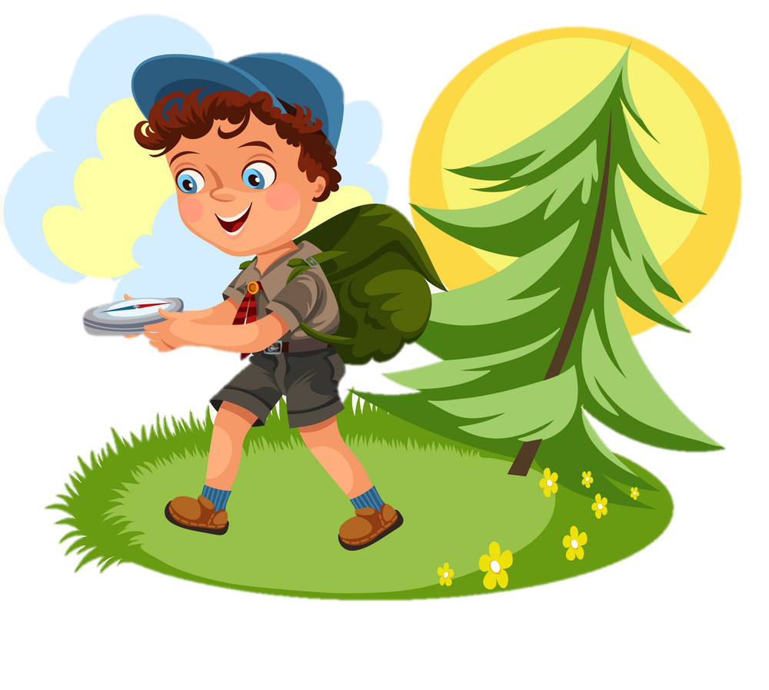

RESIDENTIAL CENTRE
School Trips Wales have 6 outdoor locations across Wales which offer a wide range of activities for schools.
  Climbing
  Kayaking
  Raft Building
  Orienteering
All activities have been risk assessed by the organisation.
Accommodation available.
Instructors have multiple National Governing Body Awards (NGBs), with 3 years post qualifying experience.
  Bush craft
  Archery
  Team Initiative Exercises

Slide 14
THANK YOU
Thank you for listening.
Are there any questions?

Slide 15
References
AnnaBurg (no date) Cartoon kids following compass in forest vector image. Available at: https://www.vectorstock.com/royalty-free-vector/cartoon-kids-following-compass-in-forest-vector-23734603 (Accessed: 2nd January 2021).
Clarizen (2018) How to Create a Progression Plan for Your Team Members. Available at: https://www.clarizen.com/how-to-create-a-progression-plan-for-your-team-members/ (Accessed: 3rd January 2021).
Guettler, T. (2018) Reach Your Goals and Plan Accordingly. Available at: https://thomasguettler.com/2018/08/31/reach-your-goals-and-plan-accordingly/ (Accessed: 2nd January 2021).
Nately-Nete. (2018) Woman on climbing wall stock illustration. Available at: https://www.istockphoto.com/vector/woman-on-climbing-wall-gm1059667166-283248328 (Accessed: 2nd January 2021).
School Trips Wales (2010-2021) School Trips Wales. Available at: http://www.schooltripswales.co.uk/information/qa-for-teachers/ (Accessed: 1st January 2021).
Welsh Assembly Government. (2008) Physical education in the National Curriculum for Wales. Cardiff: Curriculum Division.

