Slide 1


Dydd Sadwrn Cenedlaethol 2
National Saturday 2

Slide 2
Amserlen y Dydd Schedule of the Day
09:30 – 10:30 | Croeso a chynllun y dydd Edrych ar y aseiniad Syniadau o ymarfer Ailedrych ar damcaniaethau | Welcome and plan of the day Revisit the assignment Ideas from practice Revisiting Theories
10:30-11:00 | Llinyn Craidd 3 Sesiwn 1: Dulliau system gyfan a sut i gynllunio ar gyfer newid cadarnhaol | Core Strand 3 Session 1: Whole systems approaches and how to plan for positive change
11-11:15 | EGWYL | BREAK
11:15 – 12:00 | Llinyn Craidd 3: Sesiwn 2: Dulliau system gyfan a sut i gynllunio ar gyfer newid cadarnhaol | Core Strand 3: Session 2: Whole systems approaches and how to plan for positive change
12.00-12.30 | Cinio | Lunch
12:30 – 1.15pm | Holi arbenigwr Suzanne Seargeant, Dave Clarke WG | ASK the Expert Suzanne Seargeant, Dave Clarke WG
1:15 – 2:15 | Llinyn Craidd 4: Cynllunio, gweithredu, a gwerthuso newid mewn ymarfer | Core Strand 4: Plan, implement, and evaluate a change in practice
2.15- 2:30 | EGWYL | BREAK
2.30-3.15 | Llinyn Craidd 4: Cynllunio, gweithredu, a gwerthuso newid mewn ymarfer | Core Strand 4: Plan, implement, and evaluate a change in practice
3.15-3.30 | Holi ac Ateb Crynodeb o'r aseiniad | Q&A Recap of assignment

Slide 3
Aseiniad – 2 rhan
Adroddiad 4,000 o eiriau i’ch cynulleidfa darged:
Dylai'r adroddiad fyfyrio ar fater sy’n rhan o ymarfer y myfyriwr lle gallai tlodi ac anfantais effeithio ar leoliad addysgol y dysgwr. Dylai’r adroddiad fod wedi’i anelu at gynulleidfa darged a ddewiswyd (e.e. staff, cyflwyniad i lywodraethwyr, Penaethiaid Gwasanaeth, uwch dîm rheoli ac ati) a bydd yn cael ei ysgrifennu mewn arddull briodol.
Rhan 1: 2,000 o eiriau 40%
DD1: Arddangos dealltwriaeth feirniadol o dlodi ac anfantais ar ddysgwyr. (20%)
DD2: Gwerthuso’n feirniadol ymarfer a mesuriadau dysgu a datblygu gyda dysgwyr y mae tlodi ac anfantais yn effeithio arnynt (20%)
Gan ddefnyddio llenyddiaeth a damcaniaeth, gofynnir i chi fyfyrio'n feirniadol ar effaith tlodi ac anfantais ar ddysgwyr yn eich lleoliad addysgol. Gofynnir i chi archwilio’n feirniadol y mesuriadau a ddefnyddir i ddangos cynnydd a datblygiad y dysgwr yn eich lleoliad addysgol, gan archwilio’n feirniadol a yw’r rhain yn llwyddo i nodi a chefnogi dysgwyr y mae tlodi ac anfantais yn effeithio arnynt.

Slide 4
Rhan 1: 2,000 o eiriau (40%)
Deilliant Dysgu 1: 20% -
Mae hon yn adran fyfyriol lle rydych yn ystyried sut y gall tlodi ac anfantais effeithio ar gynnydd a datblygiad addysgol dysgwyr mewn cyd-destun penodol (ysgol, ystafell ddosbarth, coleg, amgylchedd addysgol arall). Mae’n dderbyniol bod yn benodol yma wrth feddwl am ddemograffeg benodol o ddysgwyr, senario neu astudiaeth achos. Dylech feirniadu gwahaniaethau o ran deall tlodi, gan gynnwys yr effaith ar ddysgwyr ac agweddau gwahanol tuag at dlodi.
Deilliant Dysgu 2: 20%
Gan feddwl am sut mae plant yn cael eu hadnabod mewn lleoliad addysgol, pa fesuriadau dysgu a datblygu sy’n cael eu defnyddio yn y lleoliad rydych chi wedi’i ddewis, ac ystyriwch sut gallai’r rhain fod o fudd i blant neu eu hatal rhag cyflawni eu potensial. Meddyliwch yn feirniadol drwyddi draw: Sut maen nhw’n cael eu hadnabod? A oes bylchau? Beth sy’n cael ei fesur? Pam? A yw’n dangos y darlun cyfannol o ddatblygiad y dysgwr? Beth sydd ar goll?
Dangoswch ddealltwriaeth o ddamcaniaethau a pholisïau perthnasol wrth gefnogi’r gwaith o werthuso’r uchod.

Slide 5
Rhan 2: Cynllun Gweithredu (2,000 o eiriau)
DD3: Archwilio’n feirniadol y dull systemau cyfan a sut mae hyn yn effeithio ar ymarfer.
DD4: Archwilio’n feirniadol sut i gynllunio, gweithredu a gwerthuso newid mewn ymarfer a fydd o fudd i ddysgwyr y mae tlodi ac anfantais yn effeithio arnynt mewn lleoliadau addysgol.
Bydd angen i chi ystyried sut y byddech yn ymateb i’r mater / materion a nodwyd ac a archwiliwyd yn Rhan 1 yn eich ymarfer eich hun. Bydd angen i chi gyfiawnhau'n feirniadol eich cynllun gweithredu arfaethedig, ac os caiff ei weithredu, arddangos pam eich bod yn credu y gallai gyfrannu at fynd i'r afael â'r materion a nodwyd. Bydd angen i chi hefyd ystyried sut byddech chi’n gwerthuso’r newidiadau y byddech chi’n eu rhoi ar waith.

Slide 6
Rhan 2: Cynllun Gweithredu - 2,000 o eiriau 50%
Sut ddylai’r cynllun gweithredu edrych?
Mae’r adran hon yn nodi eich newid mewn ymarfer er mwyn ymateb i dlodi ac anfantais yn eich lleoliad addysgol. Gan ddefnyddio’r mater / materion a godwyd yn rhan 1 yr aseiniad hwn, archwiliwch yn feirniadol a chynnig datrysiadau i’r problemau a nodwyd. Bydd angen i chi gyflwyno tystiolaeth o fyfyrio beirniadol ar heriau eich datrysiadau arfaethedig. O fewn y cyd-destun a nodwyd.
Gellir ysgrifennu eich cynllun gweithredu ar ffurf tabl neu gan ddefnyddio is-benawdau. Bydd yn defnyddio tystiolaeth empirig o lenyddiaeth, polisïau a damcaniaethau perthnasol, a dylid cyfeirio atynt drwyddi draw. Bydd angen i chi ystyried eich nodau penodol (a pham rydych chi’n ei ddewis/eu dewis), sut byddwch chi’n gwerthuso neu’n mesur cynnydd, yr heriau o ran cyflawni eich nodau (gwnewch yn siŵr eu bod yn berthnasol o ran ymateb i dlodi ac anfantais) a nodwch ddyddiad gorffen realistig ac amserol (os yw’n briodol). Mae’r rhain yn nodau CAMPUS ar gyfer eich cynllun gweithredu.

Slide 7
Deilliant Dysgu 3: 20%
Mewn un adran o’ch cynllun gweithredu, mae angen i chi ystyried pwyslais presennol y llywodraeth ar ddulliau systemau cyfan a beth mae hyn yn ei olygu i’ch ymarfer a’ch cynllun gweithredu arfaethedig. Gallai hyn fod yn gysylltiedig â’r pwyslais newydd ar Ysgolion Bro yng Nghymru, neu ddulliau systemau cyfan eraill a sut y gall y dull hwn fod yn fuddiol, er bod ganddo heriau. Efallai y byddwch yn ystyried sut y gallai gweithio gydag eraill ar draws systemau fod yn heriol wrth weithredu eich datrysiad arfaethedig.
Deilliant Dysgu 4: 30%
Ystyriwch eich datrysiad arfaethedig. Sut fyddech chi’n cynllunio i wneud hyn? Beth fyddai’r pryderon? Sut fyddech chi’n ei roi ar waith? Beth yw'r heriau? Sut fyddwch chi’n gwybod ei fod yn gweithio? Beth fyddwch chi’n ei ddefnyddio i werthuso newidiadau i ddysgwyr? Beth yw’r rhwystrau rhag gwerthuso’r newid hwn?

Slide 8
Assessment overview
Assessment: Report (4000 words) 2 parts
This module offers one assessment. This is worth 100% of the overall module grade.
Part 1 2,000 words 40%
LO1: Demonstrate a critical understanding of poverty and disadvantage on learners. (20%)
LO2: Critically evaluate the practice and measurements of learning and development with learners who are impacted by poverty and disadvantage (20%)
Drawing from literature and theory, you are asked to critically reflect on the impact of poverty and disadvantage on learners in your educational setting. You are asked to critically examine measurements used to show the learner progress and development in your educational setting, critically exploring whether these successfully identify and support learners who are impacted by poverty and disadvantage.

Slide 9
What should part 1 look like?
Learning Outcome 1: 20% -
This is a reflective section where you consider how poverty and disadvantage may affect learners’ educational progress and development in a particular context (school, classroom, college, another educational environment). It is acceptable to be specific here in thinking about a particular demographic of learners, a scenario or case study. You should critique differences in understanding poverty including the impact on learner and differing attitudes towards poverty.
Learning Outcome 2: 20%
Thinking of ways children are identified in an educational setting, what measurements of learning and development are used in your chosen setting and consider how these might benefit or prevent children from achieving their potential. Think critically throughout: How are they being identified? Are there gaps? What is being measured? Why? Does it show the holistic view of the learner’s development? What is missing?
Demonstrate understanding of relevant policy and theories in supporting evaluation of the above.

Slide 10
Part 2: Action plan (2,000 words)
LO3: Critically explore the whole systems approach and how this affects practice.
LO4: Critically examine how to plan, implement, and evaluate a change in practice that will benefit learners who are impacted by poverty and disadvantage in educational settings.
You will need to consider how you would respond to the issue(s) identified and examined in Part 1 in your own practice. You will need to critically justify your proposed plan of action, and if implemented demonstrate why you believe it might contribute to addressing the issues identified. You will also need to consider how you would evaluate the changes that you would implement.

Slide 11
What should Part 2 look like?
This section sets out your change to practice to respond to poverty and disadvantage in your educational setting. Using the issue(s) raised in part 1 of this assignment critically explore and propose solutions to the problems identified, You will need to evidence critical reflection on the challenges of your proposed solutions. Within the context identified.
Your action plan can be written in table form or in subheading form. It will draw upon empirical evidence from literature, relevant policies, and theories and be referenced throughout. You will need to consider your specific goals (and why you are choosing it/them), how you will evaluate, or measure progress made, the challenges in attaining your goals (make sure that they are relevant to responding to poverty and disadvantage) and show a realistic, timely end date (if appropriate). These constitute SMART goals for your action plan.
Learning Outcome 3: 20%
In one section of your action plan, you need to consider the government’s current emphasis on whole systems approaches and what this means for your practice and your proposed action plan. This could be related to the new emphasis on Community Focussed Schools in Wales, or other whole systems approaches and how this approach can be beneficial but have its challenges. You may consider how working with others across systems may provide challenges to implementing your proposed solution.
Learning Outcome 4: 30%
Consider your proposed solution. How would you plan to do this? What would be the concerns? How would you implement it? What are the challenges? How are you going to know if it is working? What will you use to evaluate changes for learners? What are the barriers to evaluating this change?

Slide 12
Ni fyddwch yn casglu, dadansoddi na chyflwyno data cynradd ar gyfer yr aseiniad hwn.
Dyddiad cau ar gyfer cyflwyno: cyn a hyd at 11:59 (23:59 awr) ar ddydd Iau 29/8/24
Dychwelyd - Dydd Iau 26/9/2024 am 14:00
You will not be collecting, analysing or presenting primary data for this assignment.
Submission deadline: before and up to 11:59 (23:59 hours) by Thursday 29/8/24
Return - Thursday 26/9/2024 @14:00

Slide 13
Syniadau o arfer
Ideas from practice
Beth oedd eich negeseuon allweddol o’r D. Sadwrn Cenedlaethol? /
What were your key messages from the First Nat Sat
Has anything we discussed made you think differently about your practice?
A oes unrhyw beth a drafodwyd gennym wedi gwneud ichi feddwlyn wahanol am eich ymarfer?
Cyflwyniad 2 funud gan ddarlithwyr / 2 minute pitch by lecturers
Pa syniadau sydd gennych? / What ideas are you thinking of?
Notes:
Pitch assignment ideas in 2 minutes based on passions.
What theories and concepts – they can use both

Slide 14
Yasmeen 2 muned
Nodi mater - Cyrhaeddiad mathemateg is yn yr ysgol gynradd ar gyfer
disgyblion incwm isel ag anghenion dysgu ychwanegol.
Adolygu ymchwil cysylltiedig - Noyes et al. (2023) ar ostyngiad mewn
llwyddiant TGAU ar gyfer myfyrwyr incwm isel, anabl o 4 oed yn Lloegr.
Ystyried fframwaith damcaniaethol - Disgwrs cyfalaf dynol
(MacKenzie a Chiang, 2023).
Archwilio mesurau tlodi ac anfantais - PDG, anfanteision nas gwelwyd
, materion dyrannu adnoddau 'gweithio'n wael’.
Dadansoddi mesur dysgu – Gallu fel cysyniad mewn perthynas
ag anghydraddoldebau (Bradbury, 2021).
Gwerthuso arferion grwpio yn feirniadol - gallu homogenaidd,
grwpio a labelu profiadau dysgwyr yng Nghymru (Conn et al., 2024).

Slide 15
Yasmeen 2 minutes
Identify issue - Lower mathematics attainment in primary school for low-income pupils with additional learning needs.
Review related research - Noyes et al. (2023) on reduced GCSE success for low-income, disabled students from age 4 in England.
Consider theoretical framework - Human capital discourse (MacKenzie and Chiang, 2023).
Examine poverty and disadvantage measures - PDG, unseen disadvantages, 'working poor' resource allocation issues.
Analyse learning measurement – Ability as a concept in relation to inequalities (Bradbury, 2021).
Critically evaluate grouping practices - Homogeneous ability grouping and labelling experiences of learners in Wales (Conn et al., 2024).

Slide 16
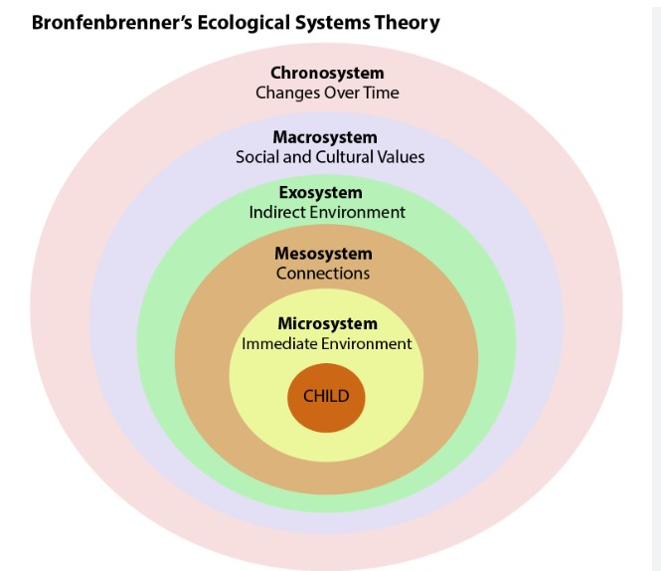
Damcaniaethau tlodi ac anfantais
Nid yw’r dysgwr yn bodoli mewn gwagle ac mae’n bwysig ystyried y cyd-destunau a’r systemau ehangach sy’n amgylchynu ac yn dylanwadu ar fywyd dysgwr.
Mae' r Exosystem, o fewn Damcaniaeth Systemau Ecolegol Bronfenbrenner, yn cynnwys materion cymdeithasol cymhleth sy'n effeithio'n anuniongyrchol ar ddatblygiad dysgwr ac a all arwain at allgáu cymdeithasol, gan amlygu pwysigrwydd ystyried y ffactorau ehangach hyn wrth werthuso effeithiolrwydd mesurau a ddefnyddir i nodi a chefnogi dysgwyr yr effeithir arnynt gan tlodi ac anfantais.

Slide 17
Theories of poverty and disadvantage
A learner does not exist in a vacuum and it is important to consider the broader contexts and systems that surround and influence a learner's life.
The Exosystem, a layer within Bronfenbrenner's Ecological Systems Theory, contains complex societal issues that indirectly impact a learner's development and can lead to social exclusion, highlighting the importance of considering these broader factors when evaluating the effectiveness of measures used to identify and support learners affected by poverty and disadvantage.

Slide 18
Safbwyntiau damcaniaethol addysg a thlodi
Terzi; Unterhalter; Judith Suissa, (2022).
Safbwynt plant/plentyndod o Ogledd Byd-eang â ‘hawliau’ sy’n ‘agored i niwed’ a De Byd-eang sy’n wydn ac yn ymreolaethol (Haines, 2019 yn cwestiynu safbwyntiau normadol ynghylch statws moesol plant fel rhai diamddiffyn a dibynnol.
Nodweddir 'addysgeg tlodi' a brofir gan ddysgwyr gan ffocws ar ddisgyblaeth, ymgysylltiad deallusol isel a ffocws ar gyrhaeddiad mewn profion.
Mae tlodi yn rym allanol – y tu allan i’r ysgol – drwy ddarparu addysgu ‘safonol’ ac ati bydd hyn yn ymateb i dlodi, neu mae elfennau camweithredol i’w cadw y tu allan i ffocws cynllunio addysg, nad yw ynddo’i hun yn ymgysylltu â phwrpas addysg y tu hwnt i ddysgu.
Theori Cyfiawnder gan John Rawls
Mae modelau gwahanol o blentyndod yn llywio’r holl ddamcaniaethau sy’n ymwneud â phlant, lle gall safbwyntiau delfrydol, arwain at bolisïau sydd, yn hytrach nag amddiffyn plant, yn eu rhoi dan anfantais bellach.

Slide 19
Theoretical positions of education and poverty
Terzi; Unterhalter; Judith Suissa, (2022)
Viewpoint of children/childhood from Global North with 'rights' who are 'vulnerable' and Global South which are resilient and autonomous (Haines, 2019 questions normative positions about the moral status of children as vulnerable and dependent.
'Pedagogy of poverty' experienced by learners is characterised by a focus on discipline, low intellectual engagement and a focus on attainment in tests.
Poverty is an outside force – external to school – by providing 'quality' teaching etc. this will respond to poverty poverty or dysfunctional elements are to be kept outside the focus of education planning, which itself does not engage with the purpose of education beyond ‘learning
Theory of Justice by John Rawls
Different models of childhood inform all theories dealing with children, where idealised views, can lead to policies that, instead of protecting children, end up further disadvantaging them.
Notes:
Theory of Justice by John Rawls, provide principled positions that can guide both the analysis of what constitutes disadvantage and ways to conceptualise it, as well as principles that can guide a fair distribution of resources. Although offering also important insights for education
Economic Capital Theory This theory posits that economic resources directly impact educational outcomes. Children from low-income families often lack access to educational resources such as books, technology, tutoring, and extracurricular activities, which can hinder their academic performance (Bradley & Corwyn, 2002).
Cultural Capital Theory (Bourdieu):
Pierre Bourdieu's theory of cultural capital suggests that children from wealthier families benefit from the cultural knowledge, skills, and attitudes that are valued by the educational system. These include language skills, familiarity with dominant cultural norms, and parental involvement in education, which can influence teachers' perceptions and students' academic success (Bourdieu, 1986).
Social Capital Theory (Coleman)
social capital theory emphasizes the role of social networks and relationships in education. Families with strong social networks can provide better support, more effective parental involvement, and access to valuable information and opportunities, which enhance educational outcomes (Coleman, 1988).
Human Capital Theory views education as an investment in human capital, where the returns are seen in the form of higher future earnings and improved socio-economic status. Children in poverty might not receive the same level of investment in their education, resulting in lower academic achievement and limited economic mobility (Becker, 1964).
Structural Inequality Theory Structural inequality theory highlights the broader socio-economic structures and policies that perpetuate inequality. It argues that systemic barriers, such as underfunded schools, discriminatory practices, and residential segregation, disproportionately affect disadvantaged students and limit their educational opportunities (Darling-Hammond, 2010).
Ecological Systems Theory Urie Bronfenbrenner's ecological systems theory examines how various environmental systems influence a child's development. Factors such as family dynamics, school environment, community context, and societal policies interact to impact educational outcomes, with poverty affecting multiple layers of these systems (Bronfenbrenner, 1979).
Intersectionality theory looks at how overlapping social identities, such as race, gender, and socio-economic status, combine to create unique experiences of disadvantage. This approach helps explain how children in poverty who also belong to other marginalized groups face compounded barriers in education (Crenshaw, 1989).
Critical Pedagogy Paulo Freire’s critical pedagogy advocates for an education system that empowers disadvantaged students by recognizing and addressing the socio-political context of their lives. It emphasizes the need for a transformative approach to education that challenges inequality and promotes social justice (Freire, 1970).

Slide 20
Safbwyntiau damcaniaethol addysg a thlodi
Theori Cyfiawnder gan John Rawls
Safbwynt plant/plentyndod o Ogledd Byd-eang â 'hawliau' sy'n 'agored i niwed' a De Byd-eang sy'n wydn ac yn annibynnol (Haines, 2019; Terzi; Unterhalter; Judith Suissa, 2022)
Damcaniaeth cyfalaf economaidd (Bradley a Chorwyn, 2002).
Damcaniaeth cyfalaf diwylliannol (Bourdieu, 1986).
Damcaniaeth cyfalaf dynol (Becker, 1964).
Damcaniaeth anghydraddoldeb strwythurol (Darling-Hammond, 2010).
Damcaniaeth systemau ecolegol (Bronfenbrenner, 1979).
Croestoriad (Crenshaw, 1989).
Addysgeg Feirniadol (Paulo Friere, 1971).
Notes:
Mae Theory of Justice gan John Rawls, yn darparu safbwyntiau egwyddorol a all arwain y dadansoddiad o'r hyn sy'n gyfystyr ag anfantais a ffyrdd o'i gysyniadoli, yn ogystal ag egwyddorion a all arwain dosbarthiad teg o adnoddau. Er ei fod hefyd yn cynnig mewnwelediadau pwysig ar gyfer addysg
Damcaniaeth Cyfalaf Economaidd Mae'r ddamcaniaeth hon yn awgrymu bod adnoddau economaidd yn effeithio'n uniongyrchol ar ddeilliannau addysgol. Yn aml nid oes gan blant o deuluoedd incwm isel fynediad at adnoddau addysgol megis llyfrau, technoleg, tiwtora, a gweithgareddau allgyrsiol, a all rwystro eu perfformiad academaidd (Bradley & Corwyn, 2002).
Damcaniaeth Prifddinas Ddiwylliannol (Bourdieu):
Mae damcaniaeth cyfalaf diwylliannol Pierre Bourdieu yn awgrymu bod plant o deuluoedd cyfoethocach yn elwa ar y wybodaeth ddiwylliannol, y sgiliau, a’r agweddau sy’n cael eu gwerthfawrogi gan y system addysg. Mae’r rhain yn cynnwys sgiliau iaith, bod yn gyfarwydd â normau diwylliannol amlycaf, ac ymwneud rhieni ag addysg, a all ddylanwadu ar ganfyddiadau athrawon a llwyddiant academaidd myfyrwyr (Bourdieu, 1986).
Damcaniaeth Cyfalaf Cymdeithasol (Coleman).
mae theori cyfalaf cymdeithasol yn pwysleisio rôl rhwydweithiau cymdeithasol a pherthnasoedd mewn addysg. Gall teuluoedd sydd â rhwydweithiau cymdeithasol cryf ddarparu gwell cymorth, cyfranogiad mwy effeithiol gan rieni, a mynediad at wybodaeth a chyfleoedd gwerthfawr, sy’n gwella canlyniadau addysgol (Coleman, 1988).
Mae Damcaniaeth Cyfalaf Dynol yn ystyried addysg fel buddsoddiad mewn cyfalaf dynol, lle gwelir yr enillion ar ffurf enillion uwch yn y dyfodol a gwell statws economaidd-gymdeithasol. Efallai na fydd plant mewn tlodi yn cael yr un lefel o fuddsoddiad yn eu haddysg, gan arwain at gyflawniad academaidd is a symudedd economaidd cyfyngedig (Becker, 1964).
Damcaniaeth Anghydraddoldeb Strwythurol Mae damcaniaeth anghydraddoldeb strwythurol yn amlygu'r strwythurau a'r polisïau economaidd-gymdeithasol ehangach sy'n parhau anghydraddoldeb. Mae’n dadlau bod rhwystrau systemig, fel ysgolion sy’n cael eu tanariannu, arferion gwahaniaethol, a gwahanu preswyl, yn effeithio’n anghymesur ar fyfyrwyr difreintiedig ac yn cyfyngu ar eu cyfleoedd addysgol (Darling-Hammond, 2010).
Damcaniaeth Systemau Ecolegol Mae damcaniaeth systemau ecolegol Urie Bronfenbrenner yn archwilio sut mae systemau amgylcheddol amrywiol yn dylanwadu ar ddatblygiad plentyn. Mae ffactorau fel dynameg teulu, amgylchedd yr ysgol, cyd-destun cymunedol, a pholisïau cymdeithasol yn rhyngweithio i effeithio ar ganlyniadau addysgol, gyda thlodi yn effeithio ar haenau lluosog o'r systemau hyn (Bronfenbrenner, 1979).
Mae damcaniaeth croestoriadol yn edrych ar sut mae hunaniaethau cymdeithasol sy'n gorgyffwrdd, megis hil, rhyw, a statws economaidd-gymdeithasol, yn cyfuno i greu profiadau unigryw o anfantais. Mae’r dull hwn yn helpu i egluro sut mae plant mewn tlodi sydd hefyd yn perthyn i grwpiau ymylol eraill yn wynebu rhwystrau cymhleth mewn addysg (Crenshaw, 1989).
Addysgeg Feirniadol Mae addysgeg feirniadol Paulo Freire yn eiriol dros system addysg sy’n grymuso myfyrwyr difreintiedig trwy gydnabod a mynd i’r afael â chyd-destun cymdeithasol-wleidyddol eu bywydau. Mae’n pwysleisio’r angen am ymagwedd drawsnewidiol at addysg sy’n herio anghydraddoldeb ac yn hyrwyddo cyfiawnder cymdeithasol (Freire, 1970).

Slide 21
Theoretical positions of education and poverty
Theory of Justice by John Rawls
Viewpoint of children/childhood from Global North with 'rights' who are 'vulnerable' and Global South which are resililent and autonomous (Haines, 2019; Terzi; Unterhalter; Judith Suissa, 2022)
Economic capital theory (Bradley and Corwyn, 2002)
Cultural capital theory (Bourdieu, 1986)
Human capital theory (Becker, 1964)
Structural inequality theory (Darling-Hammond, 2010)
Ecological systems theory (Bronfenbrenner, 1979)
Intersectionality (Crenshaw, 1989)
Critical Pedagogy (Paulo Friere, 1971)
Notes:
Theory of Justice by John Rawls, provide principled positions that can guide both the analysis of what constitutes disadvantage and ways to conceptualise it, as well as principles that can guide a fair distribution of resources. Although ofering also important insights for education
Economic Capital Theory This theory posits that economic resources directly impact educational outcomes. Children from low-income families often lack access to educational resources such as books, technology, tutoring, and extracurricular activities, which can hinder their academic performance (Bradley & Corwyn, 2002).
Cultural Capital Theory (Bourdieu):
Pierre Bourdieu's theory of cultural capital suggests that children from wealthier families benefit from the cultural knowledge, skills, and attitudes that are valued by the educational system. These include language skills, familiarity with dominant cultural norms, and parental involvement in education, which can influence teachers' perceptions and students' academic success (Bourdieu, 1986).
Social Capital Theory (Coleman)
social capital theory emphasizes the role of social networks and relationships in education. Families with strong social networks can provide better support, more effective parental involvement, and access to valuable information and opportunities, which enhance educational outcomes (Coleman, 1988).
Human Capital Theory views education as an investment in human capital, where the returns are seen in the form of higher future earnings and improved socio-economic status. Children in poverty might not receive the same level of investment in their education, resulting in lower academic achievement and limited economic mobility (Becker, 1964).
Structural Inequality Theory Structural inequality theory highlights the broader socio-economic structures and policies that perpetuate inequality. It argues that systemic barriers, such as underfunded schools, discriminatory practices, and residential segregation, disproportionately affect disadvantaged students and limit their educational opportunities (Darling-Hammond, 2010).
Ecological Systems Theory Urie Bronfenbrenner's ecological systems theory examines how various environmental systems influence a child's development. Factors such as family dynamics, school environment, community context, and societal policies interact to impact educational outcomes, with poverty affecting multiple layers of these systems (Bronfenbrenner, 1979).
Intersectionality theory looks at how overlapping social identities, such as race, gender, and socio-economic status, combine to create unique experiences of disadvantage. This approach helps explain how children in poverty who also belong to other marginalized groups face compounded barriers in education (Crenshaw, 1989).
Critical Pedagogy Paulo Freire’s critical pedagogy advocates for an education system that empowers disadvantaged students by recognizing and addressing the socio-political context of their lives. It emphasizes the need for a transformative approach to education that challenges inequality and promotes social justice (Freire, 1970).

Slide 22
Damcaniaethau / theories
Sonya a/and Yasmeen
Conn, C., Thomas, D.V., Knight, C., Greenway, C. and Formby, L., 2024. Learner experiences of low attainment groups in the context of a rights approach to education. Pedagogy, Culture & Society, [online] Available at: https://doi.org/10.1080/14681366.2024.2311640
"We conclude that in a high-pressured system organised as ability hierarchies, expressing a desire not to be included may be more important than expressing dissatisfaction with the system itself."
Notes:
This passage of text implicitly touches on systems theory by acknowledging the broader educational system and its impact on individual behaviour and expression.
Importantly, the authors are pointing out that the learners' responses need to be understood within the context of the wider educational system, rather than viewed in isolation.

Slide 23
Damcaniaethau / theories
Sonya a/and Yasmeen

Slide 24
Yasmeen
Ailedrych ar y mater - Cyrhaeddiad mathemateg is yn yr ysgol
gynradd ar gyfer disgyblion incwm isel ag anghenion dysgu ychwanegol.
Mabwysiadu dull systemau cyfan - ystyried systemau addysgol,
cymdeithasol, economaidd, iechyd a pholisi sy’n effeithio ar
gyrhaeddiad disgyblion mewn mathemateg.
Cynnwys lluniadau damcaniaethol, Bronfenbrenner, Damcaniaeth
Fforddi Gibson, Ymagwedd Gallu Strategaethau cynllun gweithredu
– dull cyfannol o asesu anghenion, cydweithio â rhwydweithiau,
addasu’r cwricwlwm, hyfforddi athrawon, dyrannu adnoddau,
ac ymgysylltu â’r gymuned.
Gweithredu newidiadau - datblygiad proffesiynol,
grwpio heterogenaidd, addysgeg dosturiol, defnyddio adnoddau,
a grwpiau cefnogi traws-system.
Gwerthuso gan ddefnyddio model CIPP [Daniel Stufflebeam] –
asesu cyd-destun, mewnbynnau, prosesau, a chynhyrchion trwy gydol y gweithredu.
Cyfiawnhad critigol: ymyrraeth gynnar, strategaethau sy'n seiliedig ar
ymchwil, mynd i'r afael â 'gweithio'n wael', a gwelliant parhaus trwy
werthuso cadarn.
Datgelu Damcaniaethau Ymhlyg: Y Fframweithiau Cudd mewn Ymchwil

Slide 25
A 120-Second Spotlight: My Assignment in a Flash
Part 1
Revisit the issue - Lower mathematics attainment in primary school for low-income pupils with additional learning needs.
Adopt whole systems approach - considering educational, social, economic, health, and policy systems affecting pupils’ attainment in maths. Include theoretical constructs, Bronfenbrenner, Gibson’s Affordance Theory, Capability Approach
Action plan strategies – holistic approach to needs assessment, network collaborations, curriculum adaptation, teacher training, resource allocation, and community engagement.
Implement changes - professional development, heterogeneous grouping, compassionate pedagogy, resource deployment, and cross-system support groups.
Evaluate using CIPP model [Daniel Stufflebeam] - assess context, inputs, processes, and products throughout implementation.
Critical justification: early intervention, research-based strategies, addressing 'working poor', and continuous improvement through robust evaluation.
Uncovering Implicit Theories: The Hidden Frameworks in Research

Slide 26
A 120-Second Spotlight: My Assignment in a Flash
Part 2
Revisit the issue - Lower mathematics attainment in primary school for low-income pupils with additional learning needs.
Adopt whole systems approach - considering educational, social, economic, health, and policy systems affecting pupils’ attainment in maths. Include theoretical constructs, Bronfenbrenner, Gibson’s Affordance Theory, Capability Approach
Action plan strategies – holistic approach to needs assessment, network collaborations, curriculum adaptation, teacher training, resource allocation, and community engagement.
Implement changes - professional development, heterogeneous grouping, compassionate pedagogy, resource deployment, and cross-system support groups.
Evaluate using CIPP model [Daniel Stufflebeam] - assess context, inputs, processes, and products throughout implementation.
Critical justification: early intervention, research-based strategies, addressing 'working poor', and continuous improvement through robust evaluation.

Slide 27
Core Strand 3: Whole systems approaches and how to plan for positive change
Llinyn Craidd 3:
Dulliau system gyfan a sut i gynllunio ar gyfer newid cadarnhaol

Slide 28
Cwestiynau beirniadol
Critical questions
Ai cyfrifoldeb ysgolion yw mynd i’r afael â thlodi plant?
Pa gymhwysedd sydd gan athrawon unigol i wneud newidiadau?
Is it the responsibility of schools to address child poverty?
What capacity to make changes do individual teachers have?

Slide 29
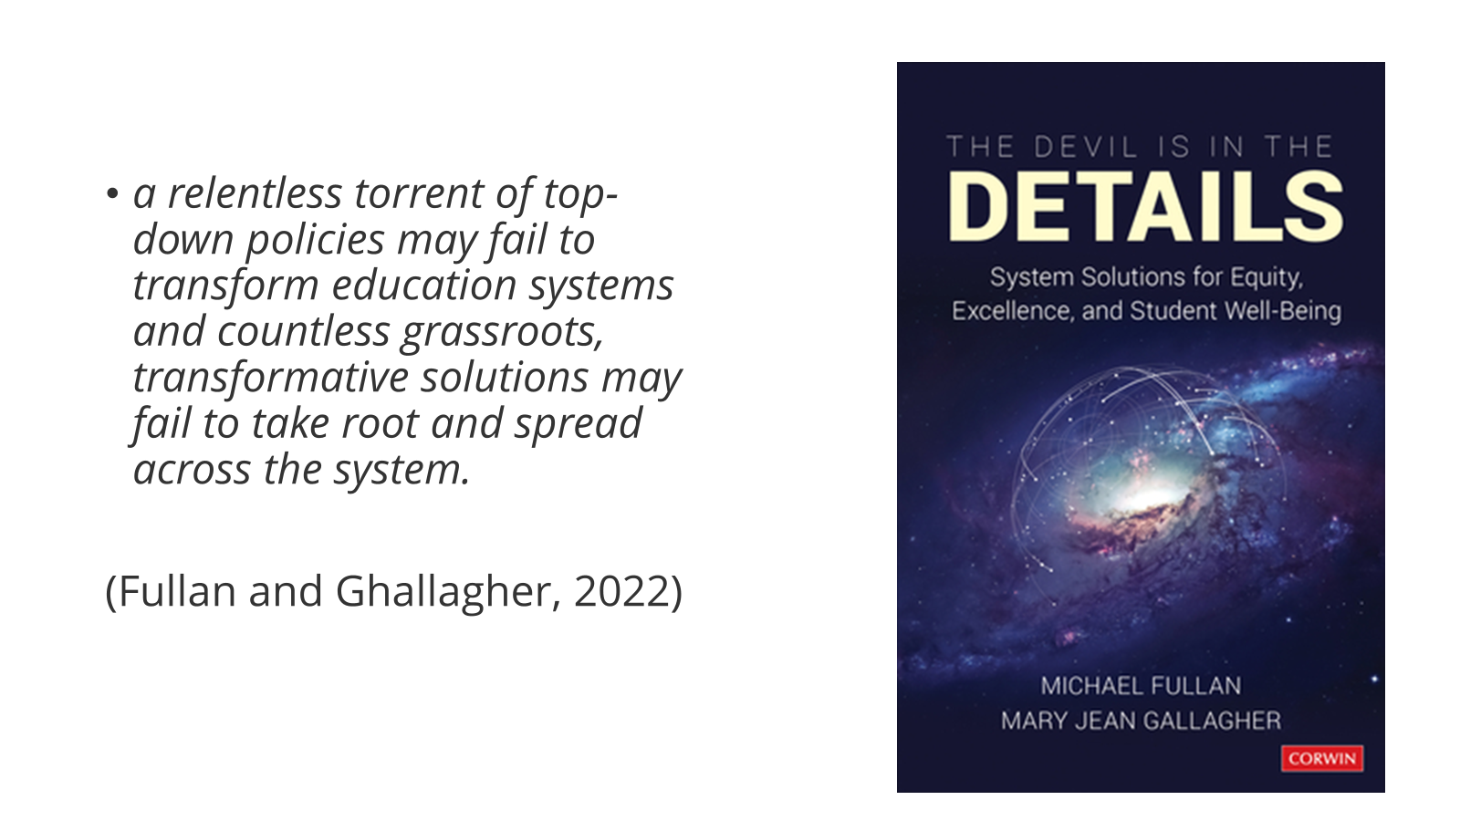
Is-Elfen 1 - Substrand 1:
Pam ymagwedd system gyfan?
Why a whole systems approach?
Notes:
We have great policies in Wales but a lack of systems approaches

Slide 30
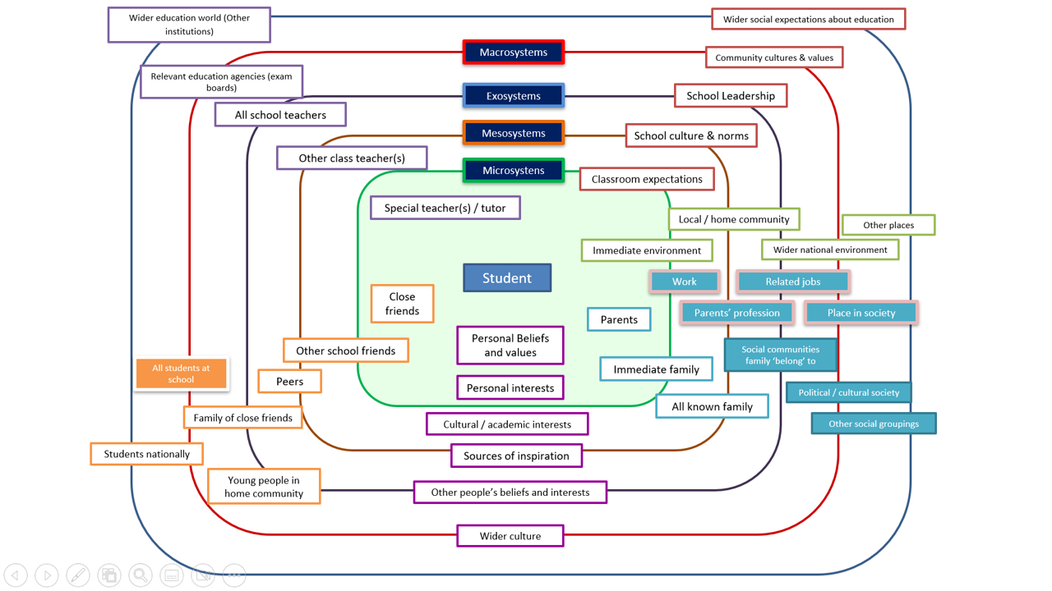
Llinyn Craidd 3:
Dulliau system gyfan a sut i gynllunio ar gyfer newid cadarnhaol
Notes:
Nigel’s slide (needs reference)

Slide 31
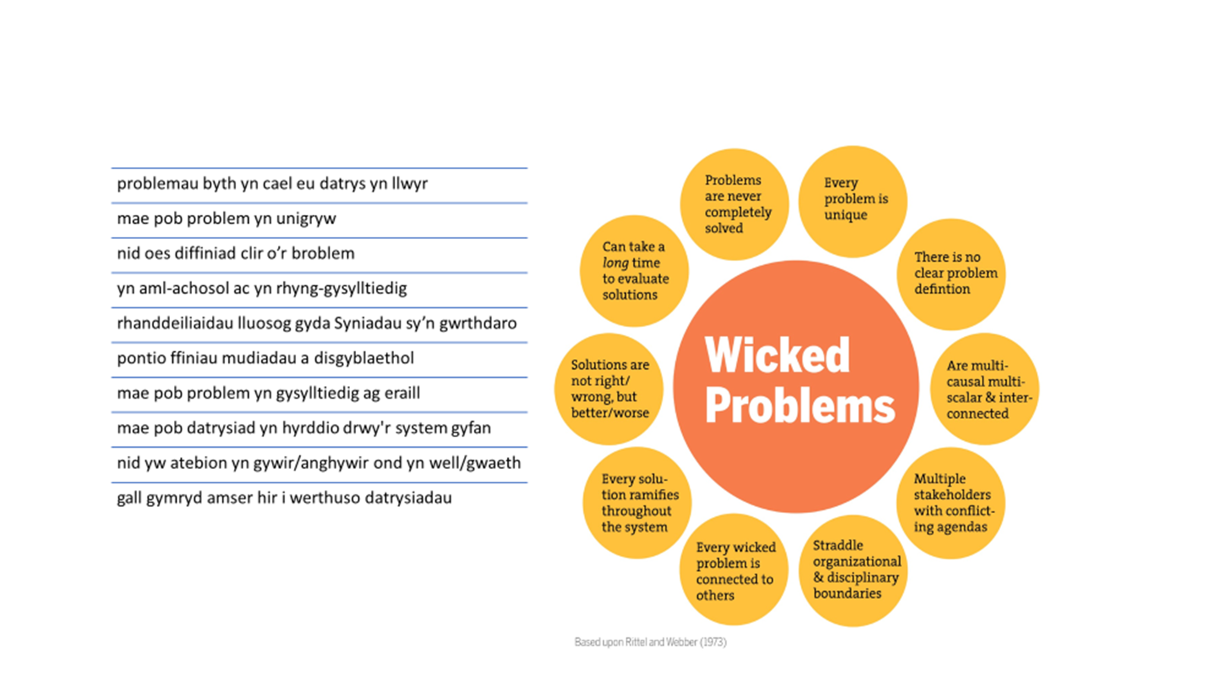
Mae tlodi yn Broblem Drygionus sy'n gofyn i bob system gydweithio
Poverty is a Wicked Problem that requires all systems to work together
2
Notes:
https://jamboard.google.com/d/1zK49zJR680FHcGcjYdB2Mx-EJod5985fdYys35iBt84/edit?usp=sharing
Rittel and Webber – Wicked problems

Slide 32
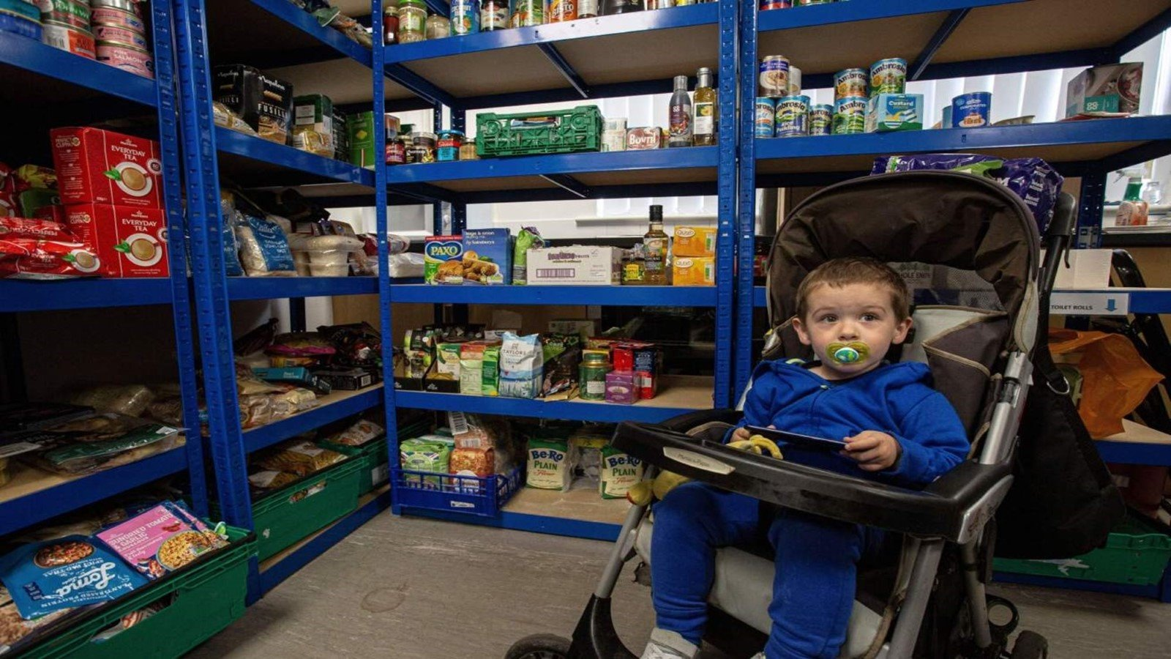
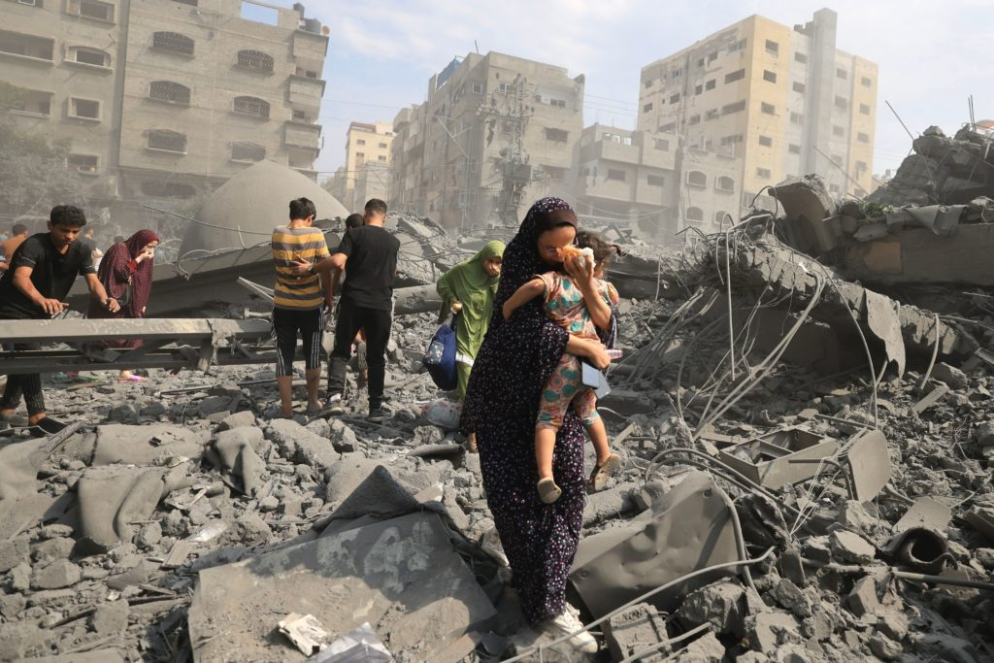
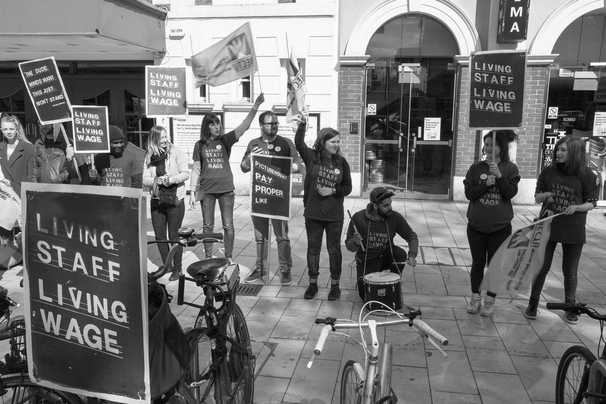
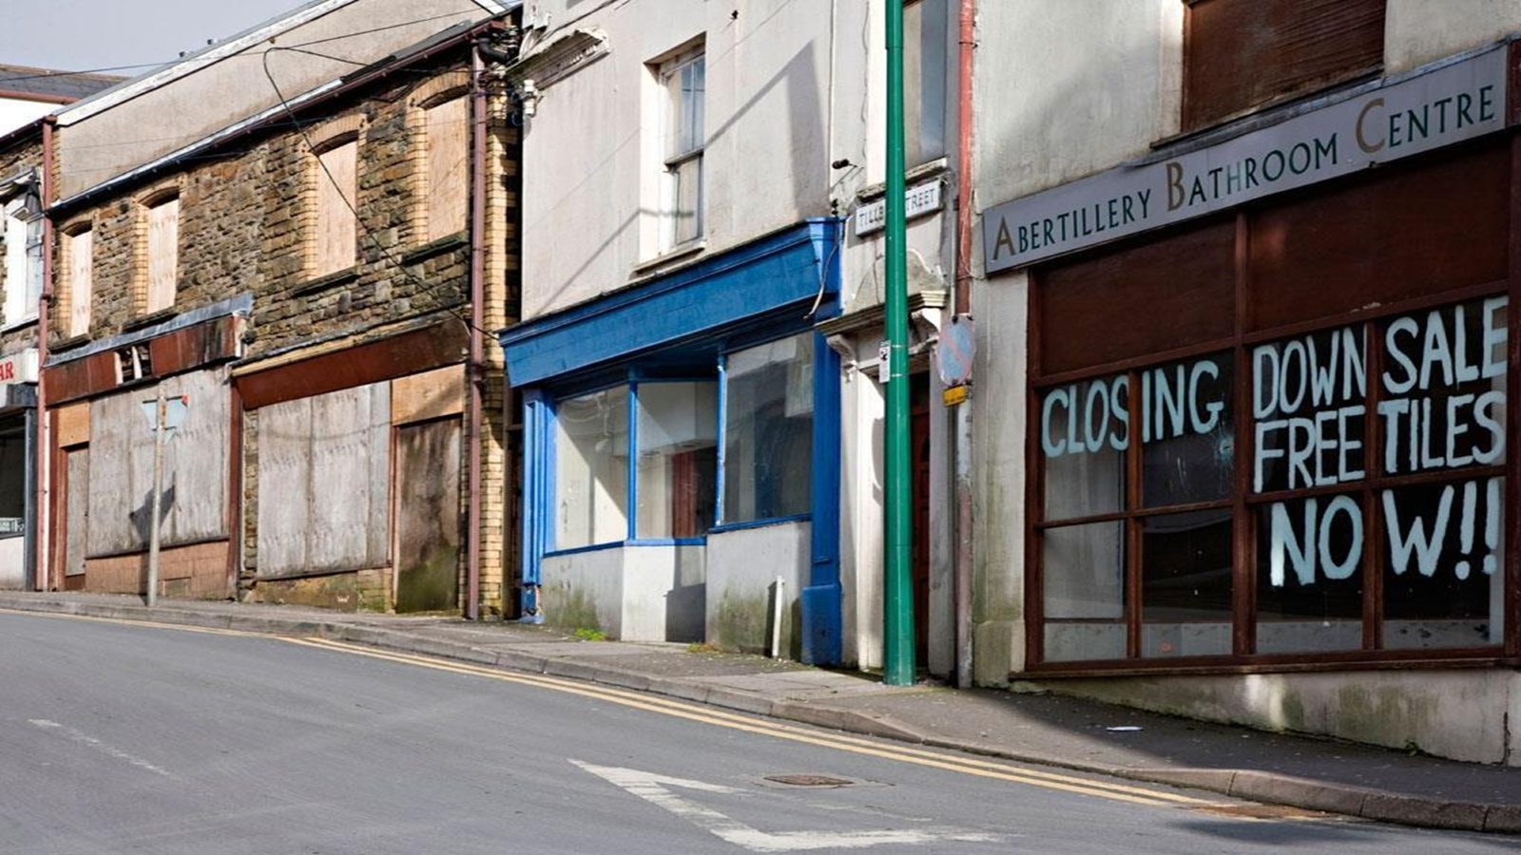
Notes:
This is from your handbook. Why are these issues that relate to poverty, learning and Consider poverty and education as a whole systems approach when looking at these images. How do they link with your understanding of poverty and education in Wales?
Choose and discuss one as a group in how systems impact on these situations and how they ca relate back to children and their learning environment. We can do this as a group or in breakout rooms

Slide 33
Gwaith grŵp /Group work:
O ystyried y dull systemau cyfan,
nodwch chwaraewyr y system
a lle mae'r rhwystrau i greu newid sefydlog o
fewn y system gyfan o un llun o’r sleid nesaf
Considering the whole systems approach, pinpoint the system players and where the barriers are to creating stable change within the whole system in one of photographs on the next slide

Slide 34
Egwyl
Comfort Break

Slide 35
Is-elfen 2: Substrand 2:
Yn yr amgylchedd dysgu: Dull Ysgolion Bro
In the learning environment: A Community Focussed Schools approach

Slide 36
Mae newid systemau’n gofyn am…
Beth mae hyn yn ei olygu yng nghyd-destun ymateb i dlodi ac anfantais yn eich lleoliad addysgol?
Sut byddai angen i chi a'ch cydweithwyr newid eich bydolwg?
Beth sydd angen digwydd i ddeall eich hun ac eraill o dan amodau cymhleth?
•Gefnogaeth i bobl yn unigol ac ar y cyd i ddeall sut mae'r 'system' yn gweithredu fel y gallant ddeall sut i atal canlyniadau gwael a chreu rhai da
I bobl i newid eu bydolwg
I bobl i ddeall eu hunain ac eraill yn well o dan amodau cymhleth
Fullan a Ghallagher (2021 ) t.32

Slide 37
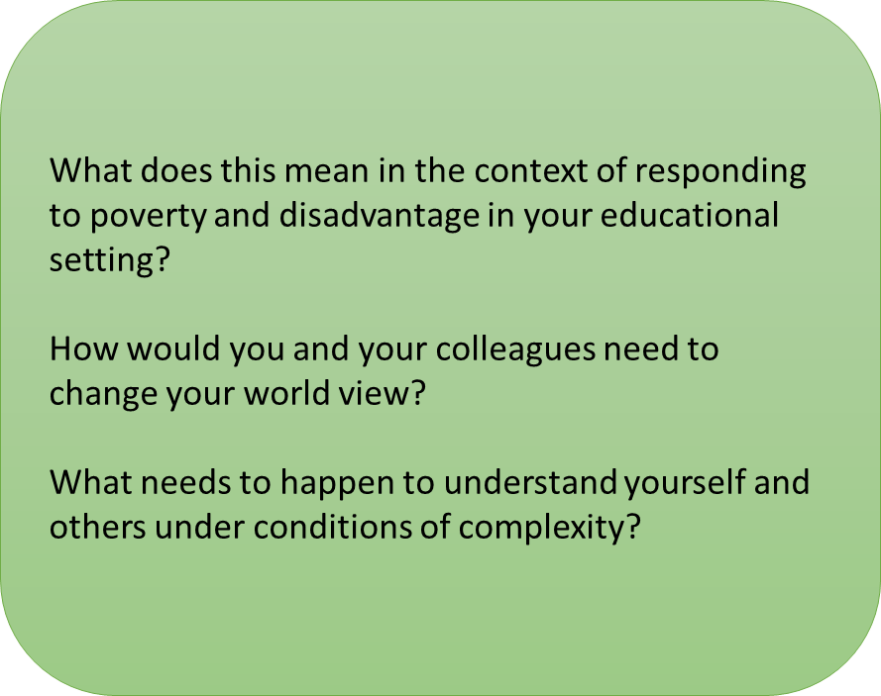
System change requires…
• Support for people individually and collectively to understand how the ‘system’ operates so they can understand how to stave off bad outcomes and create good ones
People to change their world view
People to understand themselves and others better under conditions of complexity
Fullan and Ghallagher (2021 ) p.32

Slide 38
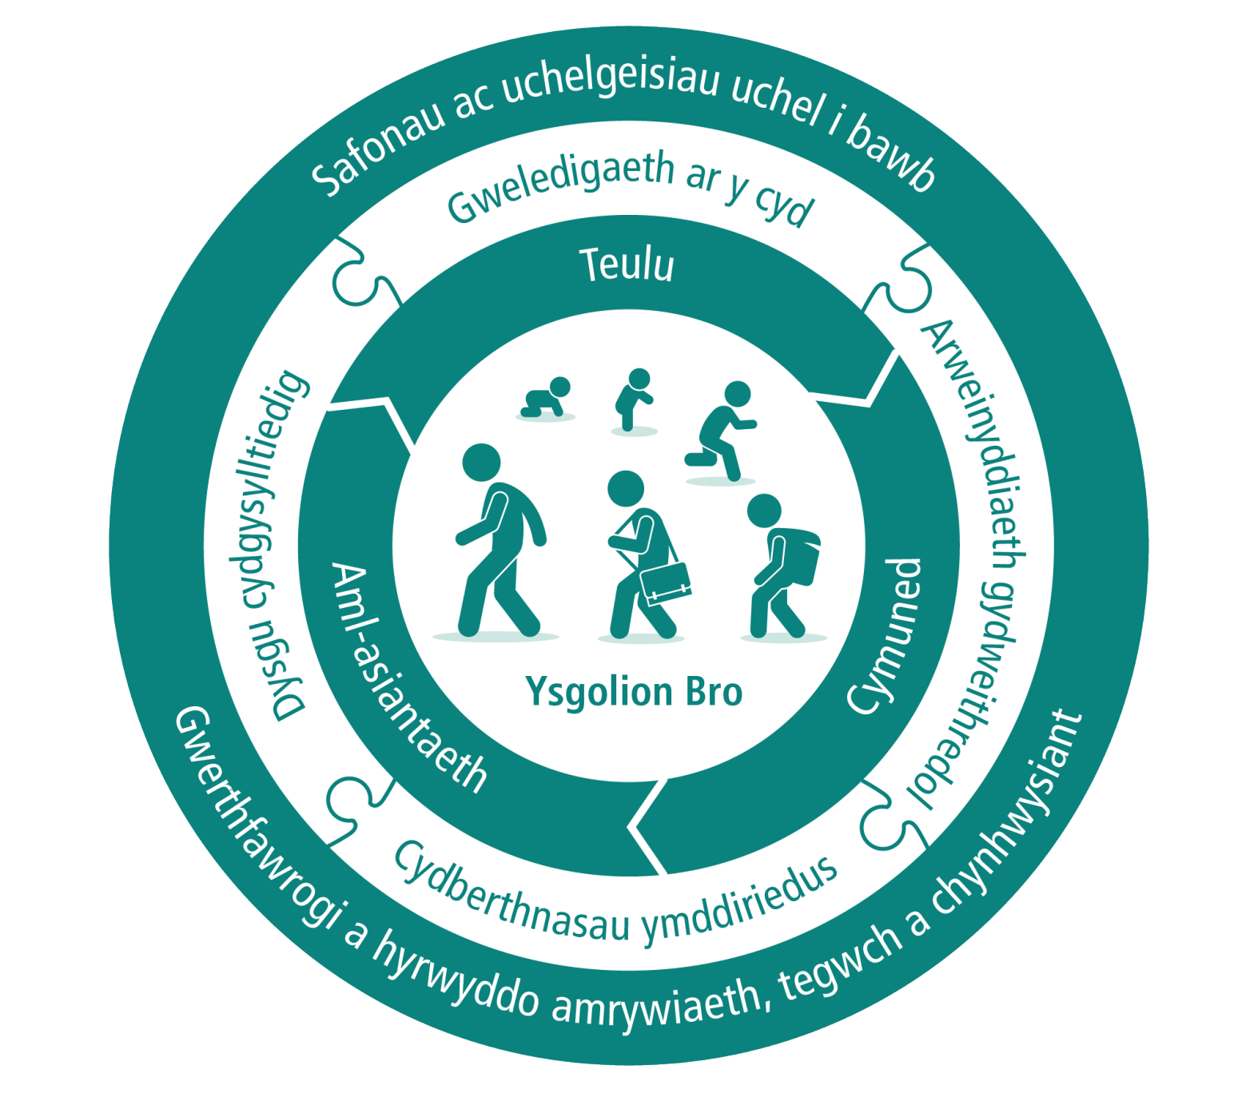
Ysgolion Bro
POB ysgol yng Nghymru i ddod yn Ysgolion Bro (LlC, 2022)

Slide 39
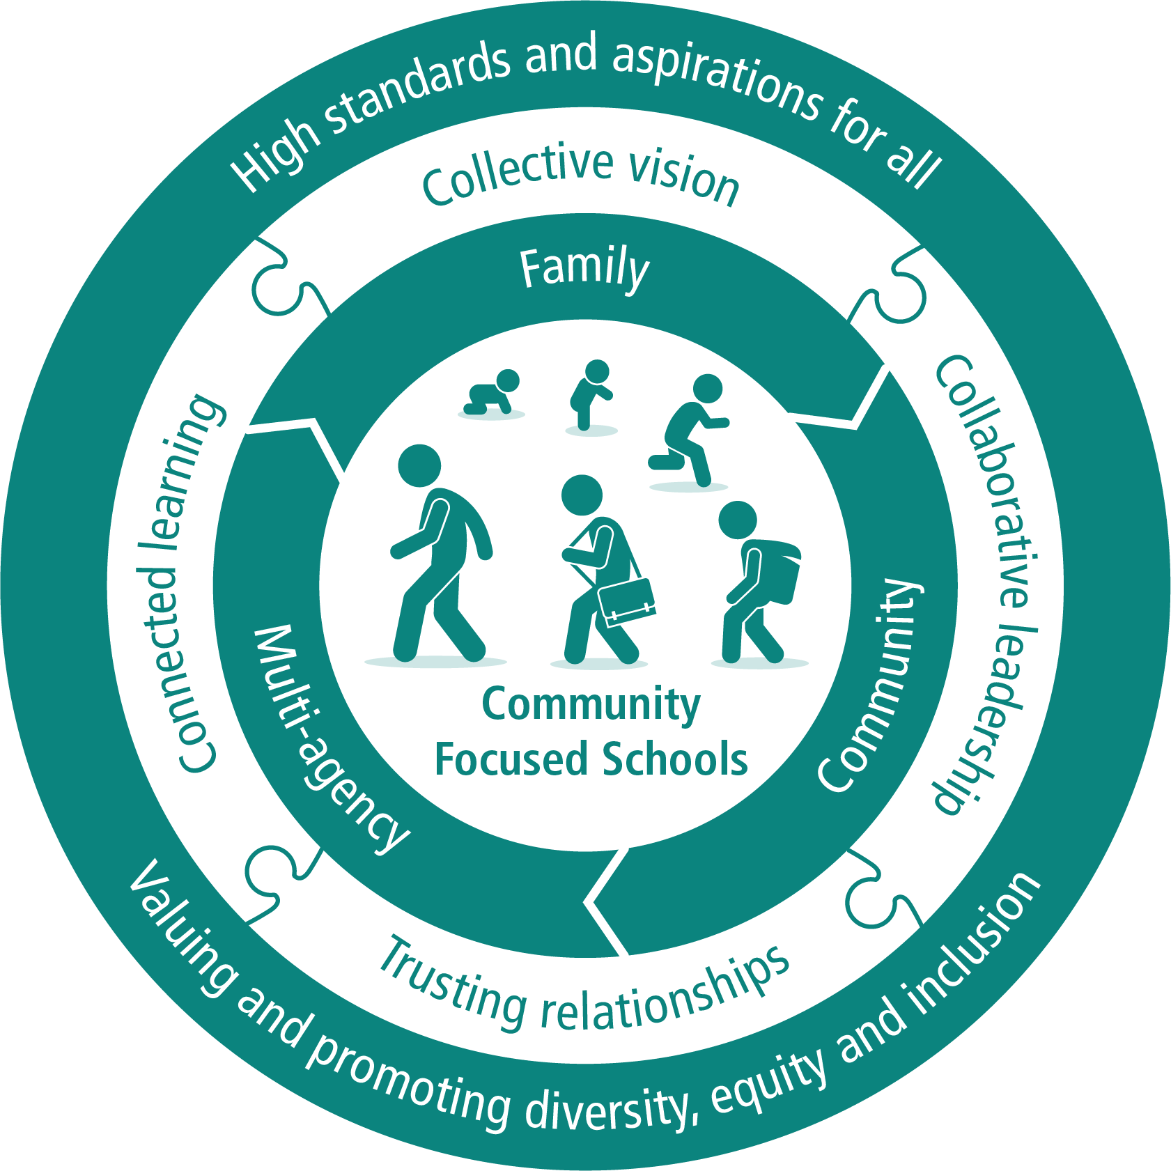
ALL schools in Wales are to become Community Focussed Schools (WG, 2022)
Notes:
The elements of family, community and multi-agency engagement are interconnected. Each element does not work in isolation but has an influence and impact on the others, combining to become a self-perpetuating model.
For example, when schools engage with families, they become more aware of the needs of families and are able to offer a broader range of services. In order to access and provide these services the school has to engage with the wider community. Examples of each element may include:
Family engagement
Working closely with families to give children and young people the best home learning environment possible. Ensuring families have the skills, confidence and resources to actively support their child’s learning at home.
Working in a constructive way with families to address any barriers to engagement.
Community engagement
Acting as a key part of the local community, offering opportunities to use the school facilities for adult learning, well-being, play, sporting, cultural and other community activities.
Signposting to other support or advice services.
Utilising the skills and organisations within the community to extend and enrich learning opportunities and to positively influence change.
Multi-agency engagement
Collaborating effectively with other key services and agencies to ensure that all children thrive and learn.
Sharing information so that children and young people and their families are able to access the appropriate support at the right time.
Supporting access to wider services which may be co-located in a school premises or located elsewhere within the community.
Developing all 3 elements in an integrated way will ensure the greatest impact on children and young people’s attainment, behaviour, attendance and aspirations and is particularly required in areas that face socio-economic disadvantage.
While it is recognised that many schools already take this approach to education, the difference between a Community Focused School and other schools is the intentional approach of bringing together these elements to support the children and families who attend the school.
There are 4 key enablers which support the progression between family, community and multi agency engagement.
Collective vision
The need for all stakeholders to help develop and realise the vision for the school, families and communities.
Collaborative leadership
Leadership across stakeholders to ensure shared voice, decision making and goals.
Trusting relationships
Trusting and non-judgmental relationships between schools, families and community members, and between staff and children or young people allowing everyone to feel listened to, valued and respected.
Connected learning
A strong focus on high quality and connected learning across home, school and the community, maximising the opportunities in each sphere.

Slide 40
Beth fydd hyn yn ei olygu i addysg?
1. ffocws ar anghenion cymdeithasol ac emosiynol, ac anghenion iechyd, pob dysgwr, gan gynnwys mynediad at amrediad rhesymegol o wasanaethau achynlluniau dysgu personol i ddysgwyr
2. cysylltiad â theuluoedd, a hwnnw’n aml yn cynnwys datblygu gwasanaeth cymorth i deuluoedd yn yr ysgol
3. cysylltiad â’r gymuned ehangach, gan ddarparu’r cyfle a’r mecanwaith i feithrin gallu yn y gymuned leol
4. darparu addysg integredig yn yr ysgol, addysg anffurfiol yn ogystal ag addysg ffurfiol, a gwasanaethau gwaith cymdeithasol ac addysg iechyd a gwasanaethau hyrwyddo
5. rheolaeth integredig sy’n aml yn cael ei chefnogi gan reolwr integreiddio
6. gwasanaethau’n cael eu darparu yn unol â chyfres o amcanion integredig a chanlyniadau mesuradwy; un nodwedd bwysig mewn llawer o achosion yw rhannu lleoliad
7. ymrwymiad ac arweinyddiaeth
8. hyfforddiant amlddisgyblaethol a datblygu staf

Slide 41
What will this mean for education?
1. a focus on social, emotional and health needs of all learners including access to a coherent range of services and personal learning plans
2. engagement with families, often including the development of a family support service in school
3. engagement with the wider community, providing both the opportunity and the mechanisms to build capacity in the local community
4. integrated provision of school education, informal as well as formal
5. integrated management often supported by an integration manager
6. services delivered according to a set of integrated objectives and measurable outcomes, a significant feature in many cases being co-location
7. commitment and leadership
8. multi-disciplinary training and staff development

Slide 42
Ysgolion Bro – Sgiliau wahanol?
Ymgysylltu â’r teulu (gweler Goodall, 2018)
Ymgysylltu â’r gymuned
Ymgysylltu â phartneriaethau amlasiantaeth
Gweledigaeth ar y cyd
Arweinyddiaeth gydweithredol
Cydberthynas ymddiriedus
Dysgu cydgysylltiedig
Notes:
Ymgysylltu â’r teulu • Gweithio'n agos gyda theuluoedd i roi'r amgylchedd dysgu gorau posibl yn y cartref i blant a phobl ifanc. Sicrhau bod gan deuluoedd y sgiliau, yr hyder a'r adnoddau i fynd ati i gefnogi dysgu eu plentyn yn y cartref. • Gweithio mewn ffordd adeiladol gyda theuluoedd i fynd i'r afael ag unrhyw rwystrau rhag meithrin perthynas dda. Ymgysylltu â’r gymuned • Gweithredu fel rhan allweddol o'r gymuned leol, gan gynnig cyfleoedd i ddefnyddio cyfleusterau'r ysgol ar gyfer dysgu oedolion, lles, chwarae, chwaraeon, a gweithgareddau diwylliannol a chymunedol eraill. • Cyfeirio at wasanaethau cymorth neu gynghori eraill. • Defnyddio'r sgiliau a'r sefydliadau yn y gymuned i ehangu a chyfoethogi cyfleoedd dysgu ac i ddylanwadu'n gadarnhaol ar newid.
Ymgysylltu â phartneriaethau amlasiantaeth • Cydweithio'n effeithiol gyda gwasanaethau ac asiantaethau allweddol eraill i sicrhau bod pob plentyn yn ffynnu ac yn dysgu. • Rhannu gwybodaeth fel bod plant a phobl ifanc a'u teuluoedd yn gallu cael y gefnogaeth briodol ar yr adeg gywir. • Cefnogi mynediad at wasanaethau ehangach a allai gael eu cydleoli ar safle ysgol neu eu lleoli mewn mannau eraill yn y gymuned.
Gweledigaeth ar y cyd Yr angen i'r holl randdeiliaid helpu i ddatblygu a gwireddu'r weledigaeth ar gyfer yr ysgol, teuluoedd a chymunedau.
Arweinyddiaeth gydweithredol Arweinyddiaeth sy'n cynnwys rhanddeiliaid, er mwyn sicrhau bod cyfle i bawb leisio’u barn a bod penderfyniadau a nodau yn cael eu gwneud ar y cyd. Cydberthynas ymddiriedus Cydberthynas ymddiriedus ac anfeirniadol rhwng ysgolion, teuluoedd ac aelodau o'r gymuned, a rhwng staff a phlant neu bobl ifanc, sy’n caniatáu i bawb deimlo y gwrandewir arnynt, a’u bod yn cael eu gwerthfawrogi a’u parchu. Dysgu cydgysylltiedig Ffocws cryf ar ddysgu cydgysylltiedig o ansawdd uchel yn y cartref, yr ysgol a'r gymuned, gan fanteisio i’r eithaf ar y cyfleoedd ym mhob maes.

Slide 43
Different Skills? Community Focussed Schools
Family engagement (see Goodall, 2018)
Community engagement
Multi-agency engagement
Collective vision
Collaborative leadership
Trusting relationships
Connected learning
Notes:
Family engagement
Working closely with families to give children and young people the best home learning environment possible. Ensuring families have the skills, confidence and resources to actively support their child’s learning at home.
Working in a constructive way with families to address any barriers to engagement.
Community engagement
Acting as a key part of the local community, offering opportunities to use the school facilities for adult learning, well-being, play, sporting, cultural and other community activities.
Signposting to other support or advice services.
Utilising the skills and organisations within the community to extend and enrich learning opportunities and to positively influence change.
Multi-agency engagement
Collaborating effectively with other key services and agencies to ensure that all children thrive and learn.
Sharing information so that children and young people and their families are able to access the appropriate support at the right time.
Supporting access to wider services which may be co-located in a school premises or located elsewhere within the community.
Developing all 3 elements in an integrated way will ensure the greatest impact on children and young people’s attainment, behaviour, attendance and aspirations and is particularly required in areas that face socio-economic disadvantage.
While it is recognised that many schools already take this approach to education, the difference between a Community Focused School and other schools is the intentional approach of bringing together these elements to support the children and families who attend the school.
There are 4 key enablers which support the progression between family, community and multi agency engagement.
Collective vision
The need for all stakeholders to help develop and realise the vision for the school, families and communities.
Collaborative leadership
Leadership across stakeholders to ensure shared voice, decision making and goals.
Trusting relationships
Trusting and non-judgmental relationships between schools, families and community members, and between staff and children or young people allowing everyone to feel listened to, valued and respected.
Connected learning
A strong focus on high quality and connected learning across home, school and the community, maximising the opportunities in each sphere.
Valuing and promoting diversity, equity and inclusion

Slide 44
CINIO / LUNCH 12pm
12.30pm -1.15pm
GOFYNNWCH YR ARBENIGWR
ASK THE EXPERT

Slide 45
Core Strand 4: Plan, implement, and evaluate a change in practice
Llinyn Craidd 4: Cynllunio, gweithredu, a gwerthuso newid mewn ymarfer

Slide 46
Pobl sy’n rhychwantu, yn croesi ffiniau ac eiriolwyr
...[school leaders] must have a keen awareness of school-community relations, group dynamics, intercultural tolerance, politics and power, team building, and community engagement and how to effectively bridge these “borders” in order to collectively work toward success.
Lopez et al., (2006 t66) yn Scanlan a Johnson (2021 t.231)

Slide 47
Boundary spanners, border crossers and advocates
...[school leaders] must have a keen awareness of school-community relations, group dynamics, intercultural tolerance, politics and power, team building, and community engagement and how to effectively bridge these “borders” in order to collectively work toward success.
Lopez et al., (2006 p66) in Scanlan and Johnson (2021 p.231)

Slide 48
Defnyddiwch Chat i…
Tackling a wicked problem [like poverty] entails facing the unknown, requiring the ability to organize for constant changes and increased levels of conflict among stakeholders
Pradilla et al. (2022)​
Yn eich barn chi, sut y bydd addysgwyr yn teimlo am y ffordd newydd hon o weithio?

Slide 49
Use Chat to…
Tackling a wicked problem [like poverty] entails facing the unknown, requiring the ability to organize for constant changes and increased levels of conflict among stakeholders
Pradilla et al. (2022)​
How do you feel educators will feel about this new way of working?

Slide 50
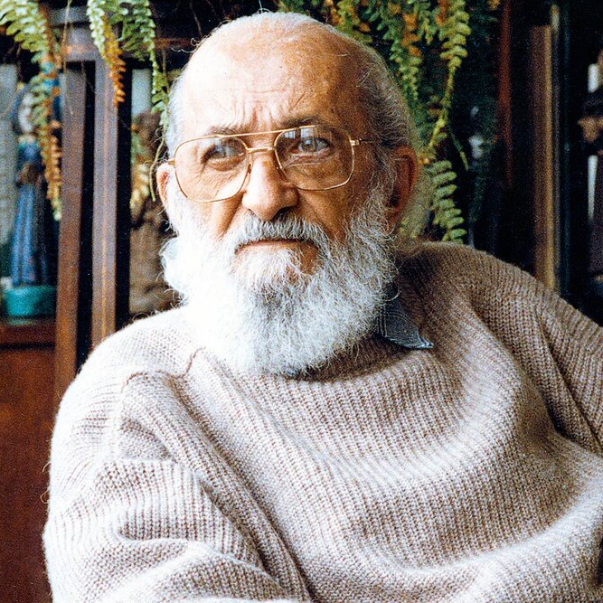
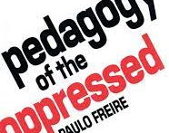
Theorïau Newid
‘Education either functions as an instrument which is used to facilitate integration of the younger generation into the logic of the present system and bring about conformity or it becomes the practice of freedom, the means by which men and women deal critically and creatively with reality and discover how to participate in the transformation of their world.’
(Fireire, 1968)

Slide 51
Theories for Change
‘Education either functions as an instrument which is used to facilitate integration of the younger generation into the logic of the present system and bring about conformity or it becomes the practice of freedom, the means by which men and women deal critically and creatively with reality and discover how to participate in the transformation of their world.’
(Freire,1968)

Slide 52

Given that teachers are the most critical in-school factors in students’ academic, social, and emotional development, what and how they teach in their classrooms is directly associated with students’ growth as critical citizens who engage in activities to improve inequality and achieve social justice (Pantić & Florian, 2015)
https://www.ed.ac.uk/education/rke/centres-groups/rten/research/teachers-as-agents-of-change

Slide 53
Athrawon fel Asiantau dros Gyfiawnder Cymdeithasol
Ymdeimlad o bwrpas – credoau athrawon am eu rôl fel asiantau dros gyfiawnder cymdeithasol a’u dealltwriaeth o hyn
Cymhwysedd – arferion athrawon sy’n mynd i'r afael â gwahardd a thangyflawni rhai myfyrwyr
Ymreolaeth – canfyddiadau athrawon o amgylcheddau a rhyngweithiadau sy’n cynnwys cyd-destun ag eraill
Atgyrchedd – gallu athrawon i ddadansoddi a gwerthuso eu harferion a’u lleoliadau sefydliadol
Pantić, N. and Florian, L. (2015) Developing teachers as agents of inclusion and social justice. Education Inquiry,Cyf. 6, Rhif. 3, tt 333 – 351

Slide 54
Teacher Agency for Social Justice
Sense of purpose – teachers’ beliefs about their role as agents and understanding of social justice
Competence – teachers’ practices addressing the exclusion and underachievement of some students
Autonomy – teachers’ perceptions of environments and context-embedded interactions with others
Reflexivity – teachers’ capacity to analyse and evaluate their practices and institutional settings
Pantić, N. and Florian, L. (2015) Developing teachers as agents of inclusion and social justice. Education Inquiry, Vol. 6,No. 3, pp 333 – 351

Slide 55
Beth yw asiant newid?
'Felly asiantau newid yw'r rhai sydd yn y sefyllfa orau i gataleiddio cyflwyniad llwyddiannus arloesiadau neu safbwyntiau i gwmni, sefydliad neu sefydliad.'
'Gall asiant newid felly ystyried newid fel rhywbeth deniadol trwy ei gyferbynnu â rhywbeth y mae athrawon yn ei ystyried yn llai deniadol. Er enghraifft, mae Schildkamp a Datnow (2020) yn nodi bod athrawon yn llawer mwy tebygol o ystyried defnyddio data i lywio eu hymarfer pan fydd ffocws penodol ar degwch, na phan ddefnyddir data yn y gwasanaeth atebolrwydd.'
Brown, White a Kelly (2021)

Slide 56
What is a change agent?
’Change agents are therefore those who are best able to catalyse the successful introduction of innovations or perspectives into a company, organisation or establishment.’
‘A change agent can therefore position a change as attractive by contrasting it with something that teachers regard as less attractive. For example, Schildkamp & Datnow (2020) observe that teachers are far more likely to consider using data to inform their practice when there is an explicit focus on equity, than when data use is undertaken in the service of accountability.’
Brown, White and Kelly (2021)

Slide 57
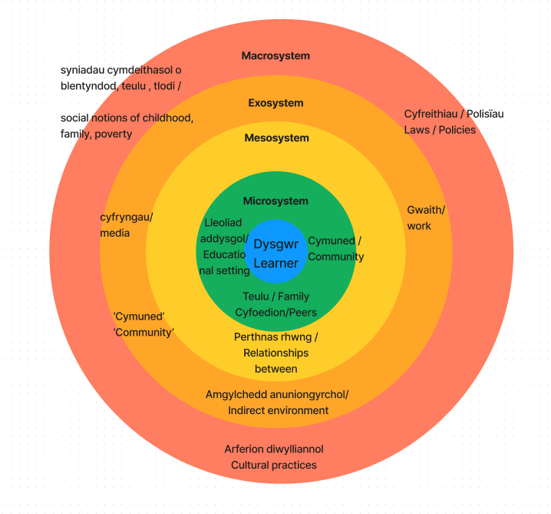
Camau cynllunio: Ble?
Planning action: Where?
Notes:
Ystafell grŵp/trafodaeth rhwng y grŵp​
Meddyliwch ble hoffech chi gynllunio eich newid i ymarfer. Ai ymyriad ar raddfa fach yw hwn gyda myfyrwyr? A yw'n gweithio mewn perthynas ag eraill yn y microsystem? A yw'n ymwneud yn fwy â sicrhau newid yn yr Ecsosystem neu'r mesosystem? Mae'n iawn dewis beth bynnag y dymunwch, ond cofiwch fod pob gweithred yn cael ei rheoli gan systemau eraill neu'n effeithio arnynt. Dyma lle gallwch chi ystyried eich rhwystrau. yn
Yn eich grwpiau meddyliwch am
Eich newid arfer arfaethedig
Sut y bydd yn dylanwadu neu’n cael ei ddylanwadu gan systemau eraill?​
Ai’r rhwystrau penodol hyn y gallwch eu hystyried yn Rhan 2?
Mesosystem – Y mesosystem yw pan nad yw microsystemau unigol person yn gweithredu'n annibynnol, ond maent yn rhyng-gysylltiedig ac yn dylanwadu ar ei gilydd. Er enghraifft, os yw teulu/cymuned dysgwr yn cyfathrebu â'r athrawon, gall y rhyngweithio hwn ddylanwadu ar ddatblygiad y dysgwr.
Exosystem: Mae’r ecsosystem yn cynnwys y gosodiadau neu’r digwyddiadau nad yw’r dysgwr yn cymryd rhan weithredol ynddynt ond sy’n cael effaith ddofn ar eu datblygiad serch hynny.
Macrosystem: cyfreithiau ac arferion gorfodi'r gyfraith, asiantaethau'r llywodraeth, pleidiau gwleidyddol, polisïau cymdeithasol, adnoddau gofal iechyd, systemau economaidd, adnoddau addysgol, y cyfryngau, a llawer o werthoedd a ffurfiau symbolaidd o ddylanwad sy'n creu'r cyd-destunau cymdeithasol, gwleidyddol ac ariannol ar gyfer datblygiad (Bronfenbrenner, 1979, tt. 22, 25, 26)
Breakout room/ discussion between the group
Think about where you would like to plan your change to practice. Is it on a small scale intervention with students? Is it working in relation to others in the microsystem? Is it more about effecting change in the Exosystem or mesosystem? It is fine to choose what ever you want, but remember that every action be governed by or effect other systems. This is where you can consider your barriers.
In your groups think about
Your planned change of practice
How will it influence or be influenced by other systems?
Are these specific barriers that you can consider in Part2?
Mesosystem – The mesosystem is where a person's individual microsystems do not function independently, but are interconnected and assert influence upon one another. For instance, if a learners family/community communicate with the teachers, this interaction may influence the learner's development.
Exosystem: The exosystem contains the settings or events that the learner does not actively participate in but that have a profound effect on their development nonetheless.
Macrosystem: laws and law enforcement practices, government agencies, political parties, social policies, health-care resources, economic systems, educational resources, media, and many values and symbolic forms of influence that create the social, political, and financial contexts for development (Bronfenbrenner, 1979, pp. 22, 25, 26)

Slide 58
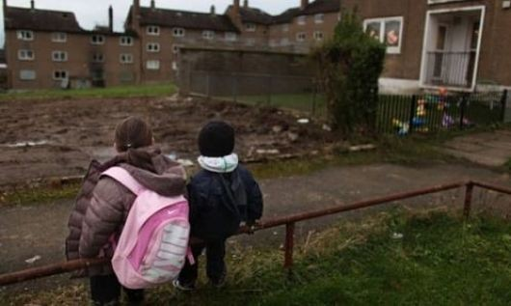
Sbanwyr Ffiniau, Croeswyr Ffiniau ac Eiriolwyr​
Mae arweinwyr addysgol sy’n croesi ffiniau diwylliannol yn gwneud eu gwaith mewn ffyrdd sylfaenol wahanol … Yn gryno, maent yn weithredwyr cymdeithasol yn ogystal ag yn addysgwyr sy’n ceisio herio a newid y byd trwy eu hymarfer.”
Lopez, Gonzalez, a Fierro (2006 tt: 67-68) mewn/in Scanlan a Johnson (2021 tt: 231):

Slide 59
Boundary Spanners, Border Crossers and Advocates
“Educational leaders who cross cultural borders engage their work in fundamentally different ways … In a nutshell, they are social activists as well as educators who seek to challenge and change the world through their praxis”
Lopez, Gonzalez, and Fierro (2006 pp 67-68) in Scanlan and Johnson (2021 pp 231):
Notes:
#In what way do you need to be a social activist?
Think back to Jeremy Miles' speech about needing radical action.

Slide 60
How 'radical' is radical?
Pŵer heriol?
Gwybodaeth, dealltwriaeth, sgiliau, gwerthoedd ac agweddau heriol?​
Trefnu Cymunedol ?
Beth arall?
Challenging power?
Challenging knowledge, understanding, skills, values and attitudes?
Community Organising ?
What else?

Slide 61

Pa heriau penodol y credwch y gallech eu hwynebu wrth gynllunio/gweithredu eich newid arfaethedig?
What specific challenges do you think you may face in planning/ implementing your planned change?
Notes:
Consider issues such as
So much change in Wales
Lack of staff
Lack of motivation
Not being able to get people to change their views
Attitudes
Lack of resources
Differing views of poverty

Slide 62
Gwerthuso newid:
Knowledge lies less in its databases than in its people"
                (Brown and Duguid, 2000 p121 cited in Fullan, 2020 p.92)
Beth fyddech chi'n ei weld? Sut fyddai'n teimlo?
Hunanwerthuso (pwy?).
Dulliau cyfranogol
Dangosyddion a cherrig milltir clir
Mwy nag un gwerthusiad o wahanol faterion
Pathfinders – Llywodraeth yr Alban (2023)

Slide 63
Evaluating change:
"Knowledge lies less in its databases than in its people"
    (Brown and Duguid, 2000 p121 cited in Fullan, 2020 p.92)
What would you see? How would it feel?
Self- Evaluation (who?)
Participatory methods
Clear indicators and milestones
More than one evaluation of different issues.
Pathfinders – Scottish Government (2023)
Notes:
A Pathfinder is a developmental process of testing and exploring approaches and of continual improvement. It is keeping true to a set of principles or high-level objectives without predefining the solutions, or the end goal.
· There is flexibility in the implementation of a Pathfinder, such that it has scope to adapt and respond to emergent outcomes and opportunities and to the varied contexts in which it is delivered.
· The Pathfinder is co-designed and delivered in partnership, engaging those with lived experience, and not implemented top down by the Scottish Government.
· A key aspect of the Pathfinder is to draw out learning to inform other work (or Pathfinders) or national policy.
· The possibility of ‘failure’ is recognised.

Slide 64
Wales Centre for Public Policy (2022) Being poor in Wales – why where you live matters (Online). https://www.wcpp.org.uk/commentary/being-poor-in-wales-why-where-you-live-matters/
Rittel, H.J.W. and Webber, M.H. (1973) Dilemmas in general theory of planning. Policy Sciences, 4, (2) pp155-159. https://doi.org/10.1007/BF01405730
Scanlan, M. and Johnson, L (2021) ‘Inclusion the social frontier: Family and community engagement’. In: Theoharis, G. Scanlan, M. (eds) Leadership for Increasingly Diverse Schools, Taylor & Francis Group, 2020. pp 227-290
Scottish Government (2023) Tackling child poverty pathfinders: evaluability assessment Available at: Appendix 2 – Best Practice Literature Review - Tackling child poverty pathfinders: evaluability assessment - gov.scot (www.gov.scot) Accessed 5/3/2024
Turnbull, N. and Hoppe, R. (2019) Problematizing ‘wickedness’: a critique of the wicked problems concept, from philosophy to practice. Policy and Society, 38:2, 315-337, DOI: 10.1080/14494035.2018.1488796
Wales Centre for Public Policy (2022) Being poor in Wales – why where you live matters (Online). https://www.wcpp.org.uk/commentary/being-poor-in-wales-why-where-you-live-matters/

Slide 65
Edge Foundation (2023) Schools for All? Available at: https://www.edge.co.uk/research/projects/research-reports/schools-for-all/
Muers, S. (2018) Culture, Values and Public Policy. London. Institute for Policy Research
Pantić, N. and Florian, L. (2015) Developing teachers as agents of inclusion and social justice. Education Inquiry, Vol. 6,No. 3, pp 333 – 351
Pradilla, C.A., da Silva, J.B. and Reinecke, J. (2022), "Wicked Problems and New Ways of Organizing: How Fe y Alegria Confronted Changing Manifestations of Poverty", in Gümüsay, A.A., Marti, E., Trittin-Ulbrich, H. and Wickert, C. (Ed.) Organizing for Societal Grand Challenges (Research in the Sociology of Organizations, Vol. 79), Emerald Publishing Limited, Leeds, pp. 93-114. https://doi.org/10.1108/S0733-558X20220000079007
Rittel, H.J.W. and Webber, M.H. (1973) Dilemmas in general theory of planning. Policy Sciences, 4, (2) pp155-159. https://doi.org/10.1007/BF01405730
Goodall, J. (2018). A toolkit for parental engagement: from project to process. School Leadership & Management, 38(2), 222–238. https://doi.org/10.1080/13632434.2018.1430689
Wales Centre for Public Policy (2022) Being poor in Wales – why where you live matters (Online). https://www.wcpp.org.uk/commentary/being-poor-in-wales-why-where-you-live-matters/

