Slide 1
A Bit about netflix
Netflix was founded in 1997 by Reed Hastings and Marc Randolph.
It began as an online mail order DVD rental store but debuted its subscription service in 1999, offering unlimited DVDs for a monthly cost.
The range of movies it began to acquire as well as the convenience served as a huge disruption to other rental shops such as Blockbuster, ultimately leading to its demise in 2013.
That same year, Netflix began releasing its own licenced content starting with its emmy award winning ‘House of Cards’. Since then Netflix has produced other award winning content such as ‘Orange is the New Black’ and ‘Stranger Things’.
Netflix has rapidly grown in the years since the previous SFF. It has more than quadrupled its subscriber count from 23.53 million subscribers in 2011 to more than 117 million subscribers in 2017. 62.8% of its subscriber base are international subscribers.
Netflix reached a revenue of $11.69 billion US dollars in 2017, a 32.41% increase from 2016
The objective to conclude the previous SFF was ‘get big fast’.
An SFF will be conducted to illustrate the differences between the previous SFF in 2011 to now.

Slide 2
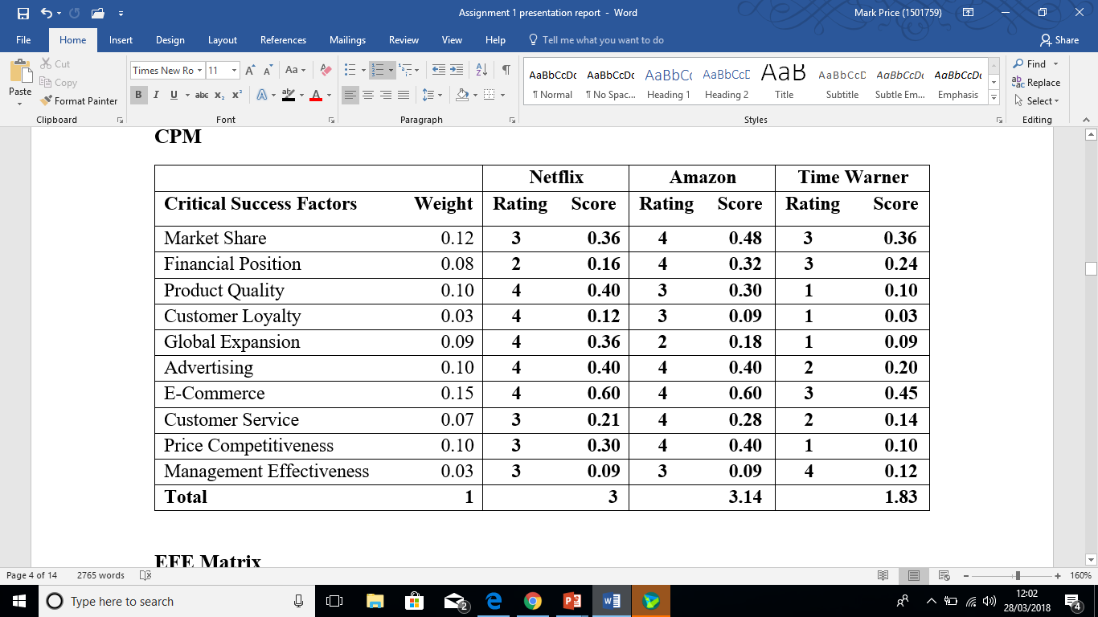
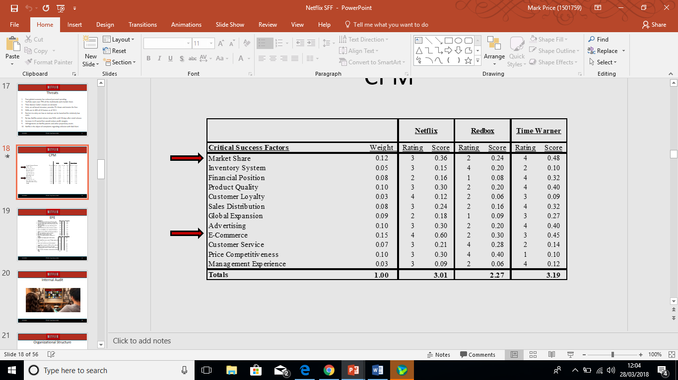
Phase 1 - CPM
2011
2018

Slide 3
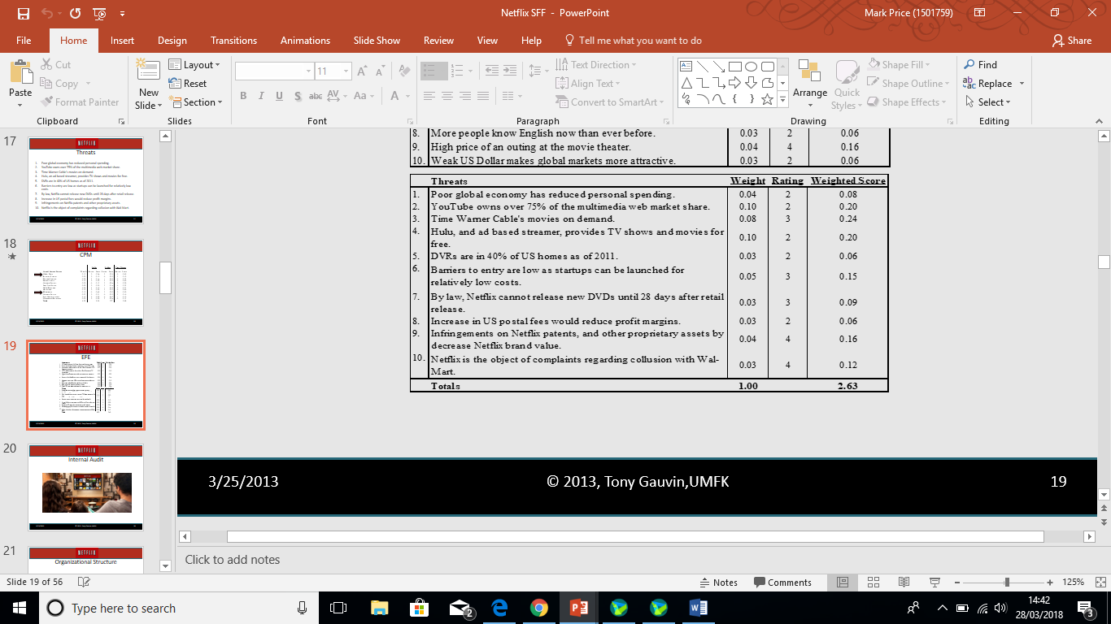
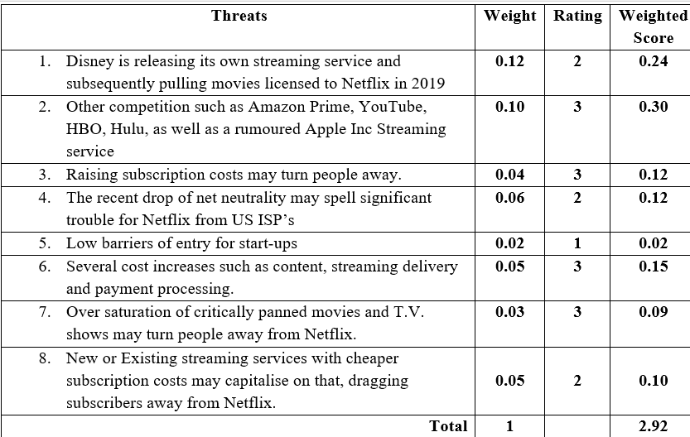
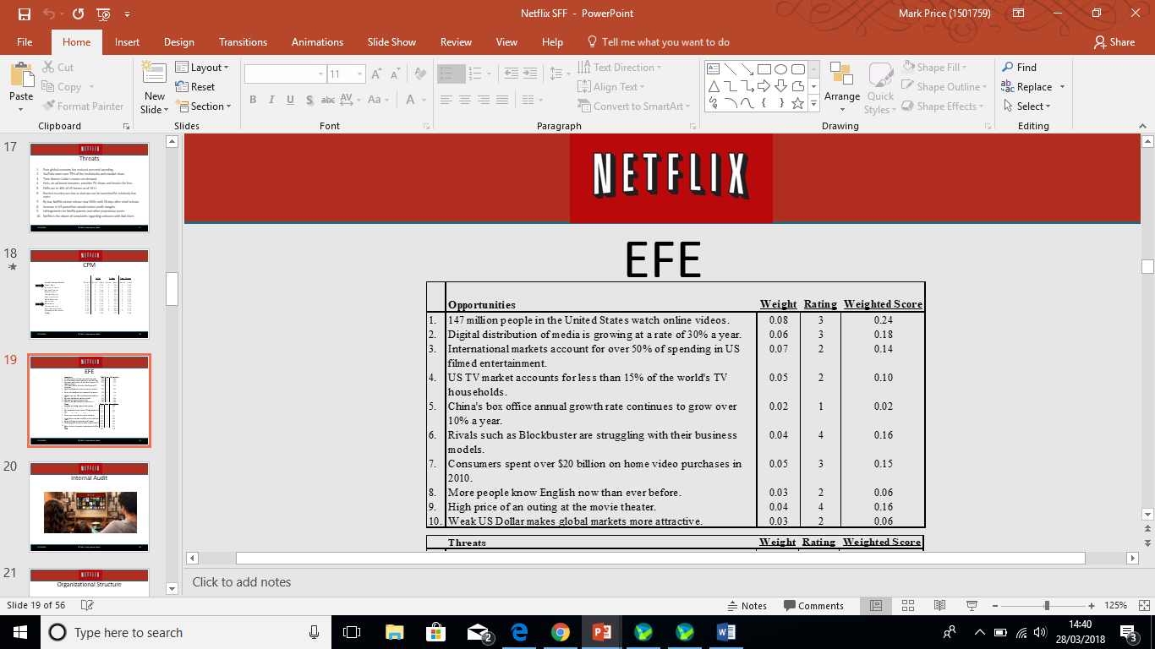
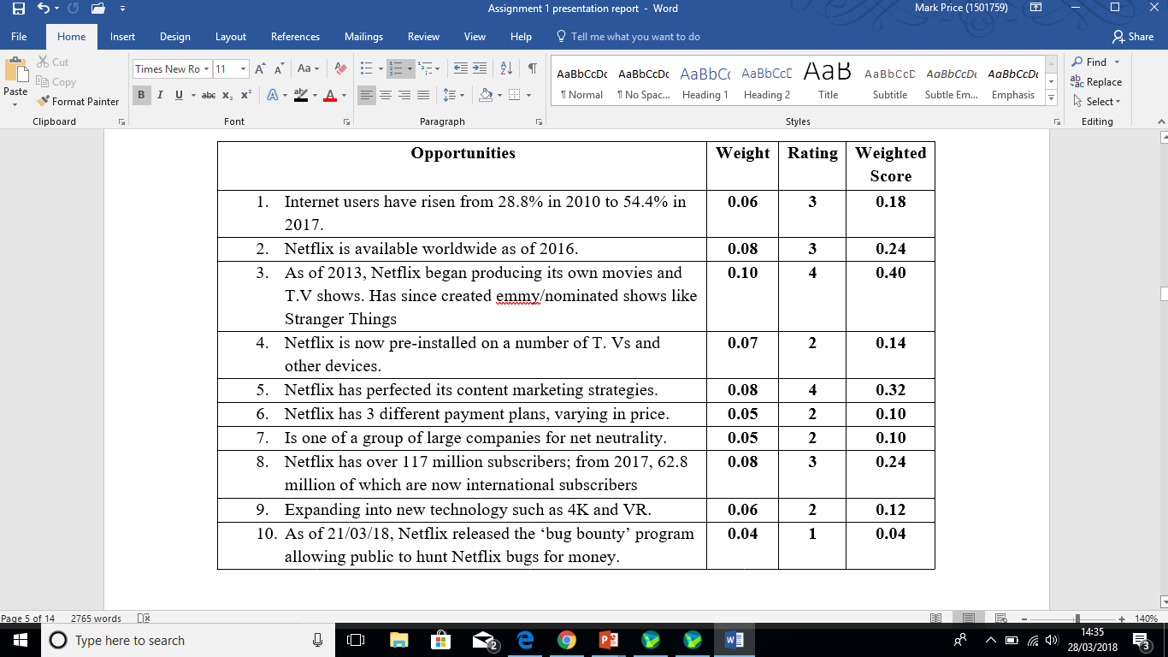
EFE
2018
2011

Slide 4
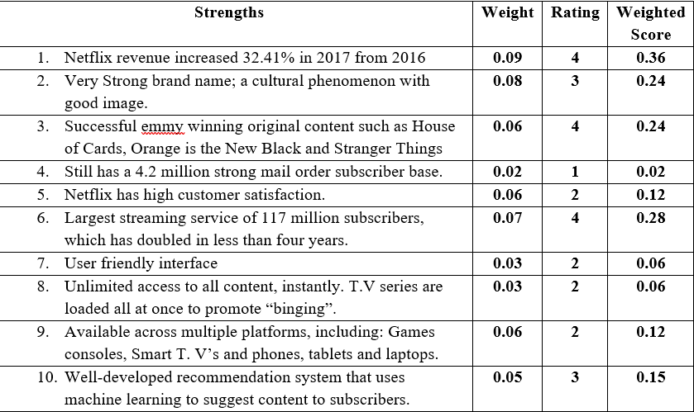
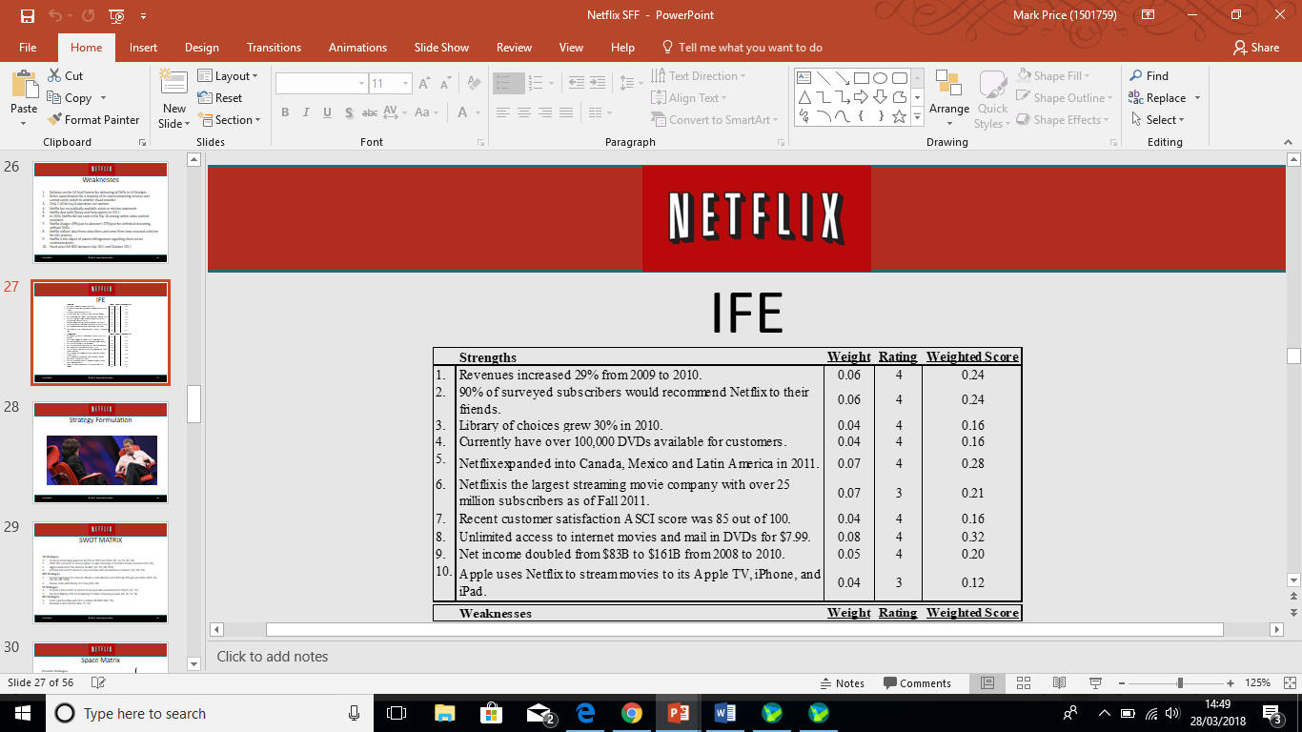
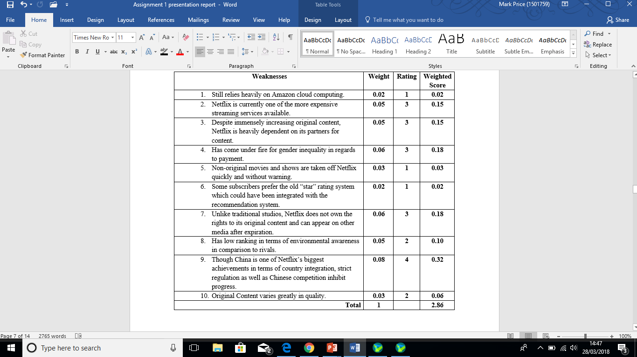
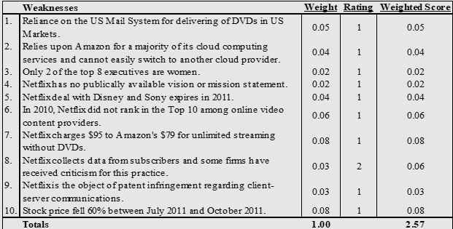
IFE
2018
2011

Slide 5
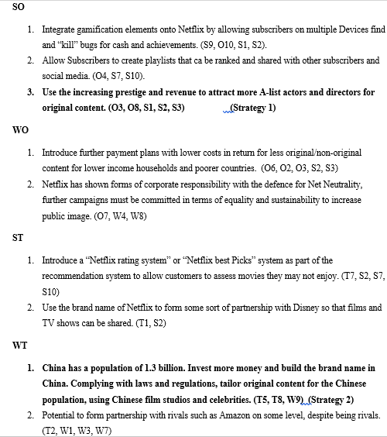
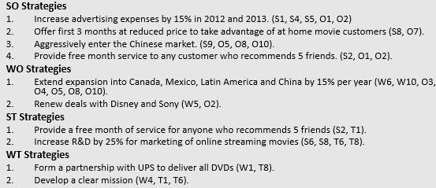
Stage 2 - TOWS
2018
2011

Slide 6
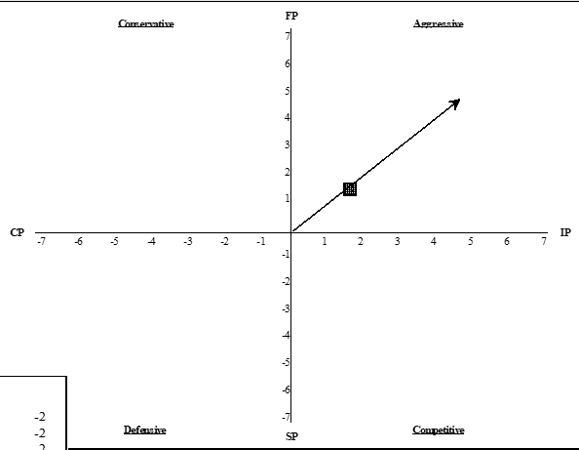
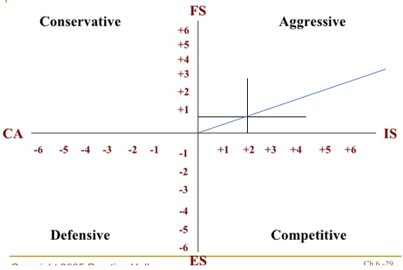
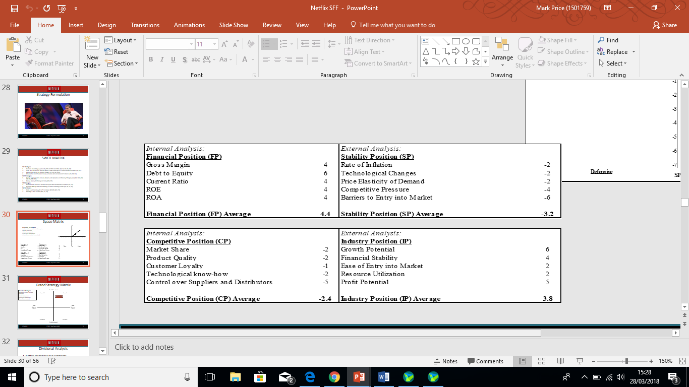
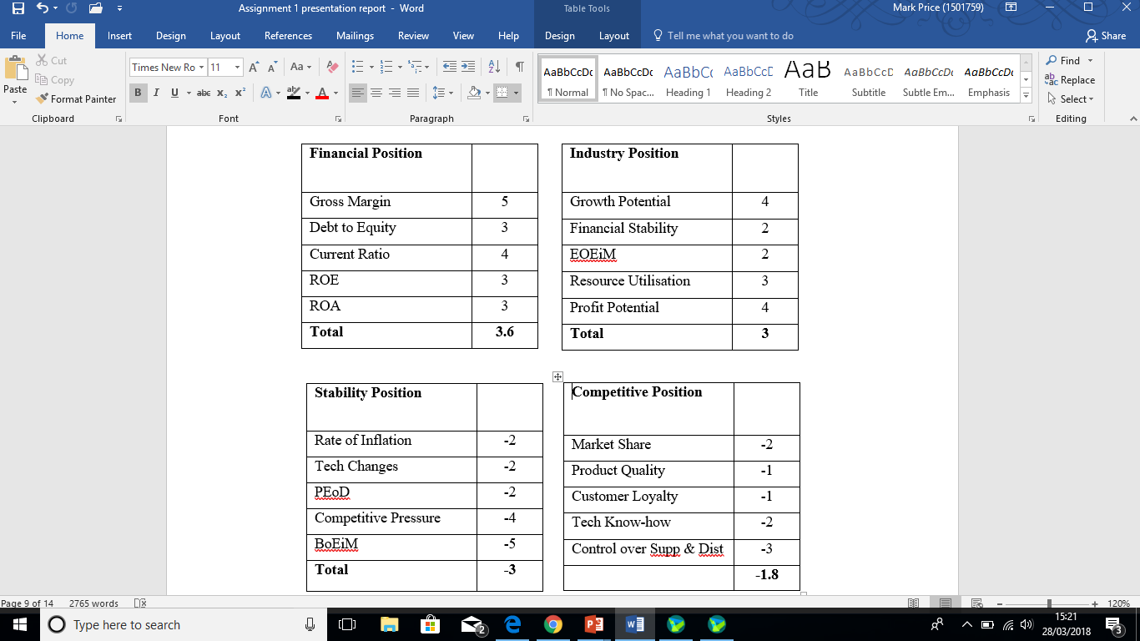
Space Matrix
2018
2011

Slide 7
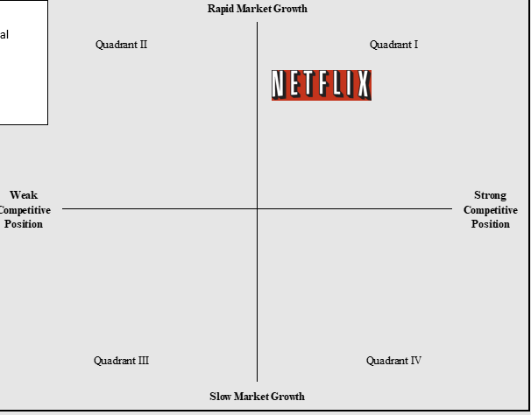
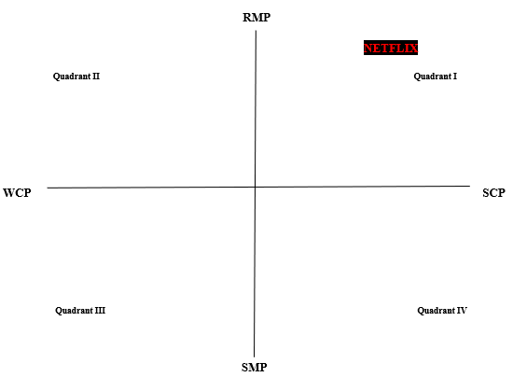
Grand Strategy Matrix
2011
2018

Slide 8
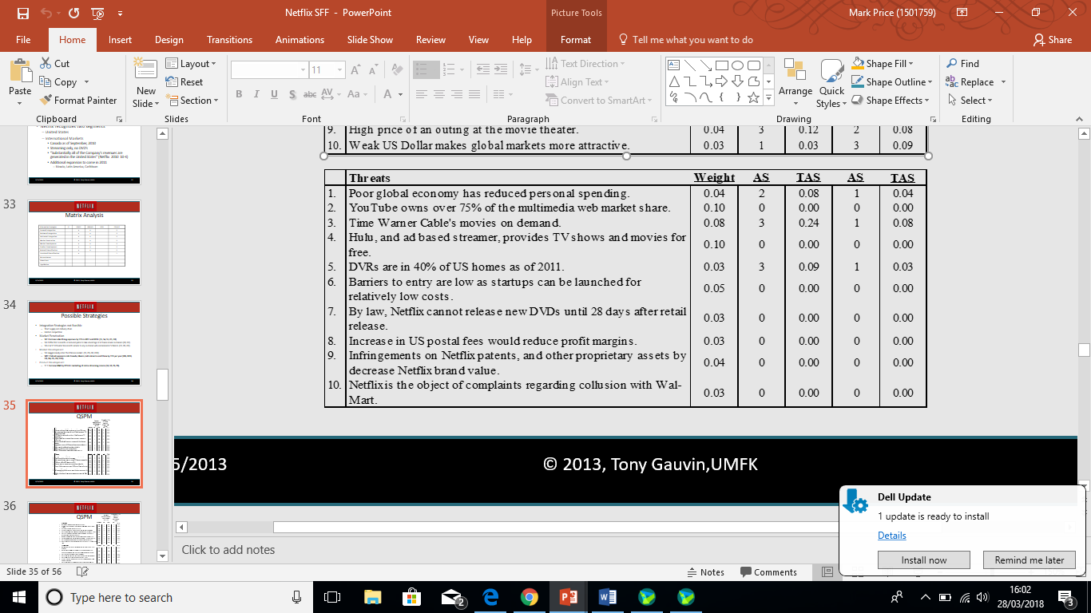
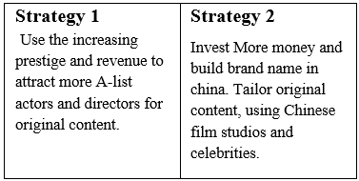
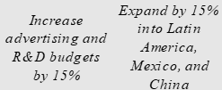
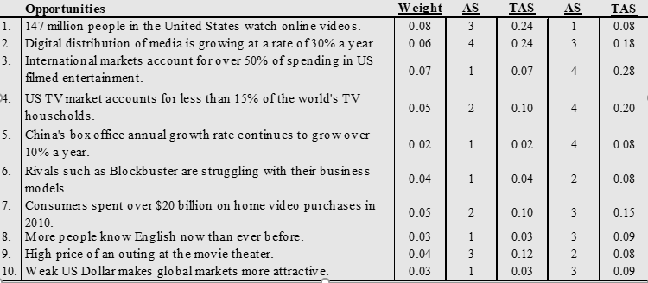
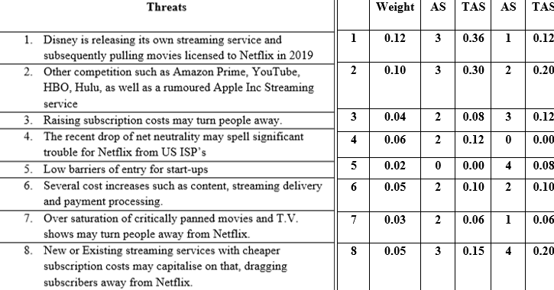
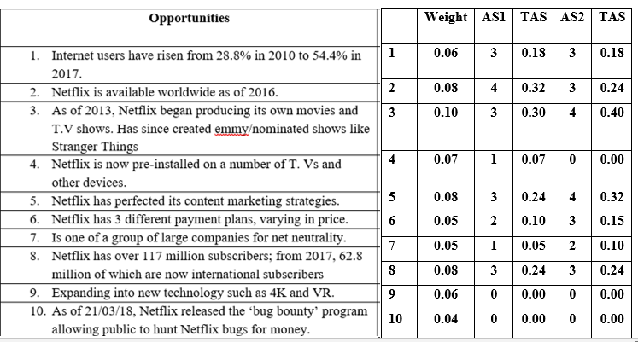
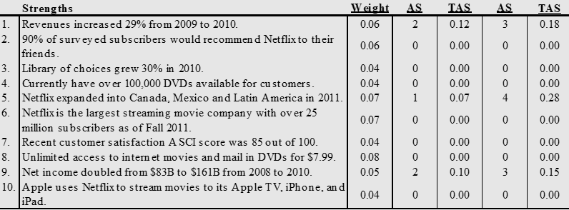
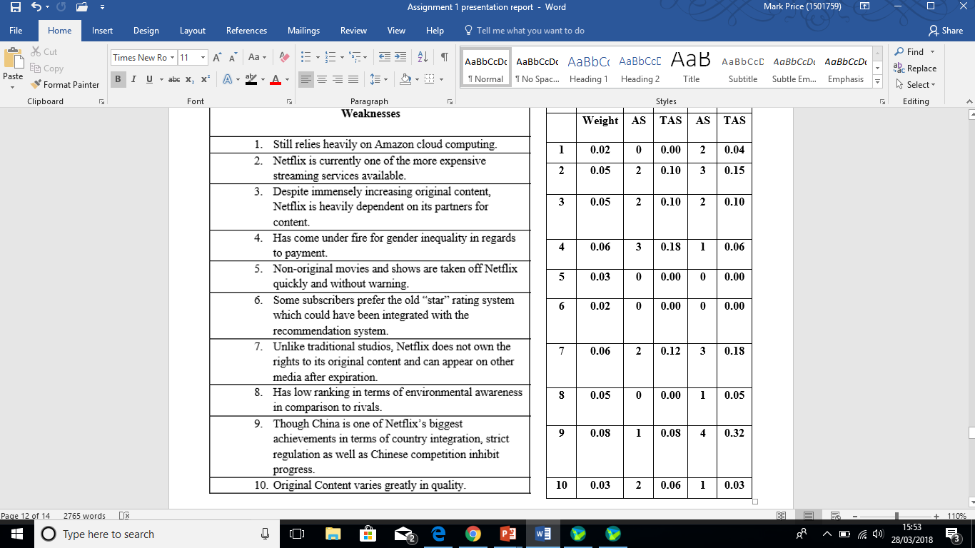
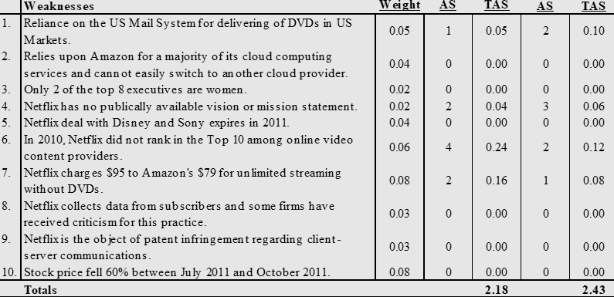
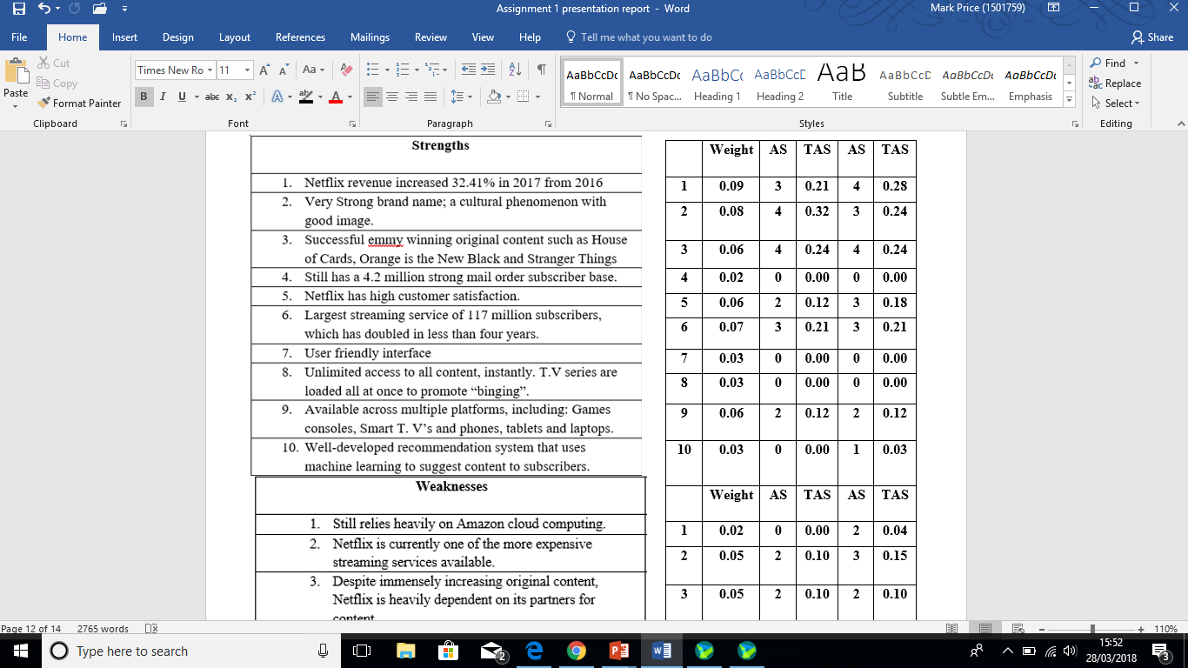
Stage 3 - qspm
2018
2011

Slide 9
Evaluation of Sff
Netflix has expanded massively over the seven years since the previous SFF.
It has become far more aggressive, constantly evolving itself and staying ahead of the game.
Vertical integration is Netflix’s main approach evident from the decision to produce and distribute its own content.
Evidently, the objective ‘Get Big Fast’ still applies to this day.
Advantages
It is a great tool for mapping out and visualising strategy at every stage of the process.
Strategies can be simultaneously evaluated.
A QSPM makes internal and external factors less likely to be overlooked as well as being able to draw attention to relationships that affect strategy decisions.
Limitations
An SFF is mainly subjective; If SFF is carried out by in-house personnel, Persaud et al (2016) suggests that this carries the limitation of bias, resulting in the compromise of credibility in the process.

