Slide 1
In the field
Fieldwork in Bore, Kenya

Slide 2
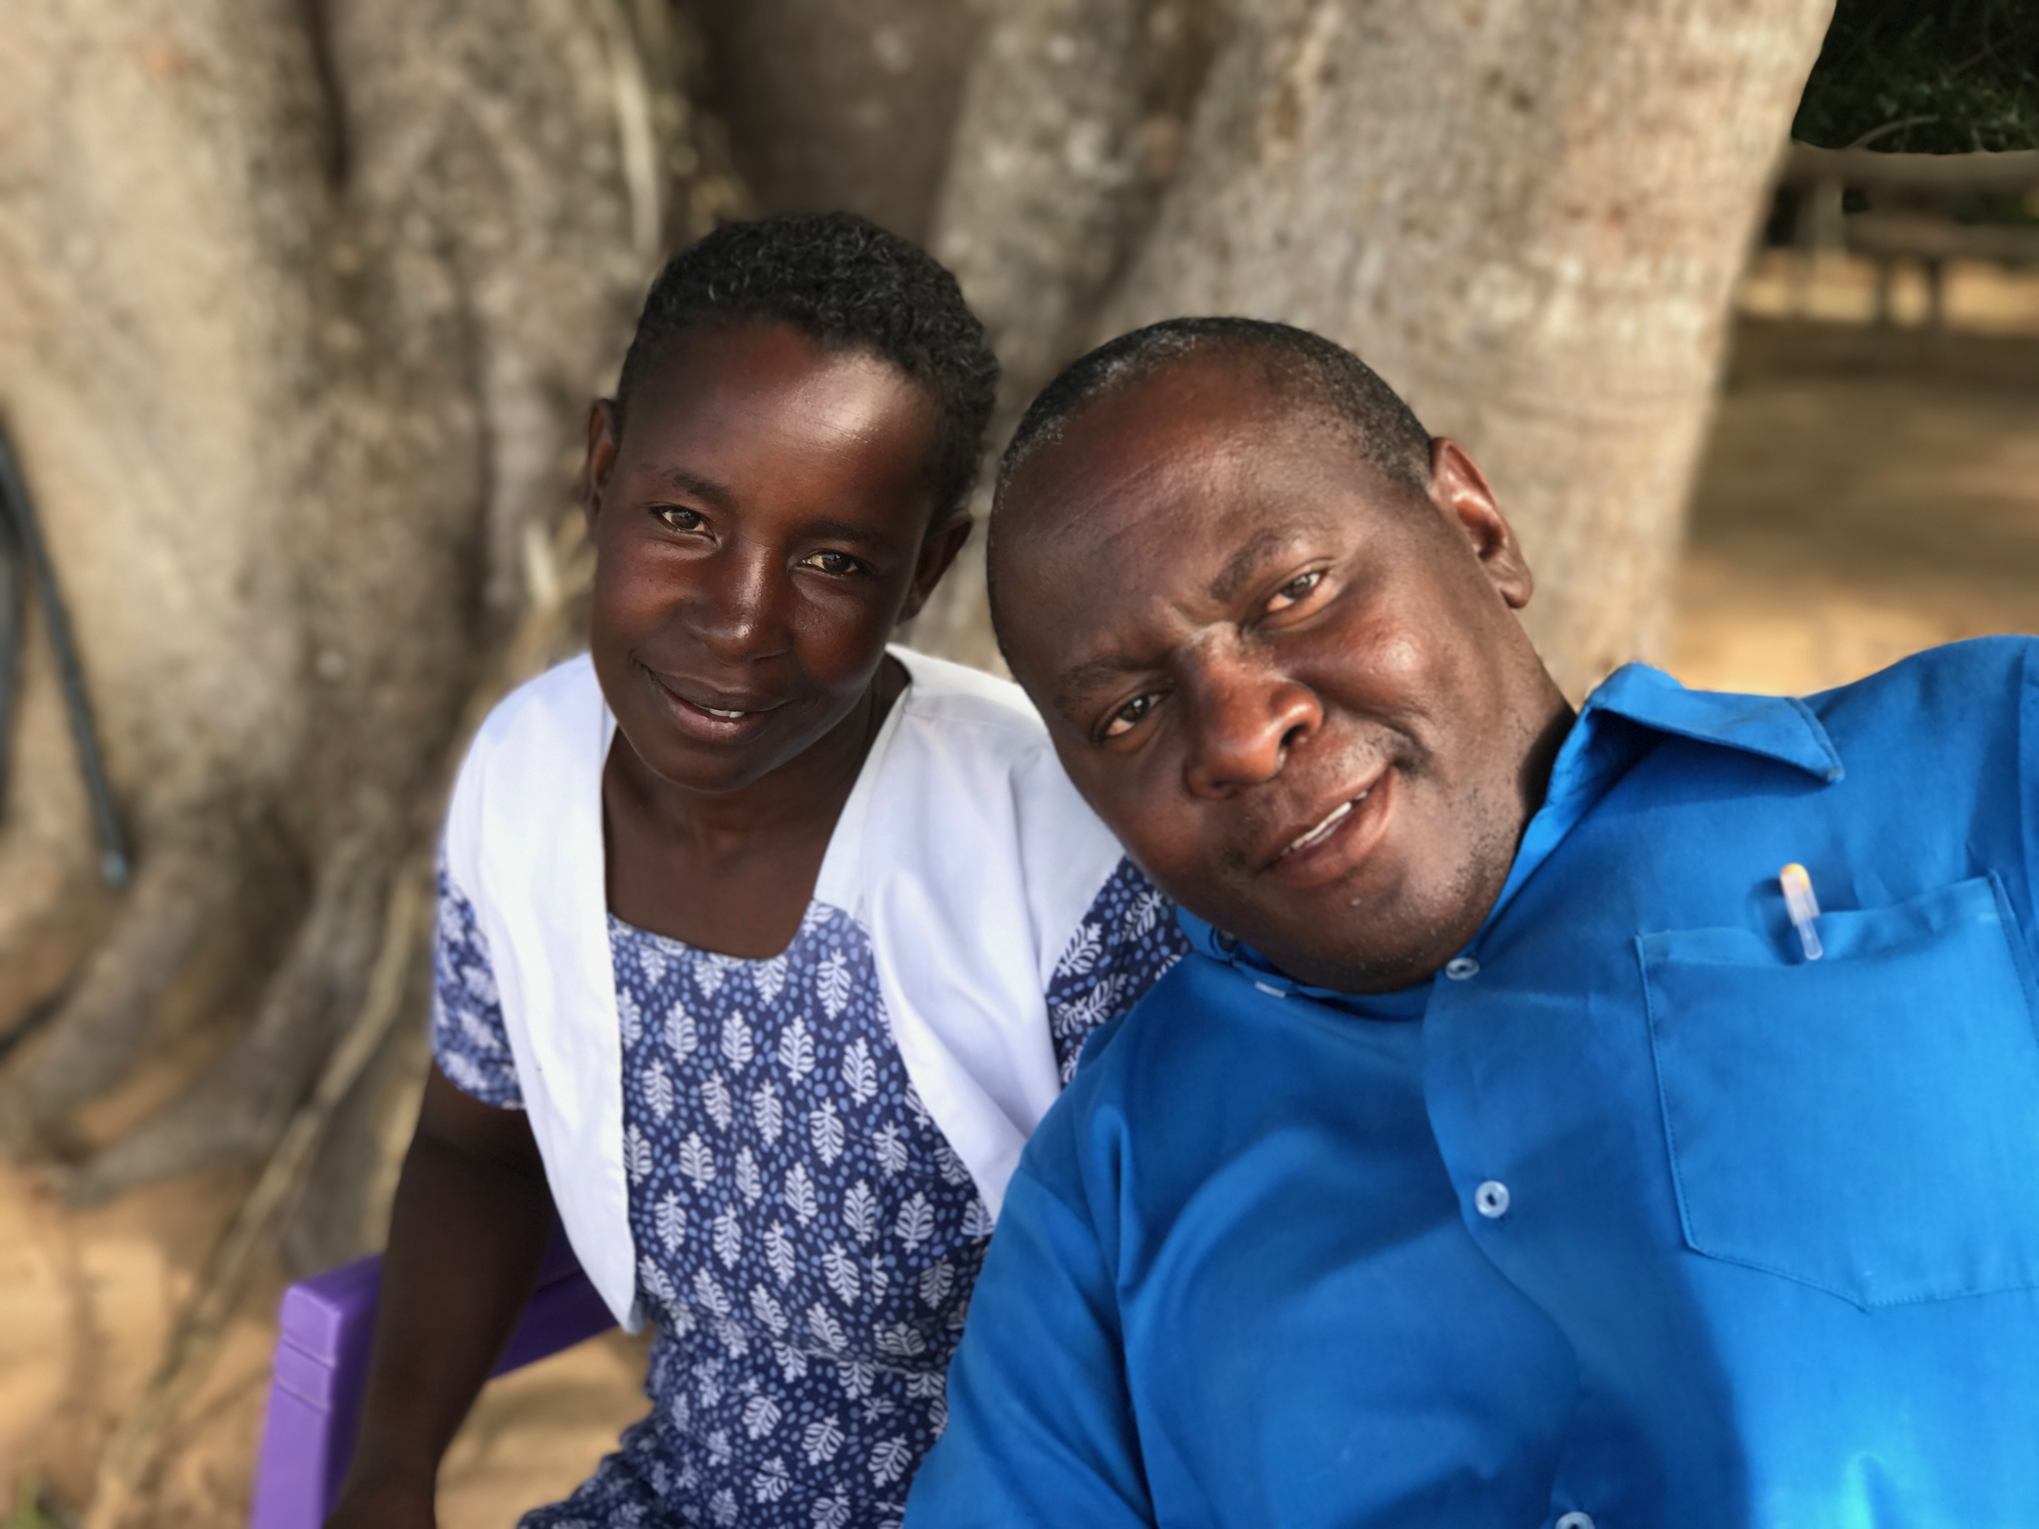
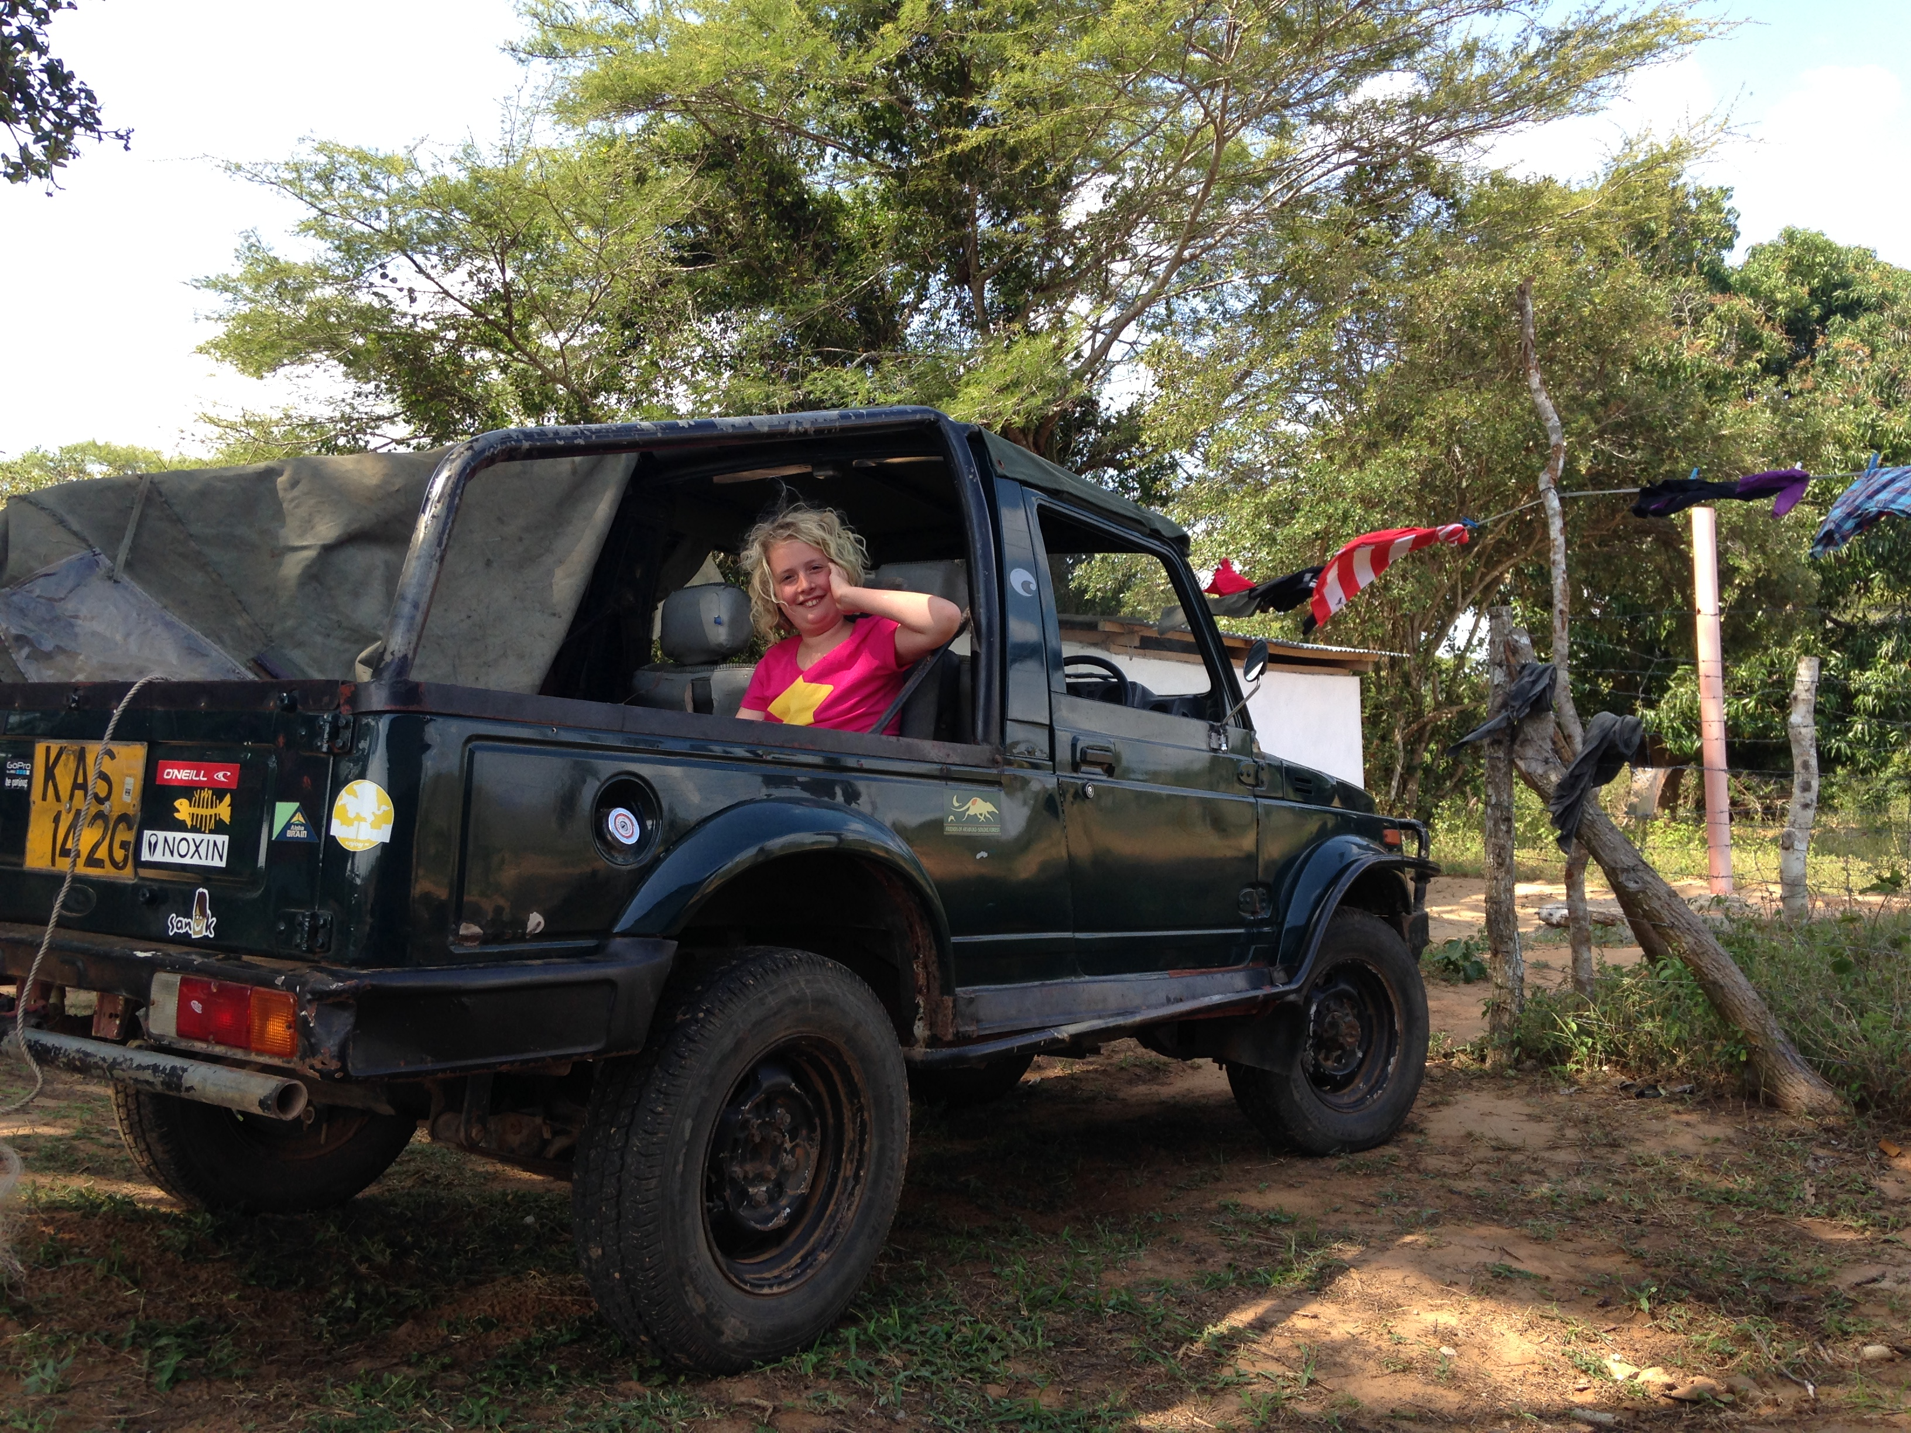
Travel details
London – Nairobi then Nairobi – Mombasa.
Alex will meet you at Mombasa and take you to Bore.
Drive time, approx. 2½ hours
Alex Katana and his wife Loice
Winston – my car, with Al in it!

Slide 3
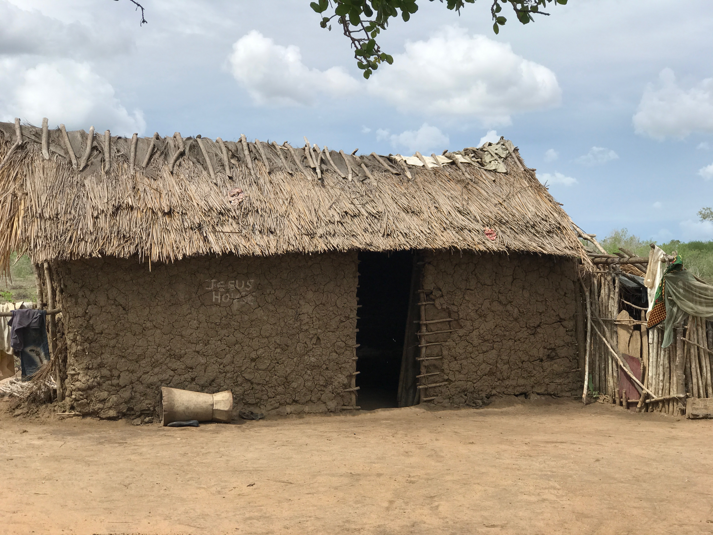
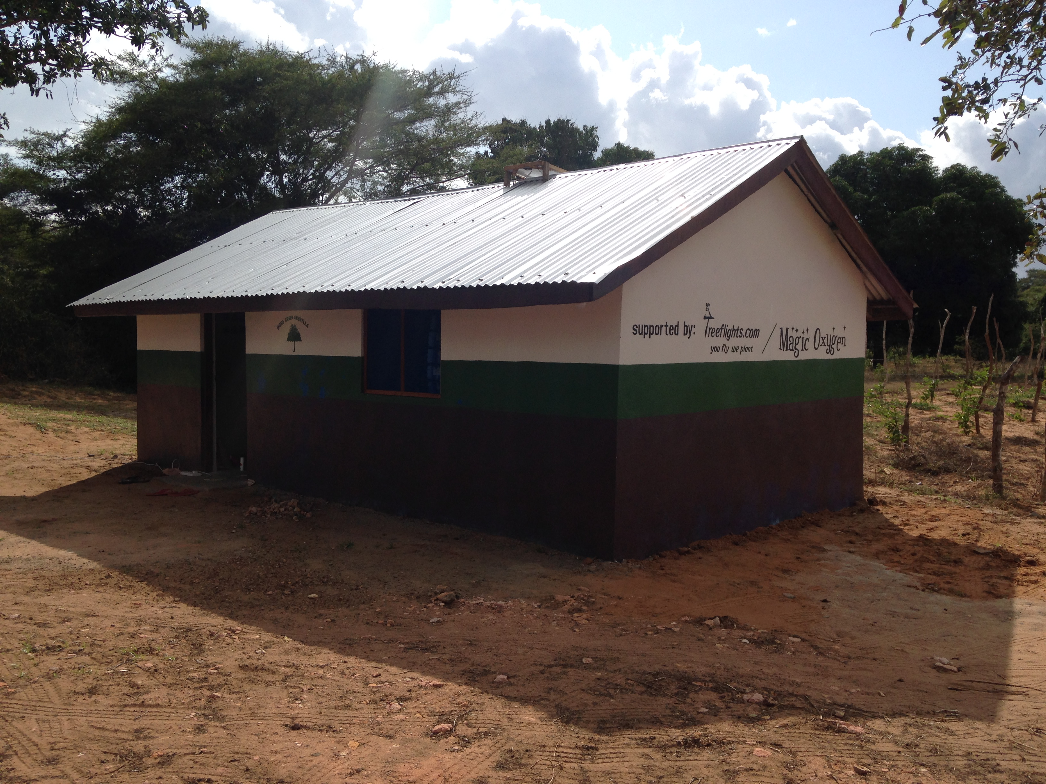
Accommodation

Slide 4
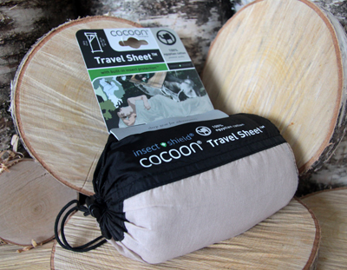
Sleeping – is going to be uncomfortable
Most people sleep on the earth or mats. You will have a foam mattress.
Take a thin sleeping bag but air it out and shake it before getting in it.
Air temp drops after midnight so you could get cold – add clothes.
About £25
http://www.traveloutdoors.co.uk/cocoon-insect-shield-travel-sheet/

Slide 5
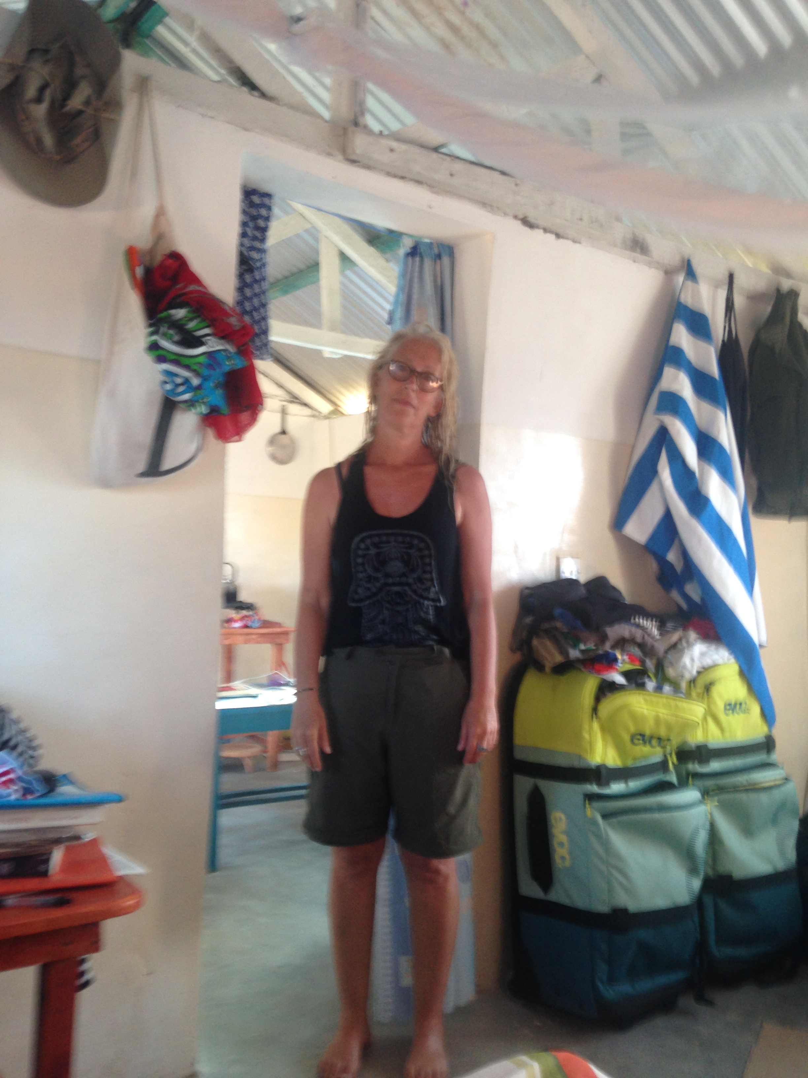
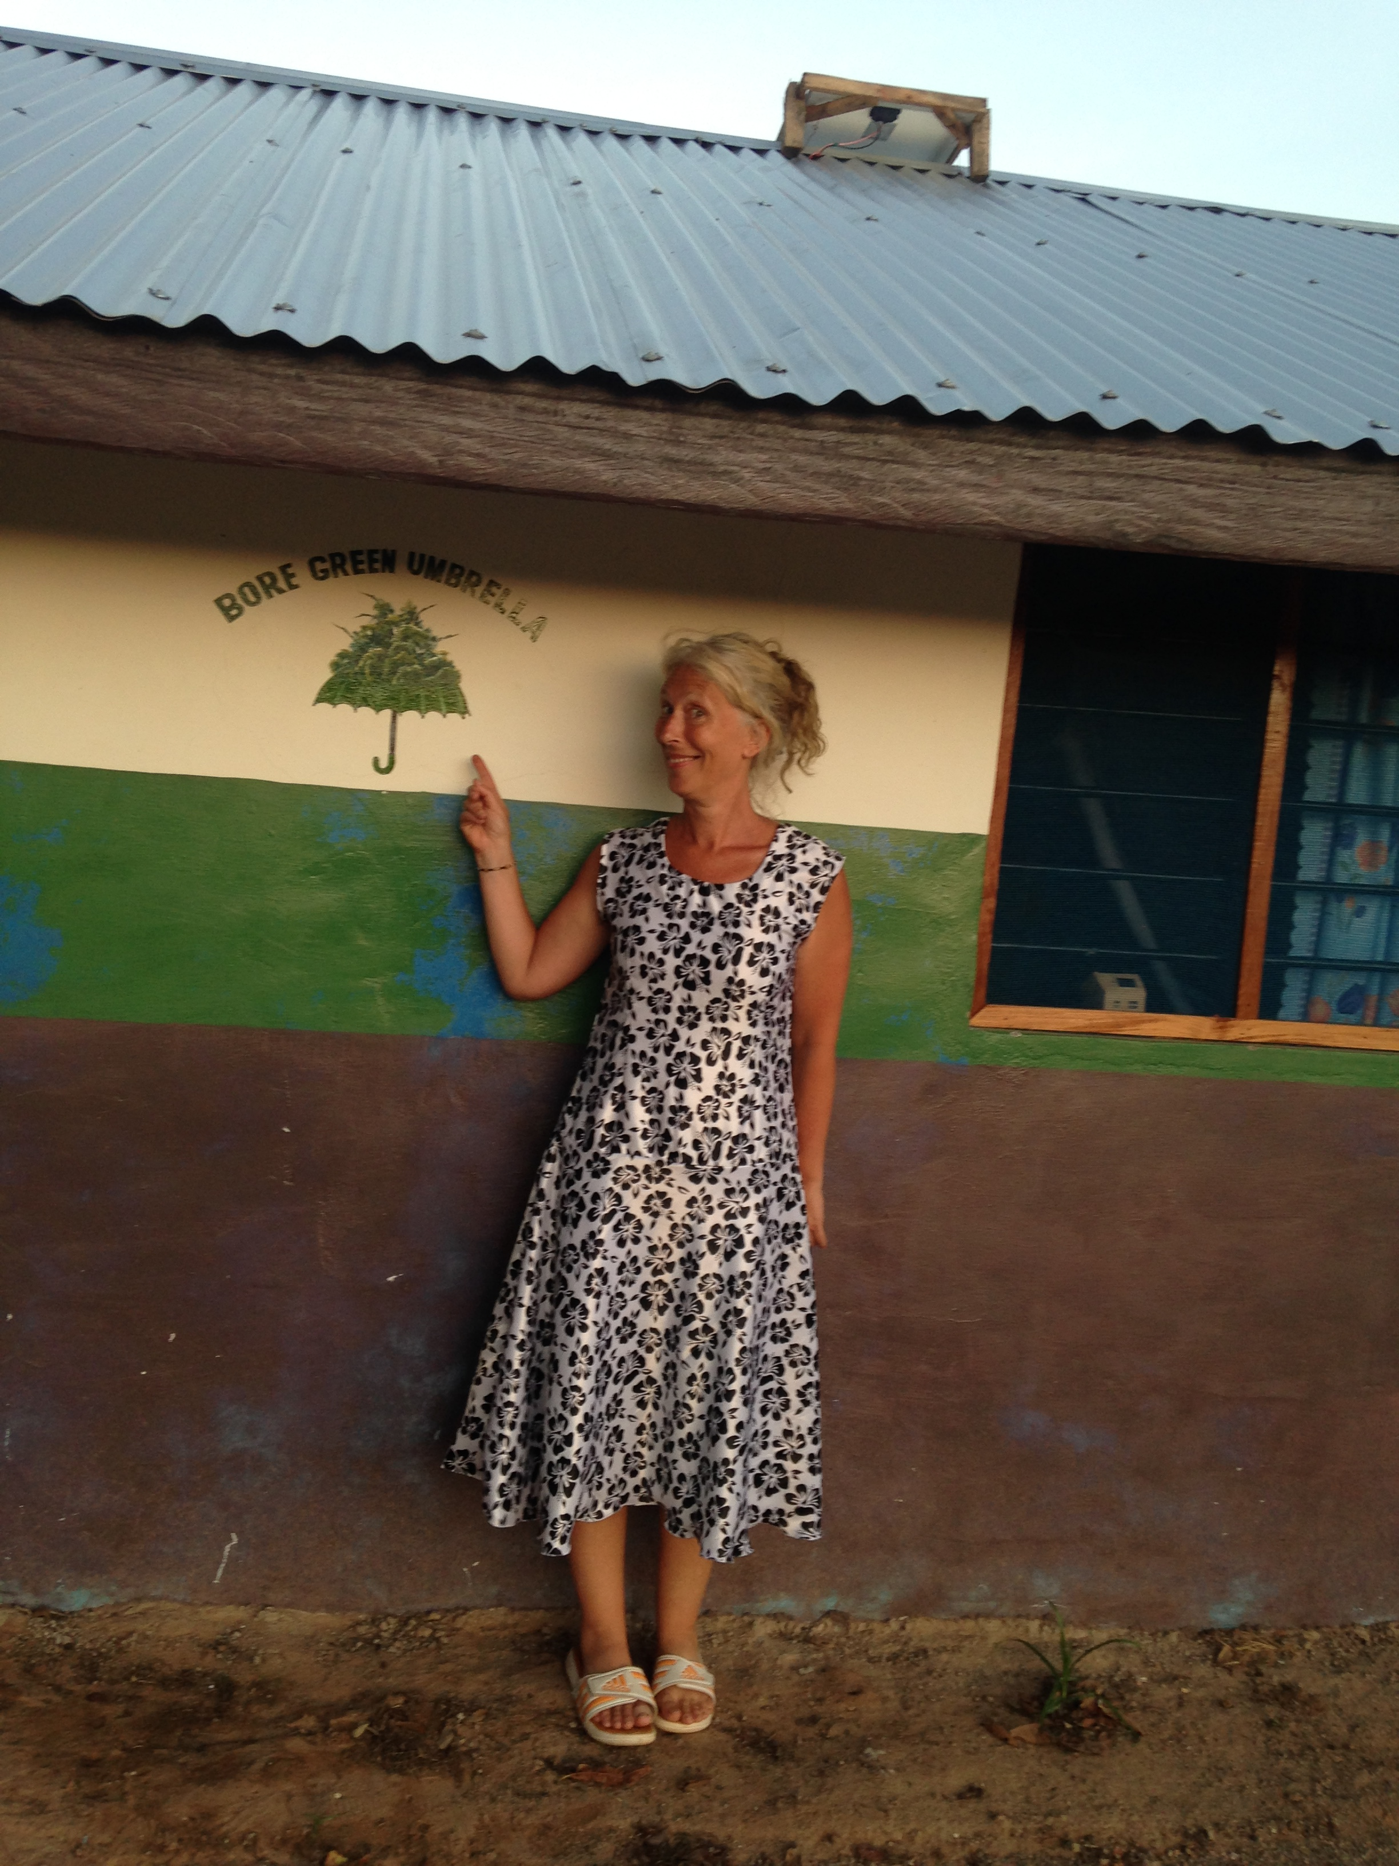
Clothing
Comfortable, cotton T shirts and shorts/trousers
Flip flops – insects can’t hide in them
Straw/cotton hat for shade
Glad rags for church

Slide 6
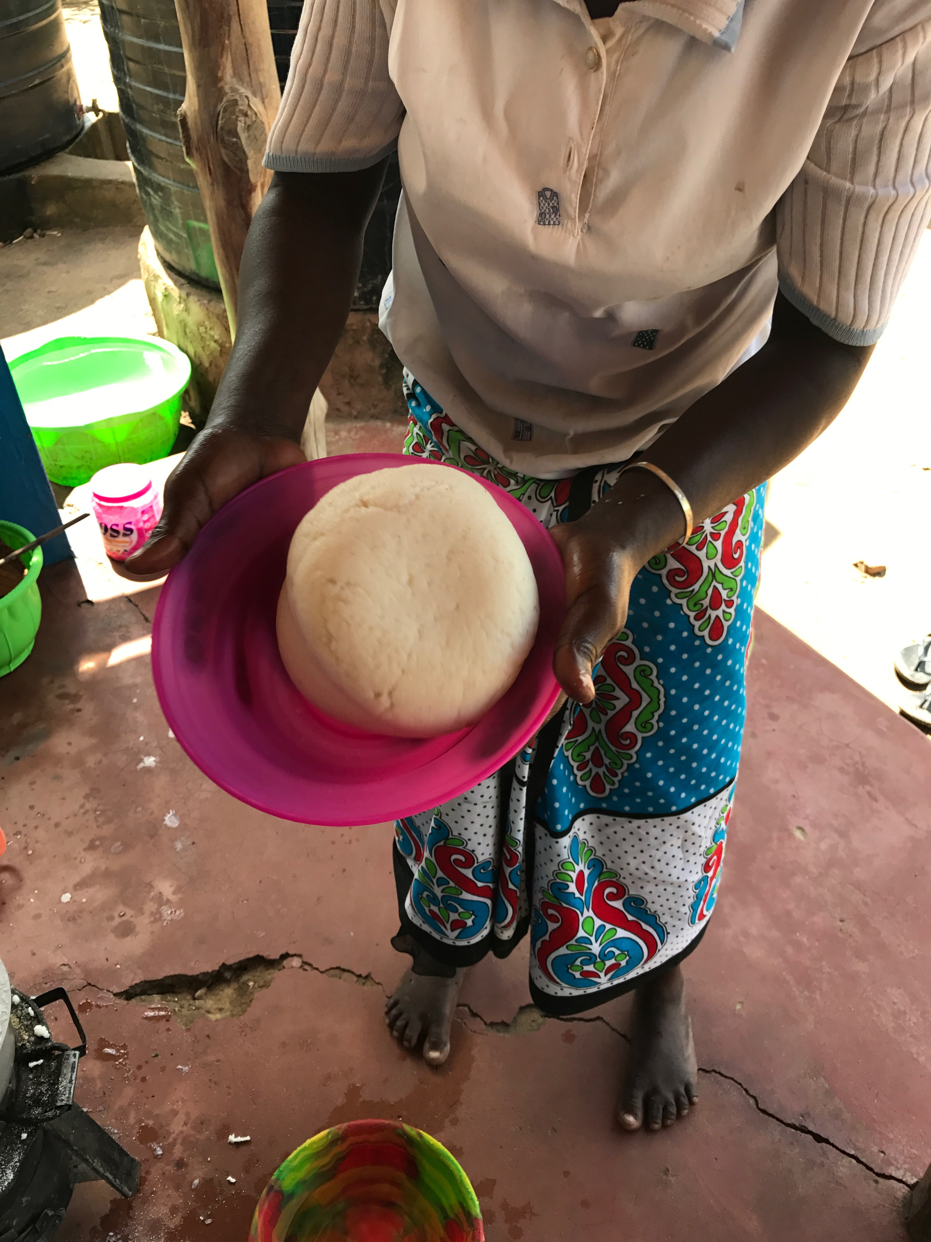
Food and drink
Staple food – Ugali (maize flour ’pudding’, with ‘relish’
Relish is leaves or fried onion and tomato
Only drink tap water…
There is one small shop that sells a few things – flour, headache pills, oil, sugar – in Bore.
Near the shop is a roadside café. They sell chapattis, chai and githeri. It’s the nearest ‘McDonalds’. Not open all day but they do deliver!
Nearest town = Garashi, 3 km

Slide 7
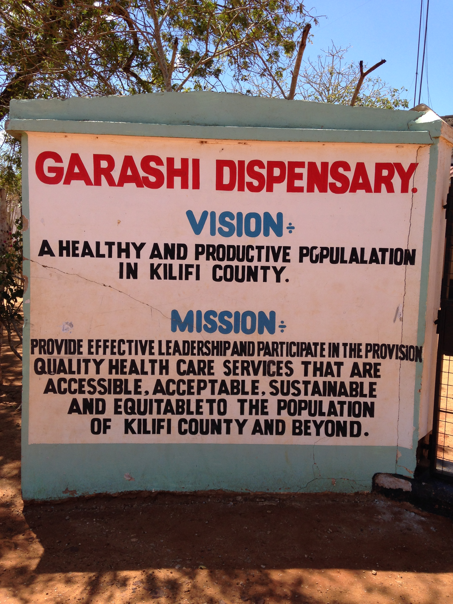
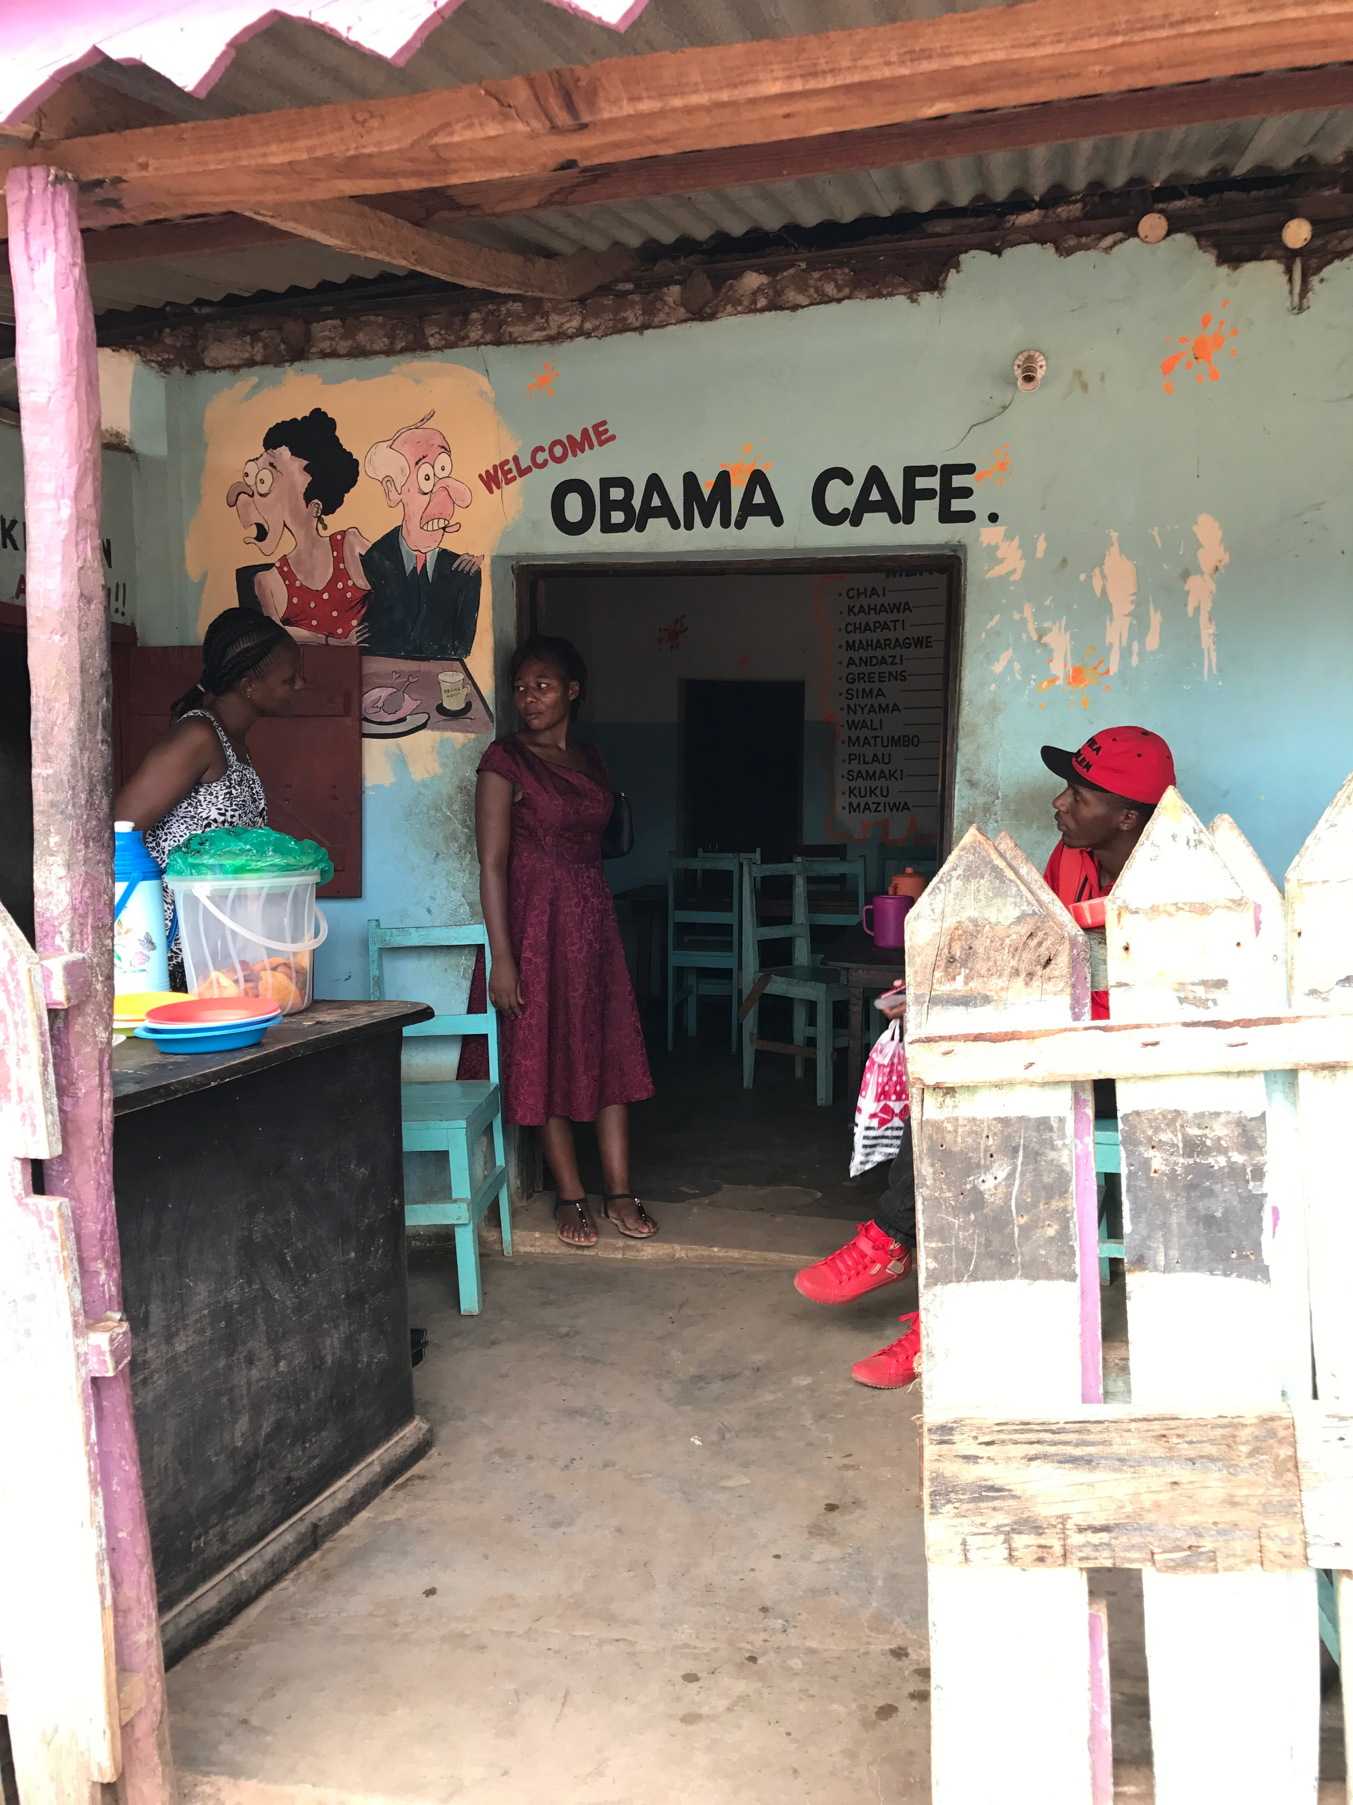
Garashi
Health dispensary/clinic where you can get antibiotics over the counter
Shops including – internet access, basic staples, fresh fruit and veg, baked goods (doughnuts, biscuits, cold drinks and crisps)
And cafes…

Slide 8
Travel light
Pack as little as possible – think practical and comfortable
Rubbish is burned so avoid taking items that can’t be disposed over ecologically.
Don’t take ANY plastic bags. Plastic bags are illegal in Kenya and can incur fines.
Alex has charging kit but don’t rely on him to charge kindles, phones etc. Use sparingly
Take pens and paper – for your journal
Have families of your home and family to show them.
Make sure you have a supply of necessary medicines, sanitary protection etc.
Take Mosiguard – there will be mosquitos at NIGHT only.

Slide 9
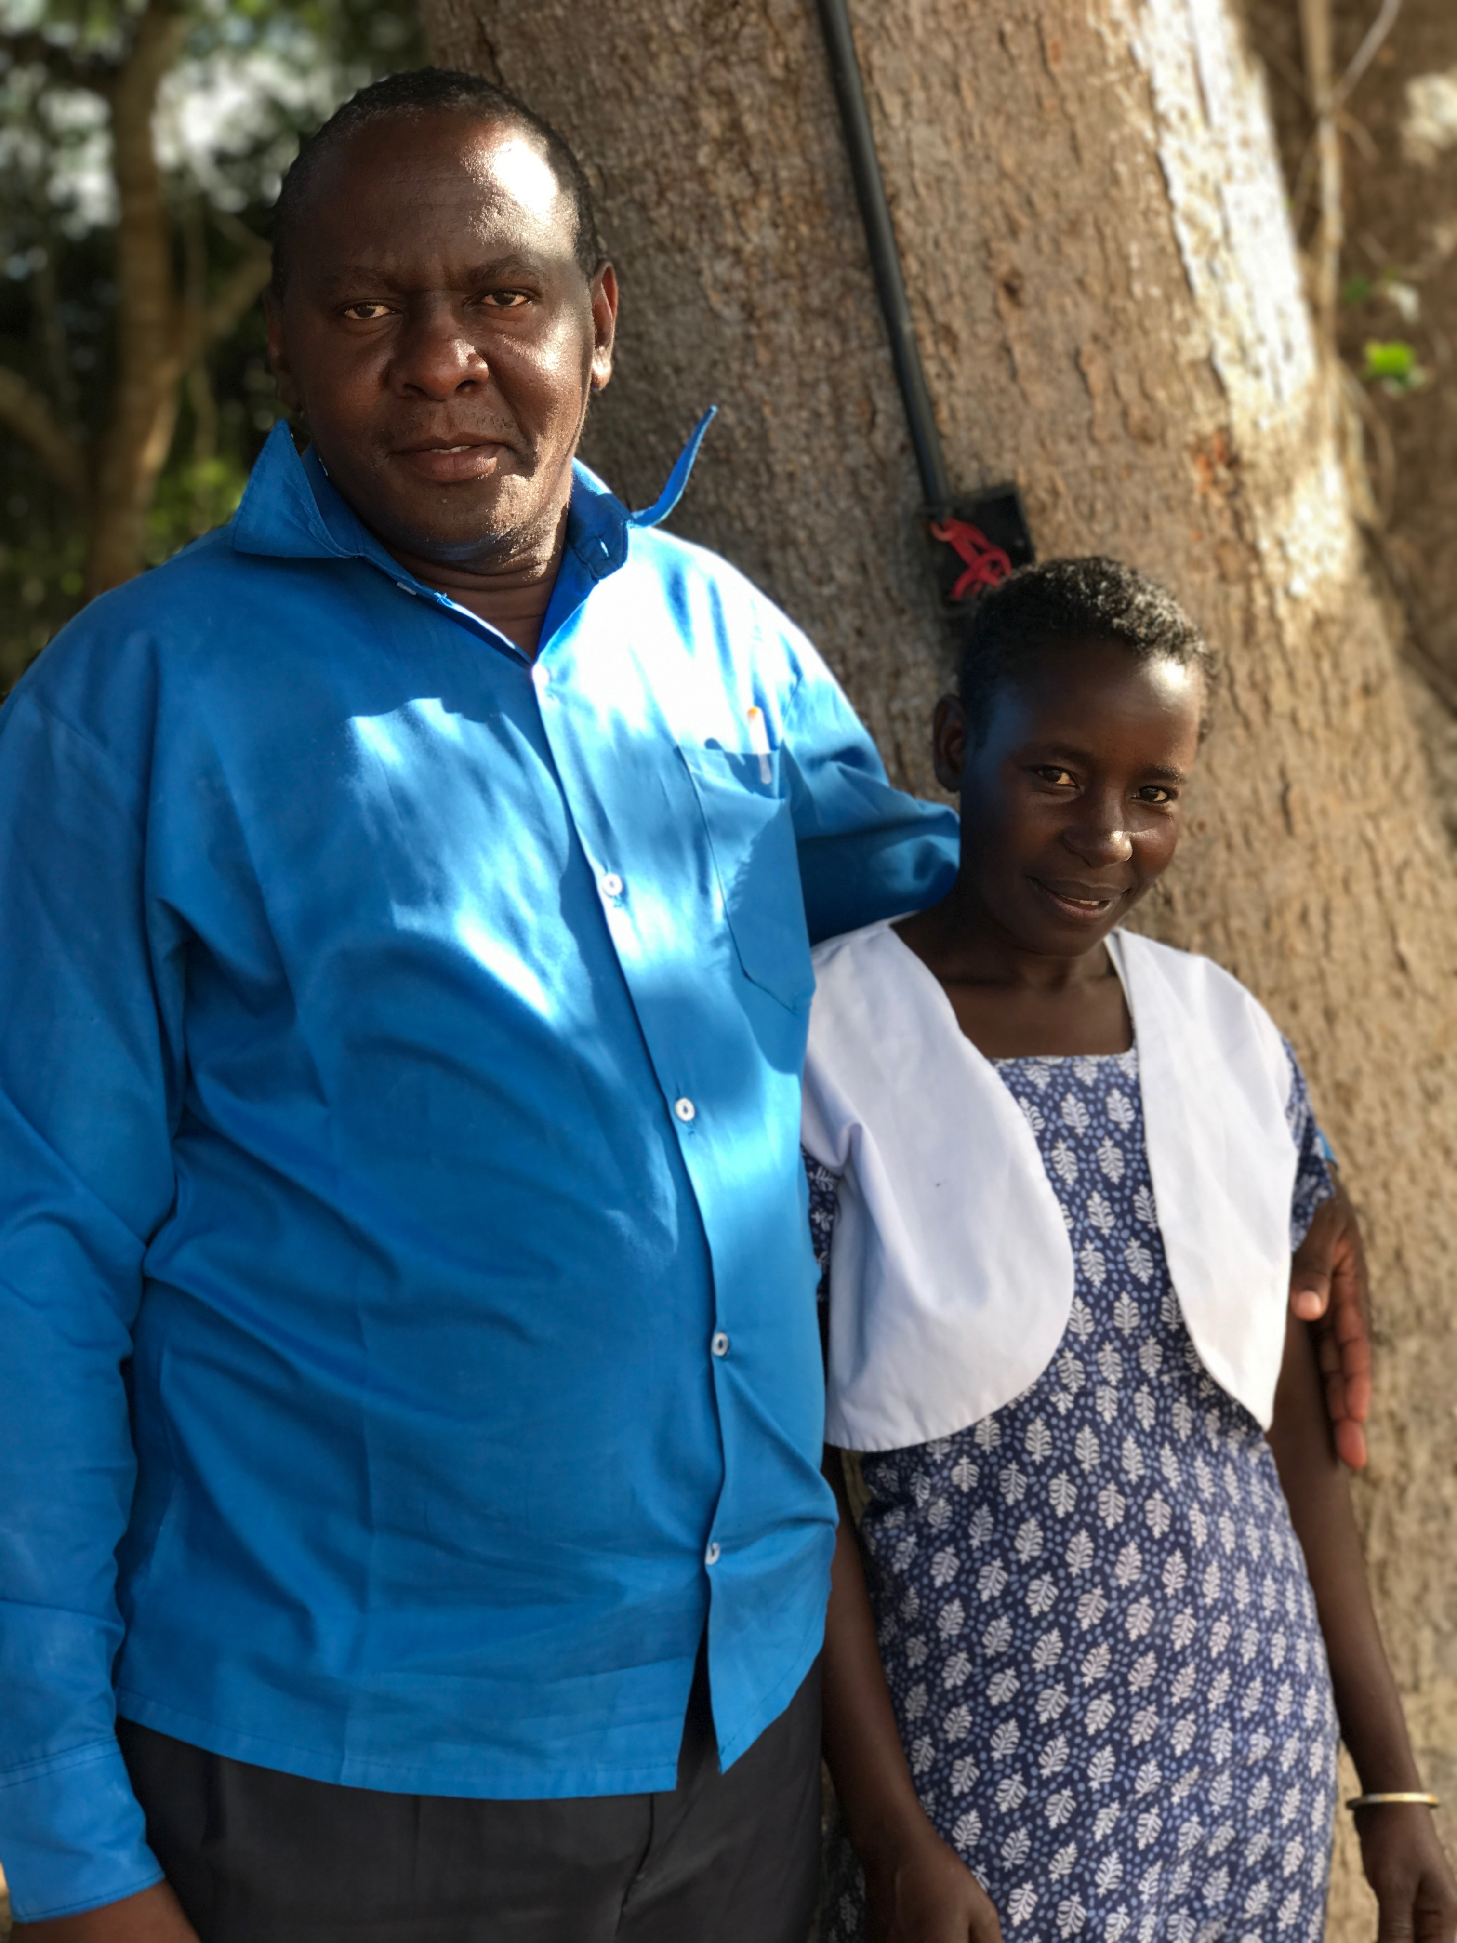
Language
Kenyans speak Swahili, English and their tribal language.
Most people can understand English in Bore – all except the very young and very old – have been taught English in school. However, you must speak slower than normal and carefully at first so that they can get used to your accents.

Slide 10
Greetings
First speaker
Reply
Zalam kadze – good morning
Sindadze – good afternoon
Zalam muka, sehmanya nawe – fine, and you?
Da – sinda (sehmanya nawe)
Nambola (sehmanya nawe) – I am fine (and you?)

Slide 11
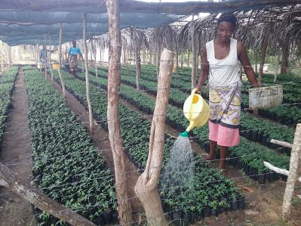
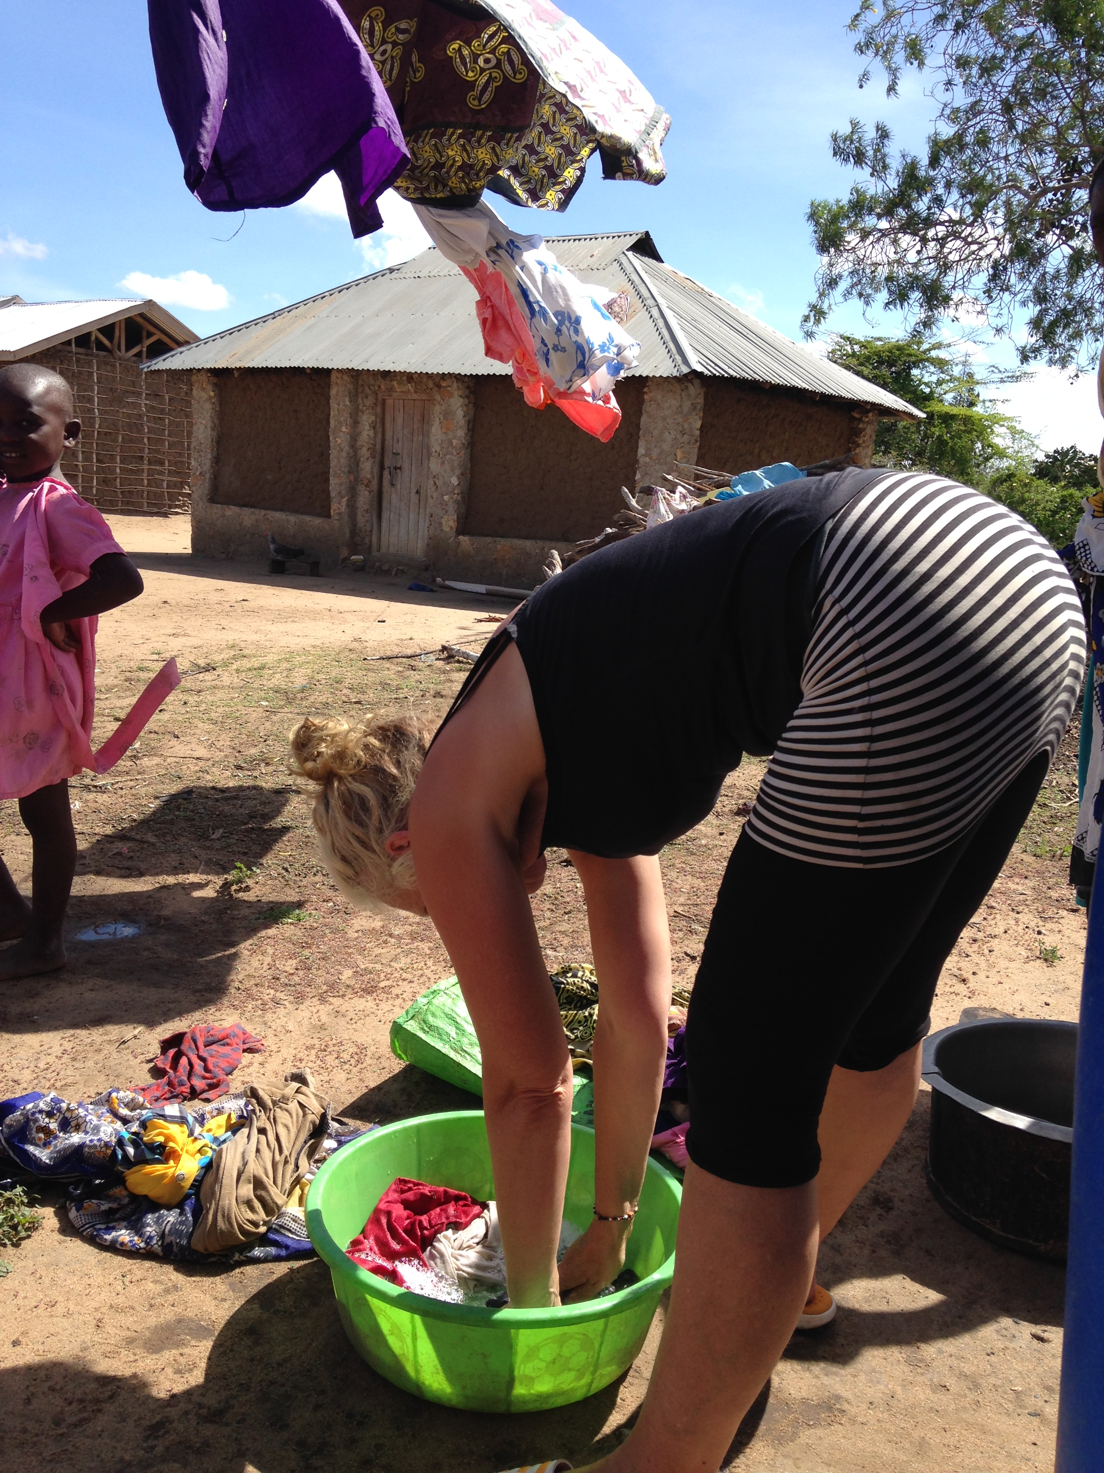
Community Carbon Link – not-for-profit
https://sites.google.com/site/communitycarbonlink/home
Activities -
  Working in the tree nursery
  School – Kundeni
  Daily chores: collecting water, firewood, preparing food, washing clothes, sewing
  Daily journal

