Slide 1
Academic Skills
Critical Thinking Skills

Slide 2
Today, we’ll look at:
What is critical thinking?
Critical thinking when reading
Logical and critical thinking

Slide 3
Activity 1
Label each statement on the next slide with Fact (F), Wrong (W) or Opinion (O)
Fact: what can be proven to be true
Opinion: a personal belief
Wrong: what can be proven to be untrue

Slide 4
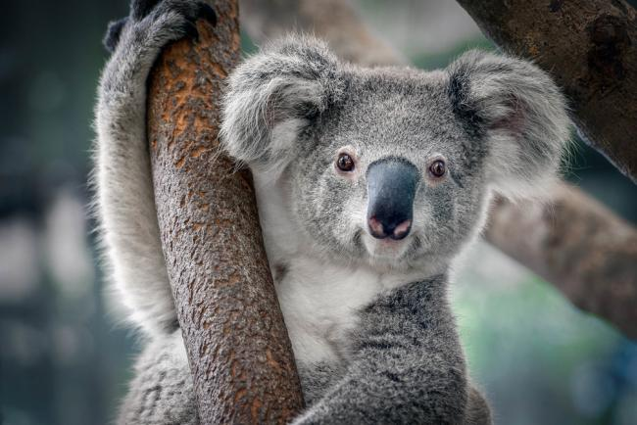
Activity 1
The koala is one of the sweetest animals.
Koalas are bears.
Koalas feed on the leaves of the Eucalyptus tree. These leaves are poisonous to many other animals.
Koalas have a special digestion system that enables them to eat Eucalyptus tree leaves.
Everybody likes seeing a koala.
Koalas are found living wild in
coastal regions of eastern and
southern Australia, and in northern
India.
Image source: https://www.wwf.org.uk/learn/fascinating-facts/koala

Slide 5
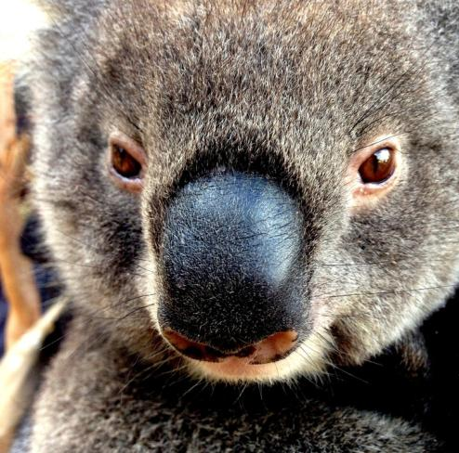
Activity 1
When people see a koala, the first thing they think of is a teddy bear.
Seeing a koala mother with her baby on a Sunday brings good luck.
People who injure or kill a koala in a road accident are brutal.
In some areas koalas are endangered, and they deserve to be protected.
Many koalas have been captured and sold to zoos overseas, but unfortunately most die within a few weeks.
Today, very few zoos and nature parks outside Australia have koalas.
Image source: https://www.wwf.org.uk/learn/fascinating-facts/koala

Slide 6
Answers
Learning to differentiate between fact and opinion is one of the basic requirements for developing critical thinking skills. In order to prove whether something is a fact or not, they might need to check by consulting the web, an encyclopaedia or other sources.
Opinion (watch out for words such as sweet, beautiful, lovely etc. These usually give evidence of the speaker’s opinion).
Wrong information (koalas are marsupials, whereas bears are placental mammals).
Fact.
Fact.
Opinion (watch out for words such as people, everybody, everywhere etc. – most times, they don’t give you precise information).
Wrong (koalas don’t live naturally in any country other than Australia).
Opinion.
Opinion.
Opinion (this could be a fact for a specific case of somebody killing a koala in a road accident, but doesn’t hold as general truth – an incident like this could happen without it being the driver’s fault)
The first part of the sentence is a fact, but the second part is an opinion (the speaker thinks that they ‘deserve’ to be protected; although most people would agree with that, it’s still an opinion).
Fact.
Fact.

Slide 7
What is critical thinking?
Critical thinking means weighing up the arguments and evidence for and against.
According to Glaser (1941), critical thinking “calls for a persistent effort to examine any belief or supposed form of knowledge in the light of the evidence that supports it and the further conclusions to which it tends”.

Slide 8
Definition
The word "critical" can mean different things in different contexts.
  it can refer to the importance of something
  It can also mean pointing out the negative aspects of something, i.e. to criticise something.
However, critical thinking at university is also about not accepting what you read or hear at face value, but always questioning the information, ideas and arguments you find in your studies.
(University of Leeds, 2020)

Slide 9
Interpreted by Cottrell (2013: 187) as:
Persistence:
considering an issue carefully, and more than once
Evidence:
evaluating the evidence put forward in support of the belief viewpoint
Implications:
considering where the belief or viewpoint leads – what conclusions would follow; are these suitable and rational; and if not, should the belief or viewpoint be reconsidered?

Slide 10
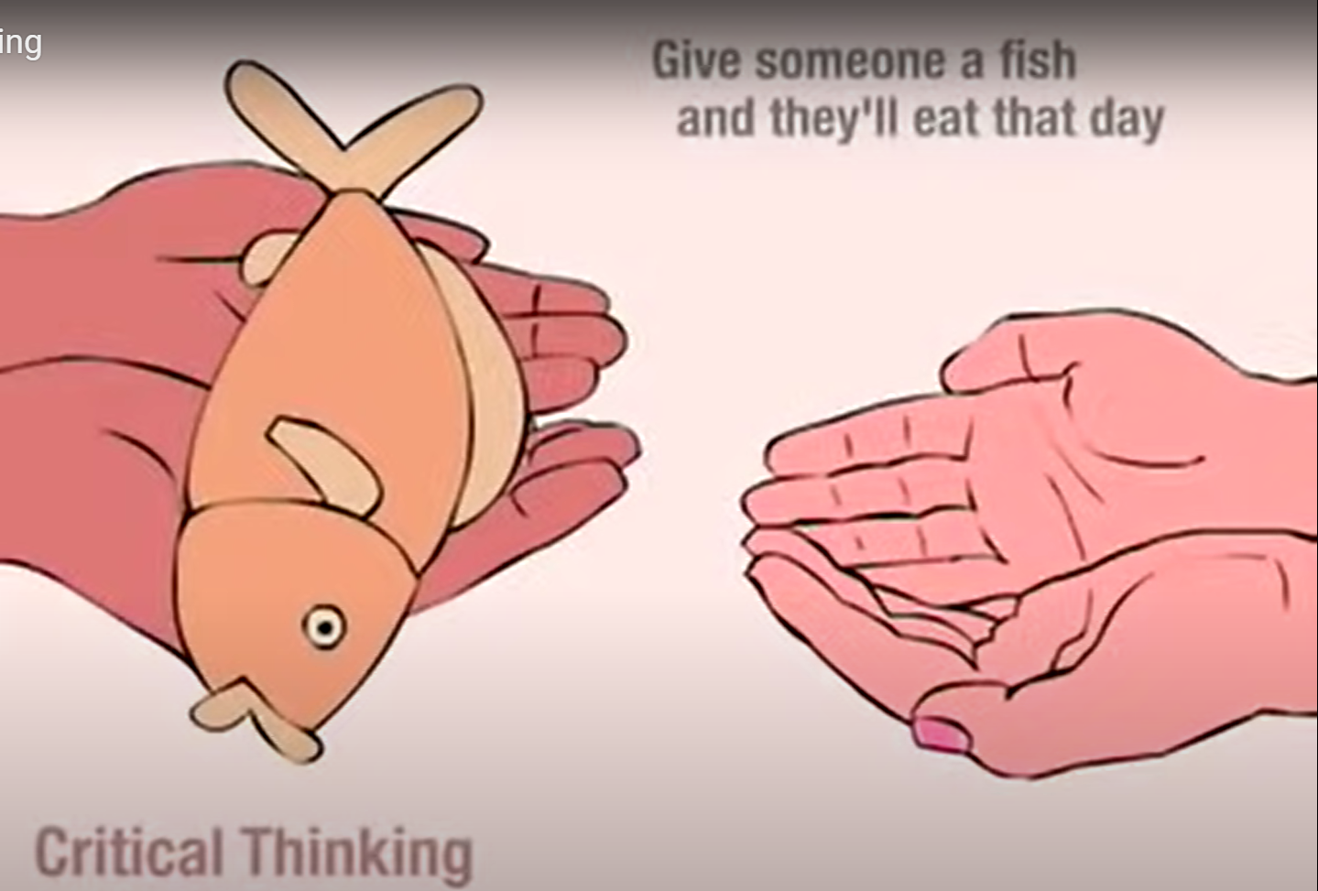
What is Critical Thinking? (Video)
https://www.youtube.com/watch?time_continue=5&v=6OLPL5p0fMg (5 mins)

Slide 11
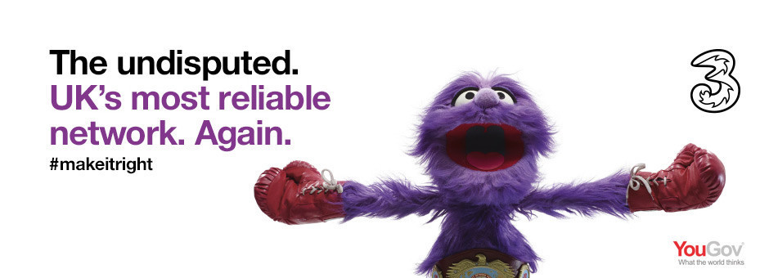
Why would EE complain to the Advertising Standards Authority (ASA) about the above advert?

Slide 12
What Three said…
YouGov logo meant that consumers would know that it’s based on the findings of a YouGov report.
Ad included a URL where further details were provided.
Copy of report ‘The Smartphone Mobile Internet eXperience (SMIX) produced in September 2015 was provided.
Consumers were asked how reliable they considered the mobile network they used in relation to a number of measures.
Three said there was no standard, objective industry test for network ‘reliability’. Three said best way to find out was to ask its customers.

Slide 13
What the ASA said…
YouGov logo was not prominent enough
Language did not make enough reference to subjective consumer views. Consumers were likely to understand that the results were based on robust objective measures of network ‘reliability’.
“The undisputed” implies commonly agreed objective measures for network reliability and that Three had scored the best against those measures and no evidence provided to the contrary.

Slide 14
The result…
The ad must not appear again in its current form. We told Hutchinson 3G UK Ltd t/a Three not to state or imply that Three was undisputedly the UK’s most reliable network unless they could demonstrate that there were commonly agreed objective measures for network reliability, that Three had scored the best against those measures, and that there was no other evidence to the contrary. We also told them not to state or imply that Three was the UK’s most reliable network unless they made clear that the claim was based solely on a survey of consumer opinions.

Slide 15
Chicago Town Pizza
https://www.youtube.com/watch?v=kI-okUd-_Vg

Slide 16
What Chicago Town Pizza said…
Sample comprised of 170 respondents from across the UK and Ireland
All respondents regular buyers of both frozen and high-street takeaway pizza for in-home consumption
Sample balanced by age, gender, and social class
Independent market research company
Question ‘Please have a look at the information shown for each of the three different pizzas you’ve tried today and tell us based on DESCRIPTION, PRICE and TASTE which one you would be most likely to buy?” (brand name was not mentioned)
Only pepperoni pizza and packaging was seen in ad made clear that the claim related to that product only as well as ‘1 flavour’ reference
Did not believe head-to-head claim (clarified by on-screen text mention of third competitor)
‘Voted’ – based on the personal opinions of consumers.

Slide 17
What the ASA said…
https://www.asa.org.uk/rulings/dr-oetker-uk-ltd-a14-262667.html#.V-ziJmZTG71

Slide 18
Critical thinking at university
A key skill that should be applied to all aspects of your studies.
You need to be able to think critically about the resources and information you use in your work.
You need to ask the right questions when reading the work of others; your writing needs to show you have the ability to weigh up different arguments and perspectives and use evidence to help you form your own opinions, arguments, theories and ideas.
Critical thinking is about questioning and learning with an open mind.
(University of Leeds, 2020)

Slide 19
Critical Thinking when reading
Identify the line of reasoning
Critically evaluate the line of reasoning
  Look for:
  Relevant, contributing and sufficient propositions
  Logical progression
  False premises
  Flawed reasoning
  (Cottrell, 2013)

Slide 20
Critical Thinking when reading
Question surface appearances and check for hidden assumptions or agendas
Identify evidence in the text
Evaluate the evidence
  Use valid criteria to evaluate evidence: dates of research, sources of information, bias, statistics, conditions of data collection, emotive language etc.
Identify the writer’s conclusions
Evaluate whether the evidence supports the conclusions
  Check for hidden false assumptions

Slide 21
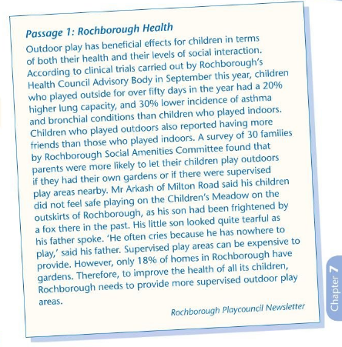
Identify the line of reasoning.
Critically evaluate the line of reasoning.
Question surface appearances and check for hidden assumptions or agendas.
Identify evidence in the text.
Evaluate the evidence according to valid criteria.
Identify the writer’s conclusion.
Decide whether the evidence given support theses conclusions.

Slide 22
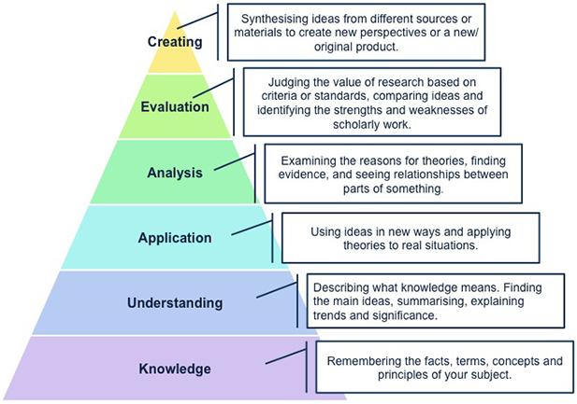
Bloom's Taxonomy of Intellectual Behaviour - or the thinking you need to do at university*
The pyramid shows the levels of thinking skills expected at university in all disciplines of study.

Slide 23
Bloom's Taxonomy of Intellectual Behaviour
The top three intellectual behaviours
Analysis, evaluation, and creating are considered higher levels of thinking and help us to demonstrate our critical thinking.
Analysis refers to the process of examining the parts of a whole, the causes and results of events, and the differences between phenomena.
  E.g. an economics student may be asked to analyse the causes of the global financial crisis of 2008-2009. To get a high mark, the student would have to do more than describe what happened. He/she would be expected to name the main factors, explain which of these were the most important, and consider how the crisis could have been avoided.

Slide 24
Bloom's Taxonomy of Intellectual Behaviour
Evaluation may seem the most difficult, because it involves expressing opinions about the work of other people, expressing a justification for choices or ideas, or assigning ‘value’ to things, concepts. Etc.
It must follow from the other types of thinking, because you must understand the theories and ideas of a subject area in order to evaluate them successfully.
E.g.the engineering student solving a design problem that has many possible solutions. The student would choose the best solution by identifying, comparing and testing the theories and ideas related to the design problem.

Slide 25
Bloom's Taxonomy of Intellectual Behaviour
Creating is the process of joining or combining information and ideas from different sources to create something new.
To create, you must be familiar with existing knowledge and practices in your field and be able to take parts of them to combine in new ways.
Consider education students designing lesson plans based on educational theories and combining techniques from different sources with their own ideas. Even if no single part of the plan is original, the 'mix' is unique.

Slide 26
Critical Thinking
In essence, critical thinking requires you to use your ability to reason. It is about being an active learner rather than a passive recipient of information.
Critical thinking is thinking about things in certain ways so as to arrive at the best possible solution in the circumstances that the thinker is aware of.
In more everyday language, it is a way of thinking about whatever is presently occupying your mind so that you come to the best possible conclusion.
(SkillsYouNeed, 2020)

Slide 27
Critical Thinking
Someone with critical thinking skills can:
Understand the links between ideas.
Determine the importance and relevance of arguments and ideas.
Recognise, build and appraise arguments.
Identify inconsistencies and errors in reasoning.
Approach problems in a consistent and systematic way.
Reflect on the justification of their own assumptions, beliefs and values.
(SkillsYouNeed, 2020)

Slide 28
The Skills We Need for Critical Thinking
The skills that we need in order to be able to think critically are varied and include observation, analysis, interpretation, reflection, evaluation, inference, explanation, problem solving, and decision making.
Specifically we need to be able to:
Think about a topic or issue in an objective and critical way.
Identify the different arguments there are in relation to a particular issue.
Evaluate a point of view to determine how strong or valid it is.
Recognise any weaknesses or negative points that there are in the evidence or argument.
Notice what implications there might be behind a statement or argument.
Provide structured reasoning and support for an argument that we wish to make.
(SkillsYouNeed, 2020)

Slide 29
Activity 2
Think of something that someone has recently told you. Then ask yourself the following questions:
Who said it? Someone you know? Someone in a position of authority or power? Does it matter who told you this?
What did they say? Did they give facts or opinions? Did they provide all the facts? Did they leave anything out?
Where did they say it? Was it in public or in private? Did other people have a chance to respond an provide an alternative account?
When did they say it? Was it before, during or after an important event? Is timing important?
Why did they say it? Did they explain the reasoning behind their opinion? Were they trying to make someone look good or bad?
How did they say it? Were they happy or sad, angry or indifferent? Did they write it or say it? Could you understand what was said?
(SkillsYouNeed, 2020)

Slide 30
Further Reading
Chapter 7 of Cottrel, S. (2013). The study skills handbook. 4th edn. Basingstoke, Hampshire: Palgrave Macmillan. Online version available at UWTSD Online Catalogue.

Slide 31
References
Cottrel, S. (2013). The study skills handbook. 4th edn. Basingstoke, Hampshire: Palgrave Macmillan.
Glaser, E. (1941). An Experiment in the Development of Critical Thinking. New York: Teachers’ College, Columbia University.
https://www.asa.org.uk/rulings/hutchison-3g-uk-ltd-a15-318391.html (Accessed: 7th August 2019)

Slide 32
References
References
SkillsYouNeed (2020). ‘‘Critical thinking Skills.’ Online: https://www.skillsyouneed.com/learn/critical-thinking.html
[accessed 25.03.2022]
The Foundation for Critical Thinking (2019). ‘Defining critical thinking.’ Online:
https://www.criticalthinking.org/pages/defining-critical-thinking/766
[accessed 25.03.2022]
University of Leeds (2020). ‘Critical thinking.’ Online:
https://library.leeds.ac.uk/info/1401/academic_skills/105/critical_thinking
[accessed 25.03.2022]
* Adapted from Krathwohl D. (2002) A revision of Bloom's taxonomy: An overview. In Theory into Practice, Vol 41, No.4, College of Education; Ohio State University. Cited after: UNSW Sydney (2020). ‘Critical thinking.’ Online:
https://student.unsw.edu.au/critical-thinking [accessed 25.03.2022]

