Slide 1
Entrepreneurship
BA Business Management
LCBB5001
Ana-Maria Popescu
2128062
Essa Bah

Slide 2
Introduction
"Green Gears" stands out as a young company well-positioned to pioneer the environmentally aware bicycle market of the future.
"Green Gears" recognises that conservation, customer pleasure, and profitability can all coexist to produce a successful and ethical company, and lays a heavy focus on all three (O’shaughnessy, 2016).
Notes:
Developments in the economic climate are being sparked by the growing popularity of green and responsible company practices in the UK. Many businesses are realising that they need to implement globally responsible approaches for the purpose of not merely satisfying the needs of positively aware customers, but also to help build a better future. In this light, "Green Gears" stands out as a young company well-positioned to pioneer the environmentally aware bicycle market of the future (O’shaughnessy, 2016). The strategic planning report for "Green Gears," a bicycle sales and repair company in Lampeter, Wales, details the company's comprehensive strategy for becoming a dominant player in the market. "Green Gears" recognises that conservation, customer pleasure, and profitability can all coexist to produce a successful and ethical company, and lays a heavy focus on all three.

Slide 3
Overview of ‘Green Gears’
Attributing bicycles in the market of the UK is the main motto of ‘Green Gear’
According to new research, bikes have been in more demand and the sales are increasing continuously
Notes:
Bicycling to work is a popular choice in the UK considering it is environmentally friendly and good for your health. The bicycle market is expanding as more and more people learn about cycling's positive health effects. Green Gears is a new company opening in Lampeter, Wales, to cater to the growing number of cyclists in the United Kingdom (O’shaughnessy, 2016). Green Gears aspires to be a leading player in the cycling business by manufacturing bicycle accessories and offering comprehensive bicycle maintenance. Approximately 3.3 million bicycles were sold in the United Kingdom in 2021, in accordance Statista (2021). However sales plummeted to 2.2 million during 2014 and 2018, the industry has lately undergone a comeback, offering even more motivation for "Green Gears" to enter this burgeoning market. The company's mission is to provide sustainable, eco-friendly, and profitable products to bicycle enthusiasts and environmentally concerned consumers. The mission of the organisation is to enhance the cycling experience by providing superior products and trustworthy maintenance.

Slide 4
Ownership of ‘Green Gears’
Green Gears is attributed to forming a partnership form of ownership.
The rationale of forming a partnership is easy formation, decision-making is shared, and both risks and liabilities are shared.
Notes:
It was a prudent move to form Green Gears as a partnership. A partnership is a form of business organisation in the United Kingdom in which the risks and rewards of doing business are shared between multiple individuals or entities. Both broad and narrow partners can bring something unique to the table. In a generalised partnership, each partner helps run its operations and shares the monetary and management responsibilities (Fox, 2012). While general partners are responsible for all aspects of the business, restricted partners invest capital but have no say in management or decisions and are therefore able to keep more of their wealth safe.

Slide 5
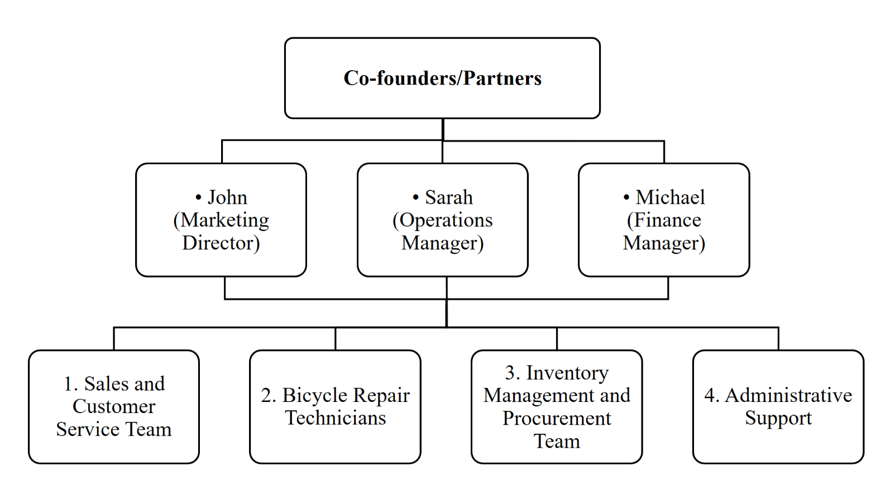
Company management
Notes:
John, an entrepreneur and marketing specialist, will oversee all promotional activities for Green Gears. His responsibilities include establishing and maintaining connections with regional cycling parties and organisations, as well as developing and promoting the brand itself (Fox, 2012).
Sarah, a graduate of engineering with a deep love for bicycles, will be in charge of managing day-to-day operations. Her responsibilities include stock control, communication with wholesalers, and smooth maintenance operations (Fox, 2012).
Michael, a student of economics, will be in charge of managing money. His responsibilities include funding, financial evaluation, cash flow governance, and forecasting. He is crucial to the company's ability to make money.
Then the organisation is forecasted to the four aspects which are sales, inventory, administration and lastly support from the technicians (Freemantle, 2018). This whole chart brings up a whole image of the organisation and it’s activities.

Slide 6
SWOT analysis of ‘Green Gears’
With consumers placing a greater emphasis on ethical practises, this is a major benefit in today's competitive market for Green Gears
The limited scope of "Green Gears" is among its main flaws
There is a responsive consumer base for environmentally friendly cyclists as people become increasingly aware of climate issues and seek out sustainable modes of mobility
Desire for non-essential products, such as bicycling and bicycle-related offerings, can be negatively impacted during recessions due to decreased consumer expenditure
Notes:
In the competitive bicycle retail and service market, "Green Gears" stands out thanks to a number of noteworthy advantages. Its strong dedication to a feasible company structure positions it as a leader in environmentally conscious practices. With consumers placing a greater emphasis on ethical practises, this is a major benefit in today's competitive market. "Green Gears" is able to meet the needs of a growing customer base by providing environmentally acceptable goods and conducting business in a sustainable manner.
The limited scope of "Green Gears" is among its main flaws. Due to the company's location, it may only serve locals in the Lampeter region. In order to grow and thrive, the company must create efficient methods of advertising to attract customers from further afield. Another difficulty lies in the ferocity of competition within the bicycle business (Seth, 2020). Bicycles and accessories can be found in abundance at well-established stores and on the web. To succeed in this saturated customers, "Green Gears" must find ways to distinguish itself from the competition and increase its market position.
There are a number of promising developments that "Green Gears" can take advantage of. The expanding demand for environmentally friendly goods represents a promising opening. There is a responsive consumer base for environmentally friendly cyclists as people become increasingly aware of climate issues and seek out sustainable modes of mobility (Seth, 2020). To meet this rising demand, "Green Gears" provides a selection of eco-friendly products. Volunteering is another exciting prospect. The company can get involved in things like neighbourhood projects, bike rides, and partnerships with non-profits.
There are dangers that could affect the "Green Gears" industry, and it's important to recognise them. Desire for non-essential products, such as bicycling and bicycle-related offerings, can be negatively impacted during recessions due to decreased consumer expenditure. Throughout recessions, the company must be ready to adjust its strategies and investigate diversification opportunities (Seth, 2020). The imminent danger of competition from the internet. Together with the ease of digital shopping, the availability of numerous online stores selling bicycles and equipment can lure clients away from brick-and-mortar establishments.

Slide 7
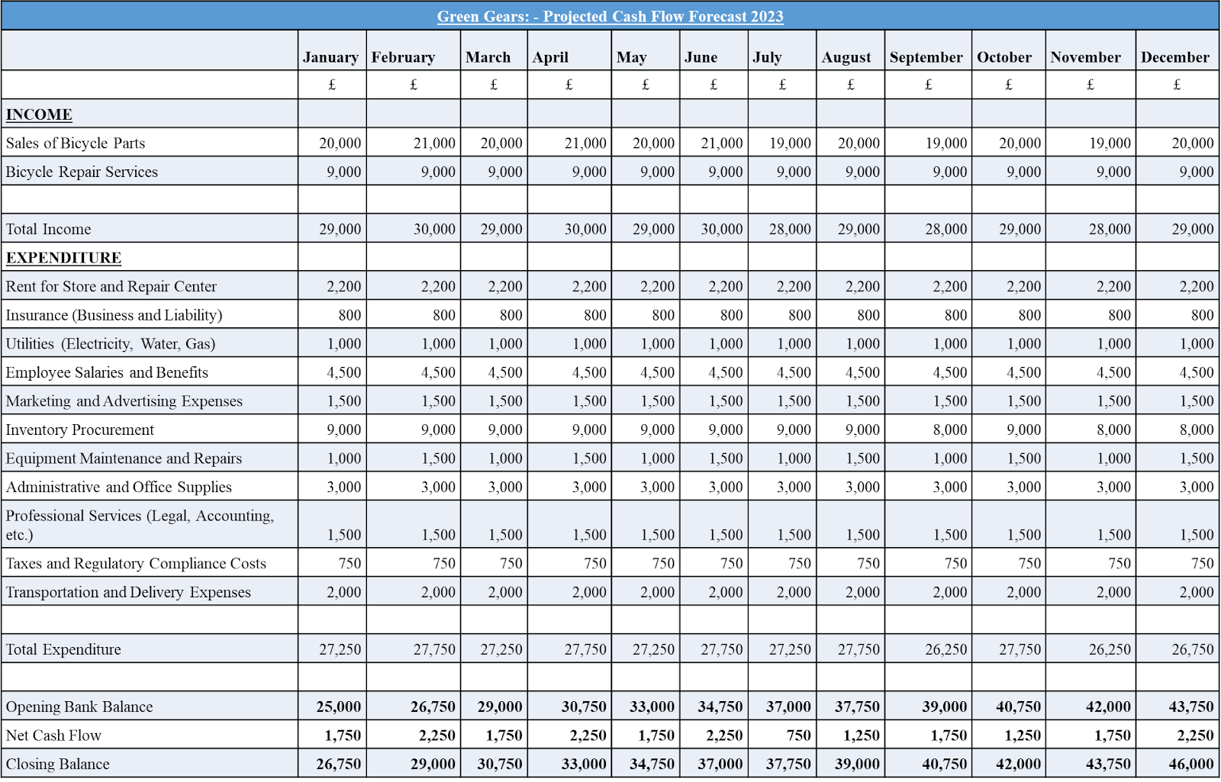
Cash Flow of ‘Green Gears’

Slide 8
Conclusion
Finally, "Green Gears" will be successful in Lampeter and further if it plays to its strengths, improves its weaknesses, takes advantage of opportunities, and guards against threats (Freemantle, 2018). Understanding and managing both of these variables is crucial to the success and longevity of the company.

Slide 9
References
Fox, L.K. (2012). Business ownership. Moscow, Idaho: University Of Idaho, Cooperative Extension Service, Agricultural Experiment Station, College Of Agriculture.
Freemantle, A. (2018). The sustainable business handbook : a comprehensive guide to responsible corporate behaviour and sustainable business practices across the triple-bottom-line. Cape Town, South Africa: Trialogue.
O’shaughnessy, J. (2016). Business organization. London: Routledge.
Seth, C. (2020). SWOT analysis. S.L.: 50Minutes.com.

