Slide 1

Developing and Managing Individuals and Teams: Recruitment and Selection
During Organisational Transformation- TESCO PLC
Student Name SHTERIYAN ZOEV
Student Number 2408130
Developing and Managing Individuals and Teams
Module Code: LCLM5002
Lecturer Name Samson Oladejo
Submission Date 15.06.2026
Notes:
This presentation explores the recruitment and selection of appropriate employees when a large-scale change is happening within an organisation like the case of Tesco. Tesco is looking to invest in digital technologies, process improvement and customer experience programmes. Attracting talented staff who possess the requisite knowledge, skills and behaviours is key to successful transformation. The presentation will define the recruitment process, discuss interview methods and techniques, critique questioning techniques and give comparisons between face-to-face and virtual interviews. Senior management are supported with recommendations to enhance recruitment choices and for the future success of the organisation. Recruitment helps to minimize hiring errors and enhance employee performance and retention.

Slide 2
Table of Contents
Company overview
Organisational transformation
Recruitment process
Job analysis
Job description and person specification
Advertisement platforms
Interview methods
Questioning techniques
Face-to-face vs virtual interviews
Conclusion
Notes:
This presentation starts by giving an introduction to Tesco and its transformation programme. It then covers the important steps of recruitment such as job analysis, job descriptions and person specifications and advertising vacancies. Three interview methods suitable for transformation roles are analysed. Justification of appropriate questioning techniques is then given. The presentation includes a comparison of face to face and virtual interviews; then, the presentation moves to suggestions and conclusions. Every section will focus on how Tesco can attract and find the talent they need to help drive organisational change and enhance business performance.

Slide 3
Overview:Tesco and Organisational Transformation
Tesco is one of the biggest retailers in the UK (Armstrong and Taylor, 2023).
The company is growing their digital services and online business.
Data Analytics is enhancing decision making across departments.
Automation is helping to improve the efficiency of operations.
Customer Experience (CX) is now a business strategy.
Specially trained staff members are needed for new transformation projects.
Effective recruitment is essential to good change.
Notes:
Tesco is still evolving its business with technology, robotics and digital. These efforts are designed to increase efficiency, cut expenses, and better customer service. This scale of change requires people with specialist expertise in project management, change leadership, operations and digital technologies. Having a strong pool of talent is necessary because organizational change can be dependent on the skill and dedication of the employees. The structured recruitment process enables Tesco to identify individuals who have the necessary technical expertise, adaptability, and leadership to help achieve transformation goals and long-term business success.

Slide 4
Recruitment Process During Transformation
Workforce Planning
Job Analysis
Person Specification
Vacancy Advertising
Application Screening
Interview & Assessment
Selection Decision
Onboarding
Fig 1: Recruitment Process
The need for the workforce must be determined prior to recruitment (Bratton and Gold, 2022).
Job analysis is used to decide duties and competency needs. Job descriptions provide a description of responsibilities and expectations.
Person specifications are used to define the skills and qualifications required.
Opportunities should be promoted via appropriate media.
Applications scrutinized based on selection criteria. Interviews and assessments are used to finalize the hiring.
Candidates who succeed fullfill the onboarding tasks.
Notes:
Recruitment during transformational changes of organisations should be systematic. Workforce planning is a process that involves determining future staffing needs and skills gaps. Job analysis gives information on duties and competencies required for success. Organisations then create job descriptions and person specifications to inform recruitment processes. Appropriate recruitment channels are used to publicise vacancies to seek out suitably qualified candidates. The shortlisted candidates are invited for interviews and assessments. The last step is to choose the right candidates and ensure their seamless fit into the company through induction processes. This organized approach makes recruitment more effective and it promotes transformation goals.

Slide 5
Job Analysis
Job analysis is used to identify important duties and responsibilities (Dessler, 2023).
It establishes knowledge, skills and abilities that need to be acquired.
Performance expectations are set forth. Information regarding workforce planning is more precise.
The evaluation of the applicants is done on the basis of objective evidence.
Clear role results in better employee performance.
The number of recruitment mistakes can be drastically minimized.
Notes:
Effective recruitment and selection is based on job analysis. Includes gathering data related to tasks, duties, working conditions, and performance requirements. Tesco will have to determine technical skills as well as behavioural skills like adaptability, communication and leadership skills during transformation. The data gained from a job analysis can be used to develop accurate job descriptions and person specifications. This will help the managers to know the type of employee required and will minimize the chances of hiring the wrong employee.

Slide 6
Job Description and Person Specification
Job Description | Person Specification
Describes the job | Describes the person
Focuses on duties | Focuses on qualities
Explains responsibilities | Explains competencies
Defines reporting lines | Defines qualifications
Used to explain the role | Used to assess candidates
Job descriptions provide information about reporting relationships and tasks (Armstrong and Taylor, 2023).
Applicants are well informed about responsibilities.
Person specifications define qualifications/experience.
Skills and Competencies required are stated.
Behavioural attributes can also be provided.
Selection become more consistent.
Equal opportunities are promoted and supported by non-judgemental criteria.
Notes:
Job descriptions and person specifications play an important role in recruitment. The job description explains the role and the work the employee will be doing and how it is going to support the organisations goals. The person specification details the knowledge, skills, experience and behaviours needed. For instance, a Change Manager could require leadership expertise, communication abilities and an understanding of change management frameworks. These documents enhance transparency and fairness, and ensure all candidates are judged on the same criteria, making it consistent and fair.

Slide 7
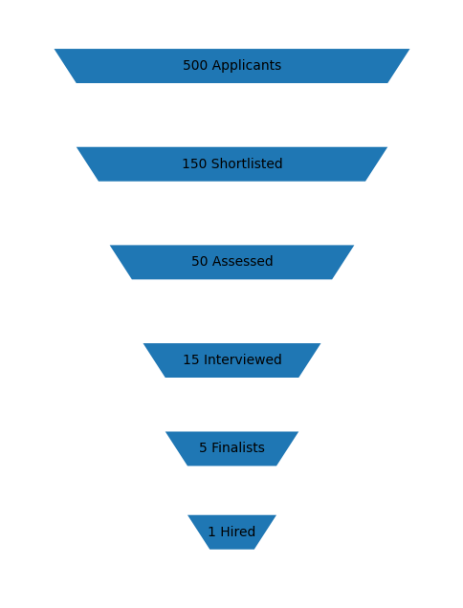
Advertisement Platforms
Tesco may post job openings on its website (CIPD, 2024).
Users can connect with professional prospects.
Online job boards make the job vacant visible.
Recruitment agencies can access for specialist talent.
Targeted recruitment is possible through professional networks.
Graduate talent is available as part of the university.
Candidates referred by employees can be of higher quality.
Fig 2: Recruitment Funnel
Notes:
Choosing suitable advertising media can help organisations attract skilled candidates. Various platforms will appeal to different segments of candidates. Experienced professionals have great potential to be attracted through LinkedIn and professional networking sites. Recruitment agencies can aid with challenging hires like digital experts and project managers. Organisations can benefit from University partnerships to identify emerging talent. Diversity of recruitment channels helps to create diversity and to ensure that the right people are available who can help the organisation to transform.

Slide 8
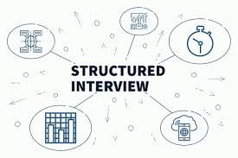
Structured Interviews
All candidates are asked the same questions in a structured interview (Taylor, 2022).
Responses are assessed using standard criteria.
Comparisons between candidates are easier.
Interview reliability is improved.
Personal bias is reduced.
Fairness and consistency is improved.
This method is suitable for Project Manager roles.
Notes:
Structured interviews are considered one of the best types of interviews. All candidates will be given the same questions and the same criteria will be used to assess the work. This helps to ensure uniformity and enables the objective comparison of responses. Structured interviews are non-biased and fair. Structured interviews are useful for organisations to assess the leadership, planning, communication and problem-solving abilities of candidates for transformation roles, such as Project Managers.

Slide 9
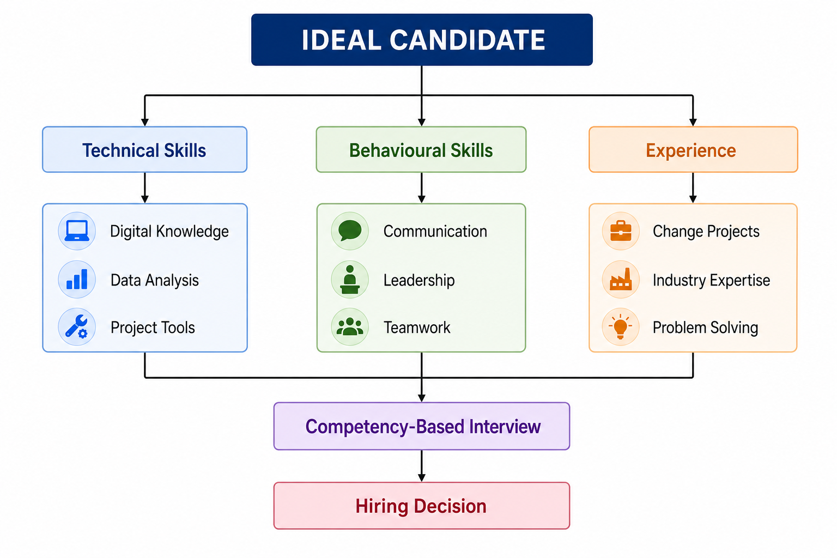

Competency-Based Interviews
Competency interviews are based on past experiences (Bratton and Gold, 2022).
Candidates provide evidence of past performance.
Leadership competencies can be assessed.
Communication and team working are assessed.
Problem-solving skills are evident.
Adaptability to change can be explored.
This is an appropriate way for Change Managers to approach it.
Notes:
Competency-based interviews focus on how candidates have exhibited specific behaviours in a specific context. Questions starting with 'Tell me about a time when' are commonly used by interviewers. This method is one that gives actual results not hypothetical ones. The key skills that Change Managers need to display are leadership, communications, resilience, and stakeholder management. Competency-based interviews offer organisations the ability to identify employees who have been successful in managing change in the workplace in the past.

Slide 10

Panel Interviews
Panel interviews are interviews conducted by a group of interviewers (Dessler, 2023).
Multiple viewpoints are helpful in making decisions.
The skills in technological competence can be evaluated. Individual interviewer bias is minimized.
HR and Line managers may attend together.
Broad opinion for candidates.
This approach can be used for Digital Specialist positions.
Notes:
A group of interviewers conduct a panel interview, where they evaluate candidates at the same time. This balances the perspectives of the interviewers, leading to a more comprehensive evaluation. Professional knowledge can be assessed by technical specialists and behavioural competencies and organisational fit by managers. Panel interviews help to minimize bias since hiring is not based on one person's opinion. This is useful for looking to hire for specialised transformation roles.

Slide 11

Appropriate Questioning Techniques
Behavioural questions are based on past experiences (CIPD, 2024).
Situational questions evaluate future decision making.
Competency questions assess particular job skills.
Open-ended questions elicit in-depth answers.
Questioning is used to elicit further evidence.
Follow-up questions enhance the quality of responses.
Using several techniques to enhance the accuracy of selection.
Notes:
Various types of questioning enable various types of information to be obtained about candidates. Behavioural questions ask about past behaviour; situational questions will discuss potential responses to workplace problems. Competency questions are used to measure job related skills and abilities. Open-ended questions allow candidates to expand on their answers, and probing questions help clarify information and delve deeper into answers. These strategies will work together to increase recruitment effectiveness and to aid organisations in identifying the best people.

Slide 12

Face-to-Face Interviews
Face-to-face interview helps to interact with the person directly (Armstrong and Taylor, 2023).
Non-verbal communication can be observed.
Stronger relationships can be developed.
Interviewers are able to get a better understanding of behaviour.
Travel expenses could be greater.
Making arrangements may be more complicated.
Organising the process may take longer.
Notes:
Interviews are an opportunity for face-to-face communication and observation. Interviewers can gauge non-verbal communication, confidence and interpersonal skills better in person than via video. These interviews are extremely helpful for candidates and employers in building better relationships. Face-to-face interviews, however, do require some extra resources: travel expenses, for one, and schedule coordination for another. Organisations need to then ask themselves if the benefits are worth the cost.

Slide 13

Virtual Interviews
Cost savings in recruitment when using virtual interviews (CIPD, 2024).
The candidates may participate from anywhere.
There is an increased degree of scheduling flexibility.
Recruitment processes speed up.
Access to a wider talent pool is possible.
Technical problems may occur.
Non-verbal communication might be more difficult to evaluate.
Notes:
With the advent of technology and new working arrangements, virtual interviews are becoming more and more common. These make it easier and less expensive for organisations to hire candidates from anywhere, and make their hiring process more flexible. Virtual interviews can help to significantly streamline the recruitment process. However, there may be technology mishaps that may affect communication, and interviewers may not be able to see non-verbal behaviours as easily. However, for a lot of recruitment activities, virtual interviews work very well, even though there are numerous difficulties.

Slide 14
Face-to-Face vs Virtual Interviews
Criteria | Face-to-Face | Virtual
Cost | High | Low
Flexibility | Lower | Higher
Travel Required | Yes | No
Body Language Observation | Strong | Limited
Candidate Reach | Limited | Global
Technology Dependence | Low | High
Relationship Building | Strong | Moderate
Face to face interviews offer more interpersonal interaction (Armstrong and Taylor, 2023).
The main advantage of virtual interviews is flexibility (CIPD, 2024).
Face-to-face techniques can strengthen relationship issues.
Virtual interviews save on travel and hotel expenses.
Face to face interviews are helpful for behavioural observation.
Virtual methods open doors to a broader pool of talent.
A hybrid approach is a blend of the strengths of both approaches.
Sources: Armstrong and Taylor (2023); CIPD (2024)
Notes:
Both types of interviews have their merits. Both face-to-face and virtual interviews offer advantages in communication and in the assessment of behaviour, but the virtual interview is more efficient and saves money. Both of these methods have their drawbacks. As a result, hybrid recruitment has become the norm for many organisations today. Initial screening can be done through virtual interviewing, and face to face interviews may be used to add to the final selection process. This is a well balanced approach that enables organisations to be as effective as possible and manage recruitment budgets.

Slide 15
Conclusion and Recommendations
Recruitment is a key element to successful transformation (Bratton and Gold, 2022).
Workforce planning should be based on job analysis.
Using accurate job descriptions increases the candidate matching.
Structured interviews help to make the interviews fair and consistent.
Competency based interview, improves selection quality.
There are hybrid approaches to interview which are more flexible.
“Right” people recruitment is a key to sustainable performance.
Notes:
To achieve effective organisational change, it is essential to find and keep qualified workers. Tesco should use the following to support its recruitment decisions: workforce planning, job analysis, job description and person specification. Structured and competency-based interviews are reliable interview methods. Questions about behaviour and situation can help identify people who are able to navigate through change well. There is an efficient and quality mix of virtual and face-to-face interviews. These recommendations will enable Tesco to hire personnel who can contribute to the organisation's transformation and future success.

Slide 16
Reference List
Armstrong, M. and Taylor, S. (2023) Armstrong's Handbook of Human Resource Management Practice. 16th ed. London: Kogan Page.
Beardwell, J. and Thompson, A. (2023) Human Resource Management. 10th ed. Harlow: Pearson.
Bratton, J. and Gold, J. (2022) Human Resource Management: Theory and Practice. 8th ed. London: Palgrave.
CIPD (2024) Recruitment and Selection Factsheet. London: Chartered Institute of Personnel and Development.
Dessler, G. (2023) Human Resource Management. 17th ed. Harlow: Pearson.
Taylor, S. (2022) Resourcing and Talent Management. 9th ed. London: CIPD Publishing.
Torrington, D., Hall, L., Taylor, S. and Atkinson, C. (2023) Human Resource Management. 12th ed. Harlow: Pearson.
Wilton, N. (2022) An Introduction to Human Resource Management. 5th ed. London: Sage.

