Slide 1

Effective Team Working
“How to use teamwork theories to improve the performance of a team in the modern workplace”
University of Wales Trinity Saint David

Slide 2
The Team
Name | Student Number
Lorena Maria Mihalcea | 2019847
Shalma Pervin | 2019669
Shah – Does not Participate

Slide 3
Presentation Overview
Topic | Student Name:
1. Organisational Context/Background | Shalma Pervin
2. Teamwork strengths within the organisation | Shalma Pervin
3. Differences between groups and teams | Lorena Mihalcea
4. Characteristics of an effective team | Lorena Mihalcea
5. Contemporary challenges faced within the organisation and how you would overcome them. | Shah- team member not present
6.Conflict handling and delegation strategies. | Shah - team member not present
7.Our Group Dynamics | Lorena Mihalcea, Shalma

Slide 4
1.Organisational Background/ Context
Shalma -

Slide 5
2. Teamwork Strengths within the organisation
Shalma

Slide 6
3. Differences between groups and teams
Teams | Groups
Refers to a group of individuals that work together to achieve a common goal | Two or more individuals that work independently to achieve particular objectives
Members are associated together in work or activity | Connected by a shared activity or interest
Have clear tasks that must be assigned to each individual. Members are interdependent (all depends on each other) | Individuals are independent therefore, the work of one will not be influenced by another
(Amsted.C. et al, 2016, p 179-182)
(Guillaume et all 2017, p 276–303)

Slide 7
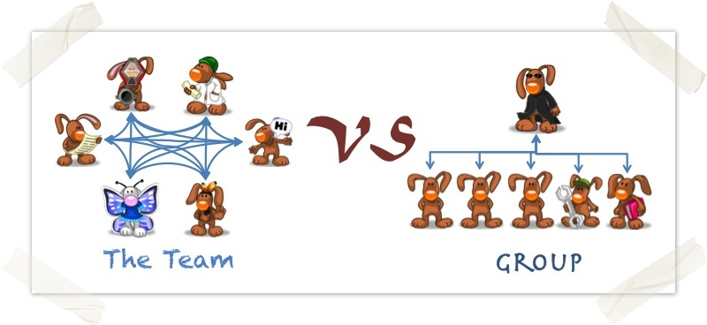
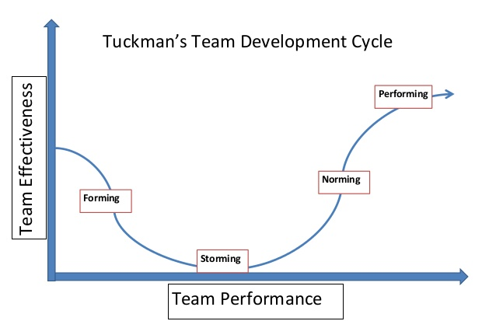
3. Differences between groups and teams
(Tuckman, 2012)
Notes:
According to DR. Tuckman (2012) teams are not starting fully formed but as groups of individuals that go through specific stages
The stages a team must go through are:
Forming: At this stage individuals are making effort to get to know each other. They are going to be positive and polite and some of them are going to be anxious. There might be confusion between individuals and their roles
Storming: In this stage appears conflicts around personalities, individuals might get frustrated with other members approach of doing things
Norming: This is the stage where individuals start to accept the differences and find ways to work together
Performing: It is the stage where the team is now effective, individuals have finally created bond and start performing the tasks.

Slide 8
4.
Characteristics of effective teams
Great Communication
Balanced Roles
Trust
Effective Team
Reliability
Support
Common Goals
Good Leadership
Constructive Conflict
Involvement from all teams members
(Belbin,2010)
Notes:
As said by Dr. Belbin (2010), assigning team roles according to individuals strengths, weaknesses, skills and their preferred role is an effective way to build a team.
The model allows us to identify how each individual prefers to contribute to the team, also gives a big picture of the balance within the team.
Belbin Model is a tool that help us to understand the success or the failure of a team.

Slide 9
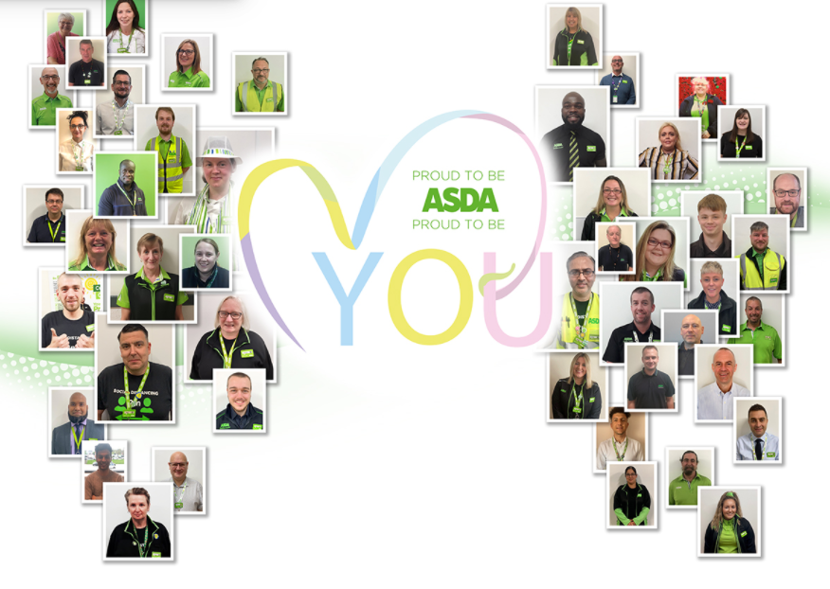
4. Characteristics of effective teams - ASDA
(ASDA, nd, online)
Notes:
Between 1991- 1995 Archie Norman, Allan Leighton, Phil Cox and Tony Campbell worked together as a team and produced a new strategy – a new way of working was created which provided a framework for a new organisational structure (www.asda.com)
In four years, Archie and his team made ASDA ” a major force in UK retailing. “ (ASDA, nd, online)
Since then, until today ASDA has achieved multiples goals which shows the support offered to their staff members.
1000 Employees at ASDA are Dementia Trained
Over 1000 Employees took part corporately supported Pride Events
Supporting Survivors of modern slavery (Bright Future Programme)
77% of employees responded positively at the statement “I am proud to work for ASDA”
16.000 Employees supported to shield through the Covid-19 Pandemic

Slide 10
Team Dynamic
Student Name | Highest team role | Second highest team role | Lowest team role
Shalma Pervin | Team worker | Co-Ordinator | Plant
Lorena Mihalcea | Plant | Co-Ordinator | Team worker
The team has identified the highest and lowest team role using (Belbin Questionnaire). The results showing balanced roles which helped the team working together effectively, avoiding any conflicts. The results is showing the highest team roles score for Shalma is Team worker which is Lorena`s lowest score. At the same time Shalma`s lowest score is Plant which is Lorena`s highest score.

Slide 11
Team Dynamic
ROLE | Strengths | Weaknesses
Team Worker | Supportive, sociable and cares about others, perceptive and diplomatic | Indecisive in crucial situations
Plant | Uses imagination to come up with creative solutions/ idea, “thinking outside of box” | Lacks effective communication

Slide 12
Reference List
Armstead C. ,Bierman D.,Bradshaw P.,Martin T.,Wright K.(2016) Groups vs. Teams: Which One Are You Leading?,Nurse Leader, Volume 14, Issue 3,Pages 179-182, (https://www-sciencedirect-com )
ASDA, 2021 Homepage – About us (www.asda.com)
Belbin, R.M. (2010) Team roles at Work. Butterworth-Heinemann Title; 2 edition Magin, M. (2004) Making teams Work: 24 Lessons for working together successfully. McGraw-Hill Pu
Guillaume, Yves R.F, Dawson, Jeremy F, Otaye‐Ebede, Lilian, Woods, Stephen A, & West, Michael A. (2017). Harnessing demographic differences in organizations: What moderates the effects of workplace diversity? Journal of Organizational Behavior, 38(2), 276–303
Tuckman, B.W. and Harper, B.E. (2012) Conducting educational research. 6th ed. United States: Rowman & Littlefield Publishers.

