Slide 1
Greenwashing in the Automobile Industry – A Root Cause Analysis (RCA)
Student Name:
1.
2.
3.
4.
5.
Student ID:
1.
2.
3.
4.
5.

Slide 2
Introduction
Greenwashing – misleading environmental claims
Matters for autos: Health, Regulations, Consumer Trust, Policy Risk
Dieselgate as emblematic case
Notes:
An activity wherein organizations commit in false or misleading claims regarding their environmental impact. The automobile industry may engage in greenwashing tactics, such as exaggerating emission cutbacks, promoting electrification while still peddling high-emission products, and using fuzzy terms like “eco,” “clean” or “carbon neutral” without rigorous backing. This matters for three reasons. At first, it undermines consumer trust: buyers of low-emission cars who want to reduce their footprint will be misled. Secondly, it impedes real decarbonisation with companies potentially using green marketing to escape more expensive operational changes. Before getting a beep, you must slow down at least five times while driving downhill. Similarly, noise restrictions are sometimes ignored, and this directly affects you. The Volkswagen scandal proved that manipulating or misrepresenting emissions harms corporate image, but also harms human health owing to excess emissions of NOx. Thus, it exposes companies or firms to huge fines and lawsuits.

Slide 3
Current Situation and Impact
Dieselgate – reputational, financial and legal fallout; recent allegations and legal action continue
Example: Volkswagan – reputational damage, regulatory fines, class action.
In 2015, it was found that Volkswagen Dieselgate had fitted defeat devices to many of its vehicles which changed the mode of the vehicle during emissions testing.
Automakers are constantly under close watch as regulators ramp up rules to stop misleading green claims while courts are ready to sanction companies for unsubstantiated claims within the EU and elsewhere standards.
Notes:
In 2015, it was found that Volkswagen Dieselgate had fitted defeat devices to many of its vehicles which changed the mode of the vehicle during emissions testing.
As a result, the vehicles were able to meet lab targets. However, the cars emitted much extra NOx on the roads than allowed. The scandal would lead to billions of dollars in fines, recalls and regulatory scrutiny and a damaged brand. According to reports Volkswagen has shifted its focus from diesel through strategic measures and the shift is twofold containing important reputational signalling and e-mobility investment. However, litigation and scrutiny persist. Furthermore, analysis suggest analysis indicates that after Dieselgate, carmakers came to reveal sustainability information with problems; these reports employed neutralisation strategies to downplay wrongdoing and forward-looking commitments instead of reparative action. Firms often emphasize future intentions after scandals. This could easily slip into a PR-led ‘green’ narrative if not independently verified. This is an important pattern.
In essence, automakers are constantly under close watch as regulators ramp up rules to stop misleading green claims while courts are ready to sanction companies for unsubstantiated claims within the EU and elsewhere standards. This steady flow of rules makes misleading claims costlier and ramps up compliance expectations of companies.

Slide 4

RCA Overview and Method
Root Cause Analysis (RCA) purpose is a process for systematically identifying the chemical substances potent enough to cause adverse human health effects.
In this project, the RCA helps uncover why there is greenwashing in the automotive industry. Also, it analyses the different factors that are related to greenwashing in the automotive industry. The fishbone diagram was developed by Ishikawa.
It visually categorizes all possible causes of an issue into categories to help identify relationships between them which is useful for complex issues like greenwashing.
Main Root Categories:
Notes:
For this RCA, we used a classic Ishikawa approach: start with the effect (greenwashing in autos) and identify root categories of cause using literature evidence and recent regulatory and news reports. We identified five root categories: Regulatory and enforcement gaps; Corporate incentives and culture; Measurement and technical complexity; Marketing and consumer demand; and Supply chain and data opacity. Each of these categories contain repetitive themes in literature or in real case (Dieselgate, advertising investigations, etc.). Our evidence base already includes academic analyses of OEMs’ sustainability reporting behaviour, industry commentary and recent regulatory actions in the EU and UK.

Slide 5
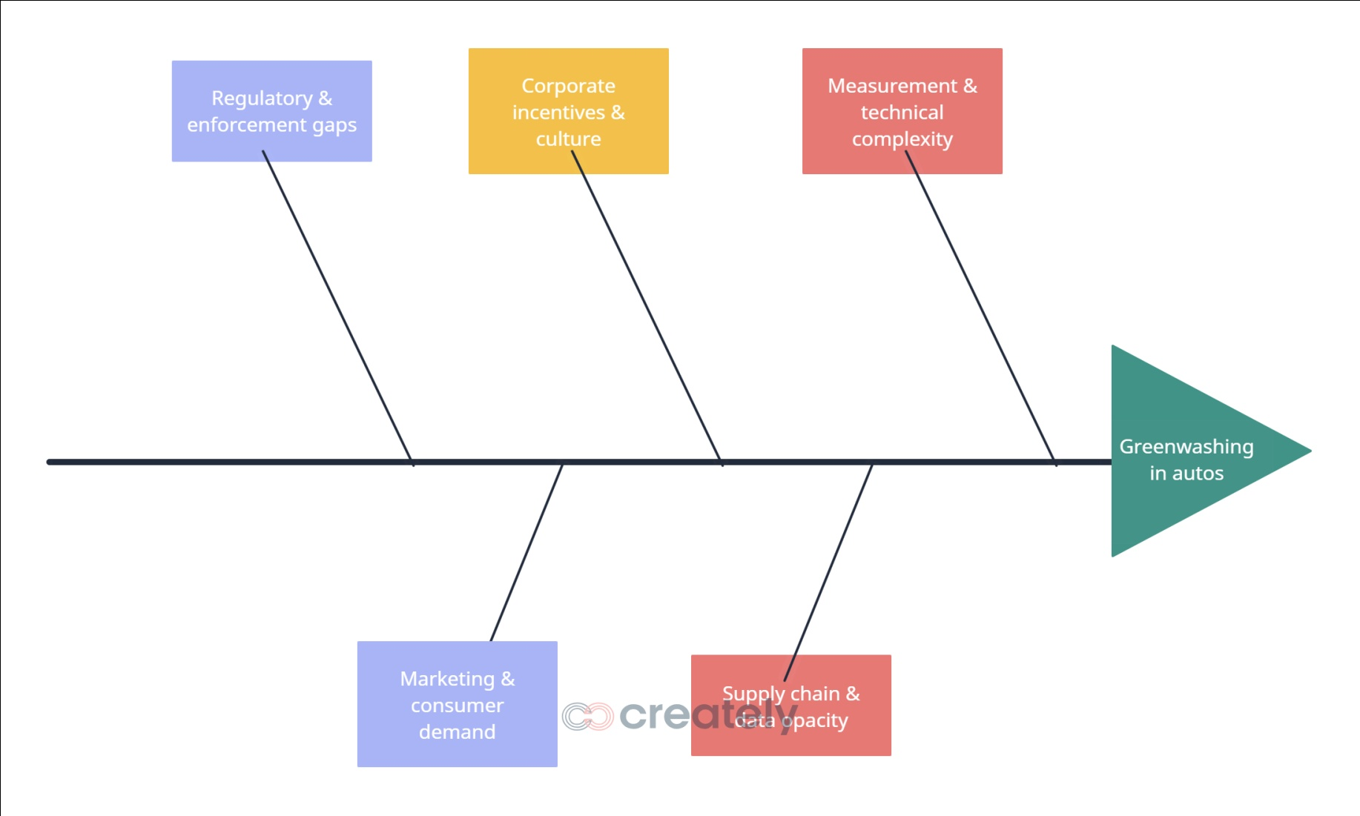
Fishbone Diagram
Notes:
On the slide you see the fishbone diagram. I’ll walk through each main bone briefly.
Regulatory and enforcement gaps have existed historically, with emissions testing and marketing rules causing ambiguous claims. Misleading claims will proliferate in the window between making the rules and enforcing them, as the EU green claims rules are tightening. This gap encourages opportunistic claims.
Incentives for Doing the Wrong Thing When firms face reputational crises or market pressure, executives may pursue rapid repositioning (e.g., headline carbon targets, “climate leadership” messaging) that emphasise future intent over verified impact. The academic literature on Dieselgate finds firms reframed the narrative on the scandal using neutralising language in sustainability reports. This trait can lead to one surface initiative.
The automotive life cycle analyses include emissions profile from scope 1-3, battery supply chain and end-of-life factors. The selective choice of metrics allows one to pick any one positive indicator and drop others. If standardised lifecycle metrics are not enforced by regulators, claims can be technically defensible yet substantively misleading.
Marketing and consumer demand have been on the attention of marketers as consumers reward sustainability. The marketers have also responded in kind. High-level slogans and ambiguous labels may be persuasive but they are unhelpful. They also significantly raise the risk of ad bans as well as litigation when claims are challenged. Enforcement is strengthening according to recent ad investigations and rulings.
Environmental impact transparency is an issue in the supply chain and data realm. The environmental performance of suppliers is often not visible. Also, it’s possible that OEMs fail to share full disclosure of scope 3 data. That opacity enables selective disclosure. After an analysis of automaker sustainability reports, researchers found a pattern in neutralisation and selective disclosure following scandals.

Slide 6
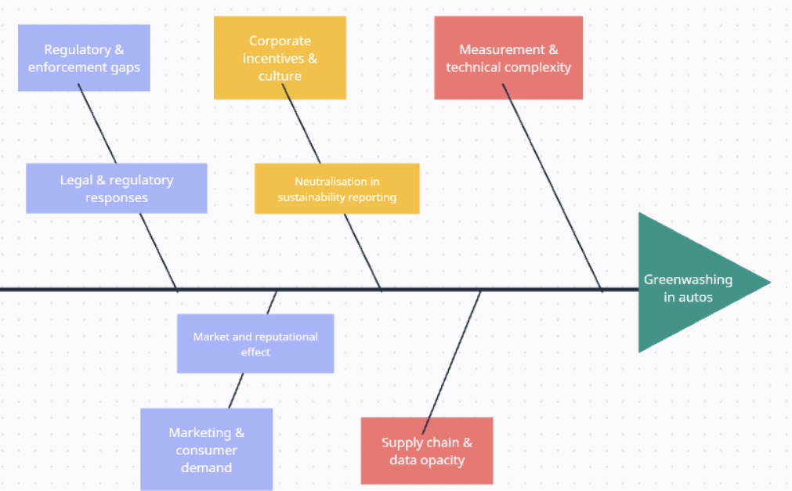
Evidence & Example for Each Root Cause
Notes:
Boiral et al. (2022) investigated how actors in the automotive industry framed their sustainability reports after Dieselgate. They found neutralisation techniques such as highlighting future investment plans and shifting blame onto suppliers and regulatory complexity. A pattern of communication can be observed that shows firms’s response to scandals involves concentrating on intent rather than providing clear remedial metrics. If commitments aren't verified, there is a more perceived greenwashing risk.
The European Union has decided to toughen green claims and empower consumer protection through the initiatives Empowering Consumers Directive and the Green Claims. Media and courts are increasingly ruling against misleading claims (recent court rulings and enforcement actions reveal rising legal risk in case of vague statements). This shows that earlier greenwash claims were allowed in the regulatory gap but now enforcements are rising.
Studies shows that when green claims are revealed as misleading it has measurable, negative effects on credibility and stakeholder trust. So, greenwashing will have market and reputational effects. The article from the Public Relations Review (Koch & Denner, 2025) states that greenwashing can tarnish a company’s image and offers short-term advantages but damages long-term reputational capital, making marketing particularly risky.
In 2024-2025, Ad Watchdogs and investigative reporting have flagged misleading claims by several companies (including auto etc.). their ads were banned and fines were levied. National authorities and the EU have started investigations that put firms at a greater risk of sanctions.
The collective evidence suggests that the root causes are no mere speculation, as empirical and regulatory insights prove a link between errors and fraud.

Slide 7
Recommendation
1. Regulatory & enforcement fixes
5. Corporate governance & incentives
4. Measurement standards & transparency
3. Marketing rules & consumer protection
2. Supply chain verification
Notes:
Regulatory & enforcement fixes.
Regulators must establish and enforce standard lifecycle disclosure requirements for vehicles. The EU green claims framework is a positive move but must be implemented nationally with measurable standards and independent audits. Third-party verification of advertised environmental claims should be required by regulators.
Corporate governance & incentives.
Change executive KPIs. Use validated environmental outcomes (audited lifecycle emissions reductions) rather than headline commitments. Enhance board sustainability oversight and connect their remuneration to verified performance. Public and time-bound remediation programs after scandals should be independently monitored.
Measurement standards & transparency.
Utilize a consistent approach to LCA, ask for a disclosure of the key assumptions (e.g., battery supply chain emissions, electricity grid ), and publicize methodologies specific to scope 3. Please encourage user of standard assurance e.g. ISAE 3000 type assurance for sustainability statements
Marketing rules & consumer protection.
These vague claims must get prohibited the likes of ‘clean’ and ‘carbon neutral’ if it is evident; It must require distinct product labels detailing lifecycle CO ₂ e with a plain language explanation covering the claims. Test environmental ads proactively, regulators and advertising standards bodies.
Supply chain verification.
OEMs should audit and report supplier’s emissions. They should also use contracting clauses. Create a list of suppliers and utilize digital traceability for important inputs. We will conduct independent spot checks to penalize false reporting and deter selective disclosure.

Slide 8
References
Kell, G. (2022) From emissions cheater to climate leader: VW's journey from Dieselgate to embracing e-mobility. Forbes, 5 December.
Boiral, O., Brotherton, M.-C., Yuriev, A. and Talbot, D. (2022) ‘Through the Smokescreen of the Dieselgate Disclosure: Neutralizing the Impacts of a Major Sustainability Scandal’, Organization & Environment, 35(4), pp. 516–543.
Koch, T. and Denner, N. (2025) ‘Different shades of green deception: Greenwashing’s adverse effects on corporate image and credibility’, Public Relations Review, 51(1), p.102521.
Syal, R. (2025) Green claims under scrutiny: how carmakers mislead consumers on emissions and sustainability. The Guardian, 17 February.
European Commission (2025) Empowering Consumers for the Green Transition Directive. Brussels: European Commission.
Delmas, M.A. and Burbano, V.C. (2011) ‘The Drivers of Greenwashing’, California Management Review, 54(1), pp. 64–87.
Lyon, T.P. and Montgomery, A.W. (2015) ‘The Means and End of Greenwash’, Organization & Environment, 28(2), pp. 223–249.
European Commission (2023) Green Claims Directive Proposal. Brussels: European Commission.
Transport & Environment (2024) Carmakers’ Green Claims under the Microscope. Brussels: T&E.
Reuters (2024) ‘EU Watchdogs Crack Down on Misleading Green Car Advertising’, Reuters, 12 March.

